Slide 1
Seismology for ”non-traditional” Performance Expectations
MS-ESS3-4. Construct an argument supported by evidence for how increases in human population and per capita consumption of natural resources impact Earth's systems.
HS-ESS3-1. Construct an explanation based on evidence for how the availability of natural resources, occurrence of natural hazards, and changes in climate have influenced human activity.
April 10, 2020
Michael Hubenthal, Senior Education Specialist

Slide 2
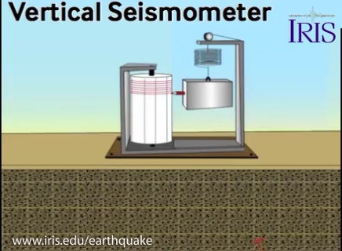
Could a seismometer provide evidence that humans are impacting the Earth system?
Why or why not?

Slide 3
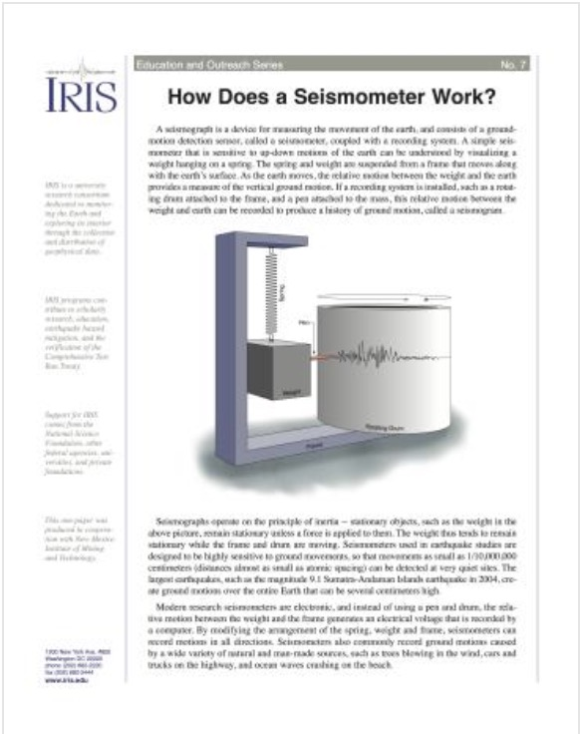
Read “How Does a Seismometer Work?” and revisit your response

Slide 4
What information does this plot display?
(Russell, unpublished)
Notes:
Data was provided by Josh Russel from LDEO.

Slide 5
This plot shows how much the ground goes up and down on average each hour and each day.
(Russell, unpublished)
Notes:
The Y-Axis displays average ground displacement. In this case we are looking at vertical displacement.
The X-Axis displays the date.
Blue = Hourly average
Red = Daily average
Note: This is not a seismogram. It does not show the ground actually going up and down. Instead it shows the AVERAGE displacement for a given time period. For example on February 12th, the ground moved up and down on average as much as ~1.9nm within an hour period.

Slide 6

Would New Yorker’s feel this ground motion? Use the information here, and the plot to explain why or why not?
1 nanometer (nm) = .001 (microns)
So, hair is roughly 100,000 nm
Notes:
Maybe! New Yorkers would feel some of this noise… for example if you were standing near the seismic station and a dump truck drove by you might feel it. However, the data shown in the plot is an average over an hour. Thus, in general the average is so small that it won’t be felt. For example, the peak average displacement on the plot is ~1.9nm, which is a tiny fraction of a human hair!

Slide 7
Let’s look at the data again. What broad patterns do you see?
Make a list and annotate your plot. Consider what each pattern means?
(Russell, unpublished)

Slide 8
Day/Night
Looking at the blue line, the upper 50% of each wave is roughly equal to day, while the lower half is roughly night.
(Russell, unpublished)
Notes:
People are active during the day… working, shopping, etc., and sleeping at night.

Slide 9
Weeks
Weekdays are highlighted in orange. Weekends are highlighted in green.
(Russell, unpublished)
Notes:
Each date in the plot is a Wednesday. The five large amplitude peaks in a row are weekdays when society is very active. The weekends, when people are less active, are the two low amplitude peaks in a row.

Slide 10
Decreases in the daily average displacement over the course of two weeks correspond with the news and public policy
Stay home order
First NYC fatality
(Russell, unpublished)
Notes:
First COVID19 death in NYC - 3/13/20
“Stay at home” order issued - 3/22/20
A few observations…
The announcement of the first death appears to have had a modest impact on behavior.
The Stay Home Order had a stronger impact.
It took roughly a week for society to comply with the stay home order.
The city that never sleeps is actually “sleeping” more now as the smallest average ground displacements (troughs) are now smaller than before the stay home order.

Slide 11
Summarize your learning
What are three ideas you have learned from this exploration of seismic data?
Describe what you would expect to see over this same period if we were to look at a seismometer in Booneville, NY (a small rural town north of of Utica, NY. Population ~2072)?
Notes:
The everyday movement of society creates disturbances of the ground that can be detected by seismometers.
There are detectable patterns in in ground motion that corresponds to people’s behavior (day/night, etc.)
The COVID19 response has altered people’s behaviors in a detectable way.
Not much change. The ground shaking created by people tends to be fairly high frequency compared to earthquake shaking and those high frequencies don’t travel as far through the earth, so they aren’t detectable at larger distances. Thus a seismometer in Booneville NY, several hundred miles from Manhattan, wouldn’t detect any of the shaking from Manhattan normally, so there would be no change. Also, the population of Booneville NY is so small that it would be unlikely to create its own detectable ground displacement at any time unless it was right next to the seismometer.

Slide 12
Construct an argument supported by evidence for how increases in human population and per capita consumption impact Earth's systems.
Seismic data provides evidence that human behavior has changed in response to policy/virus.
If human behavior has changed? Where else might we look for impacts?
Use the internet to explore how the Earth system might change if there was a decrease in per capita consumption or human population.
Behavior change = decreased consumption or a proxy for decreased human population
Notes:
A reduction in seismic noise is useful for seismologists for their research. However, a reduction itself doesn’t really impact the environment much. However, if we think about it as evidence of a behavior change or a proxy for decreased human population, we can see that this “event” offers a rare opportunity.
Pollution measures
Light pollution
Noise pollution
Air quality
Water quality
Consumption measures
Electricity
Water

