Slide 1
TA Station Power
Team Meeting, 11/10/2015

Slide 2
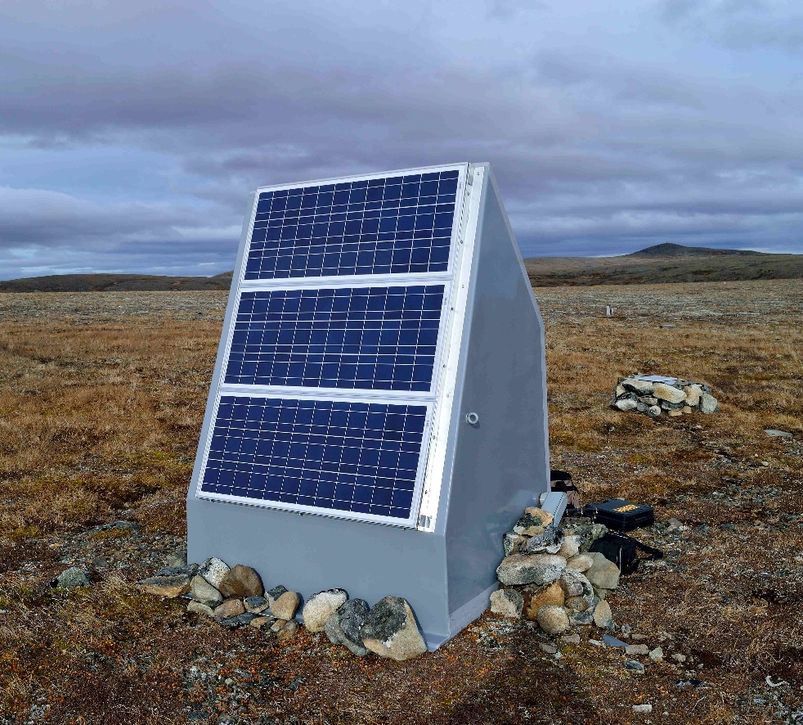
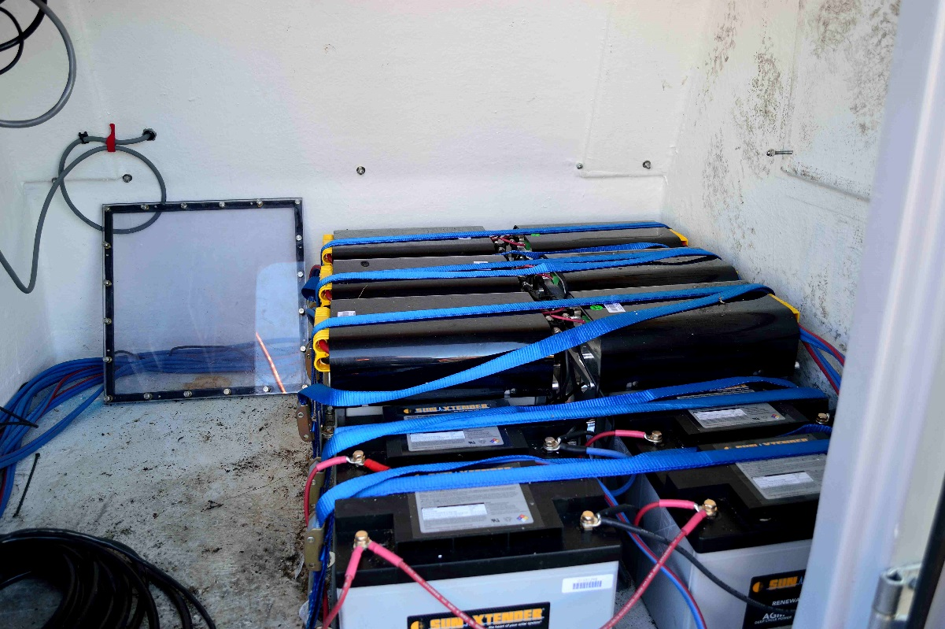
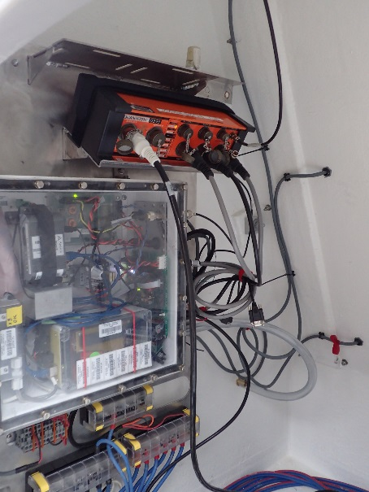
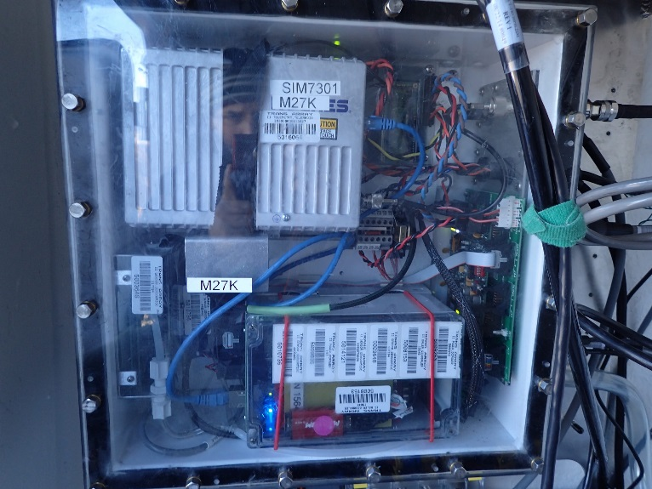
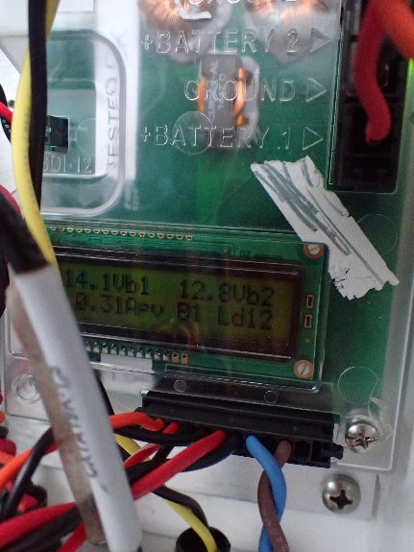
Autonomous Power System – In the field
Why Lithium?
-Significant weight and volume savings (41.9Wh/lb vs 21.25Wh/lb)
-Improved cold weather and self discharge performance
-Improved lifespan
-Increased cost and complexity

Slide 3
Autonomous Power System Block Diagram
Battery 1
LiFePO₄
LiFePO₄
Energy Input
Solar Panel
LiFePO₄
LiFePO₄
Charge controller
LiFePO₄
LiFePO₄
MCU
Solar Panel
Battery 2
Solar Panel
AGM (Lead acid)
AGM (Lead acid)
AGM (Lead acid)
AGM (Lead acid)
MCU
Load1
Load2

Slide 4
Lithium Battery Block Diagram
LiFePO₄ Battery
Cell 1
Cell 2
Cell 3
Cell 4
Four 3.4V, 180Ah cells in each battery
Voltage and temperature sensing on each cell
Active cell balancing to prevent capacity mismatch
Sub millisecond control of output terminals
  Short circuit, under/over voltage, under/over temperature protections
Voltage
Voltage
Voltage
Voltage
Temperature
Balance control
Temperature
Balance control
Temperature
Balance control
Temperature
Balance control
Battery Management System
Issues:
CC MCUs susceptible to damage during programming
Switch that controls battery output has failed in many batteries deployed in the field
Battery Terminals

Slide 5
