Slide 1
Transportable Array
9th Annual Team Meeting
  Bob Busby
  TA Manager
TA Team Meeting
La Jolla, CA
Nov 9-10, 2015

Slide 2
Prior Venues
Jackson Hole, WY 2007
Black Hills, SD 2008
Arbor Day Lied Lodge Nebraska 2009
Minnesota, 2010
Wisconsin Dells 2011
Adirondacks NY 2012
Woods Hole, MA 2013
Mt Hood Oregon 2014
La Jolla Shores California 2015

Slide 3
Meeting Objectives
Acknowledge success we have had!
Reaffirm the Project Goals
Sharpen the vision of the coming year’s plans
Understand and appreciate the roles of people dedicated to the Project
Many activities have evolved or changed entirely in the past two years. This Team responds to change.

Slide 4
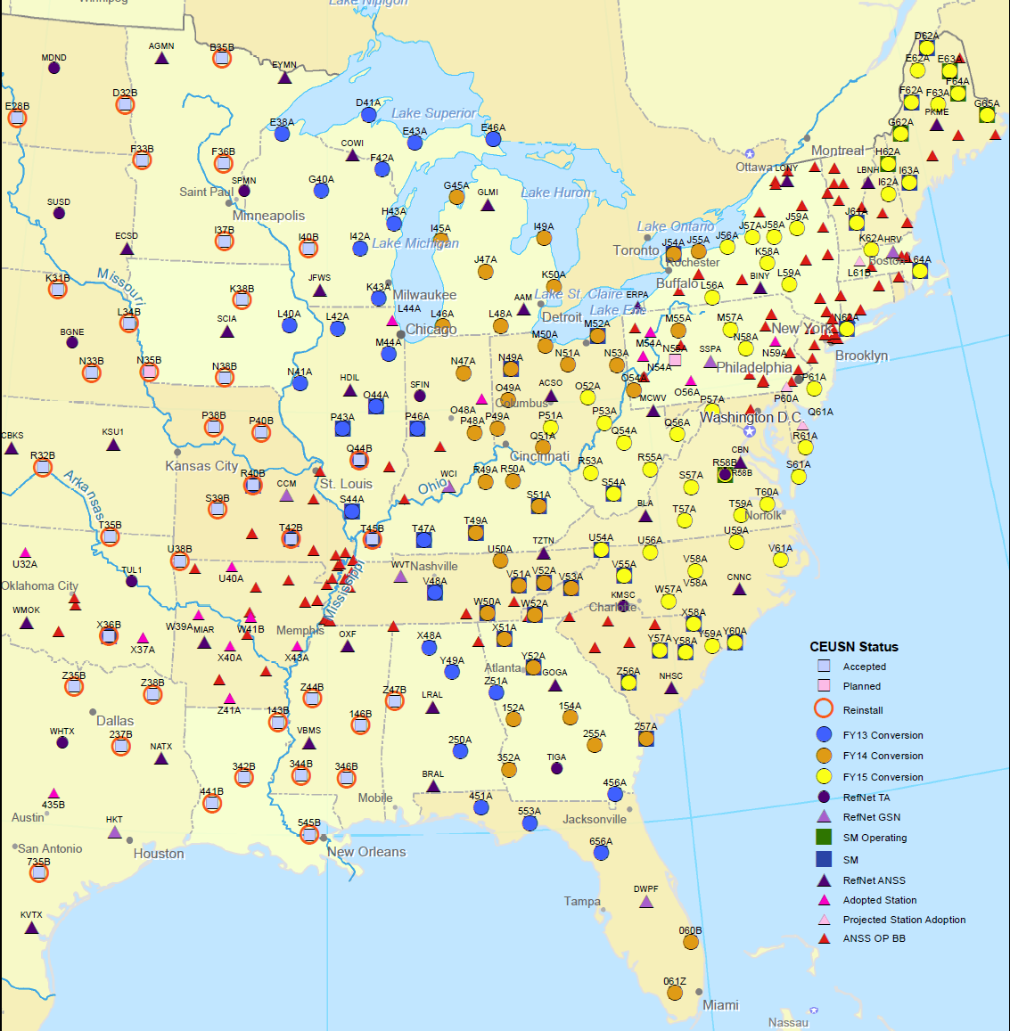
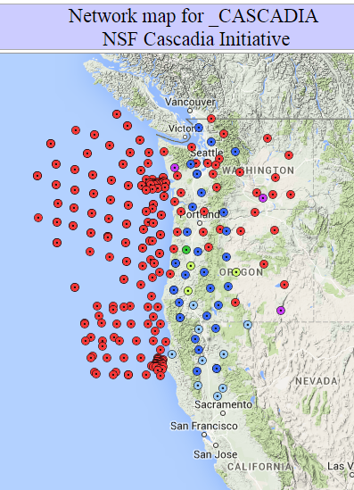
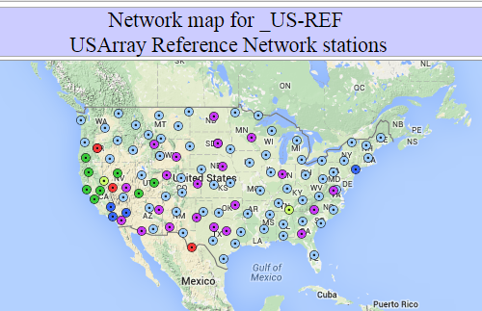
TA includes?
46 Stations, eventually 190
158 Stations
27 Stations
20 Reference Stations, 20 EARN stations

Slide 5
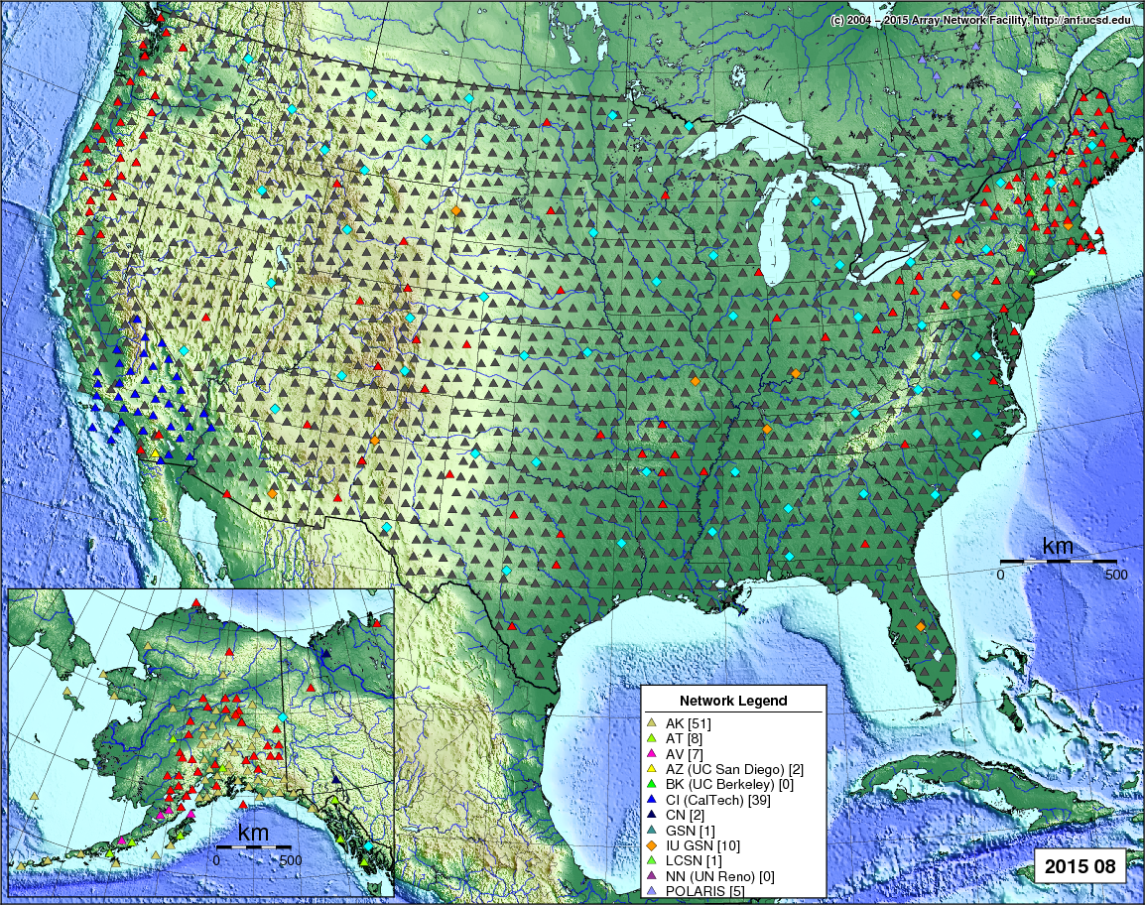
And, done.
1717 Stations
2004 - 2015
Removal
Anthony Kim
Pete Smolinski
Ken Oliver
Dave Traber

