Slide 1
Transportable Array
9th Annual Team Meeting
  Bob Busby
  TA Manager
TA Team Meeting
La Jolla, CA
Nov 9-10, 2015

Slide 2
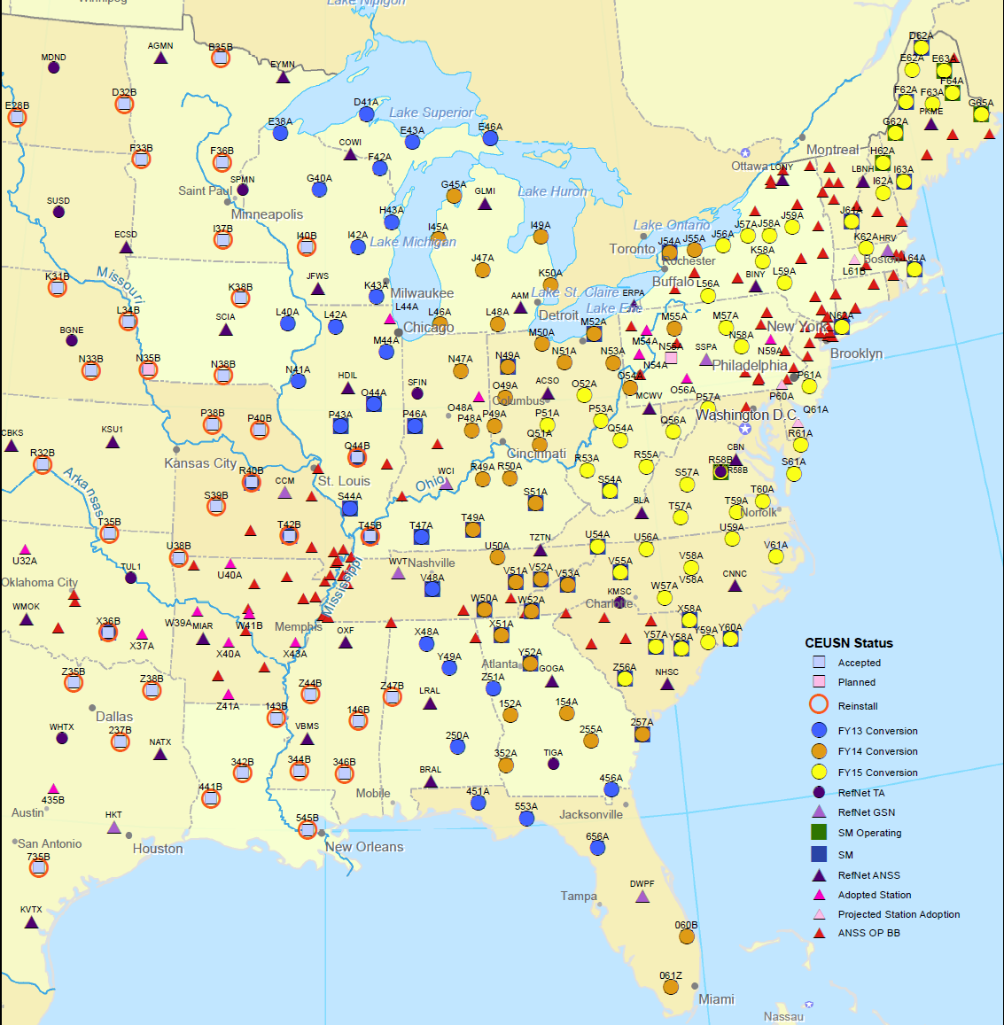
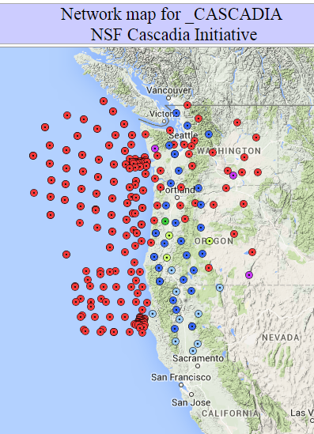
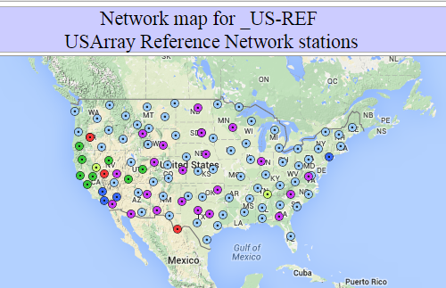
TA Tasks
46 Stations, eventually 190
158 Stations
27 Stations
20 Reference Stations, 20 EARN stations

Slide 3
Lower 48
Cascadia -- 27 Stations, each with BB and SM, Pressure and Infrasound- ends 2015
    Adoption of Equipment,
    Transfer of permits
    Training new operator
    15 in Oregon, 5 in CA and 7 in WA
CEUSN -- 158 Stations, to 2017
EARN -- 20 Stations, subscriber model
Reference Net – 20 Stations, to 2019
      Includes TUL1 and R11A upgrades

Slide 4
CEUSN
158 Stations
Stations operated by TA
  115 with Broadband Sensors
  43 with BB and Strong Motion
  100 sps for BB and SM
  [200 sps for SM]
60 stations from ANSS, Refnet, GSN
~100 stations from Regional Networks
Up to 2017:
Supported by NSF
With addon by USGS
After 2017 ???
Engage DOE, NRC
CEUSN WG
See updates at:
www.usarray.org/ceusn

Slide 5
CEUSN
Lingering Tasks:
Add (5) SM
200 SPS SM
Event triggered
Continuous
Arkansas
USGS Equipment
Duplicate stations
Budget: $7M replaced
All the Sensors
All the huts
All the LiFePO4
See updates at:
www.usarray.org/ceusn

