Slide 1
Transportable Array 9th Annual Team Meeting
Bob Busby
TA Manager
TA Team Meeting
La Jolla, CA
Nov 9-10, 2015

Slide 2
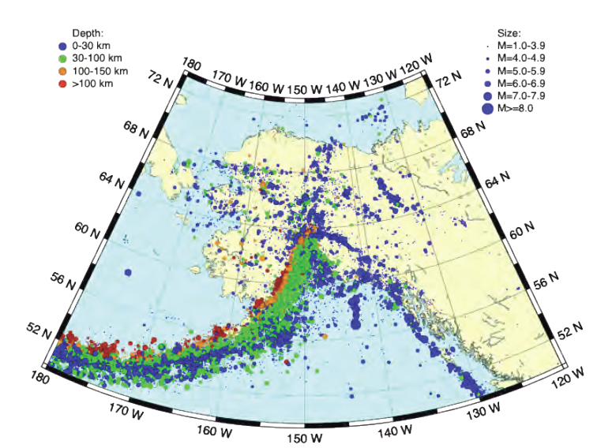
TA in Alaska / Yukon
~265 sites, 190 new
85 km spacing
Broadband Seismometers
Infrasound, pressure
90 met packages
<2hr Communications
fully deployed 2017
Seismicity in Alaska & Yukon
www.usarray.org/alaska
Notes:
Introduction Slide to the Alaska TA (ATA) Project
294 is the SAGE proposed plan, due to budget this has been descoped to 262-278 stations per TA AC recommendation and Board Approval.
The seismicity pattern in AK is shown over five years. The Fairbanks to King Salmon is well instrumented from the road side. The distribution of Blue (existing) stations is typical of AK.
The TA project brings extensive geographic coveragewith dense station spacing, a technique that has proved to reveal detailed structure at range of scales from crustal to deep mantle, or about 4 miles to 1000 miles.

Slide 3
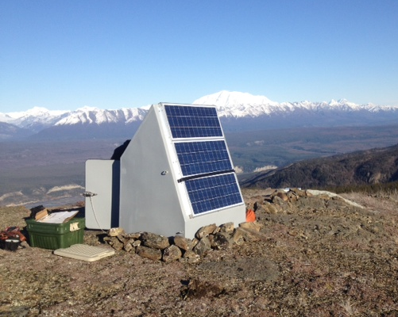
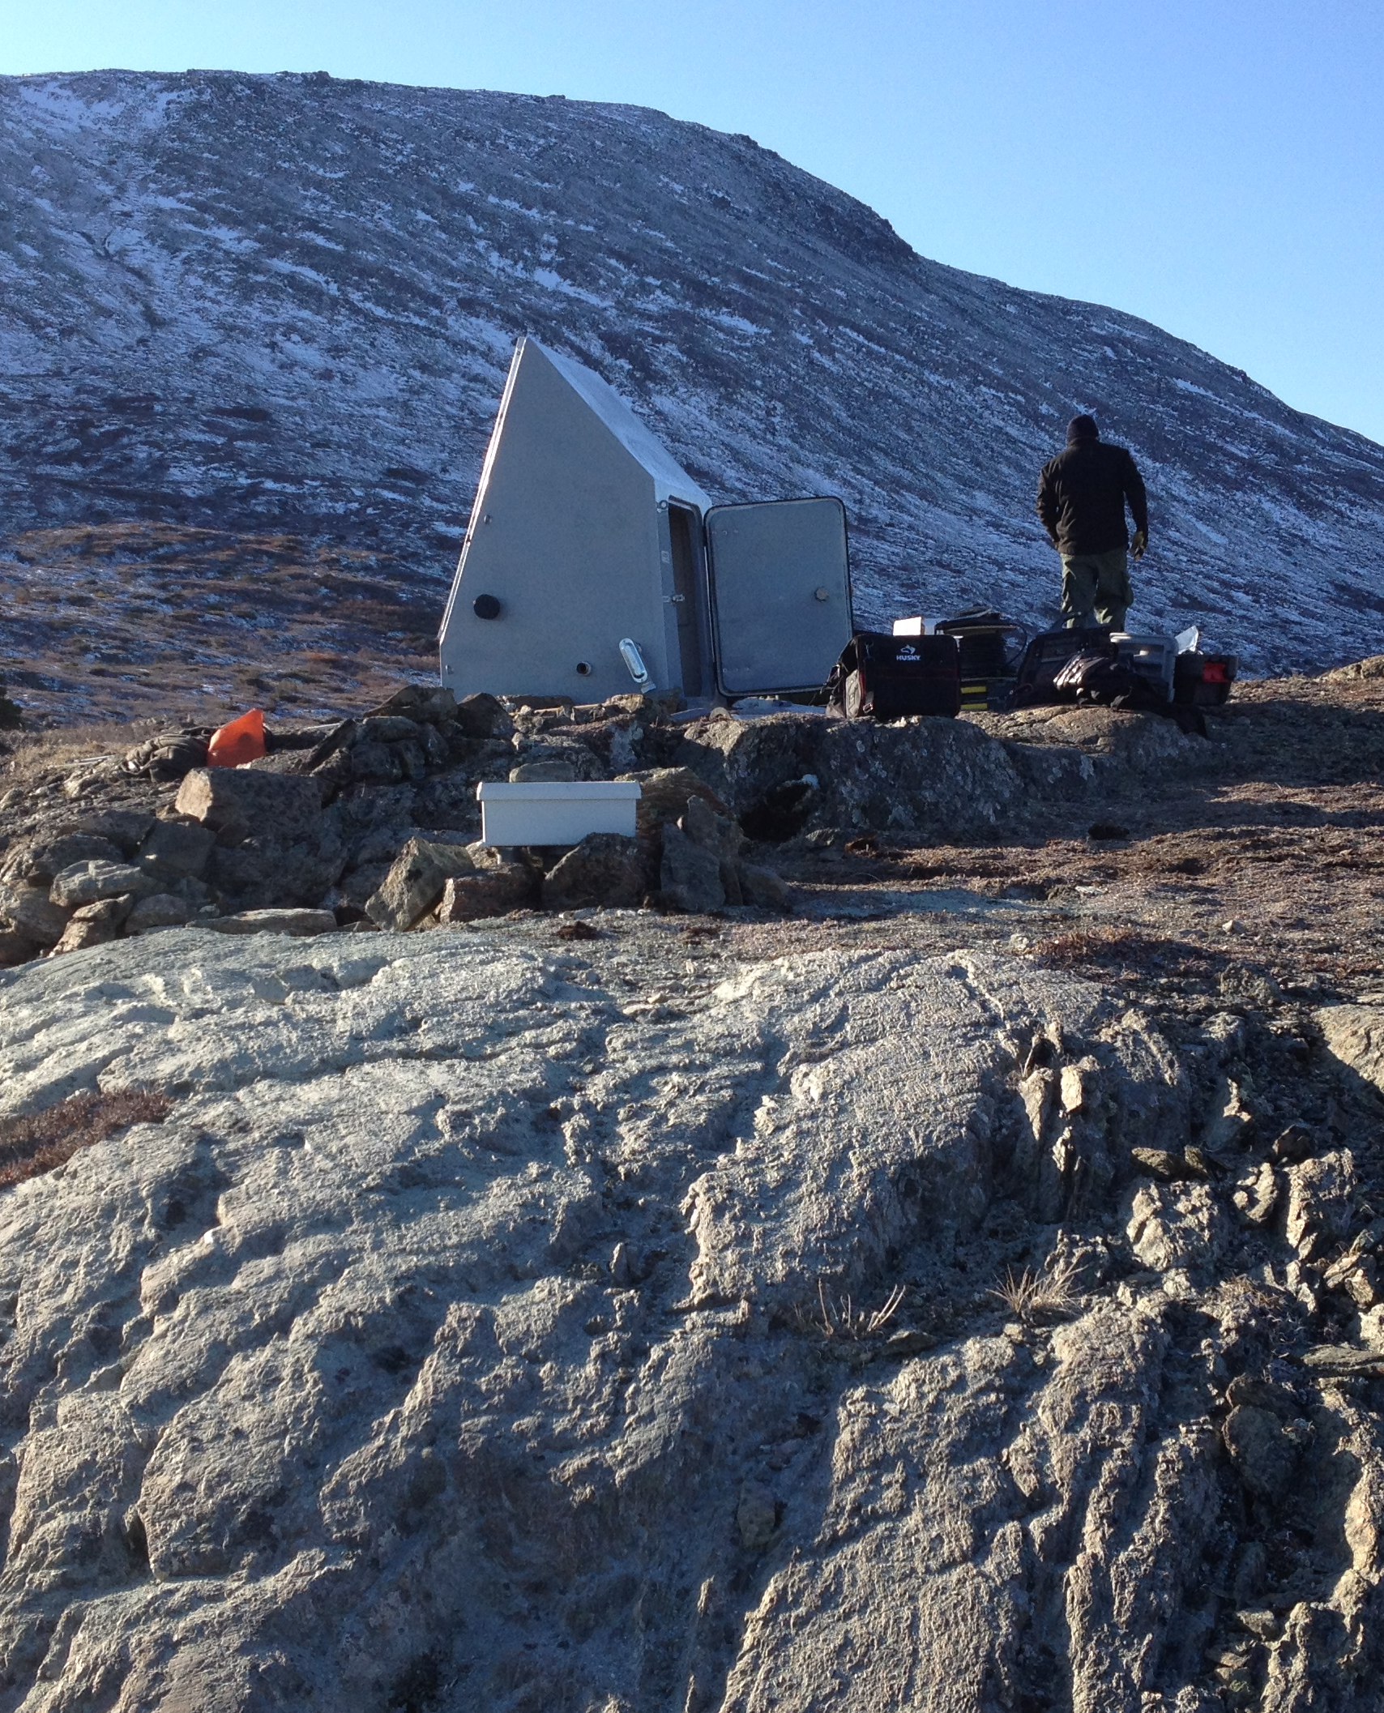
Basic Description of Buried Sensor Design for AK
Sensor: 3 component Broadband seismometer & auxiliary sensors
Datalogger & local data storage
Power & data telemetry
N25K Seismic Station
**Stations would be in place for
3 to 5 years**
Footprint ~10 feet X 20 feet

Slide 4
Proposed Installation Plan
TA Built Stations
Current 46
FY16 72
FY17 73
Total 190
Existing 75
266 Install Plan

Slide 5
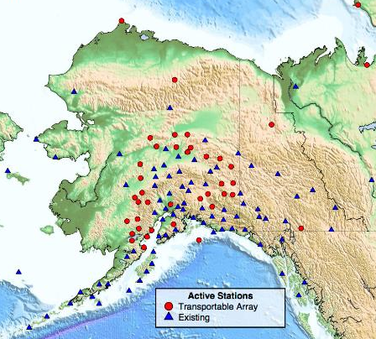
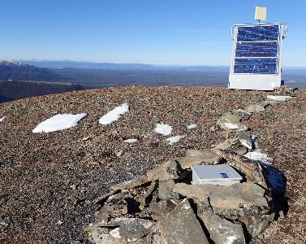
Alaska TA Status
Completed first major season in Alaska
32 new installs (36 planned)
A total of 46 new stations operating
Key technologies
Power systems - challenging
Communications - great
Sensor emplacement - great

Slide 6
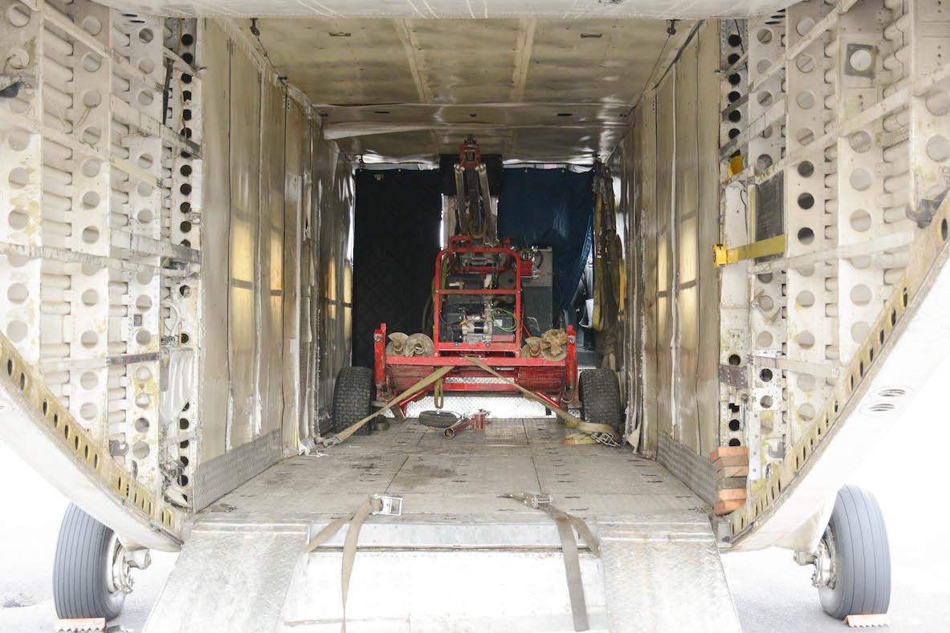
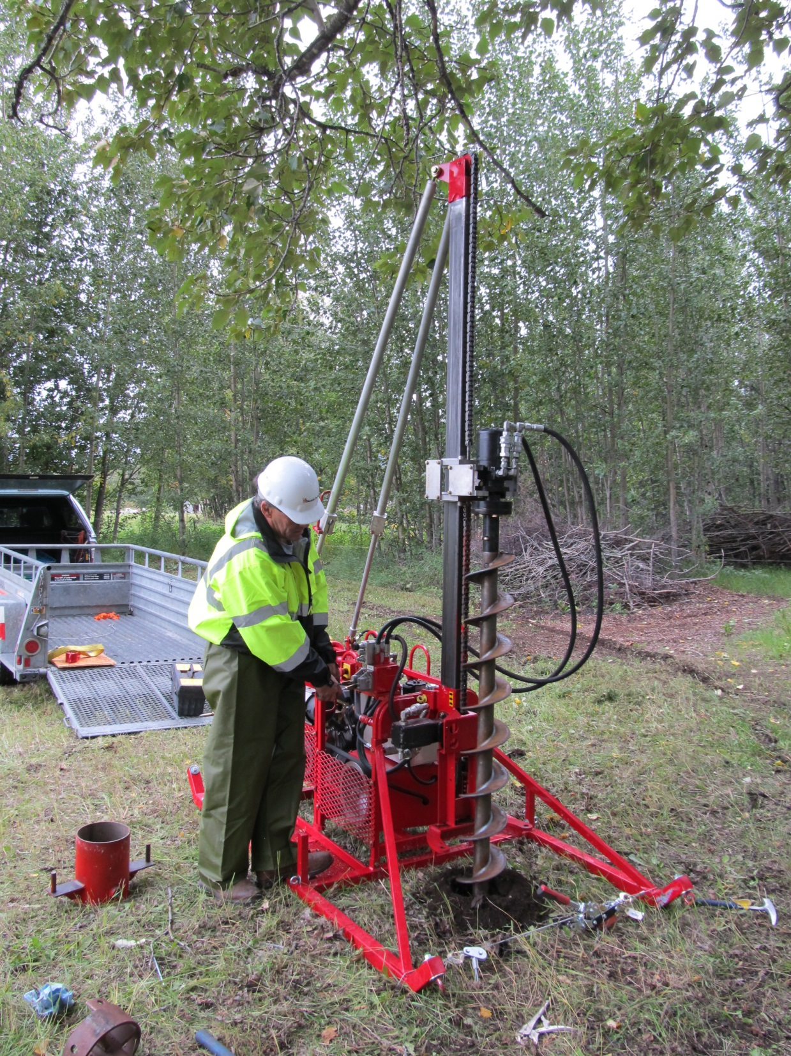
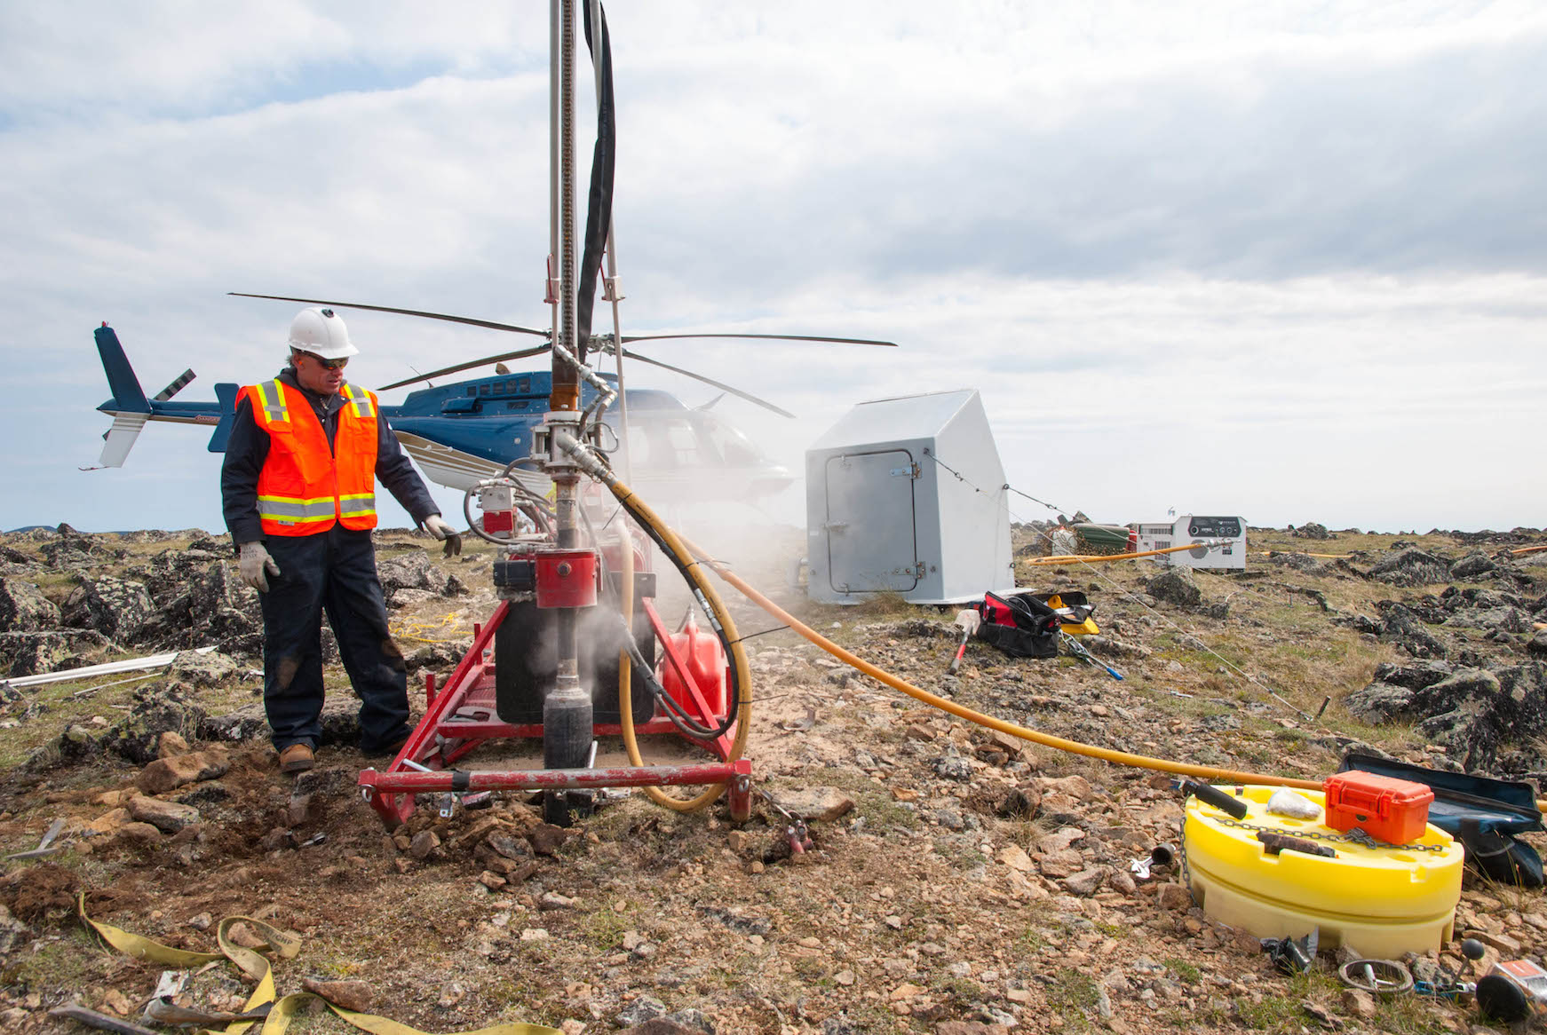
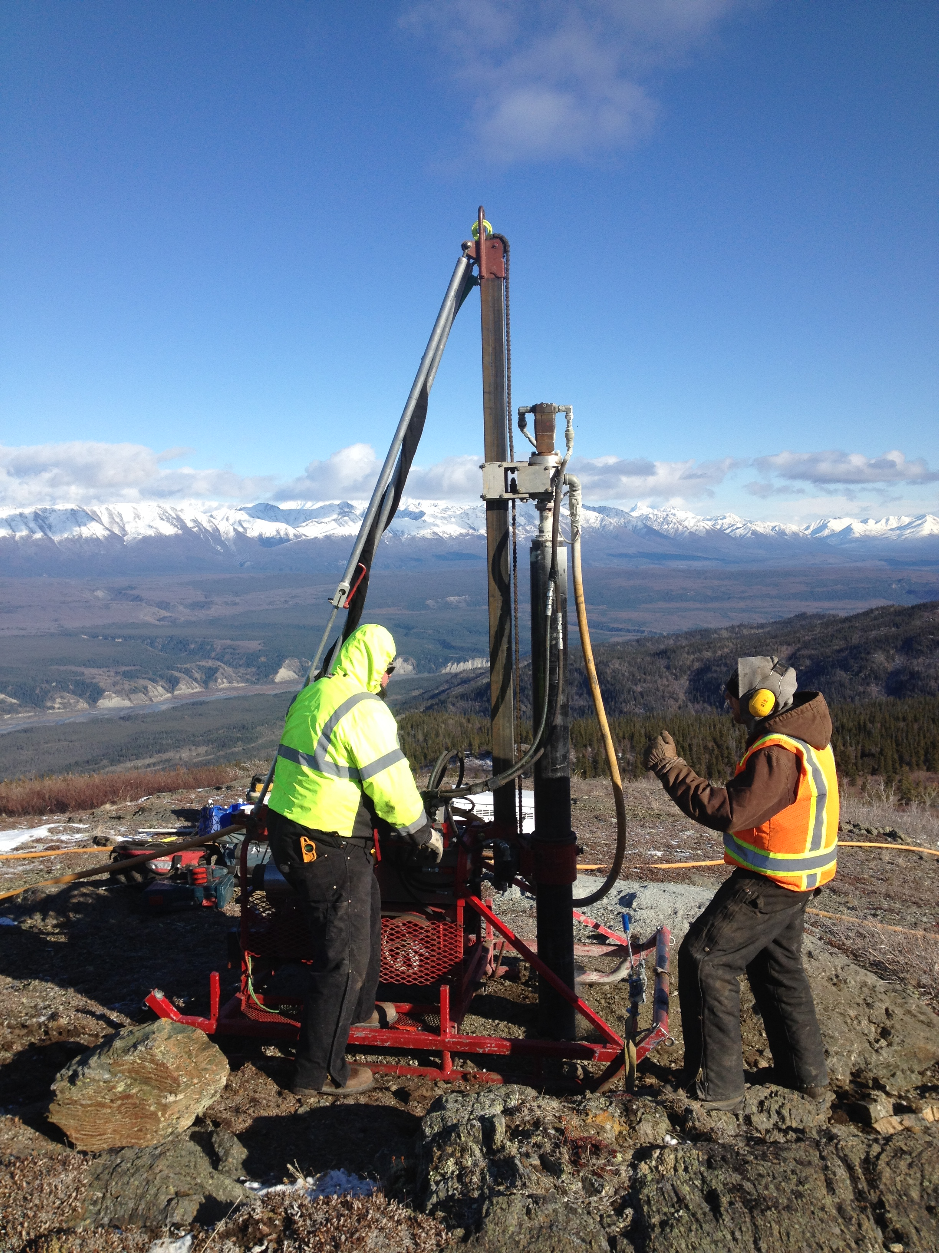
Sensor Emplacement
The Lund-Drill is designed for TA in Alaska:
1600 lbs Sling load weight
28% Augering
3% Backhoe
69% Downhole Hammer
NEED: a hole in rock, frozen ground or
up to 5M into soils.
Drill in Skyvan, bound for Middleton Island
Hammer drill, N25K
Hammer Drilling, AK.SCRK
Mike Lundgren auger in Palmer AK

Slide 7
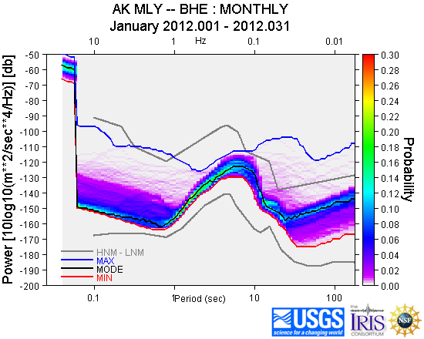
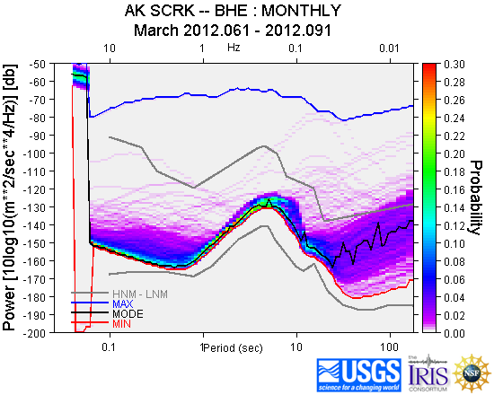
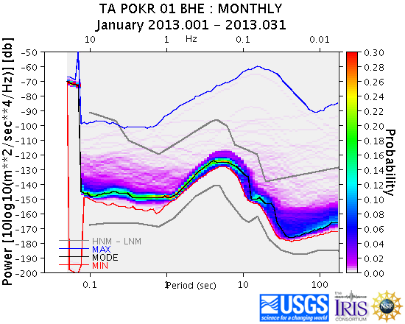
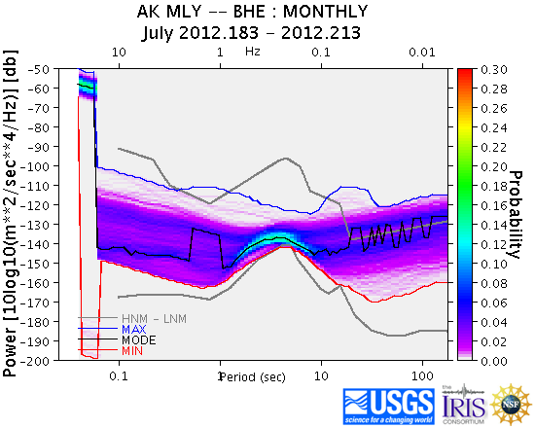
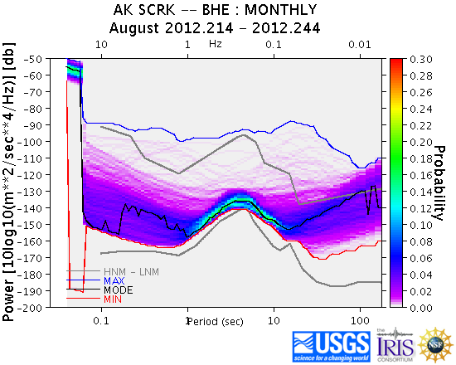
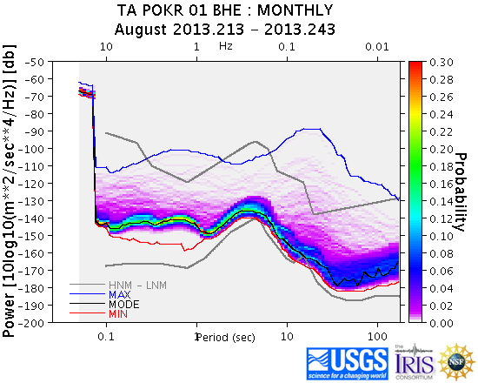
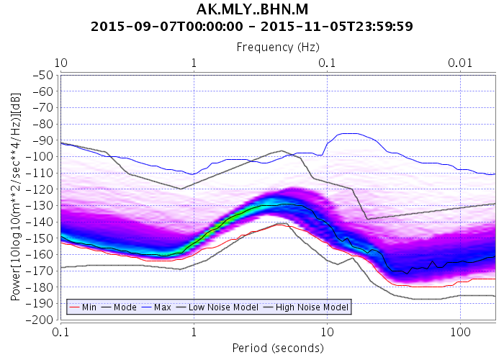
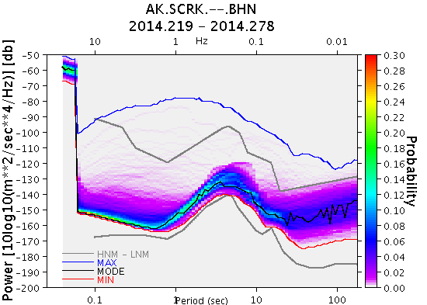
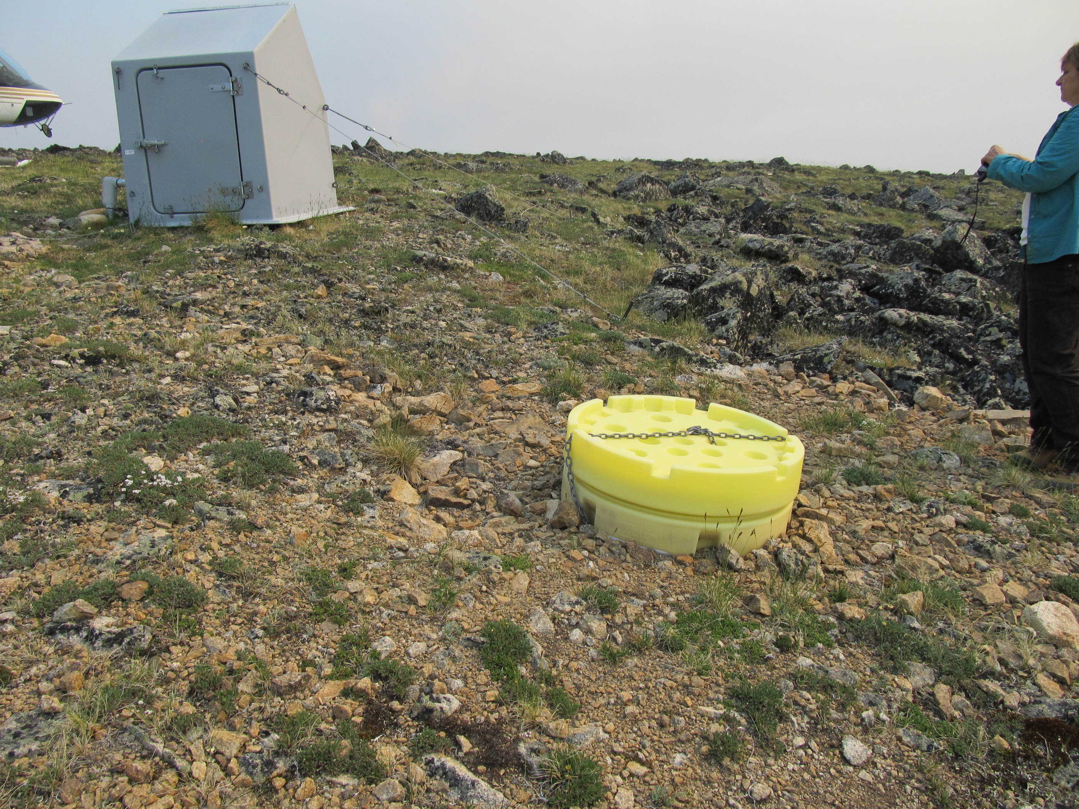
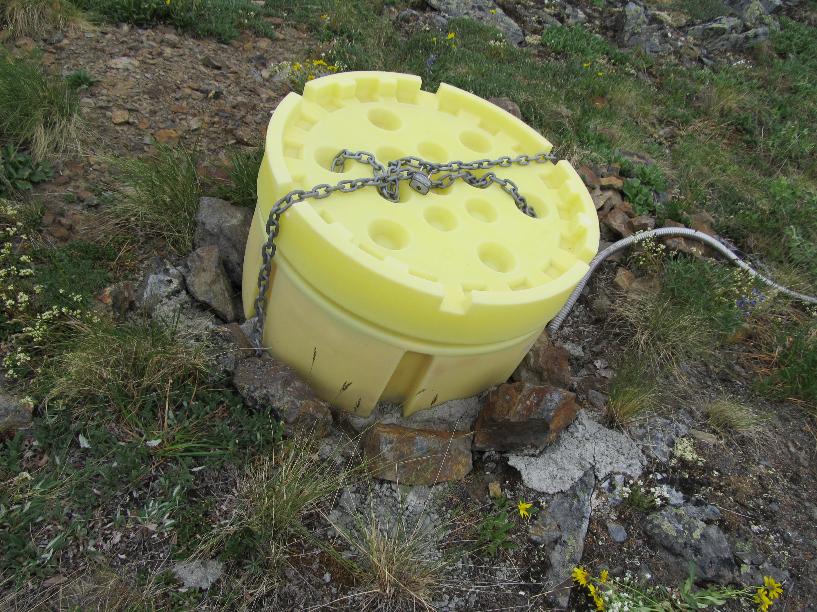
Station Installation
AK.MLY
AK.MLY
AK.SCRK

Slide 8
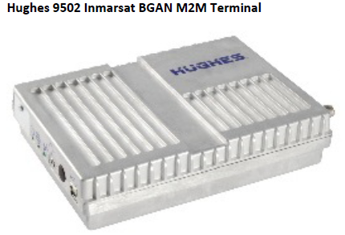
Communications
Objective:
Deliver 40 Mbytes/day, with latencies under 4-6 hours. Need not be a continuous connection, but that is preferred when power and cost allow it. Must be under 2 Watts average daily power.
12 Gb/day compared with about 23 Gb/day today.
Send data as streaming packets and file transfers of low rate data to obtain best continuity at lowest transfer volume.
Options:
Freewave and Cell where available, village wifi
HughesNet VSAT
InMarSat M2M BGAN Hughes 9502 terminal
Iridium DoD RUDICs XEOS XI-100B
~ $1780K annually
11-15W full transmit at 400kbps
1W standby, SMS wakeup
0.1W sleep
$1000

Slide 9
Station Power
Design Goal is 17kwh available onsite
4.3 kwh / month for a 6W station
(8) LiFePO4 180AH batteries, 440 lbs
(24) AGM 100AH 60% in cold, 1680 lbs
The 1240 lbs difference is an extra flight adding ~$8250 to cost of install AND to remove. Difference in cost of Batteries is $11.2K.

Slide 10
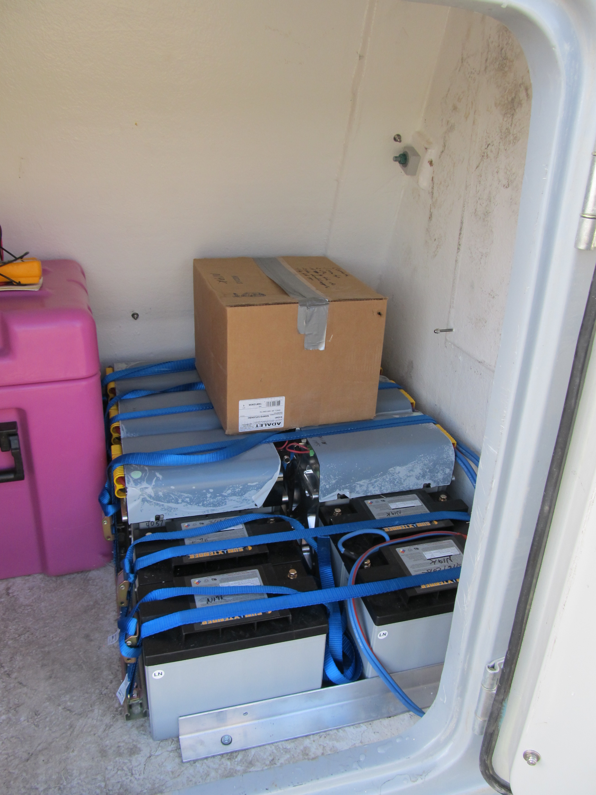
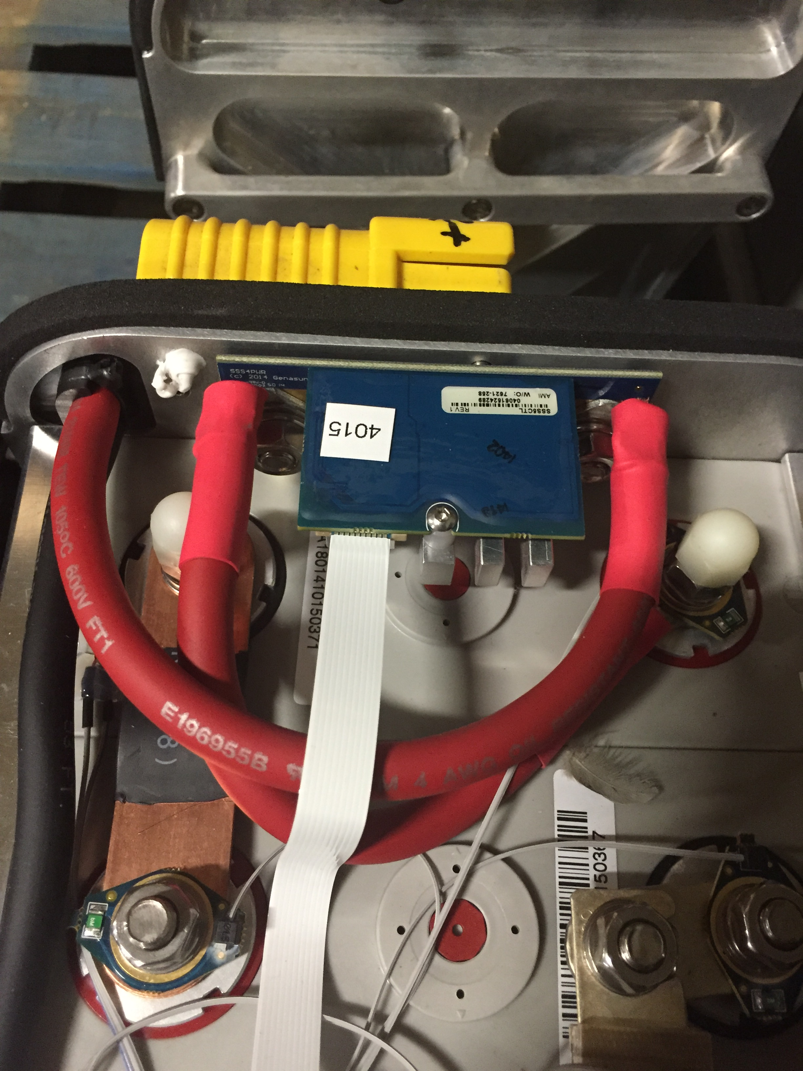
Station Power
LiFePO4 Battery Issue
Safety switch becomes defective after deployment
Results in charged batteries disconnected from load.
Replace solid-state switch
Charge Controller
Unexpected state if a battery reappears. Results in permanent damage to Controller.
Horowitz and Hill, 1989

Slide 11
TA AC Governance
TA Advisory Committee
Freymuller, Jeff (Chair) University of Alaska, Fairbanks
Lin, Fan-Chi University of Utah
Schmerr, Nick University of Maryland
Prejean, Stephanie Alaska Volcano Observatory, USGS
Stachnik, Josh Lehigh University
Audet, Pascal Univ of Ottawa
Busby, Bob IRIS-Transportable Array Manager
Vernon, Frank (Observer) University of California, San Diego (Array Network Facility)
Potential Incoming
Pavlis, Gary
Schmandt, Brandon
Tape, Carl

Slide 12

For More Information
On the Web
EarthScope
www.earthscope.org
USArray
www.usarray.org
PBO
pboweb.unavco.org
National Science Foundation
www.nsf.gov
EarthScope is funded by the National Science Foundation.
EarthScope is being constructed, operated, and maintained as a collaborative effort with UNAVCO, IRIS, and Stanford University, with contributions from the US Geological Survey, NASA and several other national and international organizations.
Notes:
Presentation notes:
1. This slide is required by the National Science Foundation, please include it in all your presentations on EarthScope
2. Please add your institution's logo if it is not already present

Slide 13
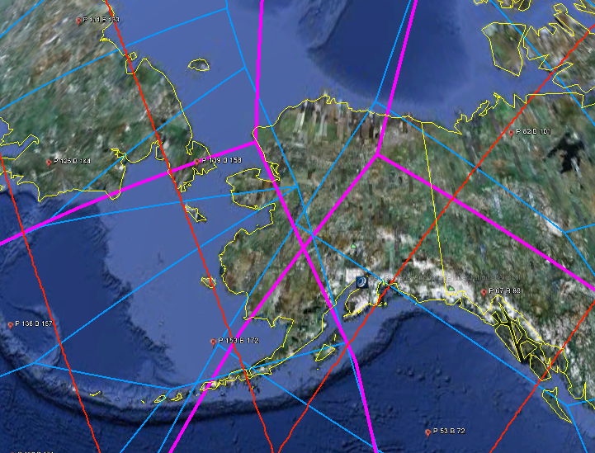
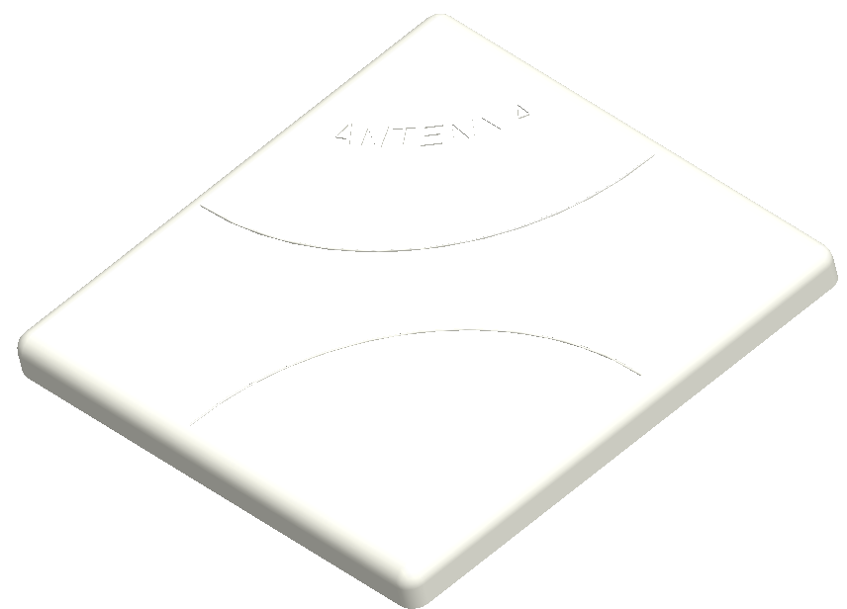
BGAN I4 EIRP Elevation
12 x 12 x 2 inch flat plate
20 degree requirement
Tested reception at all
Reconned sites in north.
Limitation is cost- $1k/mo
350kbps bandwidth
2Gbyte/mo throughput
RED Lines = 10 Degree elevation = minimum recommended for BGAN
PINK Lines = Regional Beams of APAC and AMER satellites = Should Work
BLUE Lines = Narrow Beams = Hard to reach
This map depicts Inmarsat’s expectations of coverage, but does not represent a guarantee of service. The availability of service at the edge of coverage areas fluctuates depending on various conditions.

Slide 14
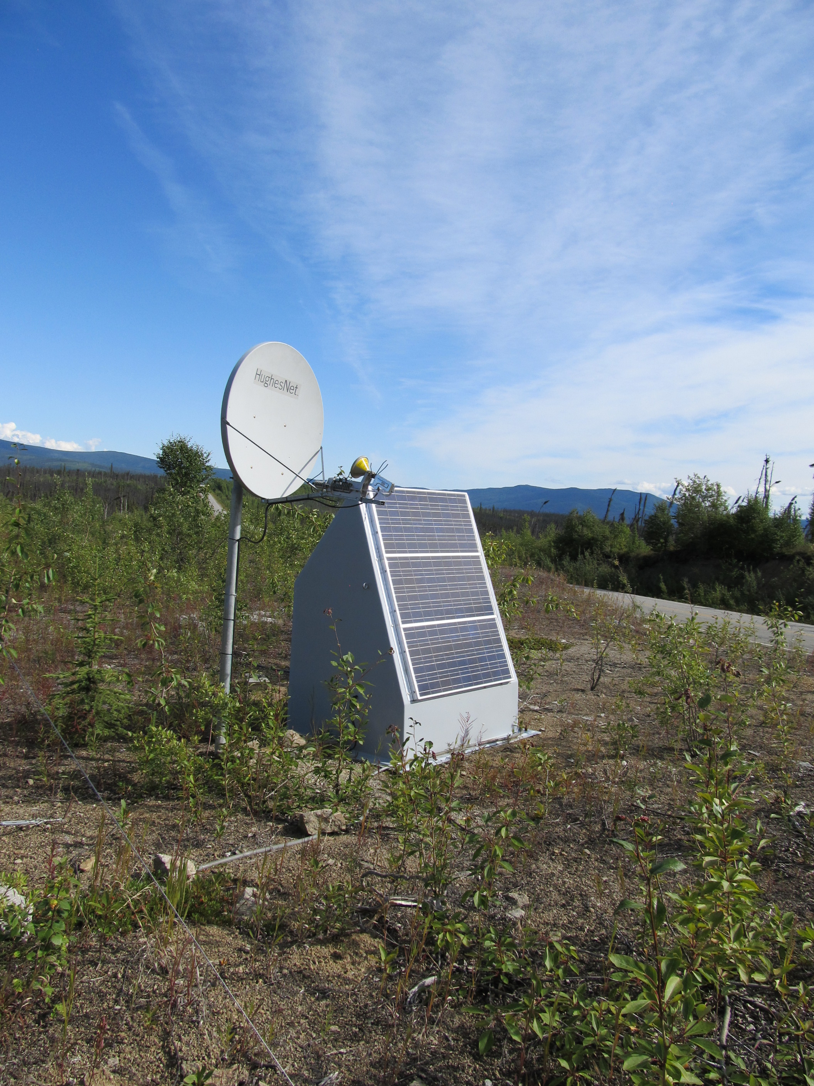
HughesNet VSAT
Works at high latitudes (north of Toolik)
High power – 30 W
Bandwidth can support two stations, usually one.
Low Cost - $90/mo
Reliability in winter,
and to maintain pointing.
TA.K27K, Chicken PBO VSAT & Hut

Slide 15
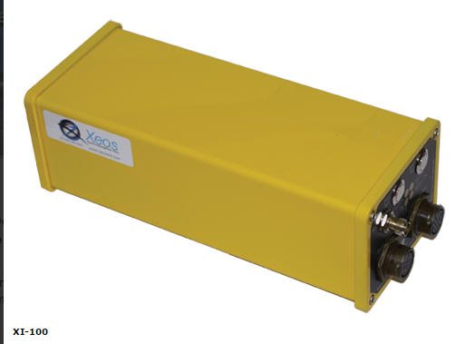
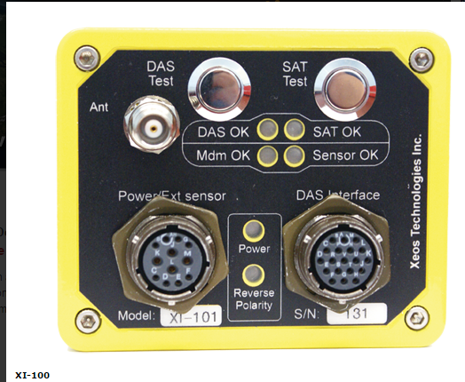
Iridium Rudics
XI-100B modem, 5 Watts
Max rate 2400 bps, 24Mbyte/day
Lots of link cycles
Cost $290/mo
Omnidirectional antenna
Rudics tunnel protocol

Slide 16
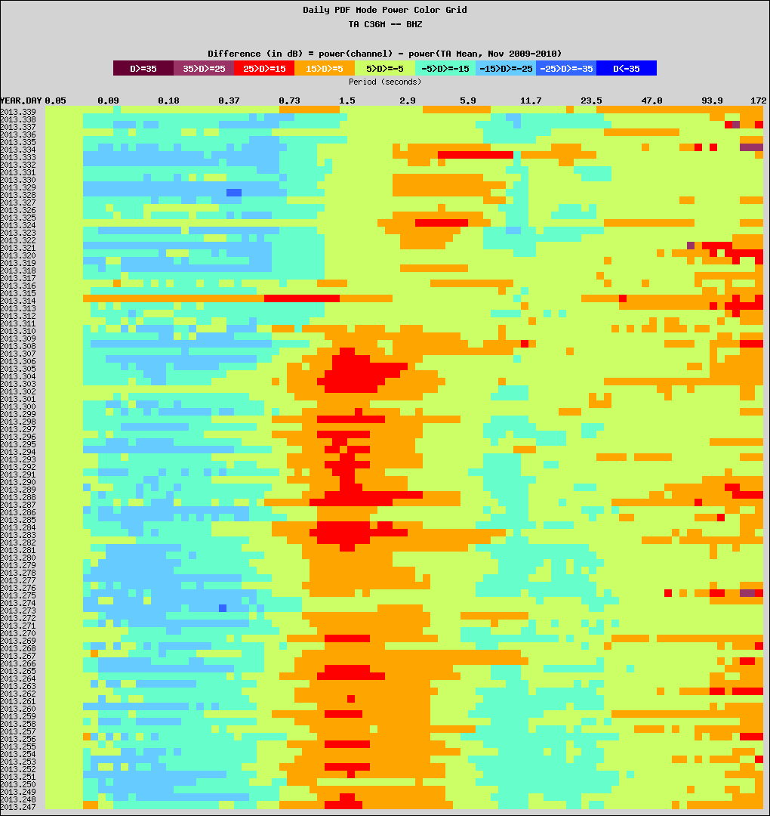
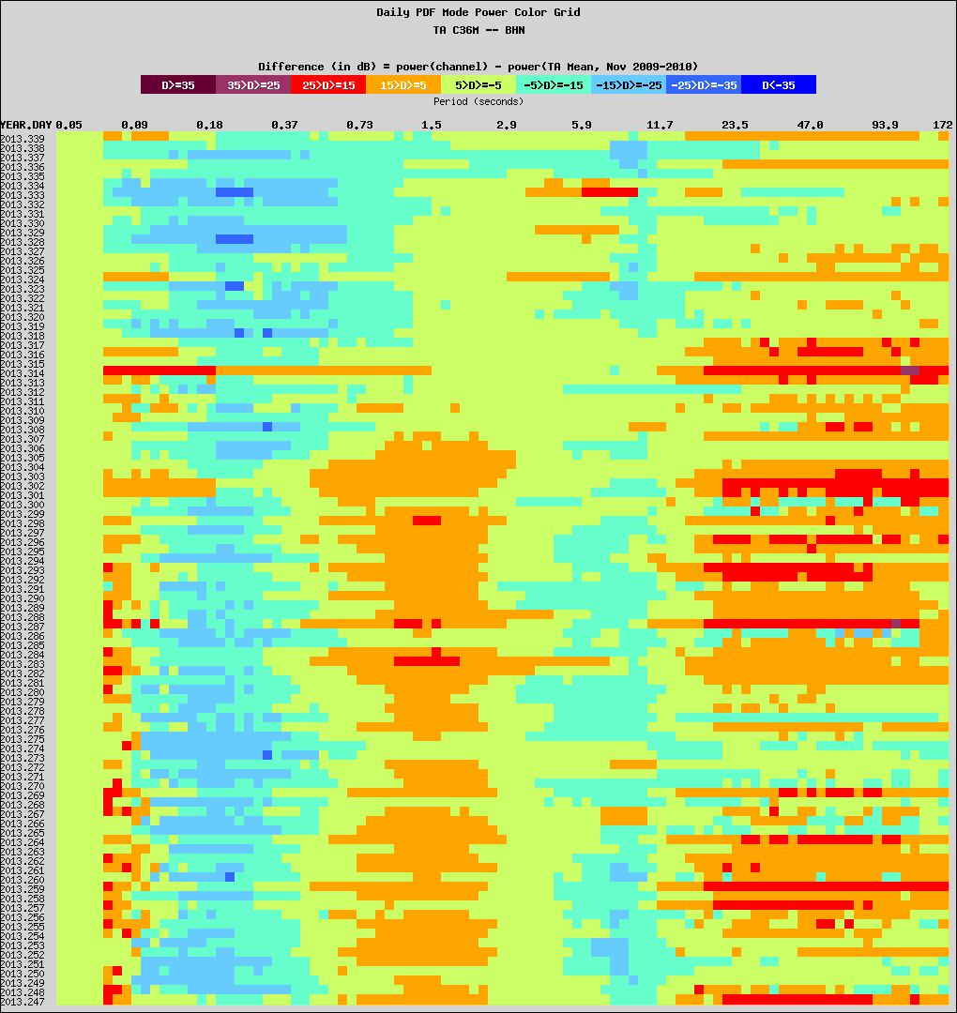
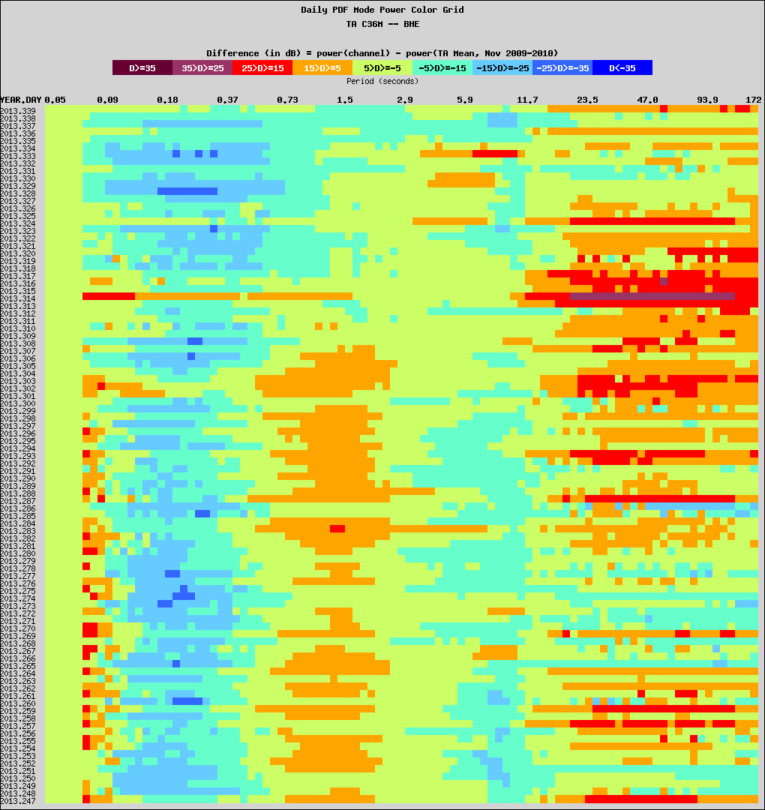
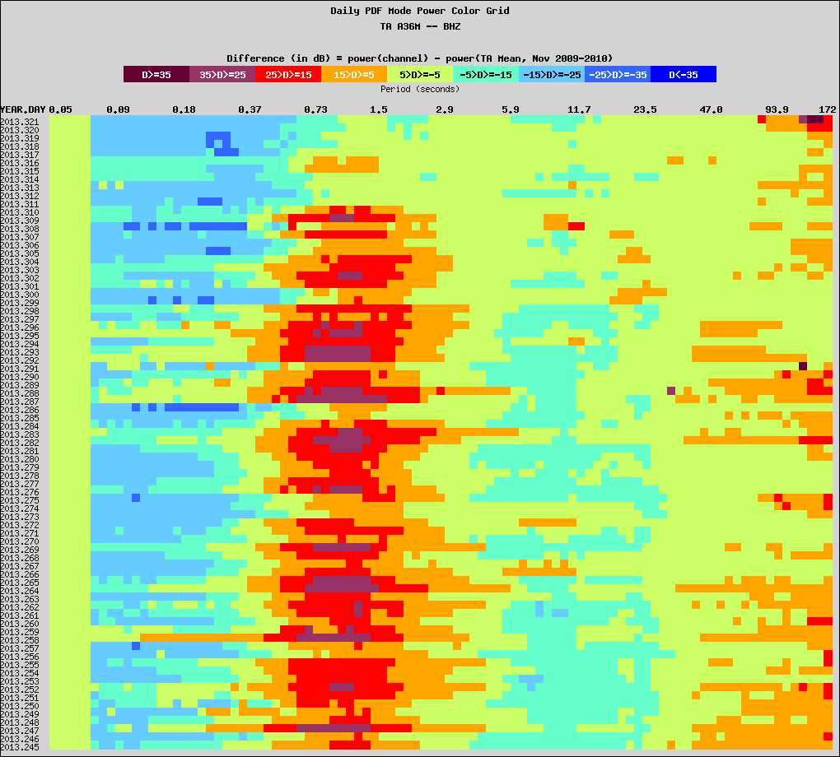
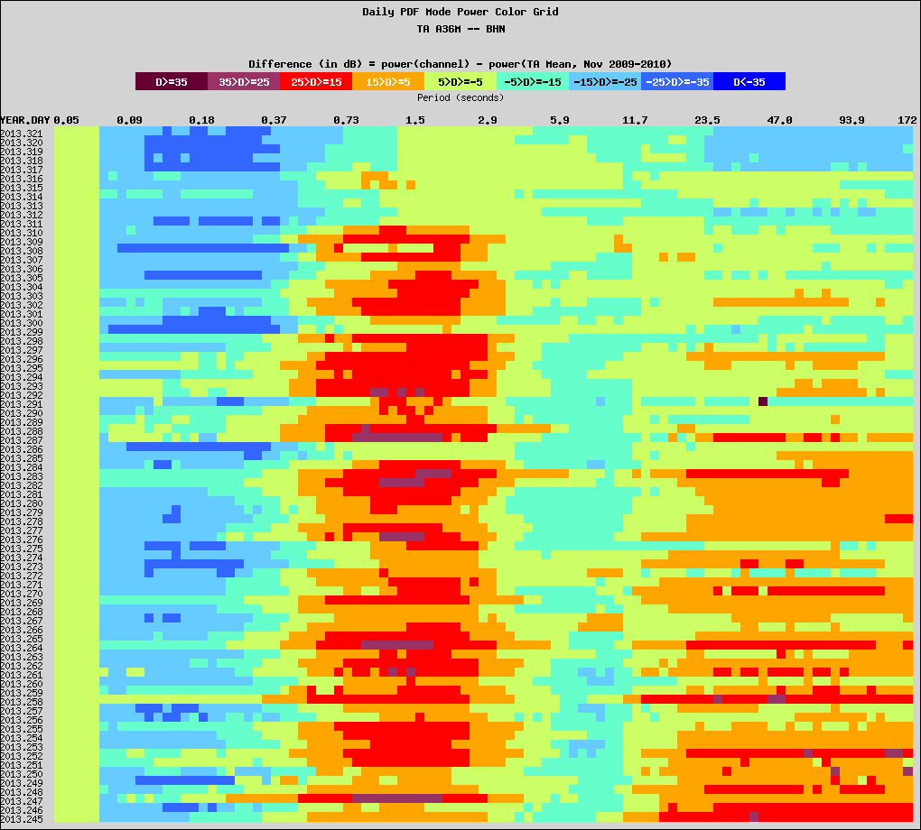
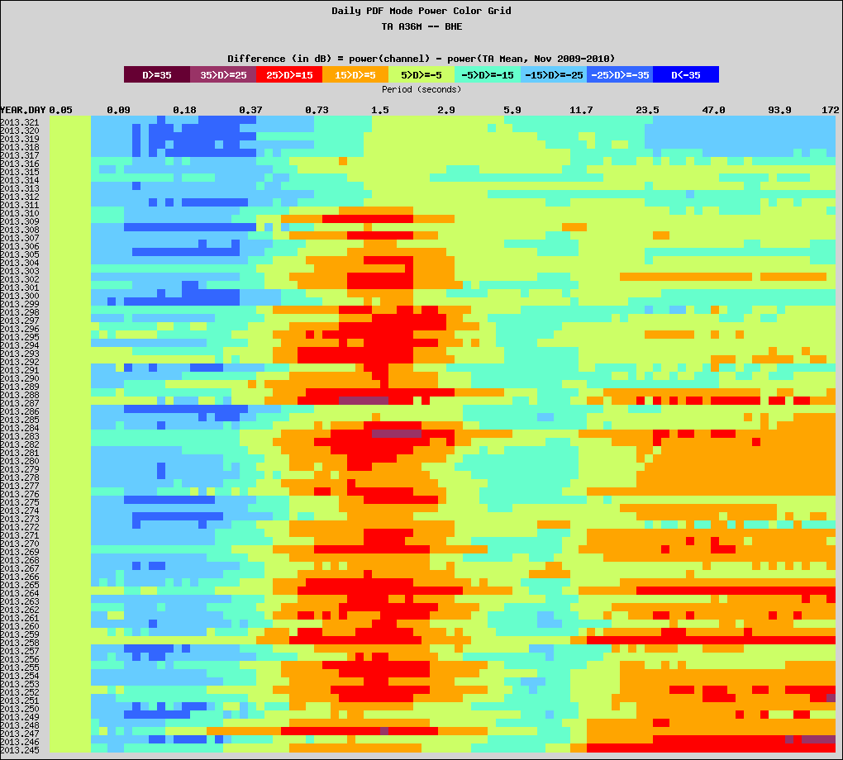
Paulatuk C36M Sachs Harbor A36M
C36M
Vertical
North
East
2013 Day 247 ----- 339
2013:289
A36M
2013 Day 245 ---- 321
2013:289
A dramatic seasonal improvement of noise performance at freeze up, of interest to sea-ice modelers.

