Slide 1
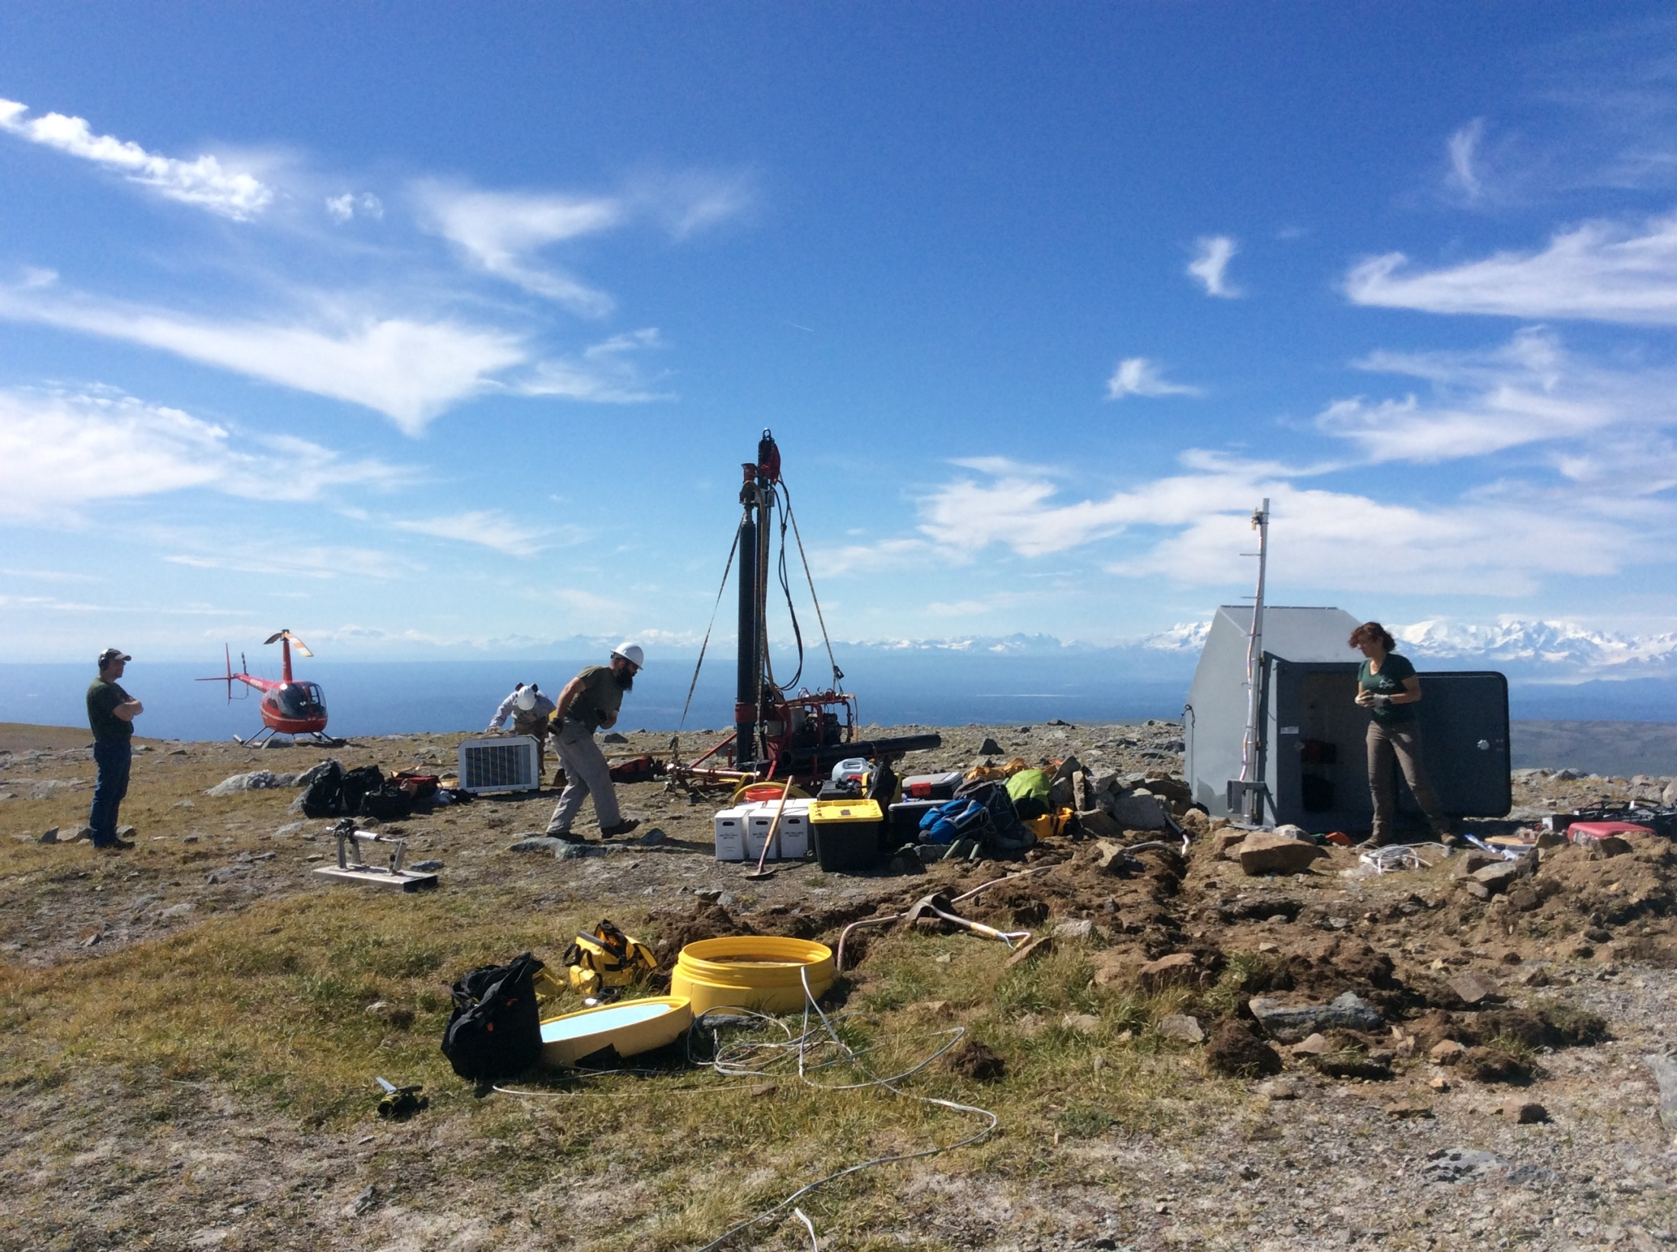


TA station integration with AEC ... Has it made a difference?
Helena Buurman
UAF/AEC
TA team meeting, November 2015

Slide 2
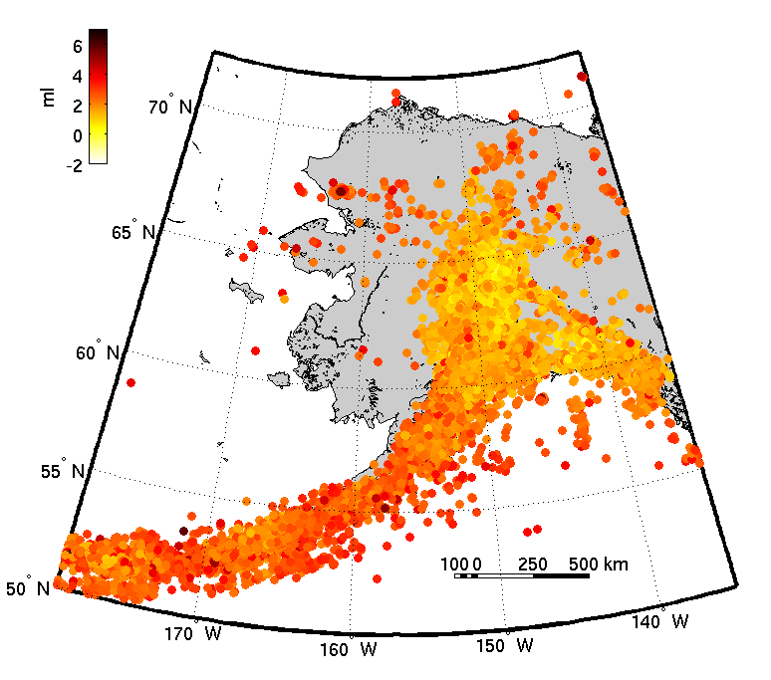
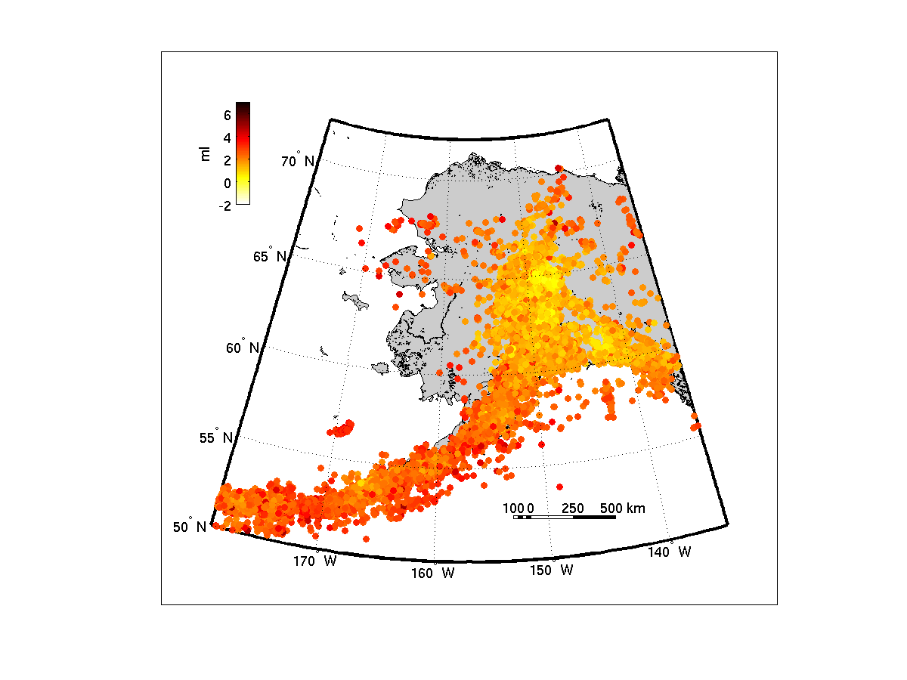
Seismicity in Alaska
“Pre-TA”
“Syn-TA”
Sep 2013 - Sep 2014
Sep 2014 - Sep 2015
39,904 earthquakes located
51,972 earthquakes located

Slide 3
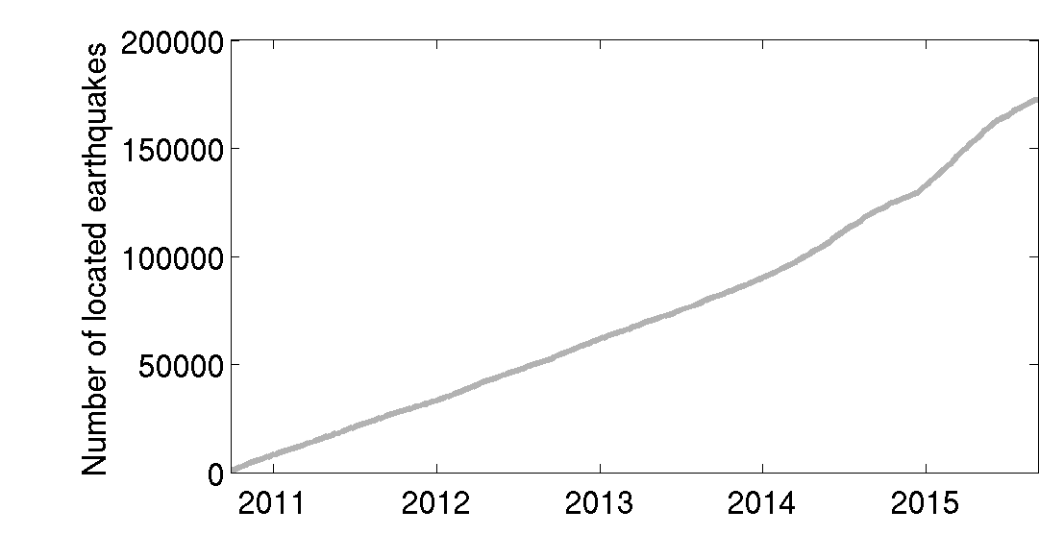
Earthquake rates in Alaska
Mysterious increase
Rat Islands 7.9

Slide 4
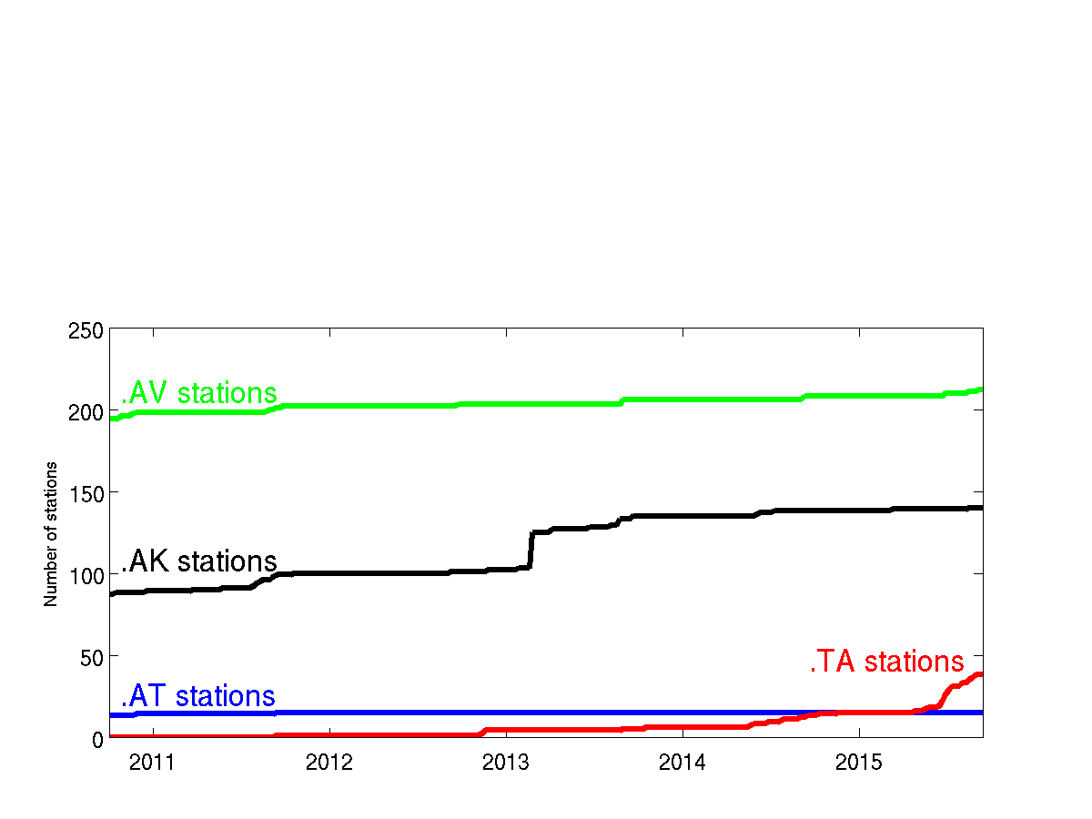
Seismometers in Alaska

Slide 5
Have the TA stations made a difference?

Slide 6
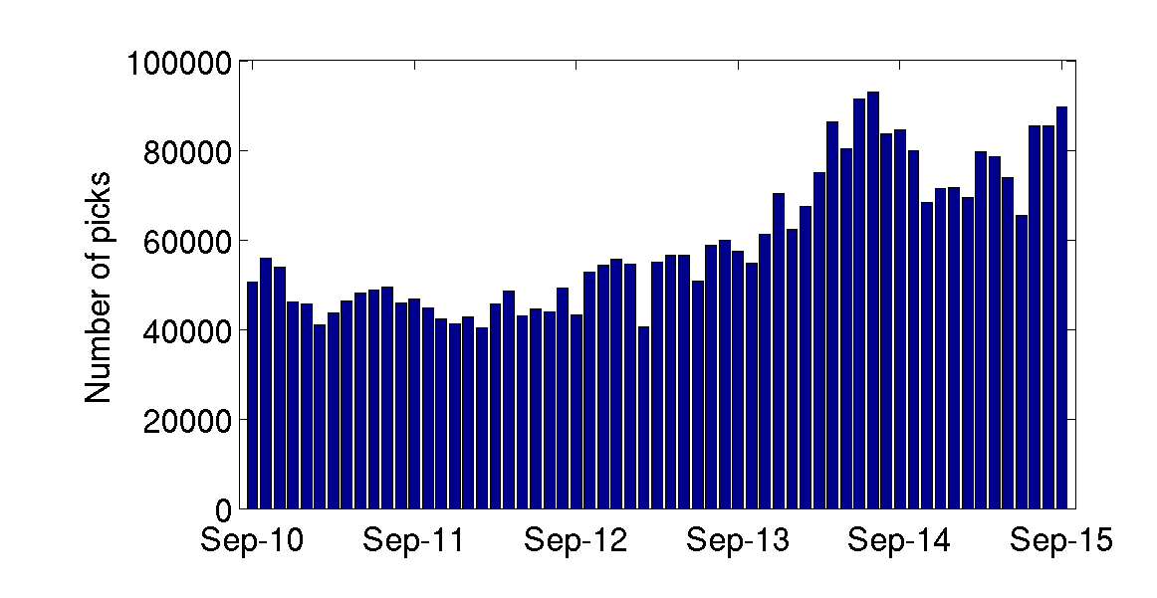
Picks made by AEC analysts

Slide 7
Picks made by AEC analysts

Slide 8
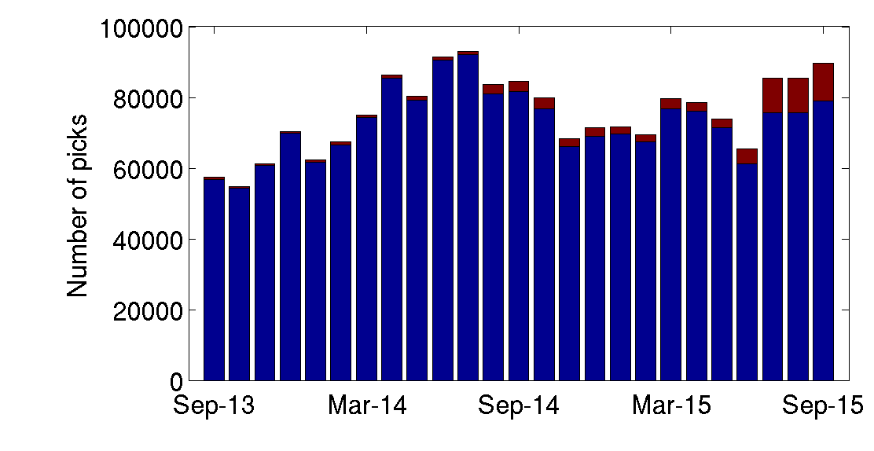
TA stations used by AEC analysts

Slide 9
TA stations used by AEC analysts
10,614

Slide 10
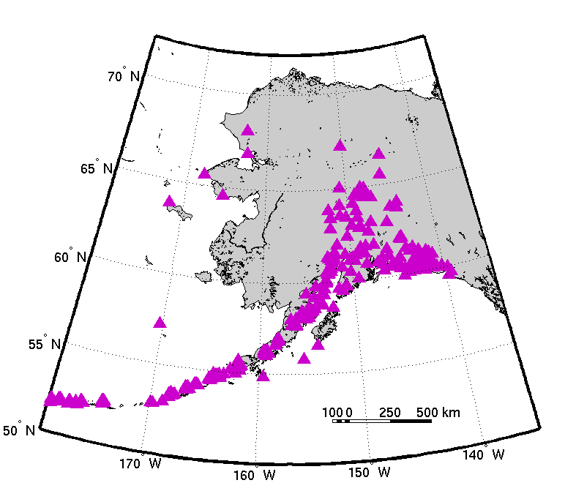
Pre-TA station distribution

Slide 11
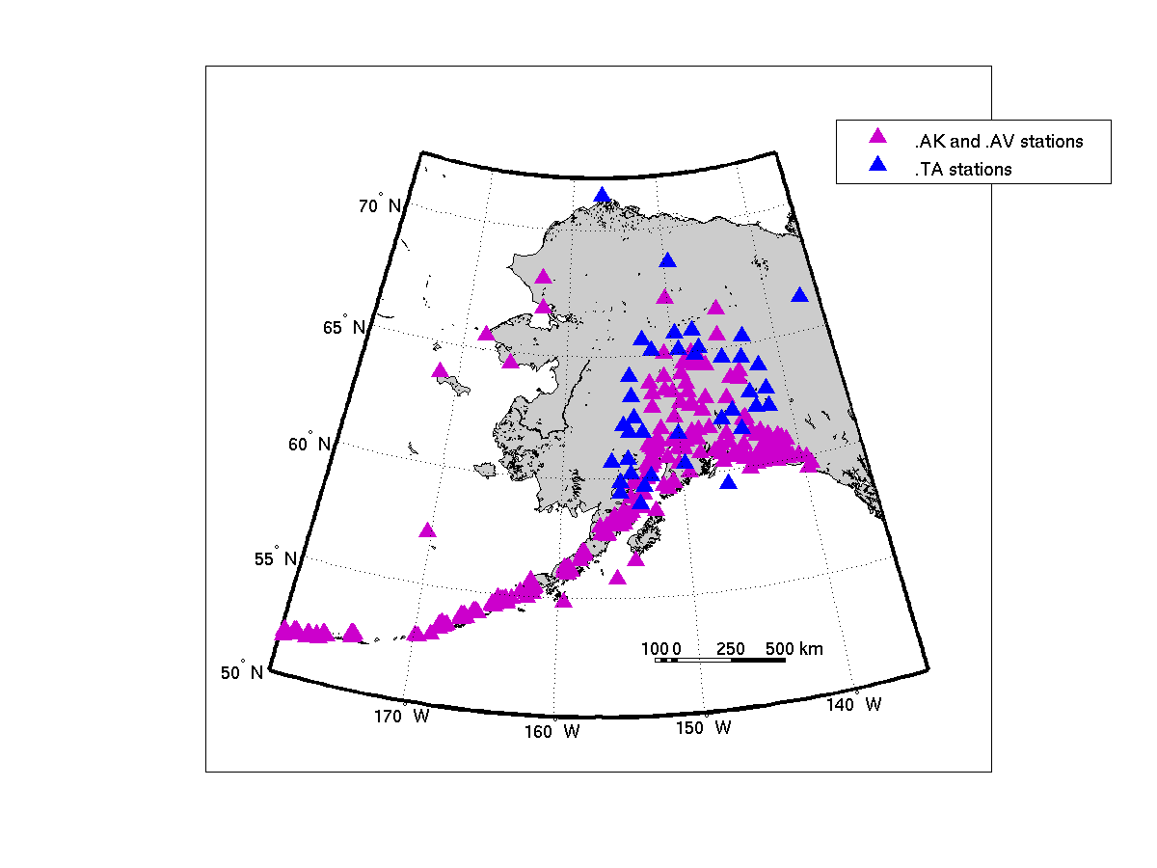
September 2015 station distribution

Slide 12
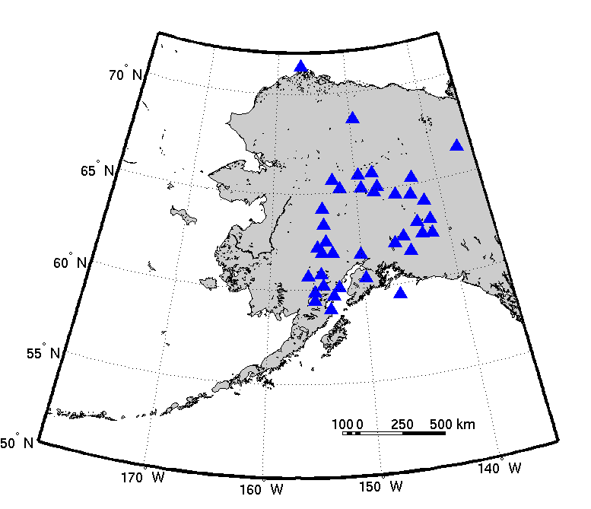
New TA stations in Alaska

Slide 13
How do the new stations impact what is located at AEC?

Slide 14

How do the new stations impact what is located at AEC?

Slide 15
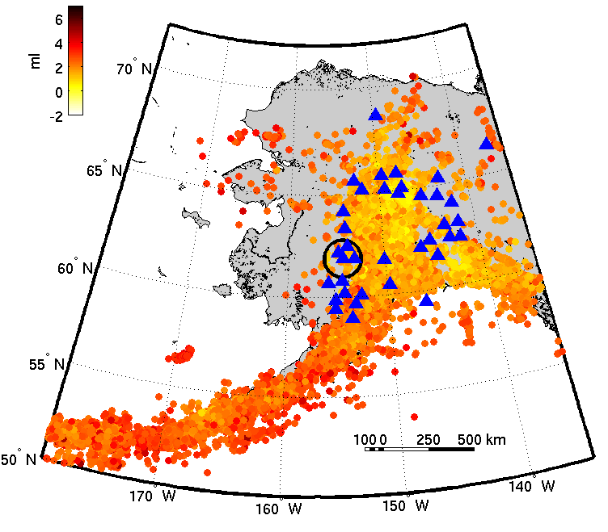
How do the new stations impact what is located by AEC?

Slide 16
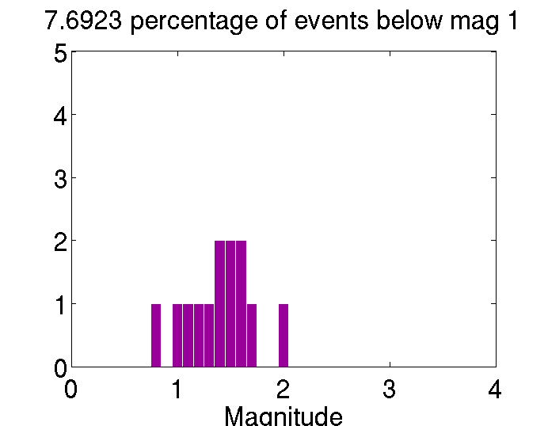
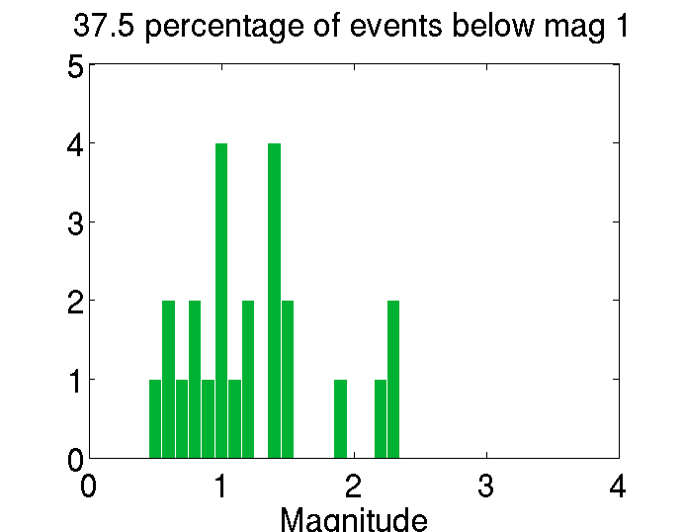
Can we see a difference in the AEC earthquake catalogue?
2014
# events
Magnitude
2015
# events
Magnitude

Slide 17
Can we see a difference in the AEC earthquake catalogue?
8%
2014
# events
Magnitude
38%
2015
# events
Magnitude

Slide 18
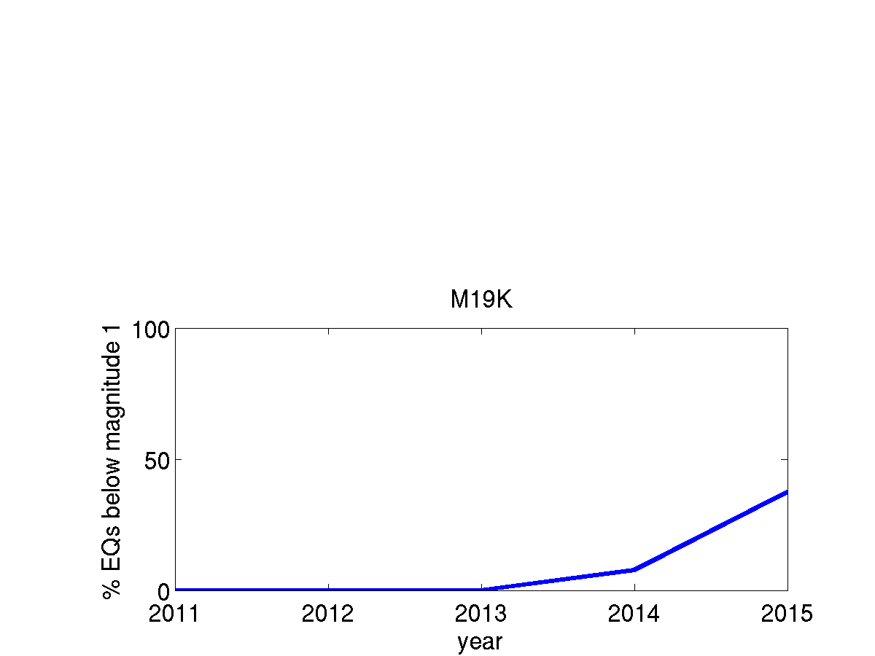
Can we see a difference in the AEC earthquake catalogue?
% events below mag. 1

Slide 19

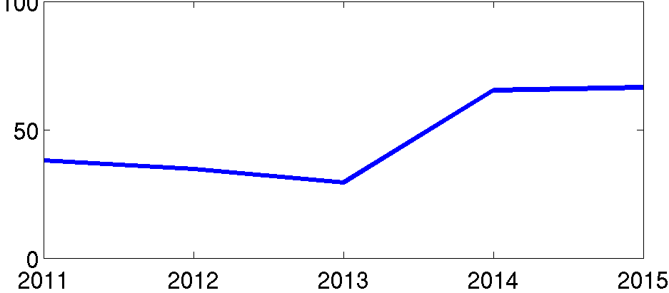
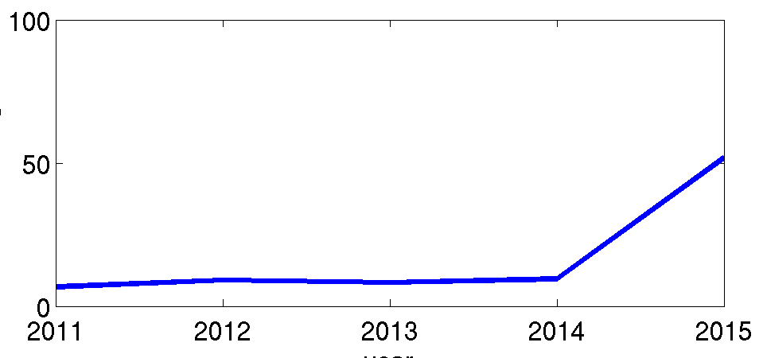
Are more earthquakes being located around new TA stations?
H23K
M19K
M26K

Slide 20

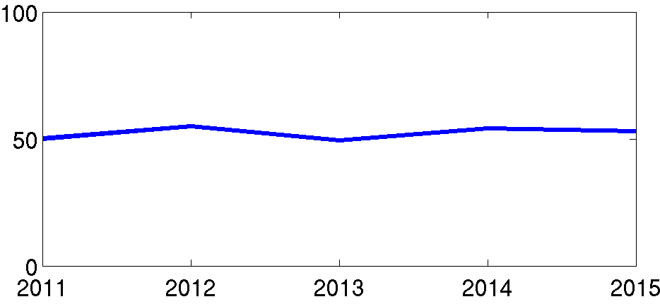
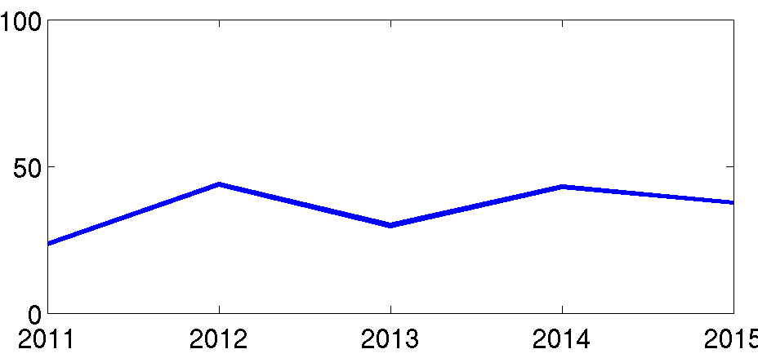
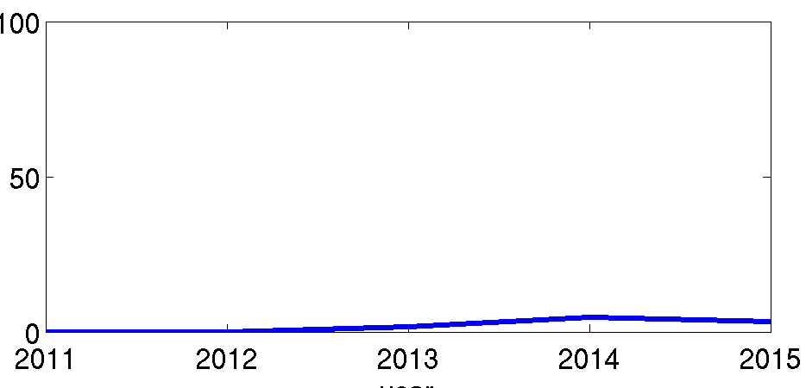
Are there changes around the existing AEC stations?
GRIN
TRF
HOM

Slide 21
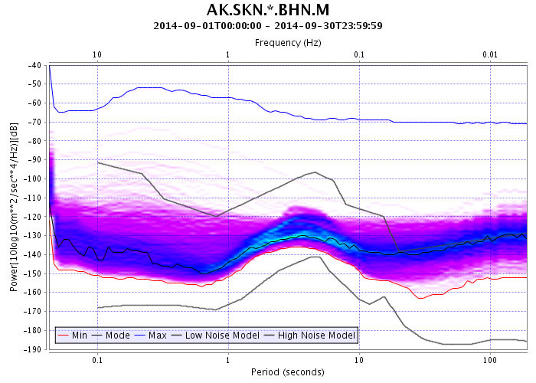
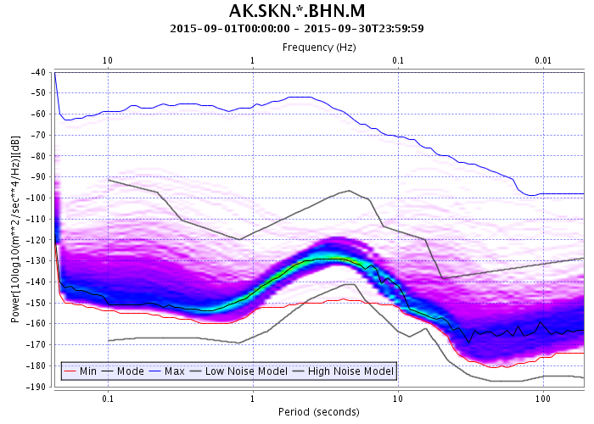
Improved noise levels at AEC upgrade sites
September 2014
September 2015

Slide 22
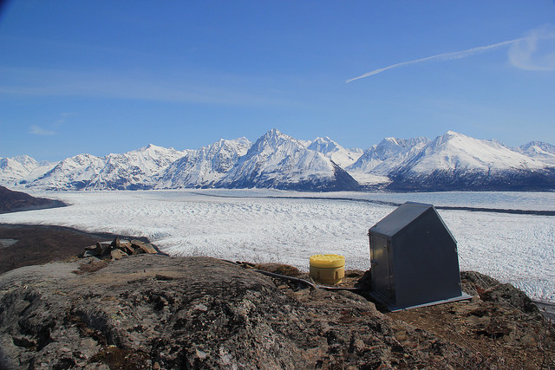
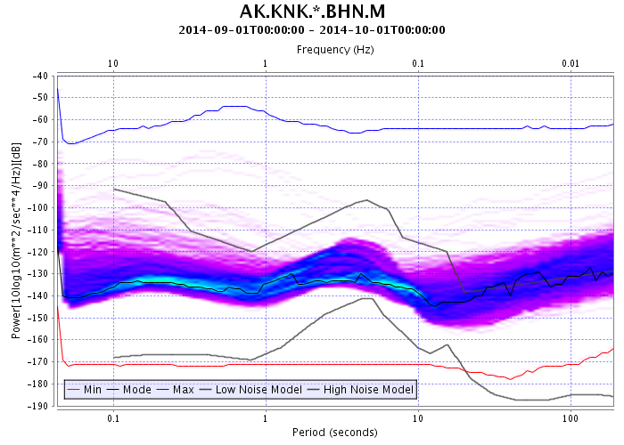
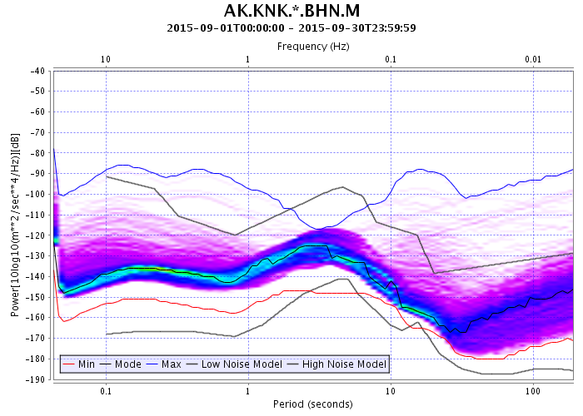
September 2014
September 2015

Slide 23
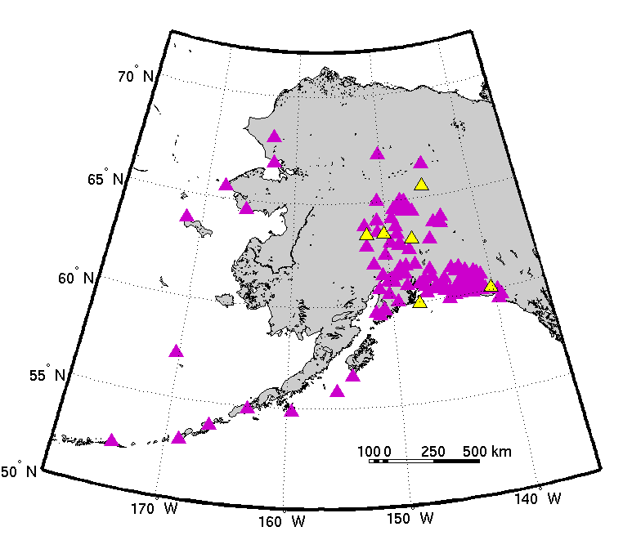
6 upgrades in 2016

Slide 24
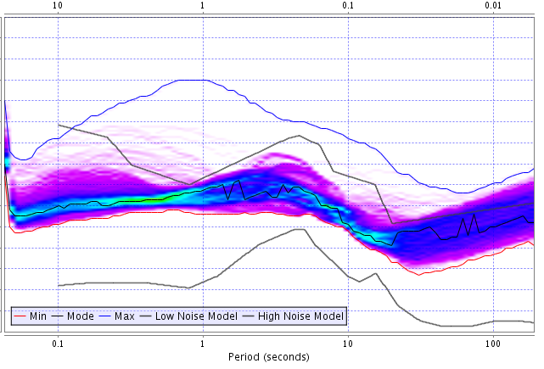
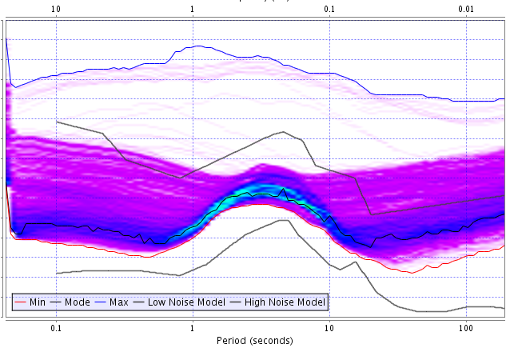
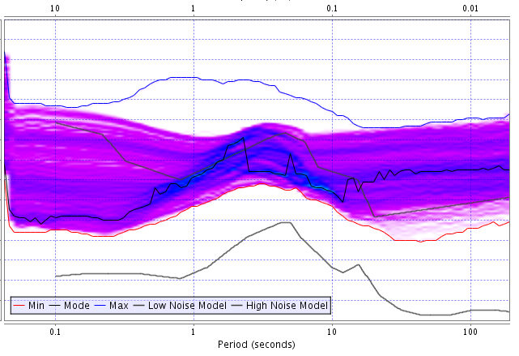
6 upgrades in 2016
PIN
TRF
KAI

Slide 25
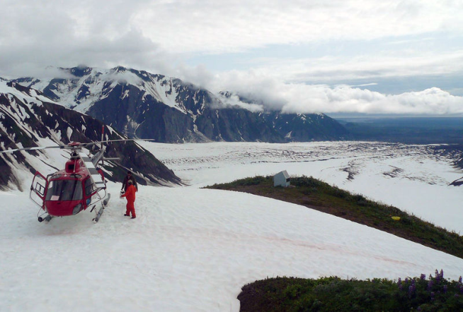
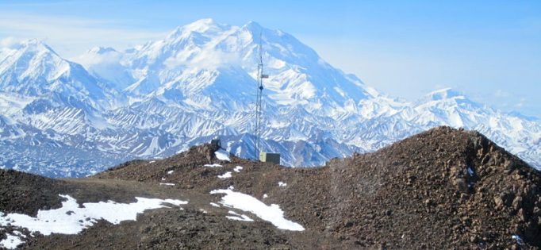
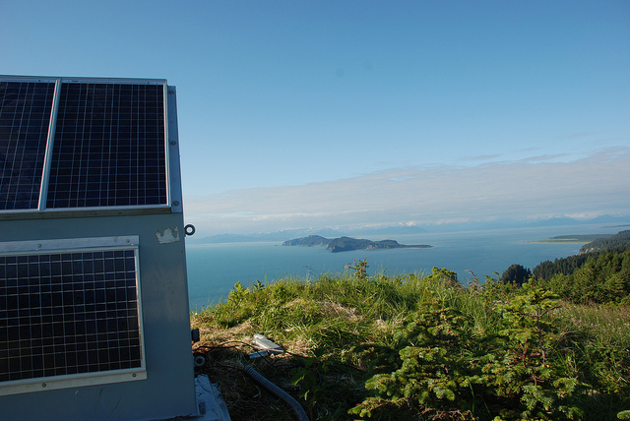
6 upgrades in 2016
PIN
TRF
KAI

