Slide 1
ANF – getting data flowing and events reviewed aka - telecommuters don’t get to wear pajamas all day
Jennifer Eakins¹
Trilby Cox²
1. ANF – Boulder, CO
2. ANF – Park City, UT
TA Team Meeting
La Jolla
09 Nov 2015

Slide 2
Outline
Bringing a station on-line - what needs to be done
  when it works
  when it doesn’t work
ANF data products – event bulletins
  We are evil people hiding earthquakes – no, not really
  Reducing duplication of work

Slide 3
Station on-line
Preliminary information needed
  Pre-online report
  q330 16 digit serial number
  station code
  comm type
  is there an episensor, extra sensor, etc.?

Slide 4
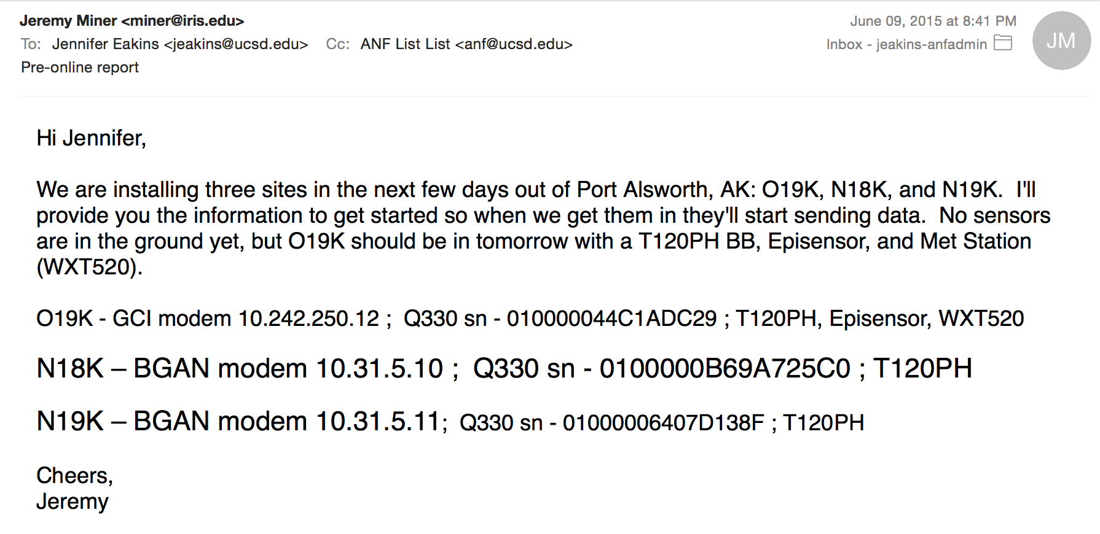
Station on-line

Slide 5
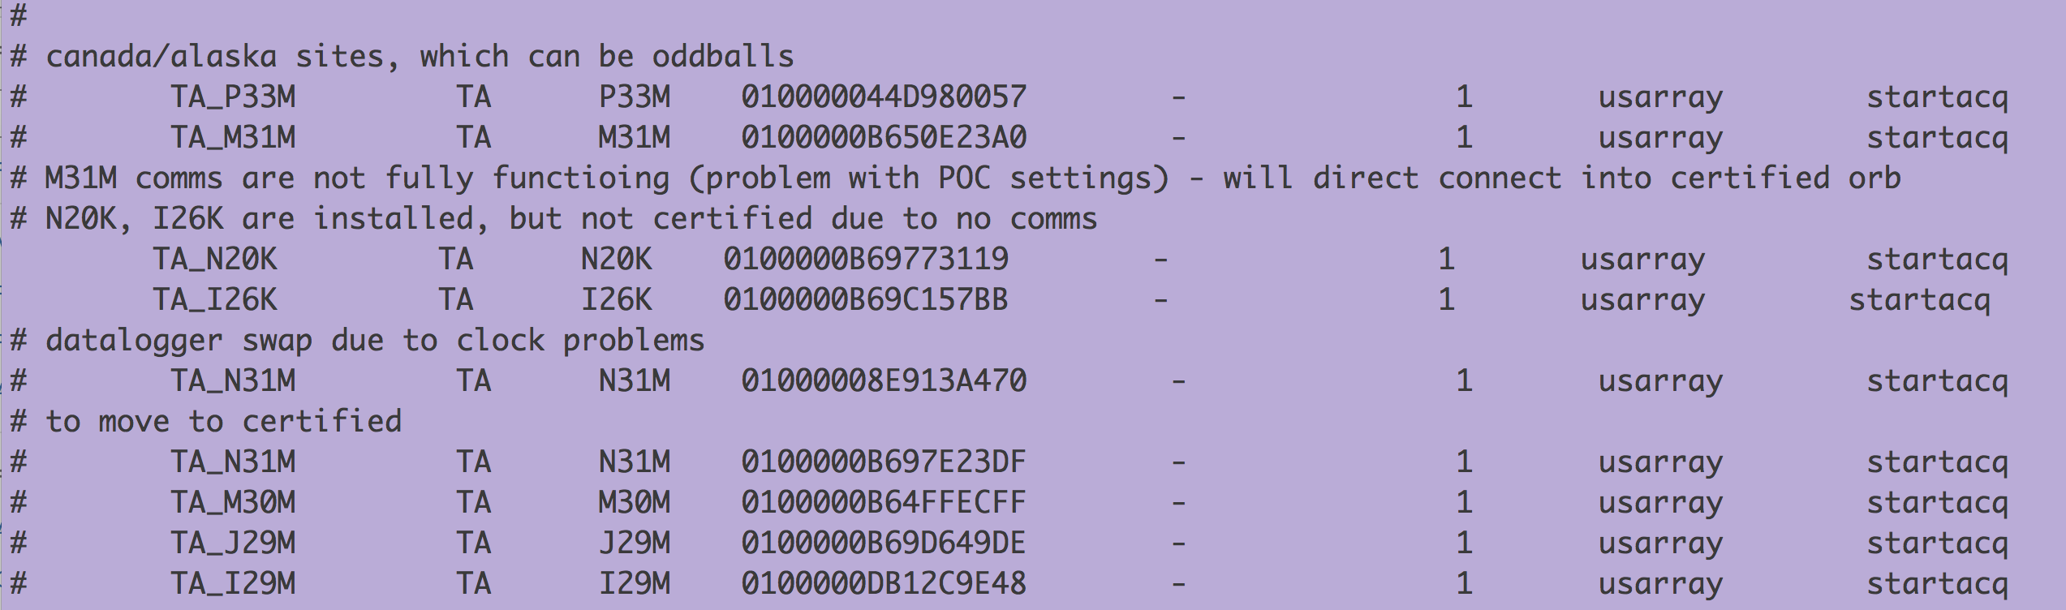
Station on-line

Slide 6
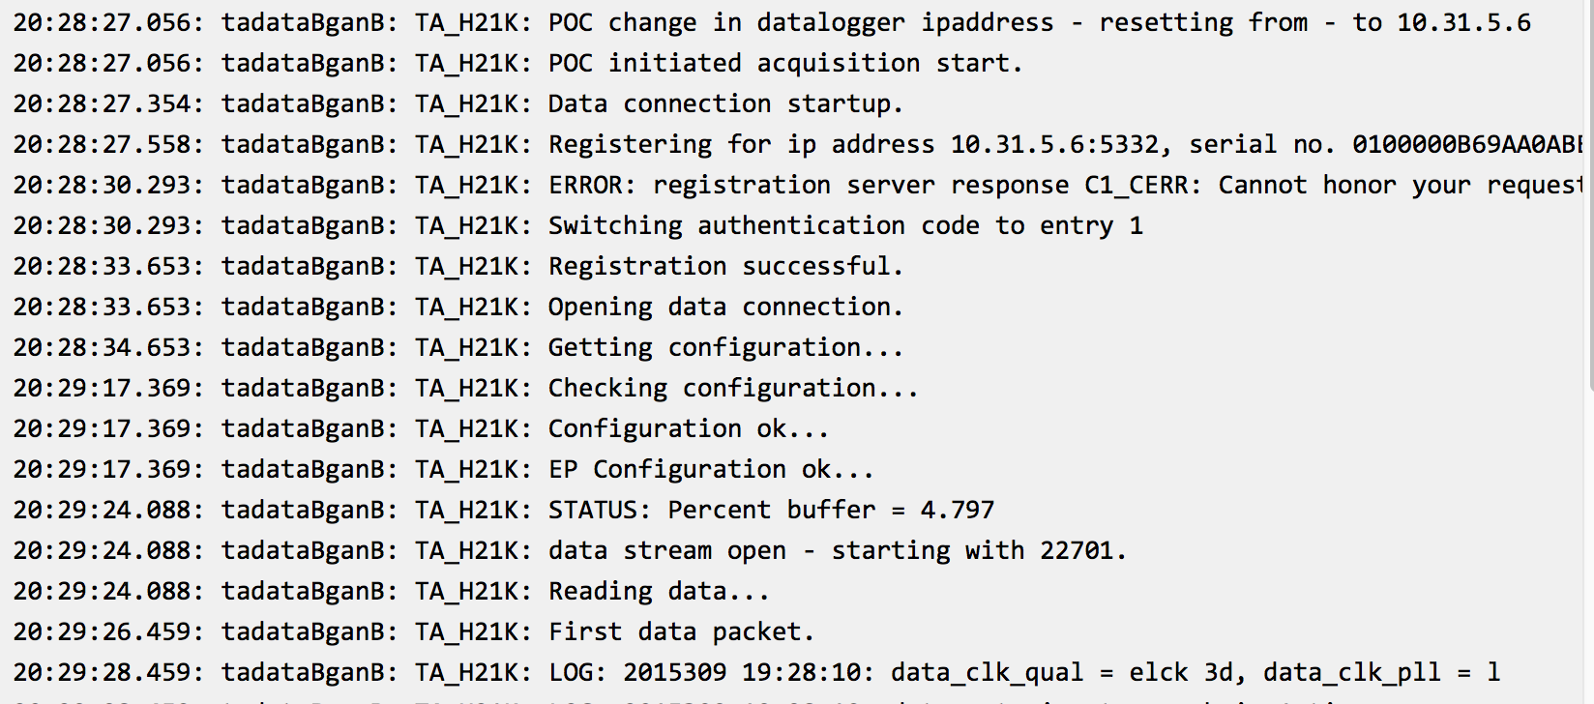
Station on-line

Slide 7
Station on-line: it’s not working

Slide 8
Station on-line: it’s not working
Are the POC settings correct?
Are the POCs set to send?
Is it a comms issue?
  Coordination with Geoff/Jon/Lisa to troubleshoot
  Hampered by missing information in Tracmor
  BGAN: we need (1) Phone number (2) IMEI (3) IMSI (4) IP address (optional)
  IMEI = International Mobile Station Equipment Identity
  IMSI = international mobile subscriber identity

Slide 9
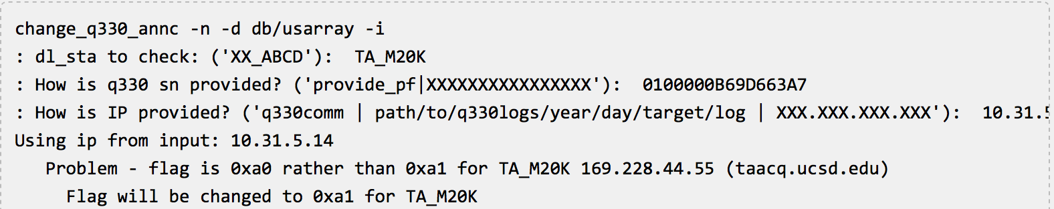
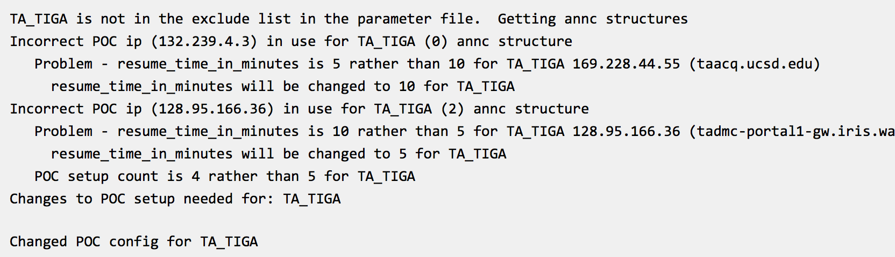
Station on-line: it’s not working
ANF can change the POC settings remotely

Slide 10
Event Bulletins
ANF data products – event bulletins
  Review of standard operations
  Cleaning up the not so good automatic solutions

Slide 11
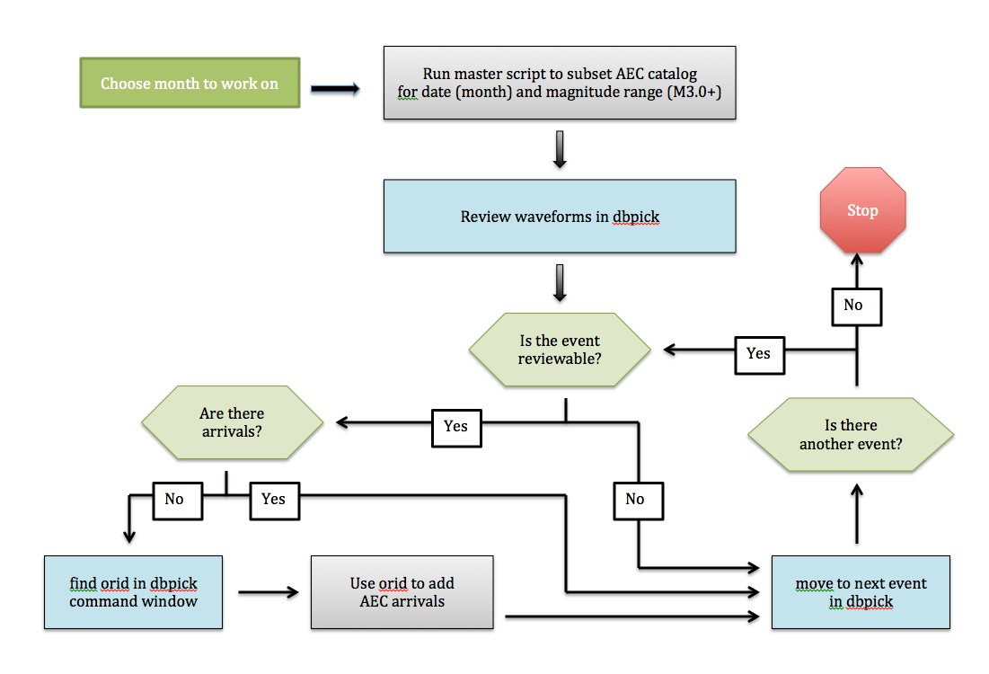
Event Bulletins
ANF reducing duplication of effort
  Addition of picks from AEC staff

