Slide 1
New TA and Upgraded AK Stations:
Noise Performance Update
Andy Frassetto
Transportable Array Team Meeting
UC-San Diego
November 10, 2015
Notes:
Also thank Frank Vernon for Pinon contributions
Main points, what we’ve learned circumstantially and what we’ve learned deliberately.

Slide 2
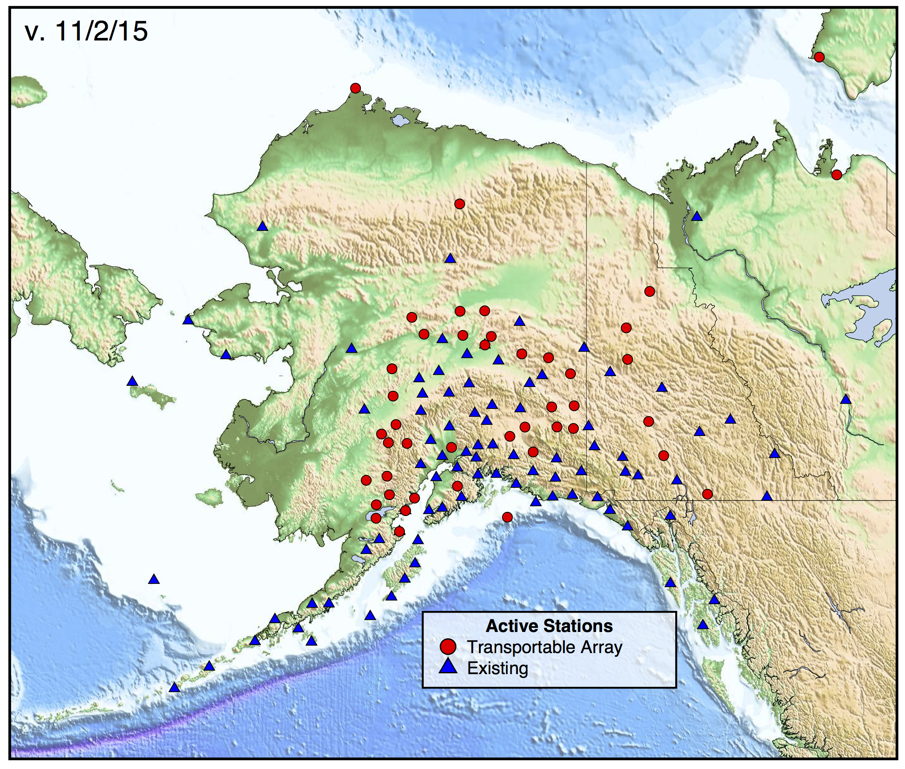
Alaska Stations
Notes:
Station “thumbprint”
Represents a 3D histogram of power vs. period, viewed from above
If a station is running well, spurious signals and earthquakes recede into the background, and you see the station’s general noise profile
Important to note, the y-axis scale is orders of magnitude, so any variations are significant

Slide 3
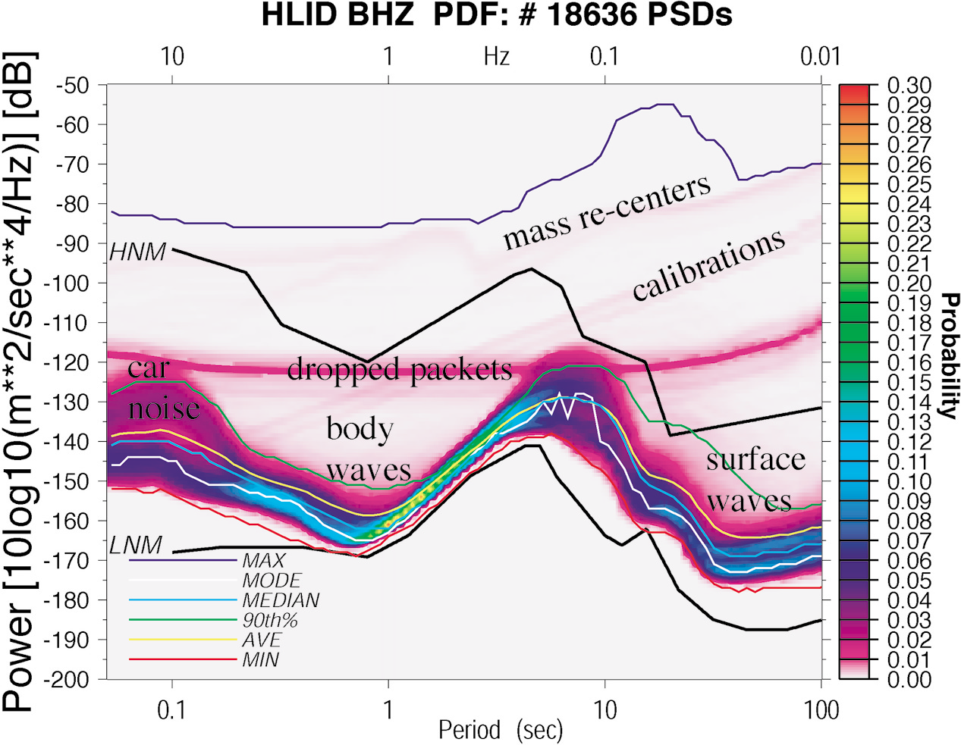

PSD-PDF Analysis
McNamara and Buland, 2004
Notes:
Station “thumbprint”
Represents a 3D histogram of power vs. period, viewed from above
If a station is running well, spurious signals and earthquakes recede into the background, and you see the station’s general noise profile
Important to note, the y-axis scale is orders of magnitude, so any variations are significant

Slide 4
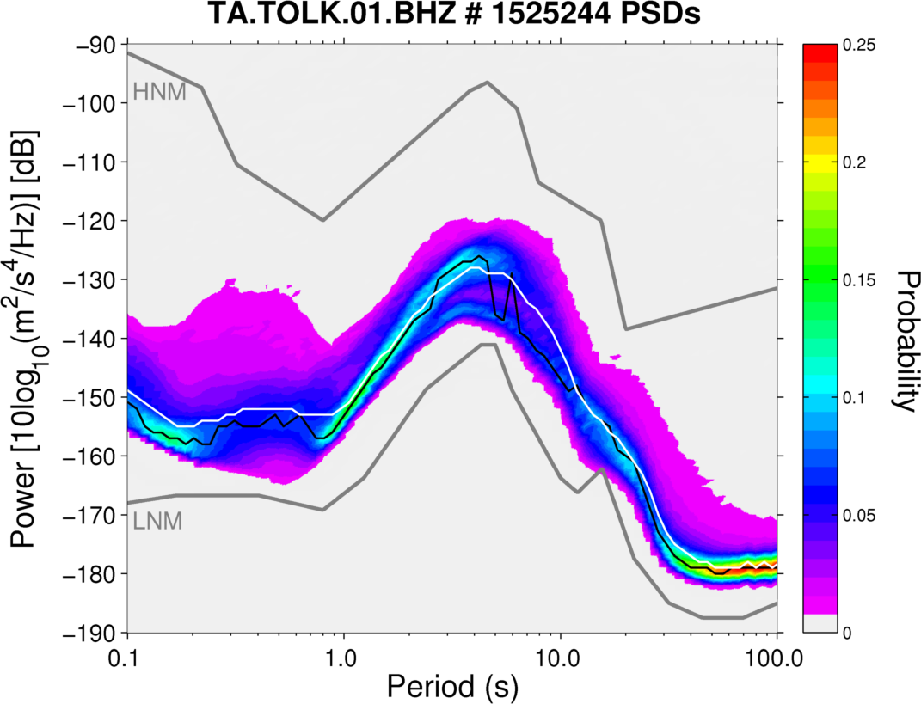
Viewing PDFs
Mode (black) – power level most observed for each frequency
Median (white) – power separating upper and lower halves of measurements
Notes:
Mode vs. median and characteristic differences between horizontal and vertical key to understand

Slide 5
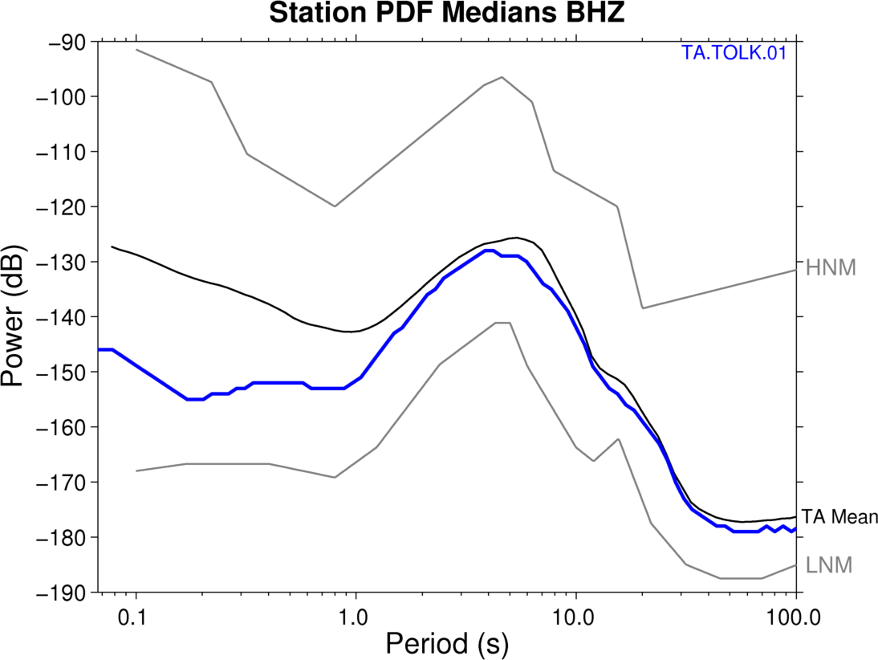
Example - TOLK
Notes:
Here’s a similar plot made for the vertical channel

Slide 6
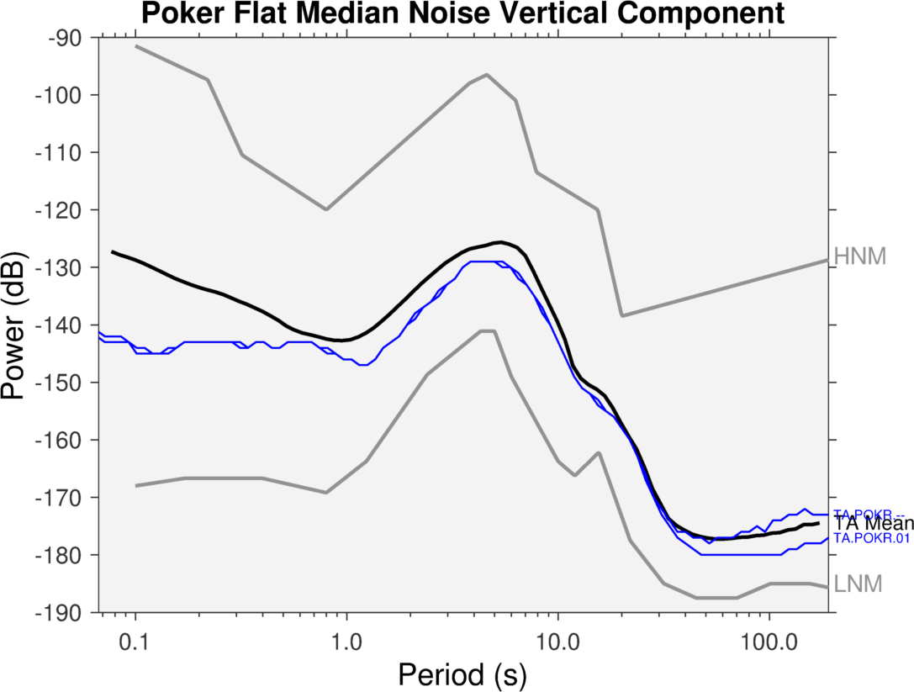
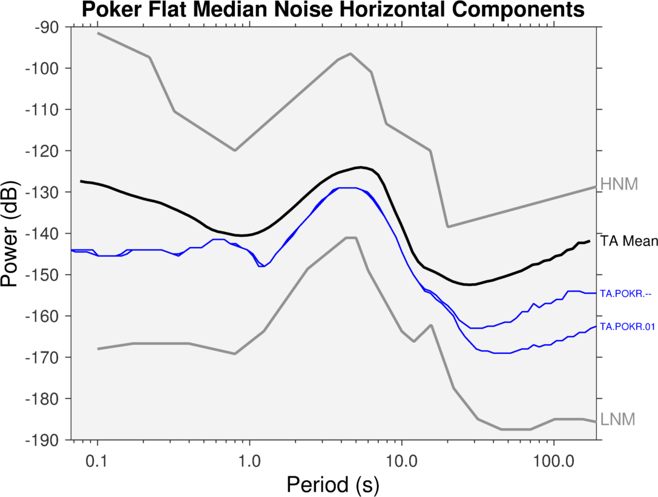
Poker Flat
Performance in 2014
TA tank vault vs. 5M auger posthole
Installed October 2012
Notes:
For the horizontals, this demonstrates the significant improvement at long periods.

Slide 7
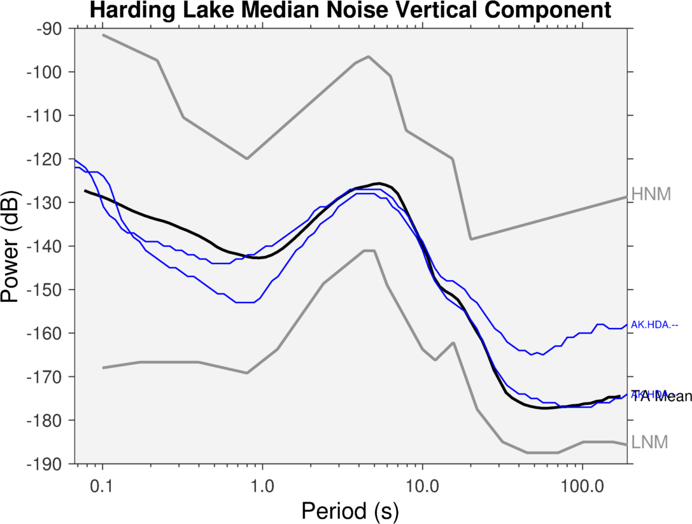
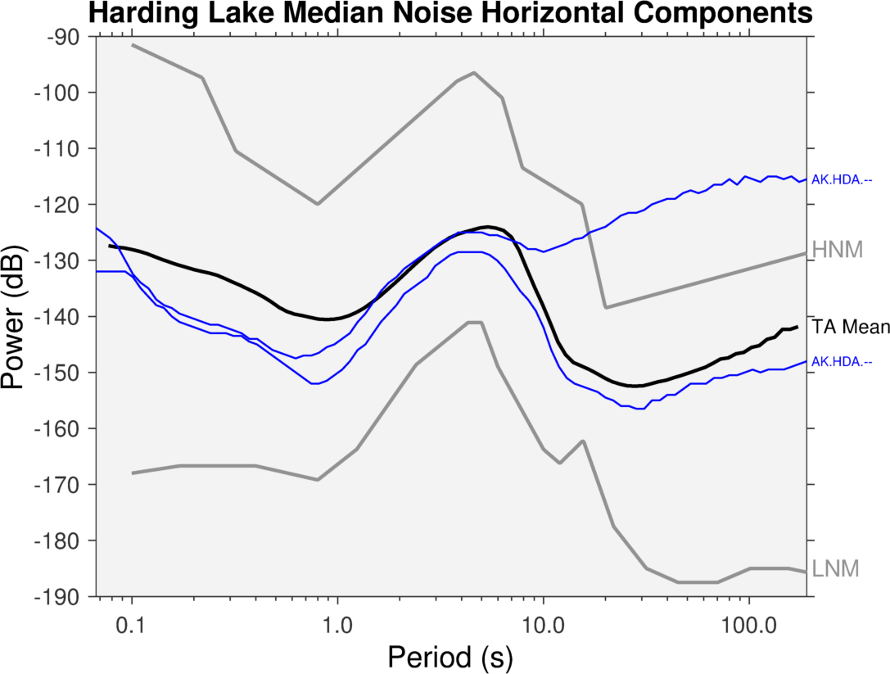
Harding Lake
1 year before and after
AEC tank upgraded to 5M augered posthole
October 2012
Notes:
For the horizontals, this demonstrates the significant improvement at long periods.

Slide 8
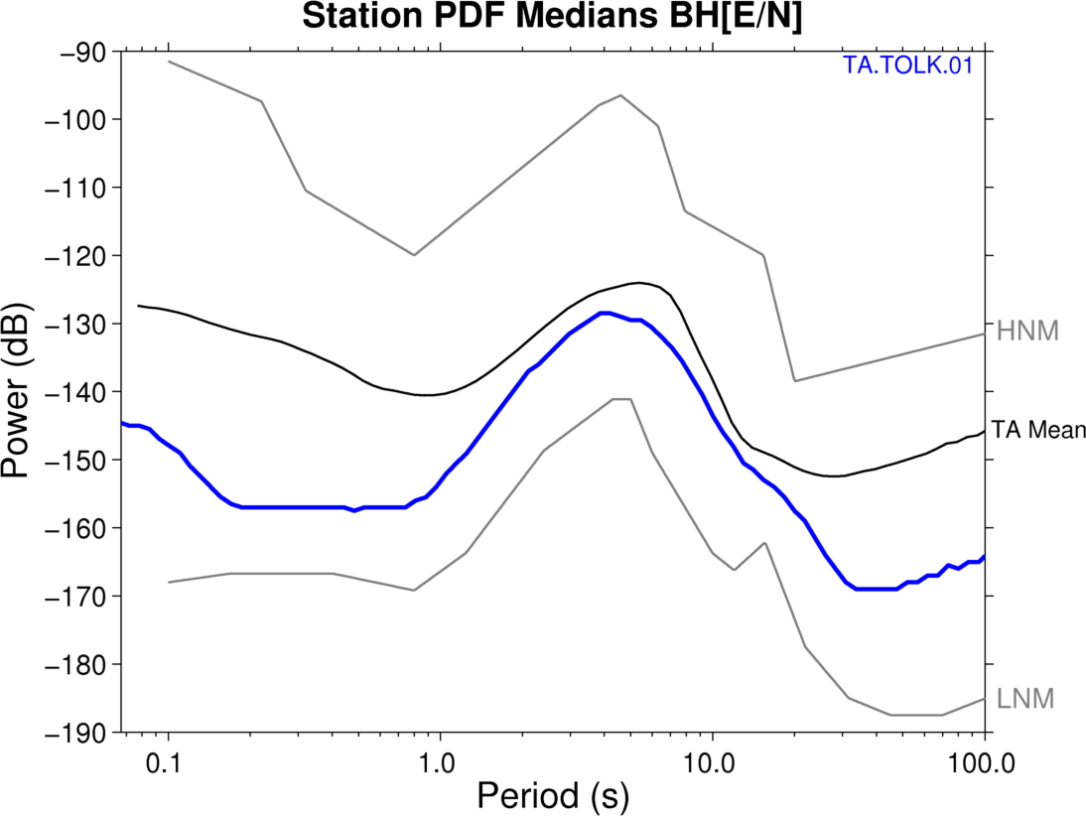
Example - TOLK
Notes:
Here’s the mode instead, you can see it’s roughly the same appearance, but slightly smoother. For this reason the medians are a little easier to compare

Slide 9
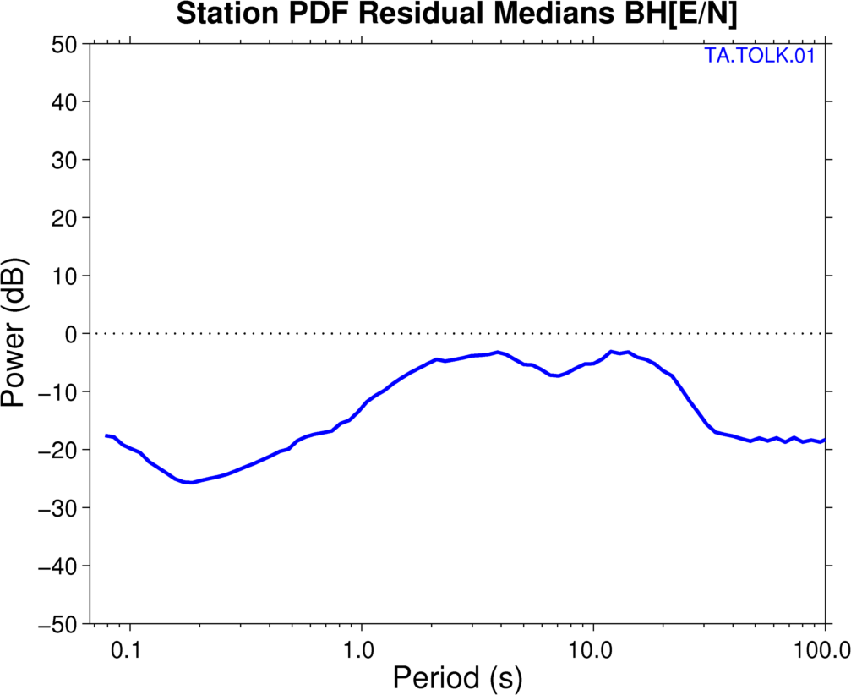
Example - TOLK
> TA Mean
< TA Mean
Notes:
For the horizontals, this demonstrates the significant improvement at long periods.

Slide 10
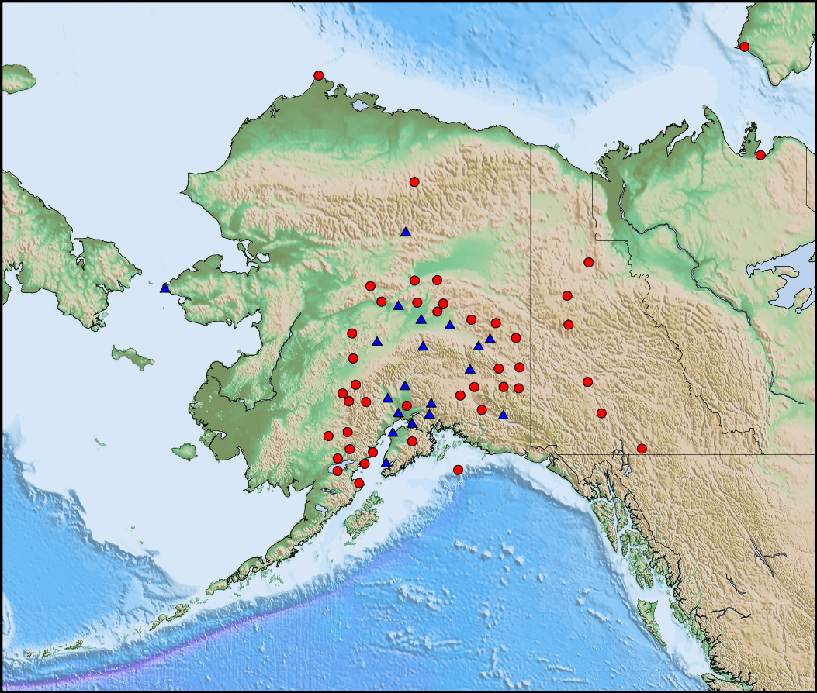
New and Upgraded
Notes:
Station “thumbprint”
Represents a 3D histogram of power vs. period, viewed from above
If a station is running well, spurious signals and earthquakes recede into the background, and you see the station’s general noise profile
Important to note, the y-axis scale is orders of magnitude, so any variations are significant

Slide 11
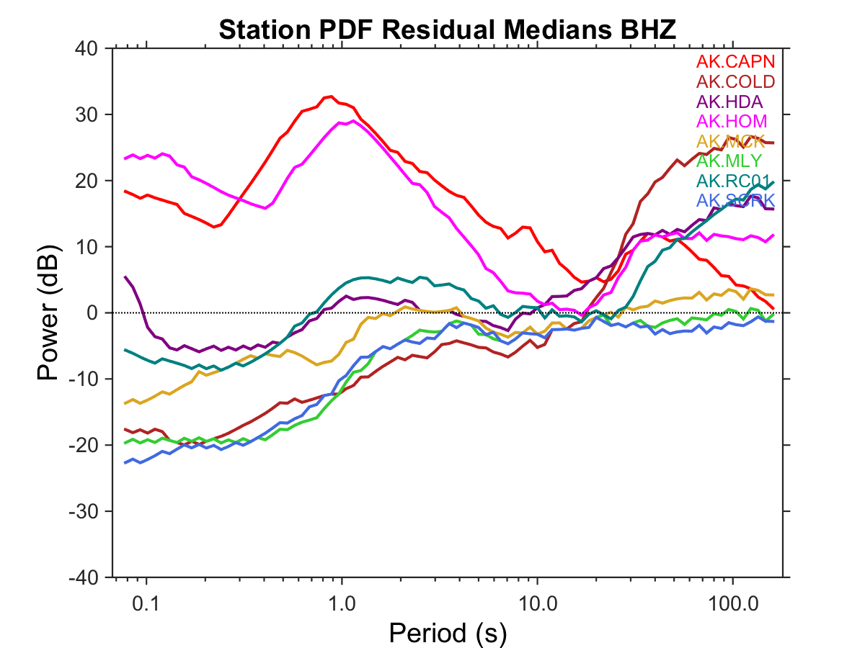
Initial Upgrades
(1 year before)
> TA Mean
< TA Mean

Slide 12
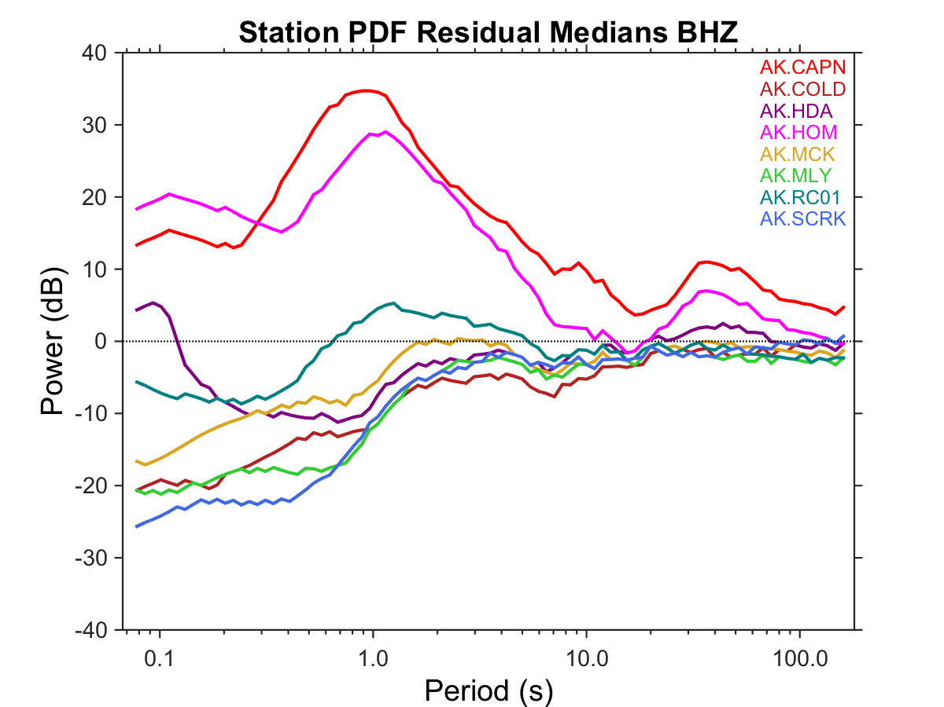
Initial Upgrades
(1 year after)
> TA Mean
< TA Mean

Slide 13
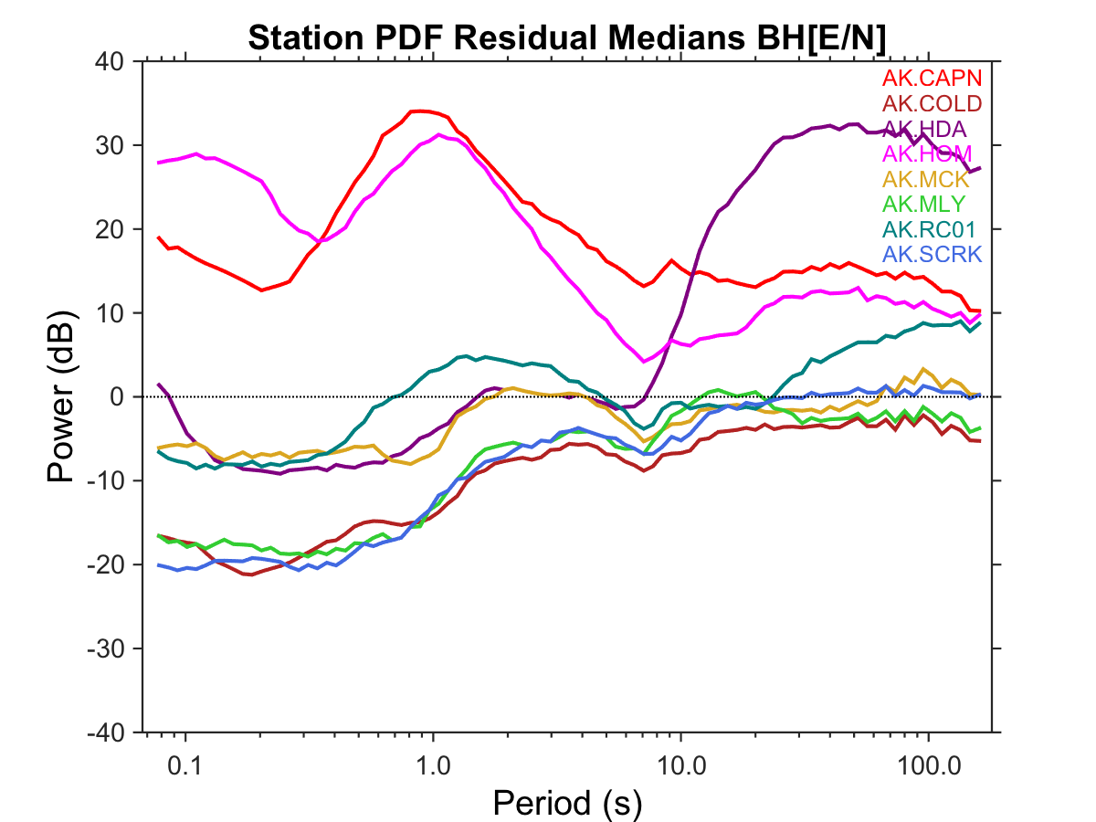
Initial Upgrades
(1 year before)
> TA Mean
< TA Mean

Slide 14
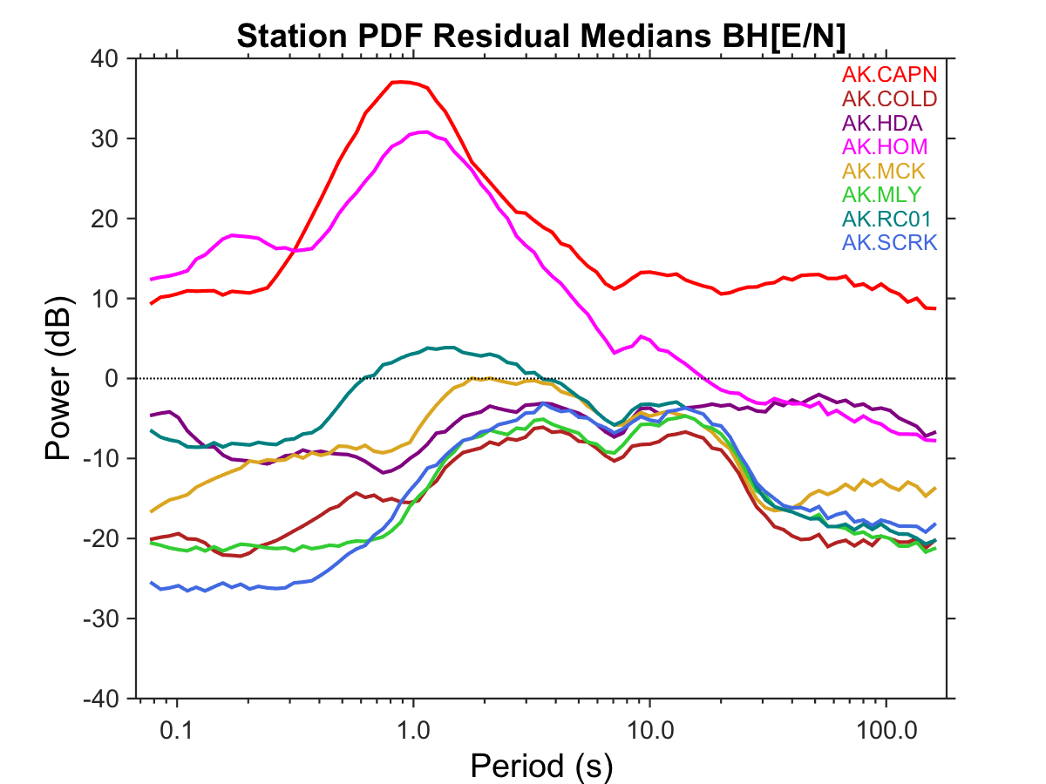
Initial Upgrades
(1 year after)
> TA Mean
< TA Mean

Slide 15
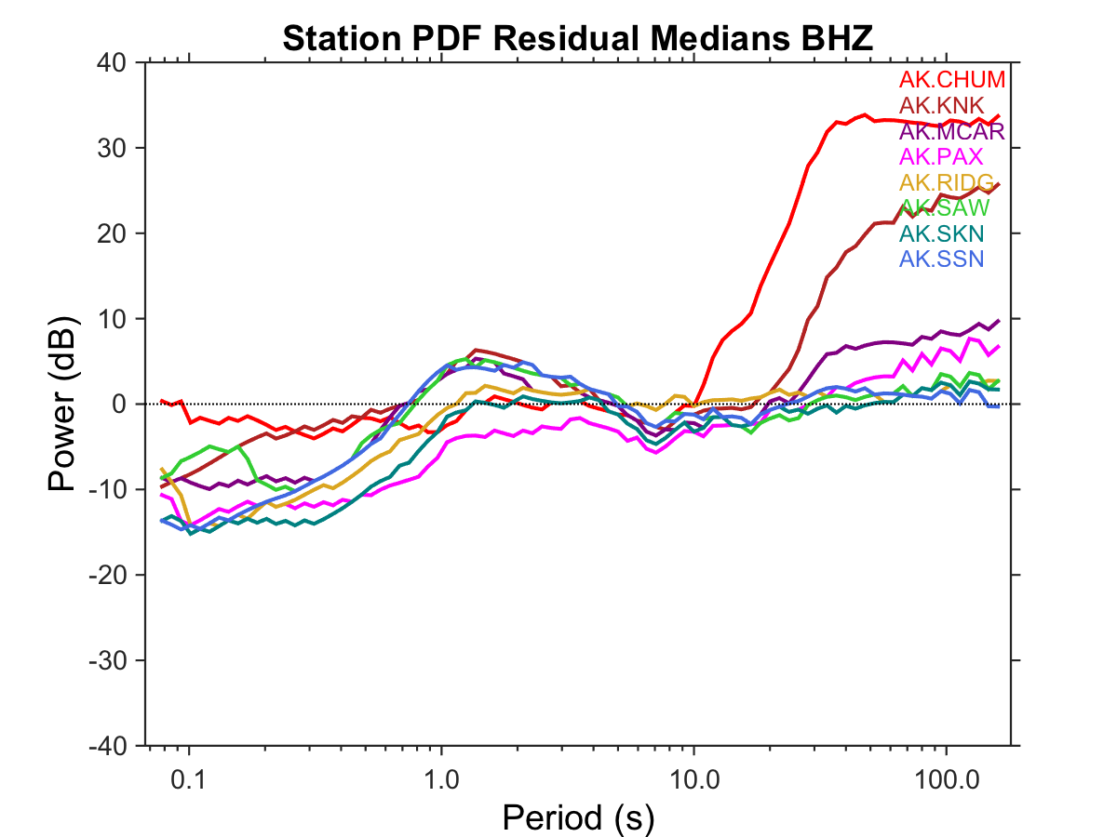
2015 Upgrades
(1 year before)
> TA Mean
< TA Mean

Slide 16
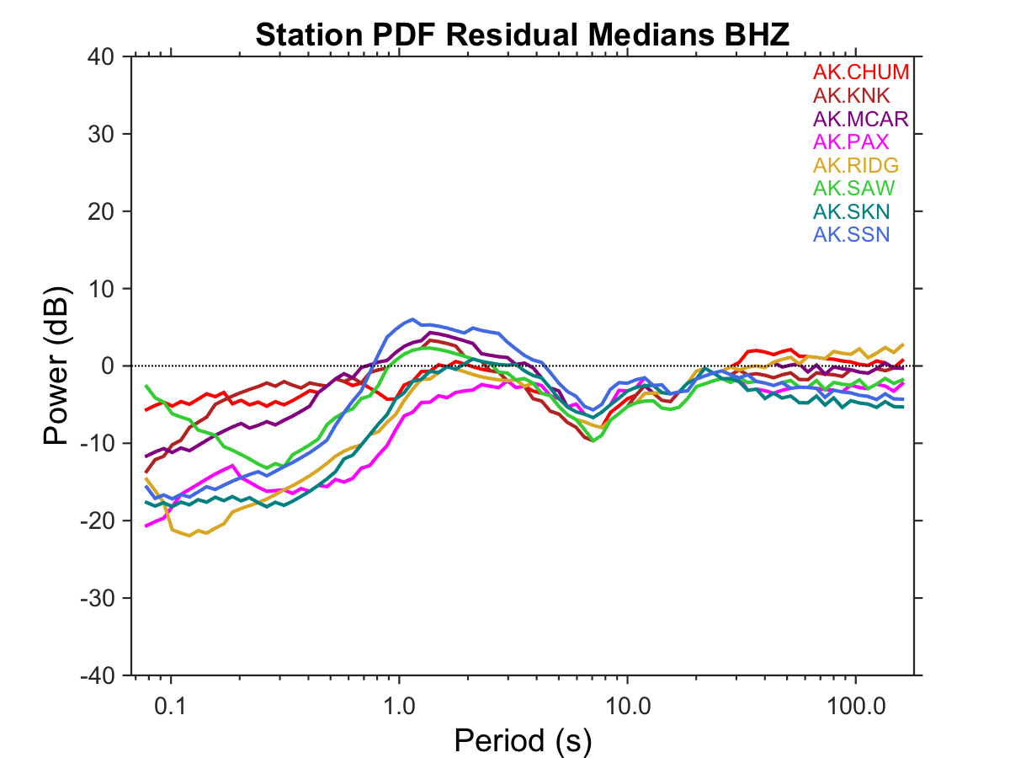
2015 Upgrades
(to present)
> TA Mean
< TA Mean

Slide 17
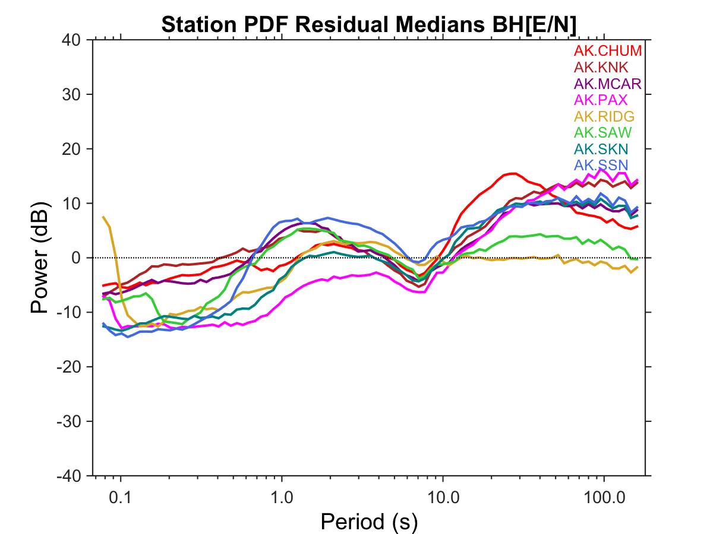
2015 Upgrades
(1 year before)
> TA Mean
< TA Mean

Slide 18
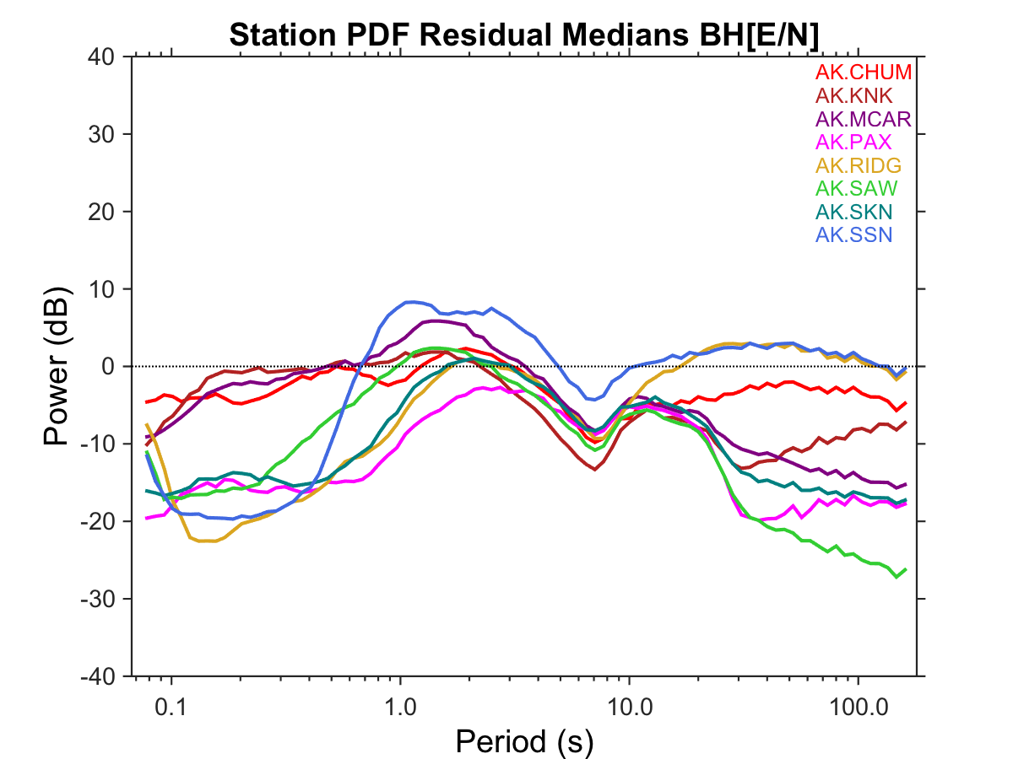
2015 Upgrades
(to present)
> TA Mean
< TA Mean

Slide 19
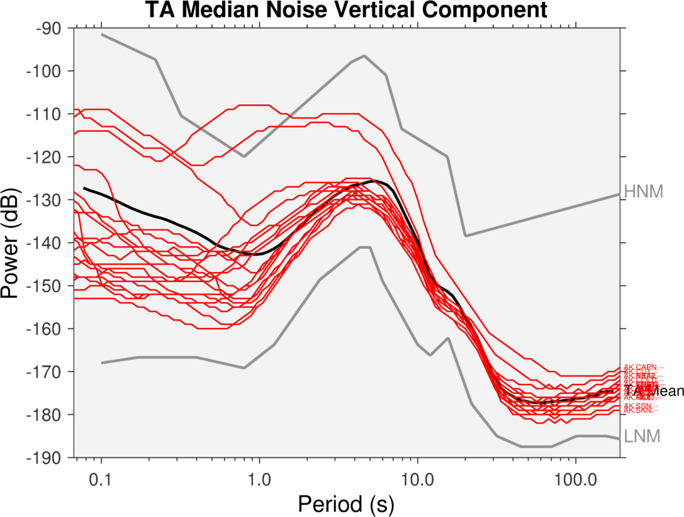
AEC Stations

Slide 20
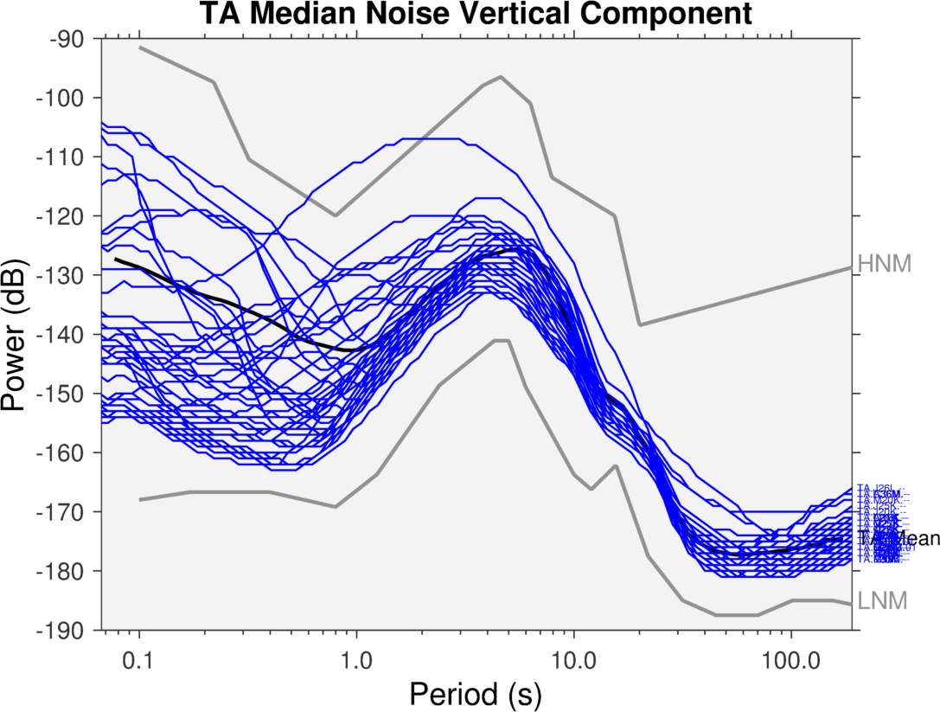
TA Stations

Slide 21
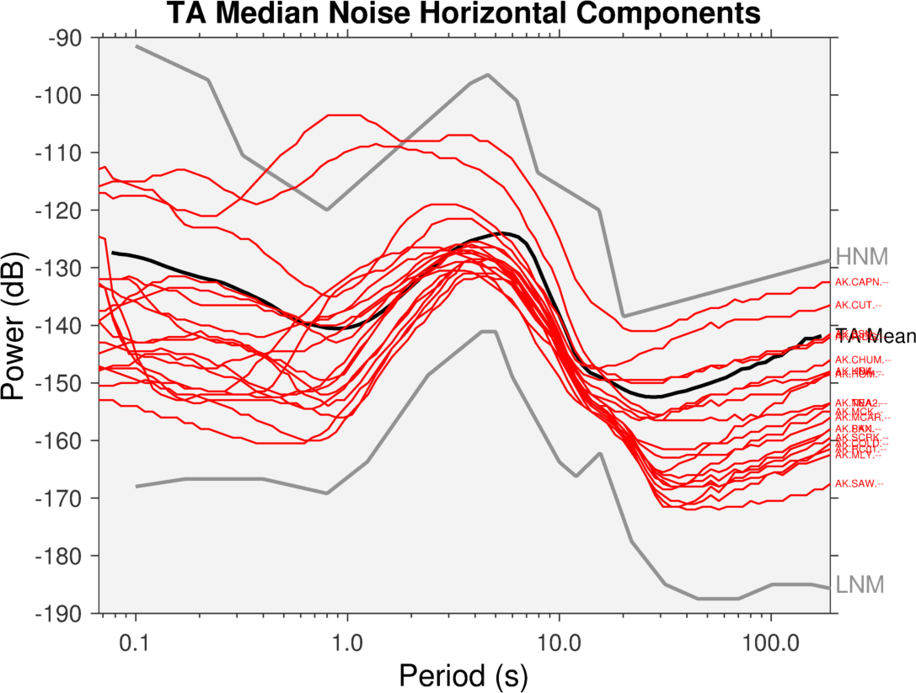
AEC Stations

Slide 22
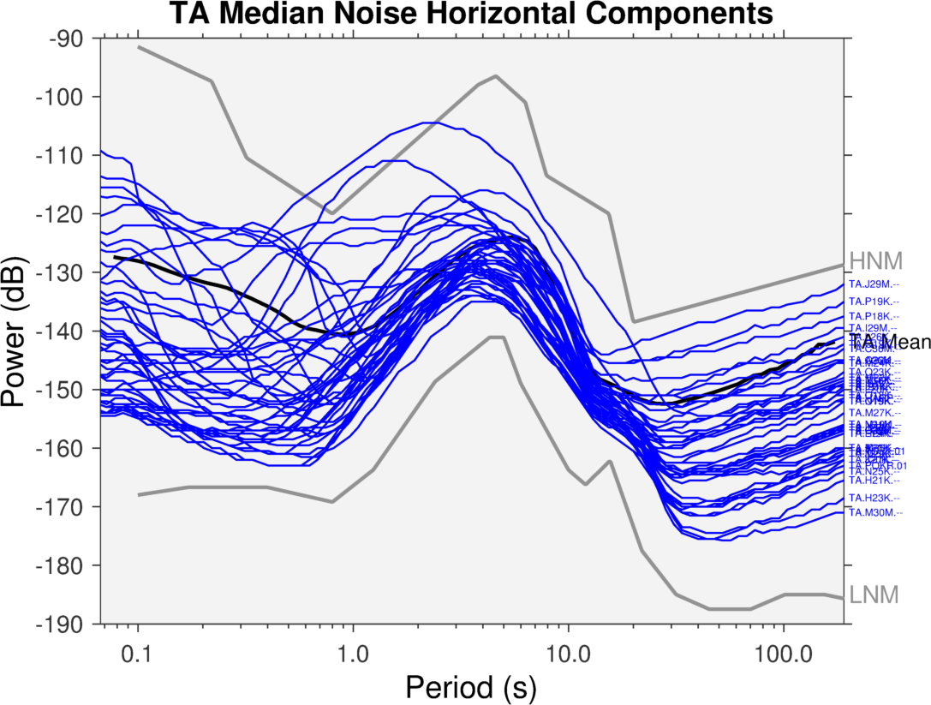
TA Stations

Slide 23
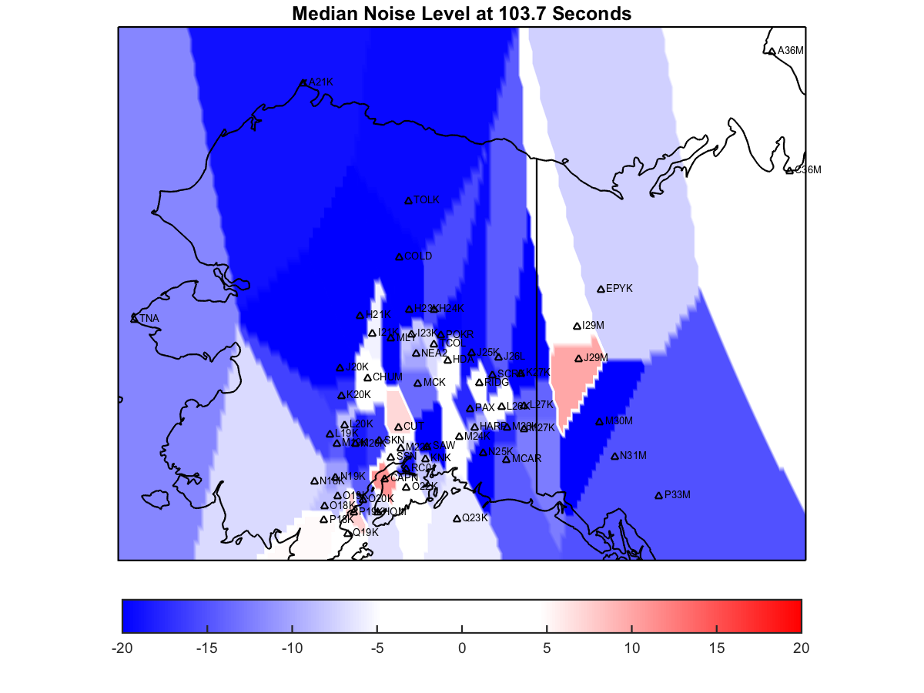
Map View

Slide 24
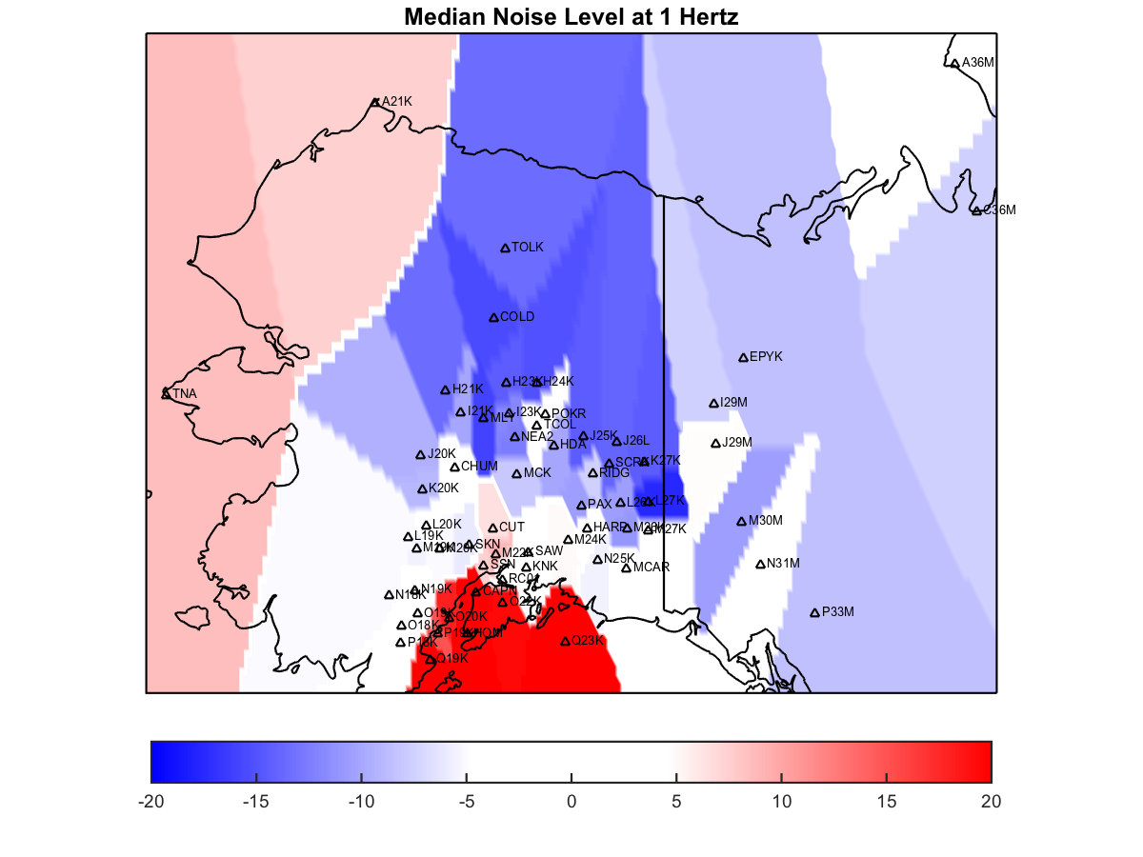
Map View

Slide 25
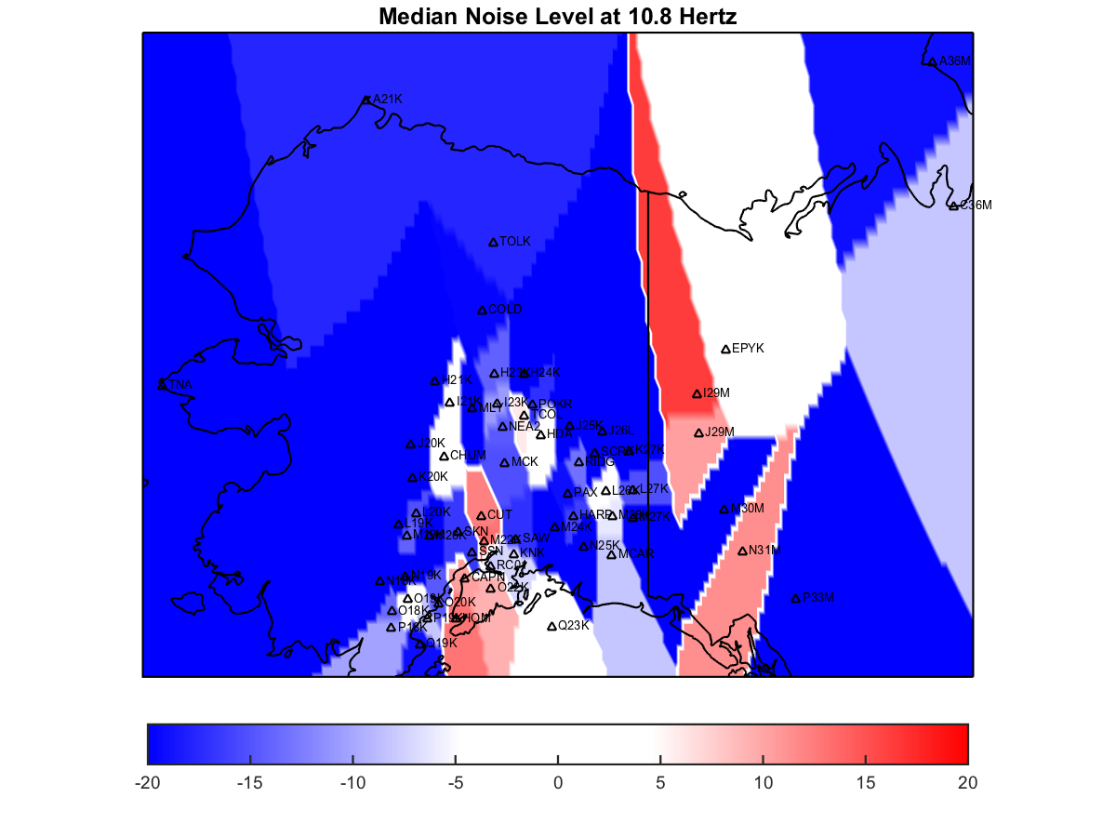
Map View

Slide 26
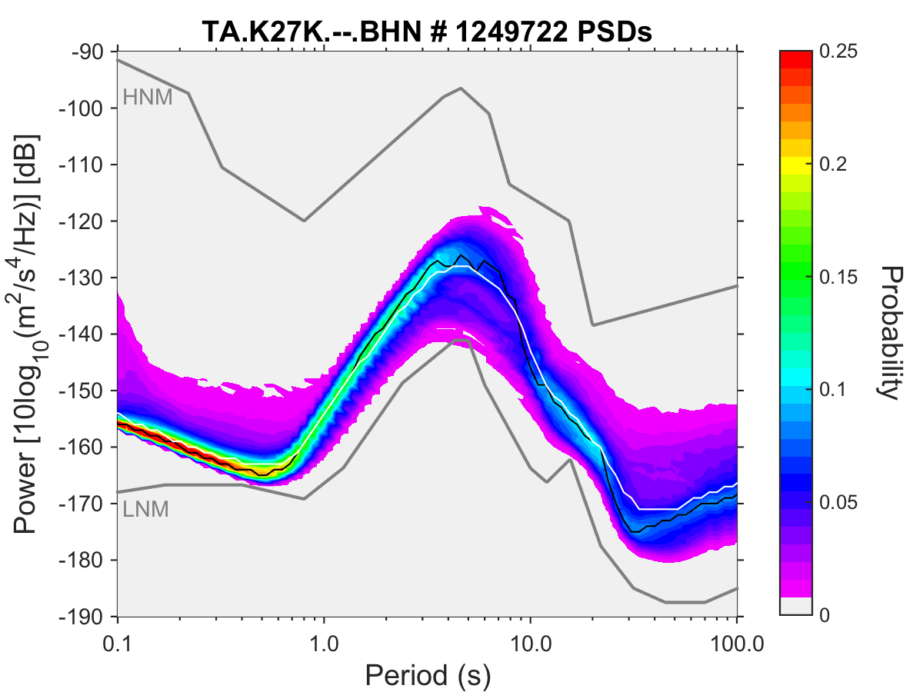
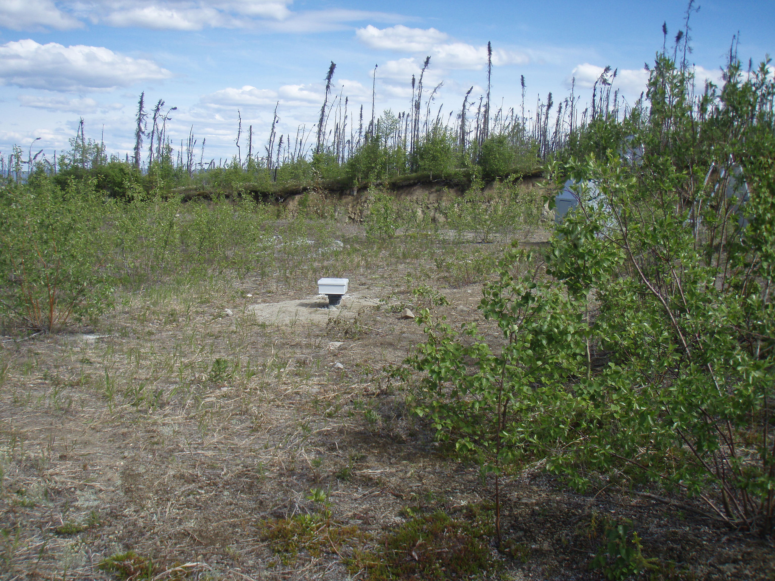
Past Champion – K27K

Slide 27
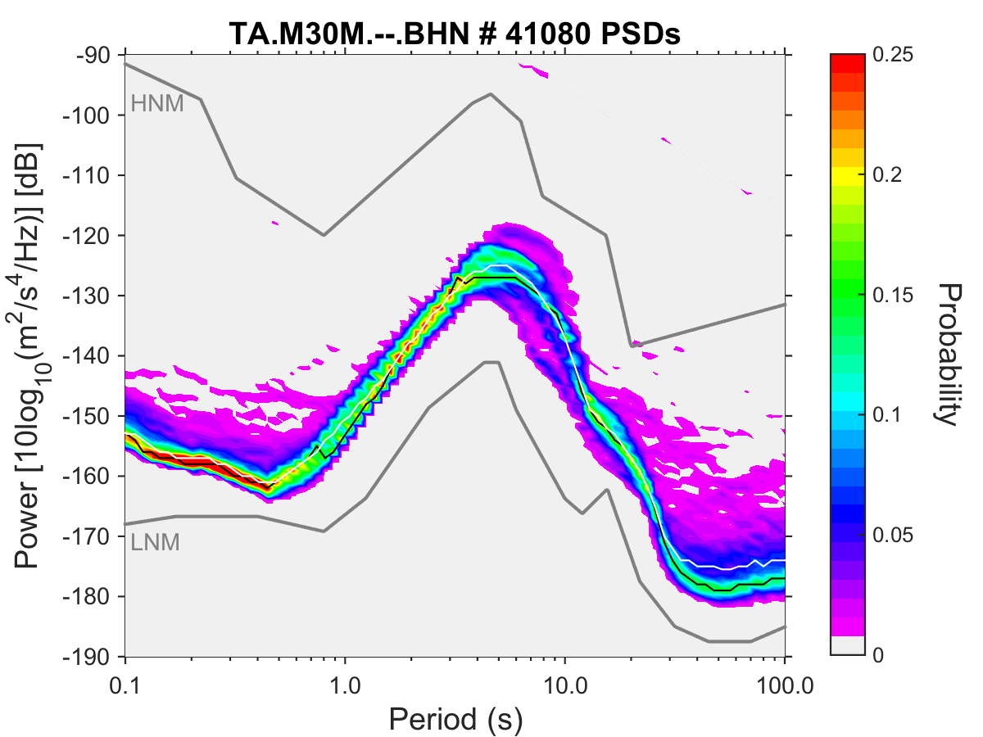
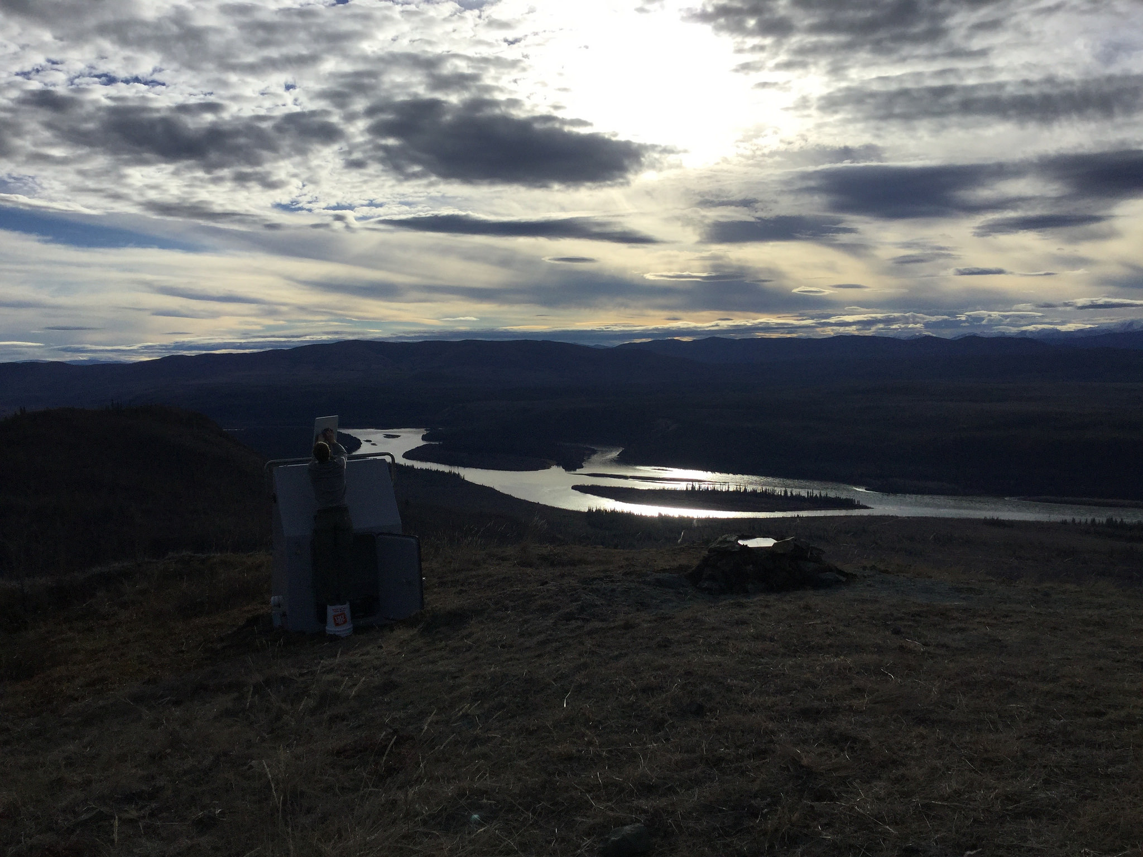
Young Upstart – M30M
Install sheet: “There will likely be traffic noise and potential noise from high voltage AC power lines overhead.”
So far, so good…

Slide 28
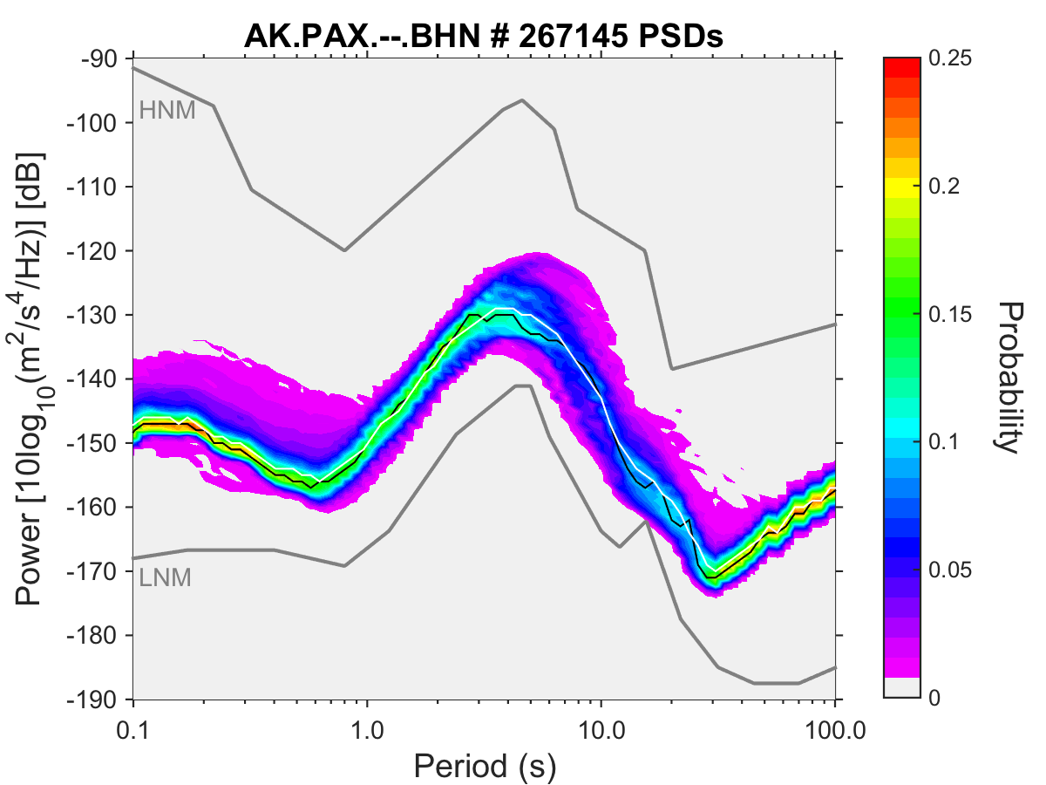
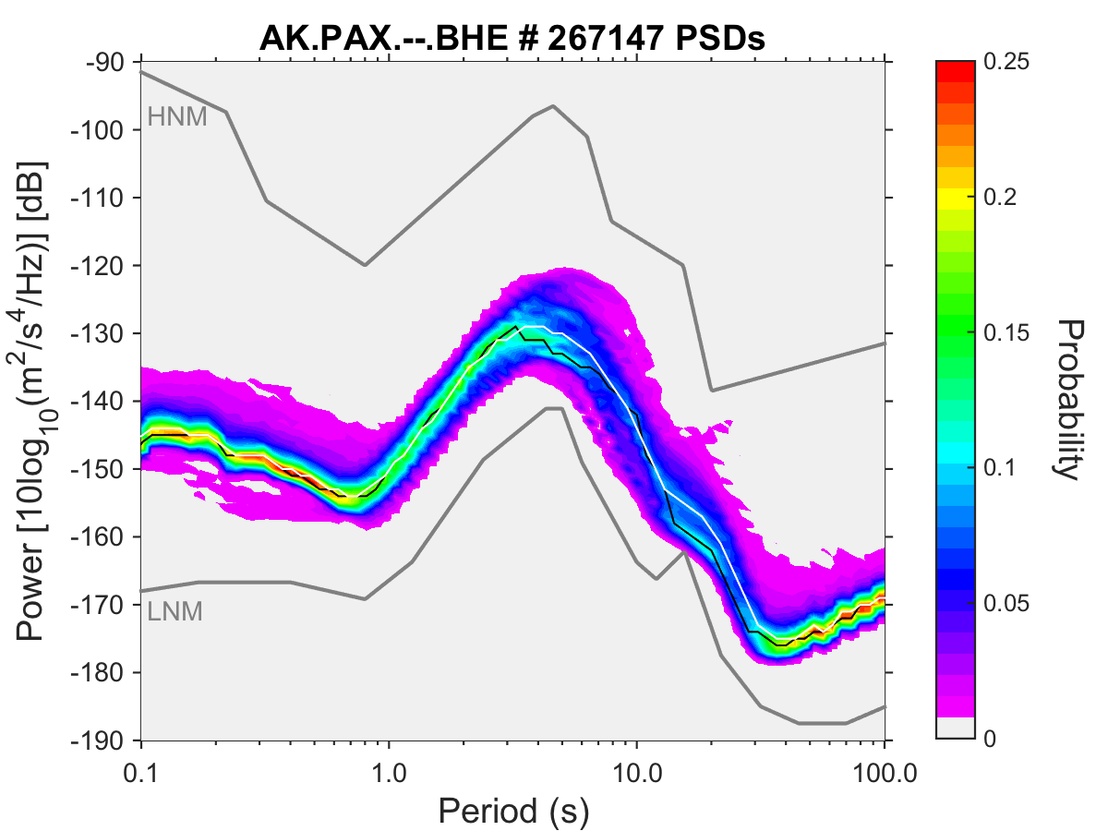
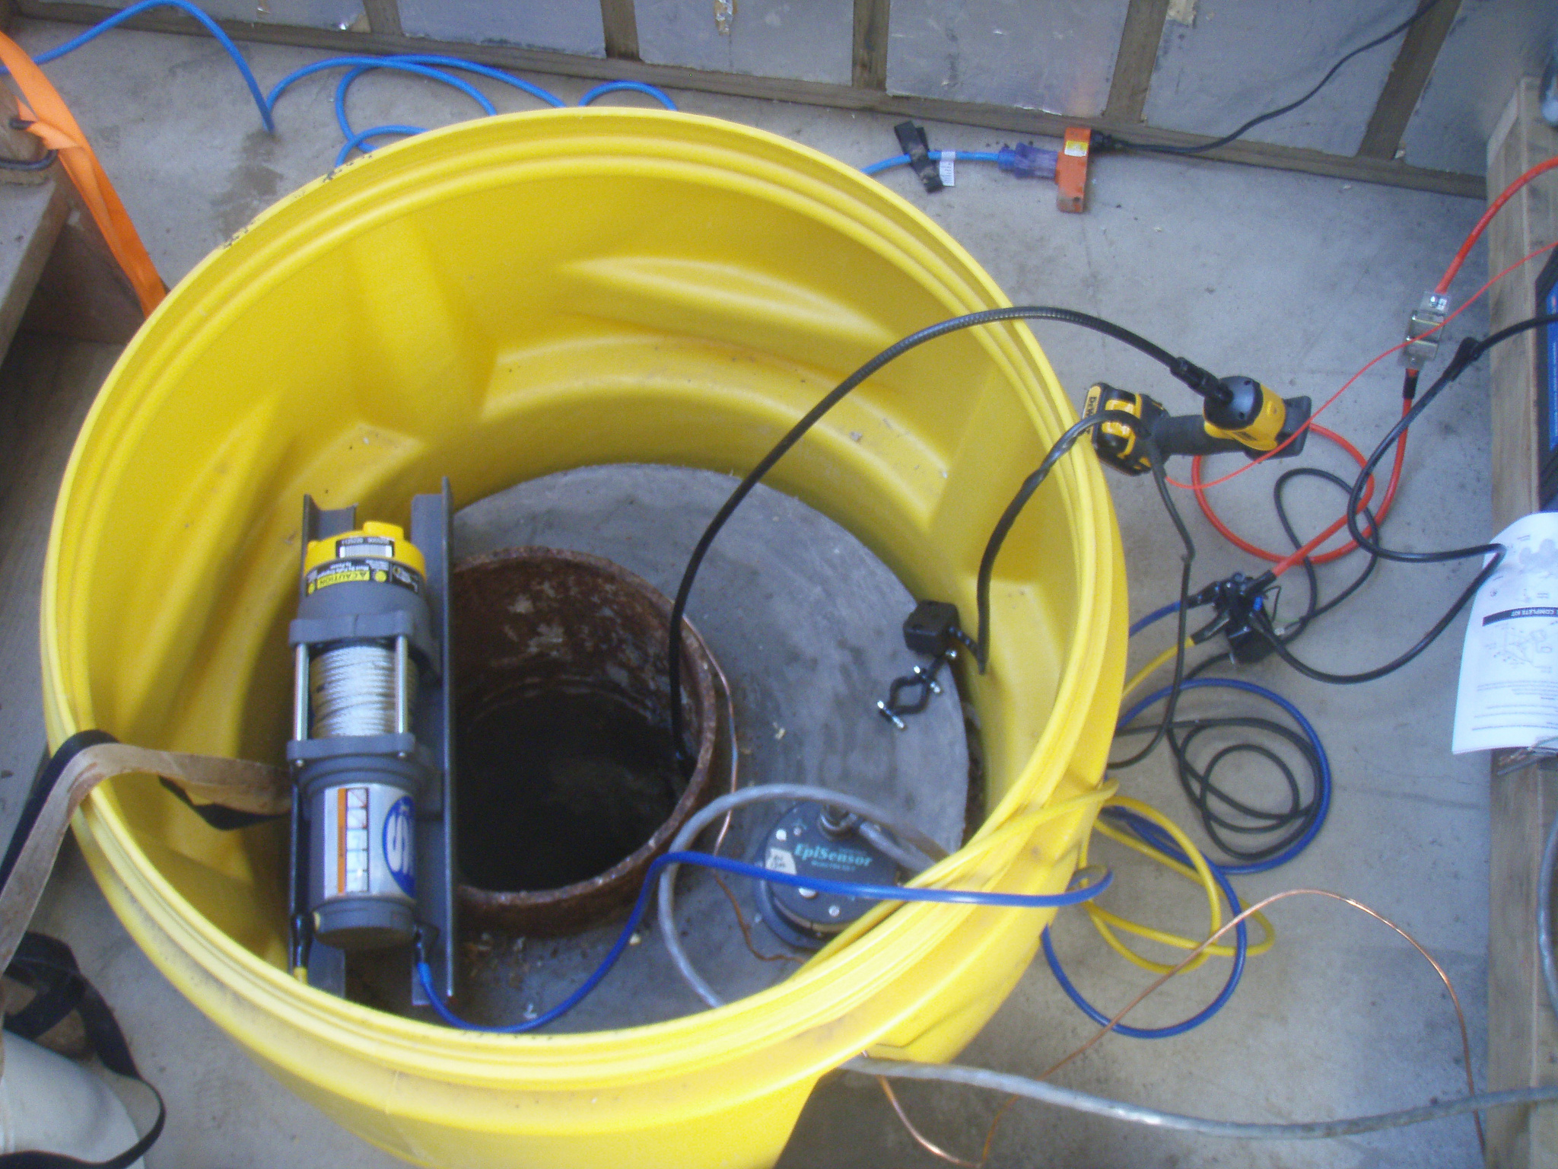
Veteran Out of Retirement – PAX
PAX using old Air Force borehole, cleared thanks to AEC efforts

Slide 29
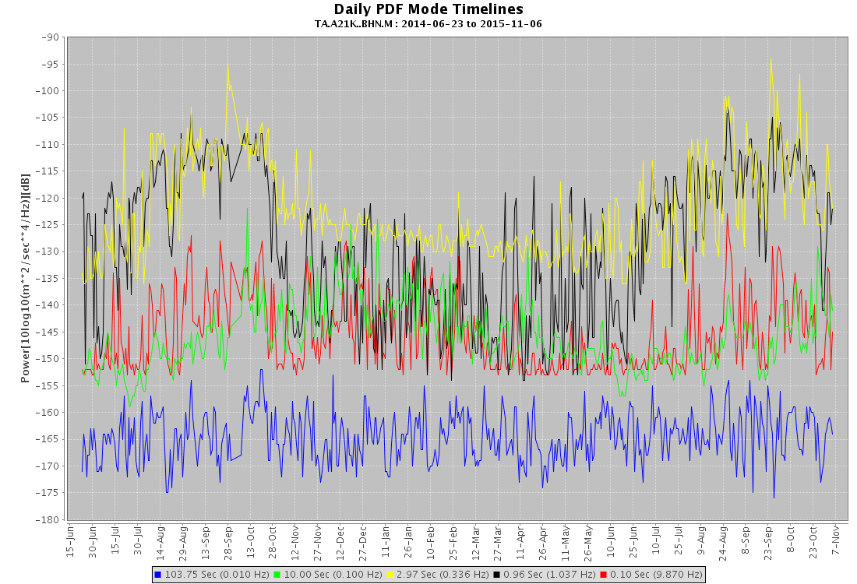
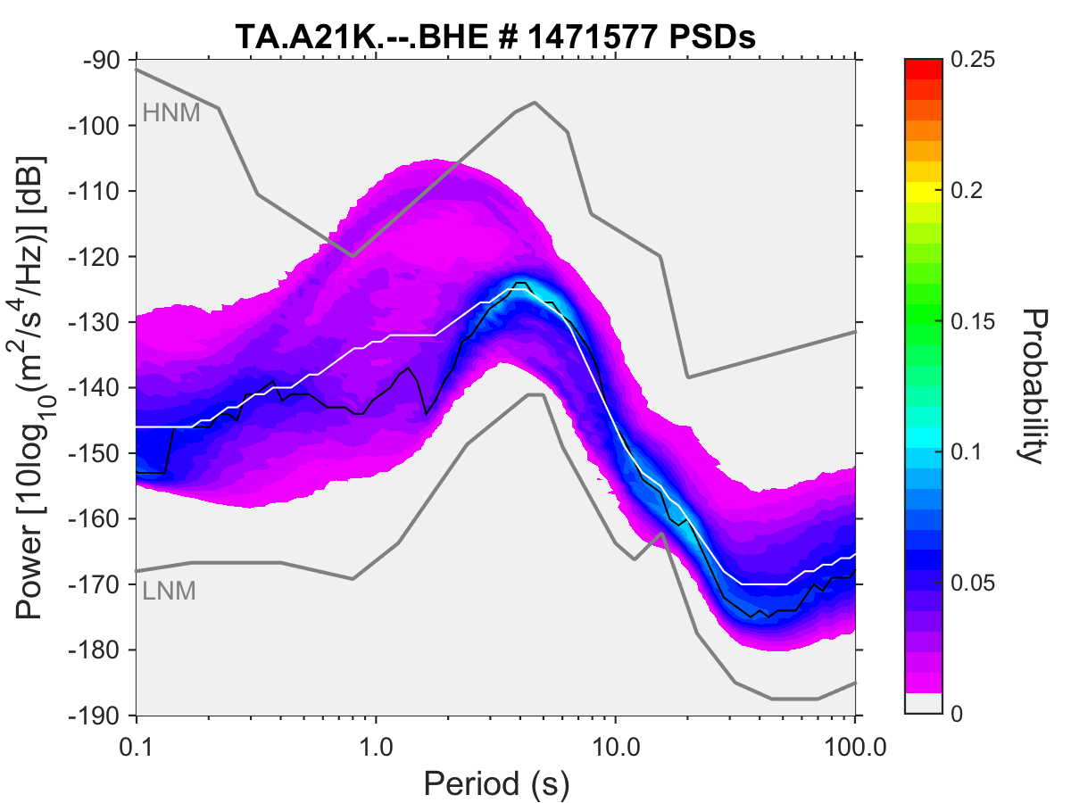
Station Seasonality

Slide 30
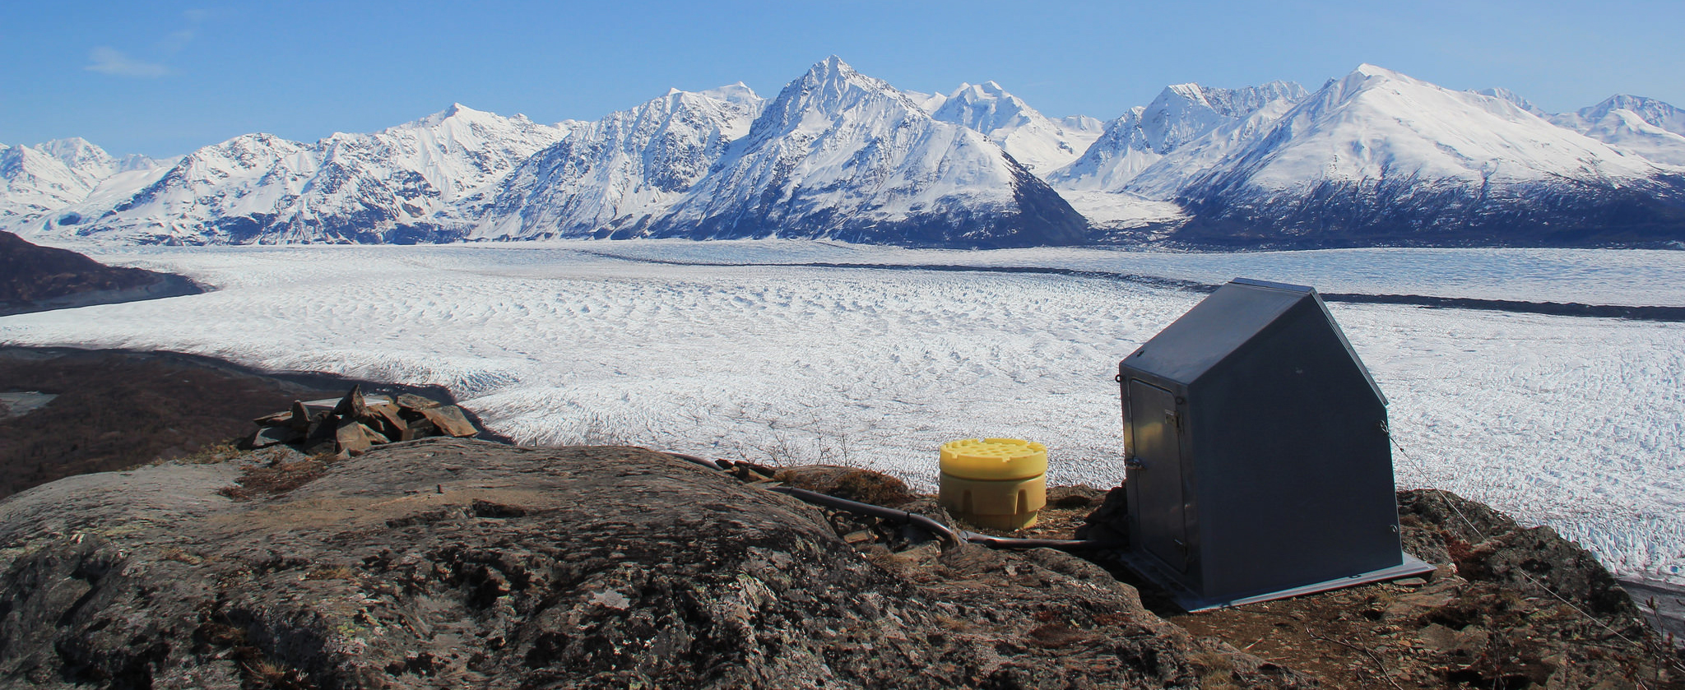
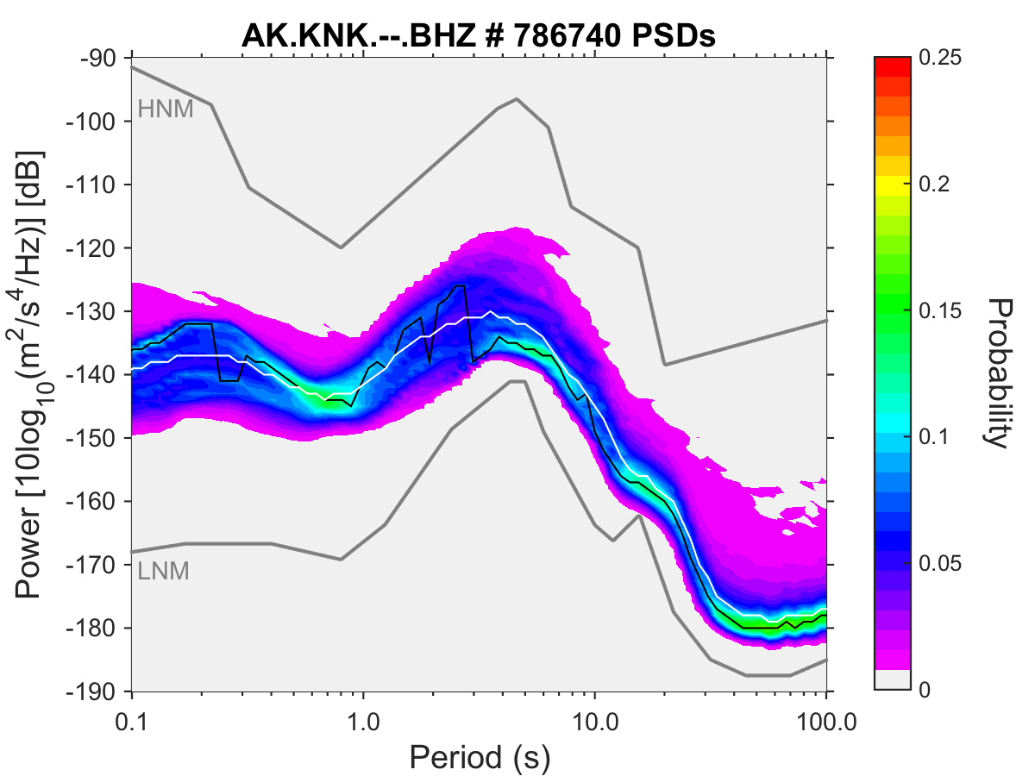


Thanks!
Elite data, ready for science-ing.
EarthScope
www.earthscope.org
USArray
www.usarray.org
National Science Foundation
www.nsf.gov
EarthScope is funded by the National Science Foundation.
EarthScope is being constructed, operated, and maintained as a collaborative effort with UNAVCO, and IRIS, with contributions from the US Geological Survey, NASA and several other national and international organizations.
Notes:
Sites in Alaska generally performing well, posthole sites general perform well and outperform vault installations. Full seasonal cycle needed to confirm this. Spread of performance appears related more to a site’s noise floor.
Pinon installs show range of performance, many factors at work. Generally posthole installs are as good, if not better, than a TA vault installation. In general sand base and fill show best results. Grouting the casing is key.

Slide 31
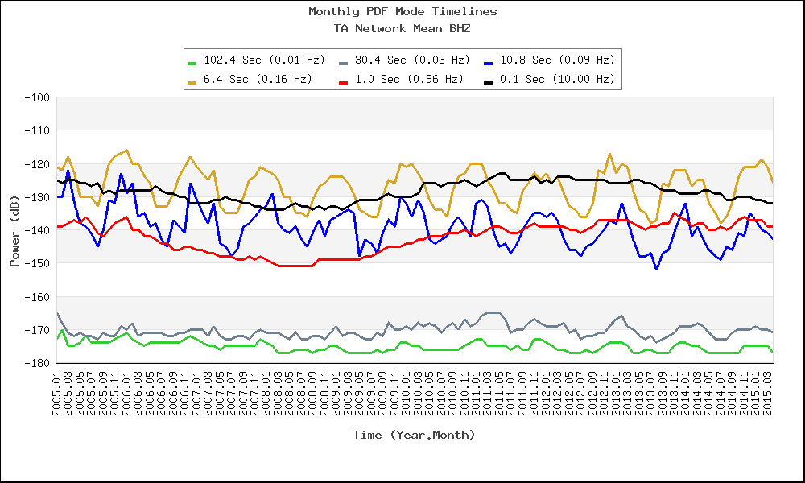
TA Noise Levels
Mode - amplitude most often observed at a frequency

Slide 32
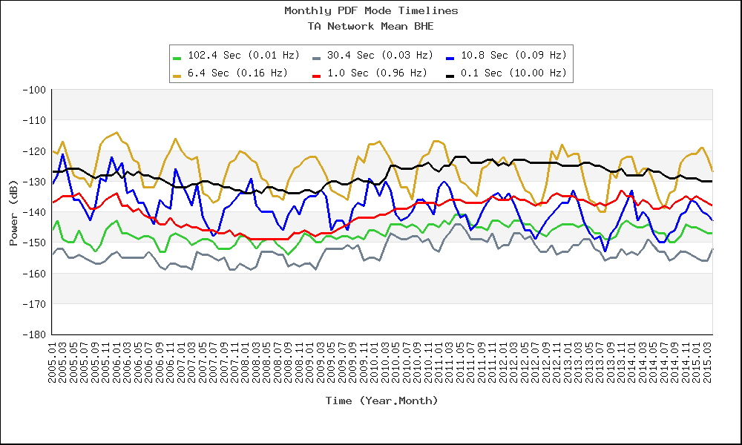
TA Noise Levels

Slide 33
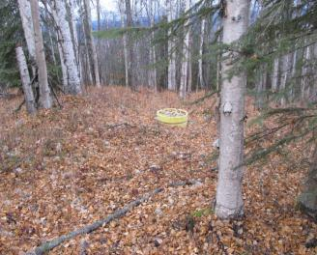
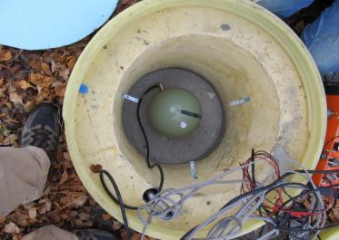
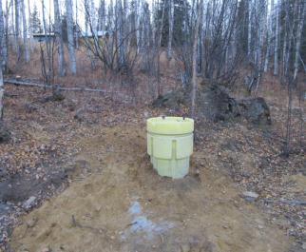
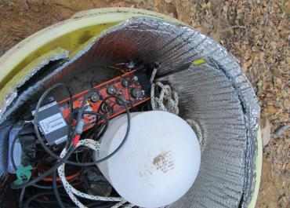
Harding Lake (HDA)
AEC Tank, T240
REINSTALLED October 2012
5M posthole, T120PH

Slide 34
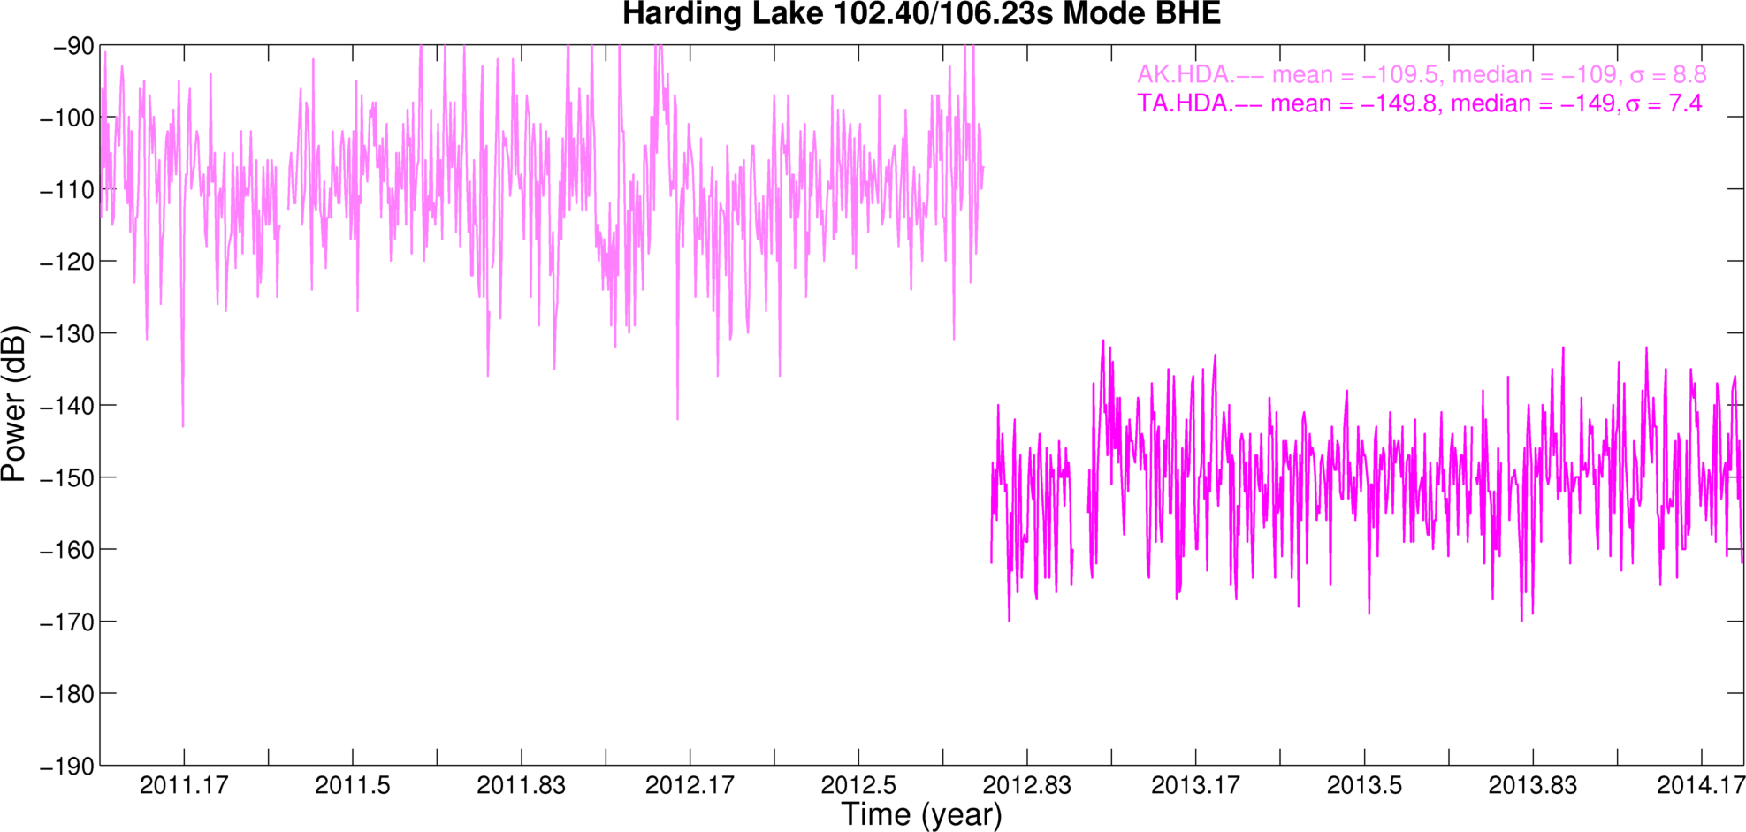
HDA Performance

Slide 35
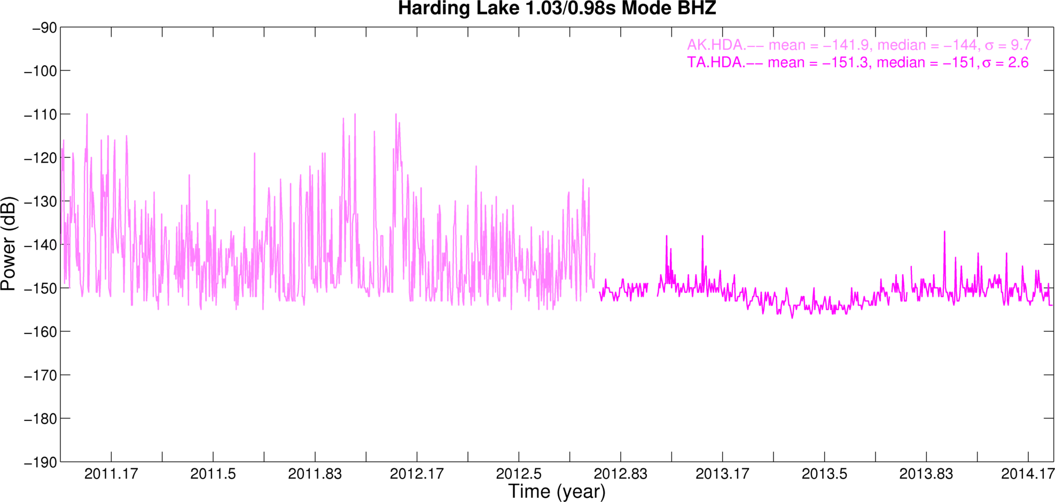
HDA Performance

