Slide 1
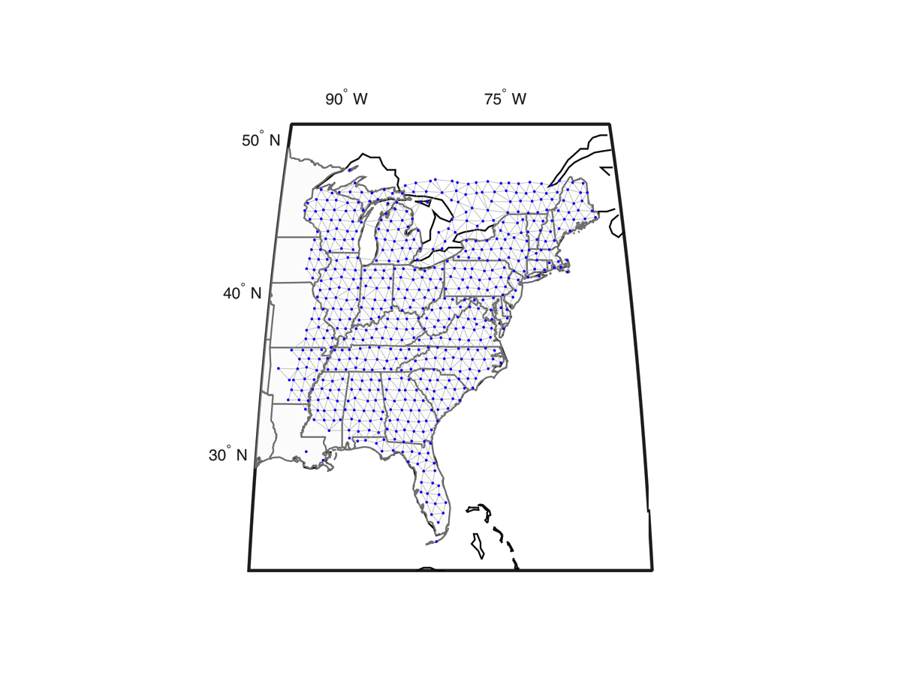
Study of atmospheric phenomena and structure using the USArray Transportable Array
Michael A.H. Hedlin &
Catherine D. de Groot-Hedlin
Laboratory for Atmospheric Acoustics
Inst. of Geophysics and Planetary Physics
University of California, San Diego

Slide 2
Content
Infrasound
The seismo-acoustic TA and AELUMA
Finding acoustic sources over the US
Study of atmospheric gravity waves

Slide 3
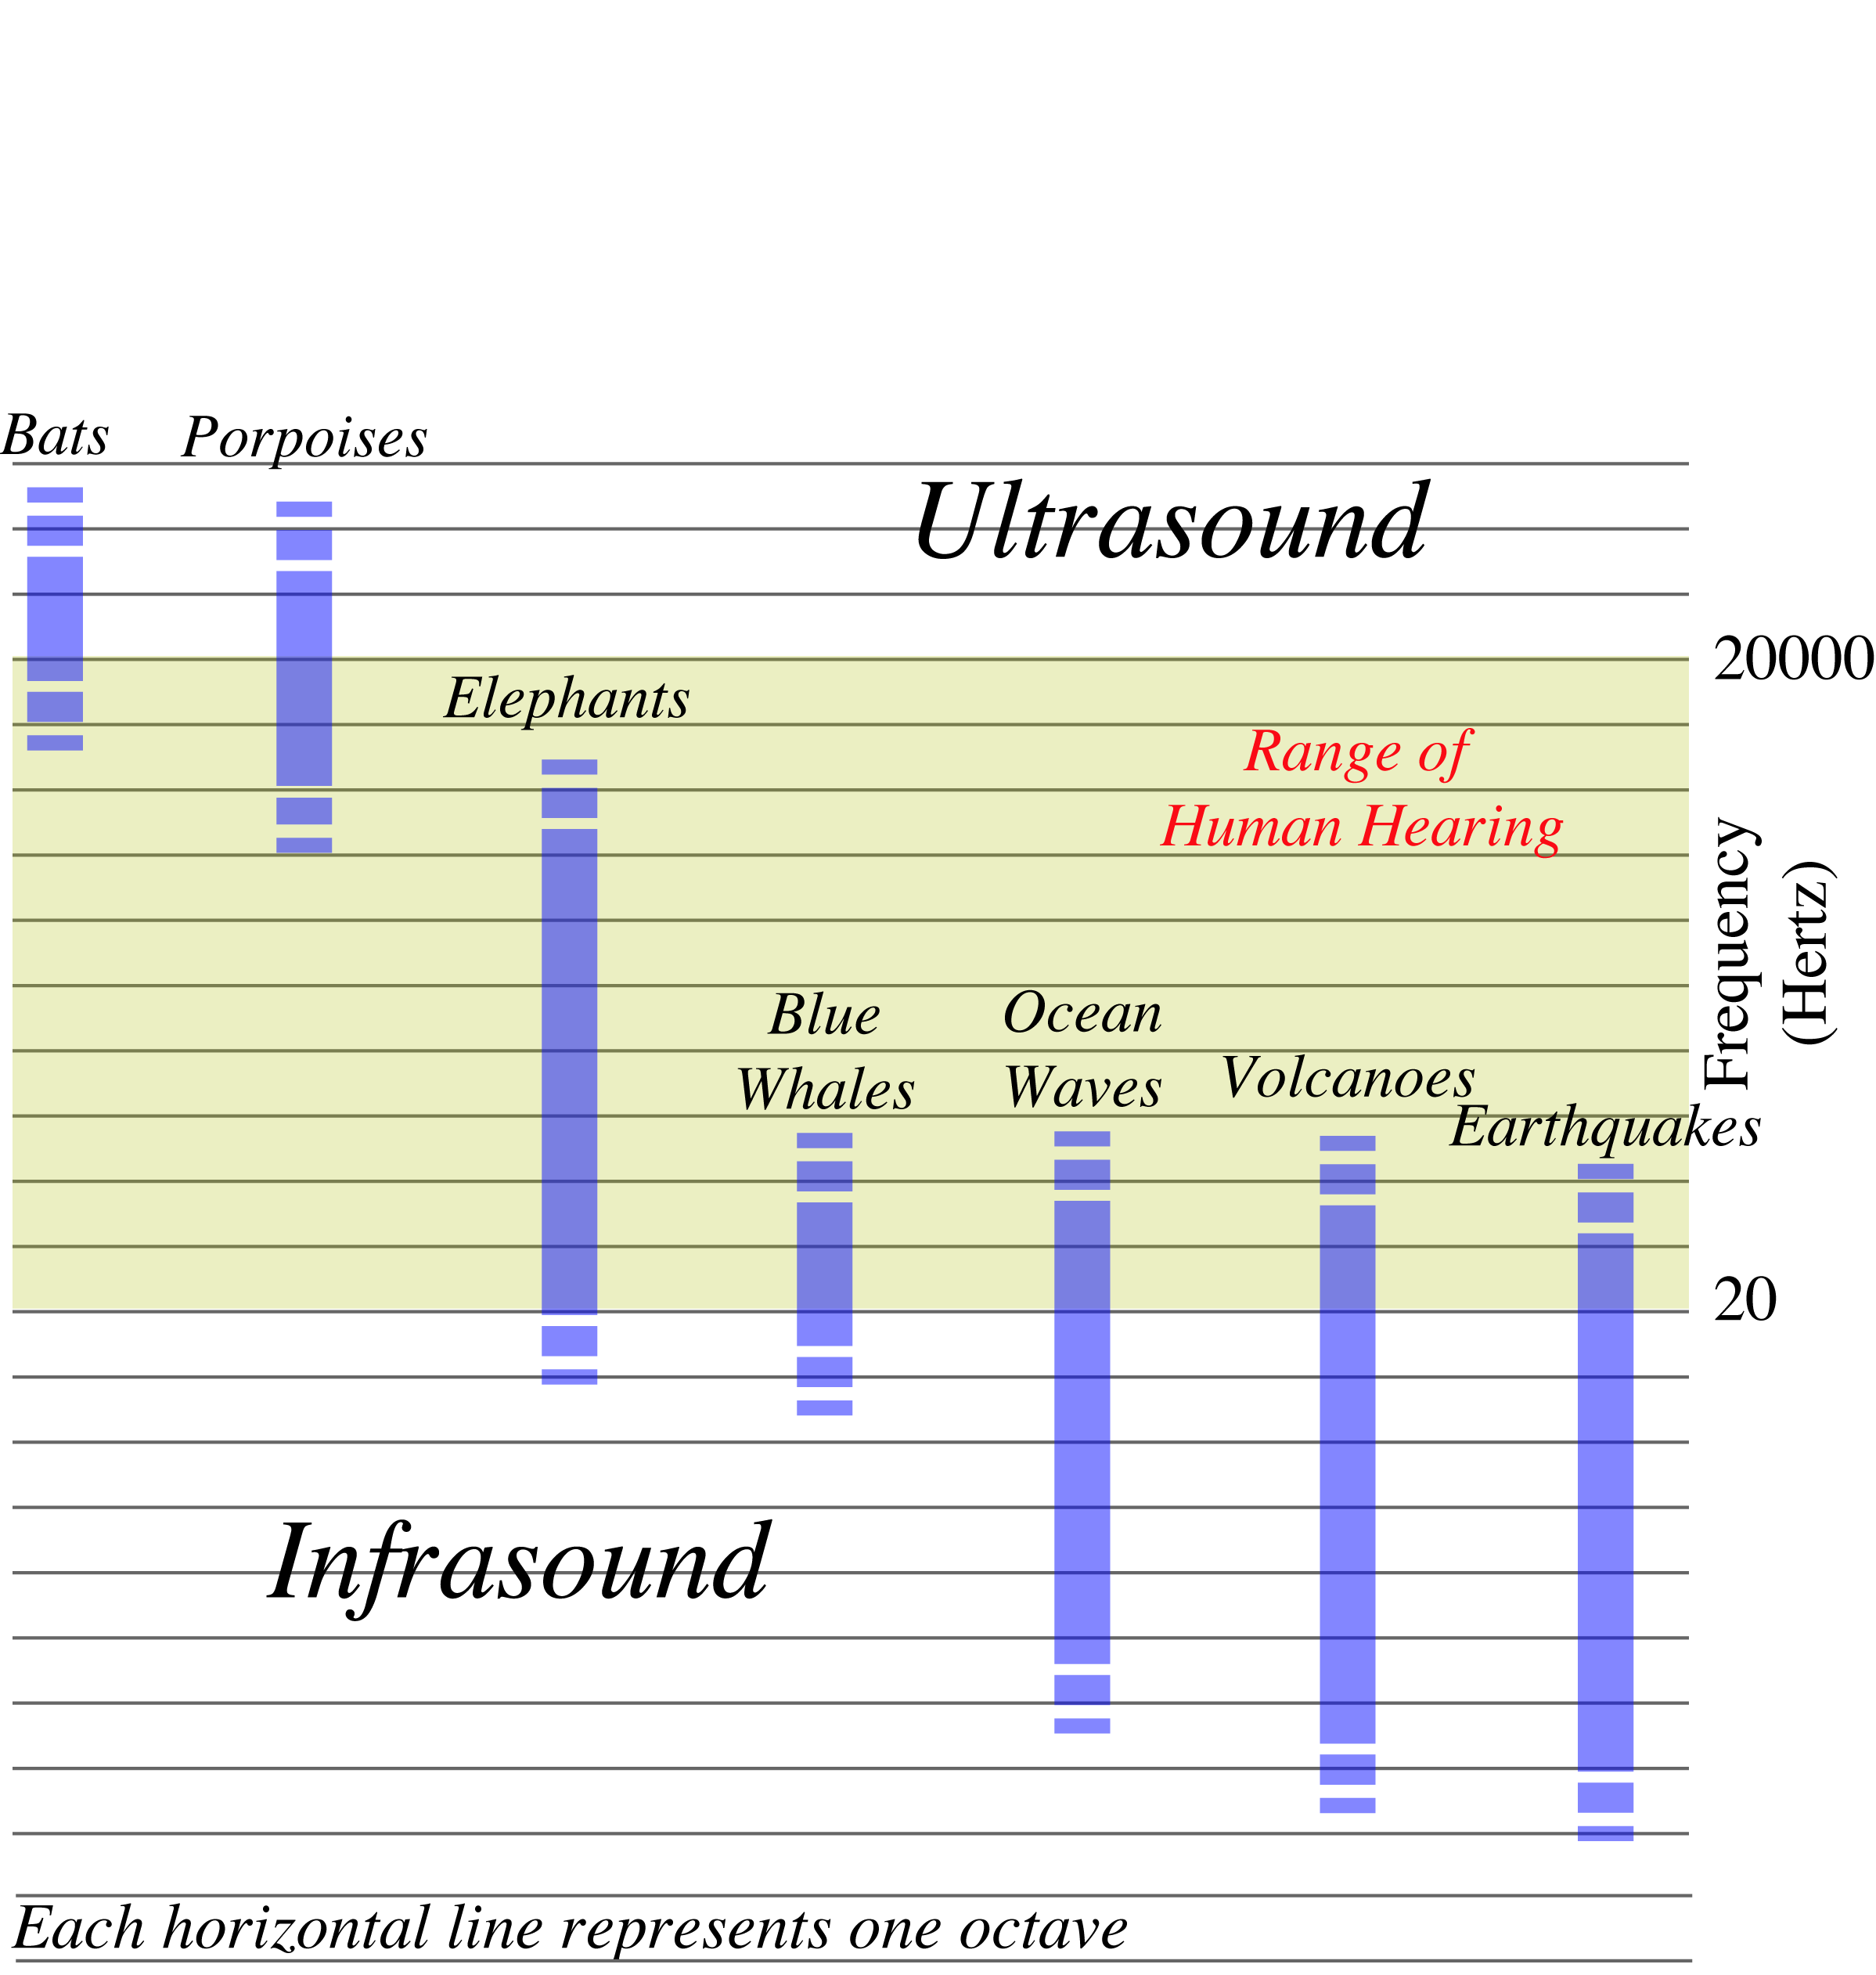
The Acoustic Spectrum
Very deep rumble is here
Notes:
Most people are familiar with ultrasound – sounds at frequencies too high to hear
Infrasound is at frequencies too low to hear.
They are valuable because they travel great distances
We are very excited about infrasound because we feel we can use it to gain a much better understanding of the atmosphere, and of significant natural phenomena and man-made activity occurring in it and in the shallow Earth.
The audible part of the acoustic spectrum ranges from approx. 20 to 20,000 Hz. Ultrasound exists at higher frequencies. Some small animals, such as bats and porpoises, communicate at those frequencies. Infrasound exists at frequencies below 20 Hz, in the subaudible range. We cannot hear infrasound, much like we cannot see infrared. As you can see from this chart, if we study the Earth’s atmosphere using infrasound we will tune into entirely different phenomena than can be heard in the audible range. The phenomena that are active at infrasonic frequencies, such as earthquakes, volcanoes, ocean waves, are less important in the audible range. Just we have learned much more about the structure and workings of the universe using infrared, we believe we can learn much more about the atmosphere, and significant phenomena active in it, using infrasound.

Slide 4
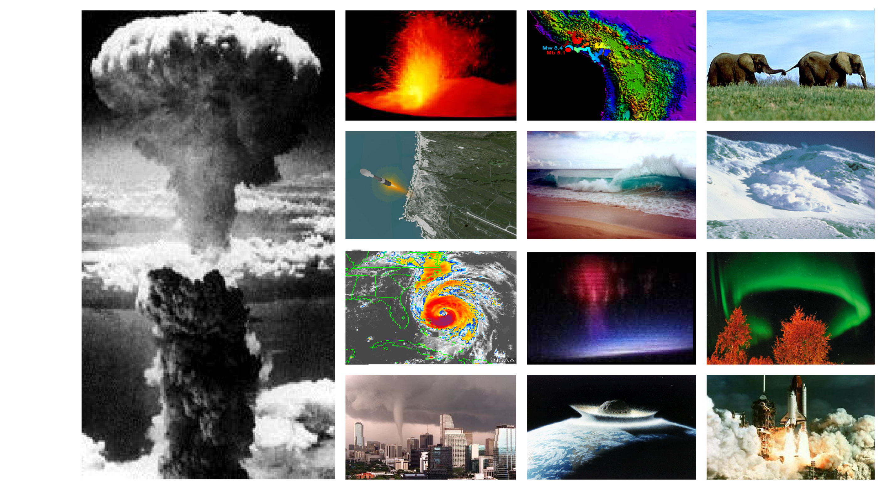
Some Infrasound Sources
Notes:
Ultimately, the network is being built for us to detect and identify signals from atmospheric nuclear tests. There are many sources of infrasound - I’ve just pictured a small subset of them here. Before we can correctly identify signals from nuclear tests, it is necessary for us to do a lot of basic research on all of the sources of infrasound. We must be able to learn how signals from these other sources differ from signals from nuclear explosions. I will only be able to talk about a small number of these sources in this talk.
Absorption of sound favors low-frequencies. Infrasound holds the promise of signal detection over long distances

Slide 5
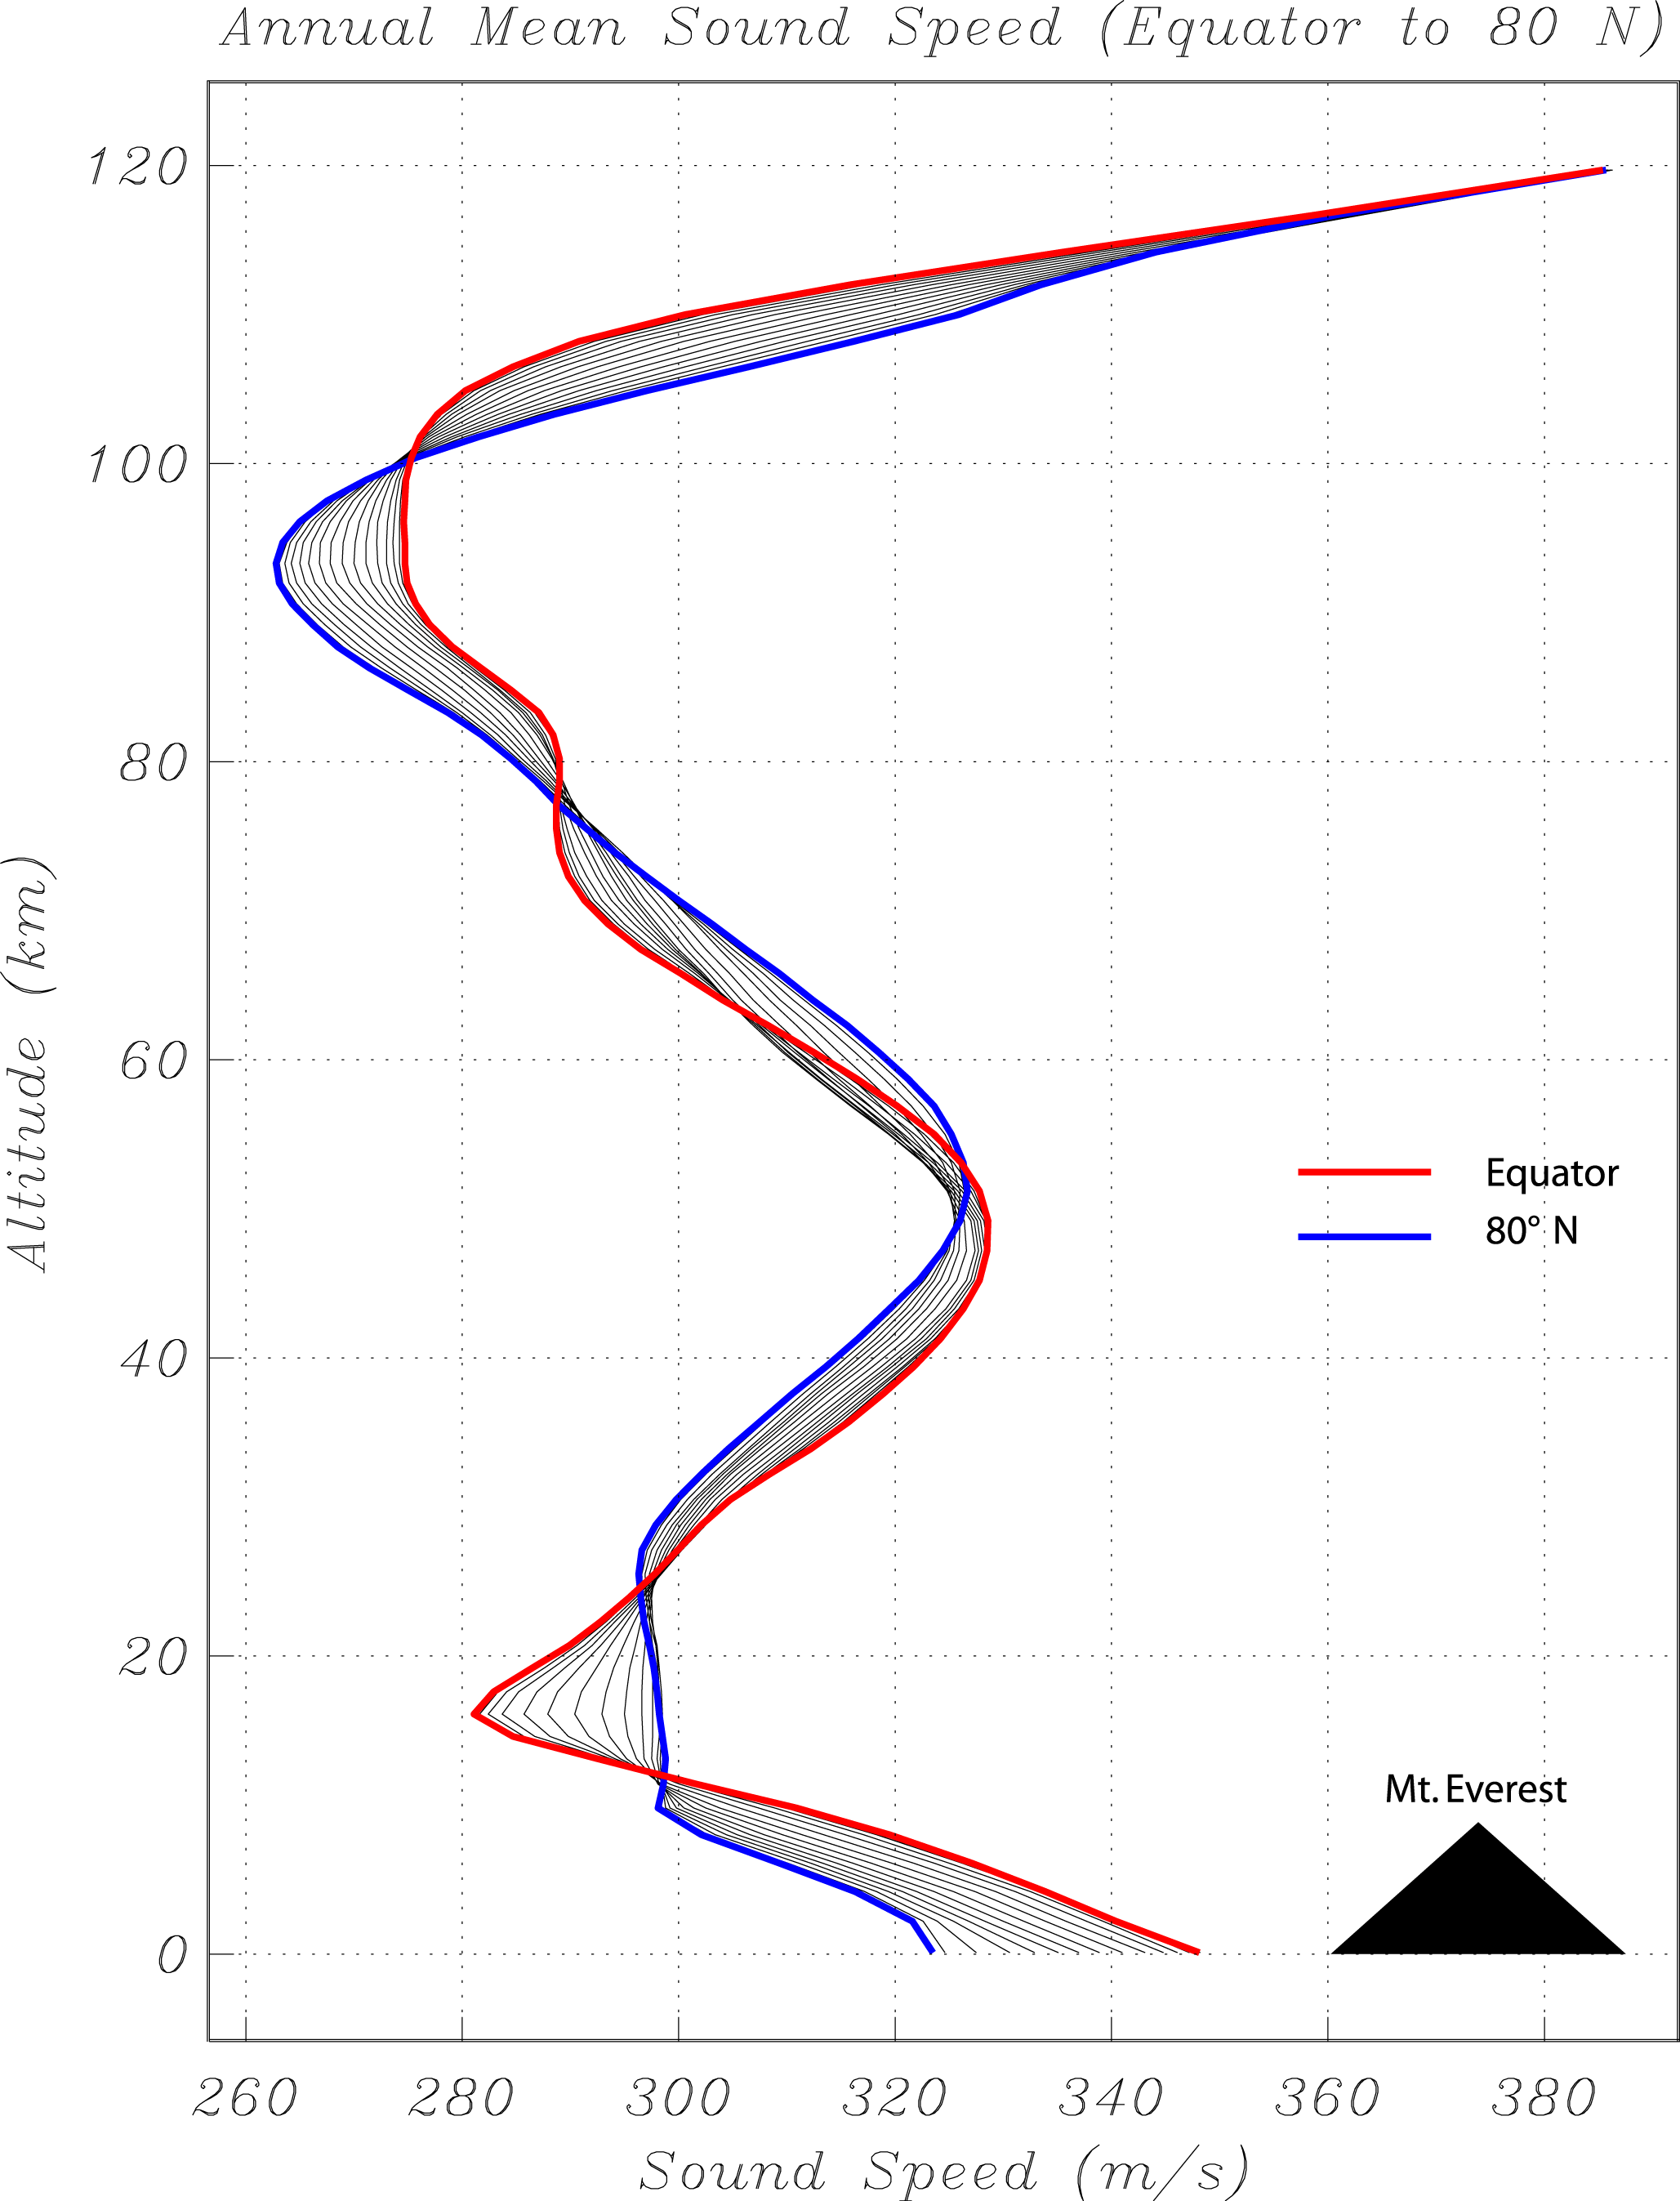
Air temperature
-
-
-
-
-
-
-
---
-
-
-
-
-
Thermosphere
Mesosphere
Stratosphere
Troposphere
100 km
Altitude
50 km
0 km
Cool Warm
Notes:
Ducting most efficient in the stratospheric and thermospheric wave guides
Propagation can be reinforced or reduced by wind. Stratospheric zonal (E-W) winds at most latitudes reverse twice a year.
Zonal winds 40-50 km altitude just below the stratopause
Propagation speed proportional to the sq rt of the absolute temp, but is also affected by wind. Varies with altitude, lat, long, time of day, day of season…
Dramatic effect on frequency content
The speed of sound is not constant. It is determined largely by the temperature of the atmosphere and the speed of the wind. This is a display that shows how the speed of sound, averaged over a long time interval, varies with latitude and altitude from 0 to 140 km above the Earth’s surface. The red curve gives the speed of sound at the equator, the blue curve tells how sound varies near the north pole. As we can see, the speed of sound decreases with increasing altitude in the lowermost layer of the atmosphere - the troposphere. This is due to the drop of temperature with increasing distance above the ground. The troposphere has cold air above warm air and is inherently unstable - it is always turning over - hence the name, troposphere. Above the troposphere temperature increases with increasing altitude and so does the speed of sound. This is the stratosphere, with hot air over cold (dense) air it is stratified - hence the name. Above the stratosphere, in the mesosphere, the temperate and speed of sound again decreases with increasing altitude. Finally, in the uppermost layer, the thermosphere, the temperature increases dramatically with increasing altitude.
One could say that sound avoids regions of high velocity - it refracts away from them. This is basic physics of wave phenomena. With favorable winds, sound will be refracted back to the surface of the Earth from within the stratosphere. Sound will also be refracted back to the ground from within the thermosphere. Under unusual conditions, we have also observed sound waves refracted back to the ground from within the troposphere.

Slide 6
The speed of sound
-
-
-
-
-
-
-
---
-
-
-
-
-
Thermosphere
Mesosphere
Stratosphere
Troposphere
100 km
Altitude
50 km
-
-
-
-
-
-
-
0 km
260 m/s 380 m/s
Notes:
Ducting most efficient in the stratospheric and thermospheric wave guides
Propagation can be reinforced or reduced by wind. Stratospheric zonal (E-W) winds at most latitudes reverse twice a year.
Zonal winds 40-50 km altitude just below the stratopause
Propagation speed proportional to the sq rt of the absolute temp, but is also affected by wind. Varies with altitude, lat, long, time of day, day of season…
Dramatic effect on frequency content
The speed of sound is not constant. It is determined largely by the temperature of the atmosphere and the speed of the wind. This is a display that shows how the speed of sound, averaged over a long time interval, varies with latitude and altitude from 0 to 140 km above the Earth’s surface. The red curve gives the speed of sound at the equator, the blue curve tells how sound varies near the north pole. As we can see, the speed of sound decreases with increasing altitude in the lowermost layer of the atmosphere - the troposphere. This is due to the drop of temperature with increasing distance above the ground. The troposphere has cold air above warm air and is inherently unstable - it is always turning over - hence the name, troposphere. Above the troposphere temperature increases with increasing altitude and so does the speed of sound. This is the stratosphere, with hot air over cold (dense) air it is stratified - hence the name. Above the stratosphere, in the mesosphere, the temperate and speed of sound again decreases with increasing altitude. Finally, in the uppermost layer, the thermosphere, the temperature increases dramatically with increasing altitude.
One could say that sound avoids regions of high velocity - it refracts away from them. This is basic physics of wave phenomena. With favorable winds, sound will be refracted back to the surface of the Earth from within the stratosphere. Sound will also be refracted back to the ground from within the thermosphere. Under unusual conditions, we have also observed sound waves refracted back to the ground from within the troposphere.

Slide 7
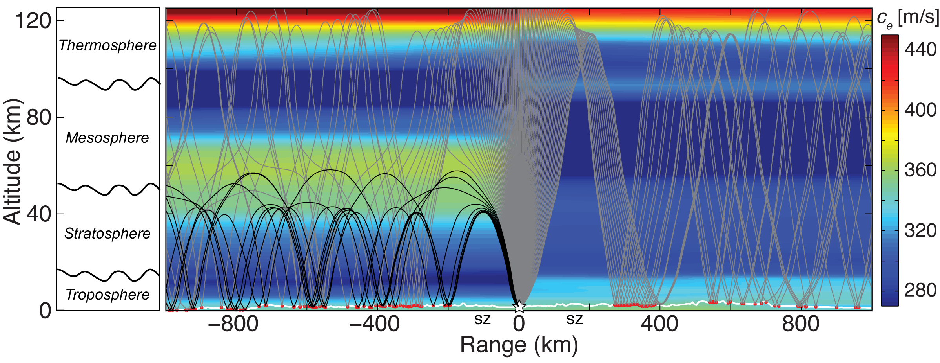
Sound speed depends on direction it travels
Wind
Source
Notes:
Winds can be significant percentage of static sound speed giving rise to highly anisotropic atmosphere forming ducts in direction of prevailing winds.

Slide 8
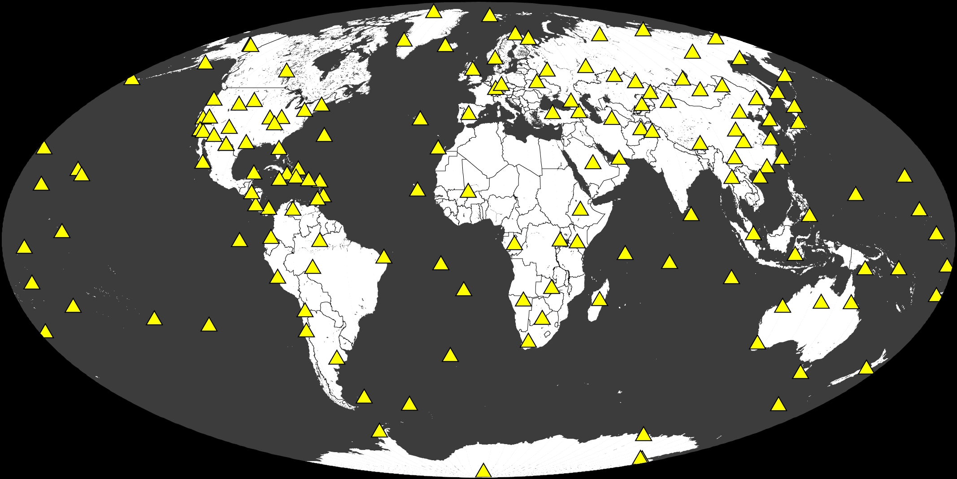
The Global Seismographic Network
Notes:
We have an unbelievably broad suite of instruments to study the Earth ranging from thousands of seismometers, hydrophones, aircraft, satellites to name a few. The seismic network, for example, has led to an enormous increase in our understanding of how the Earth’s interior works, its structure, what causes Earthquakes. The sensors give us early warning of large, dangerous earthquakes.

Slide 9
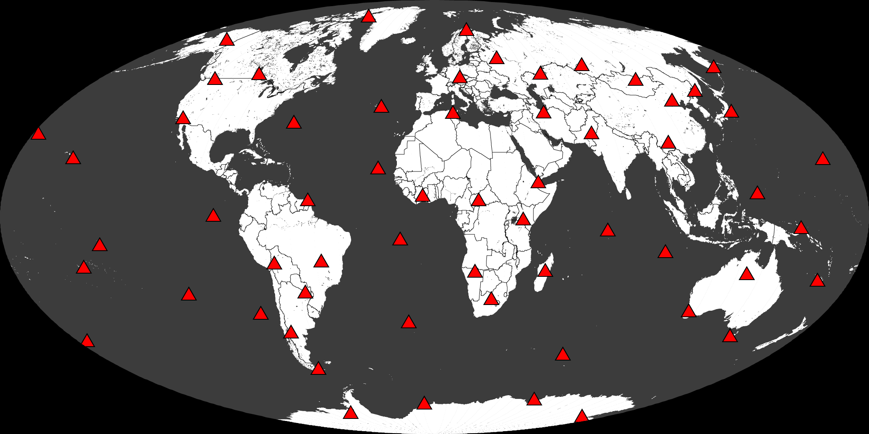
IMS Infrasound Network
Notes:
46 operating around the world
We have an unbelievably broad suite of instruments to study the Earth ranging from thousands of seismometers, hydrophones, aircraft, satellites to name a few. The seismic network, for example, has led to an enormous increase in our understanding of how the Earth’s interior works, its structure, what causes Earthquakes. The sensors give us early warning of large, dangerous earthquakes.

Slide 10
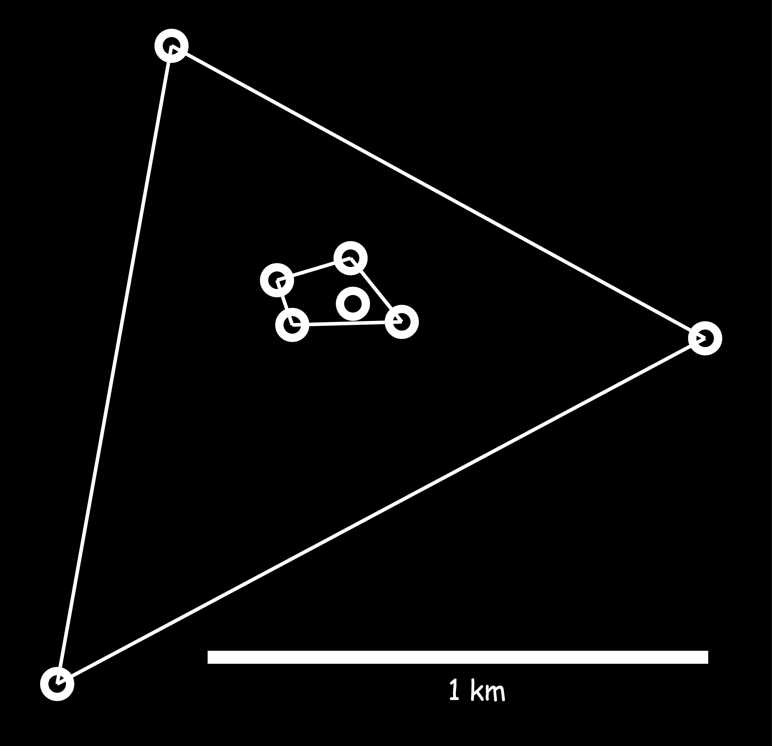
Infrasound Network

Slide 11
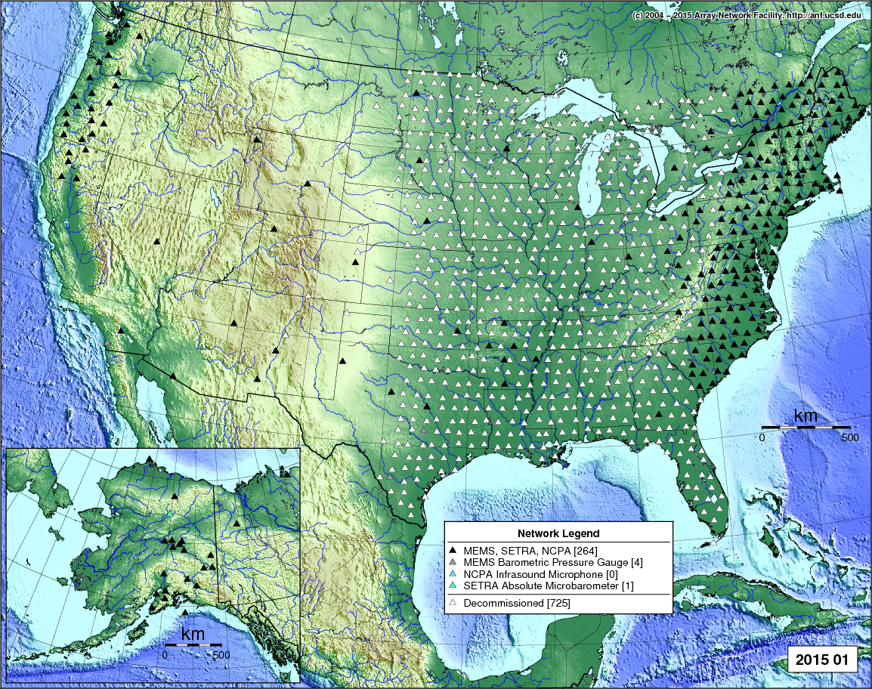
TA sites with atmospheric sensors

Slide 12
TA sites with atmospheric sensors
IMS infrasound arrays

Slide 13
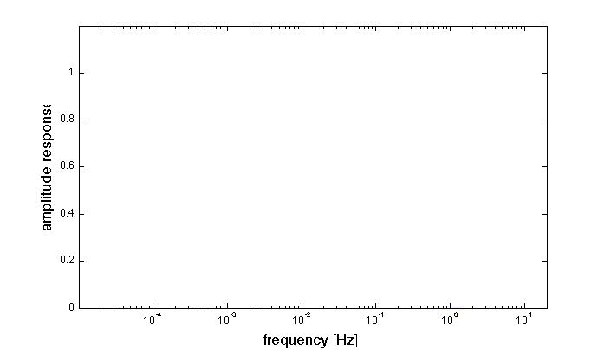
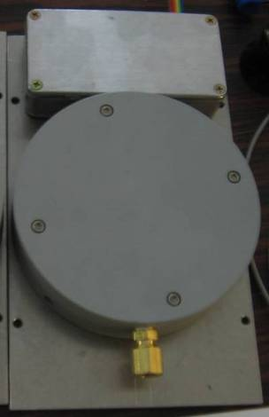
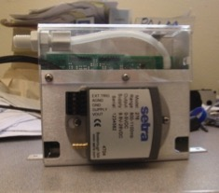
Addition of atmospheric sensors
Setra Barometer
EP - LDO, EP - BDO
NCPA Infrasound Microphone
EP - LDF, EP - BDF
MEMS Barometer
EP - LDM
13
From Bob Busby
Overlapping pass-bands provides continuous coverage from DC to 20 Hz
Notes:
Three sensors at each site
MEMS: D.C. – 100 s
Setra: D.C. – 1 Hz
NCPA infrasound microphone: 200 s – Nyquist

Slide 14
Detecting/locating infrasonic events

Slide 15
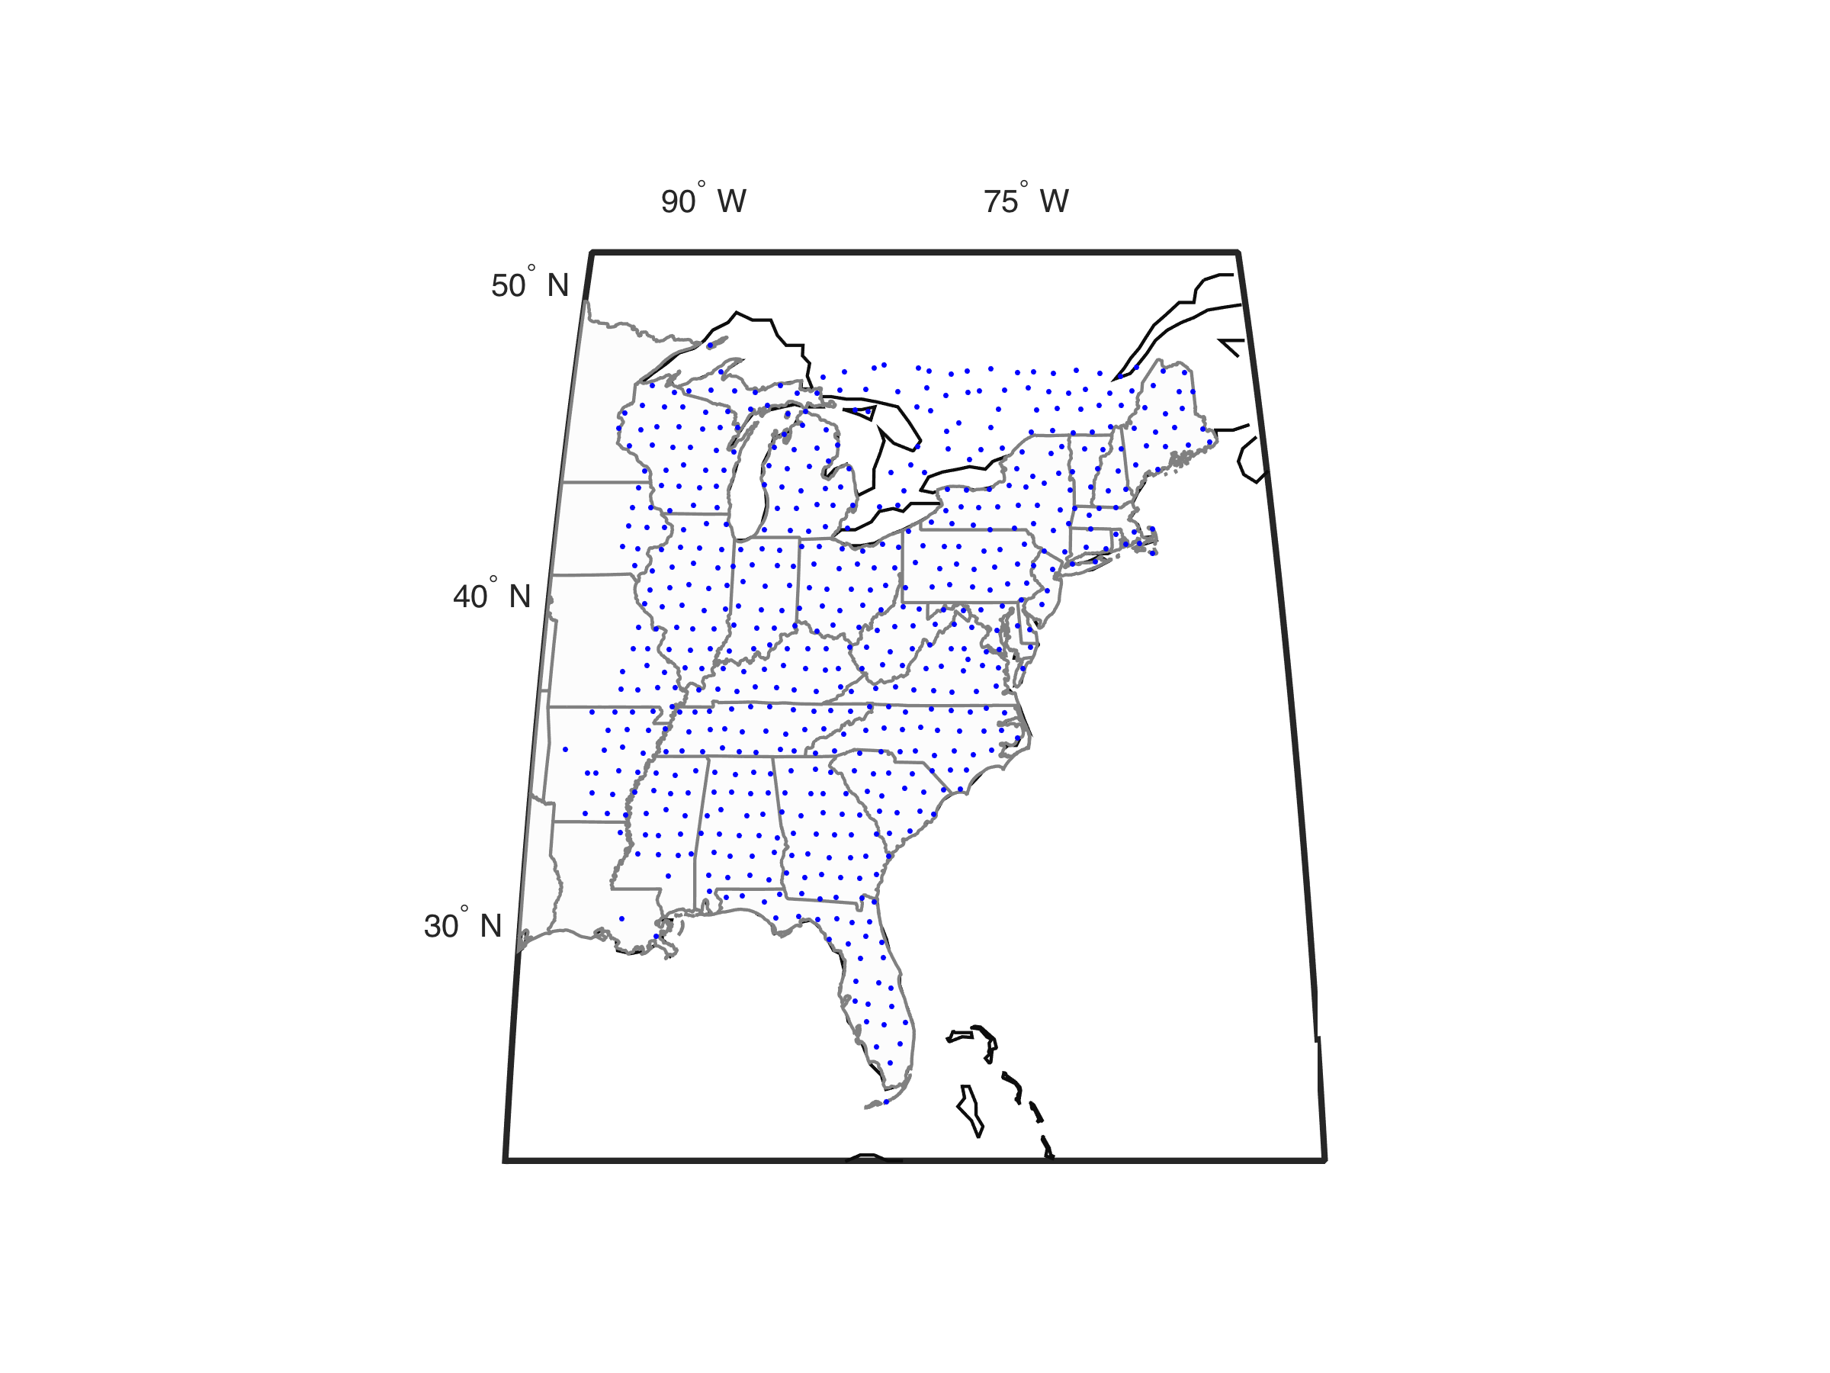
TA sites in 2013
> 500 sites
Notes:
588 station locations shown in the study area.

Slide 16
Triads available in 2013
> 1,000 triads shown here
Notes:
1037 triads

Slide 17
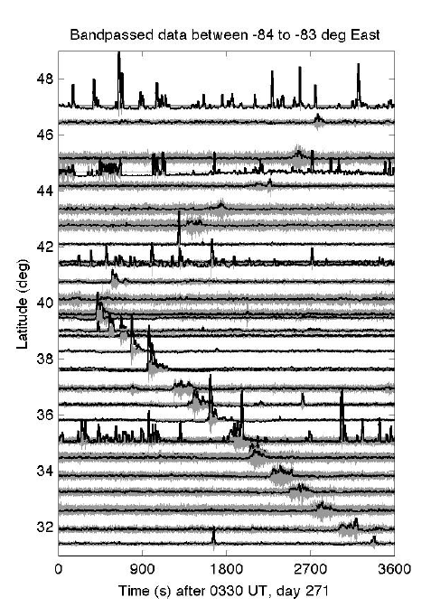
Triads available in 2013
> 1,000 triads shown here
Notes:
1037 triads

Slide 18
Example event: a bolide
JD 271, 2013
de Groot-Hedlin and Hedlin, GJI (2015)

Slide 19
Example event: a bolide
de Groot-Hedlin and Hedlin, GJI (2015)

Slide 20
2-8 Hz acoustic catalog
2,220 events in 2013
de Groot-Hedlin and Hedlin, GJI (2015)

Slide 21
2-8 Hz acoustic catalog
70° W
90° W
Jan 1
Dec 31
2,220 events in 2013
de Groot-Hedlin and Hedlin, GJI (2015)

Slide 22
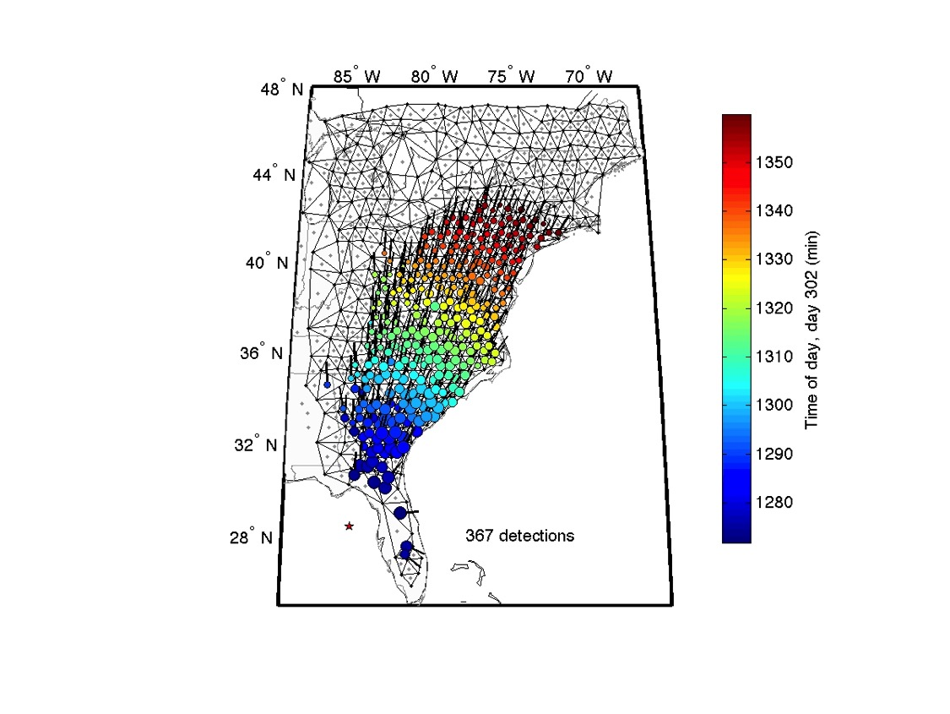
Some of these events are huge
20:56 UT
JD 302, 2013

Slide 23
Some of these events are huge
2,000 km
20:56 UT
JD 302, 2013
1,000 km
de Groot-Hedlin and Hedlin, GJI (2015)

Slide 24
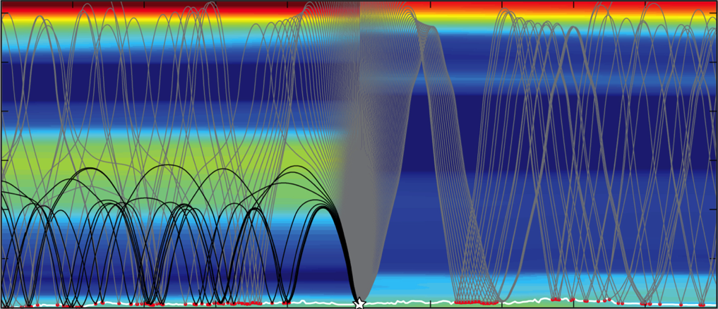
Some of these events are huge
2,000 km
20:56 UT
JD 302, 2013
1,000 km
Wind
Wind

Slide 25
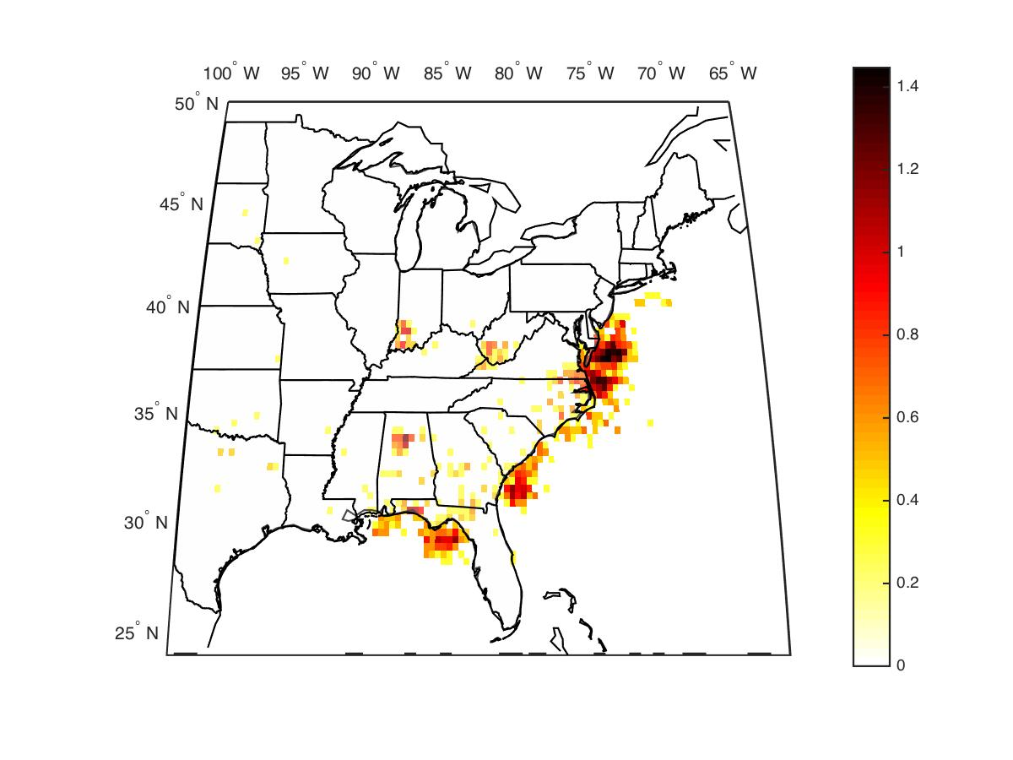
Histogram of acoustic activity
2012-2014

Slide 26
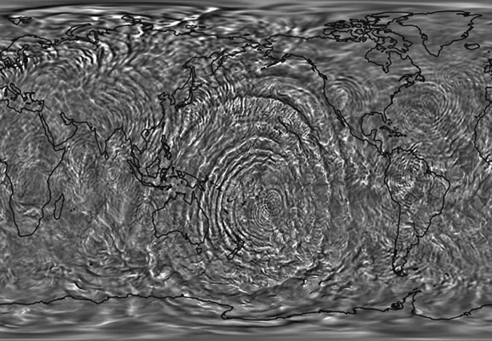
Study of atmospheric gravity waves
Background: Liu et al. (2014), Gravity waves simulated by high-resolution Whole Atmosphere Community Climate Model,
Geophysical Research Letters

Slide 27
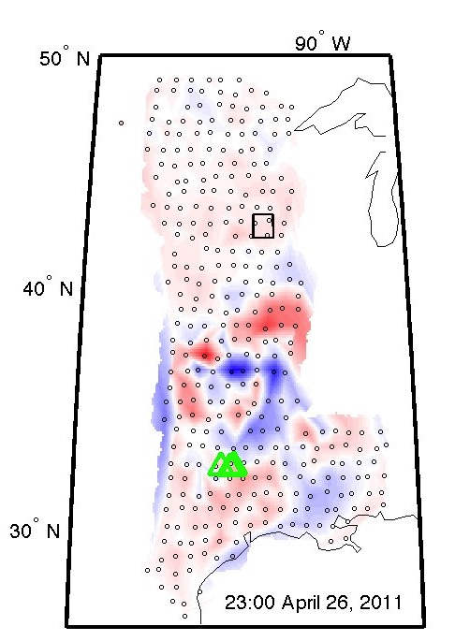
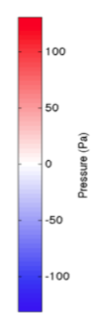
Atmospheric gravity waves
2-4 hour
Notes:
Gravity waves in lower thermosphere (~ 100 km altitude) excited by a tropical storm

Slide 28
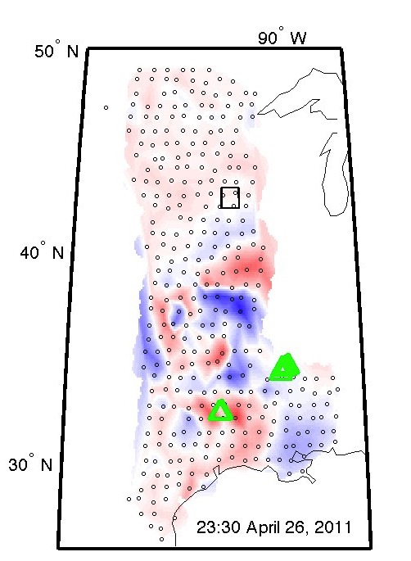
Atmospheric gravity waves
2-4 hour
Notes:
Gravity waves in lower thermosphere (~ 100 km altitude) excited by a tropical storm

Slide 29
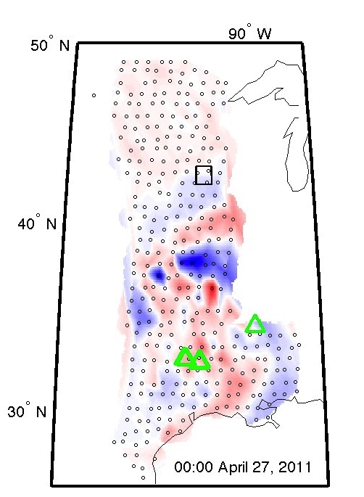
Atmospheric gravity waves
2-4 hour
Notes:
Gravity waves in lower thermosphere (~ 100 km altitude) excited by a tropical storm

Slide 30
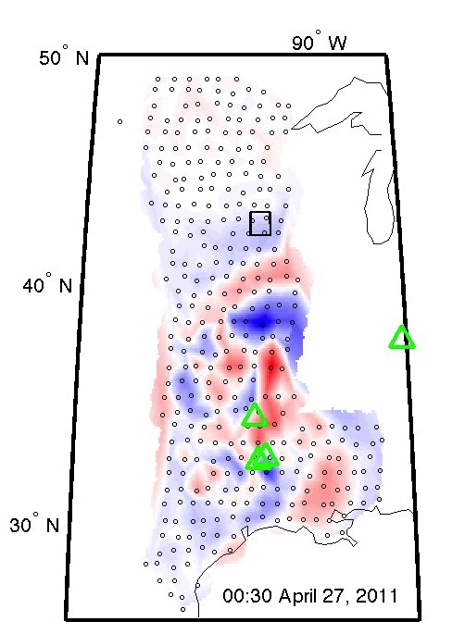
Atmospheric gravity waves
2-4 hour
Notes:
Gravity waves in lower thermosphere (~ 100 km altitude) excited by a tropical storm

Slide 31
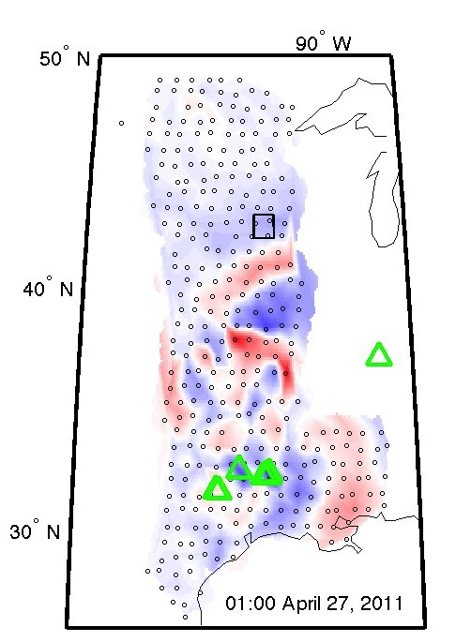
Atmospheric gravity waves
2-4 hour
Notes:
Gravity waves in lower thermosphere (~ 100 km altitude) excited by a tropical storm

Slide 32
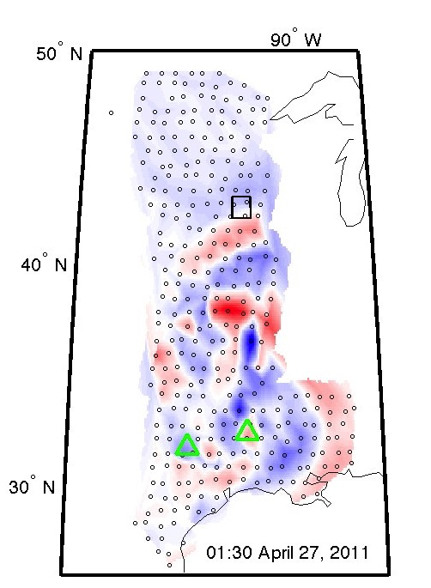
Atmospheric gravity waves
2-4 hour
Notes:
Gravity waves in lower thermosphere (~ 100 km altitude) excited by a tropical storm

Slide 33
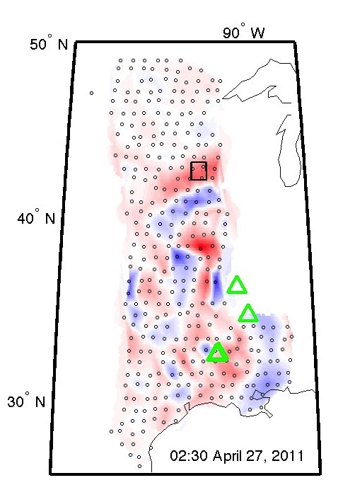
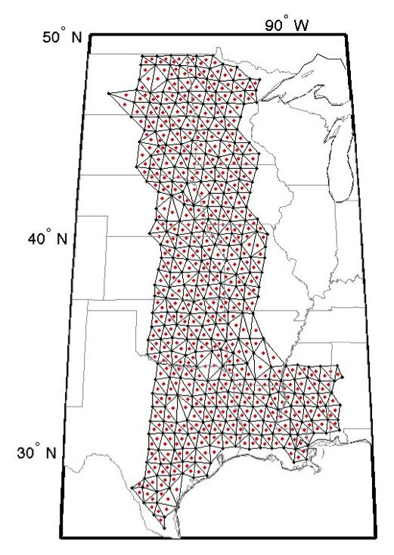
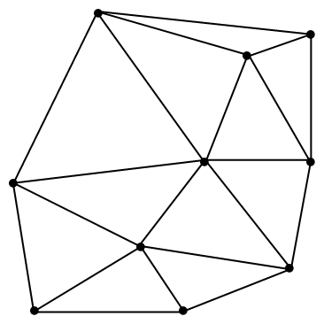
Atmospheric gravity waves
Delauney triangulation defines 580 three-element arrays
de Groot-Hedlin et al., EPSL, 2013
Notes:
Gravity waves in lower thermosphere (~ 100 km altitude) excited by a tropical storm
Coherent processing

Slide 34
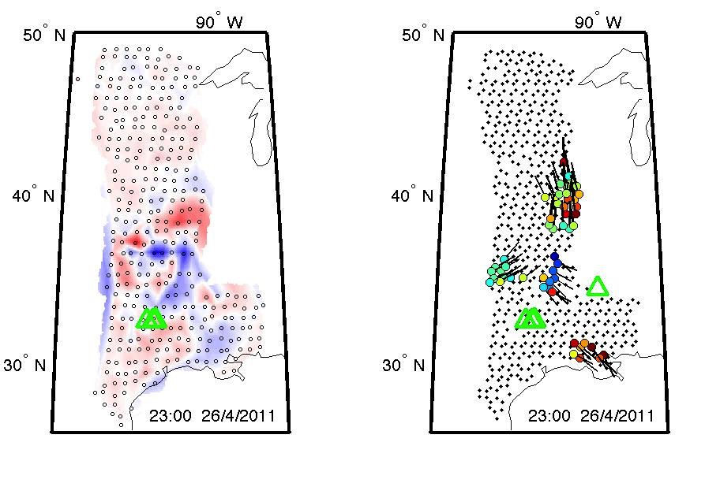
de Groot-Hedlin et al., EPSL, 2013

Slide 35
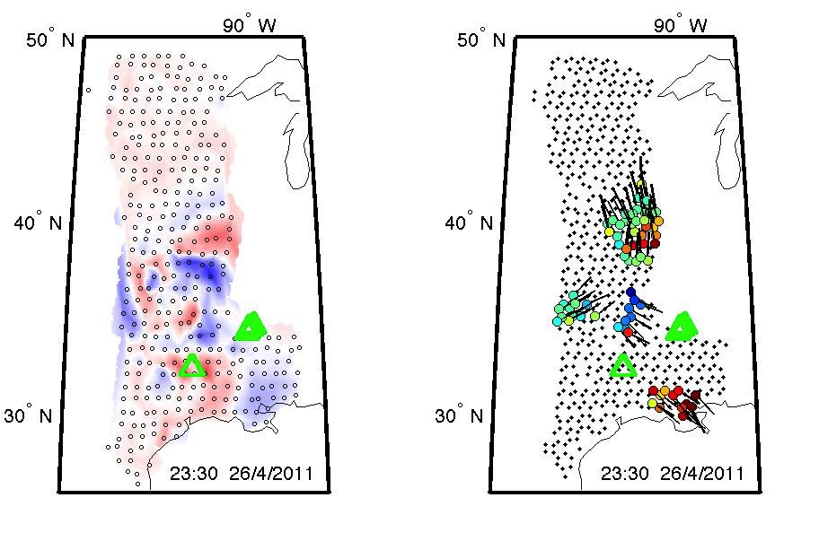
de Groot-Hedlin et al., EPSL, 2013

Slide 36
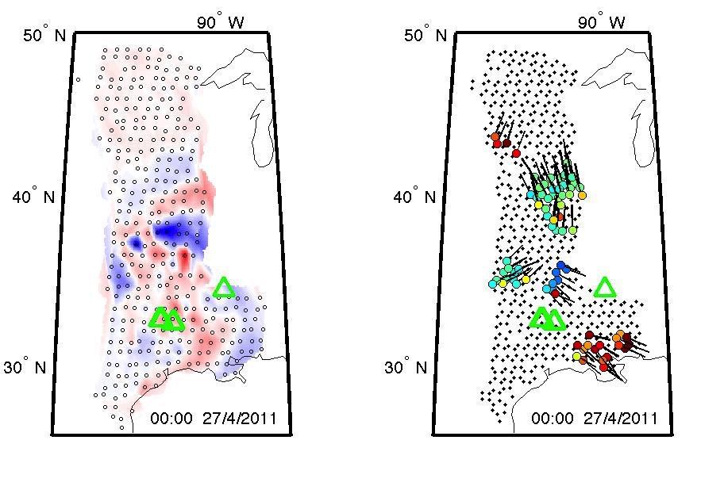
de Groot-Hedlin et al., EPSL, 2013

Slide 37
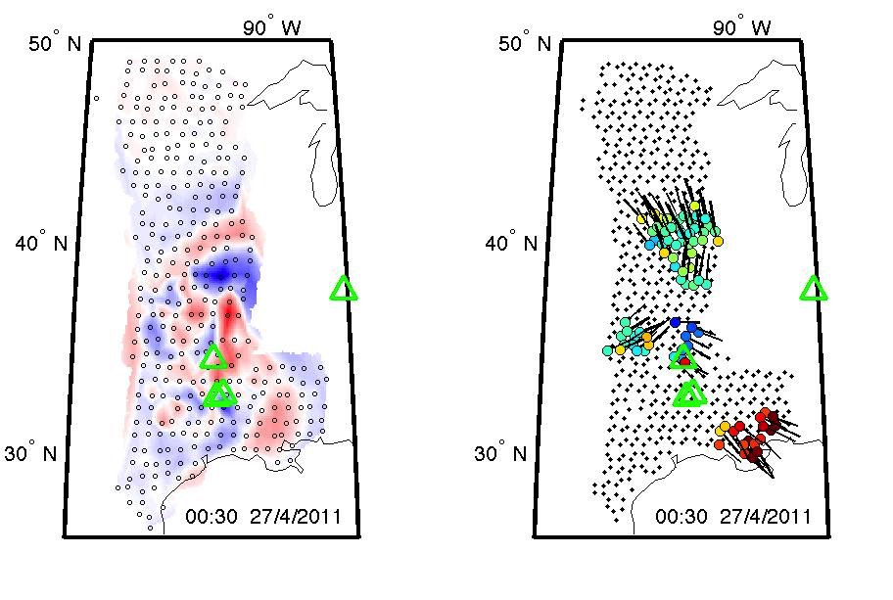
de Groot-Hedlin et al., EPSL, 2013

Slide 38
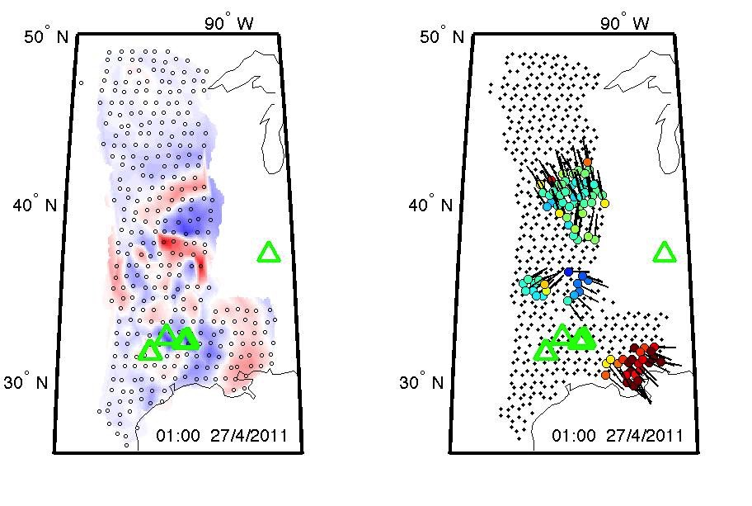
de Groot-Hedlin et al., EPSL, 2013

Slide 39
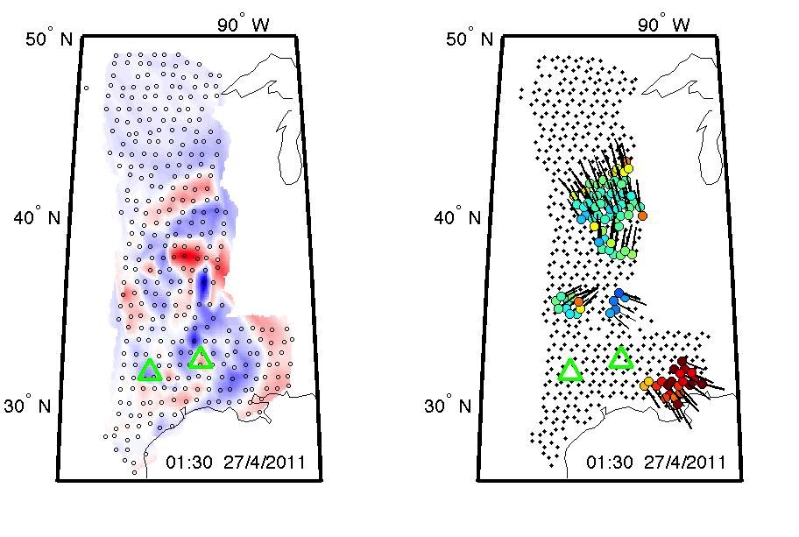
de Groot-Hedlin et al., EPSL, 2013

Slide 40
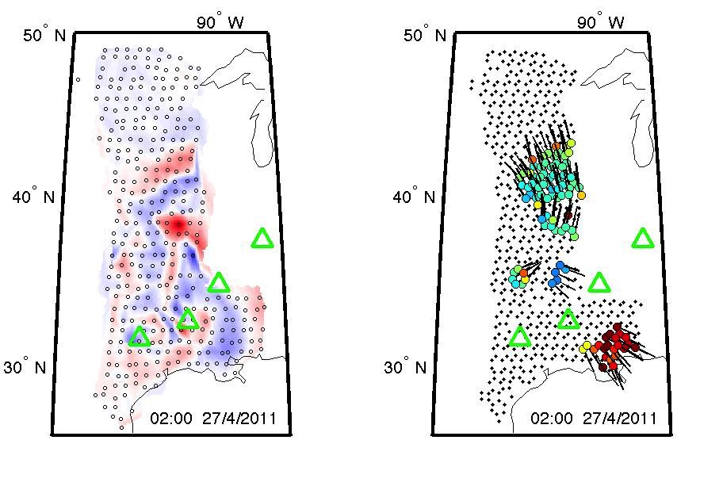
de Groot-Hedlin et al., EPSL, 2013

Slide 41
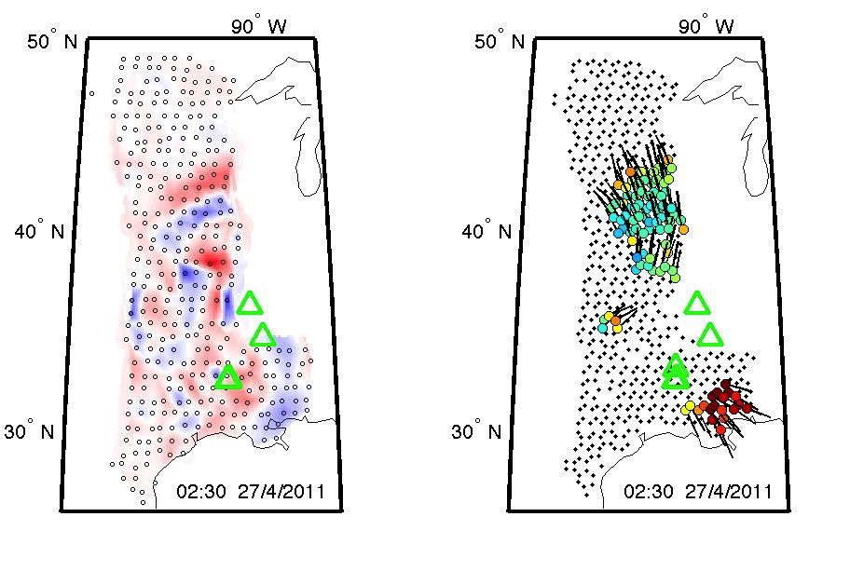
de Groot-Hedlin et al., EPSL, 2013

Slide 42
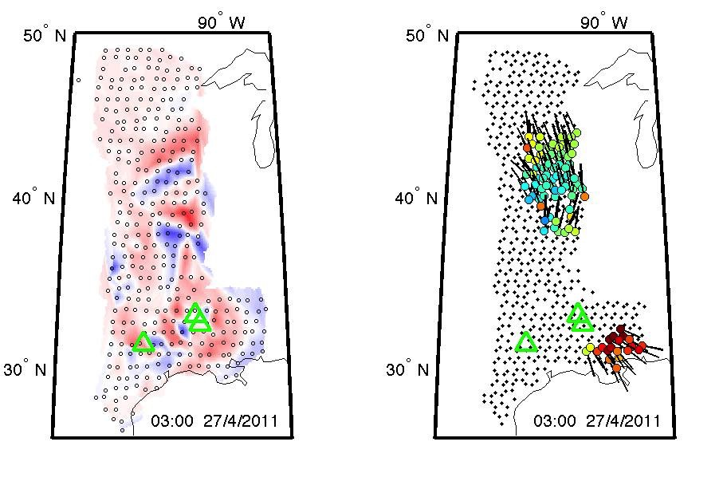
de Groot-Hedlin et al., EPSL, 2013

Slide 43
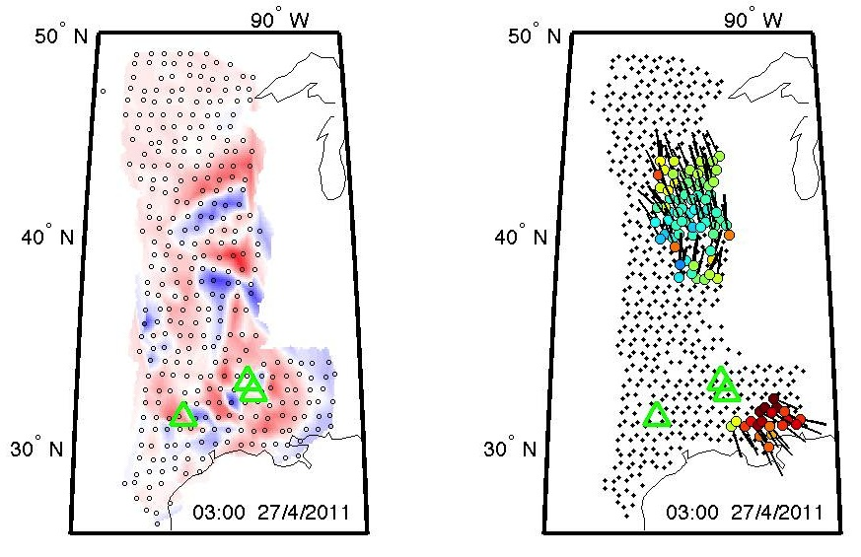
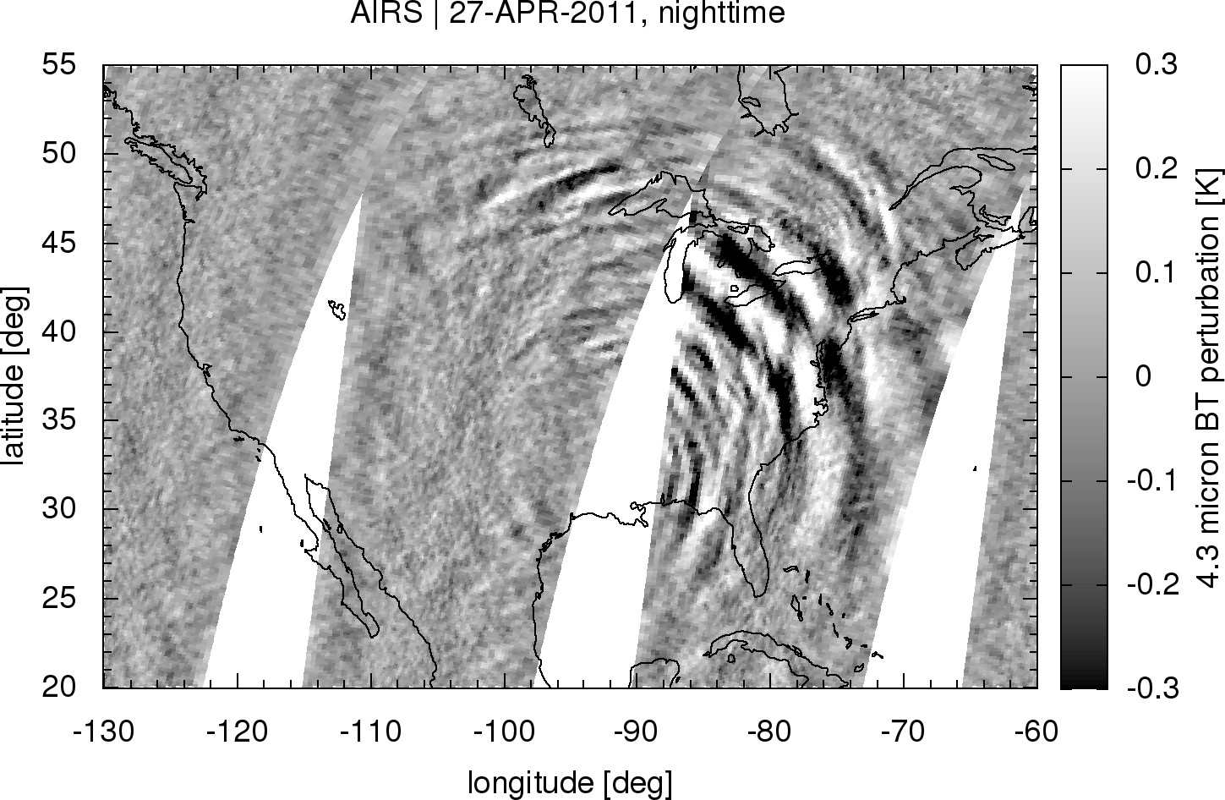
Case studies: Comparison with satellite observations
Gravity waves observed at ground level using the TA
Gravity waves observed in the stratosphere from space
From Lars Hoffmann

Slide 44
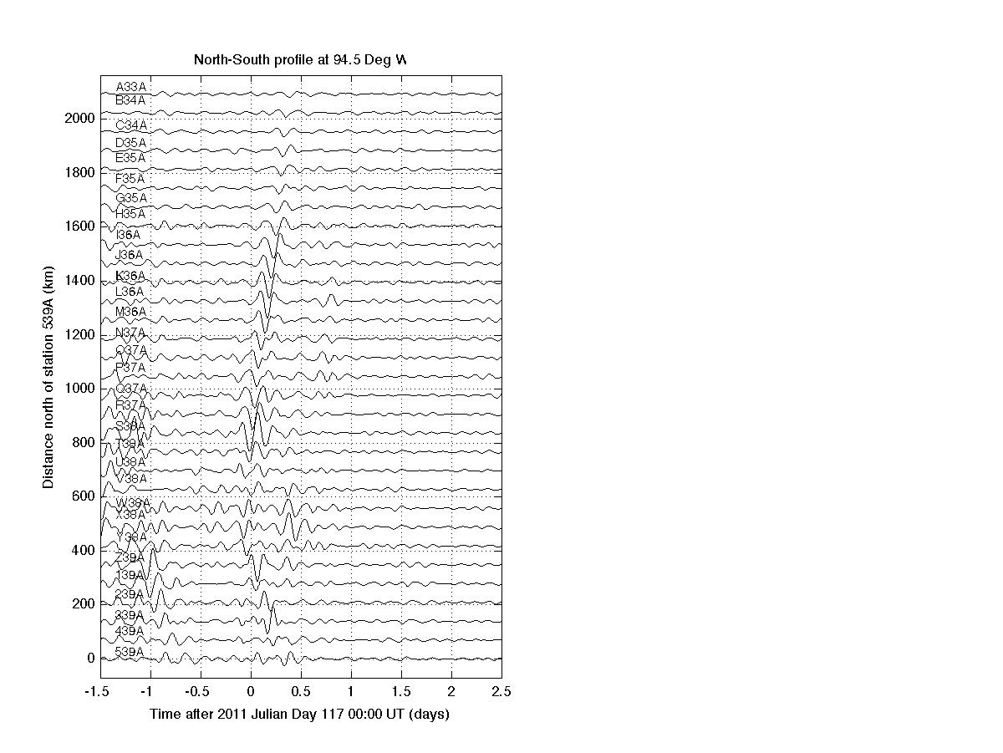
Case studies: Comparison with satellite observations
Gravity waves observed at ground level using the TA
Gravity waves observed in the stratosphere from space
From Lars Hoffmann

Slide 45
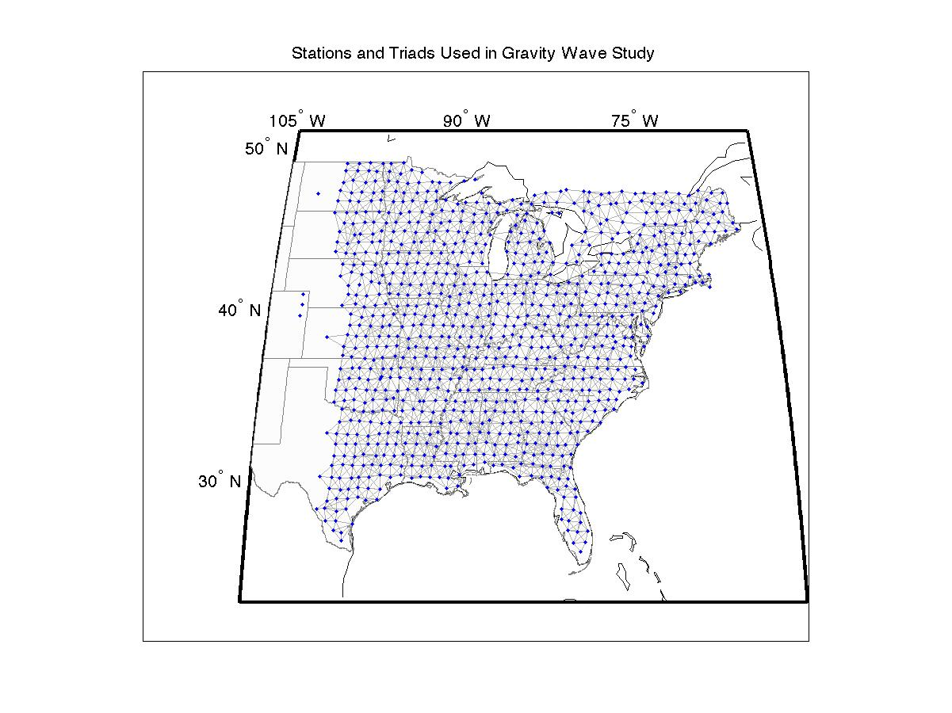
Long-term occurrence of gravity waves
2010-2014 TA – over 3,000 triads

Slide 46
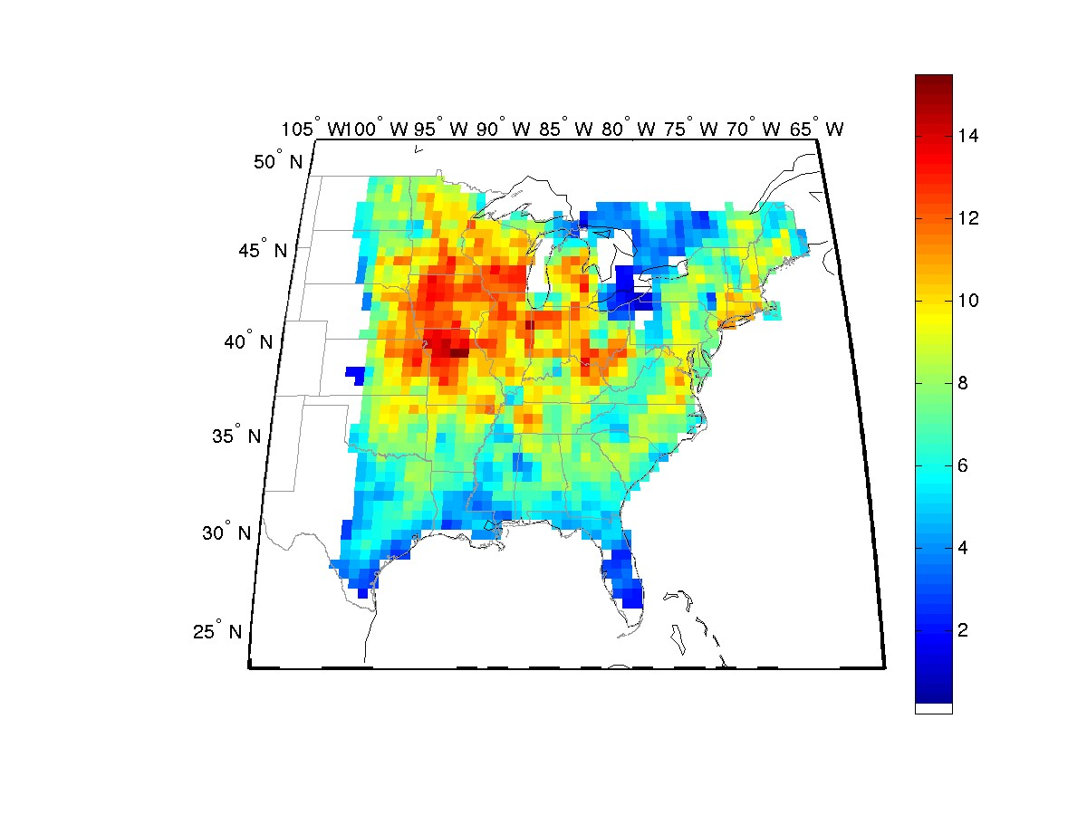
Gravity wave occurrence
Observed on ground by TA 2010-2014

Slide 47
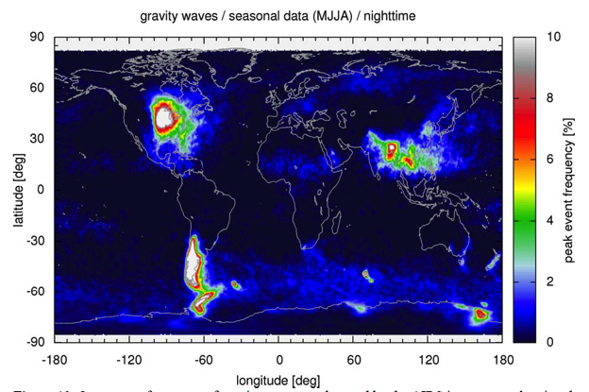
Gravity wave occurrence
Observed on ground by TA 2010-2014
Observed in stratosphere in summer months/nighttime by AIRS sensor 2003-2011
From Lars Hoffmann

Slide 48
Summary
The dense seismo-acoustic TA permits new lines of research
The triad method can be adapted to a range of pressure/acoustic/seismic networks
The extended triad method (AELUMA) reveals several “acoustogenic” regions in the eastern US
Some particularly large events
Some repeating source regions
Preliminary study of gravity waves in the eastern US shows general agreement with satellite data
Project is supported by NSF contract EAR-1358520

