Slide 1
Alaska TA Communications
Jeremy Miner
AOC Field Operations Manager
Station Specialist
TA Team Meeting
Nov 9-11 Scripps UCSD
La Jolla, California

Slide 2
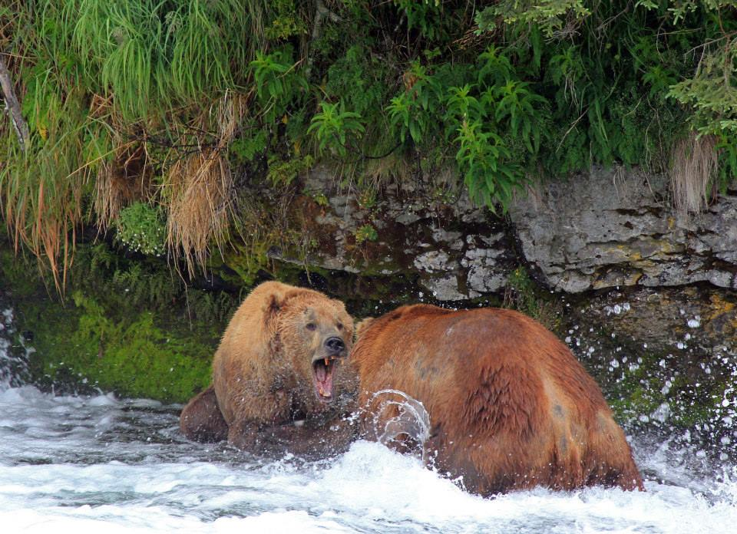


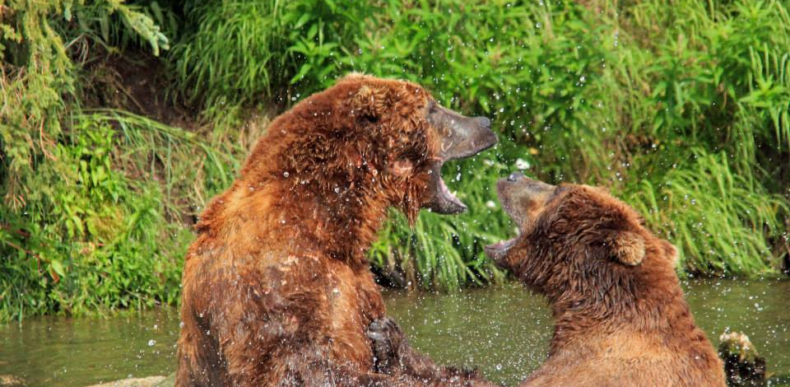
Bears
Obligations

Slide 3
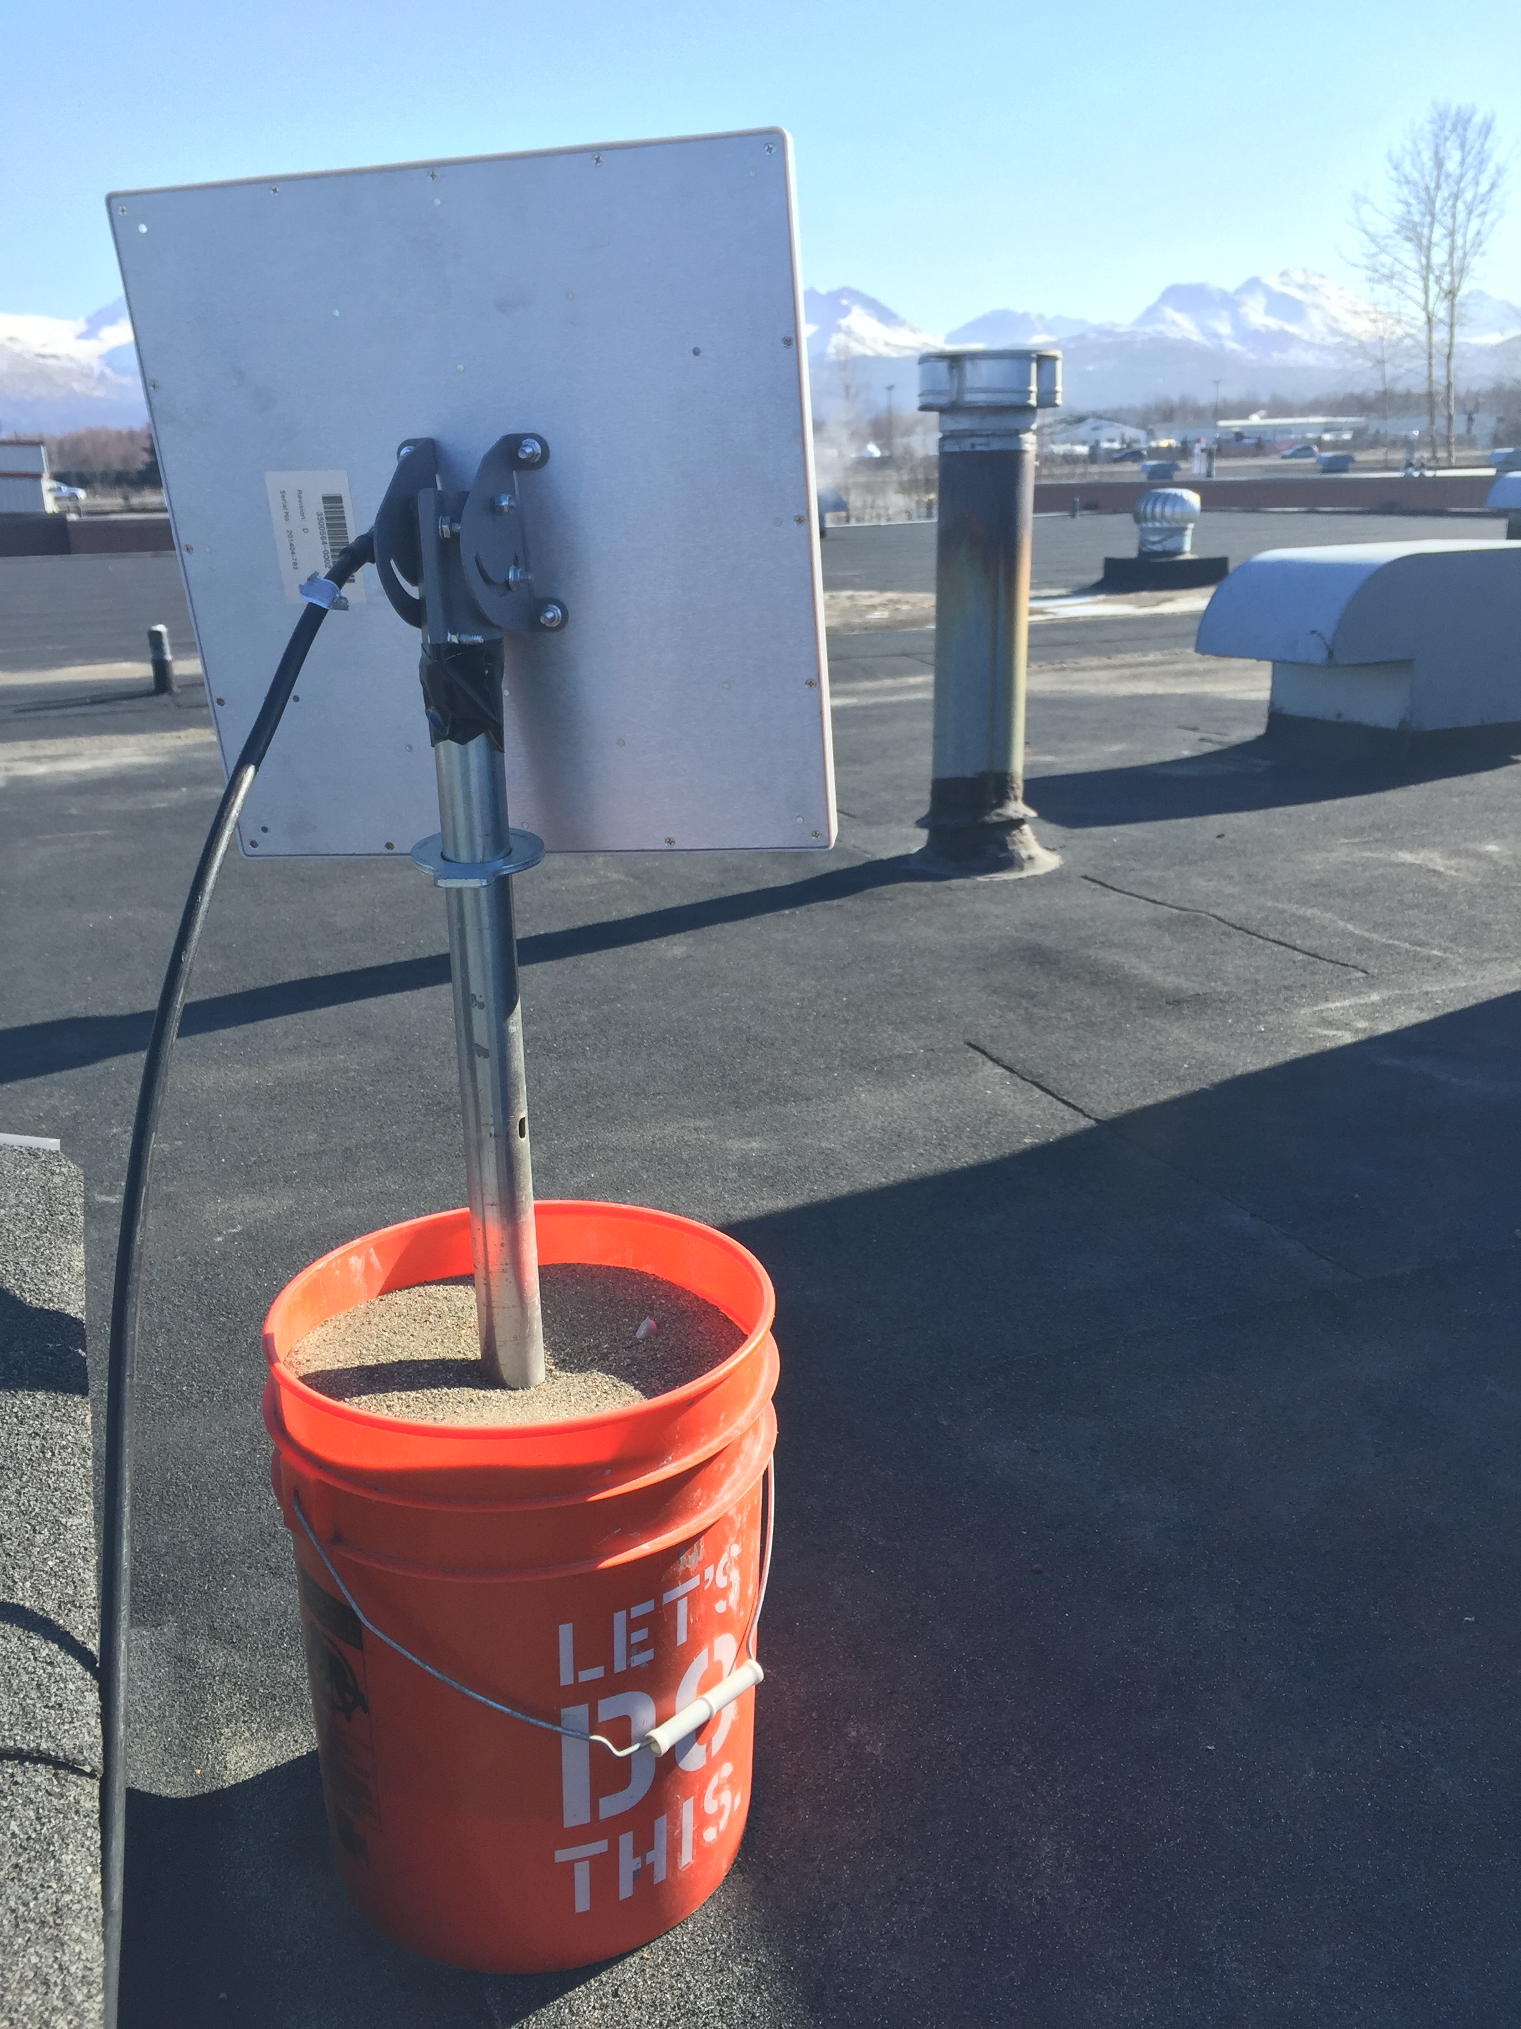
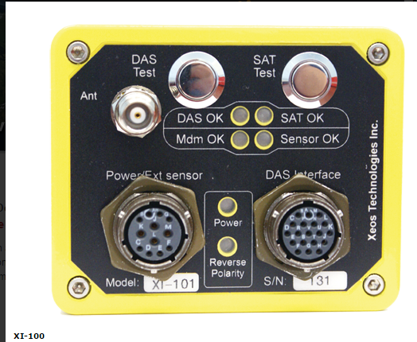
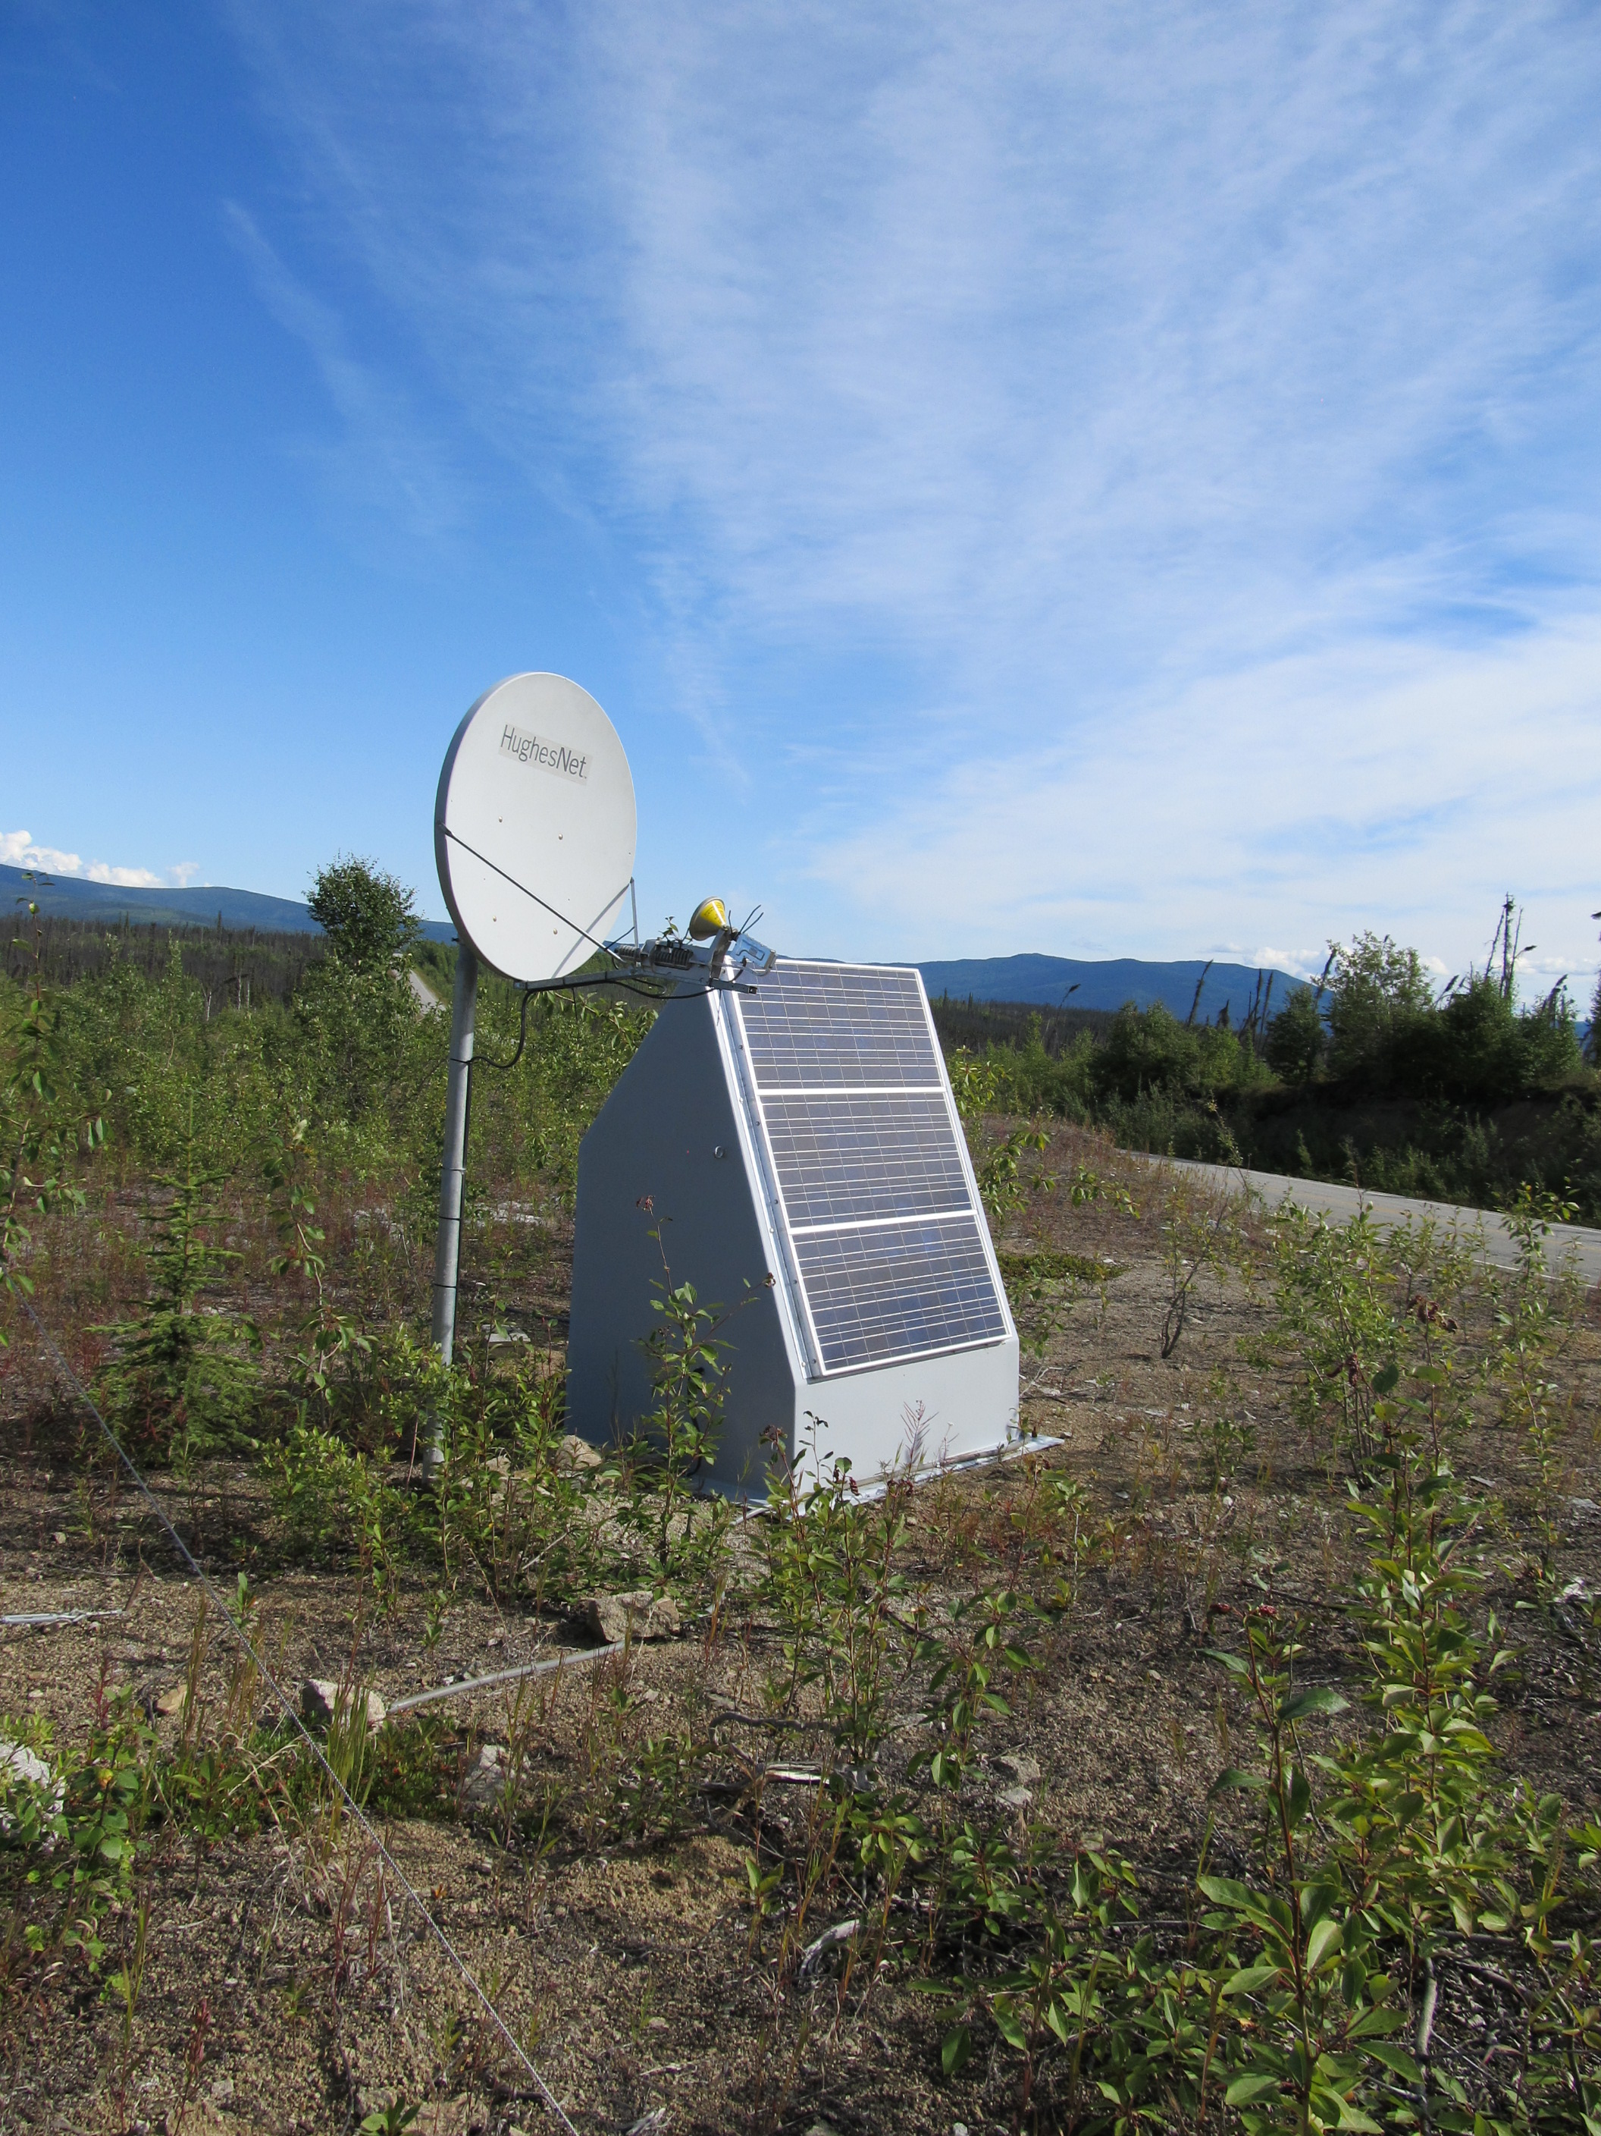
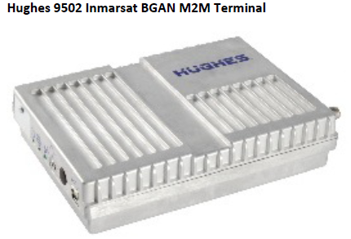
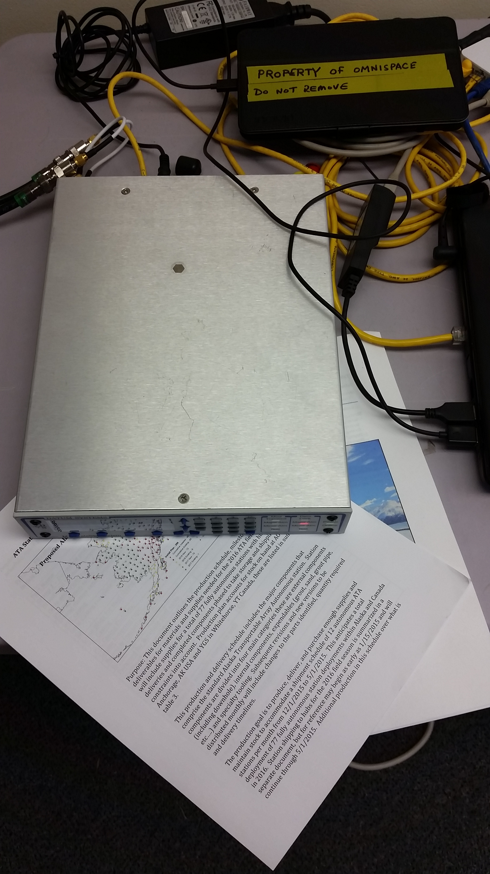
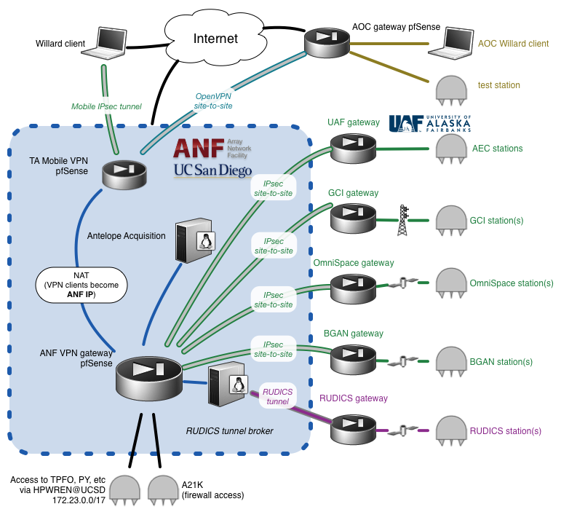
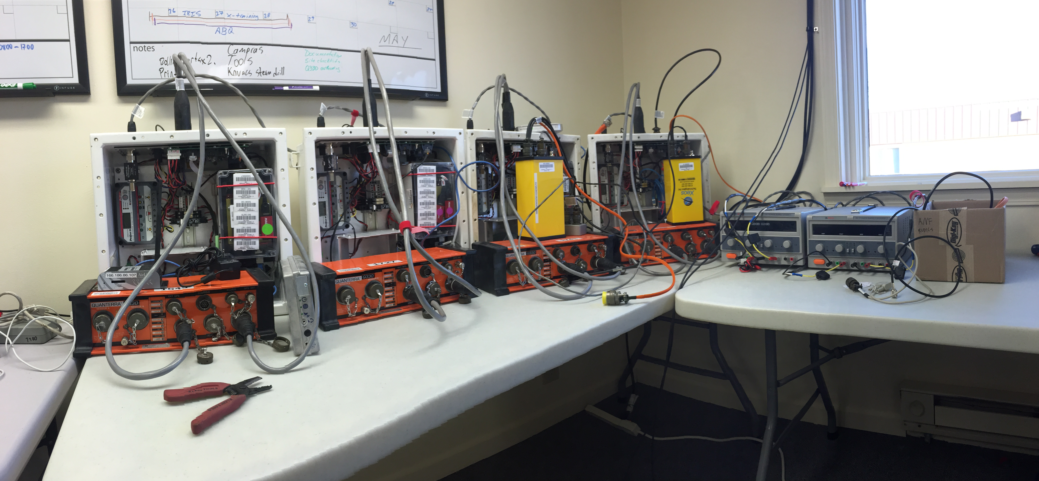
Communications
The deployment of Alaska TA stations has confirmed the challenge of communications in remote regions. Sparse cellular and custom radio networks are leveraged where possible, but are very limited. Satellite communications paths must be used for a significant portion of the array. Local topography and vegetation can limit the effectiveness of locking on geosynchronous satellites.

Slide 4
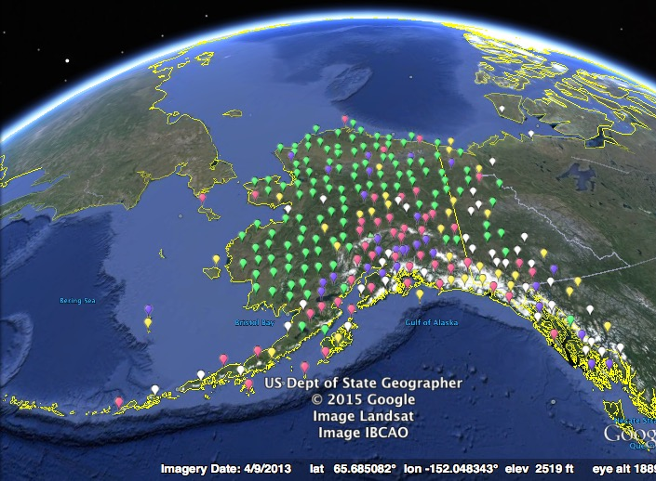





Complex Communications
“Scientists with Borderline and Bipolar personality disorders exhibit strong need for instant data gratification so they can satiate their compulsive hoarding disorder for data that they may never use.”
BGAN
RADIO
INTERNET
VSAT
CELL
Sept 30, 2014 Station Operating Status
Notes:
The current status , as of Sept 30 2014, of the Lower48 TA. One last year rolling up the array along the eastern US and Canada. It is the highest population density of the TA deployment and the potential

Slide 5
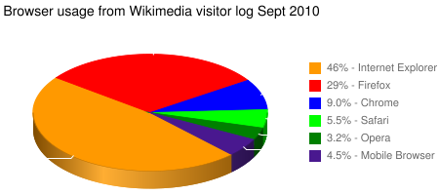

TA in Alaska / Yukon
Comms – In order of Usage
BGAN
Radio to internet
Internet
VSAT
Cellular
Iridium (Xeos)
OmniSpace
Comms – In order of Cost
BGAN $$$$$
Iridium (Xeos) $$$
VSAT $$
Radio to internet $$
Internet $
Cellular $
OmniSpace $????$
~VS~
Notes:
Introduction Slide to the Alaska TA (ATA) Project
294 is the SAGE proposed plan, due to budget this has been descoped to 262-278 stations per TA AC recommendation and Board Approval.
The seismicity pattern in AK is shown over five years. The Fairbanks to King Salmon is well instrumented from the road side. The distribution of Blue (existing) stations is typical of AK.
The TA project brings extensive geographic coveragewith dense station spacing, a technique that has proved to reveal detailed structure at range of scales from crustal to deep mantle, or about 4 miles to 1000 miles.

Slide 6
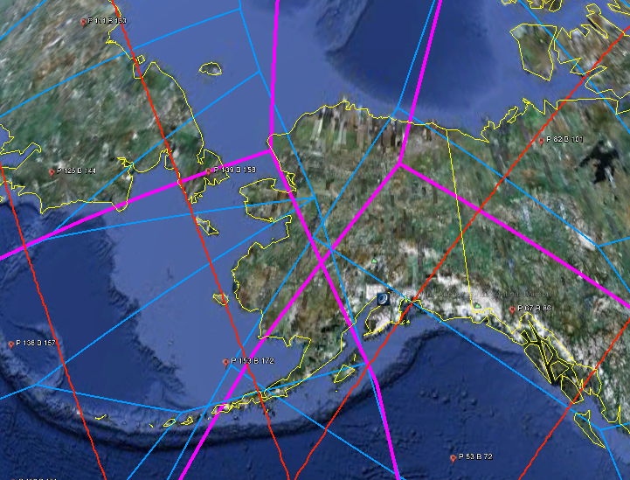
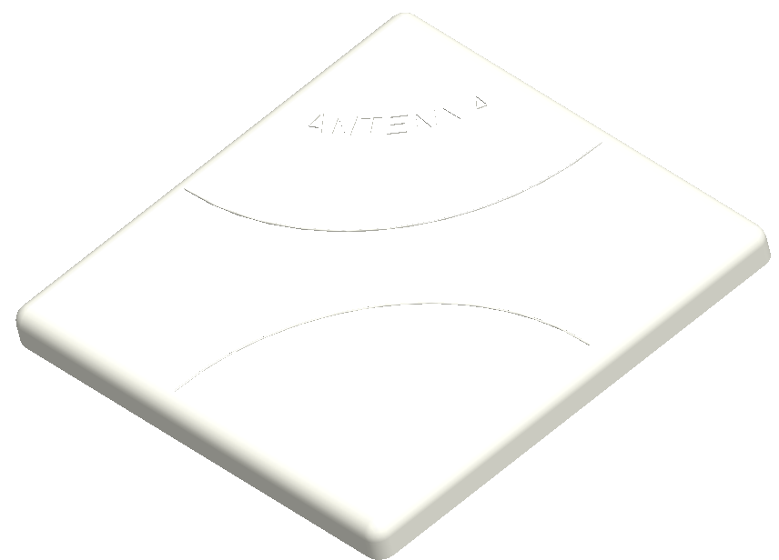
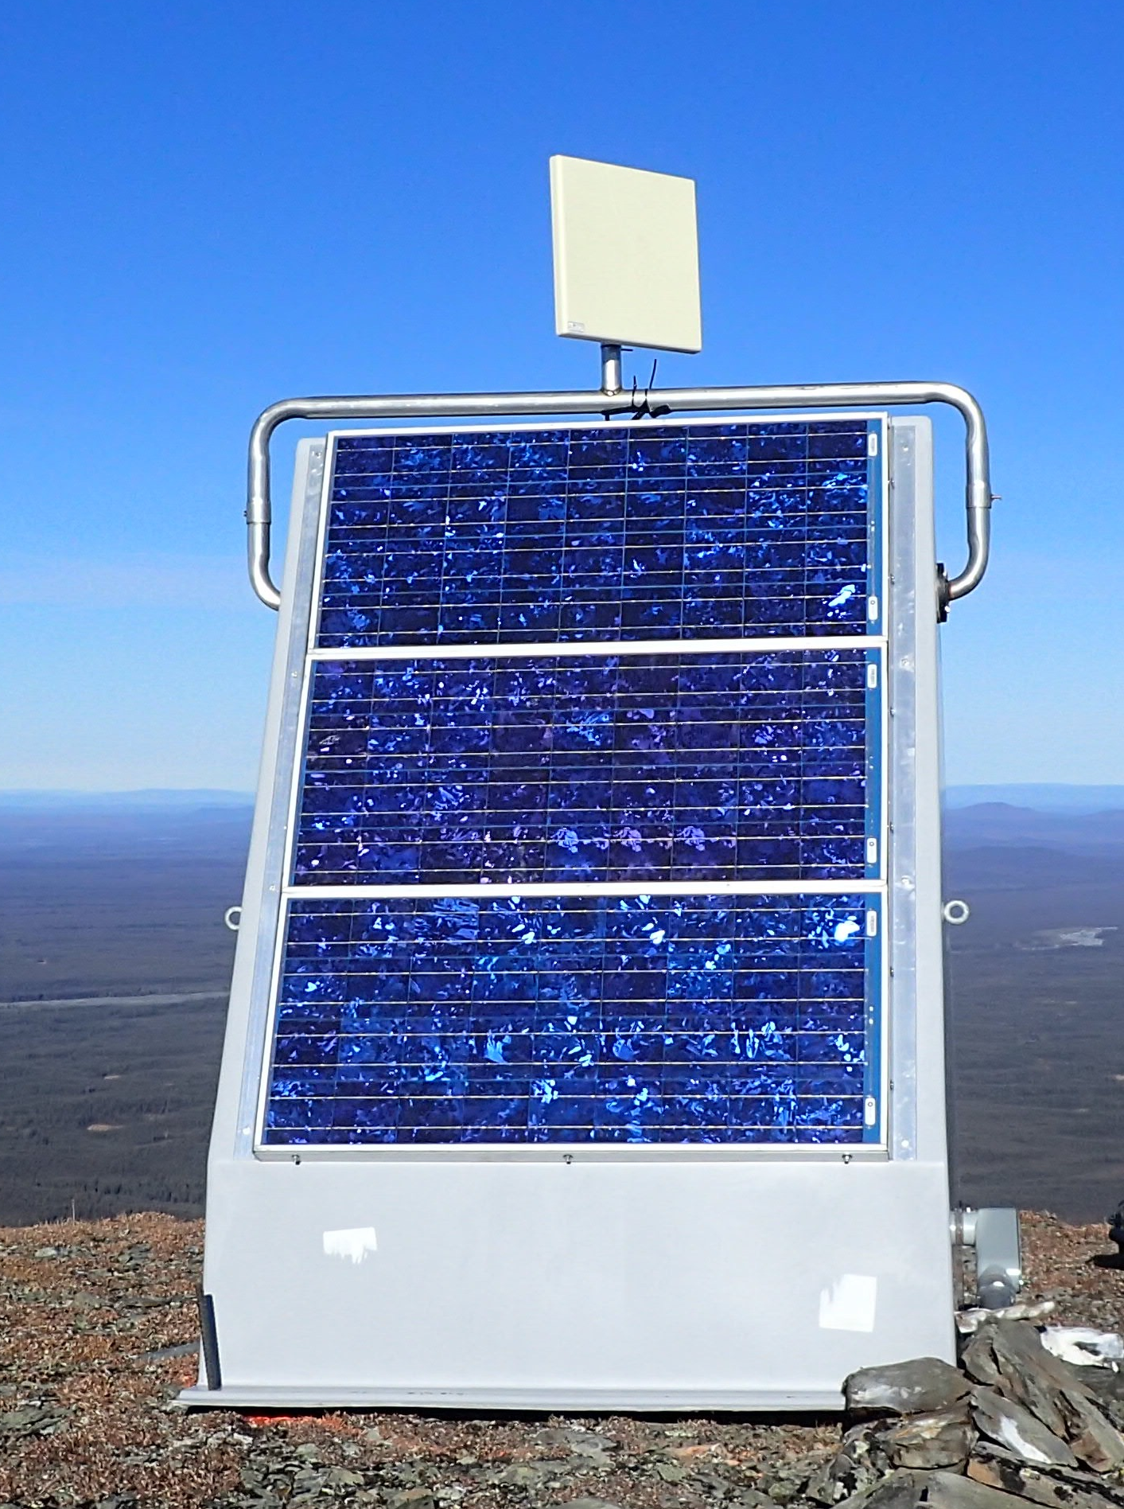
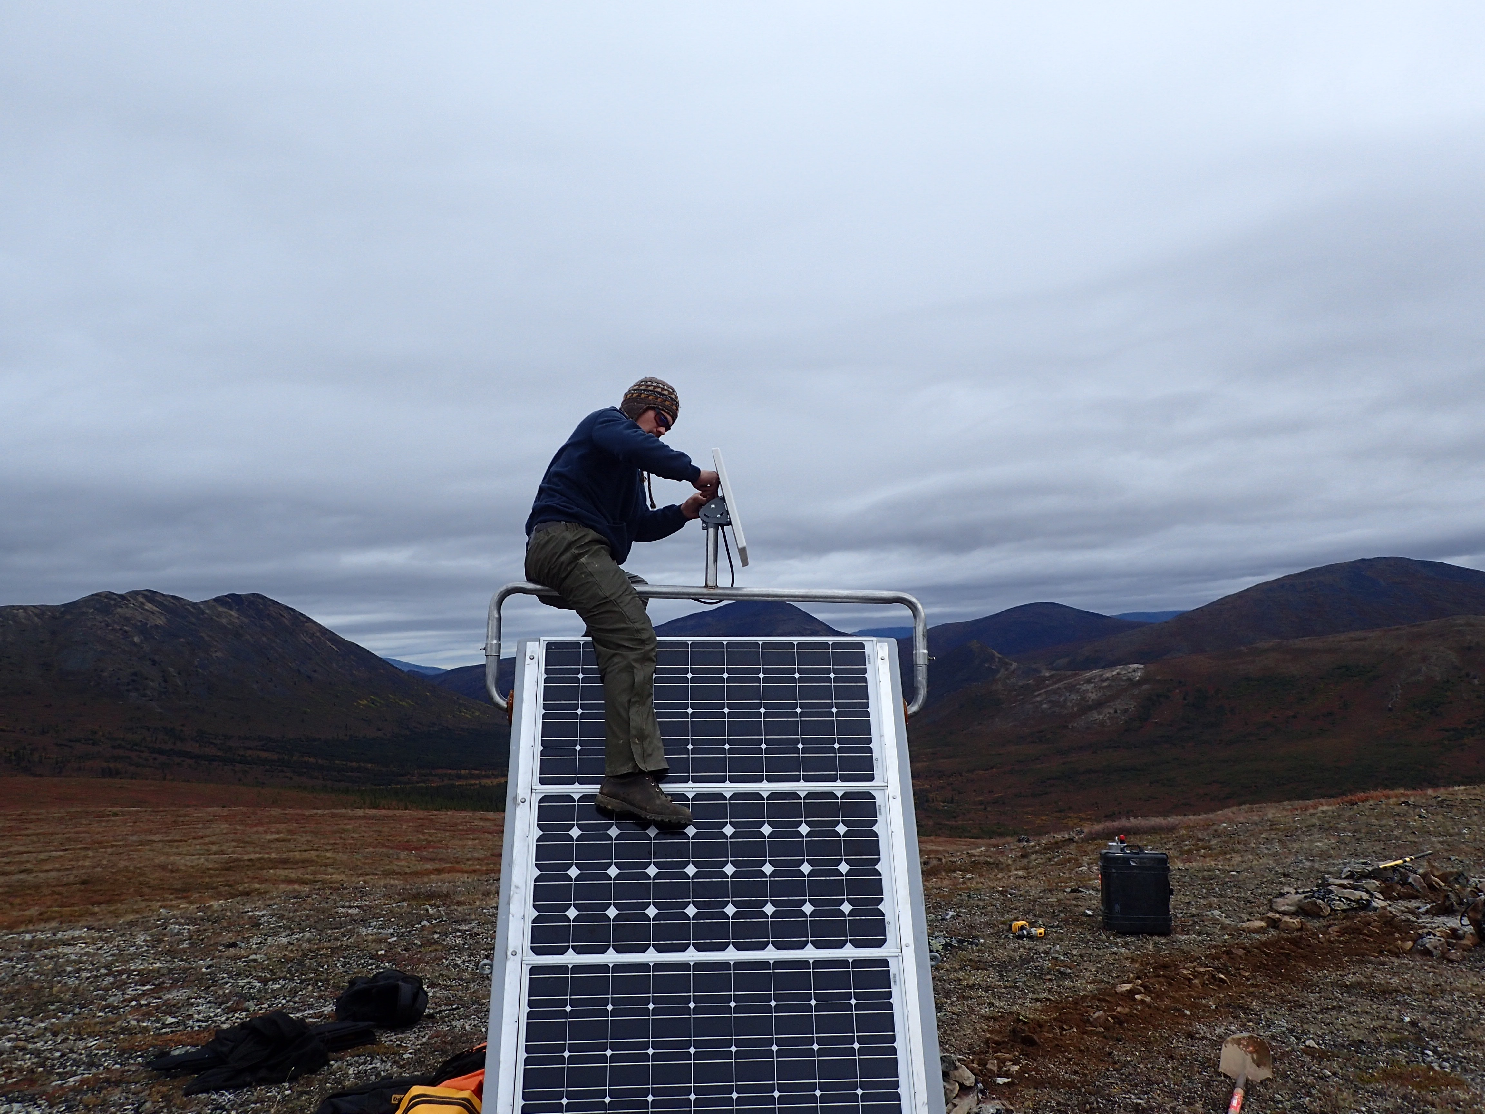
BGAN – Work horse and cash cow
15 x 15 x 2 inch flat plate
Tested reception at all
Reconned sites in north.
TA.J26L, Joseph Creek BGAN & Hut (DC)
RED Lines = 10 Degree elevation = minimum recommended for BGAN
PINK Lines = Regional Beams of APAC and AMER satellites = Should Work
BLUE Lines = Narrow Beams = Hard to reach
This map depicts Inmarsat’s expectations of coverage, but does not represent a guarantee of service. The availability of service at the edge of coverage areas fluctuates depending on various conditions.
Cost- $1000/mo
350kbps bandwidth
2Gbyte/mo throughput

Slide 7
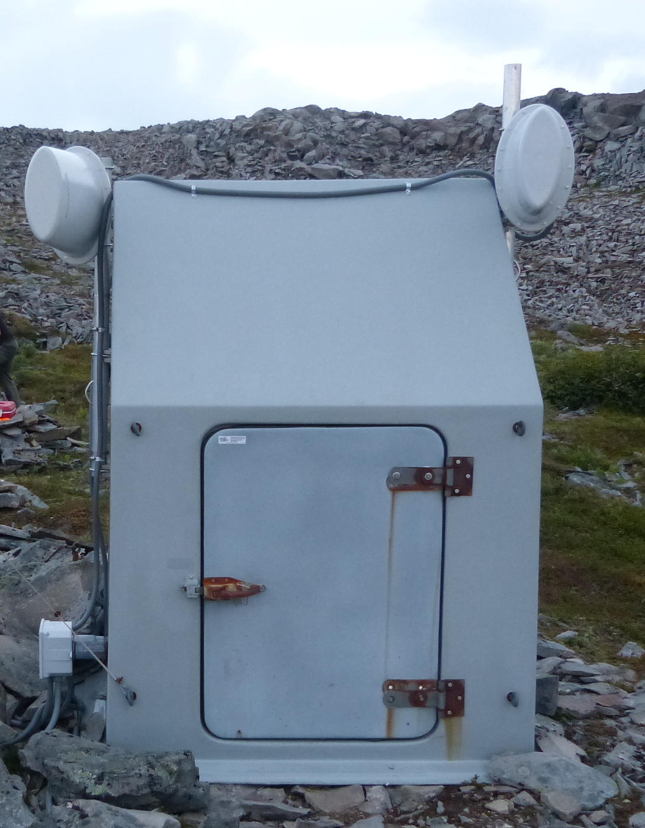
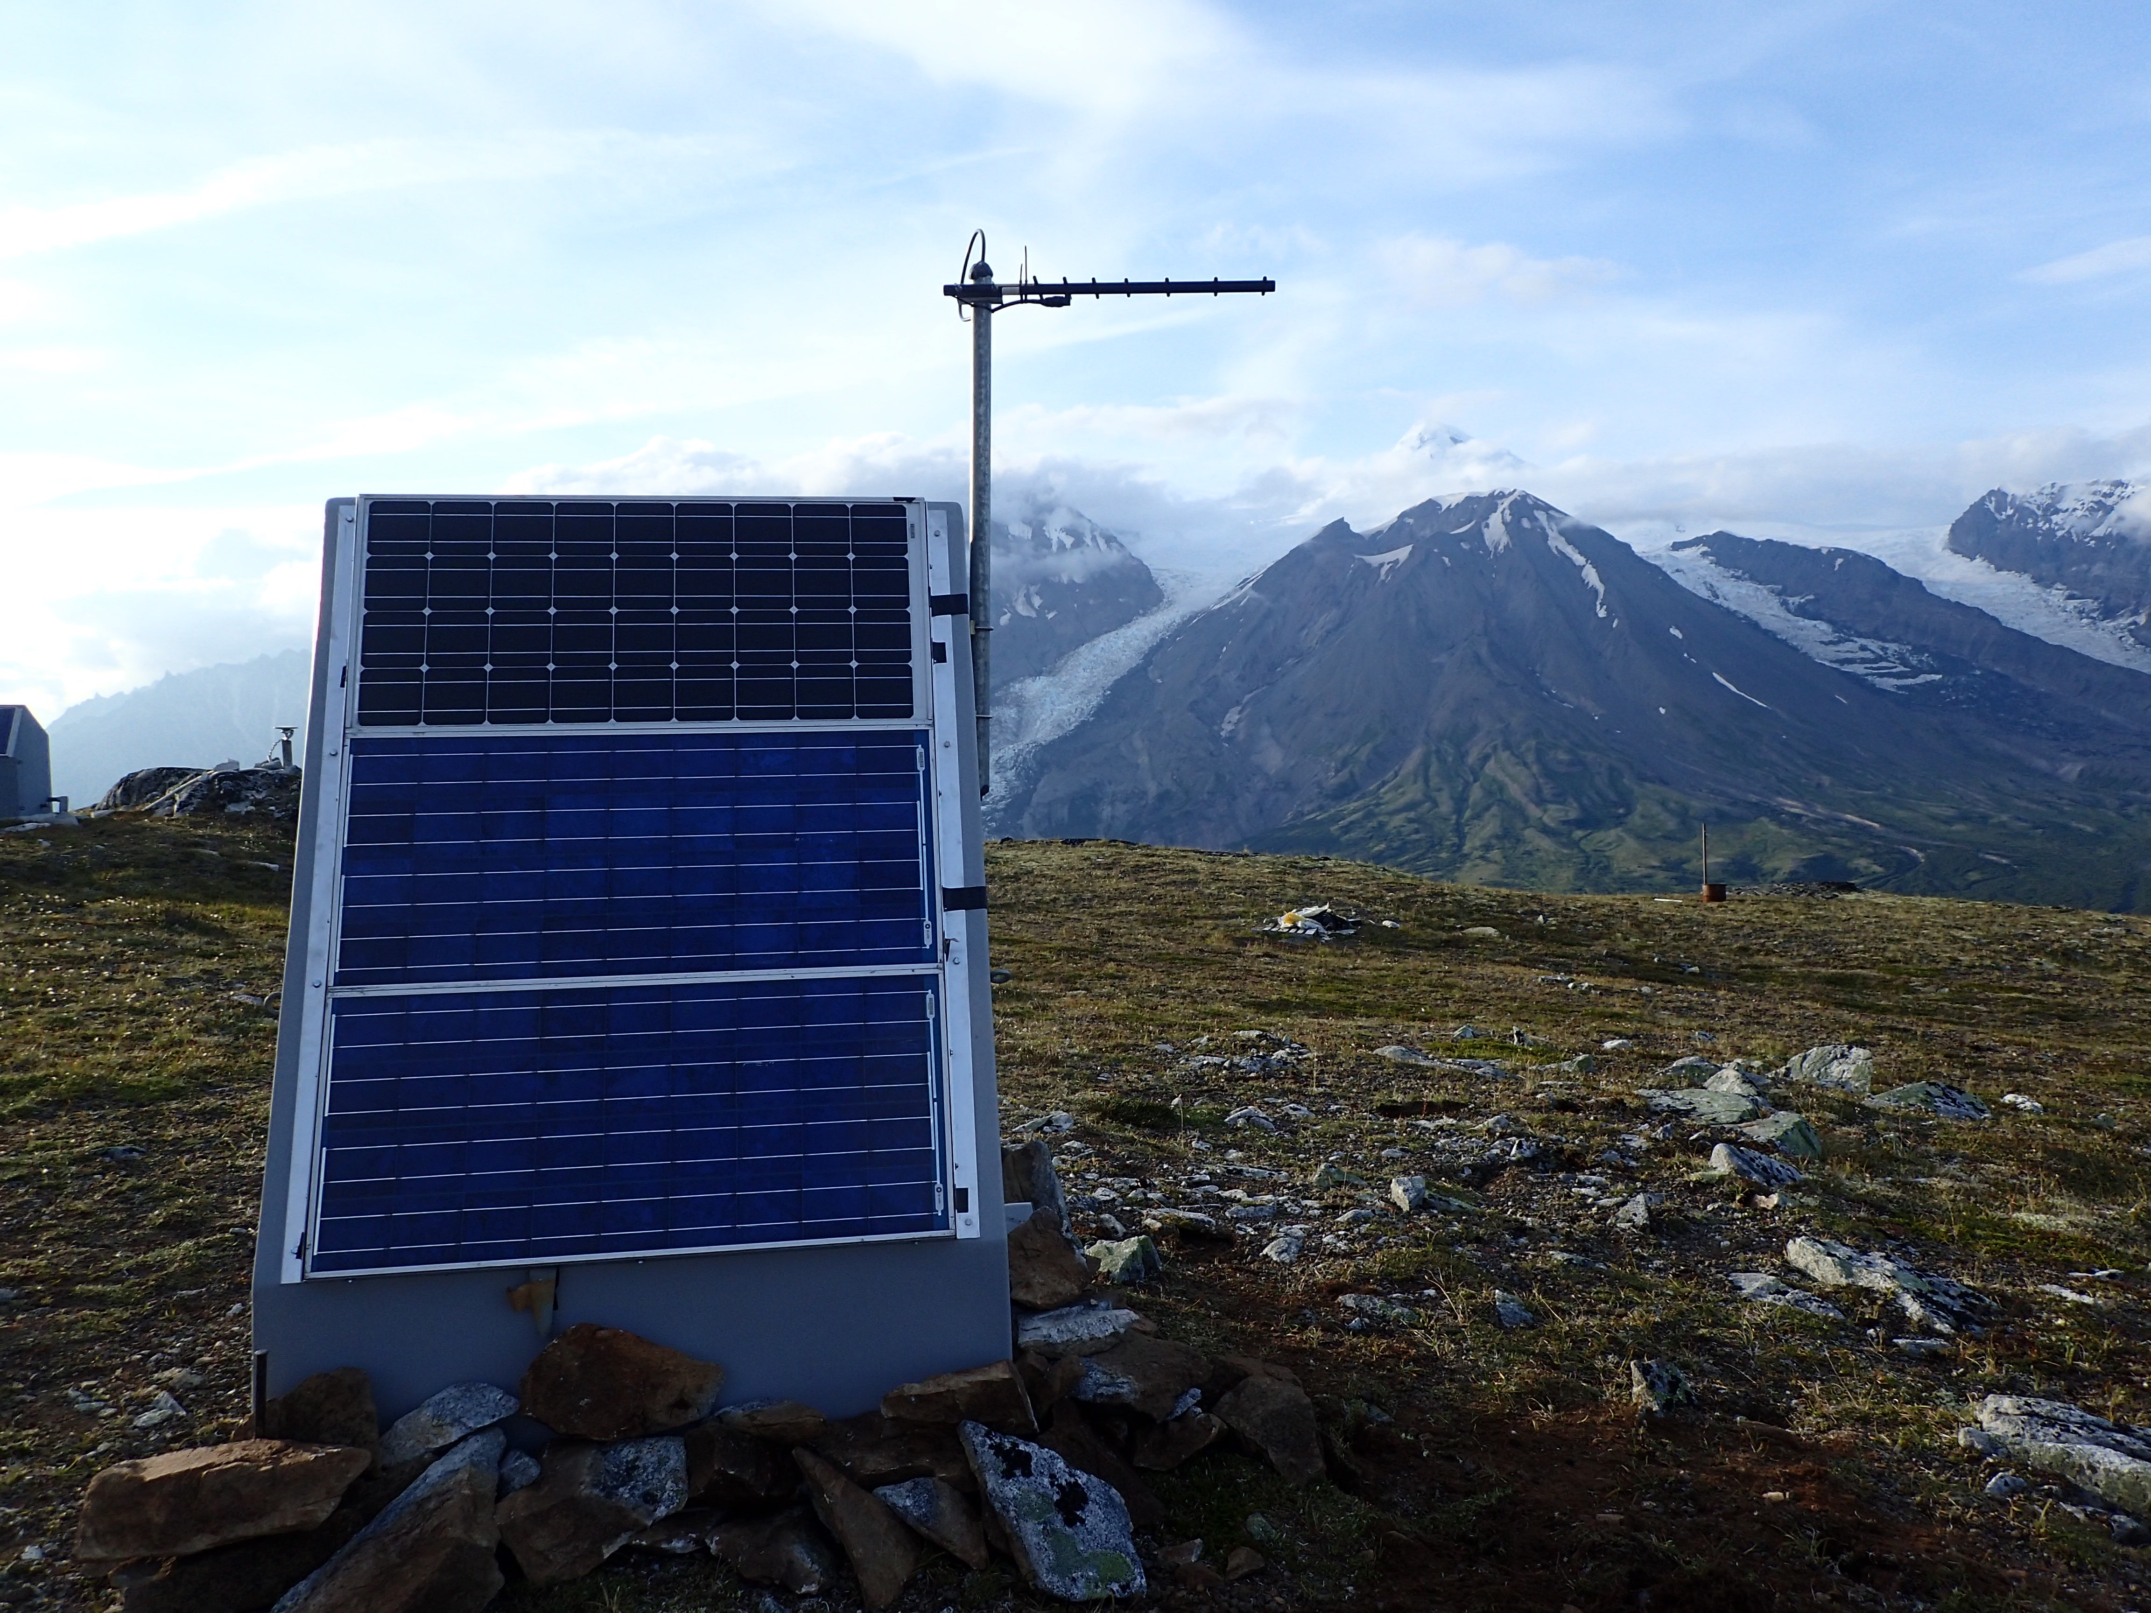
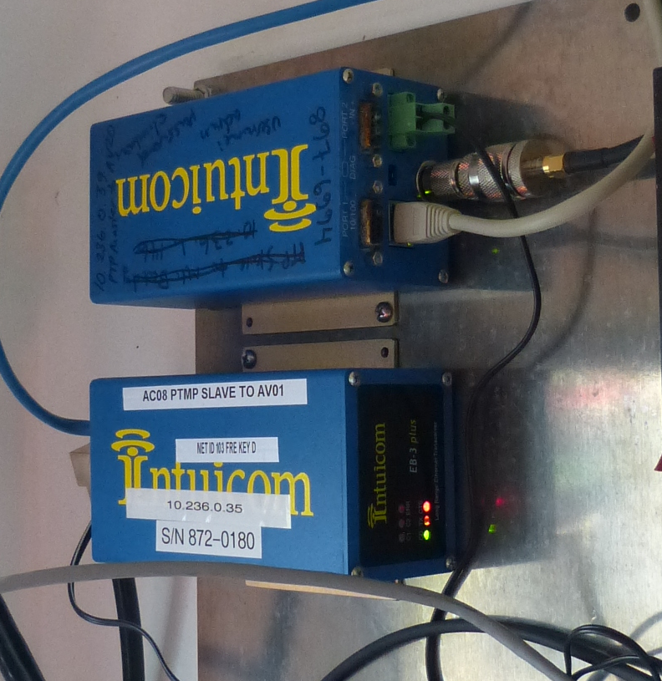
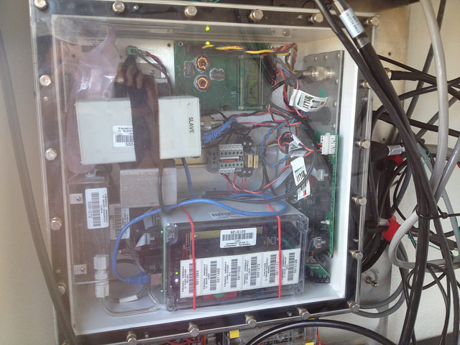
Radio to Internet/Cell
Cost based off of hub comms $80-$150
Limited by topography
Availability of repeaters
Availability of hubs
Radio selection - reliability
TA.Q19K, Mt. Douglas PBO Radio & Hut (DC)
TA.N20K, Mt. Spurr Radio & Hut (DC)

Slide 8
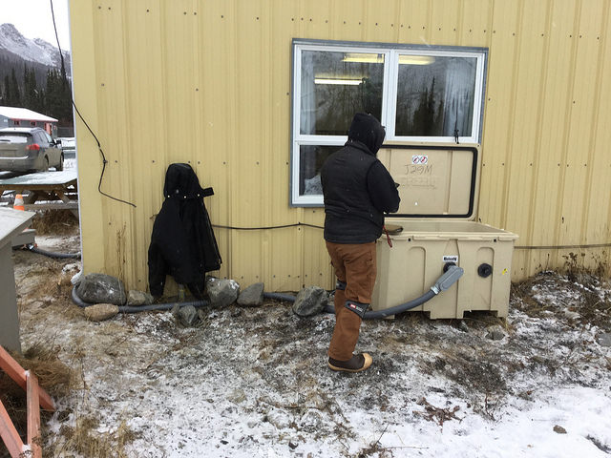
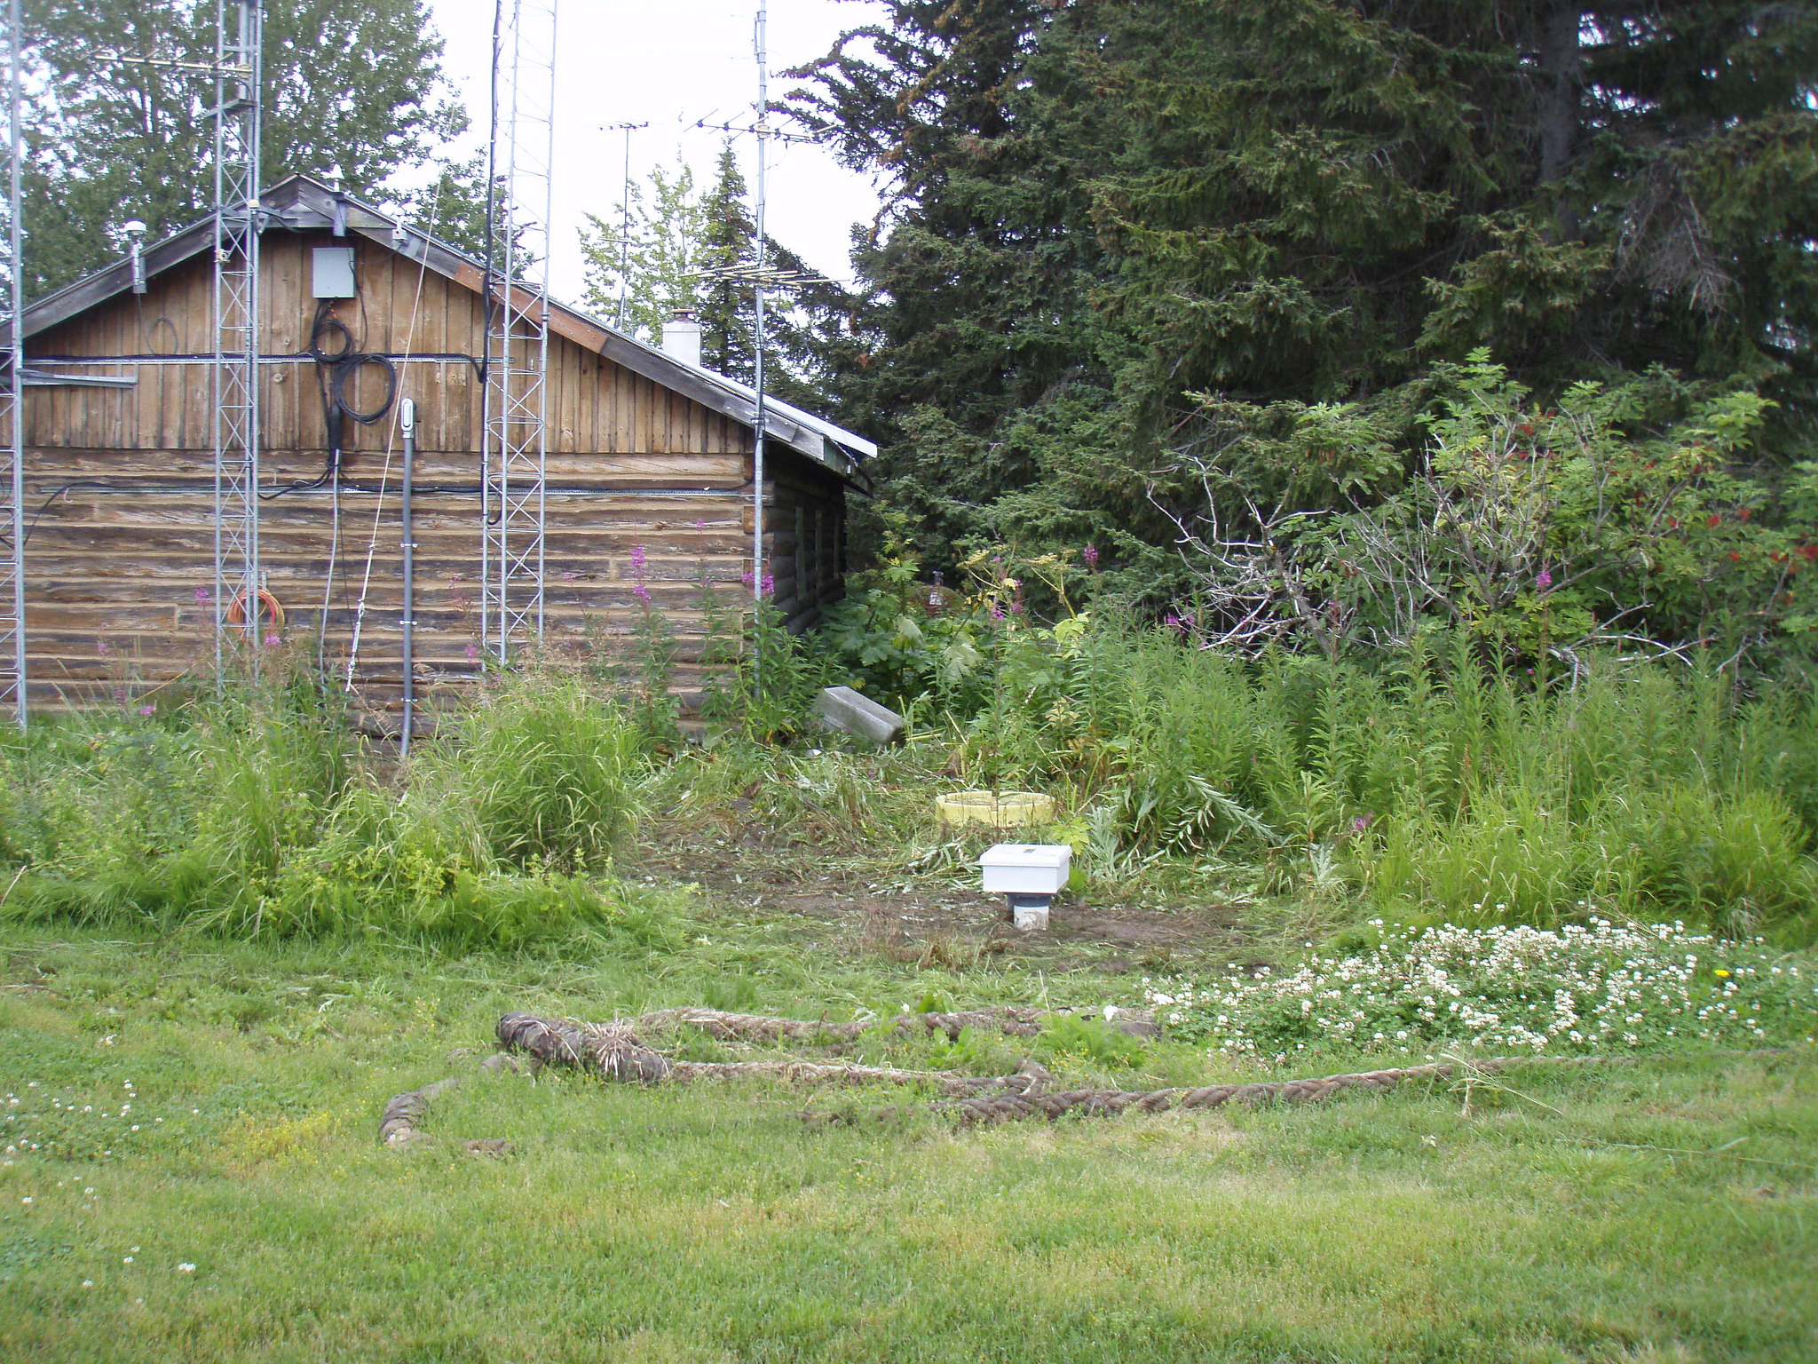
Internet – Noisy Umbilical
Community hub stations
Cost effective ~$80-$120/month
Relatively reliable
Easy access for service/maintenance
Limited geographically to developed areas = high noise environments
Connected to a umbilical chord for power and comms
TA.J29M, Klondike Camp, Yukon (Internet & AC)
“Don’t handicap your stations by making their communications too easy.”
- No one, ever
AK.HOM, Homer, AK (Internet & AC)

Slide 9
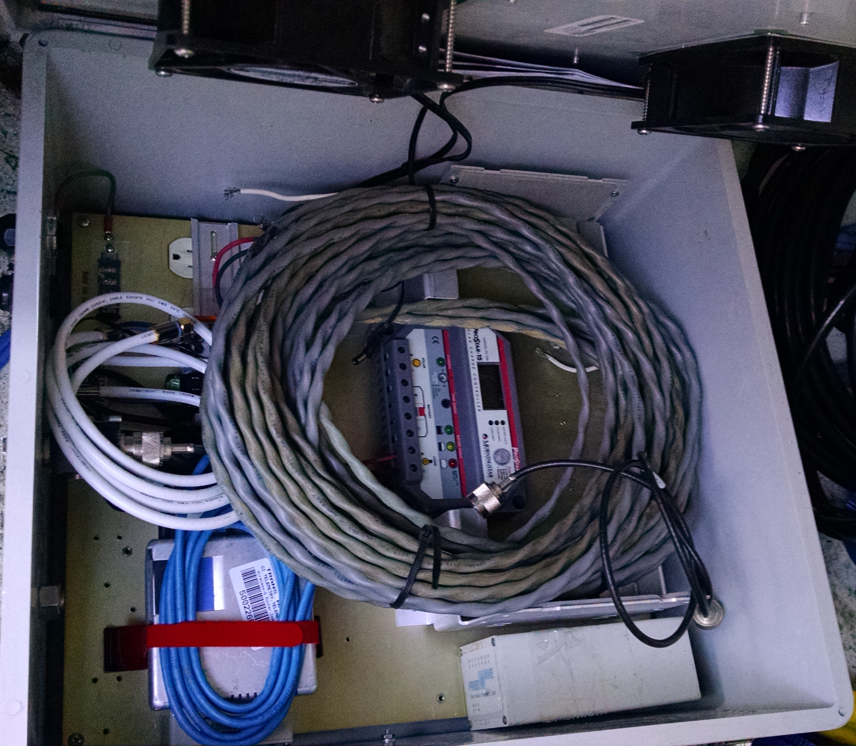
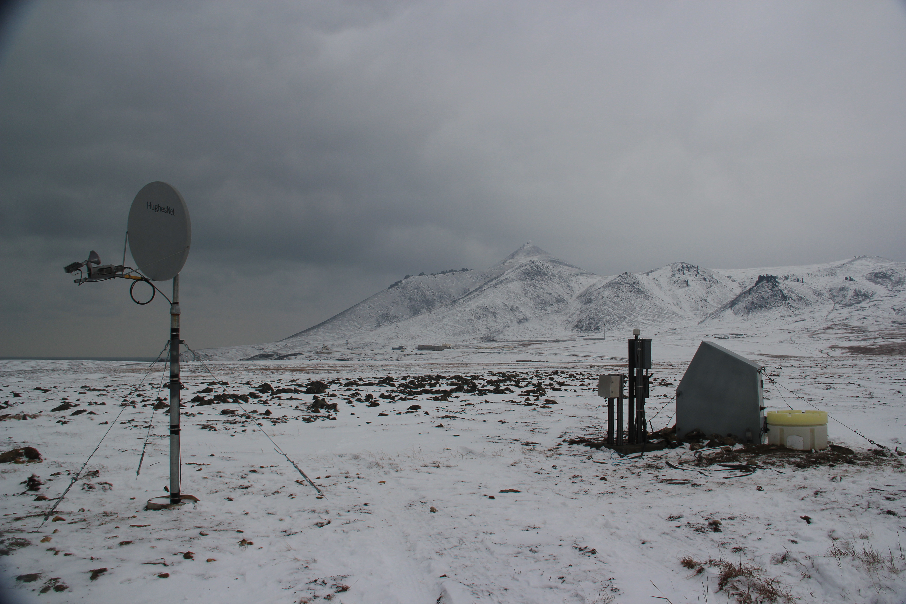
HughesNet VSAT – Power Piggy
Works at high latitudes (north of Toolik)
High power – 30 W (AC –vs- DC)
Bandwidth can support two stations, usually one.
Low Cost - $90/mo
Reliability in winter and to maintain pointing.
AK.TNA, Tin City AEC VSAT & Hut (AC)
TA.K27K, Chicken PBO VSAT & Hut (DC)

Slide 10
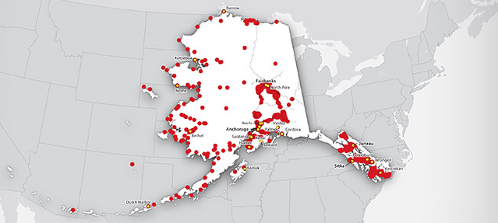
Cellular
The most spatially limited option in the Alaska TA
Cheapest ~$40/month
Connectivity is variable for data
Can operate as hub for radio sites
We don’t feel as bad when these sites burn down – flush with cell modems

Slide 11
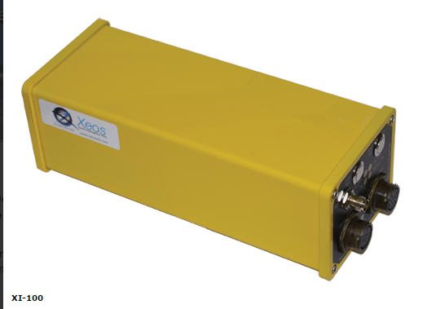
Iridium Rudics
XI-100B modem, 5 Watts
Max rate 2400 bps, 24Mbyte/day
Lots of link cycles
Cost $290/mo
Omnidirectional antenna
Rudics tunnel protocol
Currently Deployed = 0
Requires reduction in SPS

Slide 12
OmniSpace
Custom Terminal -- S band
Boeing GEO satellite in MEO
Max rate of 128kbps
(3) 30 min links per day
Single downlink Brewster WA
Cost $400/mo for 1.2Gbyte
Omnidirectional antenna
VPN tunnel
Noisiest paper weight in AOC
Currently Deployed = 0
Would require power cycling at DC sites

Slide 13
2016 Smooth Plan
Ideal Communications Scenario
Pre-mobilization Tracmor
Pre-mobilization email to ANF (Jennifer)
Pre-online report - redundant
Installation and data is flowing
If something goes wrong
A sat phone call to our telemetry angel (Jennifer)

Slide 14
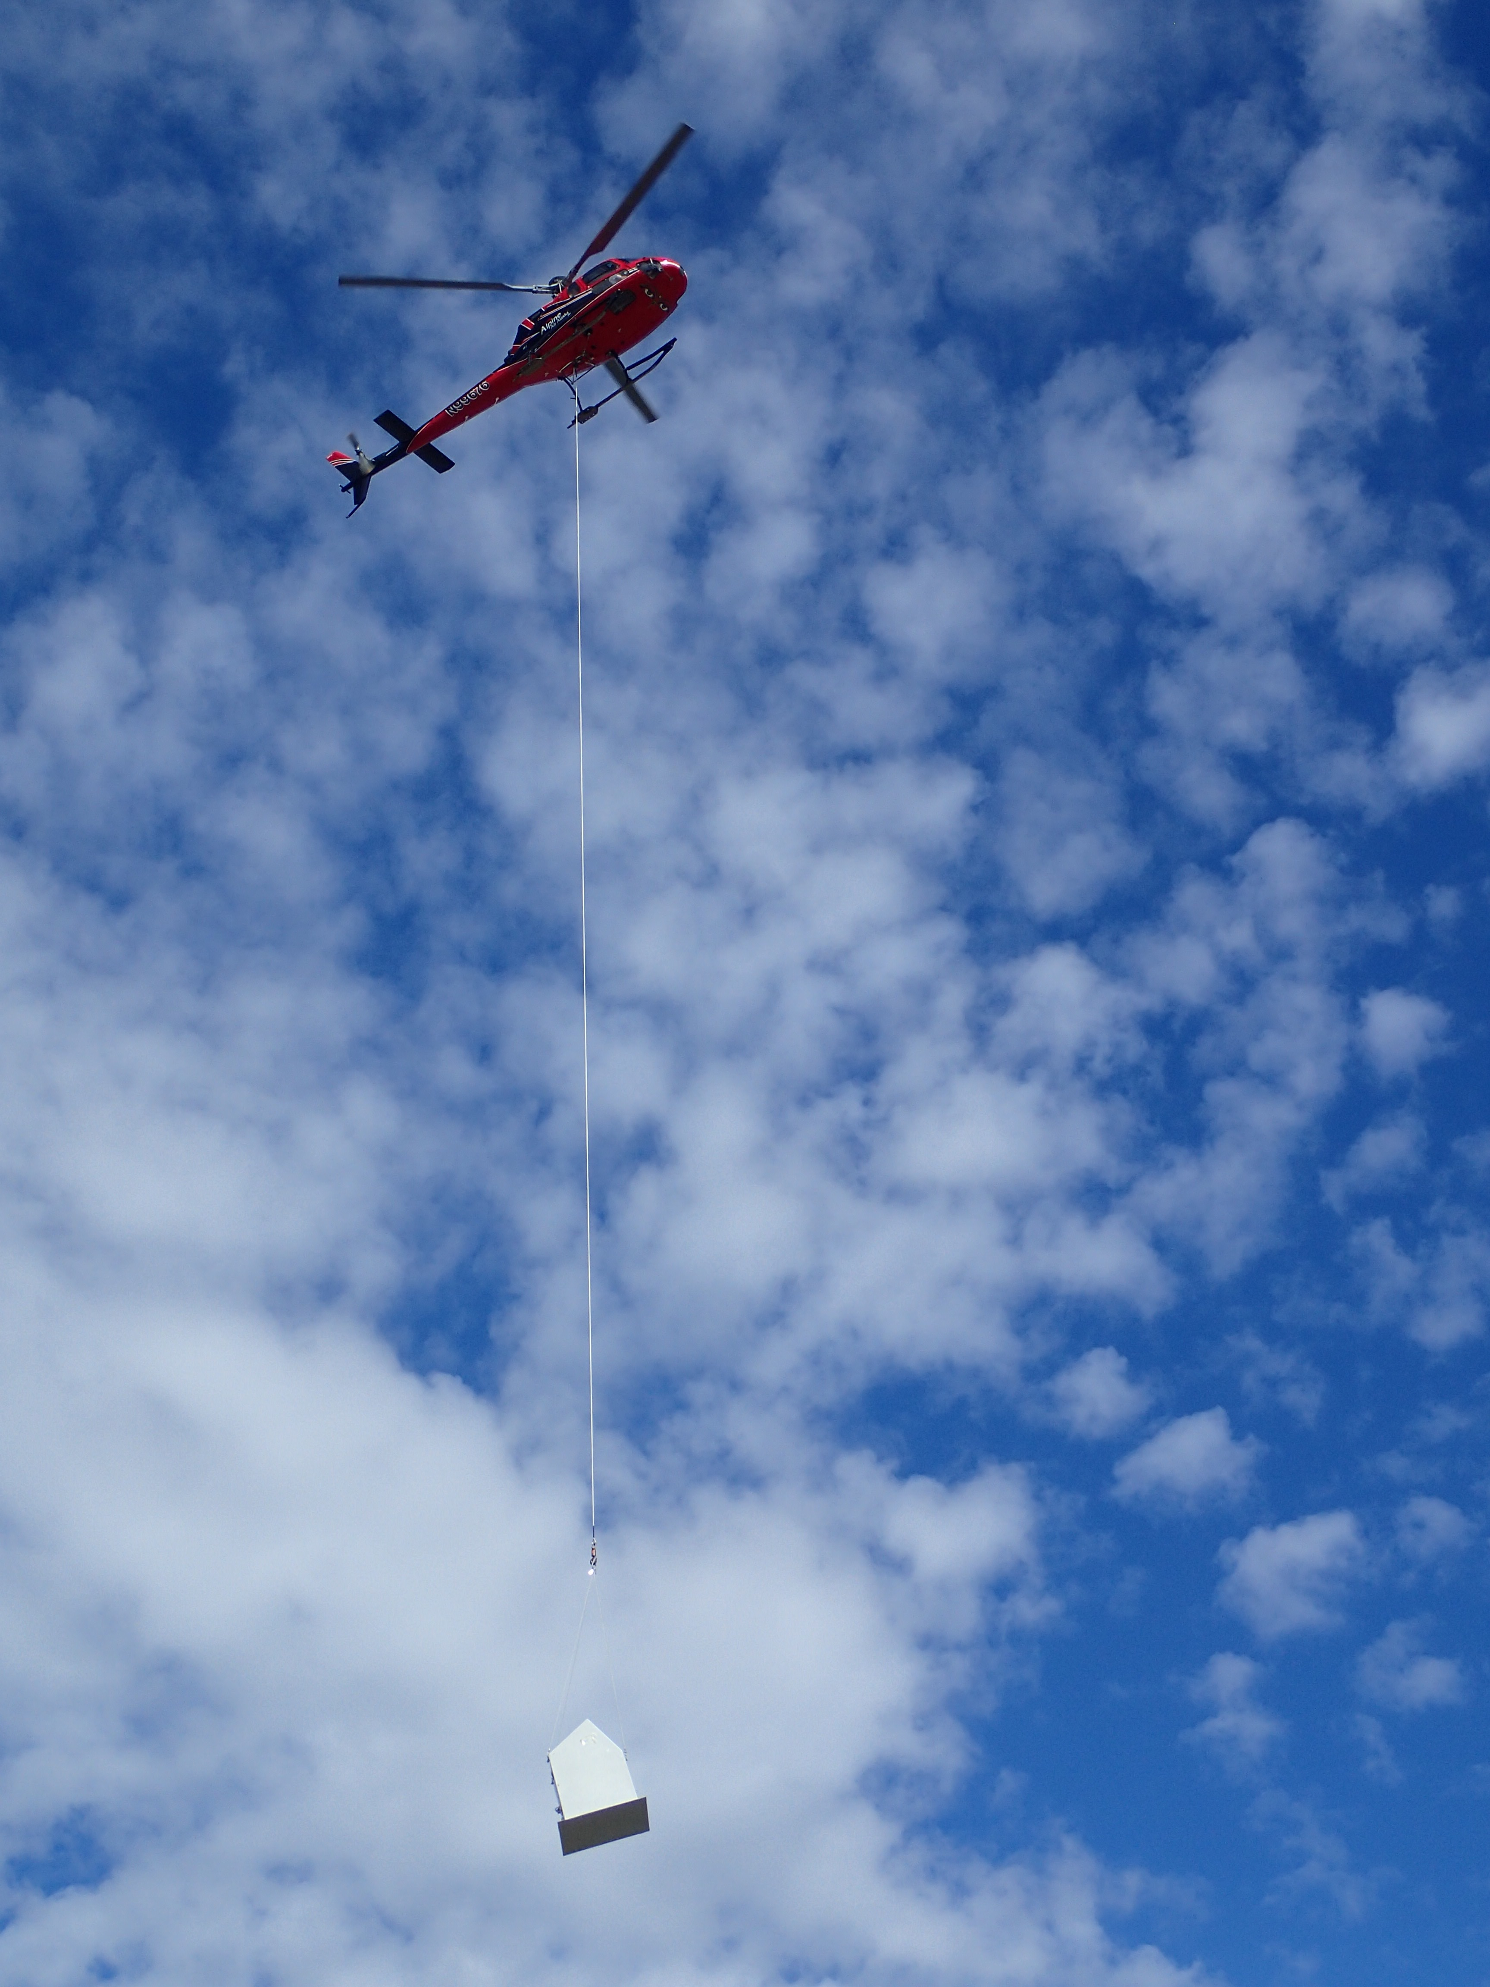
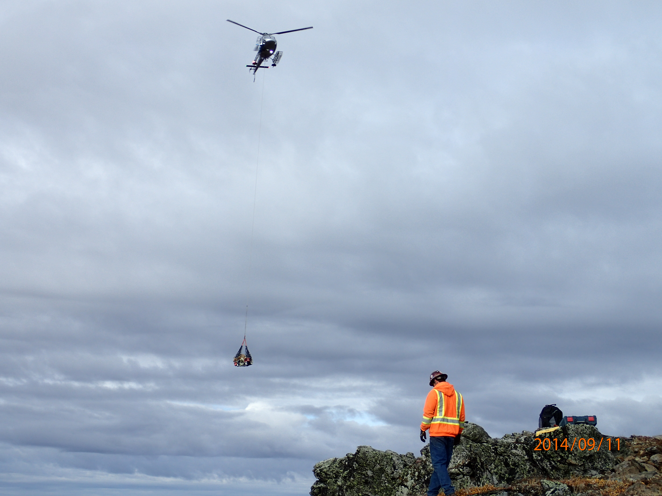
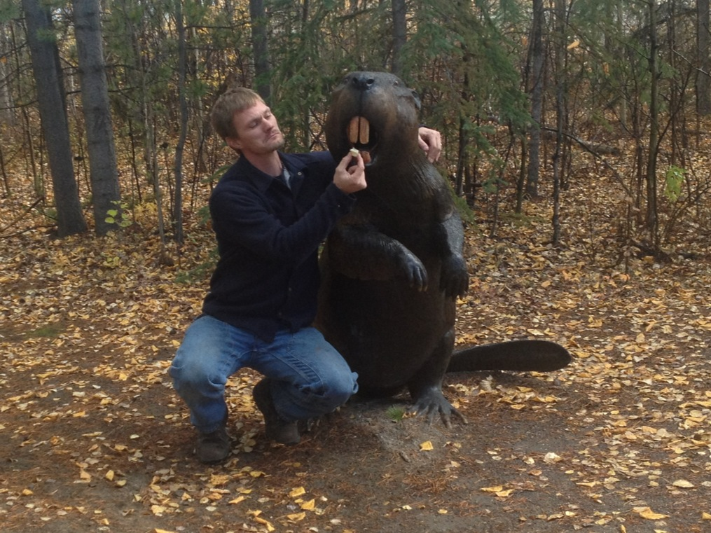

For More Information
Questions, Comments and Thanks.
EarthScope is funded by the National Science Foundation.
EarthScope is being constructed, operated, and maintained as a collaborative effort with UNAVCO, IRIS, and Stanford University, with contributions from the US Geological Survey, NASA and several other national and international organizations.
Notes:
Presentation notes:
1. This slide is required by the National Science Foundation, please include it in all your presentations on EarthScope
2. Please add your institution's logo if it is not already present

