Slide 1

TA – Northwest Canada
First Nations
Permitting
Collaborations
Outreach
Michael Schmidt
TA 2015 Team Meeting
La Jolla, California
November 9th and 10th, 2015
Michael.Schmidt@UCalgary.ca

Slide 2
Territories / Provinces
Nunavut
Yukon
Territory (YT)
Northwest Territories (NWT)
British
Columbia (BC)
Alberta

Slide 3
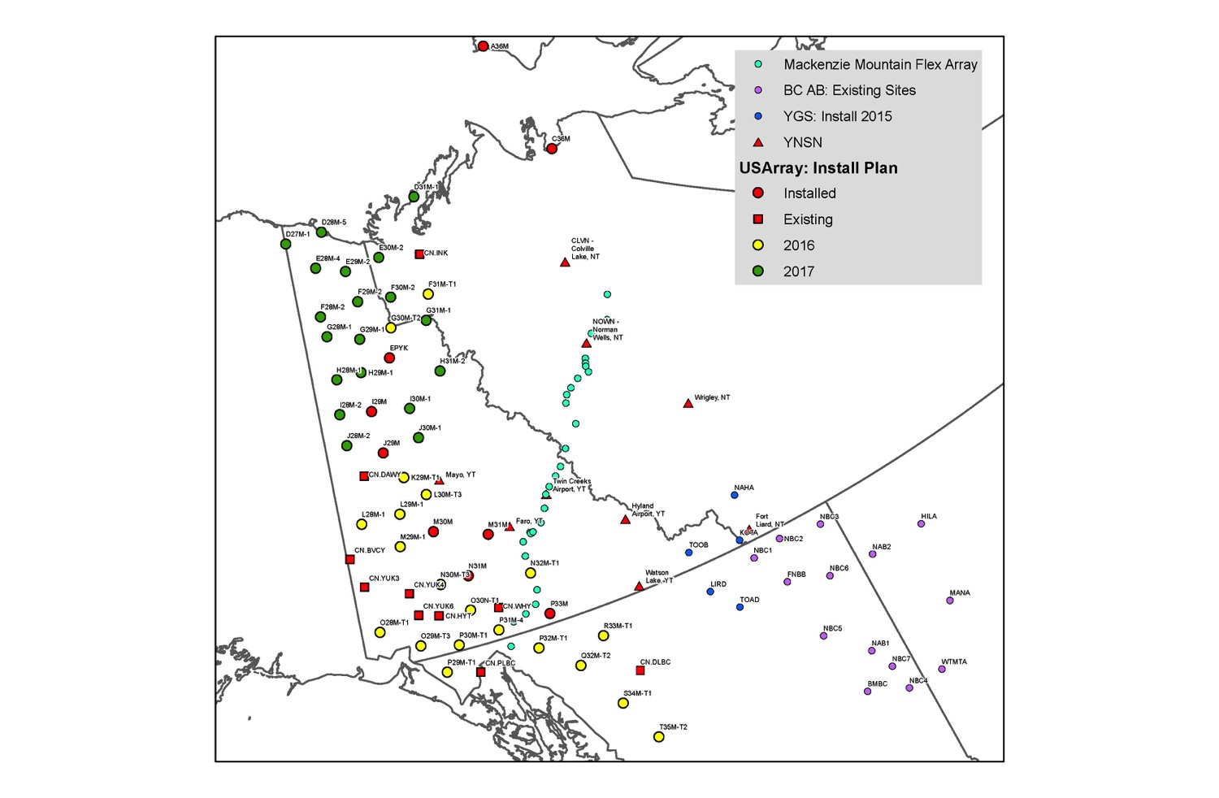
Overview
~56-60 Sites Proposed
Yukon 44
Northwest Territories 7
British Columbia 8
Existing:
NRCan (GSC) 9
(plus an additional 5 in SW Yukon)
U. of Ottawa (YNSN) 2
  (plus an additional 7 east of TA)
De-Scoped
Yukon 8
Northwest Territories 3
Installed:
NWT: 2
Yukon: 7
To be installed (TA): ~28
Other Networks:
  Yukon Geological Survey: 5
  Mackenzie Mountain Earthscope Project transect: ~30 (YT+NWT)
  NEBC: 10 (+Alberta)

Slide 4
Overview
2017
2016
AK
BC

Slide 5
Overview
Before Descoping
NWT
AB
AK
YT
BC

Slide 6
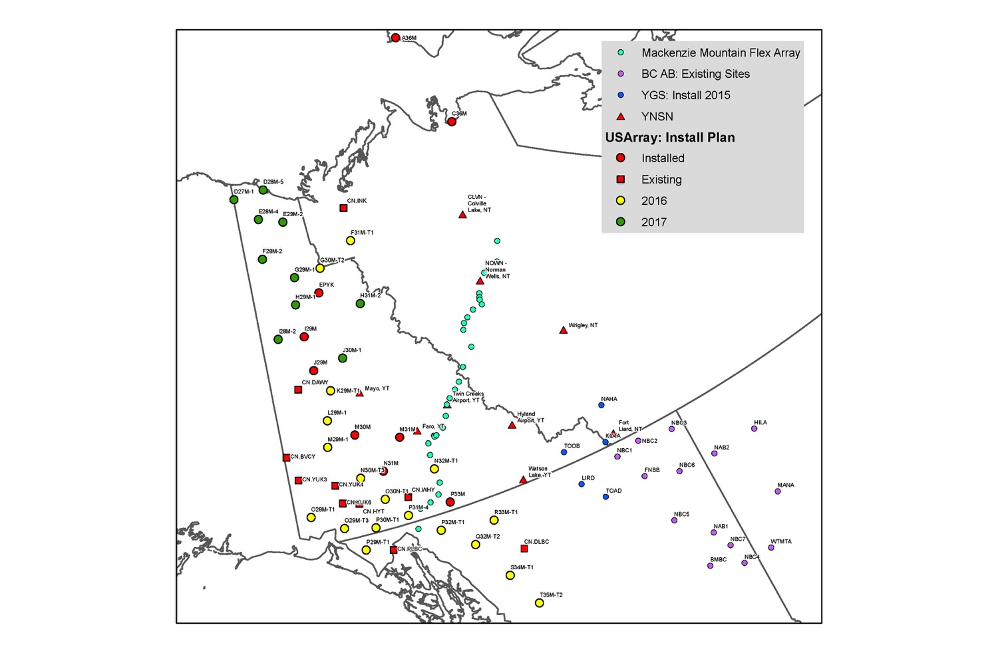
Overview
After Descoping
NWT
AB
AK
YT
BC

Slide 7

Overview
After Descoping
Richardson Mountains
NWT
AB
AK
YT
BC

Slide 8
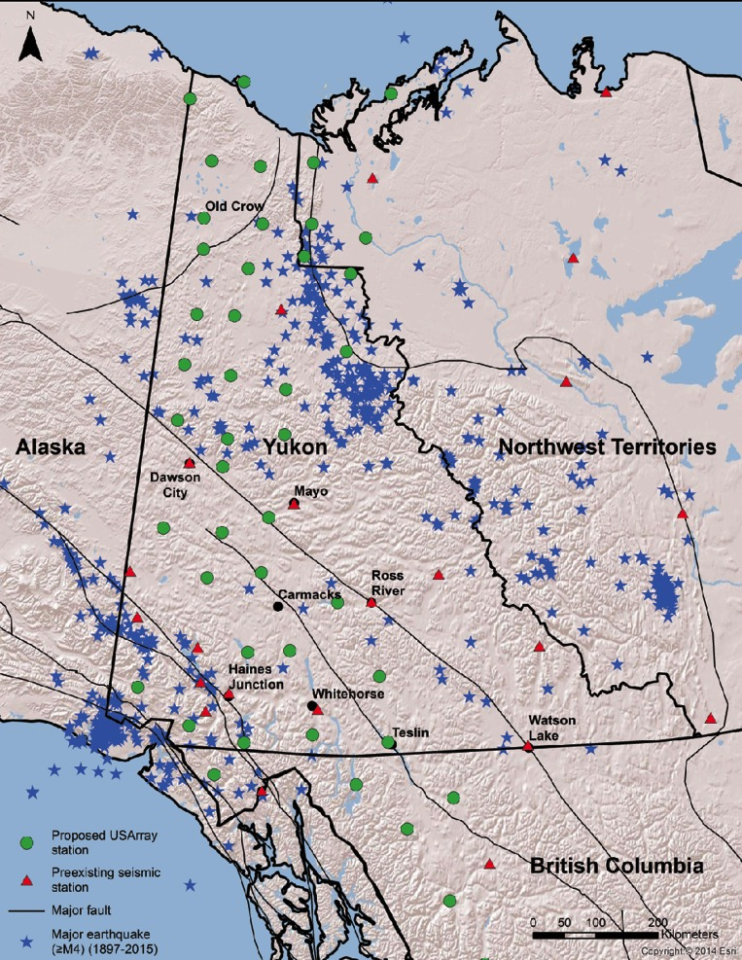
Overview
Seismicity >M4 1897 - 2015
Richardson Mountains
X
X
X
X
X
X
X
X
X
X
X
?
Map: J. Cubley 2015

Slide 9
Jurisdictions Non-First Nation
Territorial / Provincial Jurisdictions
Yukon (YT)
Northwest Territories (NWT)
British Columbia (BC)
X
X
X
X
X
X
X
X
X
X
X
Map: J. Cubley 2015

Slide 10
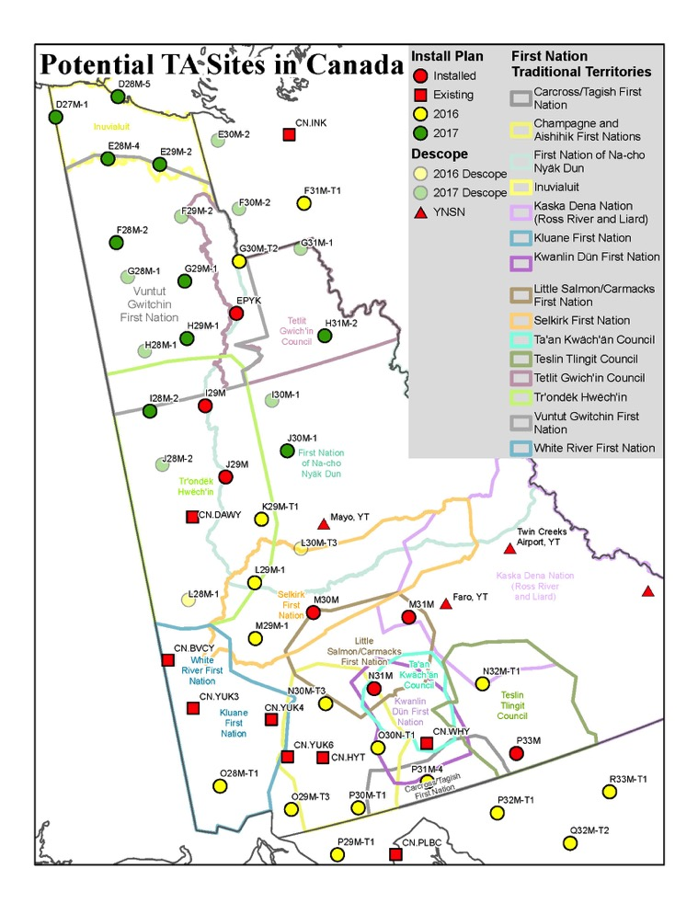
Jurisdictions - First Nations Yukon
14 First Nations in Yukon
Land claims and self-government agreements have been signed with 11 First Nations
Under the land claim agreements the lands are one of:
Category A (surface and subsurface rights)
Category B (surface rights)
Yukon “Crown” Lands
Impact on Permitting:
Category A and Category B:
  Require direct permitting with First Nation
  YG cannot permit
Yukon “Crown” Lands:
  Requires Permitting via Yukon Lands (YG)
  Requires consultation with and permission from FN
NB overlapping jurisdictions between FN’s

Slide 11
Jurisdictions - First Nations Yukon
Example
Initial Recon: N30M-7-2
New Recon:
N30M-T1 -> N30M-T4

Slide 12
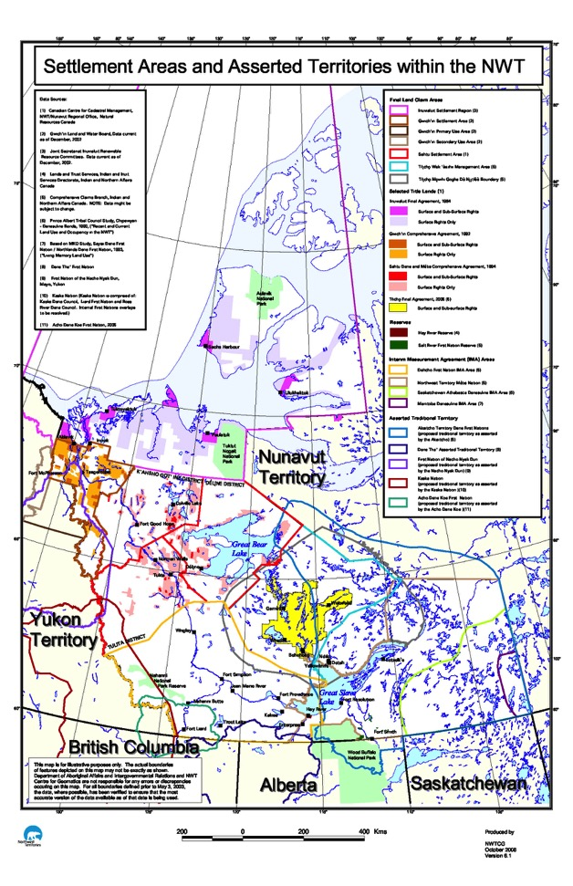
First Nations – NWT
NWT:
  Science Permitting – Aurora Research Institute (Inuvik)
  First Nation (e.g. F31M – Tsiigehtchic)
Inuvialuit
(extends into Yukon)
Gwitchin

Slide 13
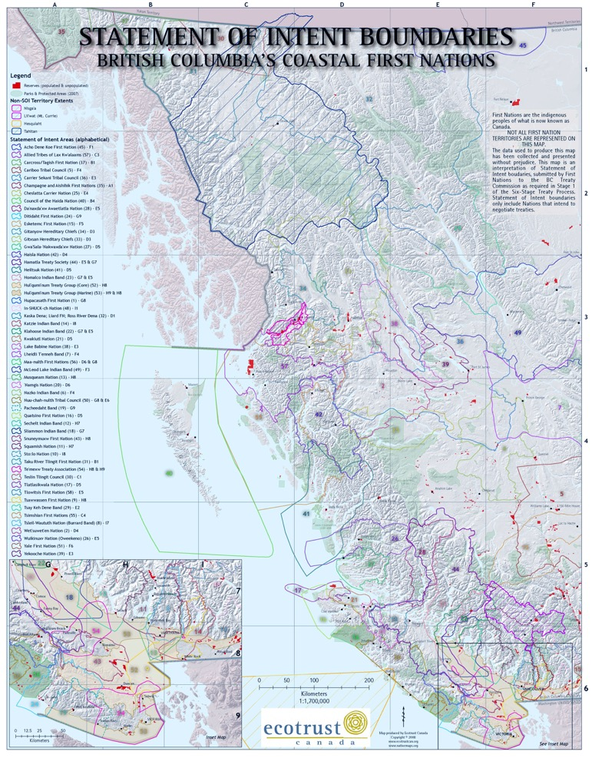
First Nations – BC
BC:
  Crown Lands – 3 sites
  Provincial Park – 1 site
  Private - 2 sites
Some overlap with Yukon First Nations, e.g. CAFN, etc.
Tahltan

Slide 14
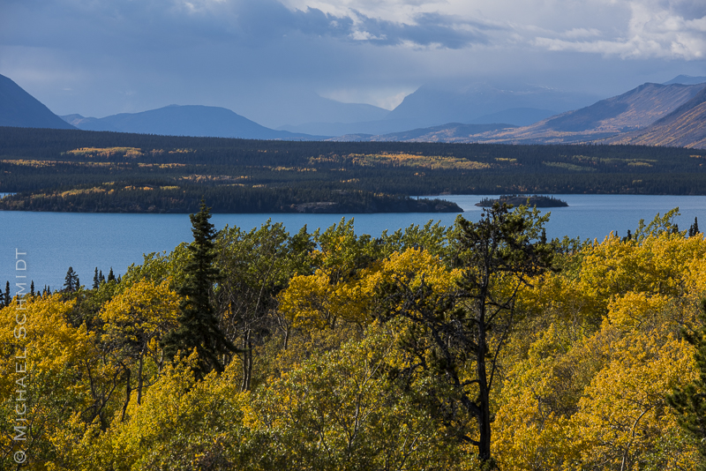
Permitting - Yukon
YESSA
Yukon Environmental and Socio-economic Assessment Act
EA: No trigger for TA sites (determined in 2012 – 2013)
  Exception: sites within National Parks
First Nations
Direct Consultation
Direct Permitting on Cat. A & B Lands
Yukon Lands (YG)
Required for
  Crown Lands
  Leased Lands (e.g. Yukon Highway Yards)
  Multiple stages (internal review, First Nation, adjacent land owners, internal committee) = 3 to 7 months;
Yukon Science and Explorers Licence (YG):
Reviews application
Circulates to other YG Departments and to First Nations
YG Departments
Yukon Highways (Highway Yards)
Wildfire / Forestry (e.g. Letter of non-objection)
Private Land Holders
Direct permitting

Slide 15
Permitting - Yukon
Cultural / Heritage Considerations
> e.g. J28M-1 (“Crown” Land)
Concern raised in letter from Tr'ondek Hwech'in First Nation to YG Heritage Branch (S&E Licensing)
Heritage / cultural potential Identified as a site possibly used by hunters (vantage point)
Archeological Consultation
Recommended site be relocated to less prominent location

Slide 16
Permitting - Yukon
Cultural / Heritage Considerations
Note:
Have to assess each site at time of installation
Relocate away from areas that could potentially be of cultural / heritage value
Example: Move back from this ridge

Slide 17
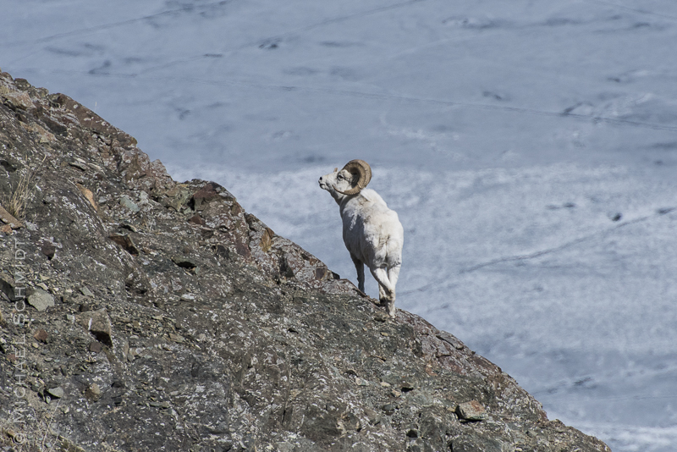
Permitting / Wildlife
Requirement Across Yukon / NWT / BC
Wildlife:
Plan (helicopter, aircraft, …) installations so as not to interfere
with nesting, lambing, calving, etc., season

Slide 18
Collaborations
Yukon Government
Yukon Geological Survey
  Pre-purchased one site (EPYK)
  Continuing support (scientific and logistical)
  New 5 Station Network
Yukon Highways
Yukon Parks
Office of Chief Science Advisor to Yukon Government Government
University of Calgary / Arctic Institute of North America
Permitting, Consultation, Outreach, Reconnaissance, Installation
David Eaton, students
Yukon College
Outreach
Yukon Research Centre
Aurora Research Institute (Inuvik, NT) - GNWT
Continuing support (scientific, logistical, technical)
University of Ottawa
YNSN Network
Pascal Audet, students
Geological Survey of Canada
YUK sites (8) operational during TA time span
CNSN Data
Pre-purchased 2 sites (A36M, C36M)

Slide 19
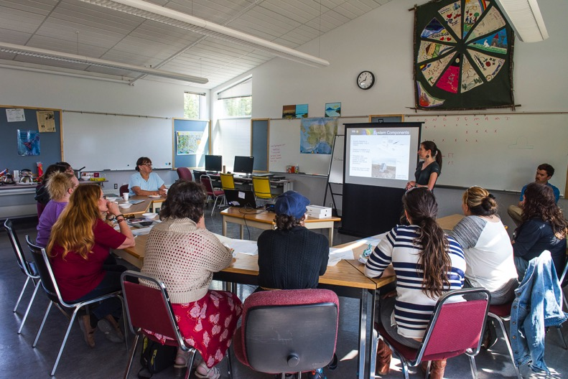
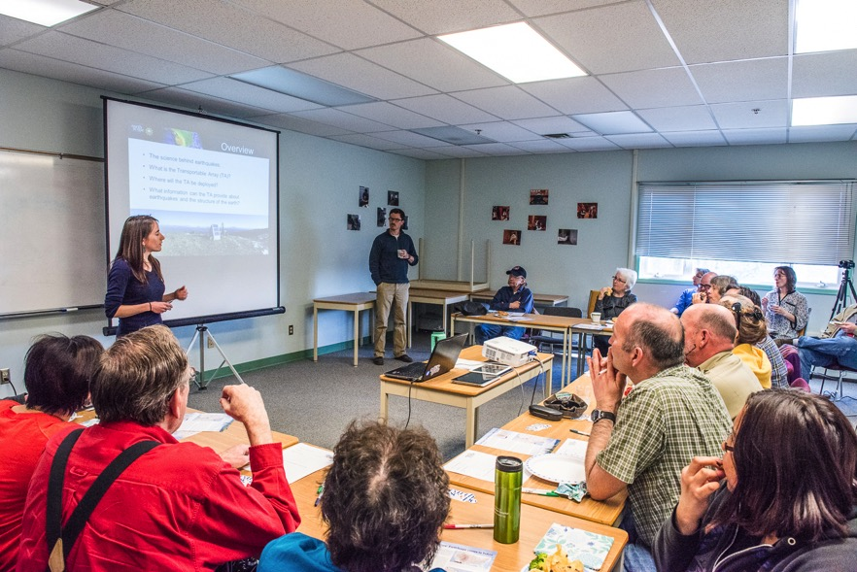
Outreach
Yukon College (Joel Cubley & Mary Samolczyk)
  Outreach presentations in 9 communities across Yukon
  YC Community Campuses
  Local organization
  Food, Coffee, etc. served
  Attendance: 0 - 20
Mayo
Haines Jct.

Slide 20
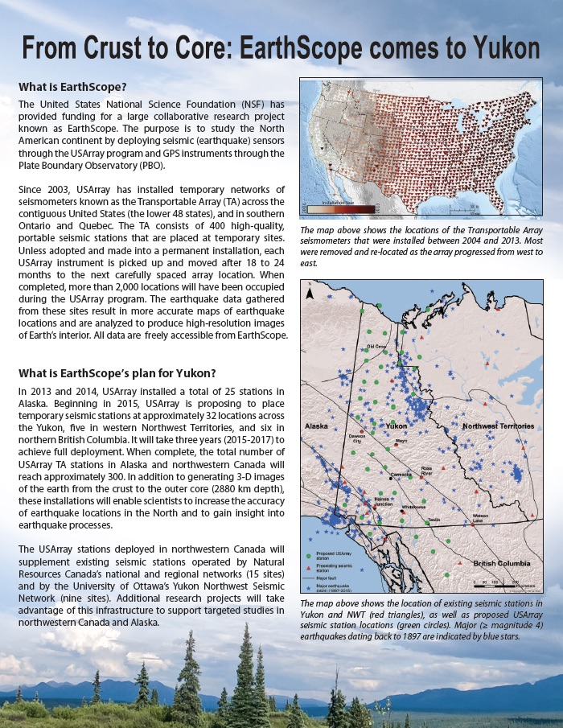
Outreach
Yukon College + AINA + IRIS / USArray…
Brochure has been extremely useful
Both paper and electronic
http://www.usarray.org/files/docs/pubs/Alaska-Yukon/Yukon_Brochure.01Apr2015.pdf

Slide 21
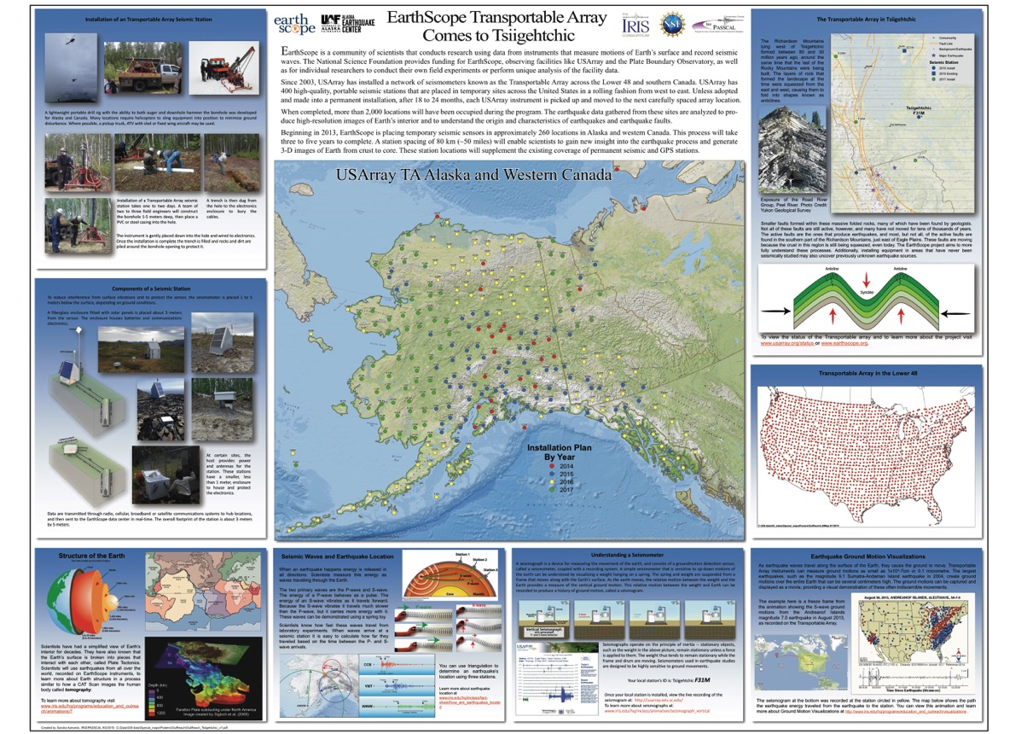
Outreach
Community
Display
Posters
e.g.
Tsiigehtchic
Others Locations:
Old Crow
Haines Jct
Tombstone
…
Media:
CBC Radio
Newspaper ….
Looking ahead:
USArray Booths
GAC-Mac 2016
Annual Yukon Geoscience Forum
“Tombstone Rocks”
Schools + Community Outreach

Slide 22
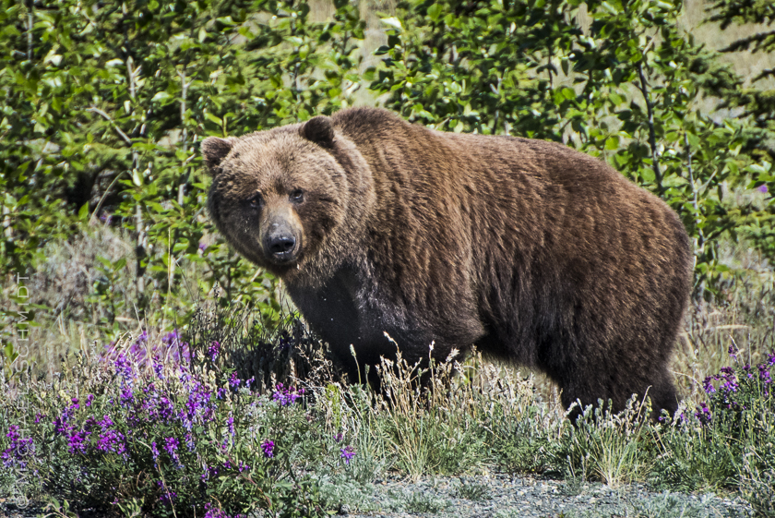
Thank you
Questions?
Go ahead – make my day

