Slide 1
MUSTANG Quality Assurance
Recent Progress and Development
Gillian Sharer
TA Team Meeting
November 9-10, 2015
With contributions from Rob Casey, Bruce Weertman, Laura Hutchinson, and Mary Templeton

Slide 2
MUSTANG
Modular Utility For Statistical Knowledge Gathering
Seismic data quality metrics and PSD,PDF web services
http://services.iris.edu/mustang/
( QUACK was officially retired in January 2015. It has been running on an unsupported basis and the oracle database that it depends on will be gone soon, possibly by the end of the year. )
Notes:
QA system, web services oriented

Slide 3
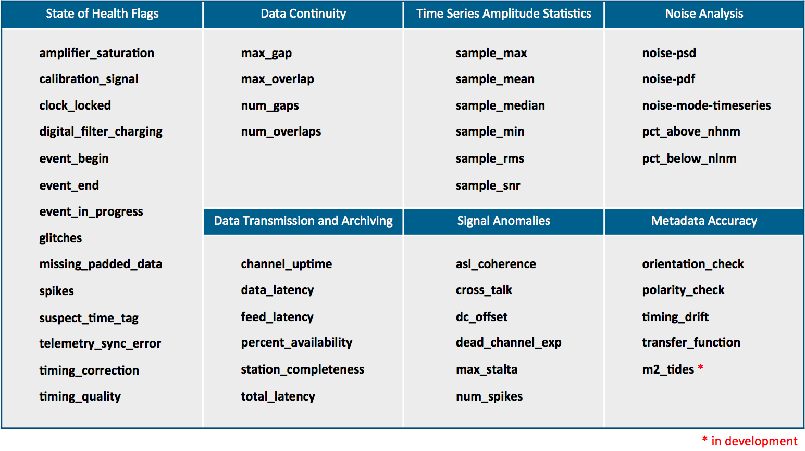
Available Metrics
Notes:
Access all these metrics through web services, which makes it easy to incorporate into scripts or import to other tools.
46 metrics
ASL has shared their coherence metric for co-located sensors

Slide 4
MUSTANG Progress
Currently, we have almost full metrics coverage of _US-TA stations going back to 2004.
In the past, we ran metrics based on virtual network designation. This has resulted in differences in metrics coverage within networks. For example, _CASCADIA-TA station coverage differs _US-TA coverage (10% vs 99% complete for sample_mean).
Now, we are running metrics on a network basis. All networks in our archive will have metrics for all their stations for (at least) current data. Channels are still limited to BH and HH..
Notes:
Once we’re certain that we can keep up with the full archive for current data, we’ll move backwards and fill in the holes in our existing archive that didn’t get run as virtual networks.

Slide 5
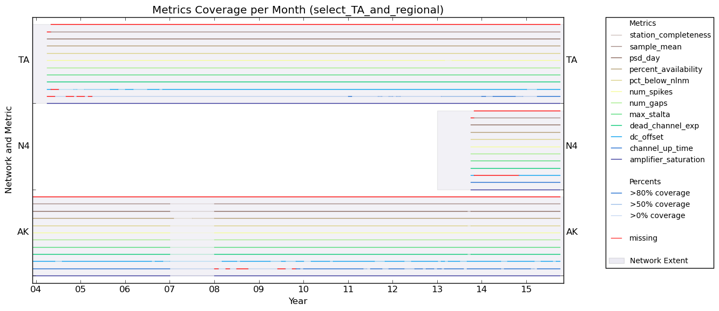
MUSTANG Progress
Metrics Coverage per Month for TA, N4, AK Networks
Notes:
Subset of 12 metrics, denoted by color. Transparency indicates whether we have > 0, 50, 80 coverage per month. Red indicates no coverage.
The network definition for N4 has a start year of 2013, and the first data in our archive is for November 2013.

Slide 6
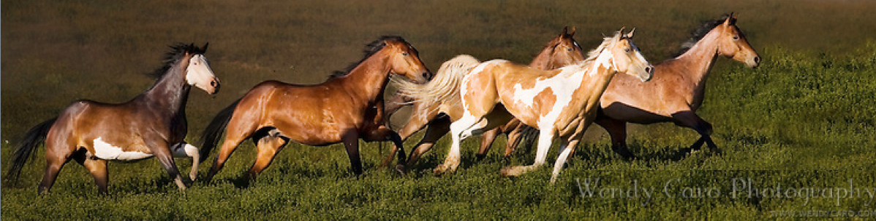
PASTURE
Process for Automated STatistic Update REponse
PASTURE is the system that facilitates the correction of metric values by MUSTANG when data changes.
Compares waveform archive dates with MUSTANG load dates and returns:
M: measurement is current
W: waveform, no measurement
S: measurement is stale and needs to be recalculated
O: measurement, but no waveform (orphan)
For each station-channel-day and metric (does not cover event-based metrics yet)

Slide 7
PASTURE
Using PASTURE to Update Metrics
Currently, automatic recalculation of stale metrics occurs:
Once a week, covering a time period of 3 weeks to 1 week prior
Every 21 days, covering the previous calendar month
The recalculation is based on a single representative metric. If this metric is stale, then all metrics for that day are recalculated.
In the future, automatic recalculation will occur on a larger time scale and all metrics will be checked for staleness.
Notes:
If we receive data outside these time periods, recalculation needs to be kicked off by hand.

Slide 8
PASTURE
Correction of PSD Values When Metadata Changes
PSD Response Refresher
compares cached responses with current metadata. This runs every Monday and marks days that need correction as “stale”.
PSD Corrector
recognizes what days are stale and applies the current response information to the PSDs.
PSD Merger
tiered storage of PSD histograms and modes for each station-channel
day, week, month, year, all
very fast data retrieval
Notes:
Internal web service
Doesn’t cover event based metrics yet

Slide 9
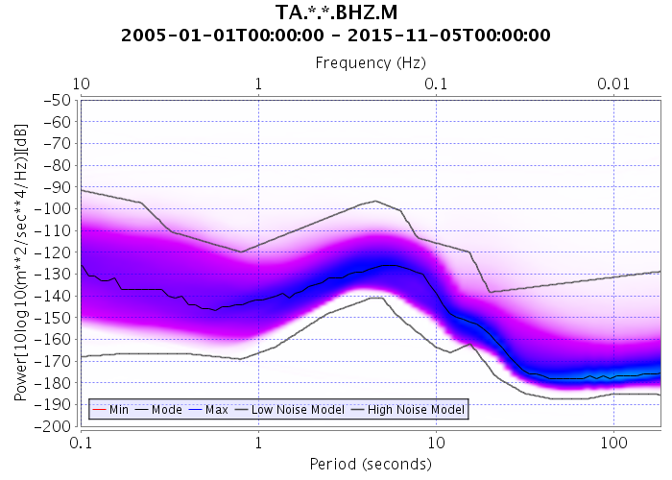
noise-pdf
url <- http://services.iris.edu/mustang/noise-pdf/1/query?target=TA.*.*.BHZ.M
&starttime=2005-01-01&format=plot&plot.interpolation=bicubic&plot.period.min=0.1
&plot.period.max=183&plot.power.min=-200&plot.power.max=-50
&plot.subtitlefont.size=18&plot.labelfont.size=16&plot.titlefont.size=20”
system.time(download.file(url,"TA.PDF.BHZ.png",method="curl"))
user system elapsed
0.039 0.033 56.176
Notes:
Composite PDF for all TA stations since 2005 takes less than a minute to create.

Slide 10
CRAN R Code
R code for MUSTANG metrics is now available from CRAN
The Comprehensive R Archive Network
https://cran.r-project.org
IRISMustangMetrics – statistics and metrics for seismic data
IRISSeismic – classes and methods for seismic data analysis
seismicRoll – additional functions operating on a rolling window
Notes:
3 packages available

Slide 11
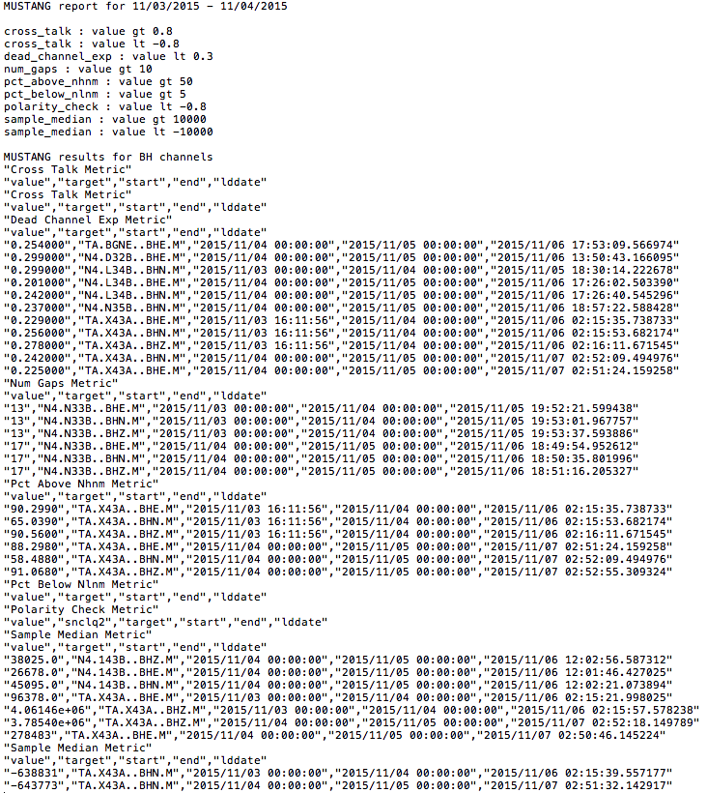
Using MUSTANG for QA
Simple text report
Created by multiple calls to services.iris.edu/mustang/measurements in a shell script

Slide 12
Using MUSTANG for QA
Prototype Report for Analyst Review
Html report created using R Markdown
Notes:
Show the html report

Slide 13
MUSTANG Quality Assurance
Recent Progress and Development
Gillian Sharer
TA Team Meeting
November 8-10, 2015
With contributions from Rob Casey, Bruce Weertman, Laura Hutchinson, and Mary Templeton

