Slide 1
Site Permitting Process and Ongoing Requirements
Molly Staats
November 9, 2015

Slide 2
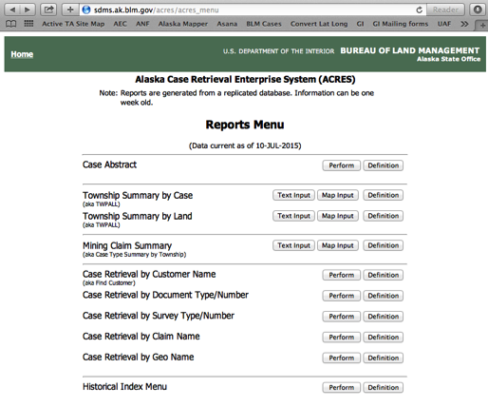
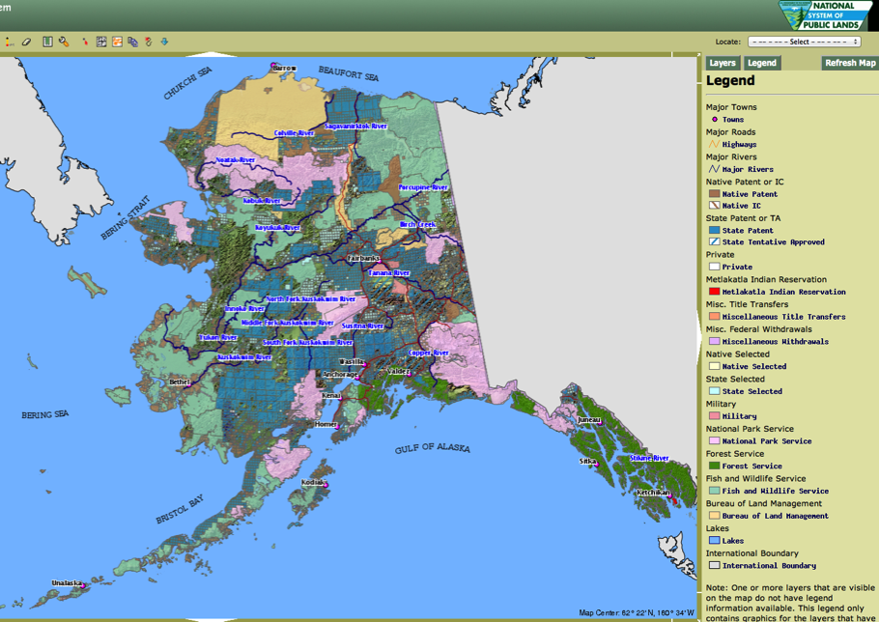
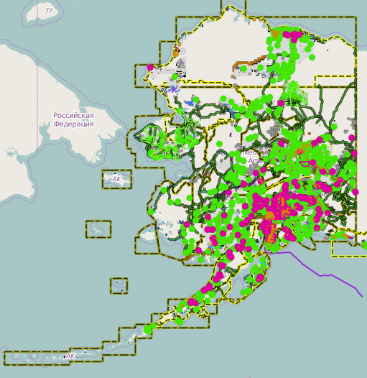
Land Status Review
BLM Mapper/ State Mapper/ Yukon Lands Viewer
Case Reviews (non state/federal lands)
Agency Internal Land Status Review

Slide 3
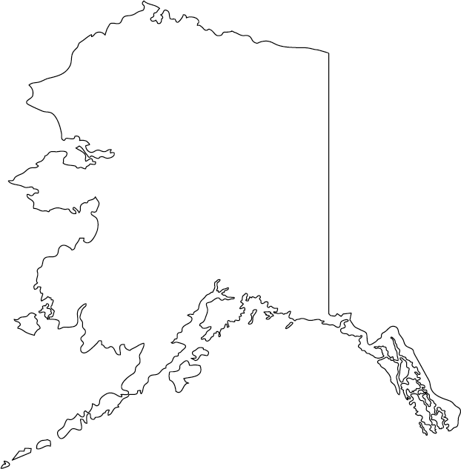
Who are we permitting with?
Primary:
Federal
BLM
NPR-A (6 months)
Fairbanks (9 months)
Anchorage (1 ½ years +)
FWS (1 ½ years +)
NPS (5 months)
State
DNR (2-3 months)
Other
Native Corps (1 month +)
Private (1 day to few weeks)
Secondary:
NSB (1 month)
Native Villages (days to months)
Military (6 months +)

Slide 4

Who are we permitting with?
Primary:
Sci and Explorers (3 months +)
Territory/Province
Yukon Lands (6 months +)
BC Lands (3 months)
National Park (3 months +)
Provincial/Territorial Park
Other
First Nations (1 month +)
Private
Secondary:
Yukon Highways (1 month +)
BC Highways (3 months +)
Notes:
----- Meeting Notes (10/30/15 16:37) -----
Overarching Sci and Expor

Slide 5
Permitting Process
Process:
Request internal land status review
In-person meeting
Official request letter and/or Application
Primary, alternates, and descope
Applications range in size/detail
Monthly check-in (Nagging!)
Permit and Payment
Delays:
NEPA
Archeological potential/ Cultural sensitivity (Install site visits)
Wilderness and Wildlife
Ambiguous land status or boundaries
Multiple permitting agencies
Notes:
----- Meeting Notes (10/30/15 16:37) -----
* NEPA-environment (national environmental policy act
* Sensitivity: Cost recovery, scheduling staff to be on site during or before (BLM and NPS)

Slide 6
Landowner Breakdown
26%

Slide 7
Landowner Breakdown

Slide 8
Status
301 Total Sites*
110 Certified
46 Installed
65 Existing
63 Permitted
15 alternates
70 Application Submitted
18 alternates
27 Require Permitting
But 10 descoped
25 AEC, AT, AVO
6 require recon
But 4 descoped

Slide 9
Next Steps
2016 Installation Permitting Stats
91 Sites (9 Descoped)
19 Existing or Co-locates
21 Permit Accepted
35 Permit Submitted
16 Need Permitting

