Slide 1
Seismology Instrumentation for Rapid Response to Geohazards
GAGE/SAGE Special Interest Group Session
August 20, 2020
Justin Sweet (IRIS), Anne Meltzer (Lehigh University),
Kent Anderson (IRIS), Bob Woodward (IRIS)

Slide 2
GAGE/SAGE Annual Meeting
August 2020 in-person meeting was postponed until August 17-19, 2021 (Breckenridge, CO)
Several of the Special Interest Group (SIG) meetings planned as part of the 2020 program are more timely this year so that important community feedback can be gathered to inform shorter-term activities.
NSF Facilities – support research and education in their fields
  UNAVCO runs GAGE (Geodetic Facility for the Advancement of Geoscience)
  IRIS runs SAGE (Seismological Facility for the Advancement of Geoscience)

Slide 3
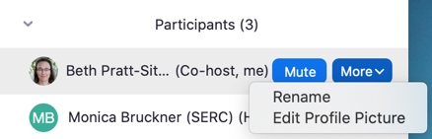
Technology
Please stay muted when you are not talking
If people start freezing up, turn off video to reduce internet load
Best to use earphones
Please put your real name in the Zoom Participant list
(if it does not just show up that way)
Use chat box a lot! (group or private messages)
Raise your hand if you have something more complicated
so we can call on you. Then you can unmute to speak.
We will not be recording the session, but will save the chat.
In breakout groups it will probably be best (internet withstanding) to turn on videos to facilitate interactions.

Slide 4

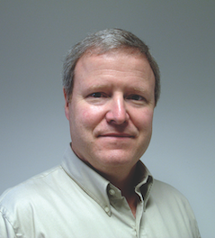
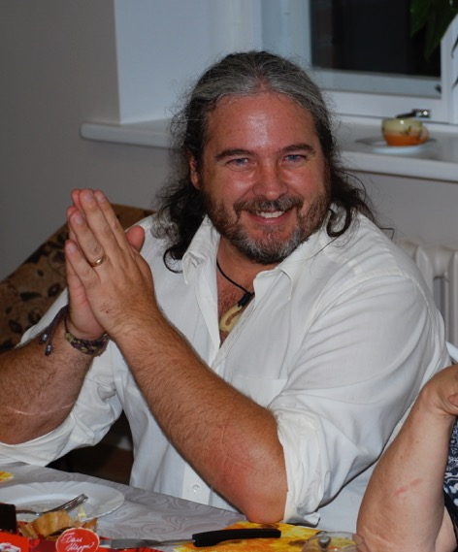
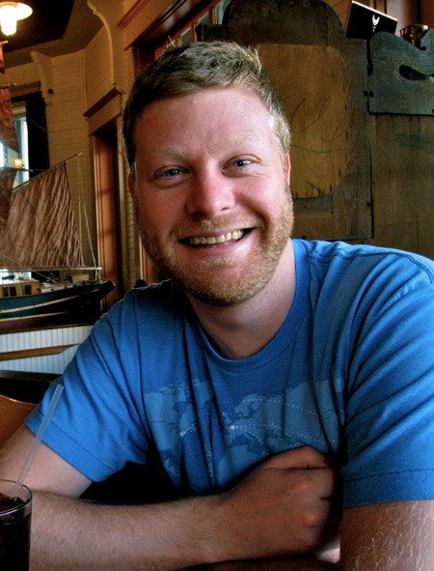
About this Session’s Convenors
Anne Meltzer
Lehigh University
Bob Woodward
IRIS
Kent Anderson
IRIS
Justin Sweet
IRIS

Slide 5
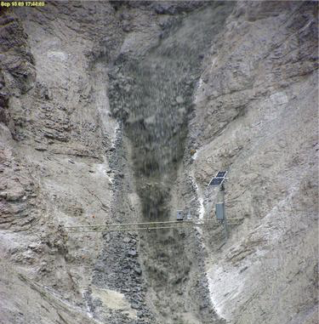
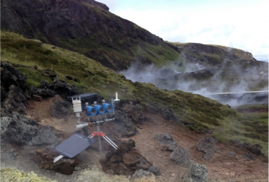
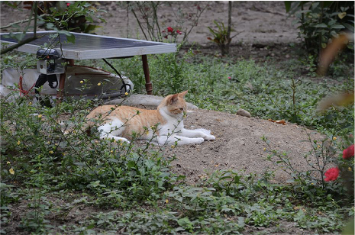
Motivations for this SIG
Rapid Response Science and Instrumentation: Community White Paper
  broad community interest in rapid response science
  need for dedicated instrumentation and infrastructure
Outcomes
  SAGE II award to enhance rapid response capabilities
  Infrastructure support for broader multidisciplinary rapid response efforts
(Photo Credit: Jeffrey Coe, U.S. Geological Survey)
(Photo Credit: Diana Roman, DTM)
(Photo Credit: Anne Meltzer, Lehigh)

Slide 12
Goal of this SIG
Gather input from the community on the current white paper draft to ensure that your rapid response science and observational needs are adequately captured.

Slide 13




Format: Breakout Discussions for Gathering Your Ideas
Participants will be randomly assigned to Breakout Groups
  5 minutes for introductions
  10-15 minutes for discussion focused on specific white paper sections
After each breakout we’ll return to the larger group for a quick recap from the organizers
There will be 4 separate breakout periods that will focus on different sections of the white paper. Within each breakout, we’ll be asking each group to consider the following questions:
  What are the most important elements of this section of the white paper?
  What did we miss?
Notes:
We thought the best way to for a group this large to have productive discussions about the white paper was to separate into smaller breakout groups of 5-10 people. We plan to have 4 separate breakout sessions of 15-20 minutes, each focused on different portions of the white paper. Between each breakout session we will return to the main SIG session for a quick recap from Anne and myself where we’ll summarize the feedback you’ve provided in the prior breakout session.

Slide 14
SIG Agenda
Breakout Session #1 (15 minutes)
  Focused on Intro and Community Process
Breakout Session #2 (15 minutes)
  Focused on Science Motivation and Observational Requirements
Breakout Session #3 (20 minutes)
  Focused on Instrumentation, Functionality, Technology, and Operational Requirements
Breakout Session #4 (15 minutes)
  Focused on Recommendations
Final Wrap Up and Next Steps
Notes:
At the very end of the SIG, Anne and I will give a final wrap up and then Kent and Bob will return to outline the next steps for our rapid response project.

Slide 15





Zoom Etiquette Reminders
Mute/unmute your microphone
To help keep background noise to a minimum, make sure you mute your microphone when you are not speaking.
Position your camera properly
For our meetings, we will all have our videos on to help build community and for us to gauge your understanding. The *exception* to this rule may be if there are connectivity issues.
Limit distractions
Please turn off notifications, closing or minimizing running apps, and muting your smartphone.
Introduce yourself in your breakout rooms
Please share your name, institution, and position/career stage

Slide 16

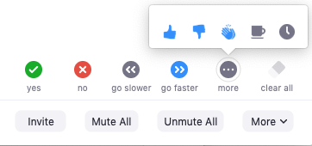
Road Guide to Today’s Session & Zoom Breakout Rooms
For technical difficulties, please use the Zoom chat box or email: prattsitaula@unavco.org

Slide 17
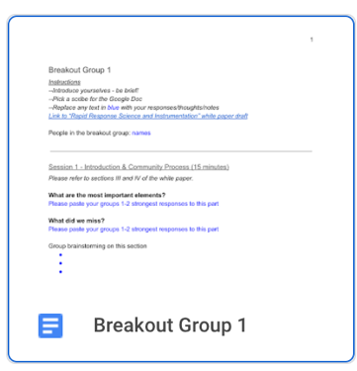
Documentation: Taking Notes in Your Breakout Room
Go to the Breakout Groups Google Folder (link in chatbox)
Click on the Google Doc with your Group #
Choose one person to take notes in this document
Type in your notes under the appropriate section
Have questions? Need help?
Please utilize the Zoom chat box or email prattsitaula@unavco.org

Slide 18
Breakout session wrap up (Anne/Justin)

Slide 19
Next Steps (Bob/Kent)

