Slide 1
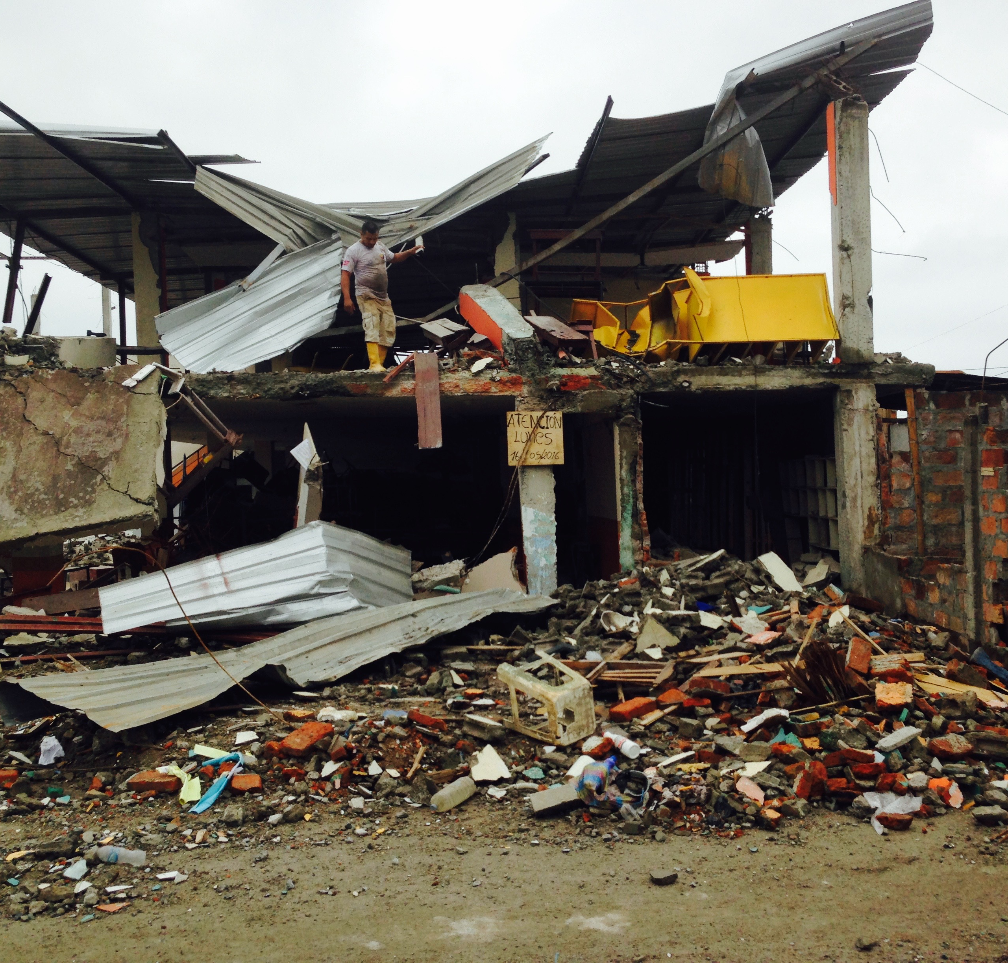

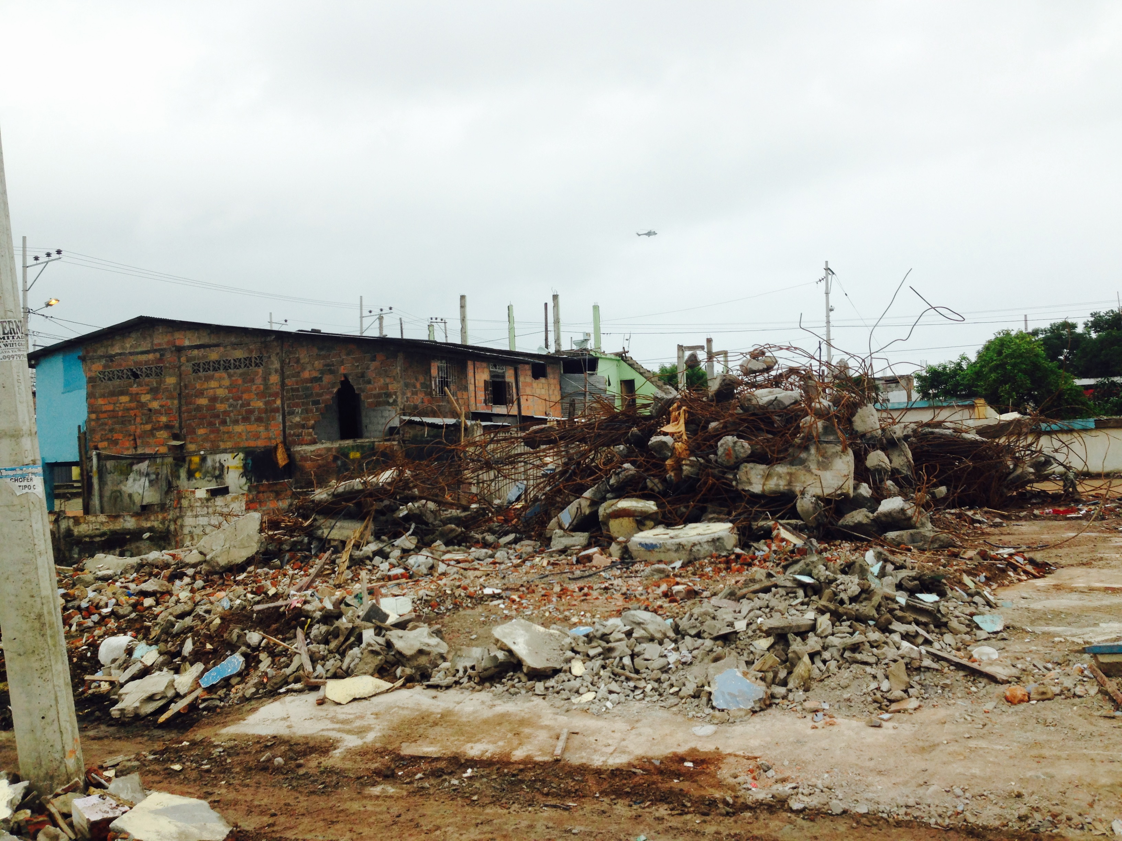
Geohazards Rapid Response - Large Earthquakes
Susan Beck
Contributions from:
Steve Roecker,
Yehuda Ben-Zion, Marianne Karplus & Zhongwen Zhan

Slide 2
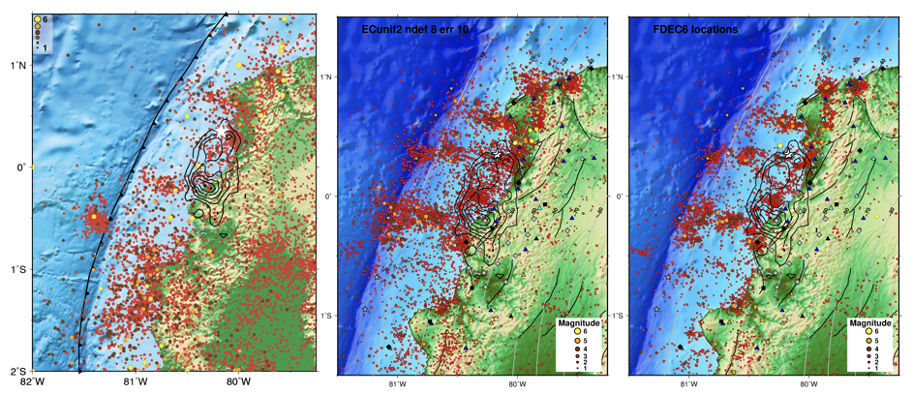
Rapid Response to Large Earthquakes –
Key Scientific Targets
Post-seismic deformation and afterslip - aftershocks, slow slip events – continuum of deformation mechanisms following a mainshock
High resolution imaging of the seismogenic zone – fluids, fault roughness, fault damage zones, asperities…
High resolution Imaging of the volume surrounding earthquake
Triggered earthquake & volcanic processes Repeating earthquakes & machine learning
2016 Pedernales Earthquake (M~7.8) Aftershock sequence
Ecuador
Sota Cordero et al., 2019, in review

Slide 3
Advantages of Aftershock Investigations for Seismology
Data Volume
Lots of events in a short amount of time; an abundance of observations is guaranteed.
Rate of activity an order of magnitude greater than background.
Important in regions we may have avoided targeting due to the time/effort required to obtain a viable dataset with a PASSCAL-type deployment.
We can get access to places that may otherwise be difficult (people/governments are more motivated to help).

Slide 4
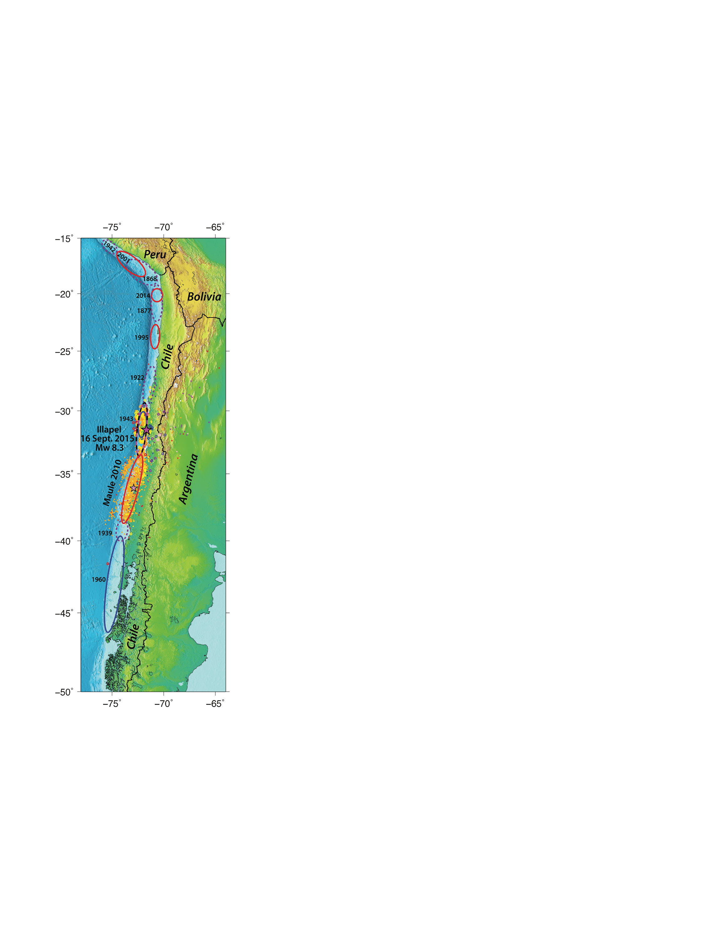
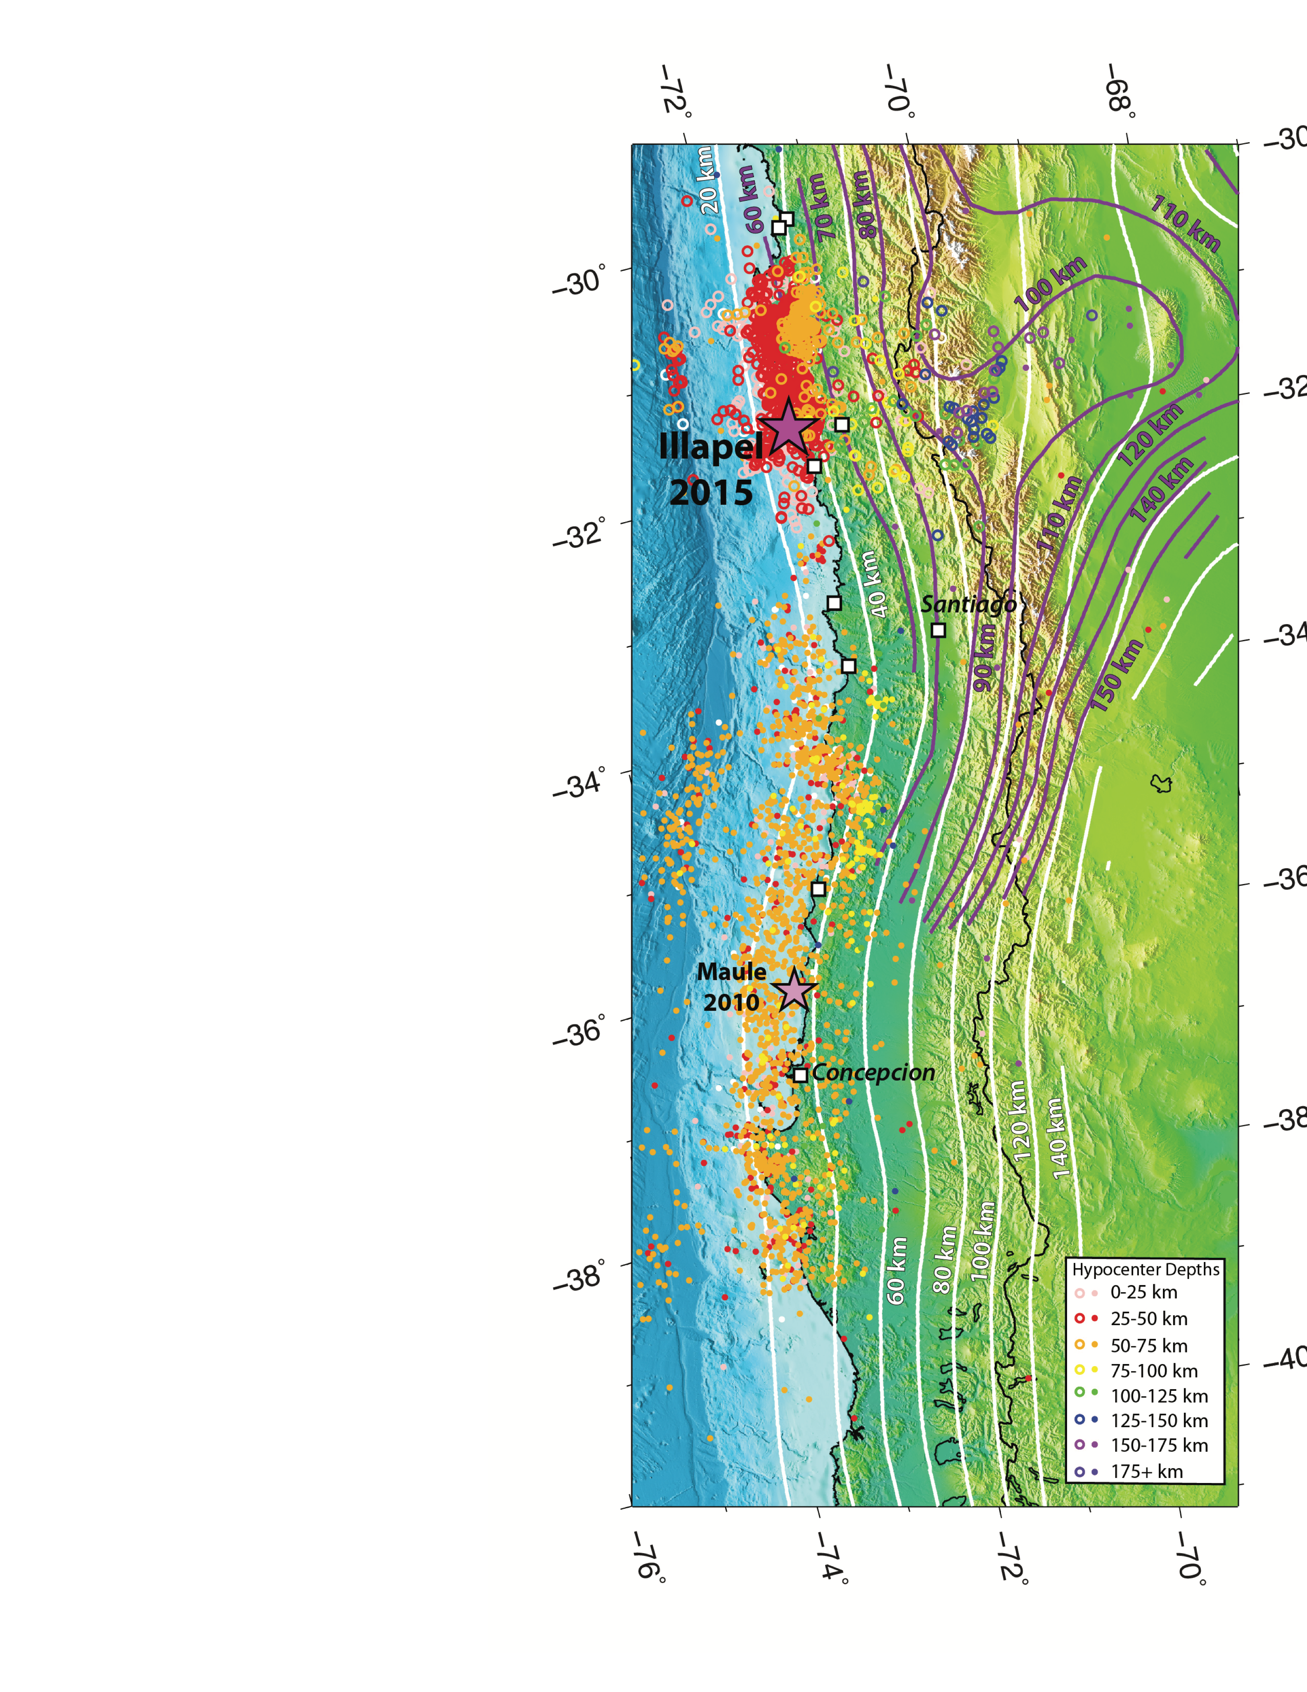
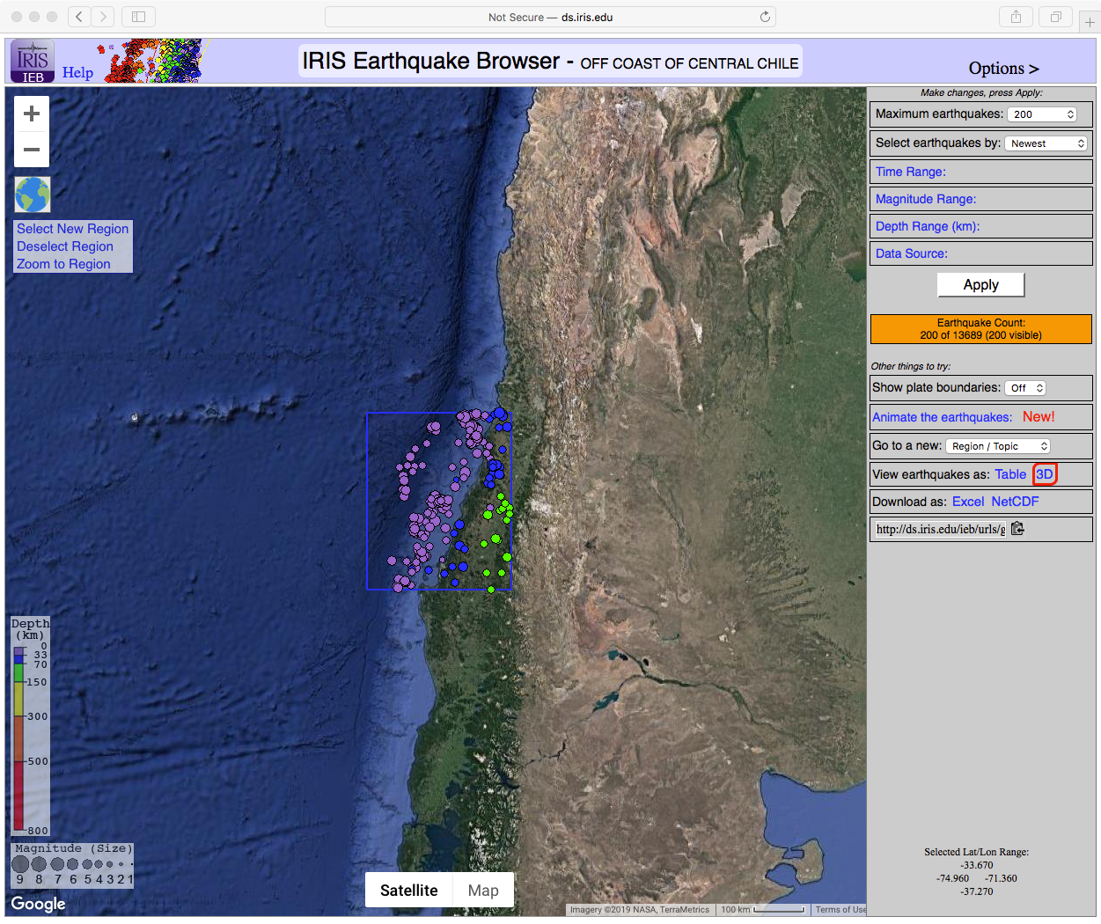
Examples in South America
2015 Illapel Mw 8.3 Earthquake
2010 Maule Mw 8.8 earthquake
BTW: 2019/09/29 Mw 6.8 earthquake
Steve Roecker
Notes:
Map of aftershocks of the Sep. 16, 2015 Illapel earthquake, color-coded by depth (key, lower right). Large purple star is the Illapel earthquake mainshock epicenter; small purple star is Feb. 27, 2010 Maule earthquake main shock epicenter. Maule aftershocks plotted as small filled circles, with same depth color coding as Illapel aftershocks (larger, unfilled circles). Two sets of isoslab depth contours shown: in white, from Hayes et al. (2012), and in purple from Anderson et al. (2007). The differences in the slab morphology estimates highlight the need for augmenting the catalog of seismicity with well-located Illapel aftershocks in the flat slab region (30°-32°S). Note that the Illapel earthquake generated many aftershocks in the flat slab region, well east and deeper than events of the Maule aftershocks sequence. Map at lower left locates the area in the context of Andean megathrusts.

Slide 5
2015 Illapel Mw 8.3 Earthquake Aftershock Sequence
About 80% of the aftershocks recorded (the dark area) are located in the upper plate. (The rupture surface is at the bottom of that dark region).
There is a fair amount of seismicity in the subduction “wedge” above the coupling zone.
These rates far exceed the ambient background, and indicates how post-seismic strain is released at depths of 10s of km.
Coast
High Andes
Diffuse Upper Plate Seismicity
End of Rupture; Elastic Coupling?
Double Seismic Zone
Something a bit odd?
W
E
Steve Roecker
Notes:
Crude W-E cross section of 27000 hypocenters from CHILLAX. High density in the rupture zone. Double seismic zone is clear; merges at about 90-100 km.

Slide 6
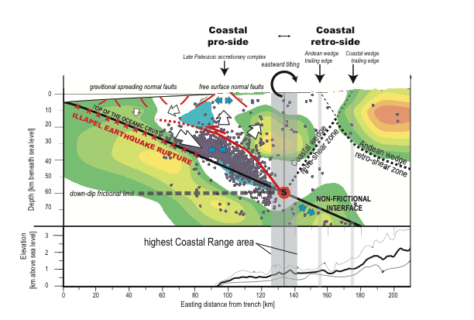
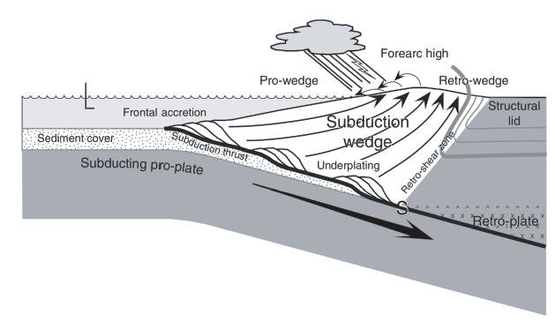
Chile Forearc – 2015 Illapel Earthquake
The tomographic image generated from these aftershocks (left) supports a tectonic environment similar to an “S-point” underplating model (right)
One problem though: There is very little sedimentary cover along this part of the arc! Where is the underplating material coming from?
Subduction Erosion!
Steve Roecker
Notes:
Interpretation of the structural architecture of the continental margin in the Illapel region. Upper panel: As a reference background, color contours represent W-E variations in Vp/Vs at 31.5ºS (Figure S7b) and solid circles show hypocenters within ±20 km of this section. Lower panel: Minimum, mean and maximum elevations along W-E oriented profiles of topography within ±20 km of 31.5ºS. The onshore Coastal wedge coincides with an east-dipping monocline that is bounded to the west by a Late Paleozoic accretionary complex (Choapa metamorphic complex shown in Figure 1). The normal faults in this complex are related to Zone 1 seismicity and accommodate uplift as free surface extension resulting from thickening of the wedge. Deeper thickening is related to Zone 2 seismicity and occurs as a compressive stacking of crustal slices transported downward from the edge of the wedge to the S-point. Offshore normal faults are caused by gravitational adjustment after tectonic erosion of the Coastal wedge. The recycling of eroded mass at and above the S-point leads to the highest elevations of the Coastal wedge being located directly above it.

Slide 7
M7.8 April 25, 2015 Gorkha earthquake,
Nepal RAPID aftershock deployment
MFT – main frontal thrust
MBT – main boundary thrust
MCT – main central thrust
MHT – main Himalayan thrust
45 broadband & short-period seismometers for 11 months
Deployed across rupture area at ~20-km spacing.
Designed to supplement Nepal Seismological Center networks.
Scientific goals: earthquake locations and mechanisms, structural studies
red dots: quakes >M4 25/4 to 12/5; blue dots: quakes >M4 12/5 to 7/6 (Adhikari et al., 2015), dots sized by depth. orange dots: NAMASTE catalog (no hypoDD); Rupture models from Elliott et al., 2016; large black triangles: 46 NAMASTE stations; small black triangles: HiCLIMB
Marianne Karplus
Notes:
On April 25, 2015, the M7.8 Gorkha earthquake began at ~15 km depth and ruptured from West to East, apparently unzipping megathrust along its northern locked edge.
It propagated ~140 km to the East.
The May 12 M7.3 large aftershock ruptured a smaller patch north and east of the mainshock rupture.
Each of these large earthquakes has associated aftershocks. Here we show earthquake locations >M4 from the Nepal Seismological Center.

Slide 8
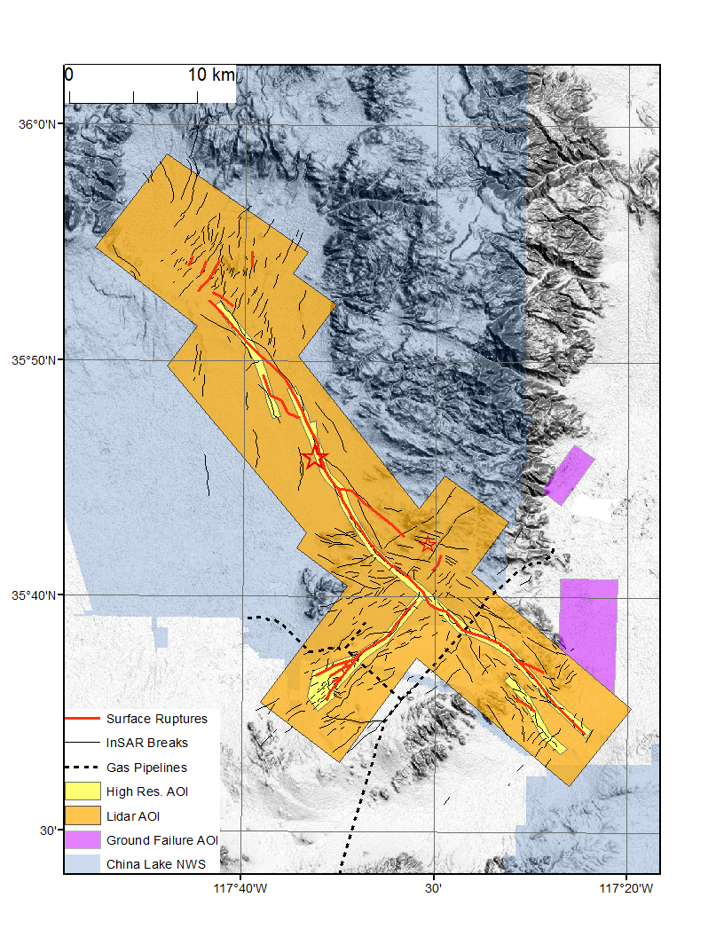
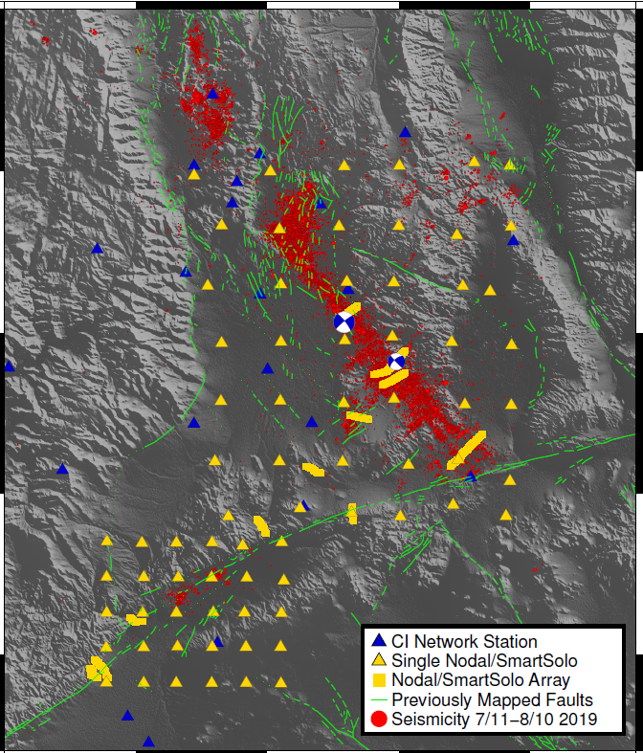
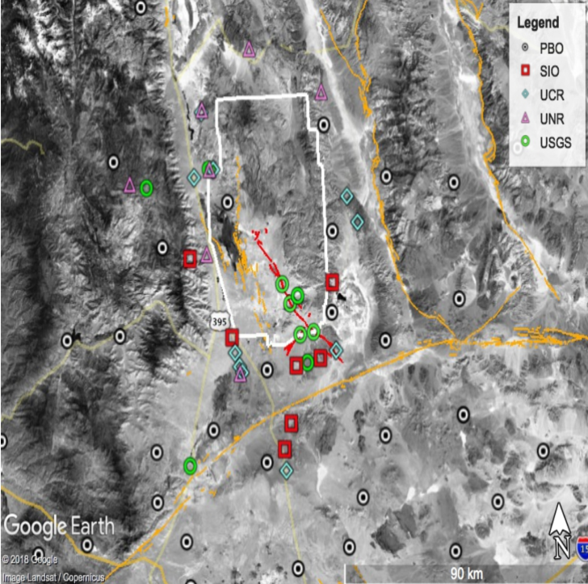
Rapid SCEC response to the 2019 Ridgecrest EQ (M~7.1) sequence
Geological mapping; Lidar
Deployment of >550 seismic sensors
GPS measurements at >20 sites; InSAR results
Kendrick, Akciz, Angster, Avouac, Bennett, Blake, Brooks, Burgess, Chupik, Dawson, DeFrisco, Delano, DeLong, Dolan, DuRoss, Ericksen, Frost, Gold, Haddon, Hatem, Hernandez, Hitchcock, Hudnut, Koehler, Kozaci, Ladinsky, Madugo, McPhillips, Milliner, Morelan, Nevitt, Olson, Padilla, Patton, Philibosian, Ponti, Pridmore, Rosa, Roth, Scharer, Seitz, Swanson, Thomas, Thompson, Treiman, Williams, Oskin
Funning, Fialko, Hammond, Kyriakopoulos, Wu, Richards-Dinger, Terry, Floyd Jin, Tymofyeyeva, Sandwell, Haase, Xu, Young, Crandall-Bear, Pecoraro, Blewitt, Kreemer
Yehuda Ben-Zion
Catchings, Allam, Steidl, Berg, Downy, Goldman, Ma, Chan,, Langermann, McEvilly, Mongovin, Gosh, Cochran, Ben-Zion

Slide 9
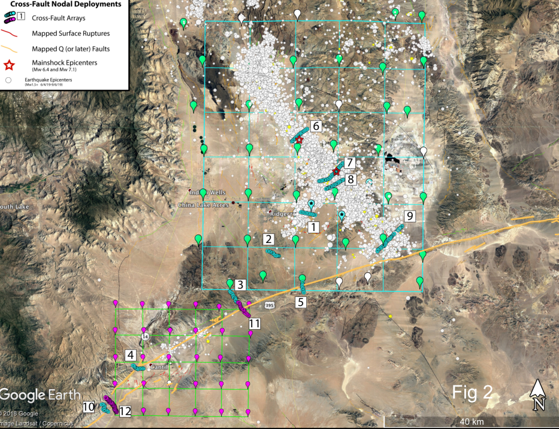
2D and linear arrays
Arrays
Two 2D arrays (50 x 60 km² with 10 km spacing and 25 x 30 km² with 5 km spacing)
Twelve 3-7 km linear arrays (100 m sensor spacing) across faults and seismicity structures (shown better next slide)
Senor types
218 3C Fairfield nodes
245 3C SmartSolo nodes
15 Broadband Sensors
3 Broadband/Node
comparison sites
Goals
Detailed event catalog
3D Vp, Vs, Vp/Vs, Q, anisotropy
Fault zone damage structure
Earthquake source properties (stress drops, full source mechanisms, directivities)
Temporal changes of Vp, Vs, Q
Comparison of sensors
Yehuda Ben-Zion
Catchings, Allam, Steidl, Berg, Downy, Goldman, Ma, Chan,, Langermann, McEvilly, Mongovin, Gosh, Cochran, Ben-Zion

Slide 10
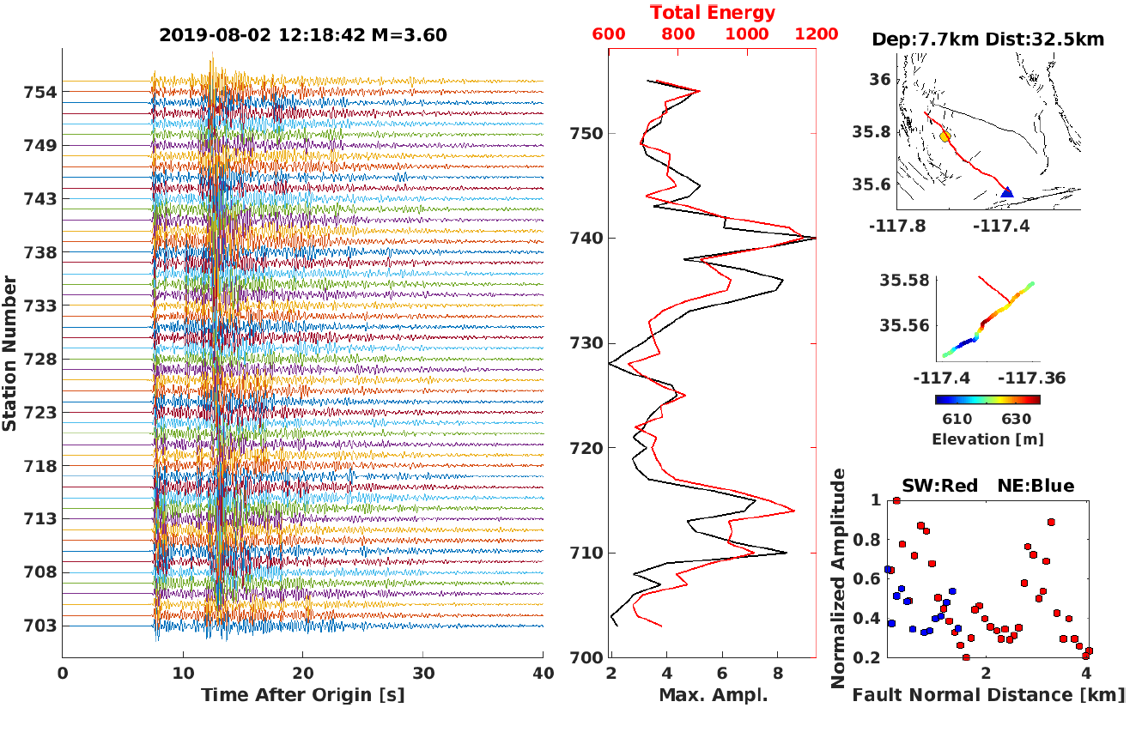
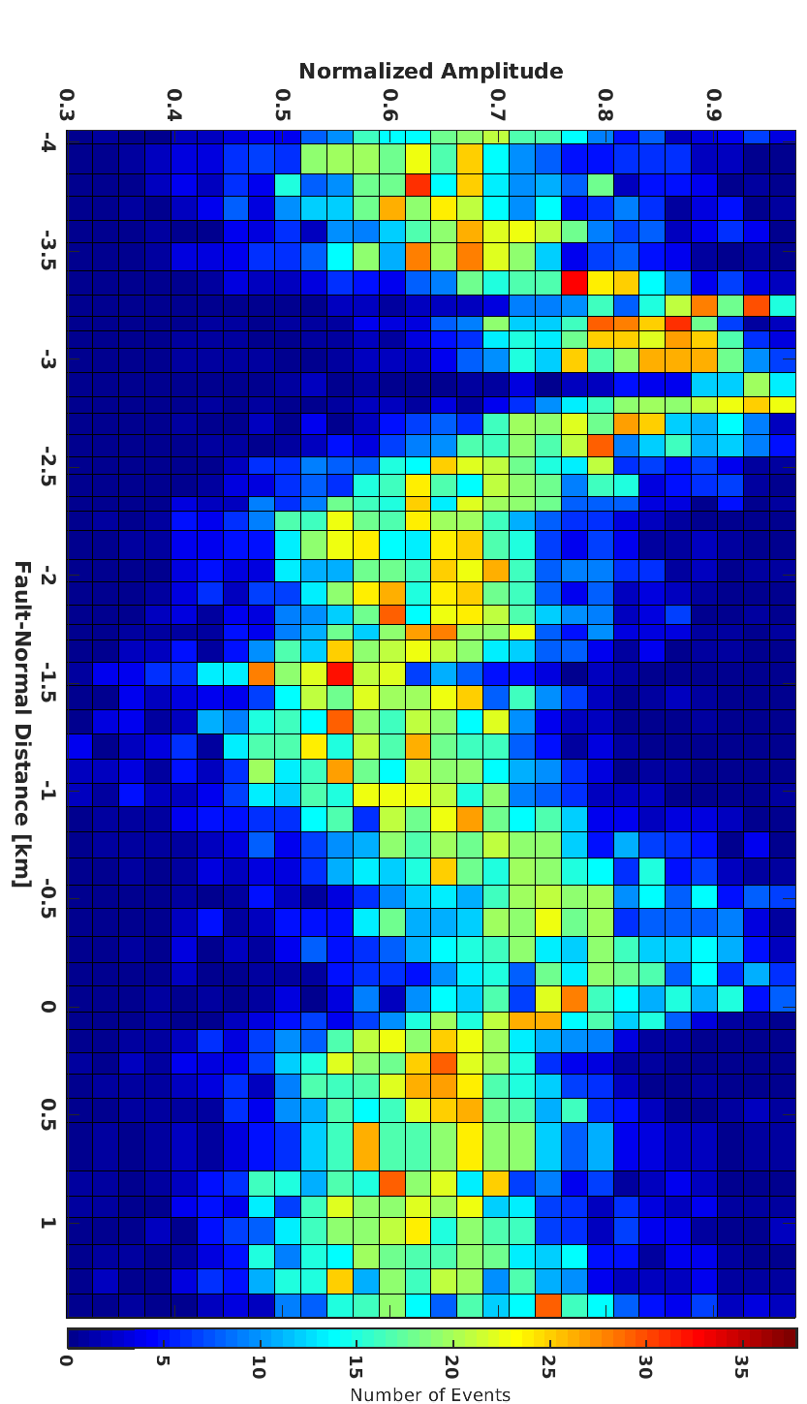
Preliminary results on fault damage zones
Fault
trace
Fault
trace
Energy distribution for example event (left) and 250 events (right) indicating two significant damage zones around two fault traces
Yehuda Ben-Zion

Slide 11
DAS: optical fiber as Distributed Acoustic Sensors
Rapid deployment of fiber seismic networks after the 2019 Ridgecrest M7.1 earthquake
“Rapid” DAS deployment
backscatter
incident
5~10 days after the M7.1
2-person team, half a day
~50 km long cable in total
Optical Fiber
incident
Computer
& Laser unit
50~100 lb.
200W power
1 m of fiber =1 strainmeters
10 km of fiber =10000 sensors
Continuous & Real-time
Suitable for “rapid” response if having access to dark fiber near source.
Zhongwen Zhan et al.

Slide 12
A M~4 aftershock recorded on the 10-km long Ridgecrest City array
0.5-20Hz
Zhongwen Zhan

Slide 13
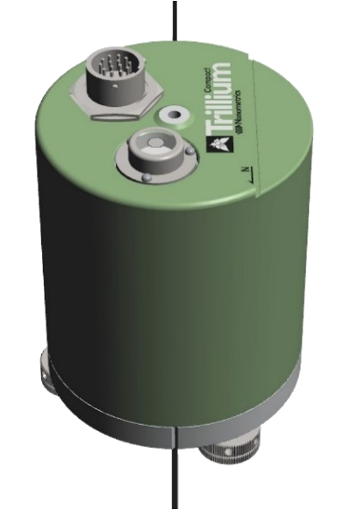

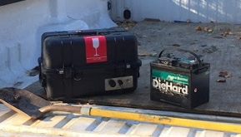
Instrumentation
Sensors – mixed mode 3 component seismic sensors (BB, short-period, nodes, accelerometers, GPS systems etc.) Direct burial sensors a must, DAS systems to use with fiber optic cables?
  Broadband may not be absolutely necessary but some BB important- Good for ambient noise looking for dV/dt. Better for any future studies.
  Recording time?
    Large earthquakes – 1+ year
    Moderate earthquakes – months to 1 year
Security - better to have everything below ground
Easy & quick to deploy
  Recorders & sensors -Light weight & small, reliable & rugged, low power – easy to transport - A large event can cover 100’s x 100’s km²
  Quick deploy boxes – just add batteries
  Telemetry – ideal but not always possible
  “Backpackable” systems

Slide 14
What seismic sensors do we need?
Equipment type | Pros | Cons
broadband (e.g. Guralp 3T) Trillium compact | broad frequency range, all sources (incl. tremor), sensitive to recording very small events | delicate, needs external recorder and power system
short period (e.g., L-22) | more robust than broadband | needs external recorder and power system, limited frequency range
strong motion/ accelerometer (e.g., episensor) | doesn’t clip for large, nearby aftershocks, good for strong motion studies, lower cost | needs external recorder and power system, less sensitive
5-Hz 3C node (e.g., Magseis Fairfield) | all-in-one system, easy-to-deploy, can be totally buried, compact, relatively robust, lower cost | lithium batteries (contained in equipment) can be hard to import, limited frequency range, 35-day battery life
Tilt meters?, Raspberry Shake?, “Cell phone” accelerometers?, Other?
Marianne Karplus

Slide 15
Discussion Questions– what do we need?
What kind of sensors do we need?
  Mixed mode direct burial seismic sensors (multiple frequency response) & continuous GPS?
  How much time do we need to record? Weeks to months to years?
  Fiber optics cables? Other technologies?
More quick deploy boxes
  PASSCAL, Carnegie, German systems are examples to consider and build on?
How important is telemetry? Satellite? Cell phone?
  Is it possible to do telemetry in a “rapid” mode? What is the Increased cost & power?
How do we improve the “rapid” process?
How do we improve coordination across multiple groups and agencies?

Slide 16
Logistics
Rapid deployment is essential
Rapid Funding
Equipment ready to go
Coordinate between GPS & seismic deployments, shipping, assessment of damage in region
Coordination between groups & agencies (USGS, GEER etc.)
International deployments
  Need to be invited into the country – in-country collaboration is essential
  Customs & Shipping can be complicated (ie. lithium batteries)
  Assessment of damage – are roads open etc., can you get where you need to go?
  International coordination – often more than one international group is deploying instrumentation
  Coordinate with US Embassy

