Slide 1
Determining Capabilities
Timeline for this project
Evaluation and qualifications
Procurement
Community Oversight
Operational Models

Slide 2
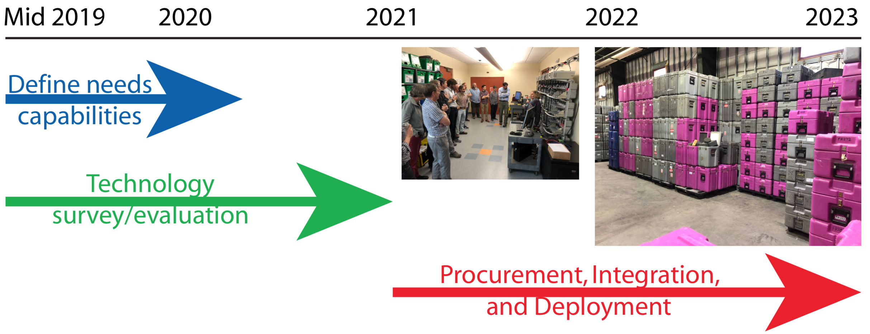

Slide 3
Evaluation and Qualifications
Identify key instrumentation types
New instrumentation (other than “more”)
Develop functional specifications, RFQ’s and evaluation criteria
Procure small evaluation sets
Evaluation and review by working group
Selection of one or more procurement options

Slide 4
Procurement
Develop final RFP’s
FAT
Integration with PASSCAL systems, inventory and logistics
USE IT

Slide 5
Community Oversight
IRIS PASSCAL Standing Committee (PASC)
Reporting to the IRIS Board of Directors
Potential Working Groups
Equipment Selection and Evaluation
Policy and Procedure approval for usage

Slide 6
Operational Models
Rapid Response will require immediately availability
Set aside equipment from the general PASSCAL Pool
Specialized PIC support to ensure it’s ready to go at all times
Need funding commitments to minimize risk
Duration may need to be limited
Difficult if short term responses turn into long term monitoring experiments
Options to transition into more standard PASSCAL experiment
Return/replace equipment to Rapid Response pool
Policy review through the PASC/IRIS Board

Slide 7
Operational Models
Coordination with other Geohazards Groups
UNAVCO/GAGE, USGS, NOAA, etc
Incorporation of coordination within SAGE policies

