Slide 1
Induced Seismicity hazards
Summary of Webinar
Thursday, September 26th @ 3pm ET
Host: Heather DeShon, SMU
Invited Speakers:
Mike Brudzinski, Miami-Ohio
Stephen Veitch, UTEP
Jake Walter, OGS
Elizabeth Cochran, USGS
Credit Grigoli et al. 2017 https://doi.org/10.1002/2016RG000542

Slide 2
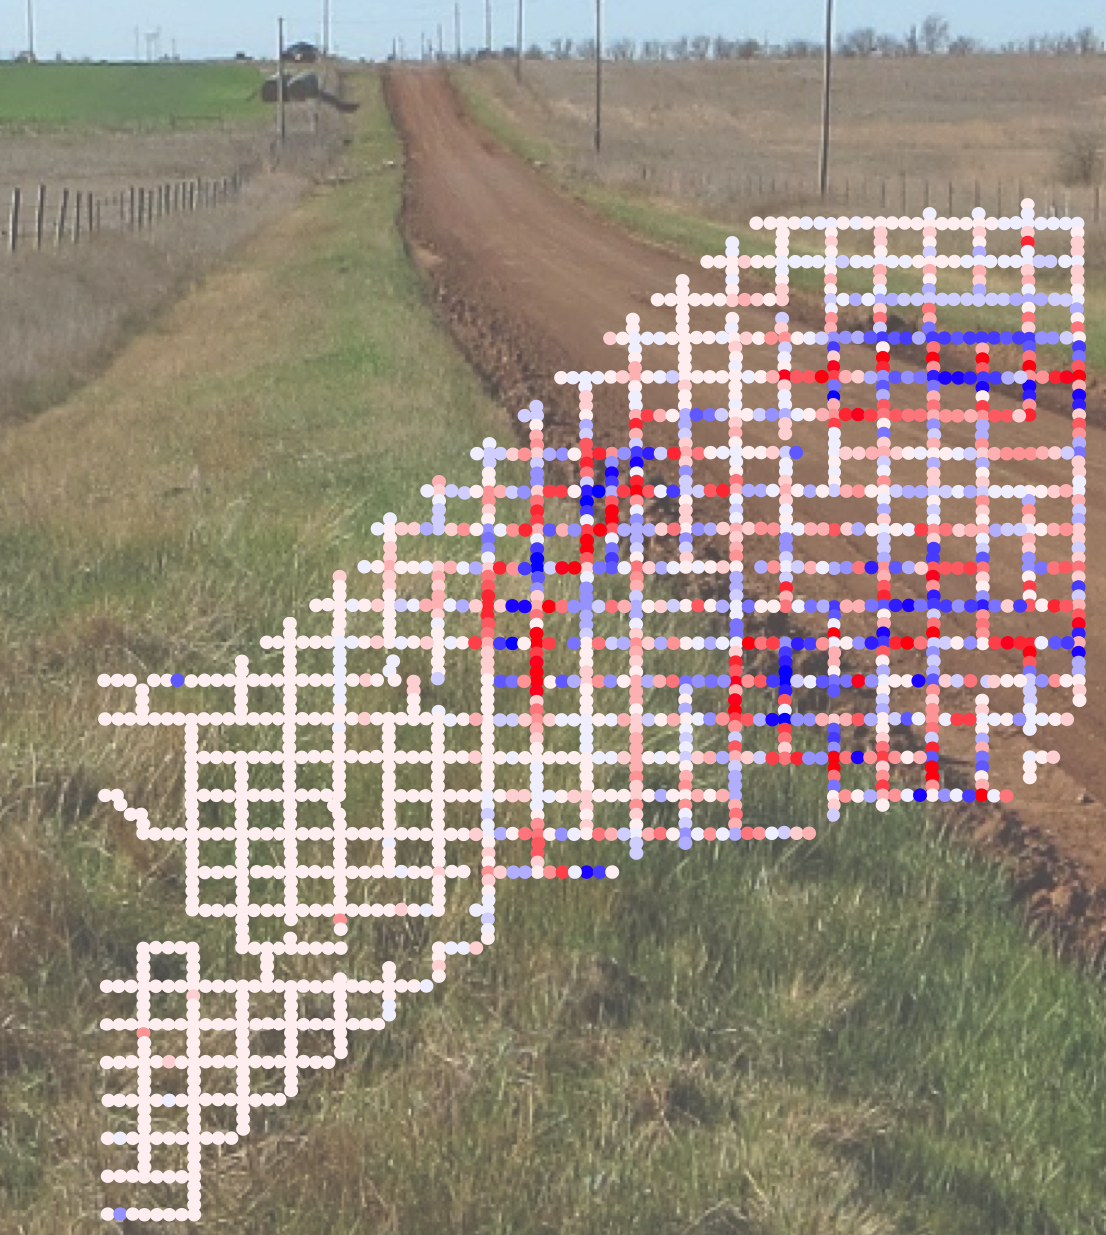
Deployment Objectives
Operational Monitoring
Real-time earthquake detection
Situational awareness for communicating to stakeholders (local, state, federal governments, emergency responders, regulators, public, etc.
Research Studies
Understand the relationship between seismicity and human activities (oil & gas activities, geothermal, CO2 sequestration, mining, dam impoundment, etc.)
Estimate expected magnitudes, resulting ground motions
Use findings to forecast hazard, inform operators/regulators on best practices.
Educational & Community Impacts
Nodal & BB deployment, OK
Image provided by E. Cochran

Slide 3
Rapid Response Challenges
Establishing a baseline dataset remains difficult & identifying the relevant data to baseline remains an issue
Events can be small & shallow, requiring many stations close to the source zone and high sampling rates
We fail to monitor the beginning of the activation of fault(s), capture the middle, and frequently have to remove instruments before the sequences end
Coverage is uneven, noise can be an issue, telemetry may not work, wide range of sensors can be in the field, tilt in clays, rural and metropolitan deployment/security concerns
Example of a typical situation:
The North Texas Rapid Response Seismic Networks

Slide 4
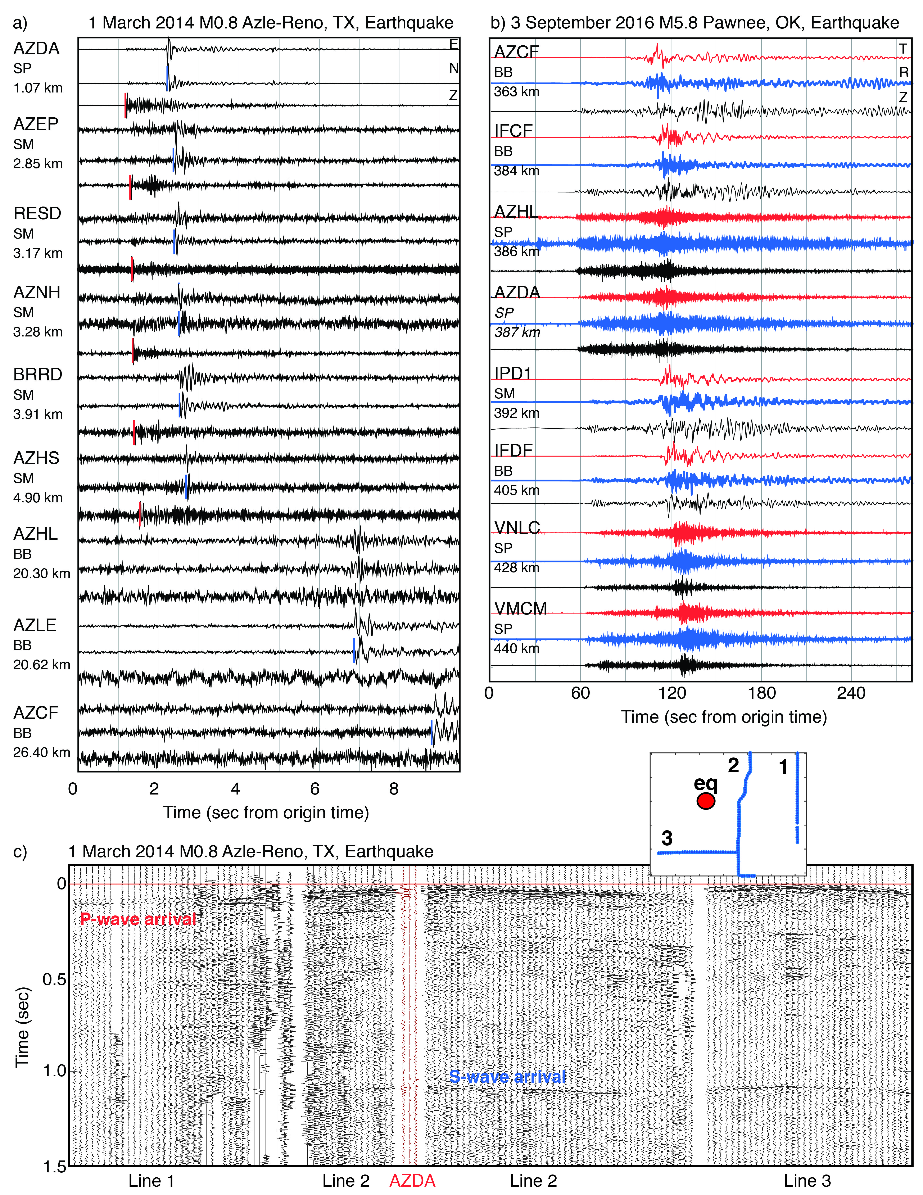
Technical Requirements
Record earthquakes across a variety of sizes
– societal obligation to assist with timely public reporting
Record strong motions
– opportunity to understand short- & long-term hazard
Continuous data, 3 component
Robust sensor housing and tilt-tolerance
– even when directly buried (reduced noise)
Telemetry-capable
Easy and fast metadata creation
– continued support of PDCC!

Slide 5
Telemetry is Key
Rapid response begins when an event of significance is detected
Template matching, location, frequency-magnitude distribution, focal mechanisms, stress drops, etc.
State geologic survey &/or USGS seeks to be first to report origin and magnitude
State regulator needs to evaluate if operator response is needed
Operators use the data to know if activity will affect them
Some are monitoring to adjust operations to avoid regulatory response
Relationships & communication with local agencies, state surveys, or landowners can really benefit (and enrich) projects regardless of the experiment style

Slide 6
Nodes are Great But….
Many traditional workflows & regional networks can’t incorporate the large amount of data
Limited battery life
batteries can’t be hot-swapped
longer term networks require frequent (monthly) visits
Cannot be telemetered
Limited to shallow burial
increased exposure to anthropogenic and environmental noise
High(ish) corner frequency
Non-standard data format
node data must be retrieved at a central server
server output is a non-standard format that requires conversion to utilize existing workflows
Low cost
Rapid deployment & turn around
Can deploy hundreds or thousands of instruments
Small footprint
Easily concealable
Flexible positioning
Deployment requires limited technical skill
Node in Pecos, TX
Provided by S. Veitch

Slide 7
A Wish List
Seismic instrumentation gives us only one perspective of the problem.
Other instrumentation:
Pressure transducers to measure pore-pressure changes at depth(s) of interest
Downhole Strain – aseismic deformation
Fiber optic/DAS for high resolution strain measurements, including downhole
InSAR/LiDAR/GNSS – ground deformation
Infrasound
Long-term seismic stations
Good, cheap telemetry
A mix of instruments & sampling rates b/c these areas are both data rich and data poor
Active sources provide key calibration data & allow fault identification w/o microseismicity
Technical guidance on setting up real-time server for seedlink streaming (reduce possibility of lost or corrupted data if making service runs)
Enough instruments to field arrays, if scientifically necessary for the PI-driven science
Magnani et al., 2017
Langenbruch et al. 2018

Slide 9
Data collection
Raw data distribution
Earthquake information to stakeholders
Permanent station
Other station
Public seedlink server
Proprietary server-side client or data collection point
Web-based map for network
Acquisition/data server
Processing server
PostgreSQL database
Rapid-response station
Web-based catalog tools
Seedlink server (IRIS)
Push QuakeML file to USGS through PDL
Other agency stations
Rapid-response station
Relationships & communication with local agencies, state surveys, or landowners can really benefit (and enrich) projects regardless of the experiment style
As of May 29, OGS is the authoritative regional network in the state, so USGS earthquakes are reported by OGS

Slide 10
Questions to Keep in Mind
Nodes in Pecos, TX
Provided by S. Veitch
What are the key missing data needed to effectively estimate short- and long-term hazard & design mitigation strategies?
What are the strengths of existing capabilities? What strengths cannot be lost?
What are the limitations of existing capabilities? Which limitations need to be overcome first to address fundamental science?

