Slide 1
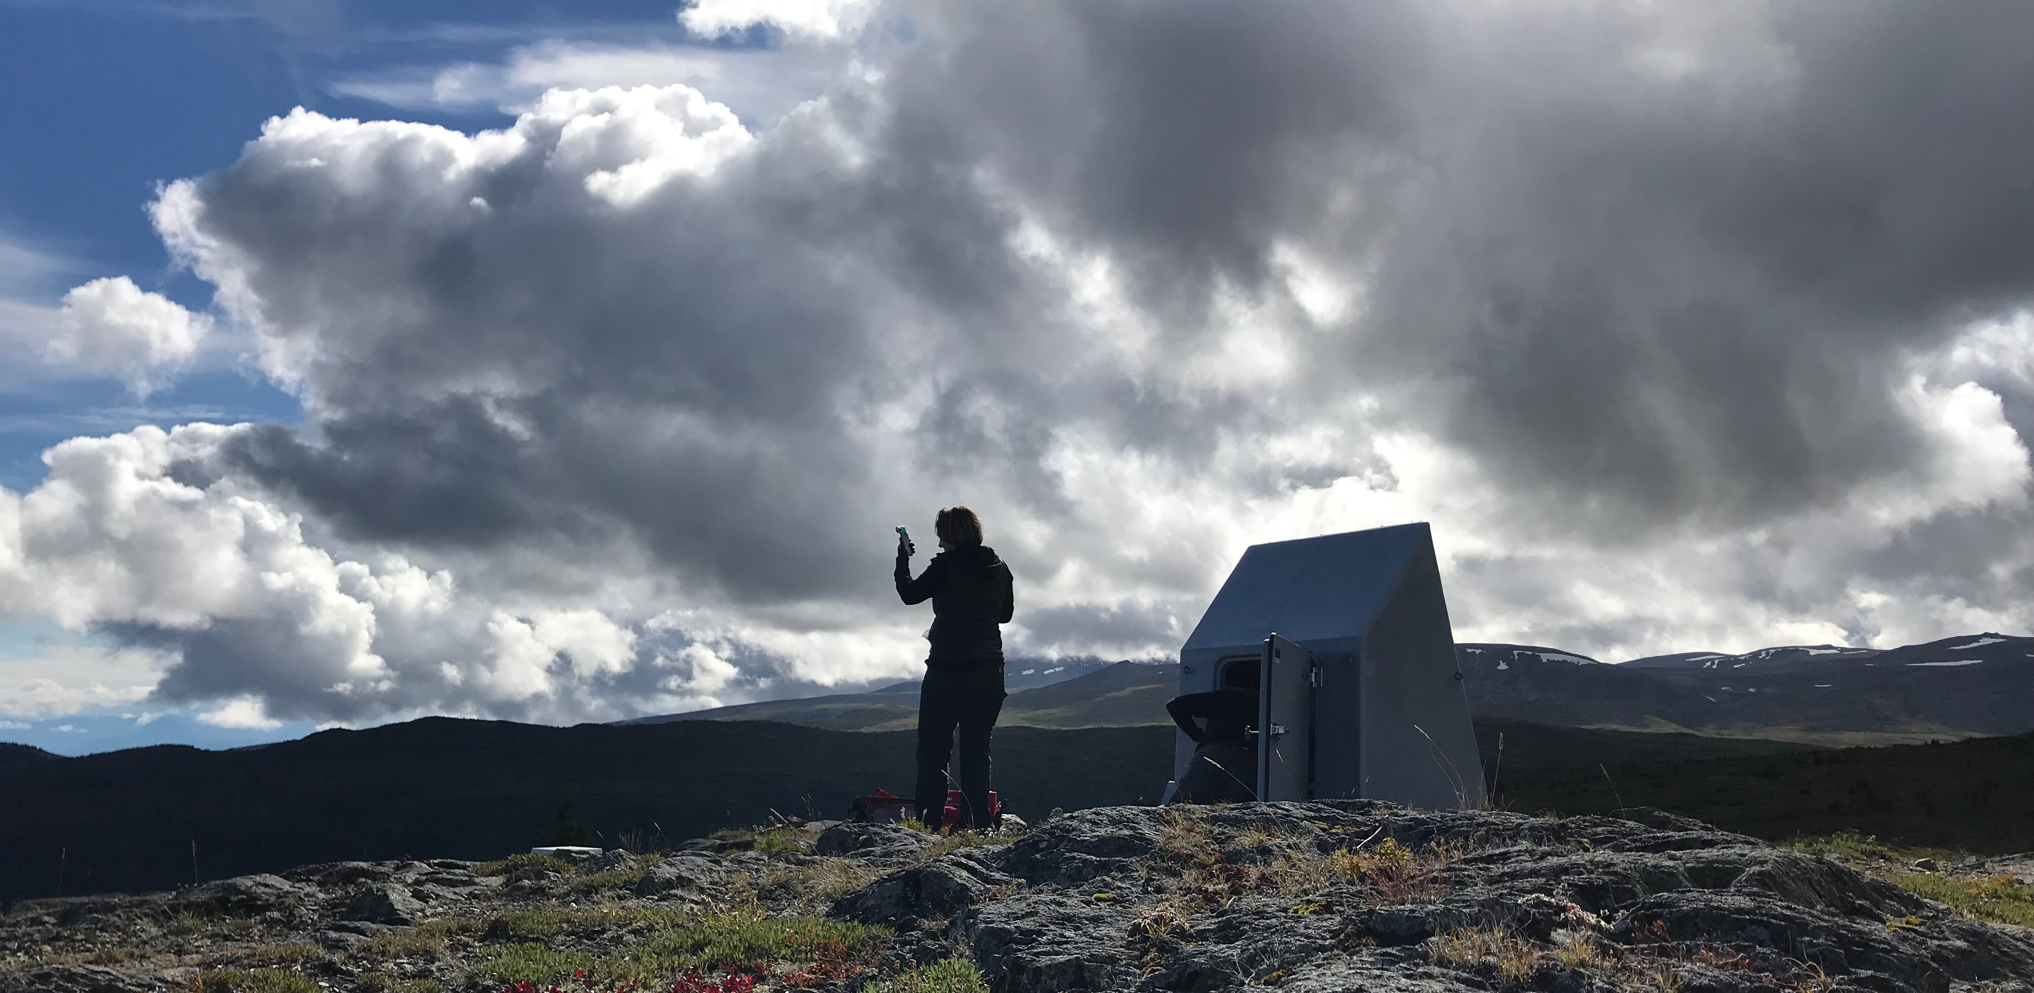
Rapid Response to Geohazards Initiative
A Frontier Initiative as part of the SAGE Facility
Mini Workshop
Portland, OR
October 8, 2019

Slide 2
Context for Rapid Response Initiative
Latest proposal successful, renewed for 5-years
SAGE or SAGE-II (not NGEO)
Seismological Facility for the Advancement of Geoscience
Continued support for IRIS instrumentation activities
GSN, PASSCAL, PASSCAL-Polar, PASSCAL-MT
Frontier Initiatives:
Enhanced instrumentation for wavefield imaging
New instruments for rapid response to geohazard events
www.iris.edu

Slide 3
Plan & Budget
Develop a dedicated rapid response capability based on community requirements
Define the community’s use cases
Unconstrained by prior practice or by specific past instrumentation
Give consideration to seismo-geodetic capability
Understand user requirements and available technology
Explore modular integration of systems
Note that parallel frontier effort in GAGE budget was not funded
Budget: ~ $1 M in procurement funding planned for SAGE budget years 3-5 (FY21-FY23)

Slide 4
Process for Community Input
Online “virtual breakout” sessions
Focused by theme
Volcanoes, Large Earthquakes, Induced Seismicity, Hydrosphere/Cryosphere
Community led, multiple short presentations, discussion
Rapid Response Mini-Workshop
This workshop!
Instrument evaluation activities during remainder of year – ready to start procurements next year

Slide 5
Telemetry Considerations
Telemetry-enabled units would provide a whole new capability for community rapid response experiments
Multiple communications topologies (e.g., ad hoc mesh networking, spoke and hub) and technologies (e.g., point-to- point, satellite) can be evaluated
Using these technologies as part of rapid response scenarios is particularly challenging
The “concept of operations” for a rapid response with telemetry must be considered
Telemetry issues include: accommodating international laws for importation, licensing, and use of the radio spectrum; developing procedures (for non- experts) for establishing and monitoring network topologies; and connectivity

Slide 6
Other Considerations – per Proposal
Incorporate accelerometers into the rapid response equipment pool for strong motion recording
Consider creating hardened systems for deployment in high-risk locations (lava or ejecta, inundation, or very strong shaking) coupled with deployment strategies that minimize risk to field personnel, while ensuring quality operations and maximum data return

Slide 7
For More Information:
www.iris.edu/rapid
We’ll post updates here
We are posting recordings of the virtual breakout sessions
Please volunteer to lead a virtual breakout!

