Slide 1
Rapid Response to Geohazards Mini-workshop
Case Studies from Colorado and New Mexico
October 8, 2019
Jenny Nakai, Postdoctoral Fellow, University of New Mexico

Slide 2
Raton Basin and Greeley work
Anne Sheehan, CU
William Yeck, USGS
Matt Weingarten, SDSU
Megan Brown, NIU
Shemin Ge, CU
Sue Bilek, NMT

Slide 3
Greeley
M3.2, 2014
Raton Basin
M5.3, 2011
Yeck et al., 2016; Nakai et al., 2017

Slide 4
Raton Basin: Historical induced seismicity
  2001 – felt earthquakes up to M4.6
  2011 – M5.3 August 2011
  The temporary deployments were valuable for identifying depths and fault planes

Slide 5
2001 and 2011 earthquakes
Barnhart et al., 2014;
Rubinstein et al., 2014

Slide 6
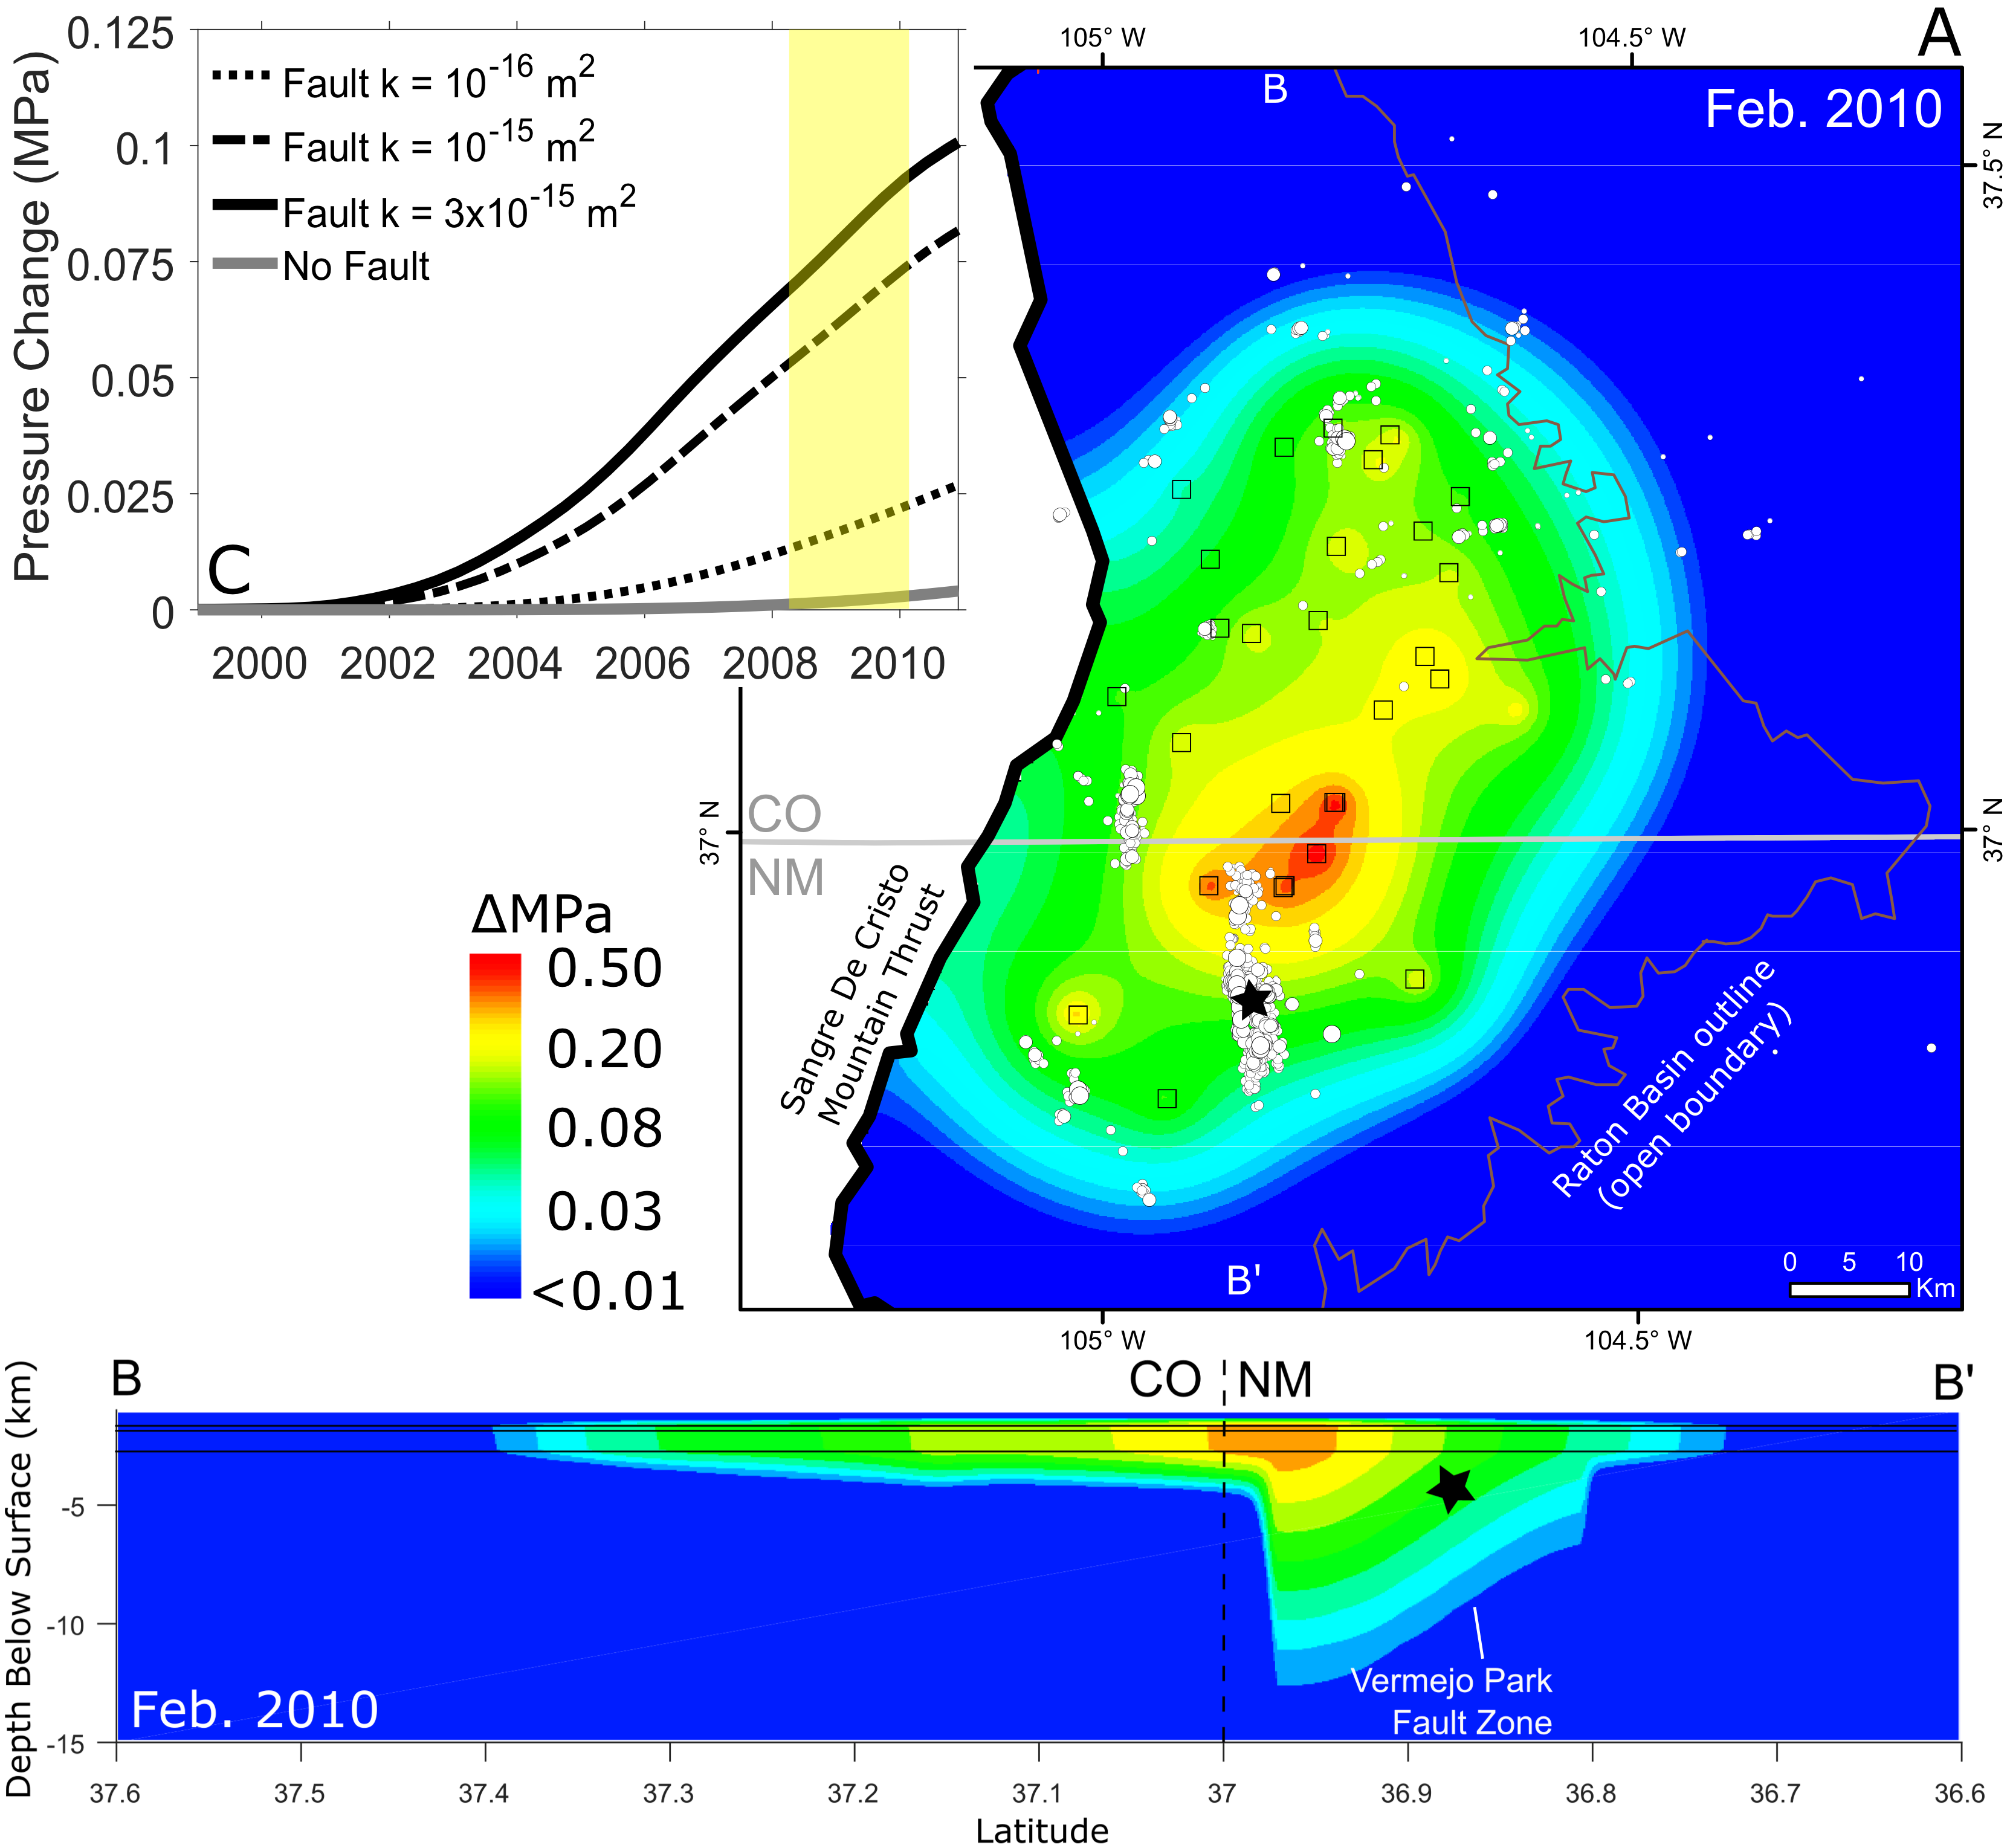
Poster: Raton Basin induced seismicity from 2016-2019 reveals short length-scale faults, Glasgow et al.
Nakai et al., 2017

Slide 7
What did the public care about?
How would you communicate your study to a resident?
Should I be scared or wary of these earthquakes?
What am I to take away? What questions should I ask the oil and gas industry?
Is it complicated when working with two different states?
Barriers to transparency?
Suggestions for better monitoring or better reporting?

Slide 8
What did the public care about?
Why are conditions different in different areas? (Oklahoma vs. Colorado)
How do these earthquakes occur?
Is there a cumulative effect from small earthquakes that could be important?
The favorite figure was the increase in M3.5 earthquakes after injection began

Slide 9
Greeley: aseismic before 2014

Slide 13
To summarize
If the focus is rapid response and mitigation:
  a logically designed small network of stations surrounding the area of concern is critical for:
    earthquake locations (azimuthal gap, aperture for expected depth, locating within the network, adequate SNR)
    magnitudes
    numbers of earthquakes
  This information, provided to regulators and industry in a concise and consistent manner, helps them make decisions that directly affect the public
If the focus is understanding the evolution of seismicity, or possibly identifying future hazards
  A survey network with wider spacing is important
  Quiet, high quality stations such as TA

Slide 14
Useful information for rapid response
Having an accurate epicenter with error ellipse is useful for planning network geometry/station spacing
General basin geology (potential faults, sedimentary sequence, any major structures/faulting in sediment, velocity models, estimates of permeability for sedimentary layers)
Quick access to injection well data such as historical injection, date the well started injecting, identifying high-rate, high-volume wells
Knowing the historical seismicity is important, this information can be buried in state open file reports of felt earthquakes from newspaper accounts. This can be hard to gather quickly
Building relationships with state officials is helpful
Communicating with local community outlets is useful
Seamless connection between earthquake monitoring and more detailed studies (e.g. data management)
Untangling possible sources of induced seismicity, fracking, secondary, tertiary recovery

