Slide 1
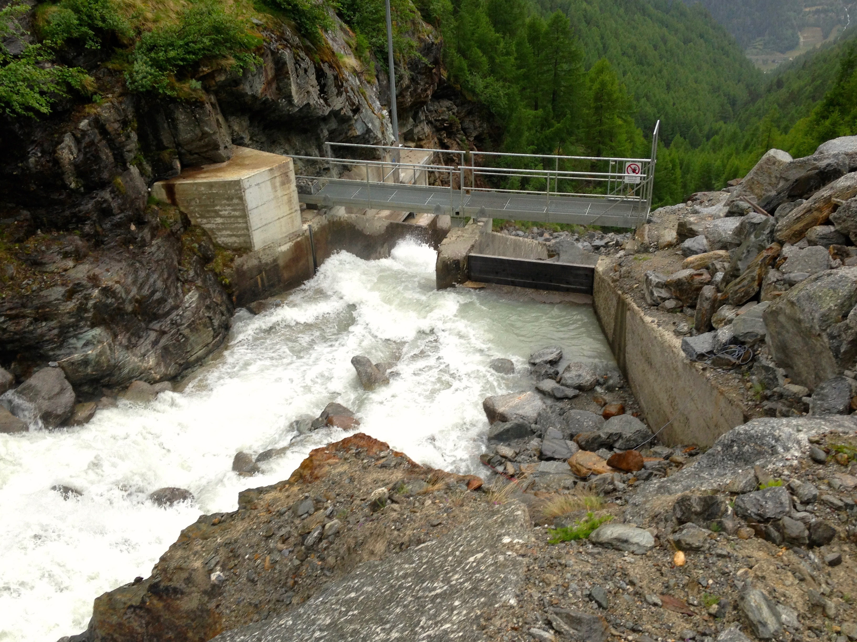
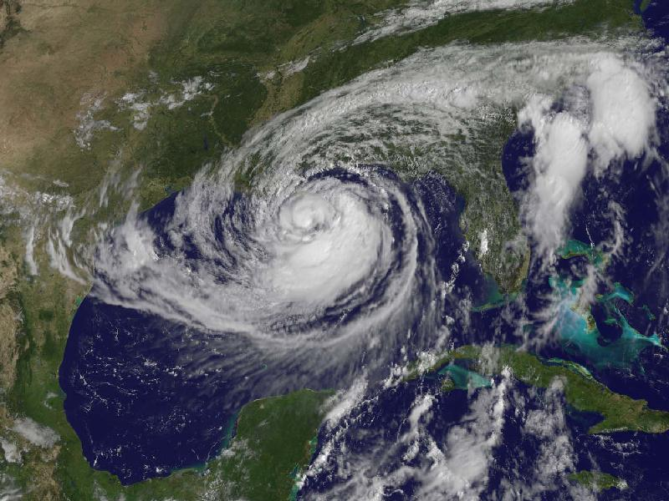

Rapid Response to Hydrologic/Cryospheric Geohazards
Victor C. Tsai
Dept. of Earth, Environmental and Planetary Sciences, Brown University
October 8th, 2019
IRIS Geohazards Workshop, Portland OR

Slide 2
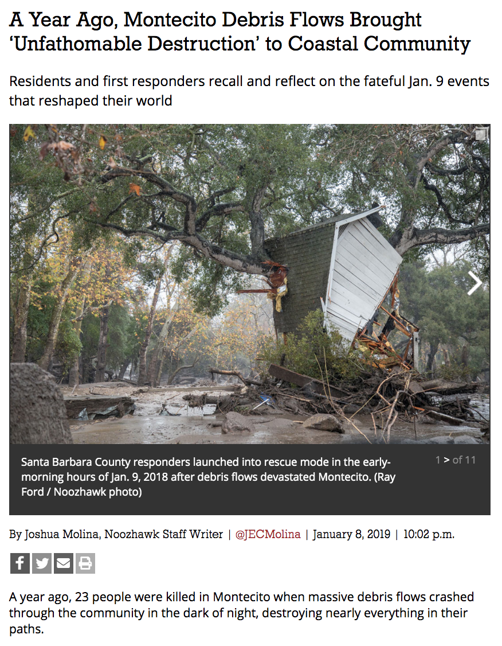
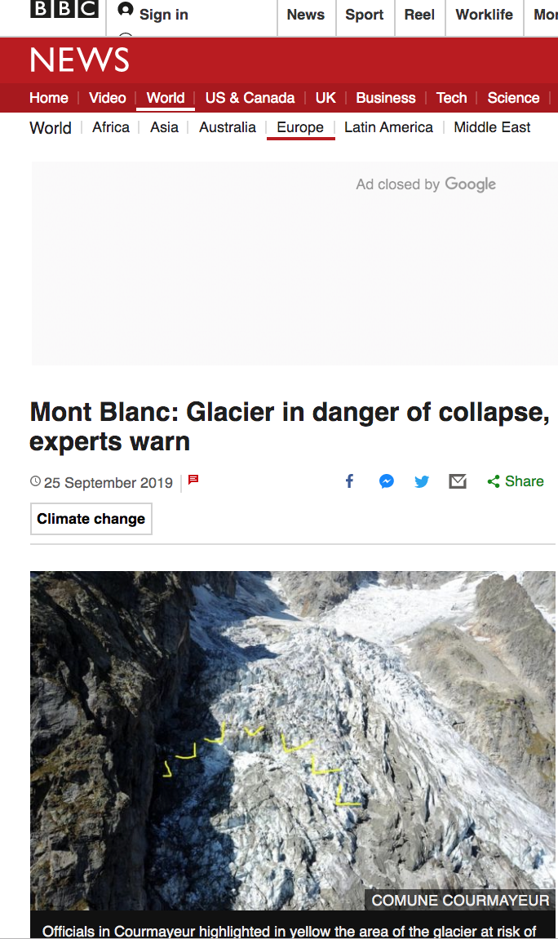
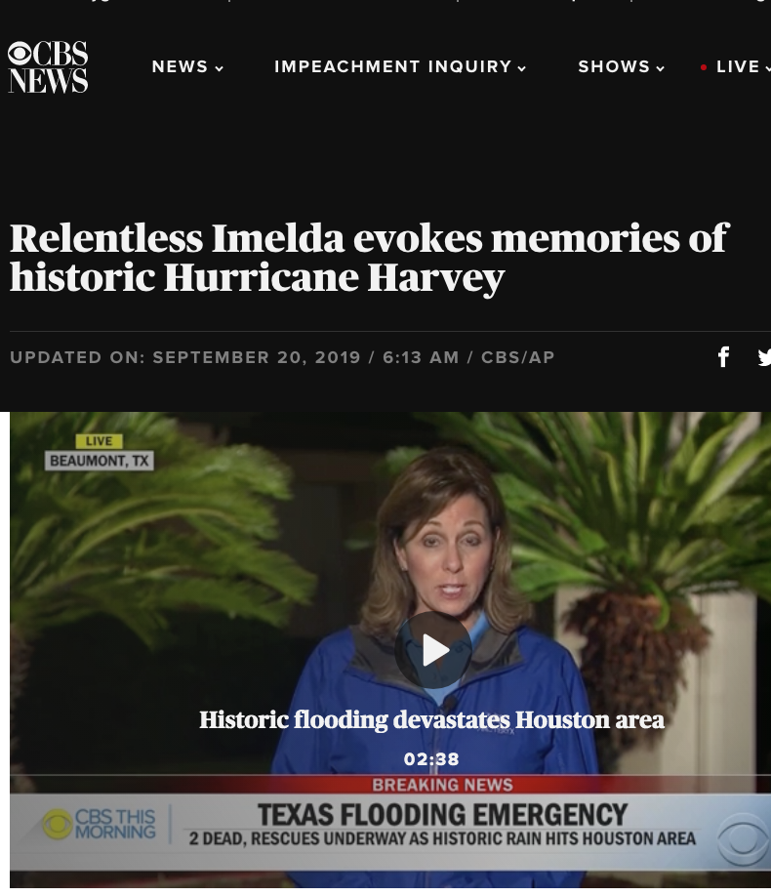
A Diversity of Hydrologic/Cryospheric Geohazard Science Targets

Slide 3
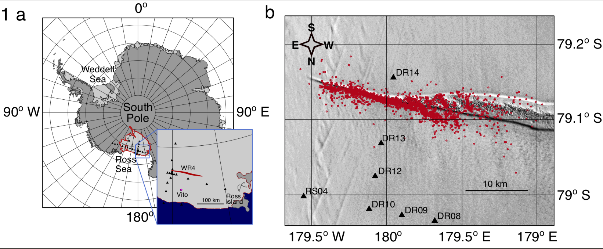
A Diversity of Hydrologic/Cryospheric Geohazard Science Targets
Brad Lipovsky: Glacial seismicity & rifting constraints on sea level rise physics
Danica Roth: Ground-motion sensing of fluvial & debris flow processes
Toshiro Tanimoto: Hurricane physics observed w/ seismics & pressure sensors

Slide 4
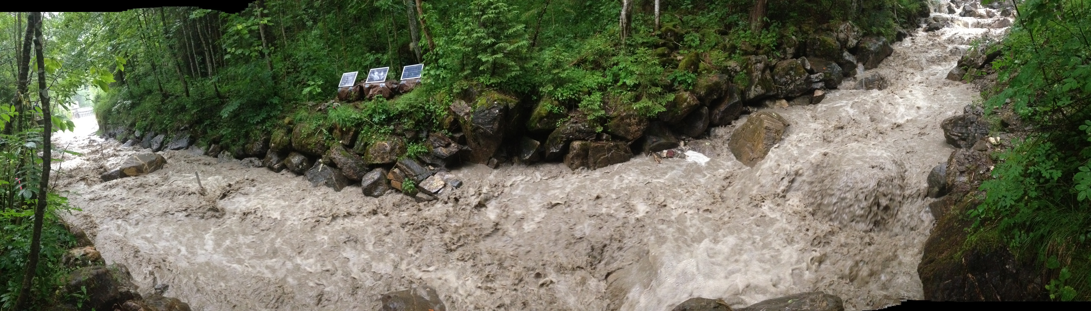
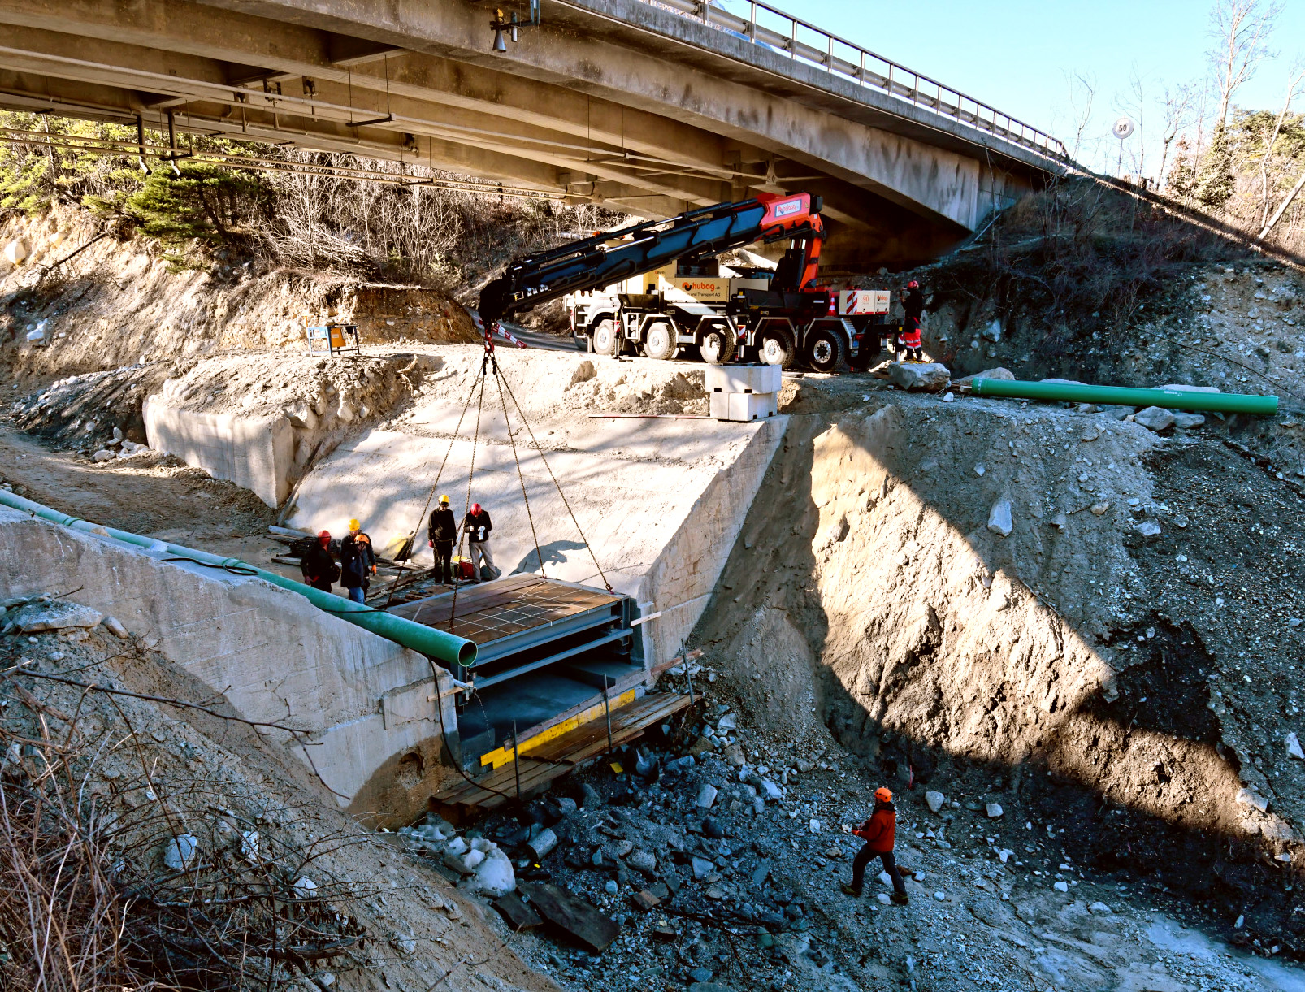
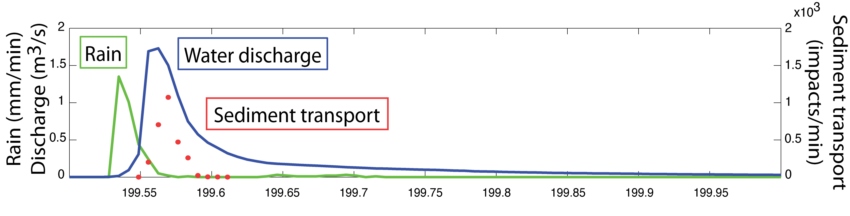
A Diversity of Hydrologic/Cryospheric Geohazard Science Targets
Brad Lipovsky: Glacial seismicity & rifting constraints on sea level rise physics
Danica Roth: Ground-motion sensing of fluvial & debris flow processes
Toshiro Tanimoto: Hurricane physics observed w/ seismics & pressure sensors

Slide 5
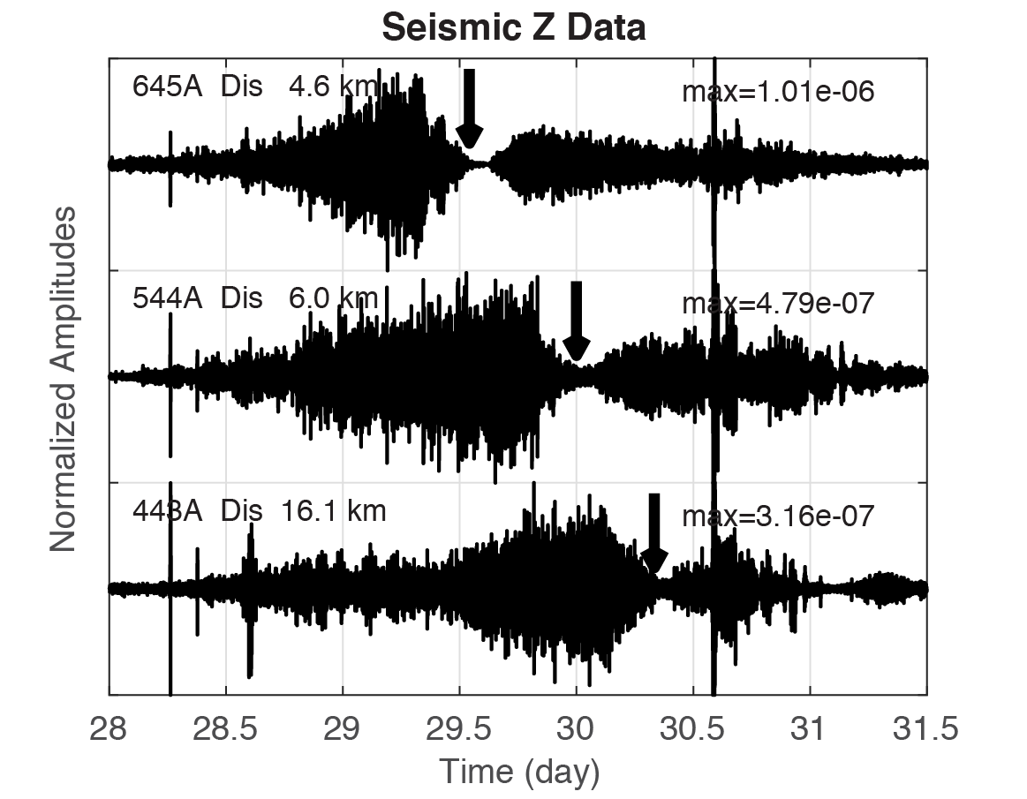
A Diversity of Hydrologic/Cryospheric Geohazard Science Targets
Brad Lipovsky: Glacial seismicity & rifting constraints on sea level rise physics
Danica Roth: Ground-motion sensing of fluvial & debris flow processes
Toshiro Tanimoto: Hurricane physics observed w/ seismics & pressure sensors

Slide 6
A Diversity of Hydrologic/Cryospheric Geohazard Science Targets
Some targets event-based & predictable (Some not; Continuum in between)
  Imminent collapse vs. Weather anticipated vs. Geologically/seasonally ready
Some knowledge gained is directly related to hazard, others more general
  e.g., Monitoring of increased seismicity pre-failure, Debris flow early warning
  e.g., Seismics from hurricanes → thermodynamics, Seismics from debris flows → erosion
Some event-based targets provide constraints not otherwise available

Slide 7
A Diversity of Hydro/Cryospheric Geohazard Science Questions
What ice sheet processes govern sea level rise?
How does microseismicity change leading up to catastrophic ice collapse?
Can rifting physics be related to ocean wave activity?
What processes cause starting/stopping of ice stream flow?
How do debris flow particle impacts cause erosion and damage?
How is ground motion from water flow (turbulence) different from impacts?
Why do hurricanes cause low-frequency ground motion?
Does the core of a hurricane behave thermodynamically as expected?
Do deep-seated landslides have precursors prior to failure?

Slide 8
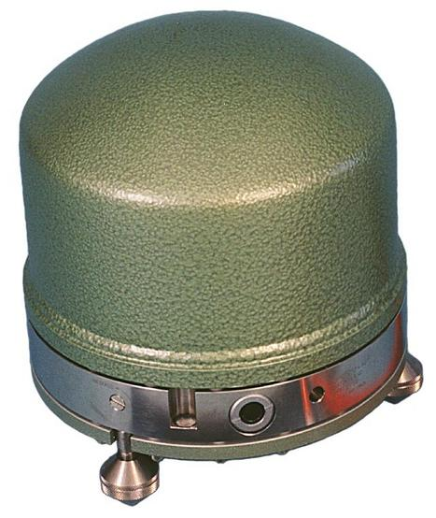
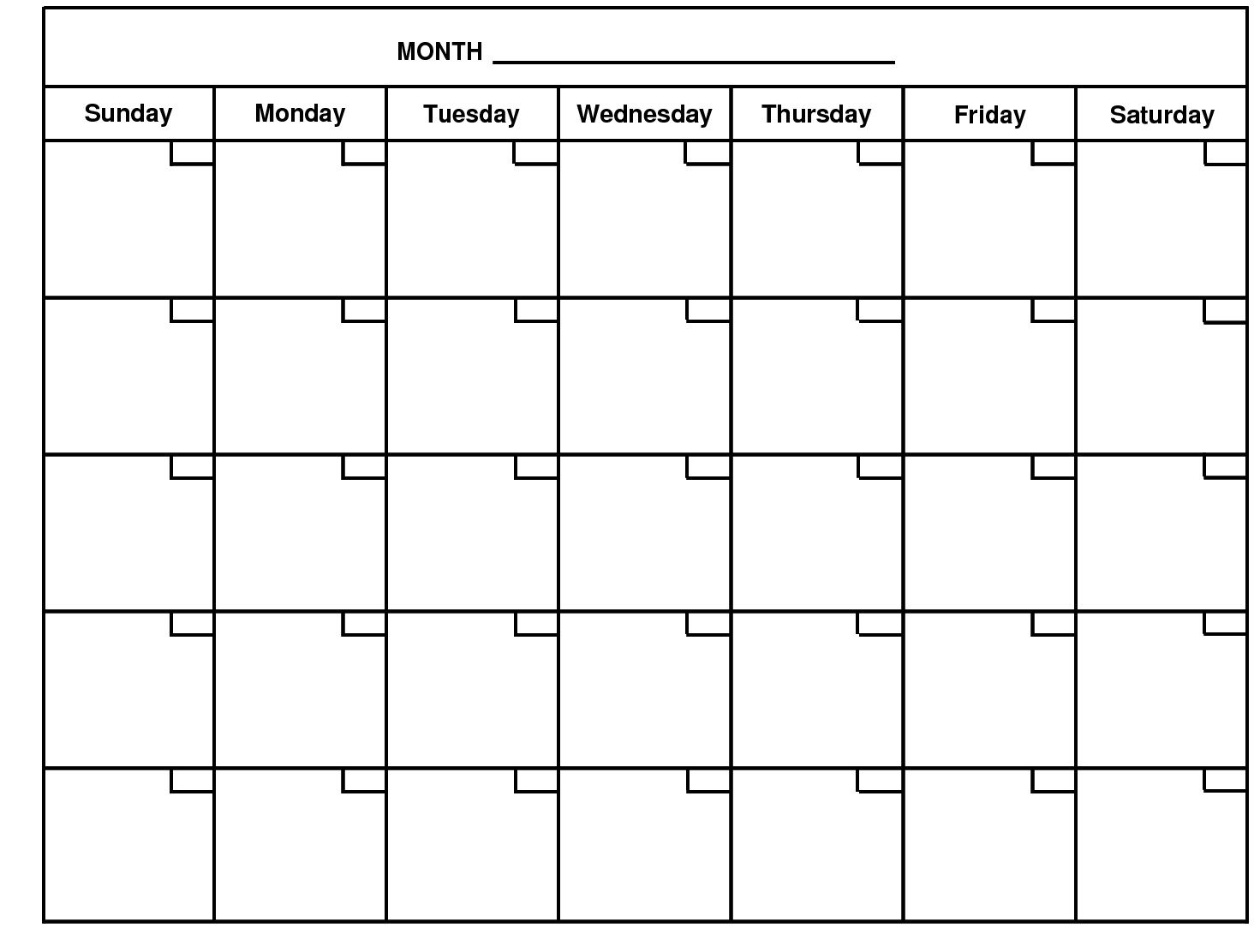

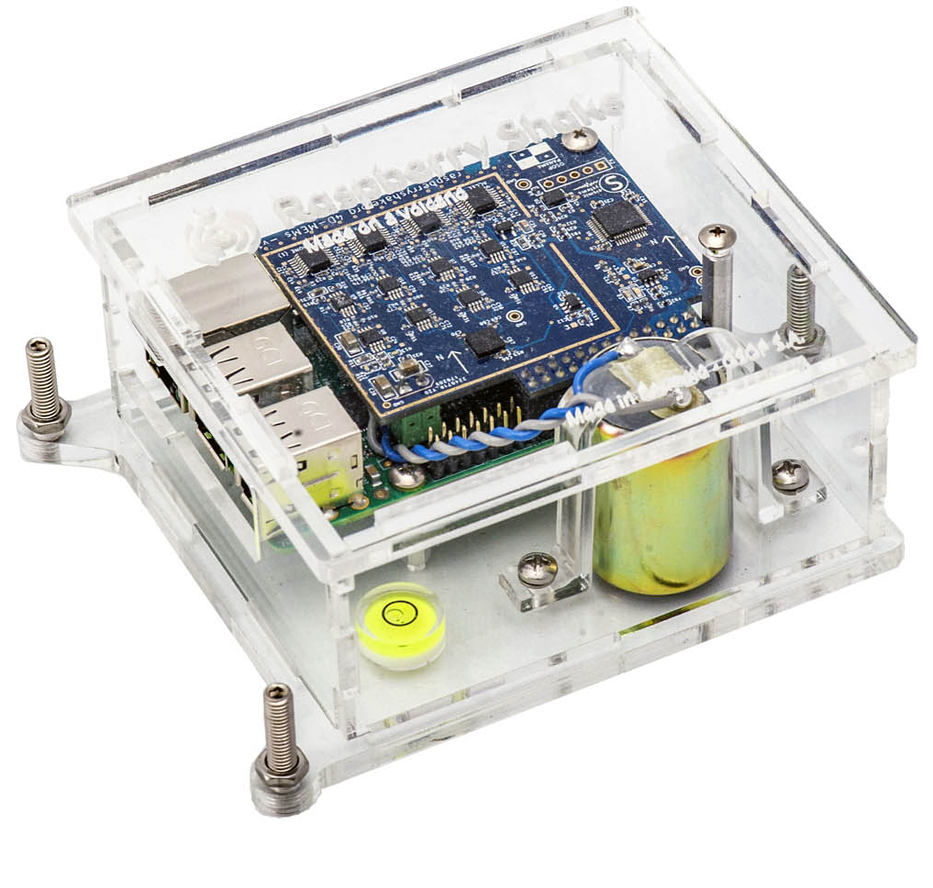
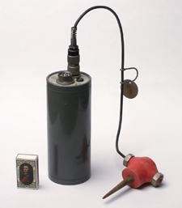
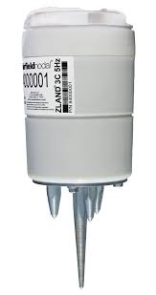
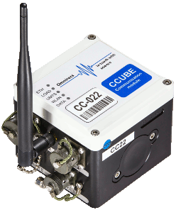


Diversity of Instrumentation for Hydro/Cryospheric Geohazards
Brad Lipovsky: Glacial seismicity & rifting constraints on sea level rise physics
  Instrumentation mostly broadband, month to year-long deployments
Danica Roth: Ground-motion sensing of fluvial & debris flow processes
  Seismic instrumentation flexible: geophones, Rasp-Pi’s, week to year-long deployments
Toshiro Tanimoto: Hurricane physics observed w/ seismics & pressure sensors
  Signals of interest mostly low frequency (broadbands), week to permanent deployment

Slide 9
Diversity of Supporting Cast for Hydro/Cryospheric Geohazards
Weather/meteorological data
Pressure sensors, pressure gauges
GPS, InSAR, other geodetic
Force plates, in situ sensors
Video cameras, time-lapse imagery
Laser scanners, lidar, DEMs
Sediment traps
Background data & observations (e.g. bathymetry, topography)
Personnel expertise! Collaborative, interdisciplinary science
Need for theoretical understanding, development in parallel

Slide 10
A Diversity of Needs for Hydro/Cryospheric Geohazards
Accelerometers, geophones, broadbands
  Many rapid deployments can use node-style instrumentation
  But real-time data availability is needed for some applications + battery life annoying
Many supporting instruments are key, ideally digitized in one system
Lead times of days, weeks, months, seasons
Less mature fields require simultaneous theoretical development
In many cases, ideal to have pre-event/post-event site characterization

