Slide 1
Evaluating Facilities-based Education and Public Outreach Activities
John Taber & Michael Hubenthal
Incorporated Research Institutions for Seismology
Hilarie Davis
Technology for Learning
5/26/16 – Large Facilities Workshop

Slide 2
Overview
Why Education and Public Outreach (EPO) in a research facility?
EPO evaluation needs
One collaborative approach: Impact Analysis Method
Potential outcomes
Critical success factors for implementation

Slide 3
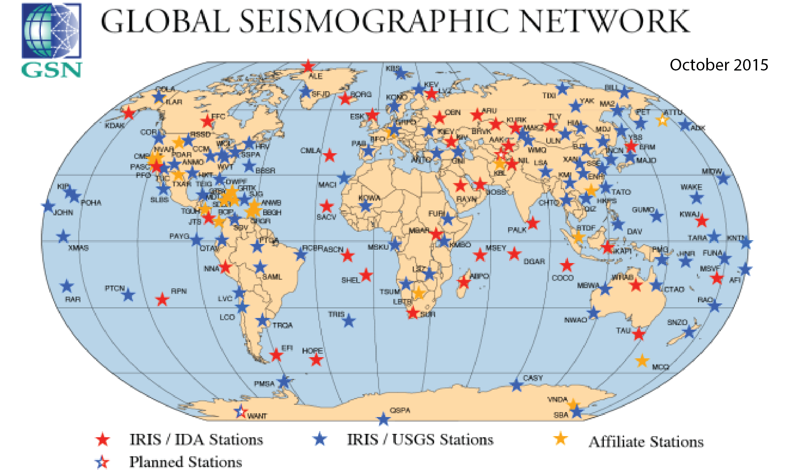
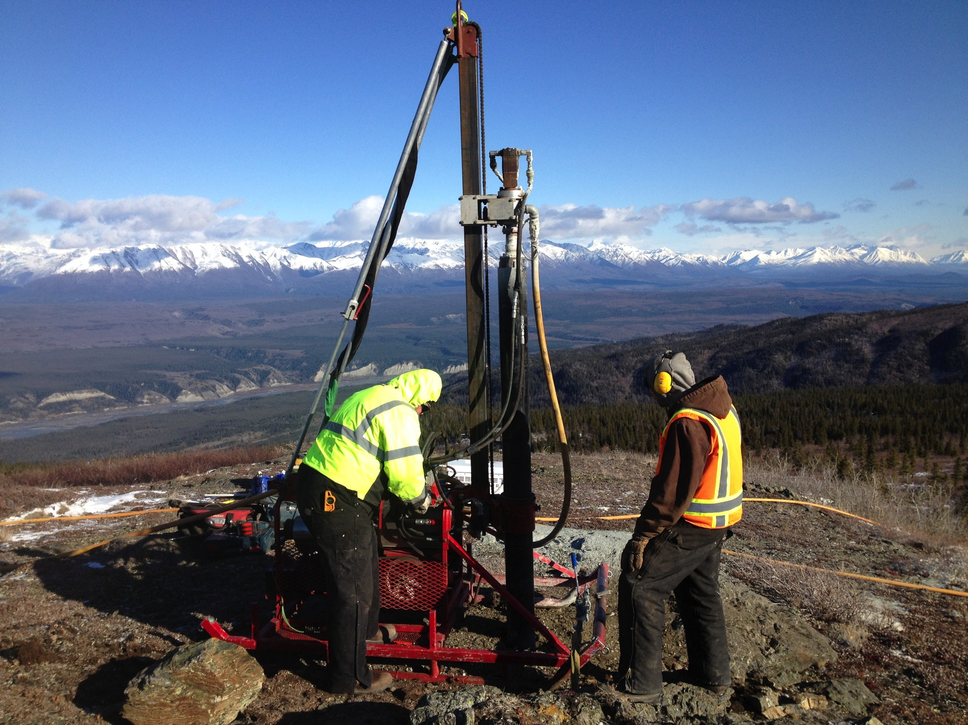

Incorporated Research Institutions for Seismology
Formed in 1984
  Global Seismic Network (with USGS)
  Portable seismographs (PASSCAL)
  Data management center
Now includes
  Education and Public Outreach
  EarthScope Transportable Array
  Ocean Bottom Seismograph Instrument Pool
  Other instrumentation
Over 120 member organizations and over 100 educational and foreign affiliates

Slide 4
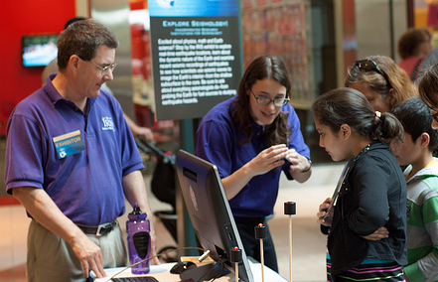
Why EPO in a research facility?
Strong NSF encouragement to add EPO
  Initiation of NSF Broader Impacts criteria (1997)
  First staff member in 1998
Value of a facility EPO program
  National consortium with local university connections
  Strong community involvement
  Unique data and scientific resources
  Stable consortium structure for long-term programs
  Professional staff
  Considerable emphasis on outreach

Slide 5
Positioning facility EPO programs
Education and outreach spectrum
NSF funded education projects (e.g. EHR)
Broader Impacts of science proposals
Facility-based EPO programs
Education research
Detailed external evaluation
Single PI outreach
Self reporting, counts

Slide 6
Reporting metrics to NSF
Instrumentation and data
  Number of portable instruments available for the research community
  % data availability of each seismic network
  % uptime for the Data Management Center
EPO
  Number of products and services provided

Slide 7
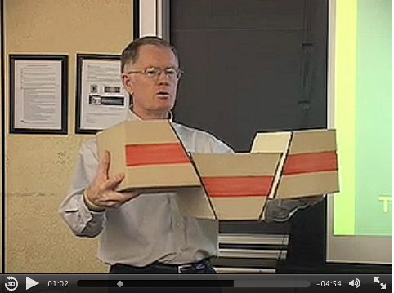
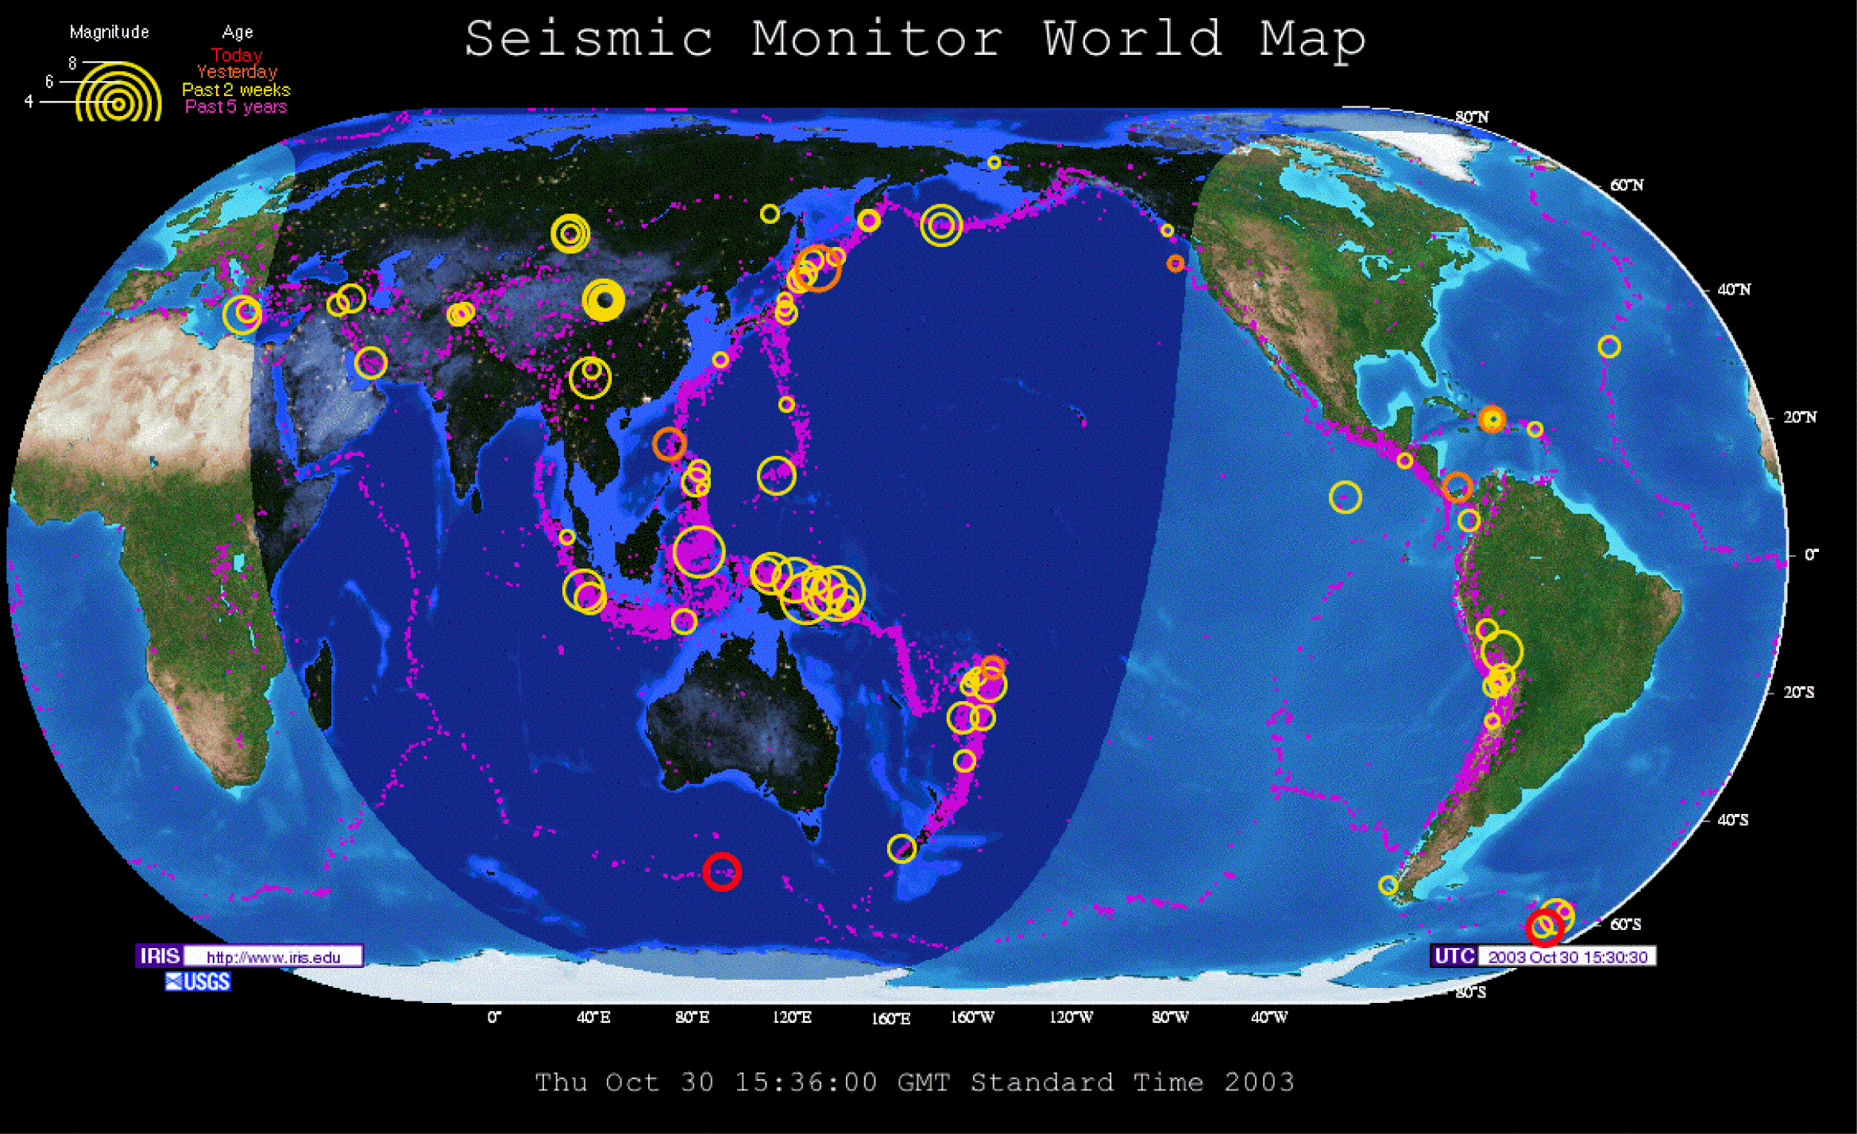
Prior IRIS EPO evaluation approach
Internal assessment during development and implementation
Occasional external assessment at conclusion of projects
Regular oversight by community steering committee
Difficult to decide on appropriate level of evaluation for a very wide range of products and services
  Millions of website visitors for a minute
  15 research interns for an entire summer

Slide 8

Need of IRIS EPO
We evaluate the products and programs in our portfolio….
but could benefit from increased consistency and rigor.
Need to assess both quality and impact

Slide 9
Desired Outcome:
Make evaluation an integral part of IRIS EPO staff’s work so
we can state why we do the activities we do (needs assessment),
enhance the impact, and
make evidence-based claims about our work.
Impact -The intended and unintended effects on the Behavior, Attitudes, Skills, Interest, Knowledge, (BASIK) of the participants (Friedman, 2008)

Slide 10
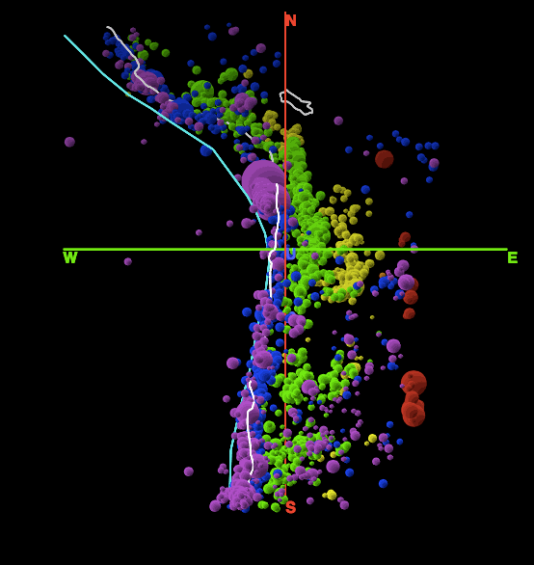
Evaluation choice
Adopted the Collaborative Impact Analysis Method of Davis and Scalice, 2015
Used by a number of NASA EPO programs
Designed to be implemented within an existing EPO program
  Focus on incremental improvements

Slide 11
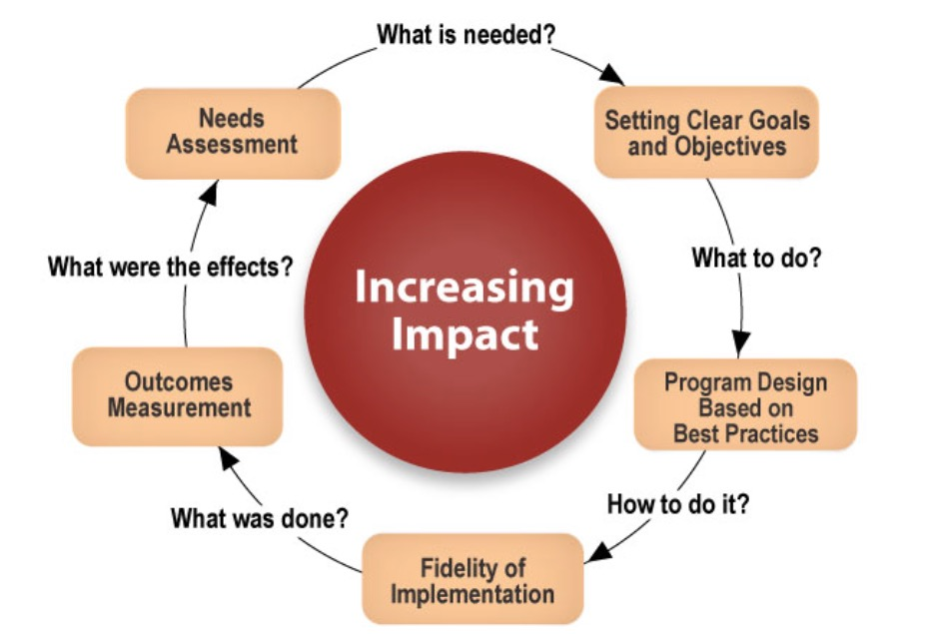
Evaluation Approach
Davis & Scalice, 2015
Notes:
Enter the cycle at any point

Slide 12
Process
Consultations with external evaluator - Assess current evaluation for each project
Internal staff development – Consultations with external evaluator, presentation, reading
Action plans - Develop internal structures and reporting mechanisms to support evaluation
Implementation - Make incremental changes to our projects to improve rubric scores

Slide 13
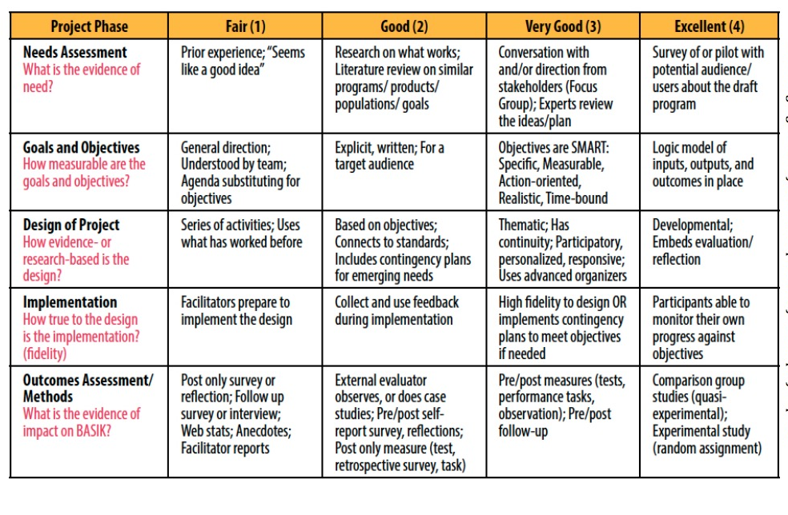
Quantitative Collaborative Impact Analysis Method
Davis and Scalice, 2015

Slide 14
Collaborative Impact Analysis Scores
VG
G
F
Min = 0, Max = 3.6, Median 1.9

Slide 15
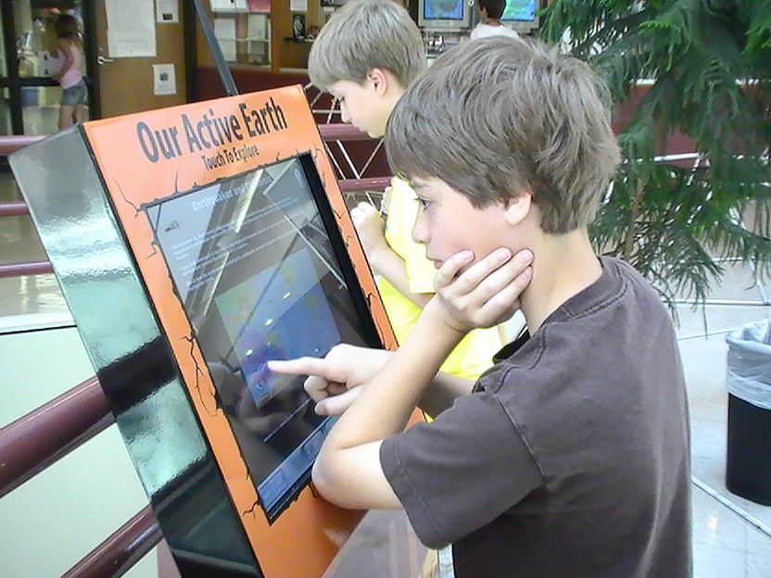
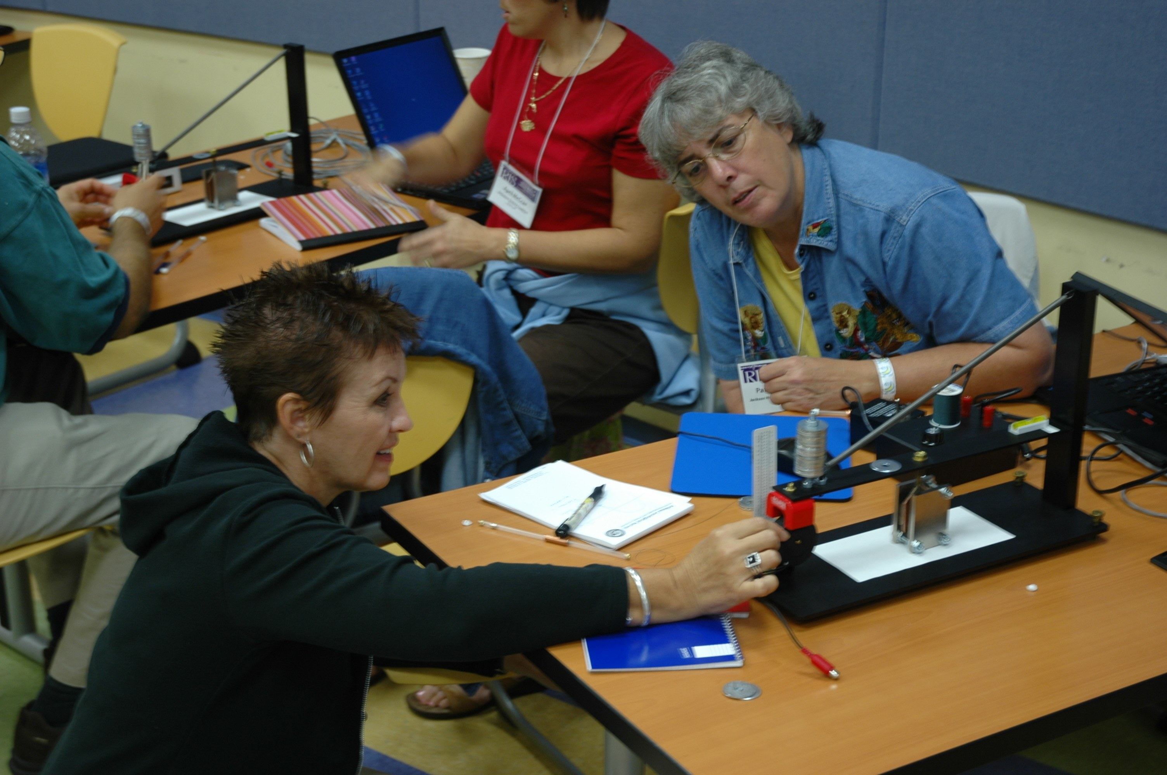
Post-consultation
What we expect
  Incremental improvement everywhere
What we don’t expect
  Achieve a 4 everywhere, unless
    Core to the mission
    Additional funding for enhancement/expansion
    A gap in the literature we can uniquely fill

Slide 16
Action Plan - Examples
Write SMART Objectives
Conduct survey of existing users
Review and update design criteria/critical features
Request pre/post survey data from collaborative workshops
Create a logic model for project
Conduct needs assessment of Educational Affiliate members of IRIS

Slide 17


IRIS/SSA Distinguished Lectureship - Example
Initial Score 1.8
  Needs Assessment - 4
  Goals and Objectives - 2
  Design - 2
  Implementation - 1
  Outcome Assessment - 0
Action Plan
  Rewrite goals as SMART Objectives
  Post lecture surveys
    Speakers
    Venue
  Obtain feedback from SSA (partner organization)
Projected Score 2.6
2016 Distinguished Lecturers

Slide 18
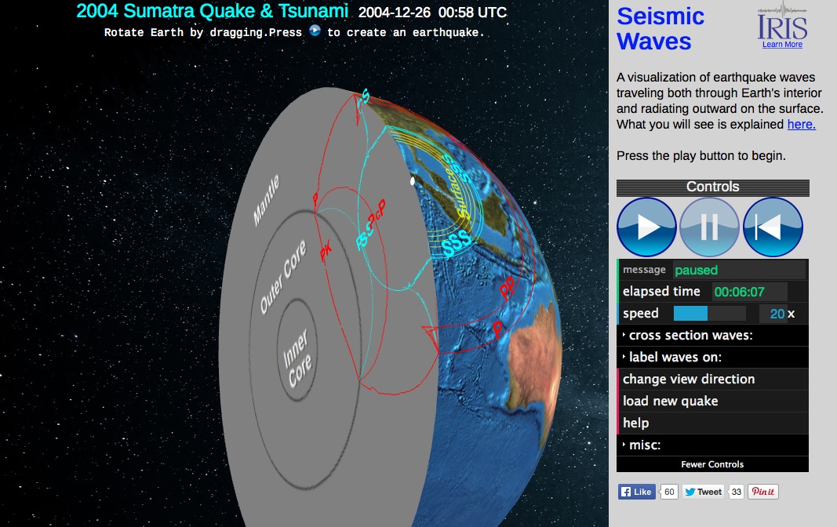
Seismic Waves web application - Example
Current Score 2.8
Actions
  Needs assessment &
  competitive analysis - 4
  SMART objectives - 3
  Critical feature list (design)
  Beta/Usability testing (implementation) - 3
  Revision based on testing (design) - 4
  Promotion (built from the above)
  Measuring effects of use (outcomes) - 1

Slide 19
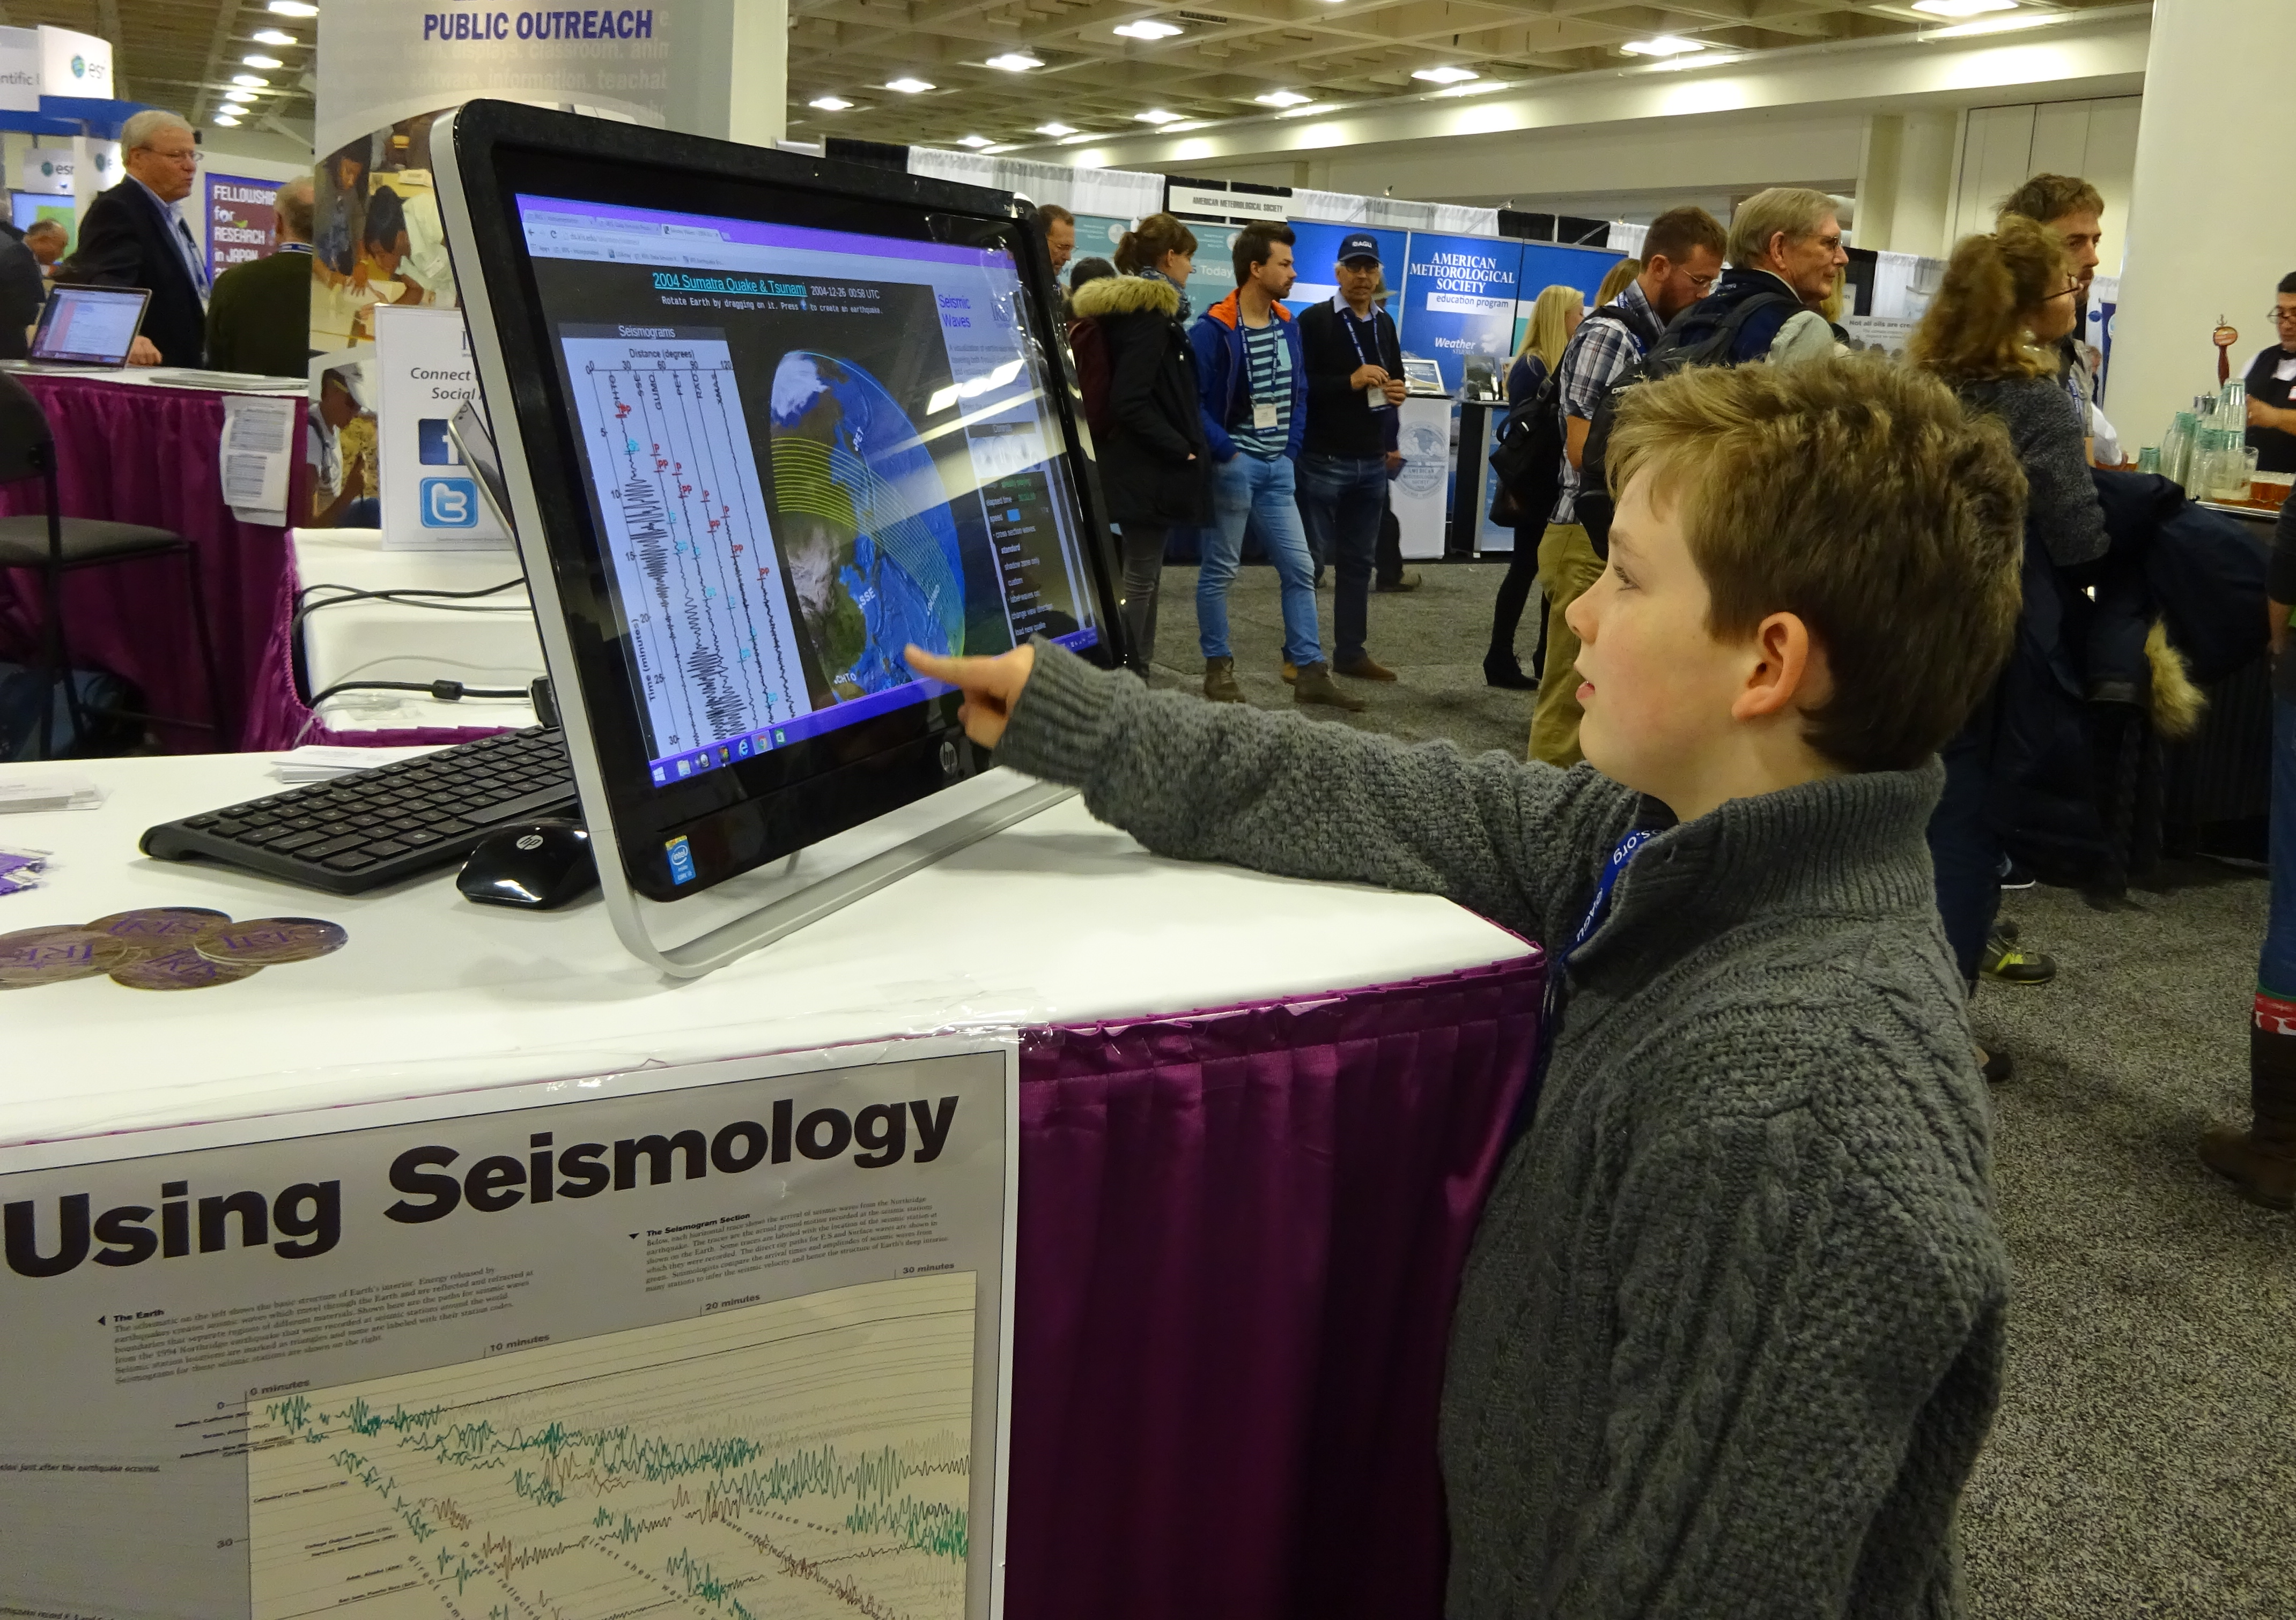
Positive Effects on IRIS EPO
Each project is explored in consultation with the evaluator, which provides
  expert outside feedback
  a benchmark score
  possible pathways to improve the evaluation
Promotes improvement, no matter the initial state

Slide 20
Positive Effects on IRIS EPO
Change in staff knowledge, attitude and behavior
  Development of staff knowledge and skills regarding evaluation
  Common language among staff
  Increased enthusiasm to collect and share data
  Desire for consultations to get evaluation ideas
  Inclusion of evaluative approaches up front for discussion of new activities
Improved impact of products and programs

Slide 21

Evaluation cycle
Combines internal and external assessment
Annually
  Build internal capacity through consultations with external evaluator
  Develop action plans to increase level of evaluation
  Collect data and prepare annual report which is reviewed by external evaluator
Every 2-3 years
  Conduct total portfolio evaluation with external evaluator, followed by strategic planning

Slide 22

Potential items to report
Lists of products/activities
Accomplishments by project
Audiences
Types of impact (BASIK),
  Counts of participants
  Deeper intervention –evidence and nature of of impact
  How measured
  Generalizability
Annually – impact analysis scores by project, mean, median

Slide 23
Evaluation process
How does this process differ from typical, single project evaluations?
  Lower cost for external evaluator
    Instead of commonly used 10% of budget
    Depending on staff time instead
  Greater staff involvement and ownership
Still challenging to include in flat budget environment

Slide 24
Potential facility model for evaluation
Planning discussion with leadership
Evaluator consultations with individual staff
Staff develop/implement action plans
Expert review and support with evaluation tools and analysis
Discuss and report results

Slide 25
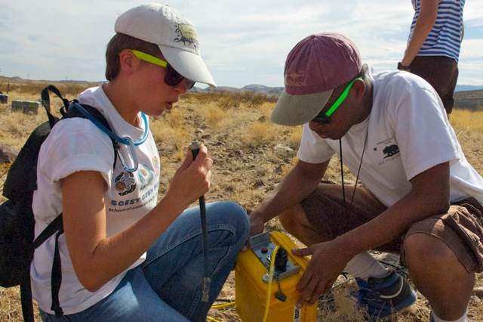
Critical Success Factors
Some existing internal evaluation expertise
Clear leadership commitment and involvement
Intentional cultural change
Ongoing support from external evaluator
Use of evaluation results for improvement and reporting

Slide 26
Summary
Collaborative evaluation method
  Capacity building of implementers
Can be initiated at any stage of the project
Evaluation integrated throughout the project life cycle
  Ongoing use of data
More focused implementation
  More efficient use of resources
Richer reporting to NSF
Greater impact

