Slide 1
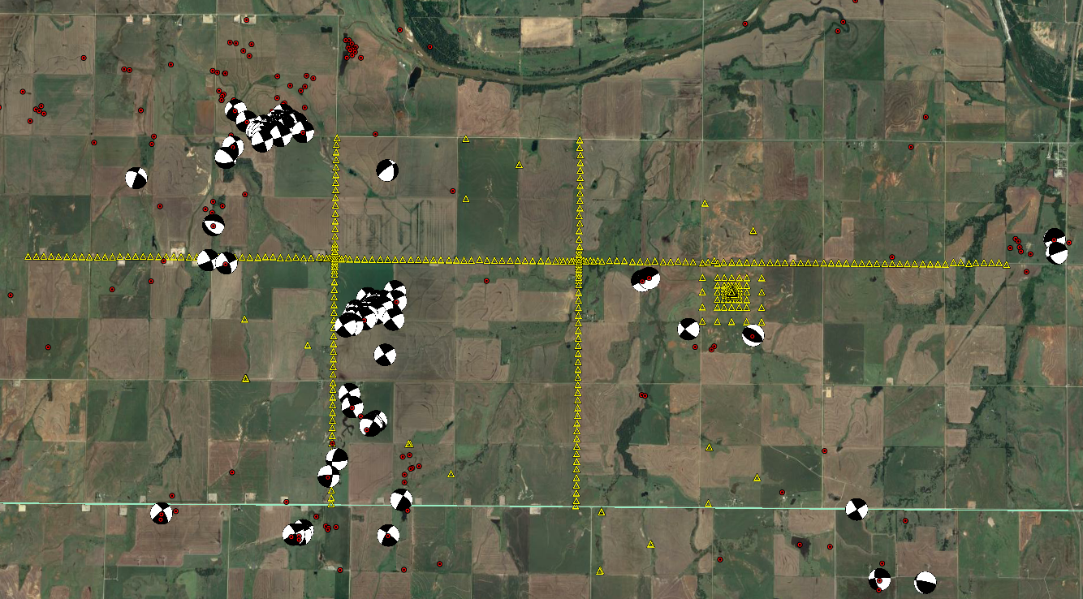
Relational Database Management Systems
A practical introduction using the IRIS Wavefields experiment
Heather DeShon
Southern Methodist University
IRIS USArray Short-course 2017
Indiana University
August 8, 2017

Slide 2
Waveform-Relocated Earthquake Catalog for Oklahoma and Southern Kansas Illuminates the Regional Fault Network by Martin Schoenball and William L. Ellsworth

Slide 4
Why do seismologists need to know about relational databases (RDB)?
Increasing complexity of seismology data acquisition requires efficient means to organize and access data
Only want to type information once and keep it in a central location! A piece of information is only found in one place
Standard RDB tools to create, edit, combine, and destroy tables already exist
Entire discipline of study in computer science

Slide 5

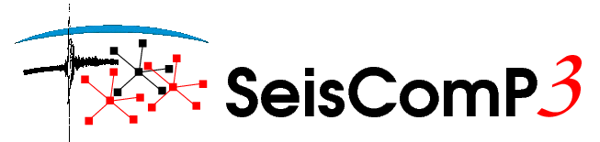
How do seismologists use RDBs?
Processing, analysis and storage of data and associated metadata
RDBs are at the heart of every seismic/infrasound network operation
Most RDBs are embedded in combinations of commercial and open source software packages
Antelope
Datascope
*Boulder RealTime Technologies/Kinemetrics
AQMS
Earthworm
*ITSI
MySQL, SQLite, postgresSQL
*gempa GmbH

Slide 6
The Wrappers
Example of a set of Python modules wrapped around an Oracle SQLite RDB to analyze infrasound data – like yesterday

Slide 7
What is Antelope?
Software platform designed to acquire, distribute, archive, and process environmental data
Provides a standard substrate (middleware) for interconnecting diverse data sources with diverse data processing
  Commercial and public-domain components
  Closed and open source components
  Can handle ANY packetized data
  Encapsulates diverse specific data formats and uses standard protocols for communication

Slide 8
more about Antelope
  Built upon the Datascope Relational Database
  Handles real-time and offline batch mode data
  Easy integration of user developed modules
  Property of Boulder Real Time Technologies, Inc (BRTT)

Slide 9
What is Datascope?
Relational database component  ASCII fixed format tables which are related or linked to each other so that every record (row) of the table is unique
Originally developed at UC-Boulder and distributed through IRIS for use with PASSCAL deployments
Academic usage was primarily offline batch mode processing for creating seed volumes, phase picking, locations, etc.
Used to create DMC SEED volumes for archiving

Slide 10
Seismology-specific processing functions using derivatives of the CSS3.0 schema
  Data and metadata archiving (waveforms, site and instr char, etc.)
  Information archiving (picks, hypocenters, etc.)
  Import/export (SEED, SAC, SEGY, etc.)
  “routine” network processing (detection, association, location, etc.)
  Ground motion estimation (similar to Shakemap)
  Interactive analysis review
  Archive management functions (backup, restore, copy, excerpt, etc.)
  Interface with other research tools (SAC, MATLAB, etc.)

Slide 11
Seismology-specific processing functions using derivatives of the CSS3.0 schema
  Data and metadata archiving (waveforms, site and instr char, etc.)
  Information archiving (picks, hypocenters, etc.)
  Import/export (SEED, SAC, SEGY, etc.)
  “routine” network processing (detection, association, location, etc.)
  Ground motion estimation (similar to Shakemap)
  Interactive analysis review
  Archive management functions (backup, restore, copy, excerpt, etc.)
  Interface with other research tools (SAC, MATLAB, etc.)

Slide 12
Why use Kinemetrics/BRTT Antelope?
It was originally designed to deal with seismic data
Contains numerous tools for processing and analyzing seismic data of many formats
Flexible enough so that users can create their own schema or integrate home-grown location algorithms, magnitude calculators, etc.
It’s FREE for research use at US educational institutions

Slide 13
Real-time or ORB system
The real time system is built around a large, flexible, non-volatile ring buffer.
Ring Buffer: a method of using memory within a computer program. “Ring” alludes to the rotation through the buffer of the positions where the next data will be read and written. When moving through the buffer, the writer moves forward one step each time it writes, and when it passes the end of the buffer it starts again at the beginning. The reader moves through the buffer in the same way.

Slide 14
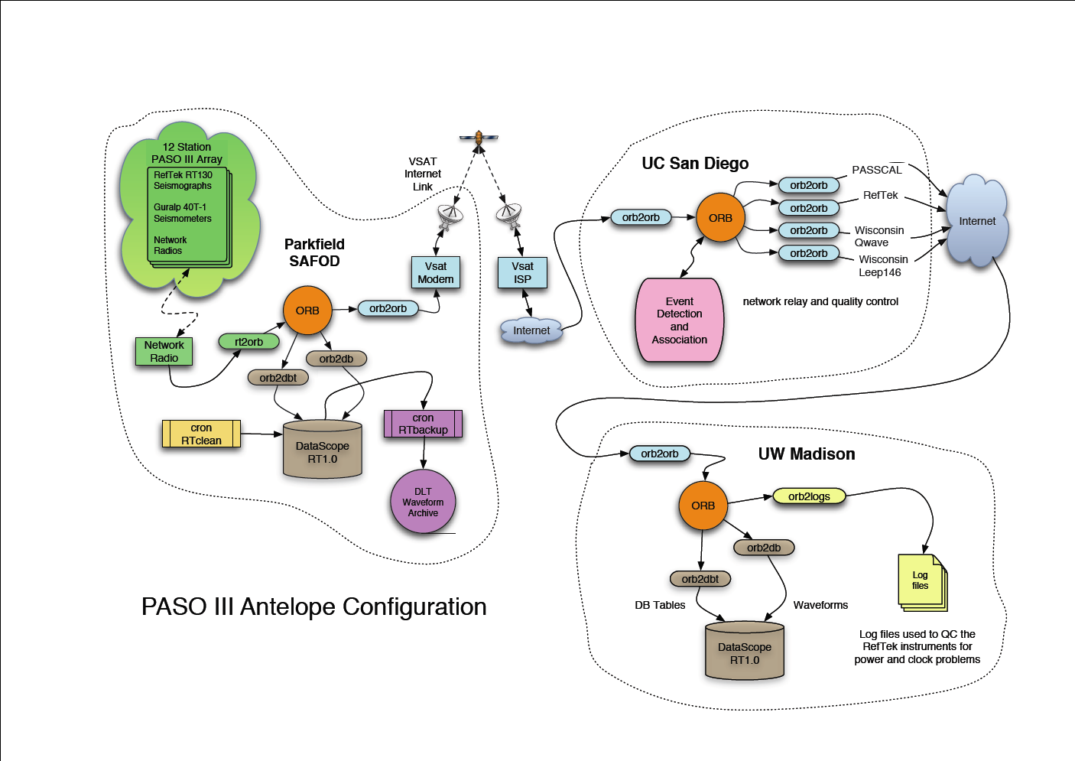

Slide 15
Offline processing or the DB system
Offline batch mode processing built upon algorithms originally developed with Datascope
The common way in which data for temporary or non-telemetered PASSCAL arrays are processed and seed files for DMC archiving are created
DB: acronym for database which marks algorithms that work with offline data (ie. dbassoc)

Slide 16
dbe - The database editor
Antelope 5.6+
Some slides may show the old version, dbe_dep

Slide 17
Relational databases – Some definitions
Table: fix format ASCII text files made up of records (rows) and fields (columns)
TABLE NAME

Slide 18
Field: has the same attributes (size, type, format) in every table in which it appears
Record: unique combination of information
FIELD
RECORD

Slide 19
Schema
The attributes and relations that define the relational database
Defined by single text file that contains
  schema description
  attribute statements for every field
  relation statements for every table which describe how the tables are linked/related

Slide 20
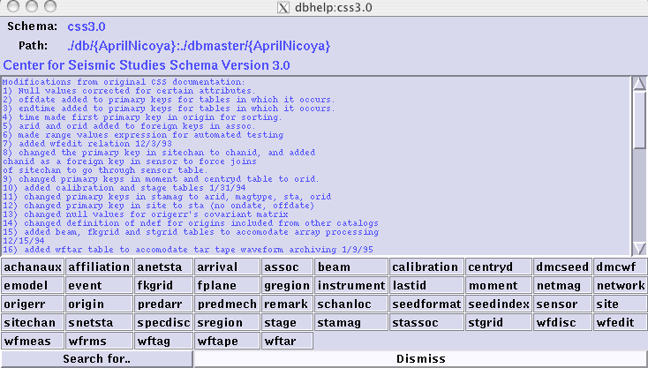
Example Schema
SCHEMA
DESCRIPTION
LIST of TABLES

Slide 21
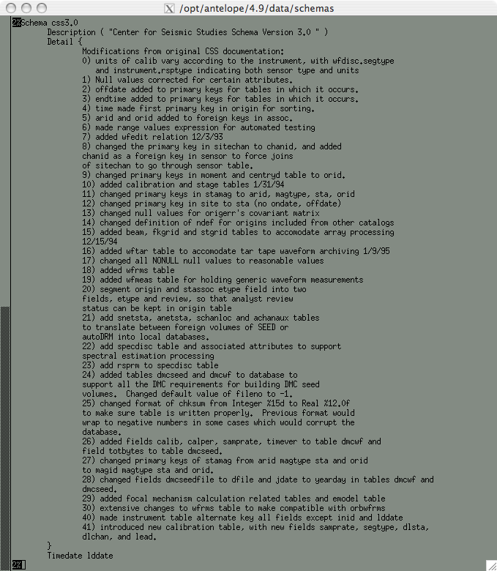

Slide 22
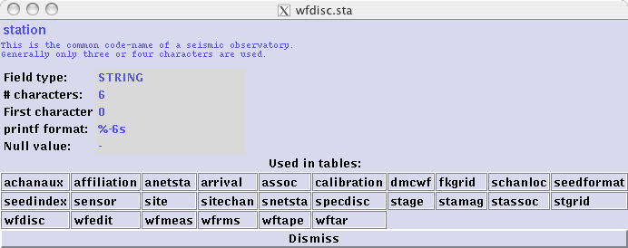
Attribute Statement
Range
Type
Format
Null value
Units
ATTRIBUTE
DESCRIPTION
& DETAIL

Slide 23
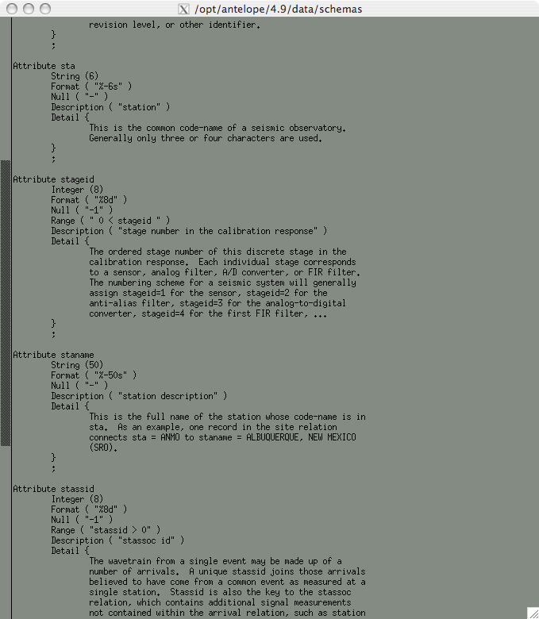
sta ATTRIBUTE

Slide 24
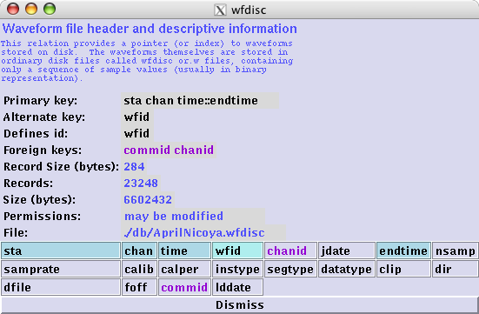
Relation Statement
RELATION / TABLE NAME
TEXT
DESCRIPTION
LIST of FIELDS

Slide 25
PRIMARY KEY: attributes which uniquely identify the records for each table
ALTERNATE KEY:
Attributes which could uniquely identify a record but were not chosen as a primary key
FOREIGN KEY: attributes of the table that are primary keys of other tables in the schema

Slide 26
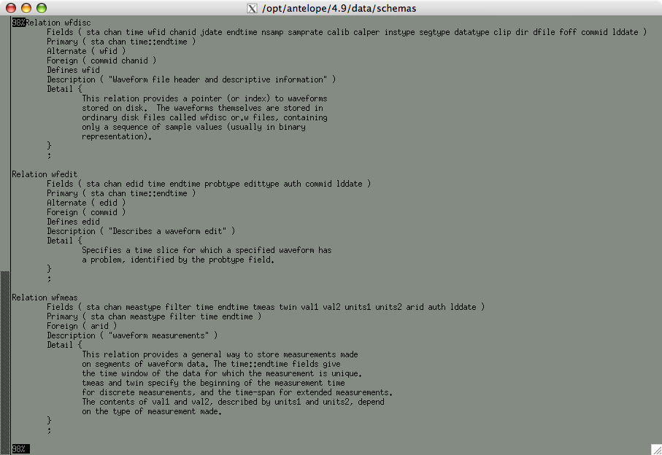
wfdisc RELATION

Slide 27
Tables are linked together by the primary, alternate, and foreign keys

Slide 28
How links via keys work
Site
  Site Table Primary Keys
  Sta
  Ondate::Enddate
SiteChan Table Primary Key
  Chanid
Alternate Key
  Sta, Chan
  Ondate::Enddate
SiteChan Subset

Slide 29
How links via keys work
SiteChan Table Primary Key
  Chanid
Alternate Key
  Sta, Chan
  Ondate::Enddate
SiteChan

Slide 30
Result of joining the sitechan and site tables
Common primary keys used for the join

Slide 31
Apply the subset
Type out the subset then click on the subset button

Slide 32
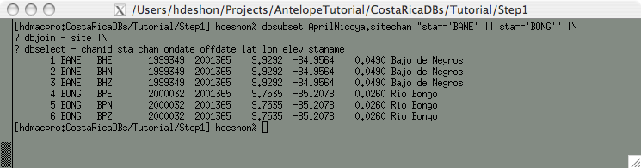
Join using the GUI dbe
or
Join via command line

Slide 33
Relational Algebra
Union: If A and B are sets, then the union of A and B is the set R that contains all elements of A and all elements of B, but no other elements.
Difference: If A and B are sets, then the difference of B and A, is the set R which contains all of elements in B, but not in A.
Rename: change the name of a field

Slide 34
Relational Algebra
Selection: selecting records by applying a test using binary operators (<,≤,=≥,>) based on the table fields
Projection: if a1,...,an is a set of field names, the result of projection is defined as the set R that is obtained when all records in R are restricted to the set {a1,...,an}
Cartesian Product: If A and B are sets, the Cartesian product is the set R containing all possible ordered pairs whose first component is a member of A and whose second component is a member of B

Slide 35
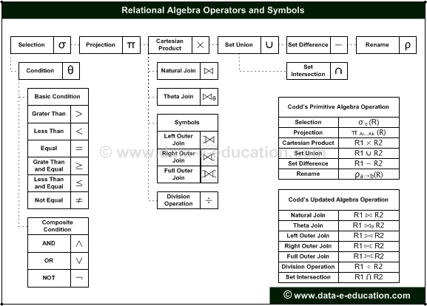
J
Ɵ
L
R
So Sort
⊆ Subset
Group
N No Join

Slide 36
Relational operations
Subset
  $dbsubset dbsite ‘lat > 35’
Sort
  $dbsort dbsite sta
Join
  $dbjoin db.arrival site

Slide 37
Select/Arrange
  %dbselect - sta lat lon elev staname
  % dbsubset AprilNicoya.site 'lat < 11 && elev > .5' |\
  dbsort - sta |\
  dbjoin - arrival |\
  dbselect - sta lat lon arid arrival.time chan
  JUDI 10.1659 -85.5387 30026 986357438.70800 BHZ
  JUDI 10.1659 -85.5387 31083 988433330.21200 BHZ
  JUDI 10.1659 -85.5387 31093 988479025.88600 BHZ
  JUDI 10.1659 -85.5387 31099 988518786.98200 BHZ
  JUDI 10.1659 -85.5387 31108 988529215.11200 BHZ
  JUDI 10.1659 -85.5387 31114 988558341.28100 BHZ
  JUDI 10.1659 -85.5387 31120 988565702.96100 BHZ
  JUDI 10.1659 -85.5387 31128 988606800.21600 BHZ

Slide 38
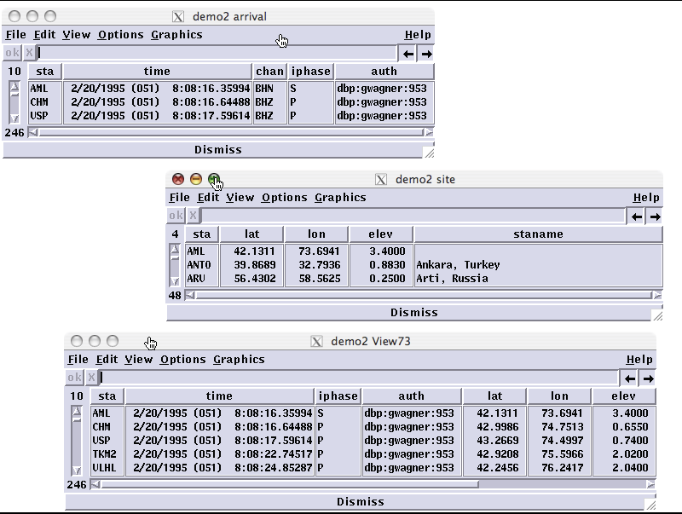

Slide 39
Relational Operators
    < : test for less than
    <= : test for less than or equal to
    > : test for greater than
    >= : test for greater than or equal to
    == : test for equal to
    ~= : test for not equal

Slide 40
Logical Operators
    && : logical AND ; tests that both expressions are true
    || : logical OR ; tests that one or both of the expressions are true
    ! : logical NOT; tests that expression is true

