Slide 1
Data Formats & Data Structures
Crossroads of Active Source and Broadband Structures
Justin Sweet
USArray Advanced Short Course, August 2017

Slide 2
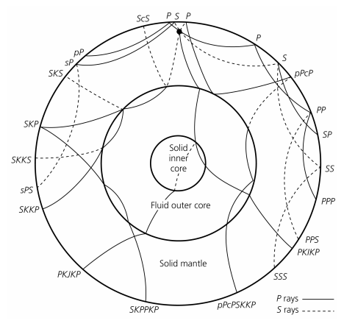
Variety of seismic deployments
Passive seismic – natural sources (earthquakes)
Tomography
Regional and Global Scale
Surface Wave
Ambient Noise Tomography

Slide 3
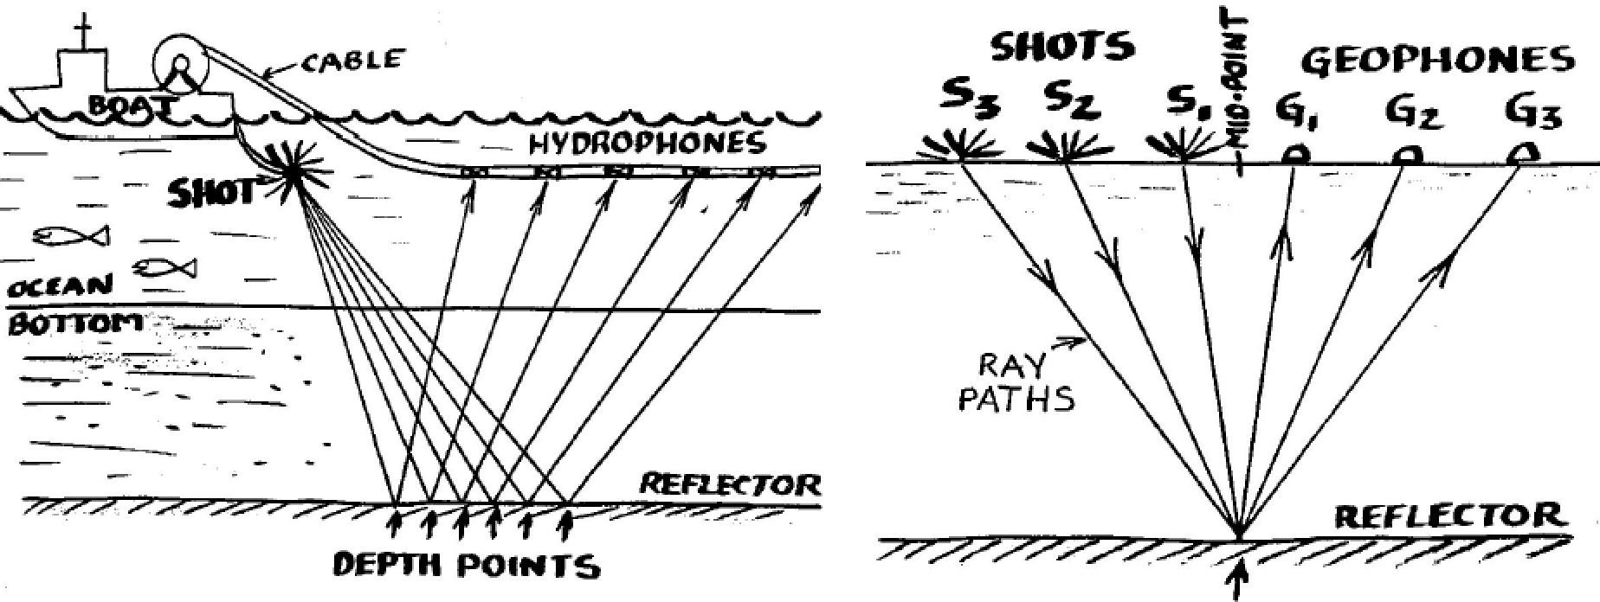
Variety of seismic deployments
Active seismic – artificial sources (explosives, hammer, etc.)
Figure from Karplus

Slide 4
Variety of seismic data formats
Passive source
SEED
SAC
Active source
SEG-Y, SEG-D, SEG-2
Both
PH5

Slide 5
SEED: Standard for the Exchange of Earthquake Data
International format, maintained by the FDSN
Includes both time series data and metadata stored separately
Comprehensive record of data recording process
200 page manual
www.iris.edu/manuals/SEEDManual_V2.4.pdf
Convert SEED to other formats using rdseed
Three common variants:
SEED
Dataless
Mini-SEED

Slide 6
SEED Structure
control headers
dataless SEED
ASCII
SEED is constructed from defined structures called blockettes
waveform data
raw data and embedded auxiliary information
Mini-SEED
binary (+ ASCII)
(full) SEED volume
SEED response information is specified as a cascade of
stages
Notes:
Even though most SEED headers are in ASCII is is not readable, certainly not editable

Slide 7
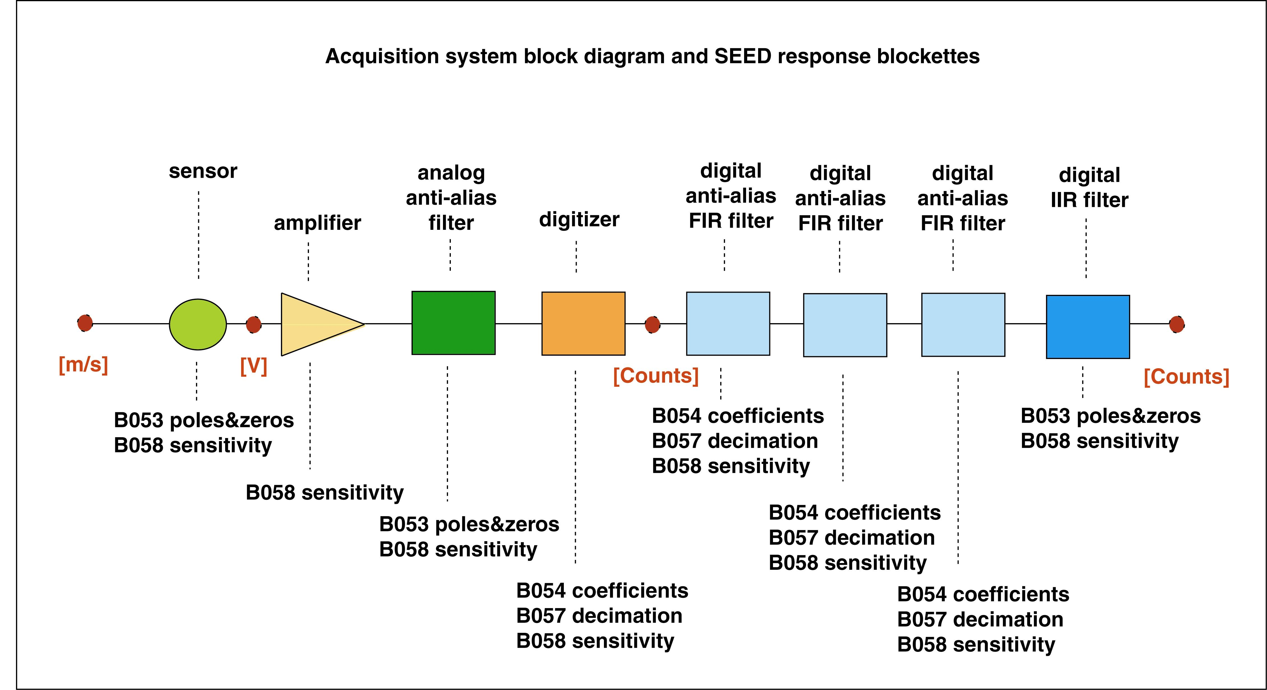
Comprehensive Metadata Representation
Notes:
- The total system sensitivity is the product of all stage sensitivities and represents the scaling from ground units to digital samples in counts

Slide 8
SAC: Seismic Analysis Code
Developed in 1980s by LLNL as a seismic data file format and processing package
Currently made available by IRIS DMC
Precision in timing and distance has improved beyond SAC single-precision capability
For sample rates >0.01s and long record lengths, timing precision in SAC is inadequate
Geographic values are marginally adequate (~1m precision)
Increasing SAC precision will change SAC header and has implications on existing programs
Addressing Precision Limitations in the Seismic Analysis Code (SAC) File Headers and Data Format from 2012 Eastern SSA presentation

Slide 9
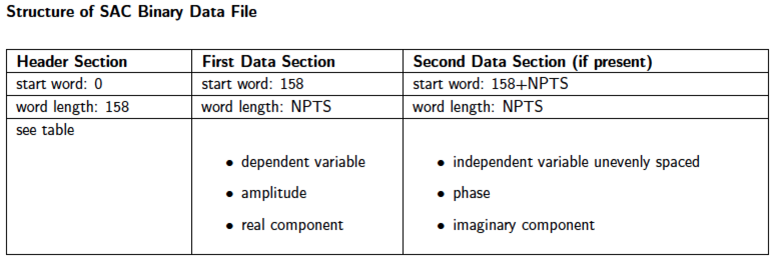
SAC: Seismic Analysis Code
Each SAC data file contains
single data set – single data component recorded at a single station
header record – describes the contents of the file
SAC binary format (most common)
Notes:
Part of the motivation for developing ASDF stems from the fact that reading and writing SAC files for a large tomographic inversion practically brings a huge parallel file system to its knees due to the very large number of involved files.

Slide 10
SEG-Y: Society of Exploration Geophysicists for storing data
Developed in 1970s for use by the active source community
Variety of flavors
SEG-D, developed for field data
SEG-P, developed for positional data
SEG-Y, intended to be format for everybody
Recent release (rev 2.0, 2017)
Higher capacity for trace data
Microsecond time-stamp accuracy
Higher-precision coordinates, depths, and elevation

Slide 11
SEG-Y: Society of Exploration Geophysicists for storing data
What’s in a SEG-Y file?
Text file header (green)
Trace header (light blue)
Actual data (purple)
Major limitation – Data & metadata stored together
Cannot update metadata (headers) without re-archiving the entire dataset

Slide 12
PH5: PASSCAL HDF5 format
Developed at PASSCAL beginning in early 2000s
Based on robust Hierarchical Data Format (HDF5) designed to store and organize large amounts of data
Stores data and metadata separately
Frontload waveform data into DMC
Efficient metadata updates
Allows access to parts of the data without needing to parse the entire file
Exposes active source data to DMC request tools

Slide 13
PH5: PASSCAL HDF5 format
Why HDF5?
20+ year history starting at NCSA
Widely used & well supported
Self-describing format
Can create your own data organization
Hierarchical
Easy to edit
Built-in compression
Fast reading

Slide 14
Format Usage: Field versus Archive
Different formats designed for different uses
Eg. SEG-D (designed for field use) vs. SEG-Y (designed for archive and analysis)
Field priorities
Easy to visualize
Archive priorities
Highly-compressible
Well-described

Slide 15
PH5 & Kitchen Software Suite
Can we design a format the works well in both the field and in the archive?
PH5 – Format definition that describes the HDF5 file organization
Kitchen – Software suite that provides the tools to interface with PH5

Slide 16
Field data → PH5 → Archive
Data ingestion
Waveform data ingested into PH5 using Kitchen suite tool (pforma)
Metadata imported automatically for some raw data formats (e.g. SEG-D), or can be imported using Kitchen GUI tool (noven)
Data QC
PH5Viewer – options to select gathers, time windows, reduction velocity, simple gain and plotting options
Development of tool to confirm all data described by metadata and/or missing metadata

Slide 17
Field data → PH5 → Archive

Slide 18
Field data → PH5 → Archive

Slide 19
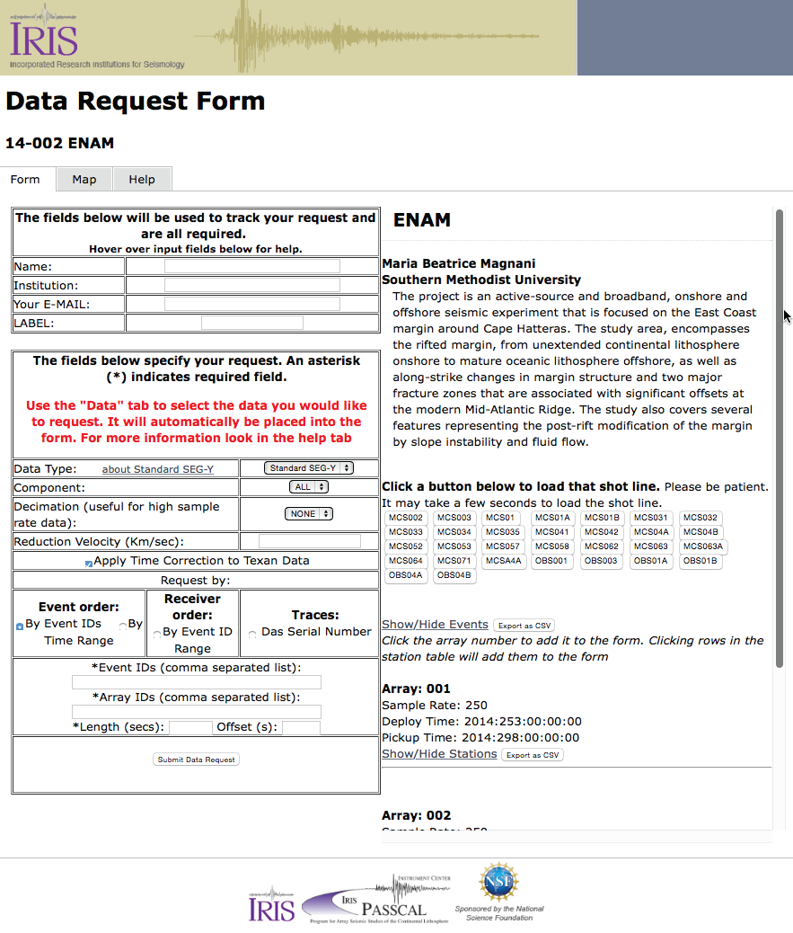
Current DMC Interface

Slide 20
PH5: PASSCAL HDF5 format

Slide 21
User access to PH5 data at IRIS DMC
Current capability – Web page interface
Allows for extraction of SEG-Y shot and receiver gathers, or SAC waveforms
Once requests made, data available via ftp
Planned capability – webservices
2 services: station and dataselect
station – access to metadata identical to standard station webservice currently in use for SEED data
dataselect – access to waveform data into mseed format
Once webservice is up and running, PH5 data will be accessible just like the rest of the DMC archive
Exposed to DMC QC tools like MUSTANG
Huge advance for active source data!

Slide 22
PH5: Container for both active and passive data
Unlike earlier formats, PH5 is capable of holding active and passive data at the same time, as part of a single dataset.
Data extraction
Active source can be output at SEG-Y
Passive source can be output at mseed or SAC.

Slide 23
Exercise: Let’s access the Wavefields dataset
DMC data access tools
http://ds.iris.edu/ds/nodes/dmc/tools
List of experiments archived in PH5
http://ds.iris.edu/pic-ph5/experiment_list.php
Presently, wavefields dataset is archived in miniseed
Accessible via webservices
Webservices info/syntax - http://service.iris.edu
Local webservices access
http://156.56.66.202:8080/fdsnws/dataselect/1

Slide 24
Exercise: Let’s access the Wavefields dataset
Timeseries
http://service.iris.edu/fdsnws/dataselect/1/
Use the URL builder to plot data from
Network: YW
Station: 511
Location: 01
Channel: HHZ
Starttime: 2016-07-13T00:00:00
Endtime: 2016-07-13T12:00:00
Add a bandpass filter from 2-10Hz
Try modifying the URL to access the local copy of the data via webservice
http://156.56.66.202:8080/fdsnws/dataselect/1

