Slide 1
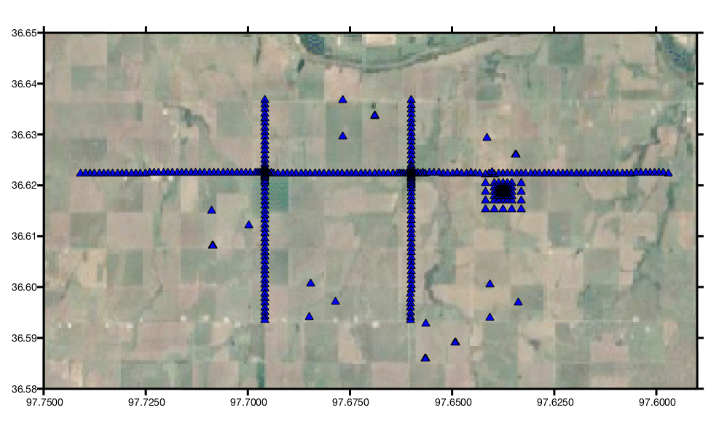
The Ideal Array
By Team Funky Beams
(+ Chuck)

Slide 2
Download and unpack seed file
Create and populate event directories with synchronized time windows of event sacs
Remove instrument response
Rotate ENZ to RTZ
Preprocessing courtesy of Chuck

Slide 3
Select subset of OK array of interest
For the Z and T components
For the gradiometer and the golay array
For each array and frequency
Determine array response
For P and S waves
Gradiometry analysis
Compute Beamforming

Slide 4
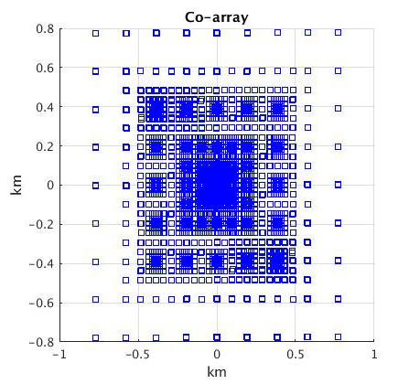
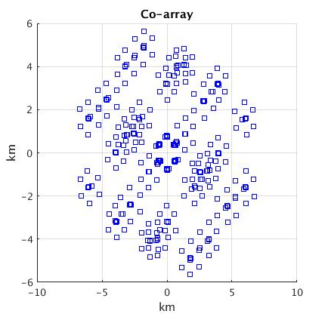
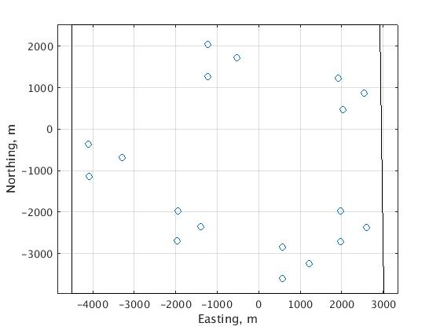
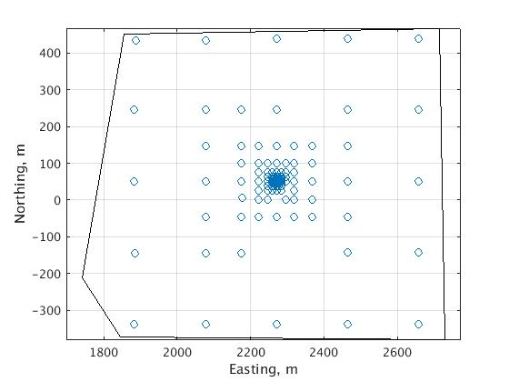
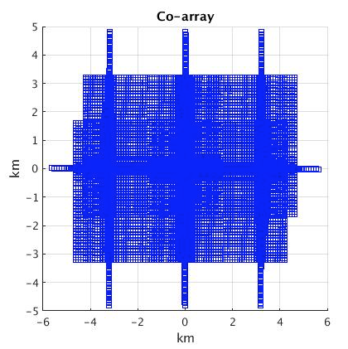
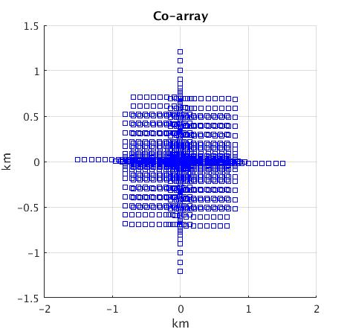
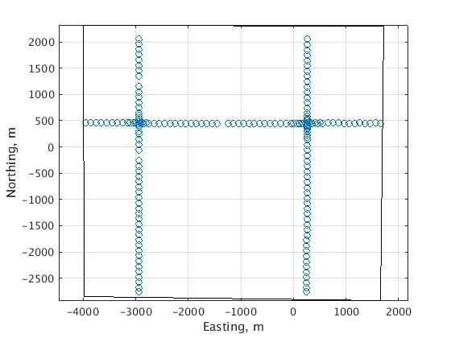
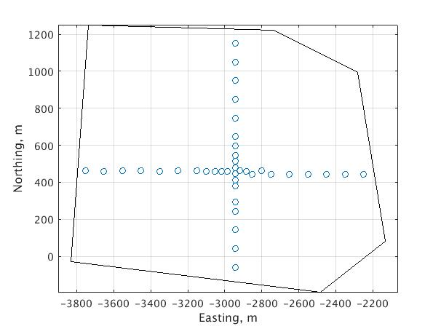
Array Geometries and Co-Arrays

Slide 5
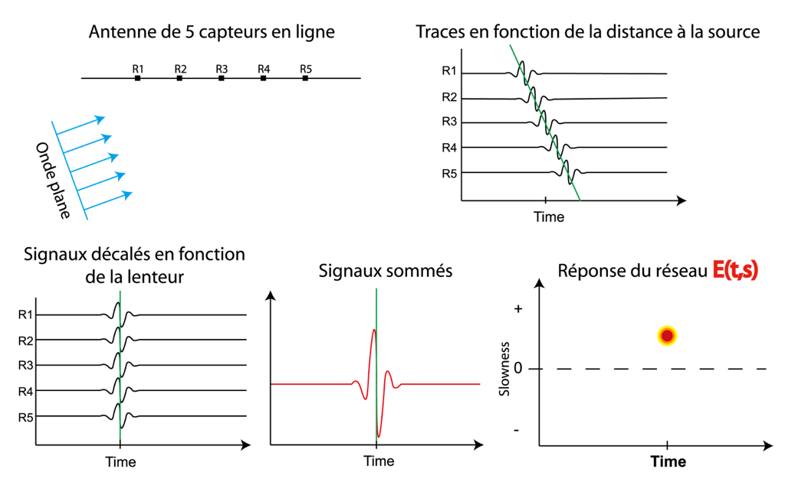
What is Beamforming?
Rost & Thomas, 2002
5 stations array
Signals: time arrival (geometry,slowness)
Plane wave
Signals shifted with the phase slowness
Stack
Beamforming

Slide 6
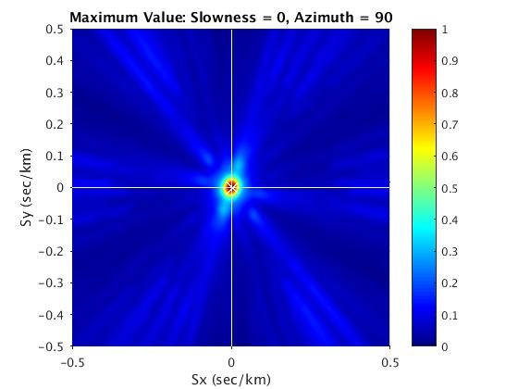
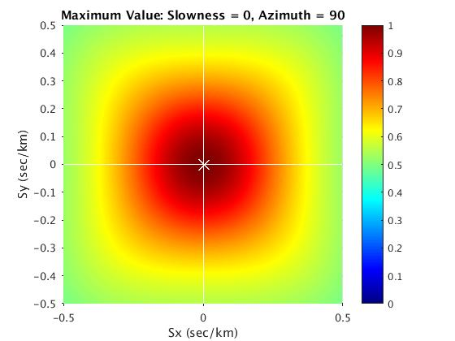
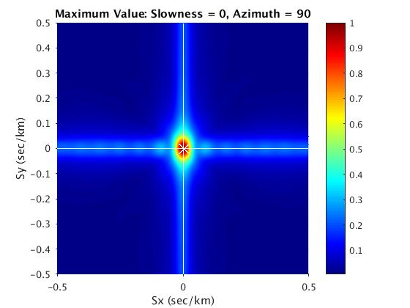
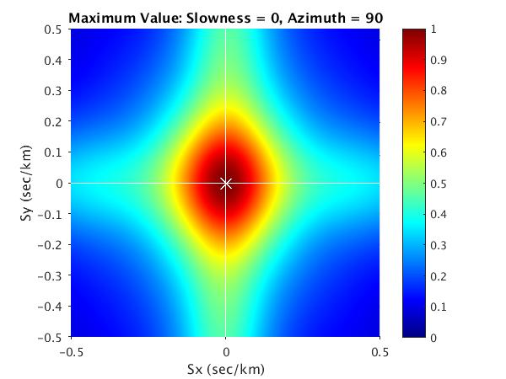
Array Response Comparison (0.5-4 Hz)
Golay
Grad
H
Cross

Slide 7
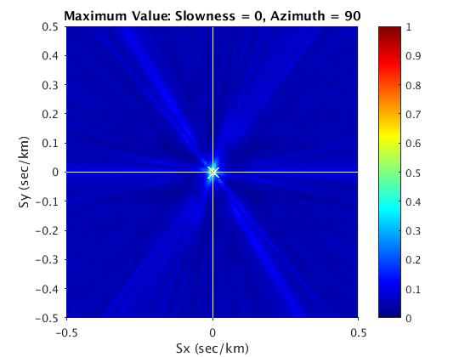
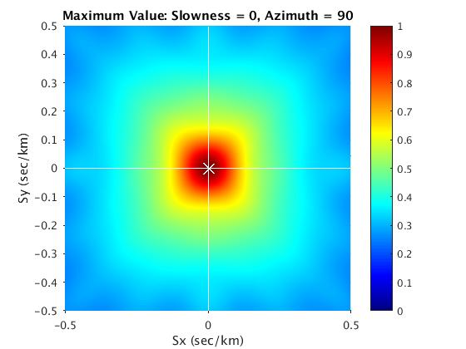
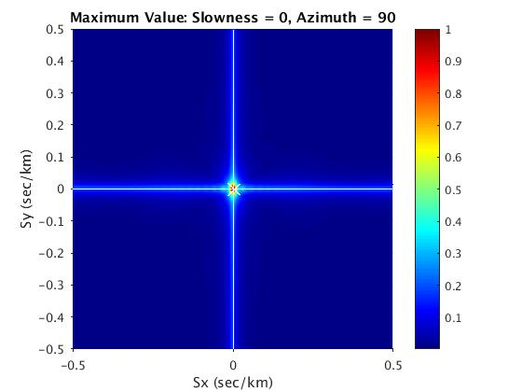
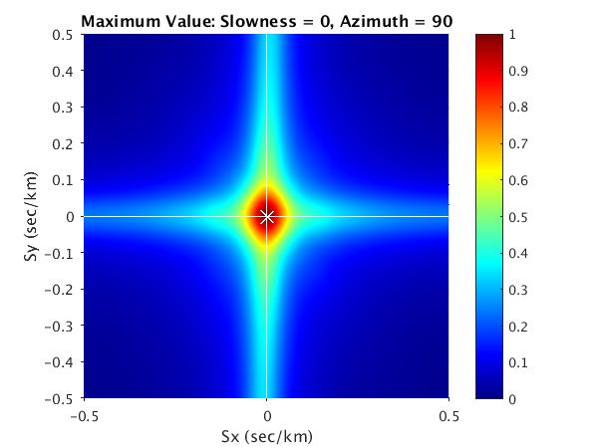
Array Response Comparison (1-12 Hz)
Golay
Grad
H
Cross

Slide 8
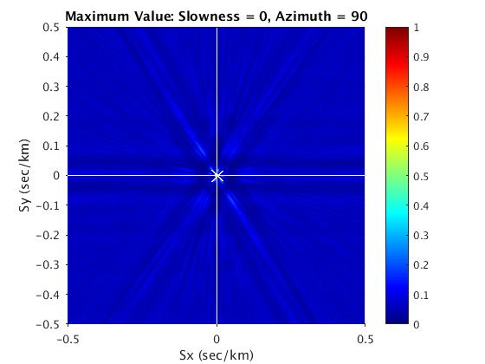
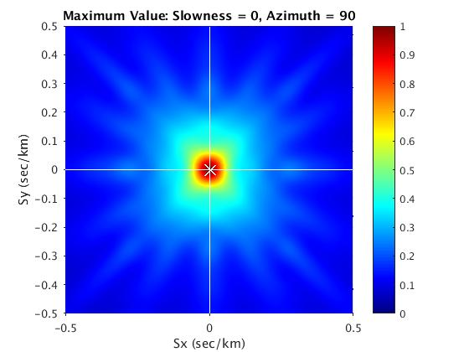
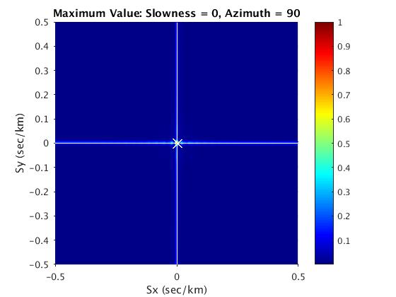
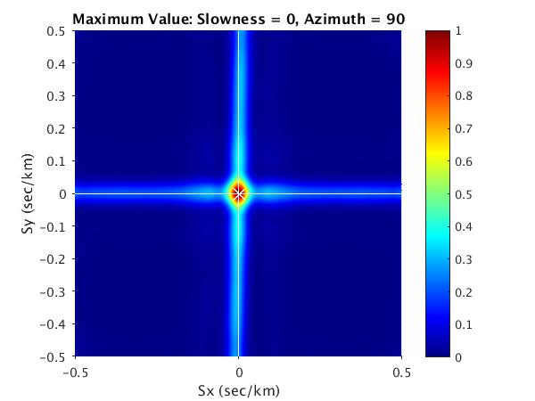
Array Response Comparison (10-20 Hz)
Golay
Grad
H
Cross

Slide 9
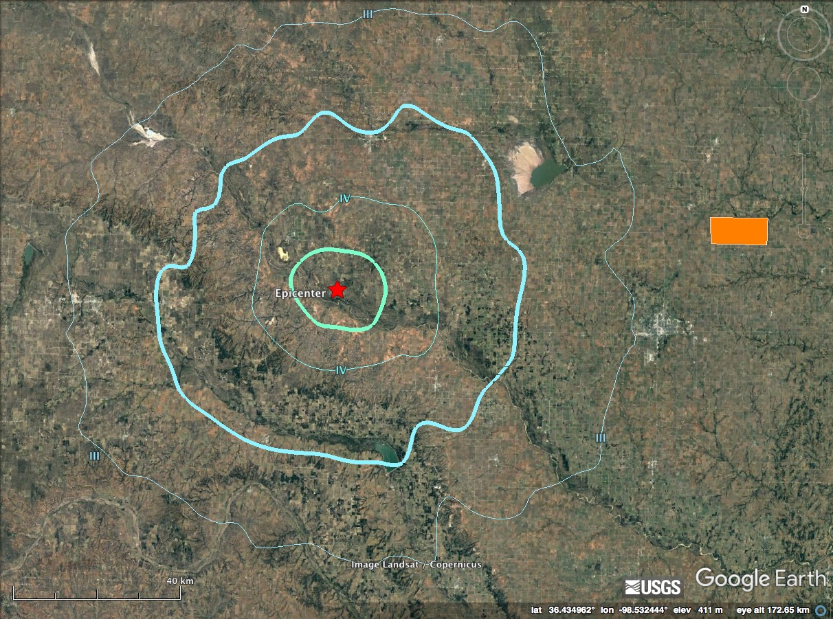
Earthquake within Fairview cluster
2016-07-08 22:29:38 (UTC)
98 km from OK array
M 4.2

Slide 10
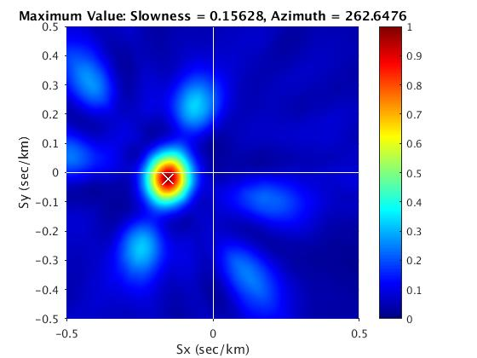
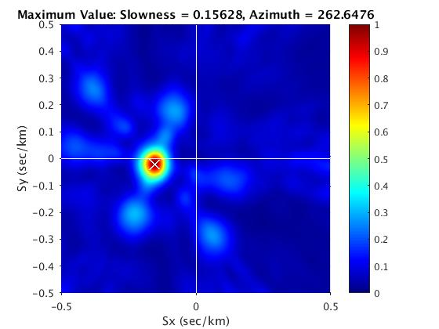
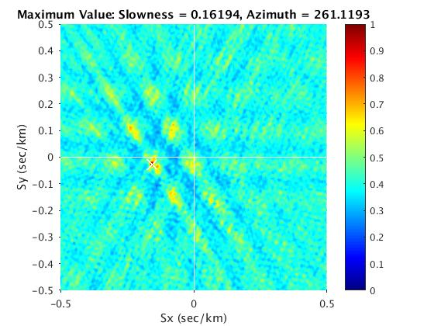
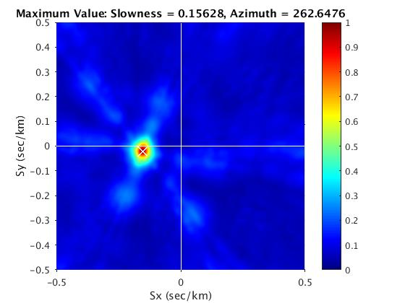
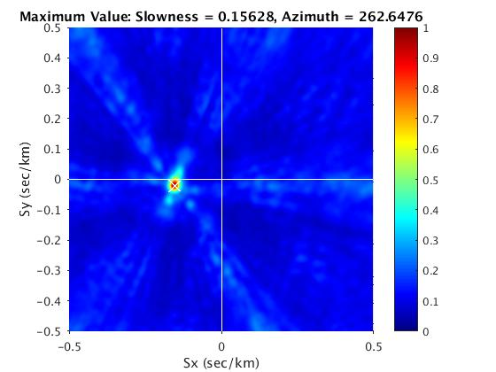
Beamforming - P wave
Golay 0.51-25 Hz
Golay 0.96-4.18 Hz
Golay 8.4-25 Hz
Golay 1-12 Hz
Golay 2-25 Hz

Slide 11
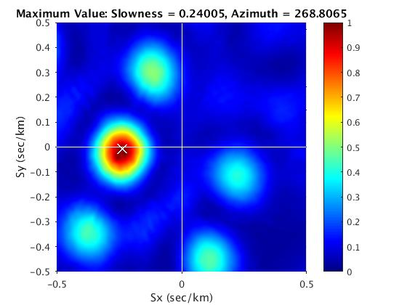
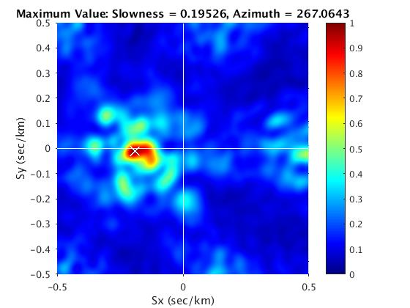
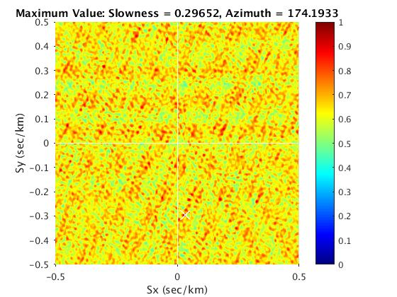
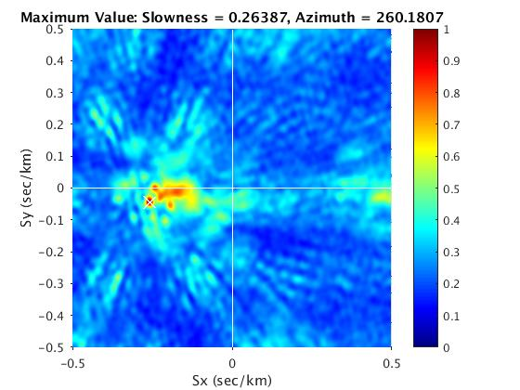
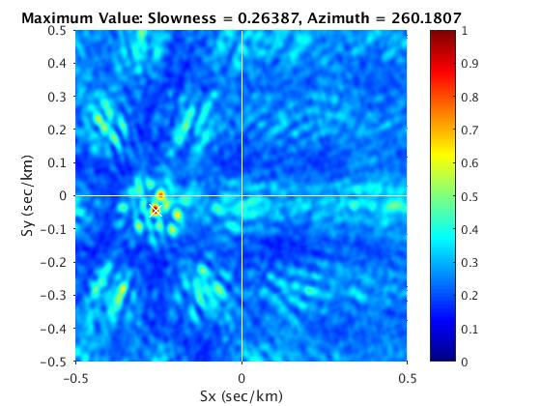
Beamforming - S wave
Golay 0.51-25 Hz
Golay 0.96-4.18 Hz
Golay 8.4-25 Hz
Golay 1-12 Hz
Golay 2-25 Hz

Slide 12
Beamforming Comparison
0.51-33.30 Hz
0.96- 4.18 Hz
1.00-12.00 Hz
2.00-62.00 Hz
8.40-62.50 Hz
P-wave
S-wave

Slide 13
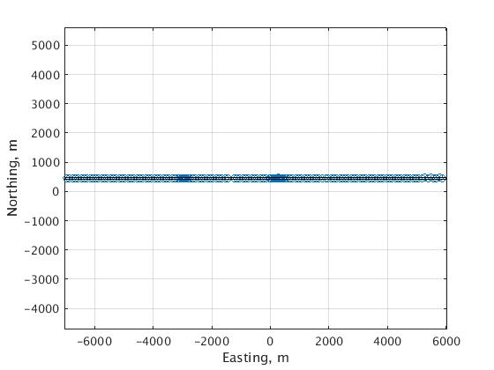
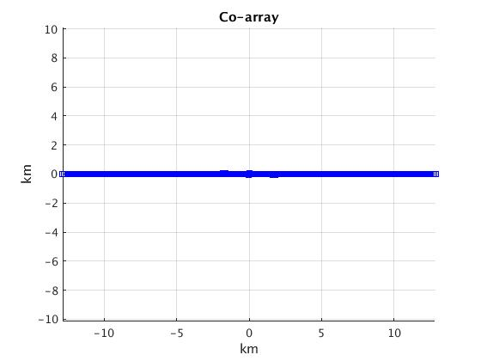
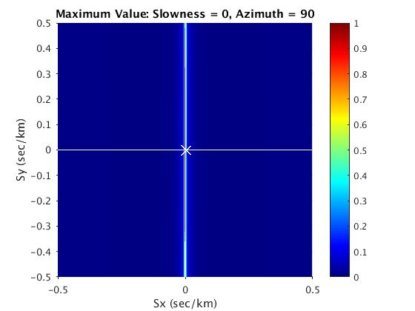
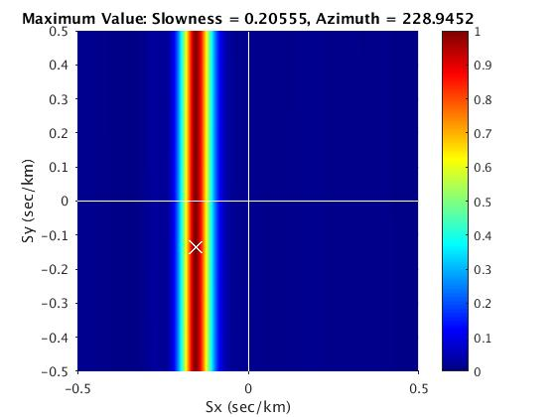
Line array

Slide 14
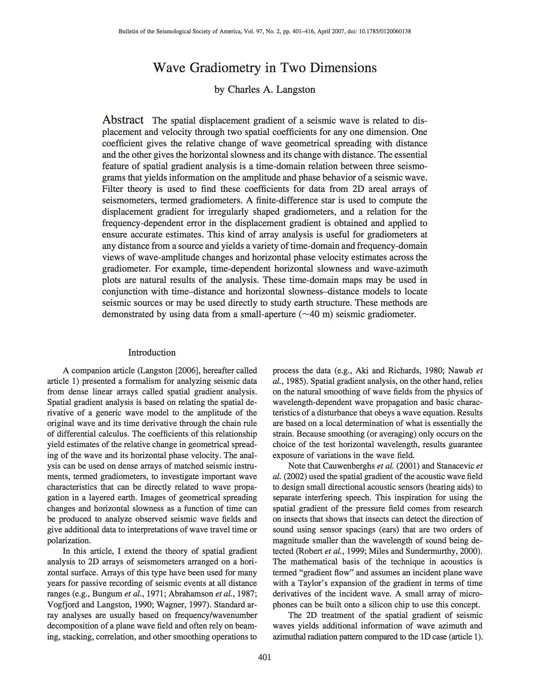
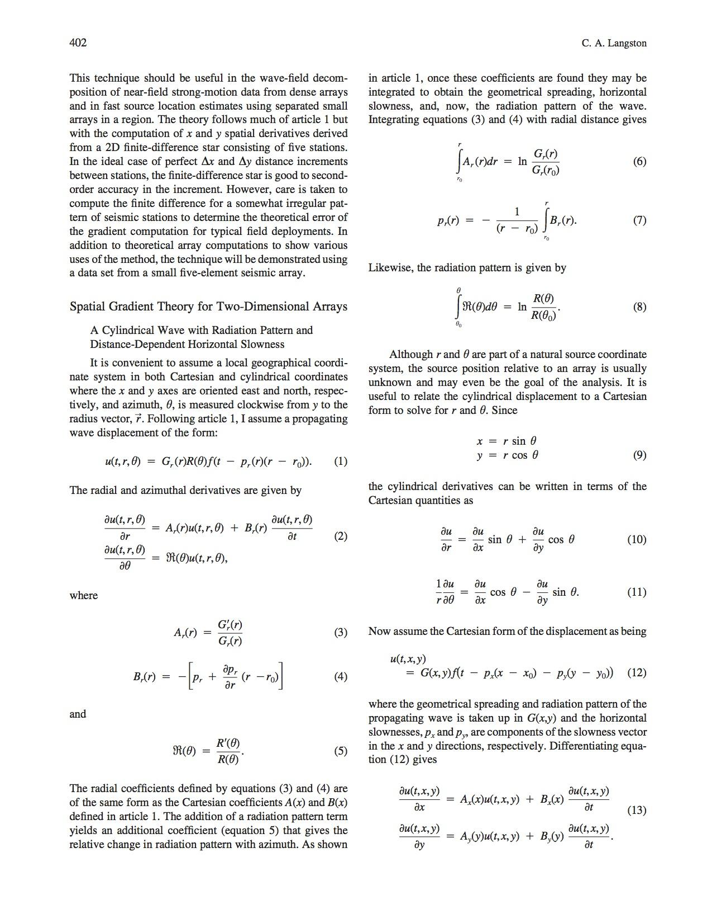
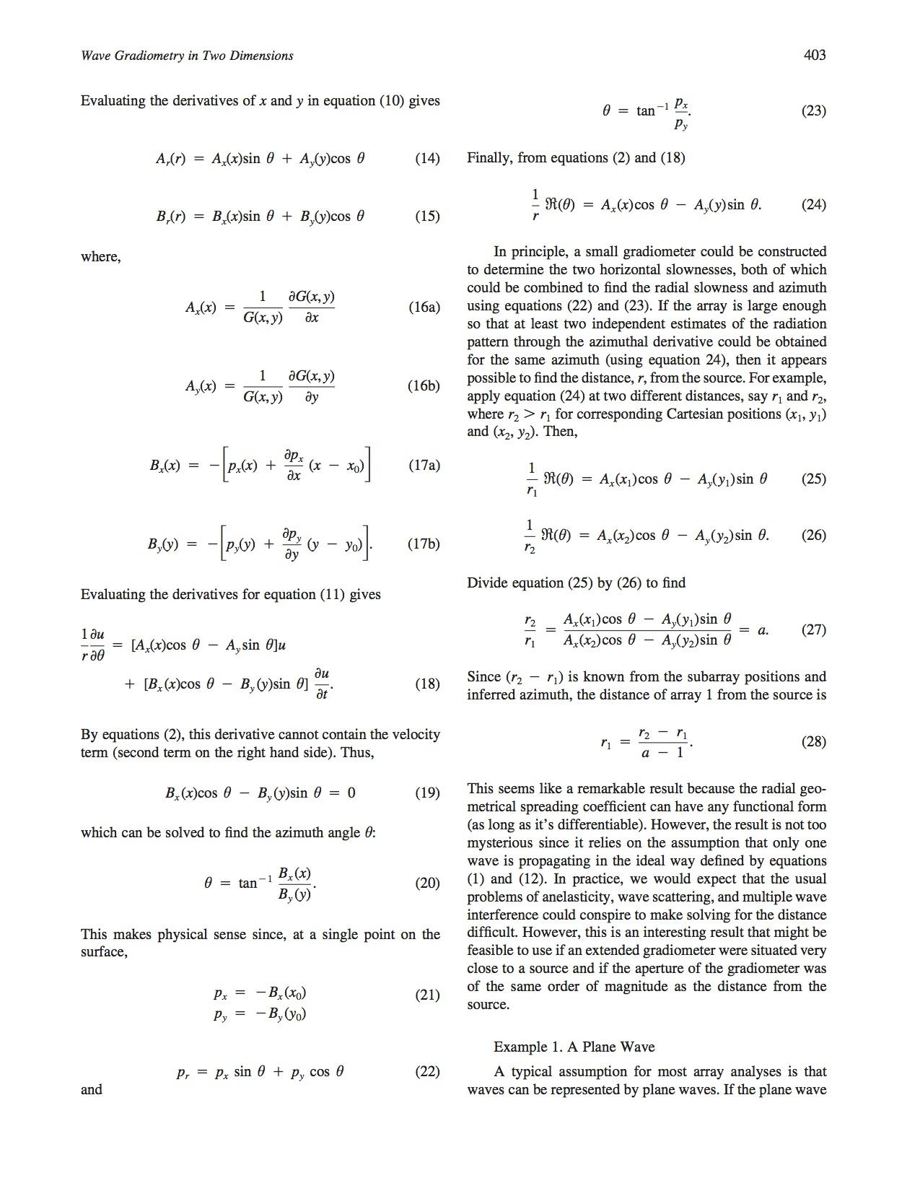
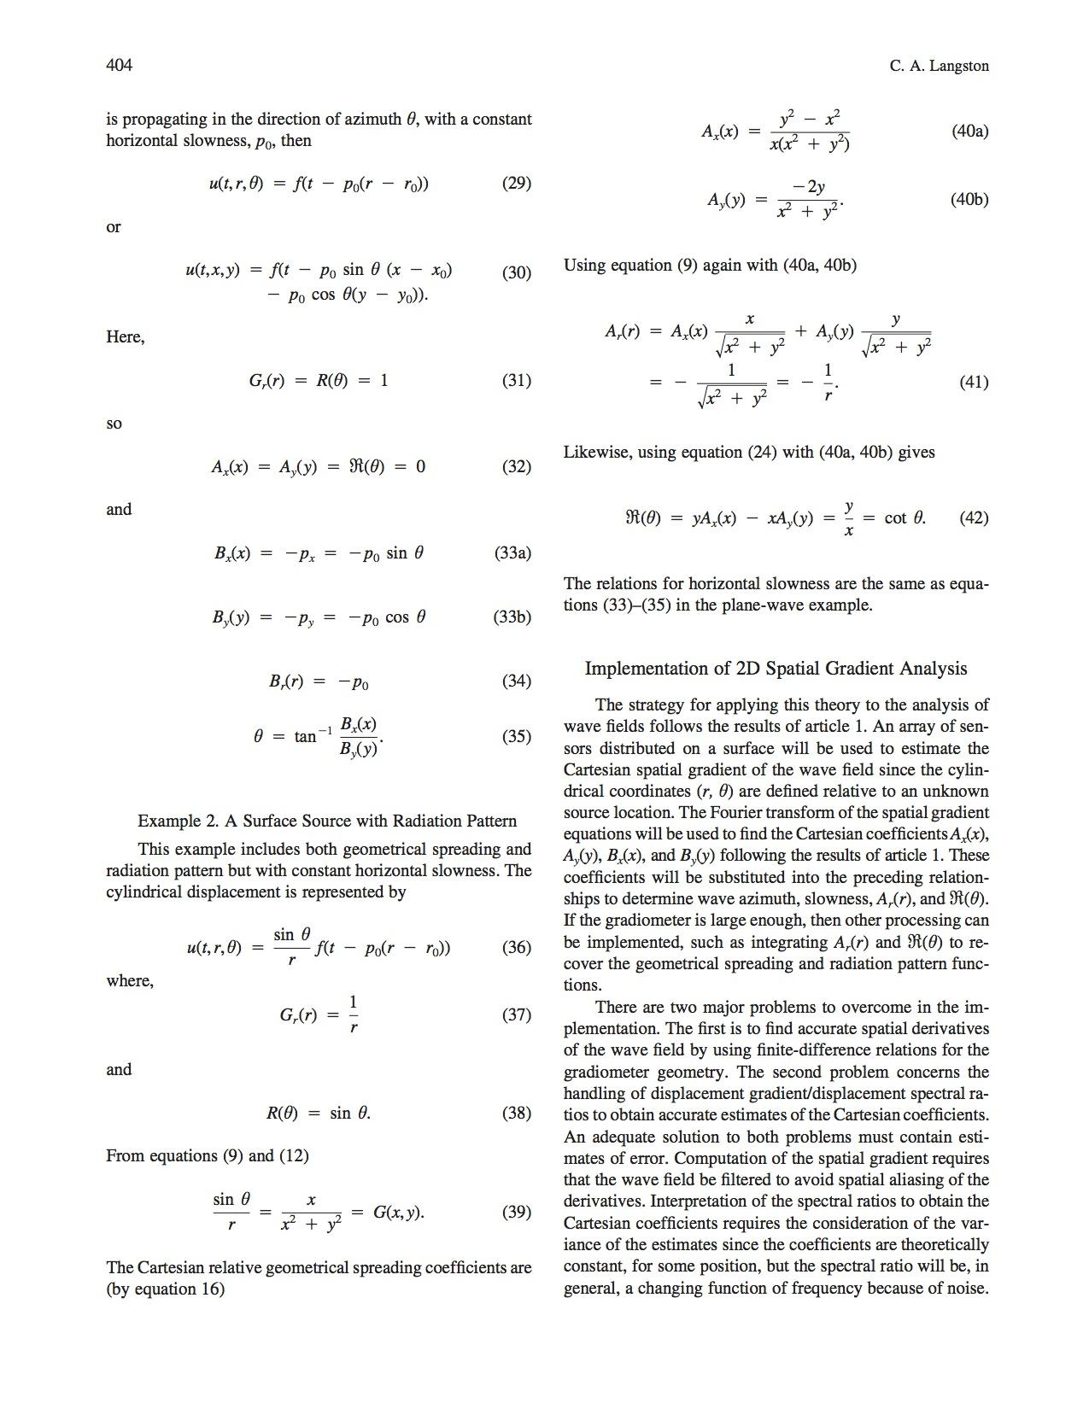
What is Gradiometry?

Slide 15
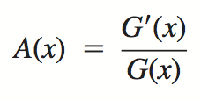
What is Gradiometry?
geometrical spreading
horizontal slowness

Slide 16
What is Gradiometry?
gradient of displacement

Slide 17
What is Gradiometry?
numerically calculate
numerically calculate
measure
invert

Slide 18
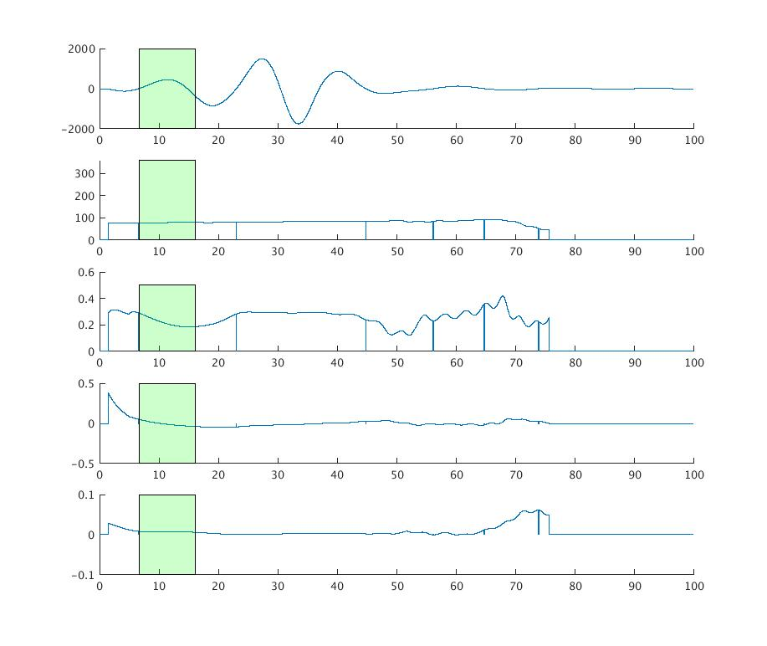
Gradiometry (Vertical) - Golay Array
Filtered 0.05-0.1 Hz
u(t)
Azimuth
Mean = 78.4019
Slowness
Mean = 0.21868
Geo. Spr.
Rad. Patt.

Slide 19
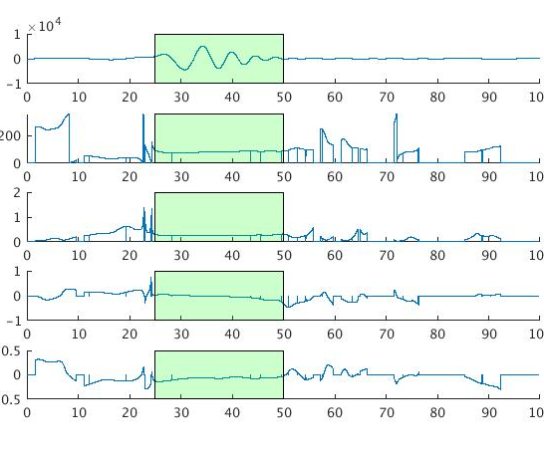
Gradiometry (Transverse) - Golay Array
Filtered 0.05-0.2 Hz
u(t)
Azimuth
Mean = 82.14
Slowness
Mean = 0.2685
Geo. Spr.
Rad. Patt.

Slide 20
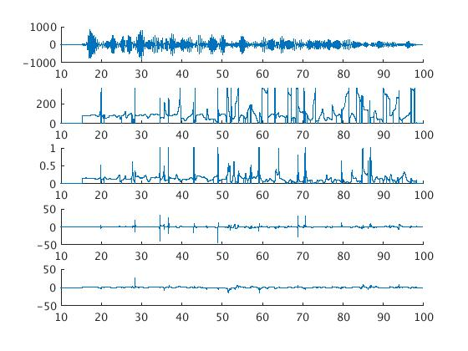
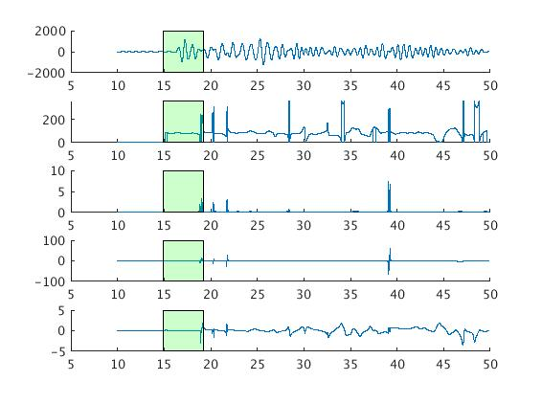
Gradiometry (Vertical) - Gradiometer
Filtered 2-3 Hz
u(t)
Azimuth
Mean = 86.945
Slowness
Mean = 0.165
Geo. Spr.
Rad. Patt.

Slide 21
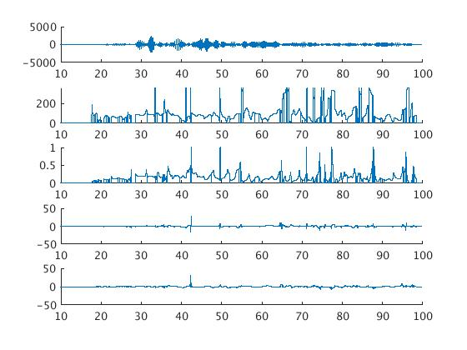
Gradiometry (Transverse) - Gradiometer
Filtered 2-3 Hz
u(t)
Azimuth
Mean = 75.2917
Slowness
Mean = 0.16313
Geo. Spr.
Rad. Patt.

Slide 22
Thank you / merci beaucoup
Conclusions
Aperture is an important control over the resolution
Golay array is efficient for beamforming
Station spacing heavily influences aliasing
Gradiometry is more influenced by station spacing
Chuck, IRIS, et al.!!!

Slide 23
Fin

