Slide 1
Using dbxcor to estimate slowness vectors of Teleseismic P-waves on Golay & Nodal sub-arrays
Louis Quinones, Shule Yu, Avinash Nayak, Alireza Bahadori
July 11st 2017
IRIS summer short course

Slide 2
Teleseismic P-waves
Used for travel-time tomography of deeper structures
Arrays can be used for event detection
Teleseismic P-waves recorded
On nodal sensors
Long beach array (10.0 Hz, Z component sensors) used by Schmandt & Clayton (2013) for resolving deeper structures below SOCAL
Teleseismic P-wave receiver functions at Yellowstone for M_{W} 5.9-7.6 earthquakes (Ward & Lin 2013)

Slide 3
What we did ?
Processed both BB and Nodal data recorded by the Oklahoma array using Antelope (Thanks to Gary !!)
Analyzed P-waves from ~8 tele-seismic events and picked arrivals using dbxcor
Analyzed FK response of the Golay and nodal sub-arrays in the frequency passband of interest
Inversed for slowness and calculated back-azimuth and incidence angles
Compared results from Golay, nodes to theoretical values predicted by IASP91
Checked distribution of relative amplitudes on the nodal sensors

Slide 4
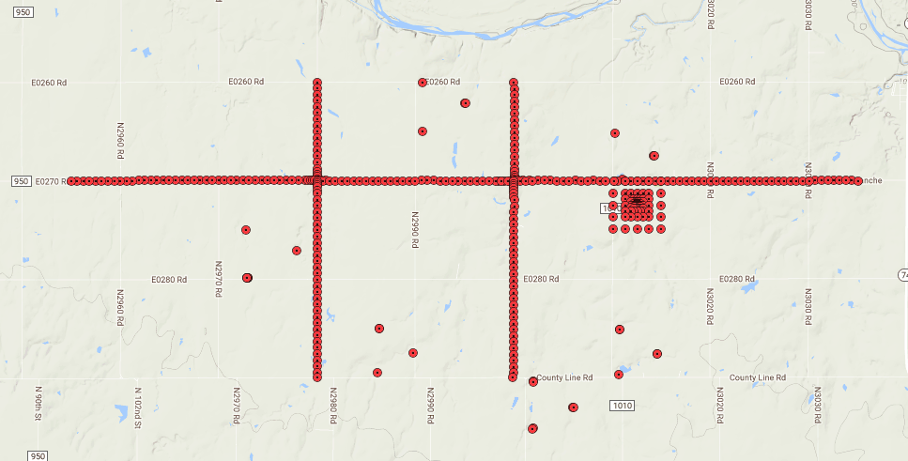
Slowness estimation
Slowness -> only horizontal slowness vector can be estimated from surface sensor deployments
Assume the horizontal slowness of one tele-seismic event is constant across the array U(Ux, Uy).
Uy
Using dbxcor (Pavlis &Vernon 2010), get arrival times at all stations
Ux

Slide 5
Slowness estimation
$U_{x}⋅(x_{i}−x_{0})$ $+ U_{y}⋅(y_{i}−y_{0})$ $= t_{i}$
Solve for unknowns U_{x} , U_{y} , c
– $t_{0}$
Known
Known
dbxcor
U_{x}.x_{i} + U_{y}.x_{y} + c = $t_{i}$ – $t$_{mean}
backazimuth = 90 – arctan $\frac{Uy}{Ux}$ ; incidence angle $θ$= arcsin$\left|U\right|Vsurface$
$Vsurface$=5.8 km/s (AK135 shallow crust velocity)

Slide 6
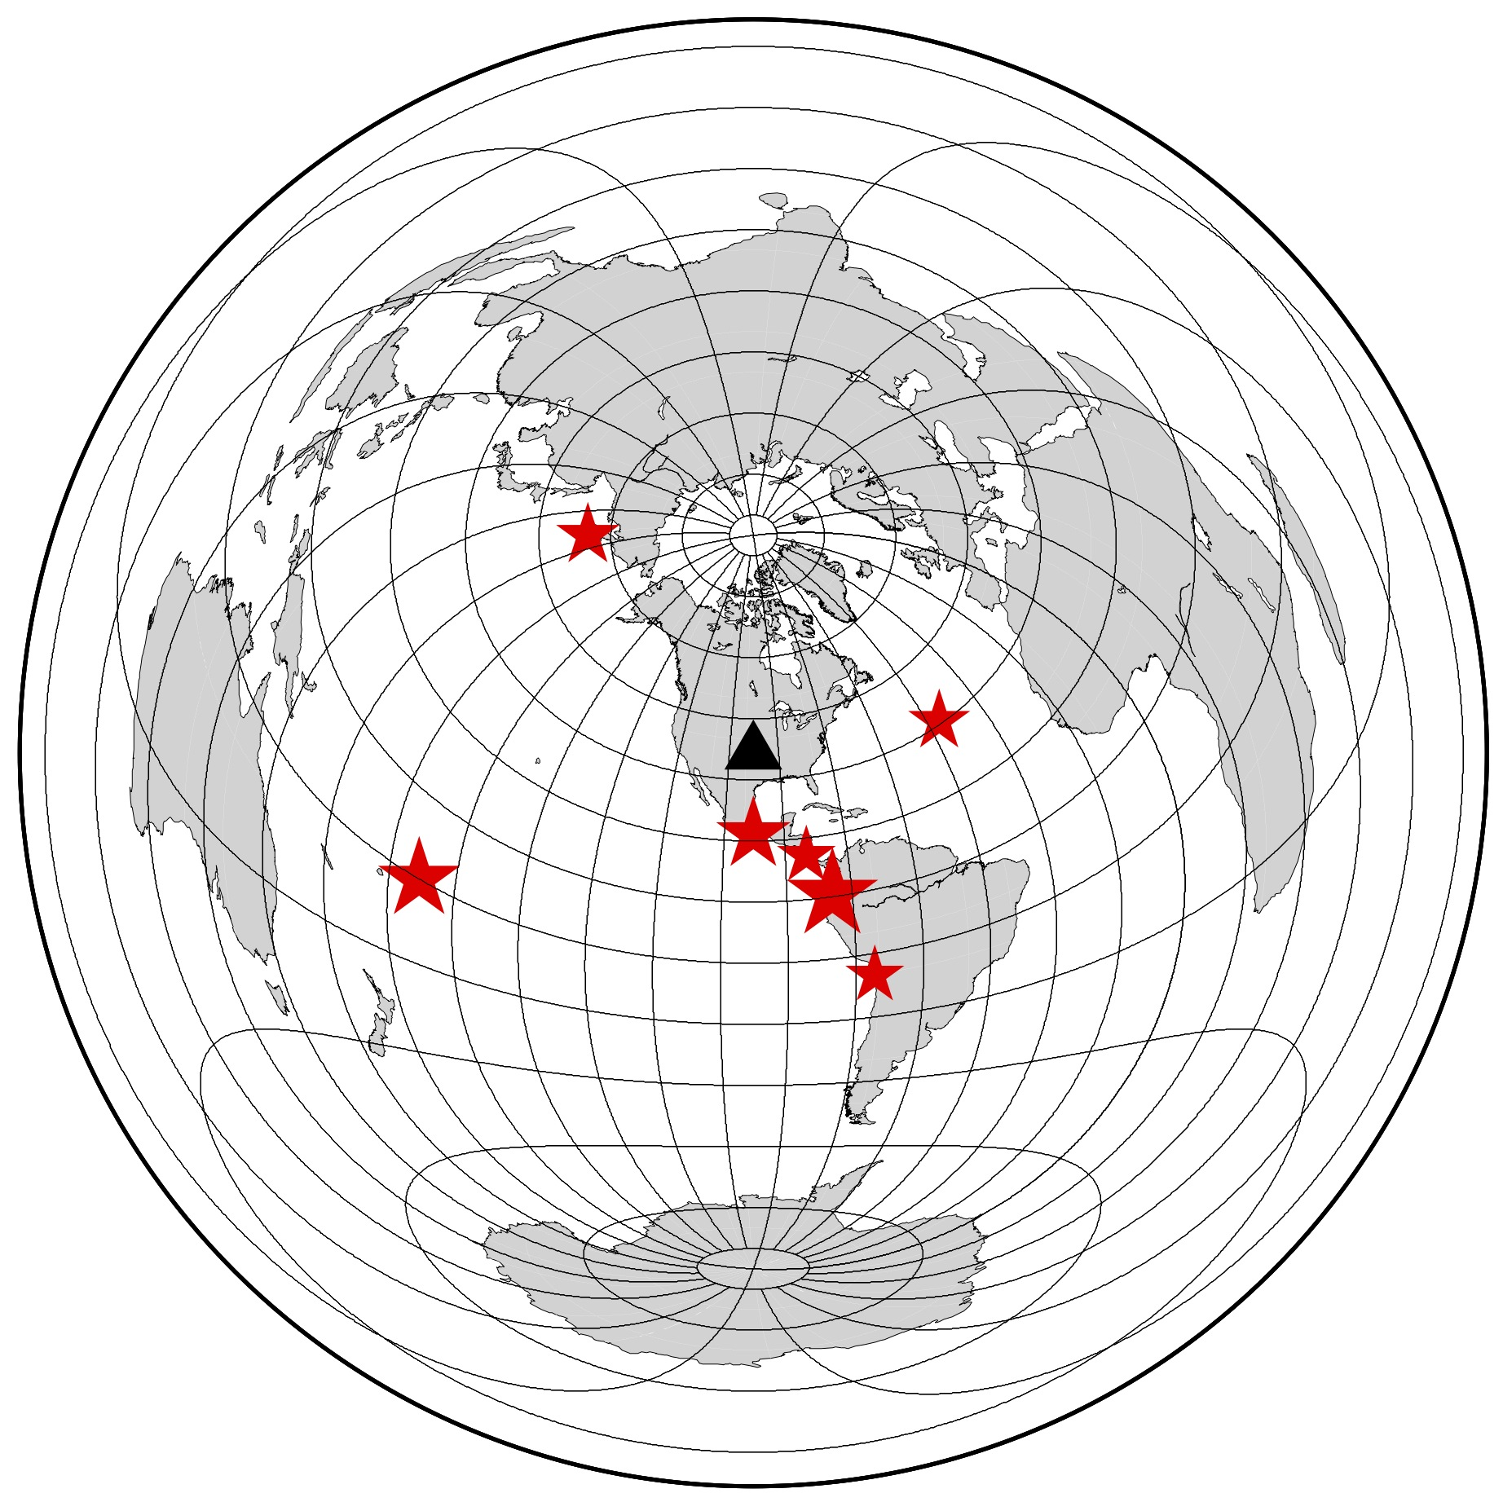
Teleseismic Data
Latitude | Longitude | Depth (km) | Magnitude
0.5812 | -79.6930 | 21 | 6.3
-15.0830 | -173.2011 | 8 | 6.0
0.5874 | -79.6358 | 17 | 5.9
55.1583 | 159.5658 | 35 | 5.3
30.6672 | -41.2834 | 10 | 5.2
-20.1900 | -70.9463 | 11.13 | 5.1
10.6630 | -85.0217 | 7.41 | 5.1
16.5502 | -97.8332 | 19.0 | 5.7
Magnitude between 5.1 and 6.3
Depth 8 to 35

Slide 7
Nodes Data
N = 370

Slide 8
Broadband Data
N = 18

Slide 9
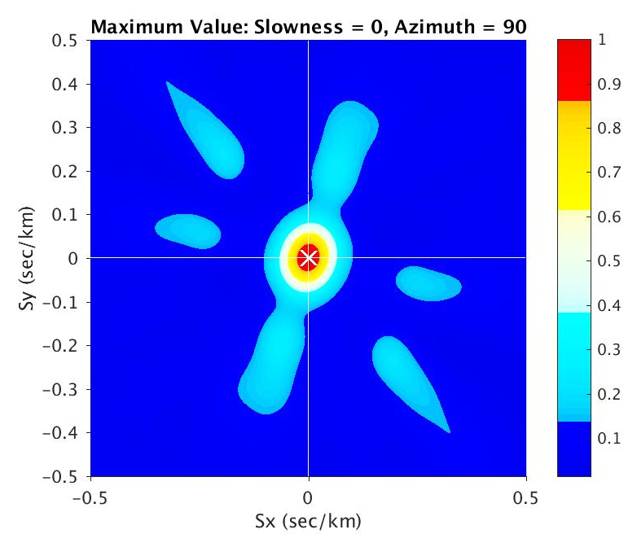
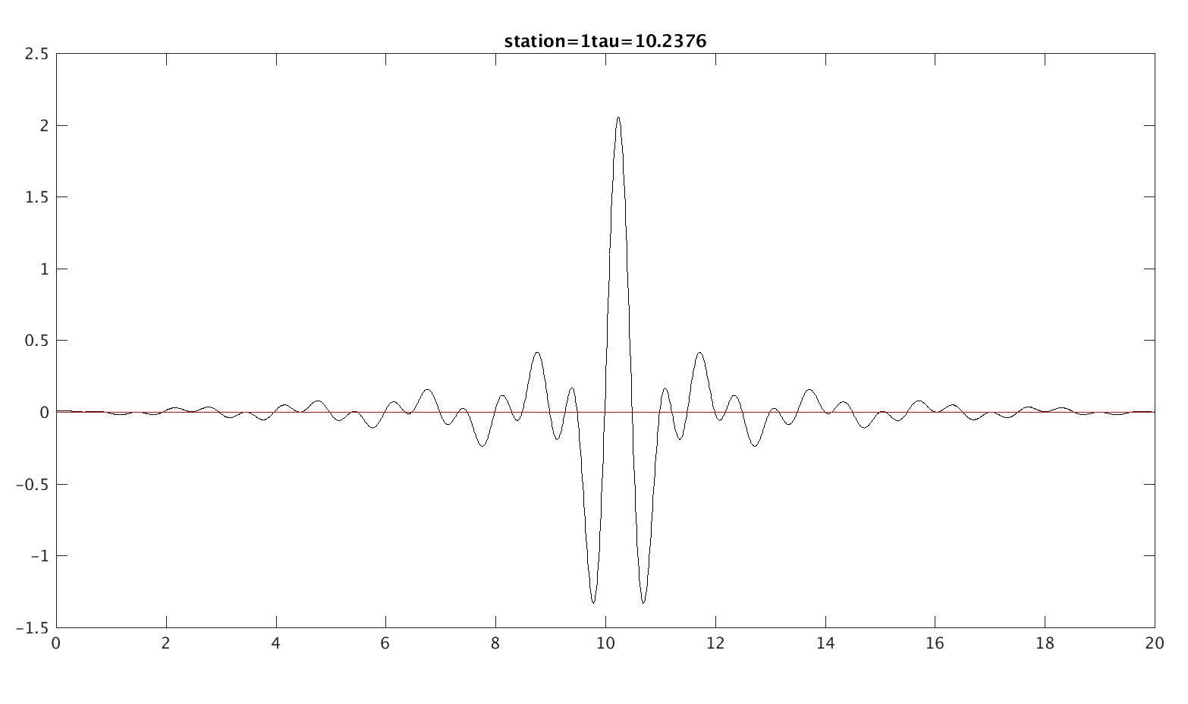
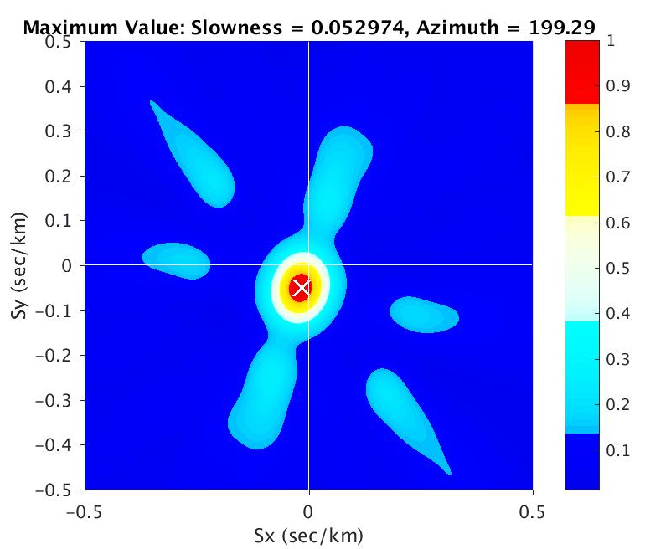
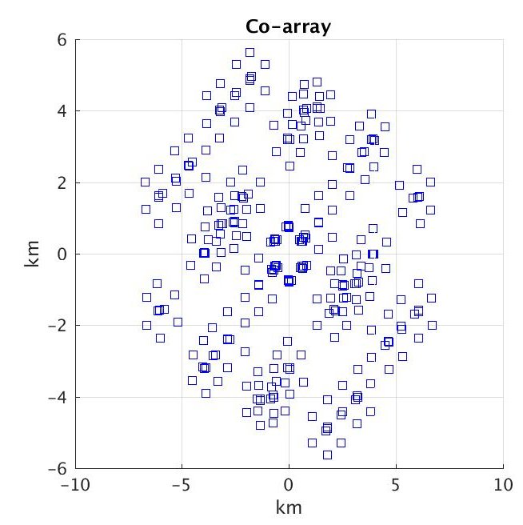
FK Analysis for Golay BB Array
Passband (0.5-1.5 Hz)
Vertical Incidence
Incidence angle ~ 19°, gcarc ~ 67°

Slide 10
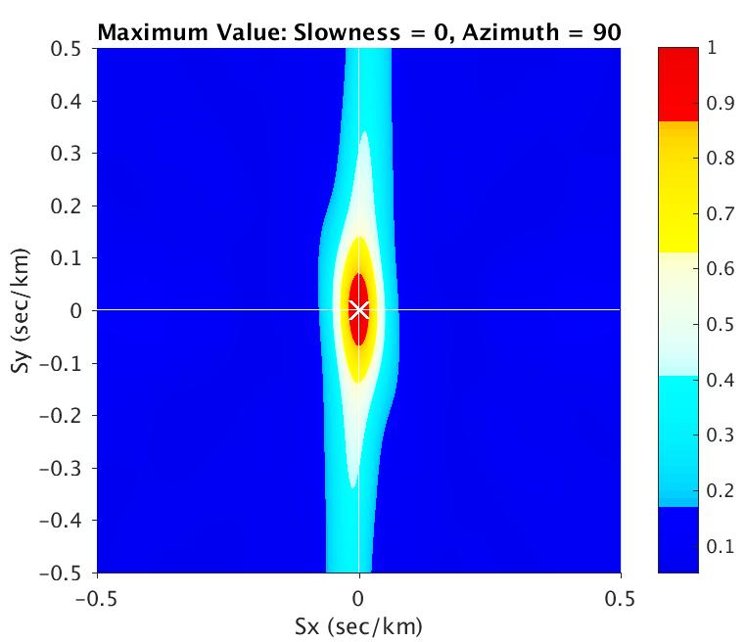
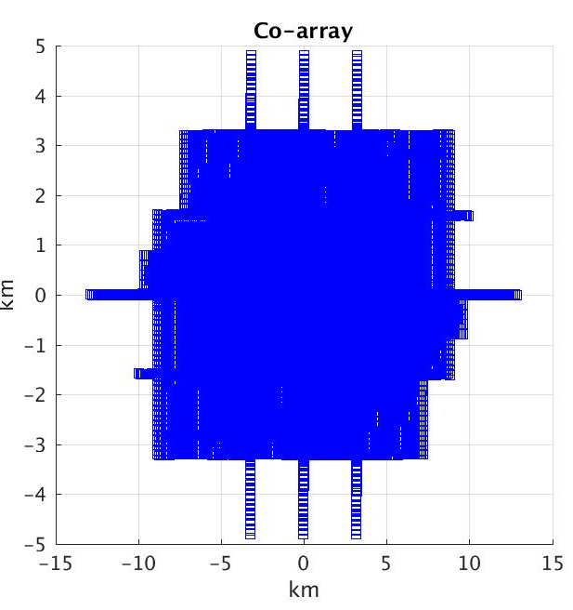
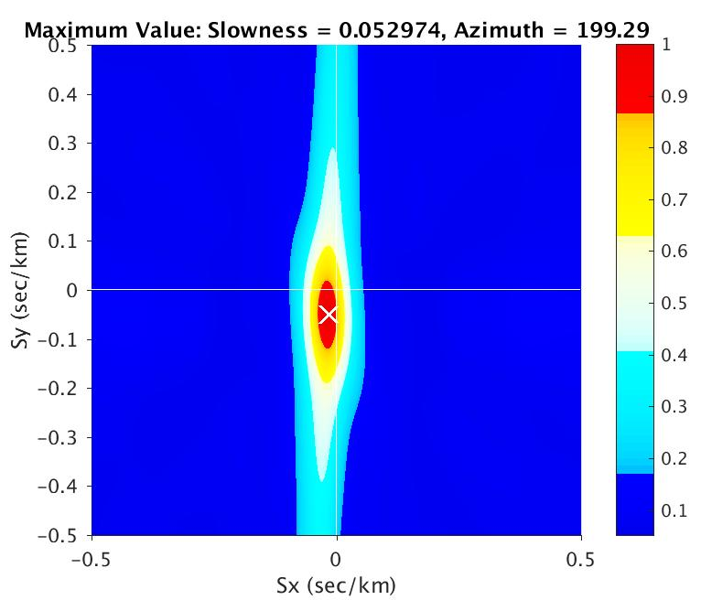
FK Analysis for
Nodal Sensors
Vertical Incidence
Passband (0.5-1.5 Hz)
Incidence angle ~ 19°, gcarc ~ 67°

Slide 11
Results

Slide 12
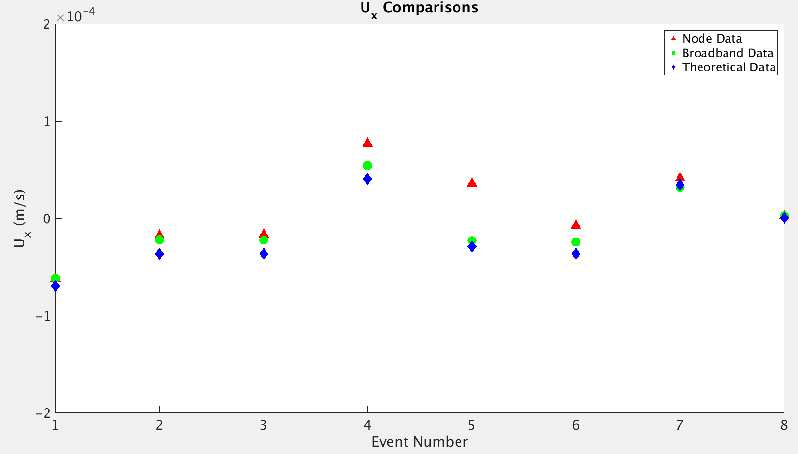
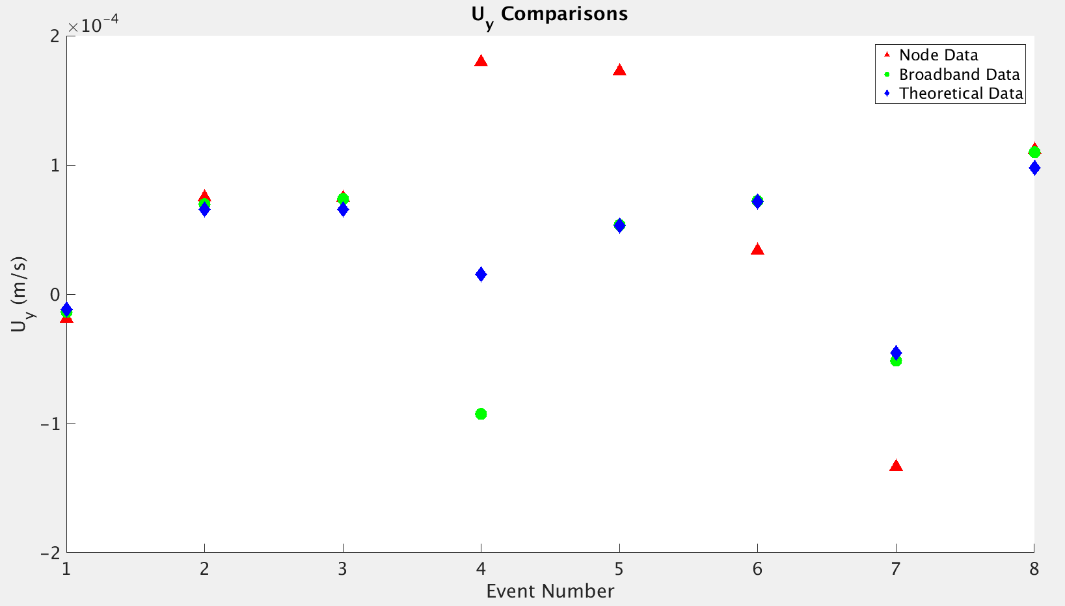
Results

Slide 13
Relative Amplitudes (log averaged) at the Nodal Sensors
7-12 measurements at each stations
dbxcor output

Slide 14
Large Fluctuations in Amplitudes (not sure what went wrong)

Slide 15
Results and Discussion
FK-analysis and results suggest greater uncertainties in slowness estimated from Nodal array compared to Golay array
Decent teleseismic P-waves for shallow depth M_{W} ~5.1-6.3 events on many nodal stations (useful for tomography ?)
Small-scale amplitude and travel-time anomalies could be possibly be mapped
Future work
Analyze slowness of other phases
Analyze distribution of relative times/amplitudes/outliers
Look at F-k response of nodal array with slightly different geometry and spacing
Do weighted inversion using coherence as weights

Slide 16
Thank you !

Slide 17
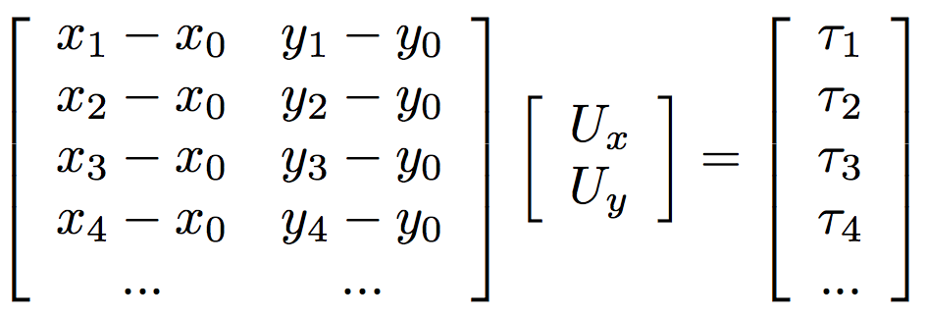
Slowness estimation
Known
Unknown
dbxcor

