Slide 1
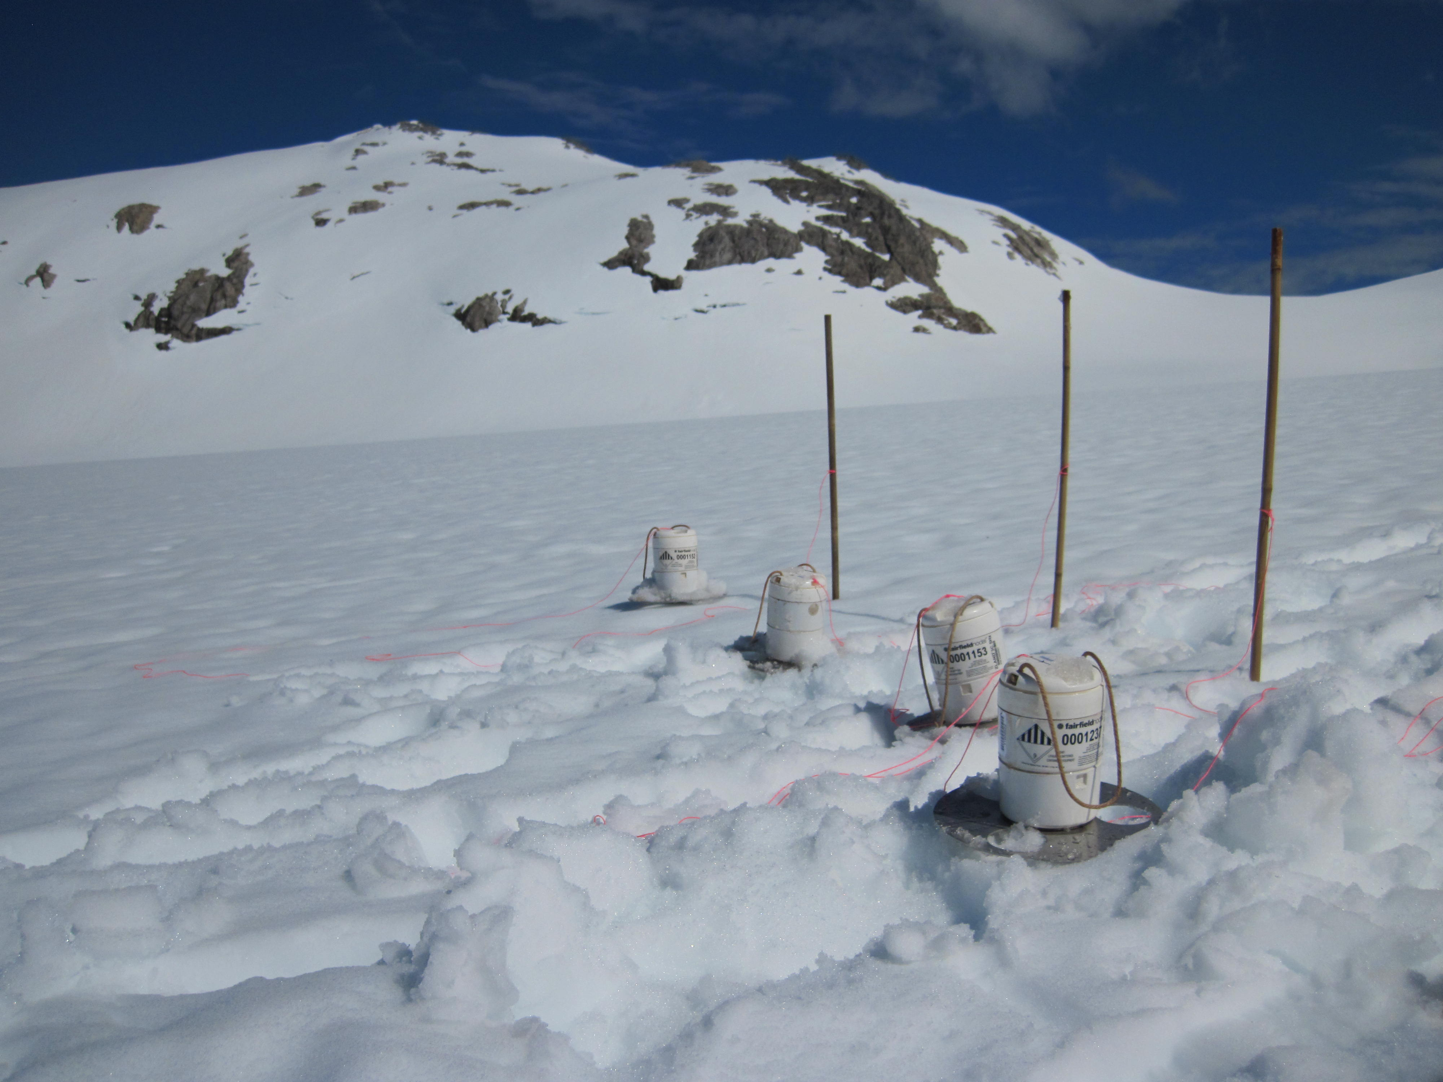
Intro to Seismometry:
How do seismic ‘nodes’ differ from other types of seismometers?
Dr. Marianne Karplus
Assistant Professor
Univ. of Texas at El Paso
Notes:
Spurious frequencies beyond 20x natural frequency.
Introduction

Slide 2
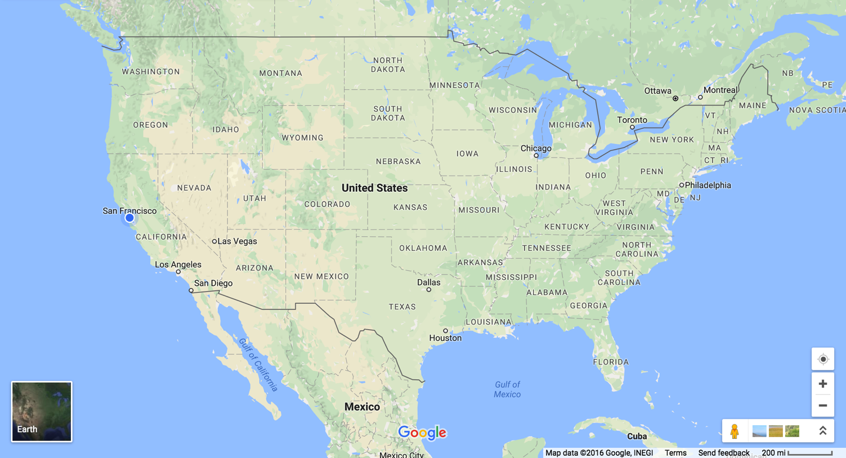
Current nodal projects – many are collaborative (active*- and passive-source)
Yellowstone*
Brady Hot Springs (PoroTomo)*
IRIS Wavefields*
San Jacinto Fault
El Paso Area
E. Franklin Mts Fault*
Rio Grande Valley*
Indio Mts*
Plus… Lemon Creek Glacier*, Southeast Alaska

Slide 3
Outline
Fairfield Nodal Z-Land, Generation 2, 5-Hz, 3-component nodes (as used in OK Wavefields)
Basic seismic instrumentation
Frequency and dynamic range of seismic signals and noise
Fairfield node self-noise and shake table tests
Oklahoma wavefields data QC (behind the scenes)

Slide 4
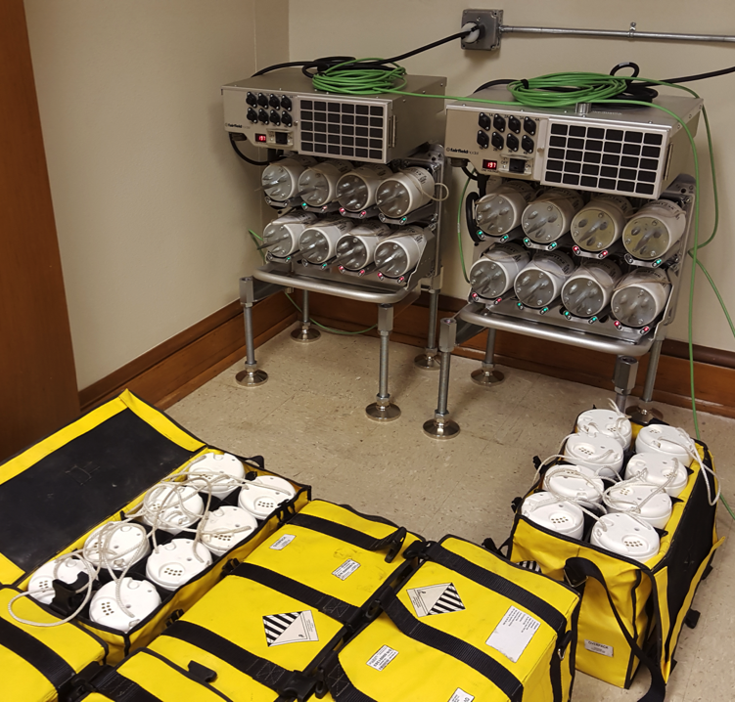
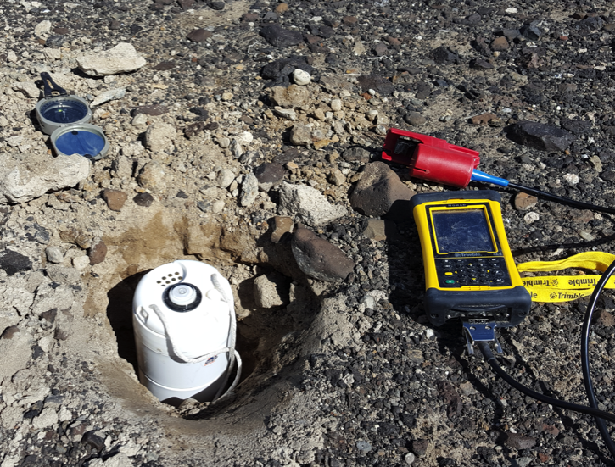
Fairfield Nodal Z-Land Gen 2 nodal system
5-Hz 3-component nodes
charging racks
handheld terminals

Slide 5
Fairfield Nodal Z-Land Gen 2 nodal system
24 bit digitizer
±10 μsecond GPS
timing

Slide 6
Seismometry and nodes (according to Shakespeare, kind of…)
William Shakespeare
“Modest doubt is called the beacon of the wise.”
“There is [no data] either good or bad, but thinking makes it so.”
“The course of [data processing] never did run smooth.”
“To thine own [seismometers] be true, and it must follow, as the night the day, thou canst not then be false to any man.”
“Let me embrace thee, [seismometry], for wise men say it is the wisest course.”
Fairfield Z-Land node
Notes:
Modest doubt is called the beacon of the wise.
There is nothing either good or bad, but thinking makes it so.
The course of true love never did run smooth.
To thine own self be true, and it must follow, as the night the day, thou canst not then be false to any man.
Let me embrace thee, sour adversity, for wise men say it is the wisest course.
- Shakespeare

Slide 7
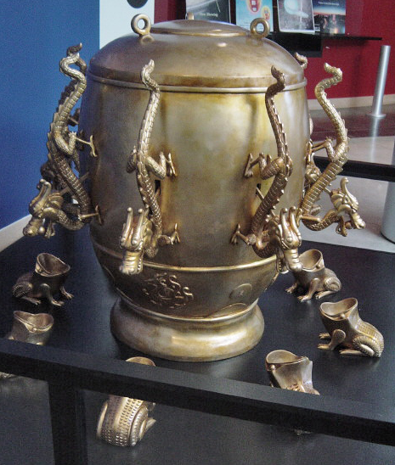
Early seismometer
Zhang Heng, 132 CE
China’s Han dynasty
When ground shook, pendulum inside the jug moved, pushed a lever that opened dragon’s mouth, ball rolled out into the toad’s mouth, and an alarm sounded.
Image source: wikipedia

Slide 8
Basic seismic instrumentation
Want to measure ‘ground motion’.
Consider a particle in the ground that, at time t₀, is located at x = (x, y, z) with respect to Cartesian axes fixed in an inertial reference frame.
At time t, this particle has coordinates u + x = (u+x, v+y, w+z) with respect to the same axes. (Lagrangian description of motion)
u = u(x, t) is the ground displacement.
Seismometer measures displacement u through time.

Slide 9
Basic seismic instrumentation
Want to record range of seismic signals and noises with wide range of frequency and amplitude.
Pre-1960s analog recording typically used different “long-period” and “short-period” seismic instruments.
Long-period: teleseismic surface waves and normal modes
Short-period: band above ocean noise (0.07 to 0.4 Hz), teleseismic body waves, regional waves such as Pn and Lg.

Slide 10
Basic seismic instrumentation
Major advance 1 (1960s): digital recording allowed ease of filtering, weak and strong signals recorded on same instrument.
Major advance 2 (1970s): instruments could maintain sensitivity across wide ranges (“broad bands”) of frequency.

Slide 11
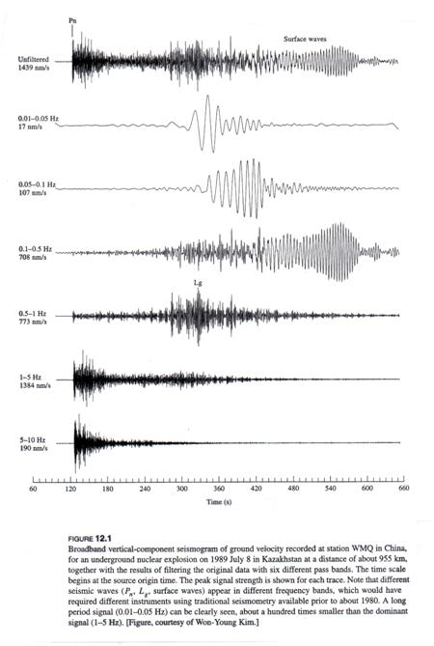
Broadband recording of an underground nuclear explosion, 1989
unfiltered
0.01-0.05 Hz
0.05-0.1 Hz
0.1-0.5 Hz
0.5-1 Hz
1-5 Hz
5-10 Hz
Aki & Richards, 2002

Slide 12
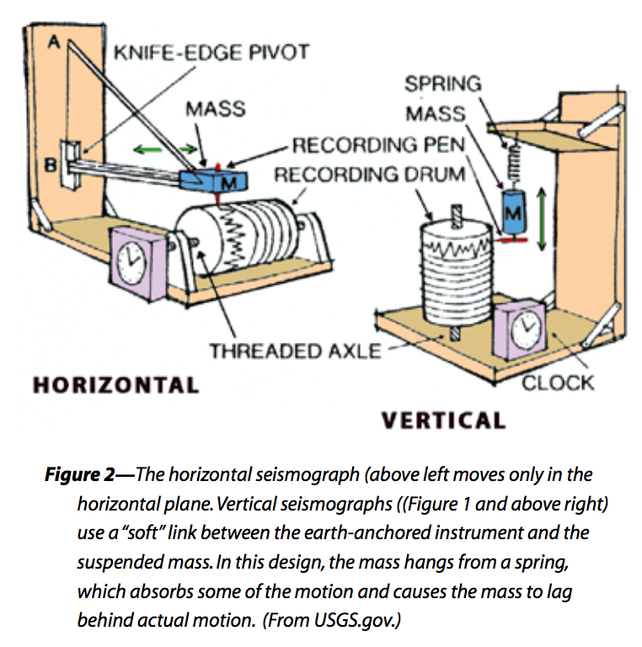
Basic seismic instrumentation
Two types of seismic motion sensor: inertial sensor and strainmeter. I will only talk about the inertial sensor.
Mass and spring systems:
Mass (M kg)
Spring stiffness (S N/m)
Damping element with constant of viscous friction (R N/(m*s))
Time-dependent ground motion: x(t)
Absolute motion of mass: y(t)
Motion relative to ground: z(t)
Acceleration ÿ relative to mass results from external force f acting on mass:

Slide 13
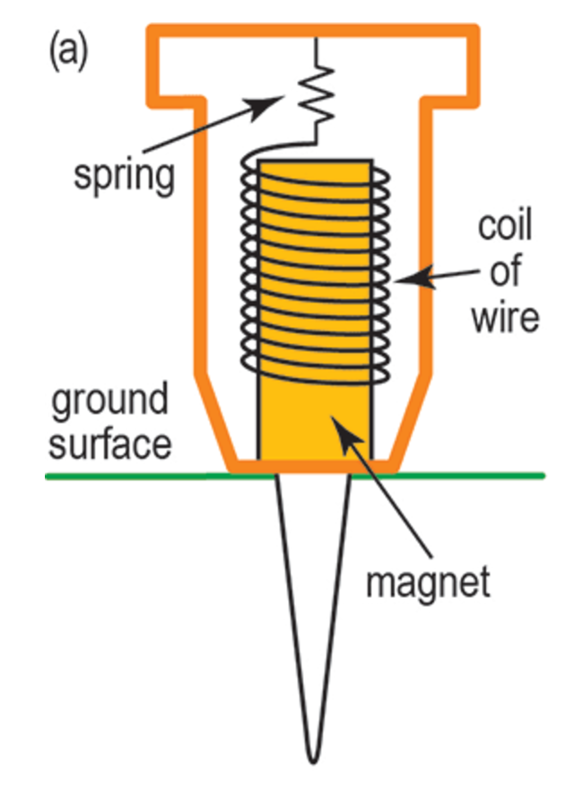
Basic seismic instrumentation: geophones
While the mass-and-spring model is useful, real seismometers are somewhat different.
Geophone seismometers typically have a coil of wire suspended by a spring that surrounds a magnet that’s coupled to the ground. When the magnet moves, the coil of wire doesn’t move, which induces an electrical current in the wire, producing a voltage that is recorded.
Reynolds, 1997

Slide 14
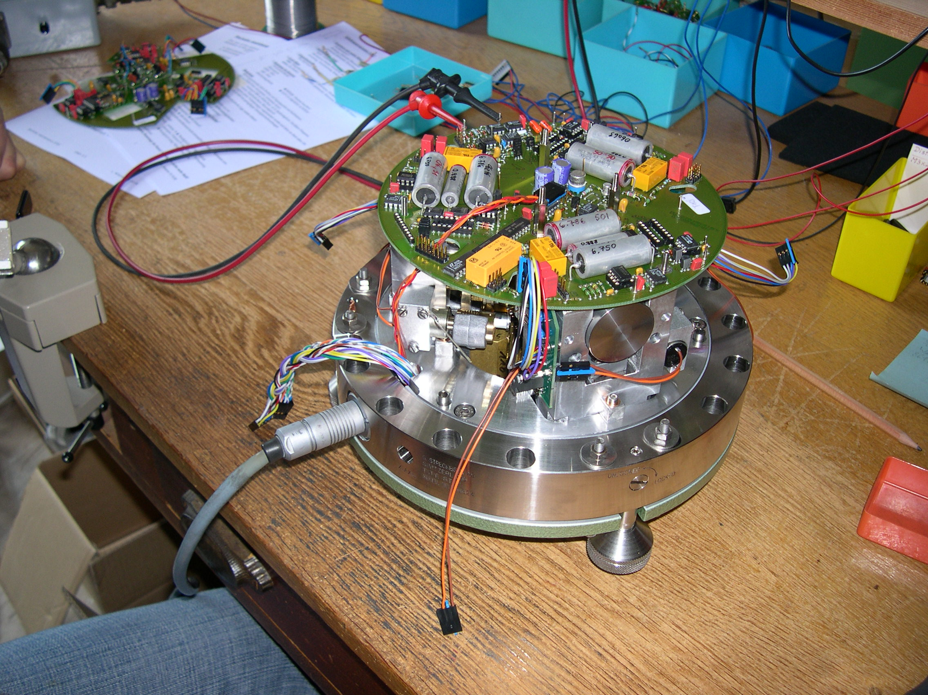
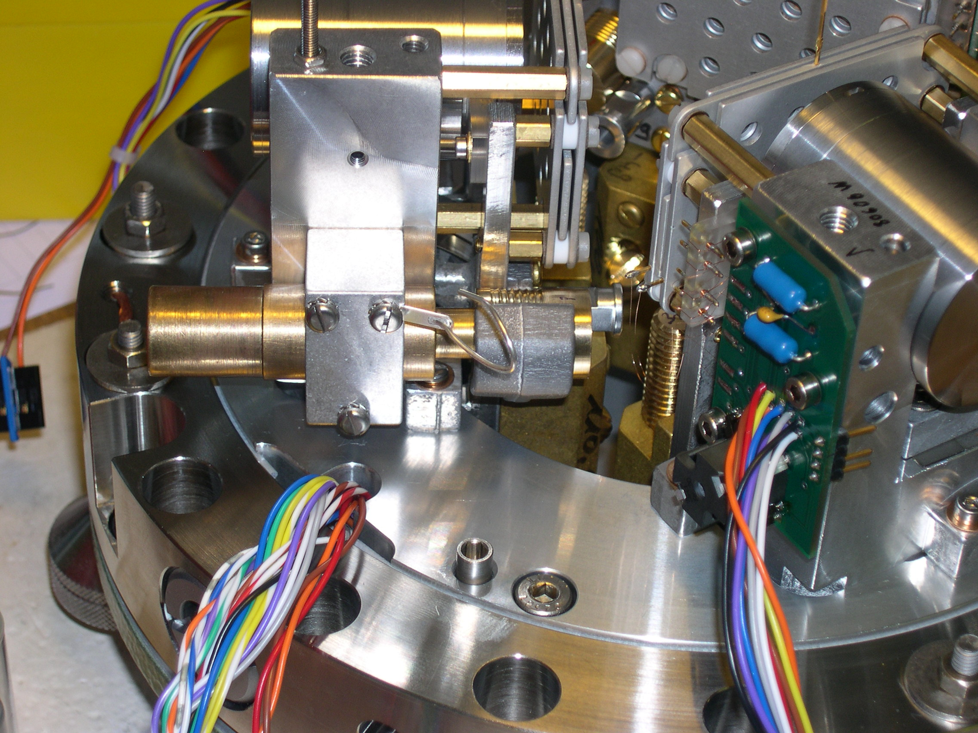
Basic seismic instrumentation: STS-2
Electronics holds mass motionless relative to frame
Distance between mass and part of frame is measured precisely by a linear variable differential transformer
Photos from osop.com.pa

Slide 15
Z-Land geophone vs. STS-2
Z-Land geophone
Natural frequency: 5 Hz
Damping: 0.70
Sensitivity: 76.7 V/ m/ s
Dynamic range: 127 dB
STS-2
Natural frequency: 0.0083 Hz
Damping: 0.707
Sensitivity: 1500 V/ m/ s
Dynamic range: 145 dB
Dynamic range: typically measured as the ratio of amplitudes of the largest signal to the smallest signal (R). Reported in decibels according to 20 log R. (e.g., if R~1e6, dynamic range is 120 dB).

Slide 16
Z-Land geophone vs. STS-2
Z-Land geophone
Natural frequency: 5 Hz
Damping: 0.70
Sensitivity: 76.7 V/ m/ s
Dynamic range: 127 dB
STS-2
Natural frequency: 0.0083 Hz
Damping: 0.707
Sensitivity: 1500 V/ m/ s
Dynamic range: 145 dB
Note: Very important to have a good transfer function for any instrument that characterizes frequency response and allows correct interpretation of signals.

Slide 17
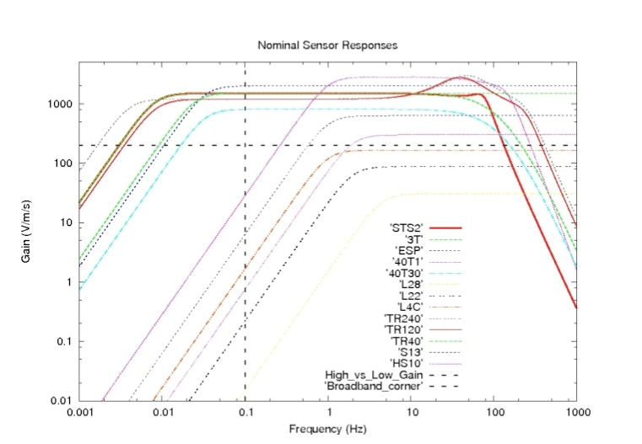
Sensor response (Gain vs. Frequency)
Source: IRIS website
Notes:
5 Hz ~ 0.02 s

Slide 18
Earth noise models
Distribution of seismic noise as a function of period.
Low noise and high noise models (Peterson, 1993): suggested lower and upper bounds on background noise found for stations on hard basement rock, based on years of empirical data collection.
Noise models typically have 2 peaks: at 0.2 Hz and 0.07 Hz. Both are due to ocean waves.

Slide 19
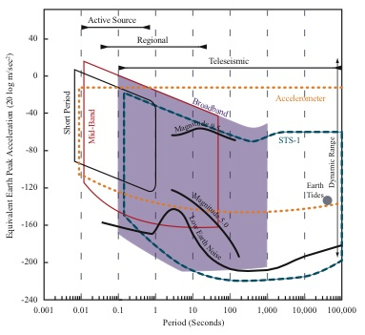
Equiv. earth peak acceleration vs. period for various signals

Slide 20
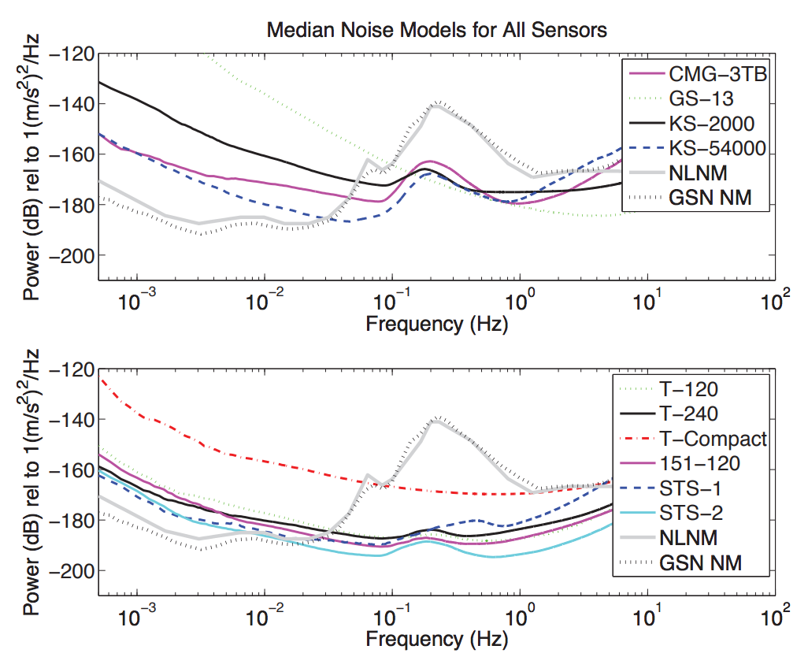
Self-noise models for various sensors
Ringler & Hutt, 2010

Slide 21
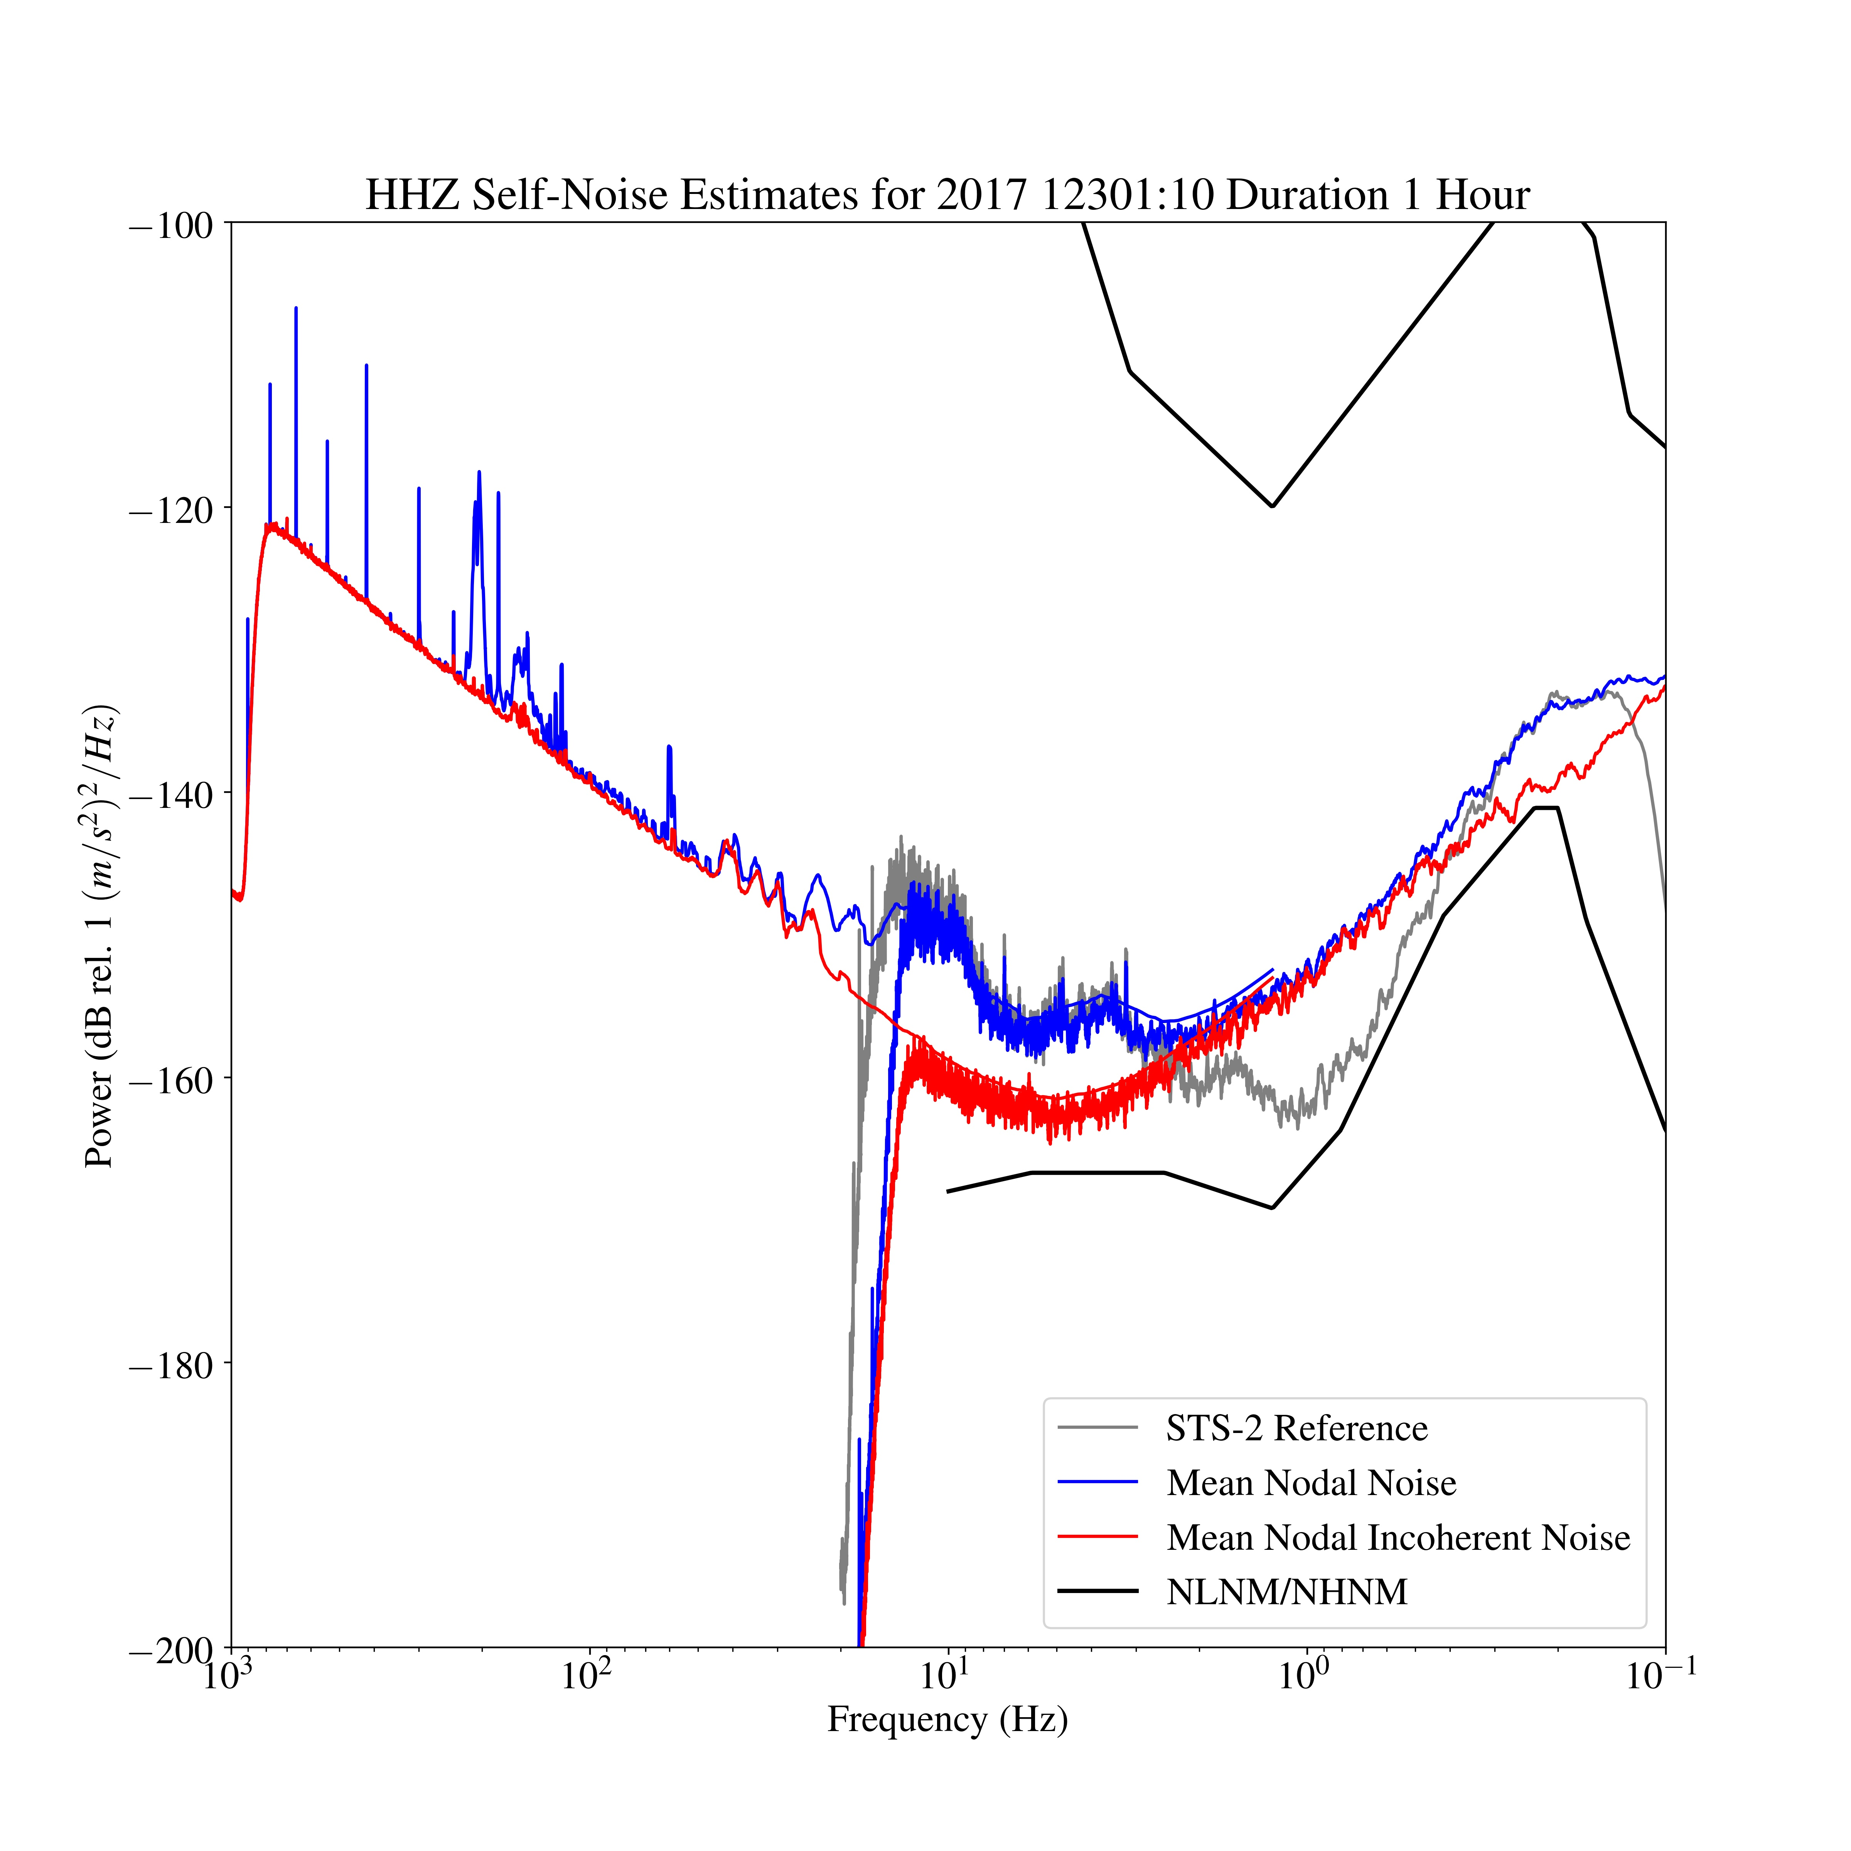
Self-noise model for STS-2 and Z-Land node
Plot from Adam Ringler, Albuquerque Seismological Lab
Notes:
Couple of basic observations:
1) You can see the digitizer noise start to ramp up at 20 Hz.
2) They are resolving the microseismic signal with about 5 dB of SNR (very good considering this was done in the summer)
3) Probably have noise levels below most site noise for frequencies higher than a Hz.
4) There is definitely a sensitivity to AC, but it is coherent on all sensors.

Slide 22
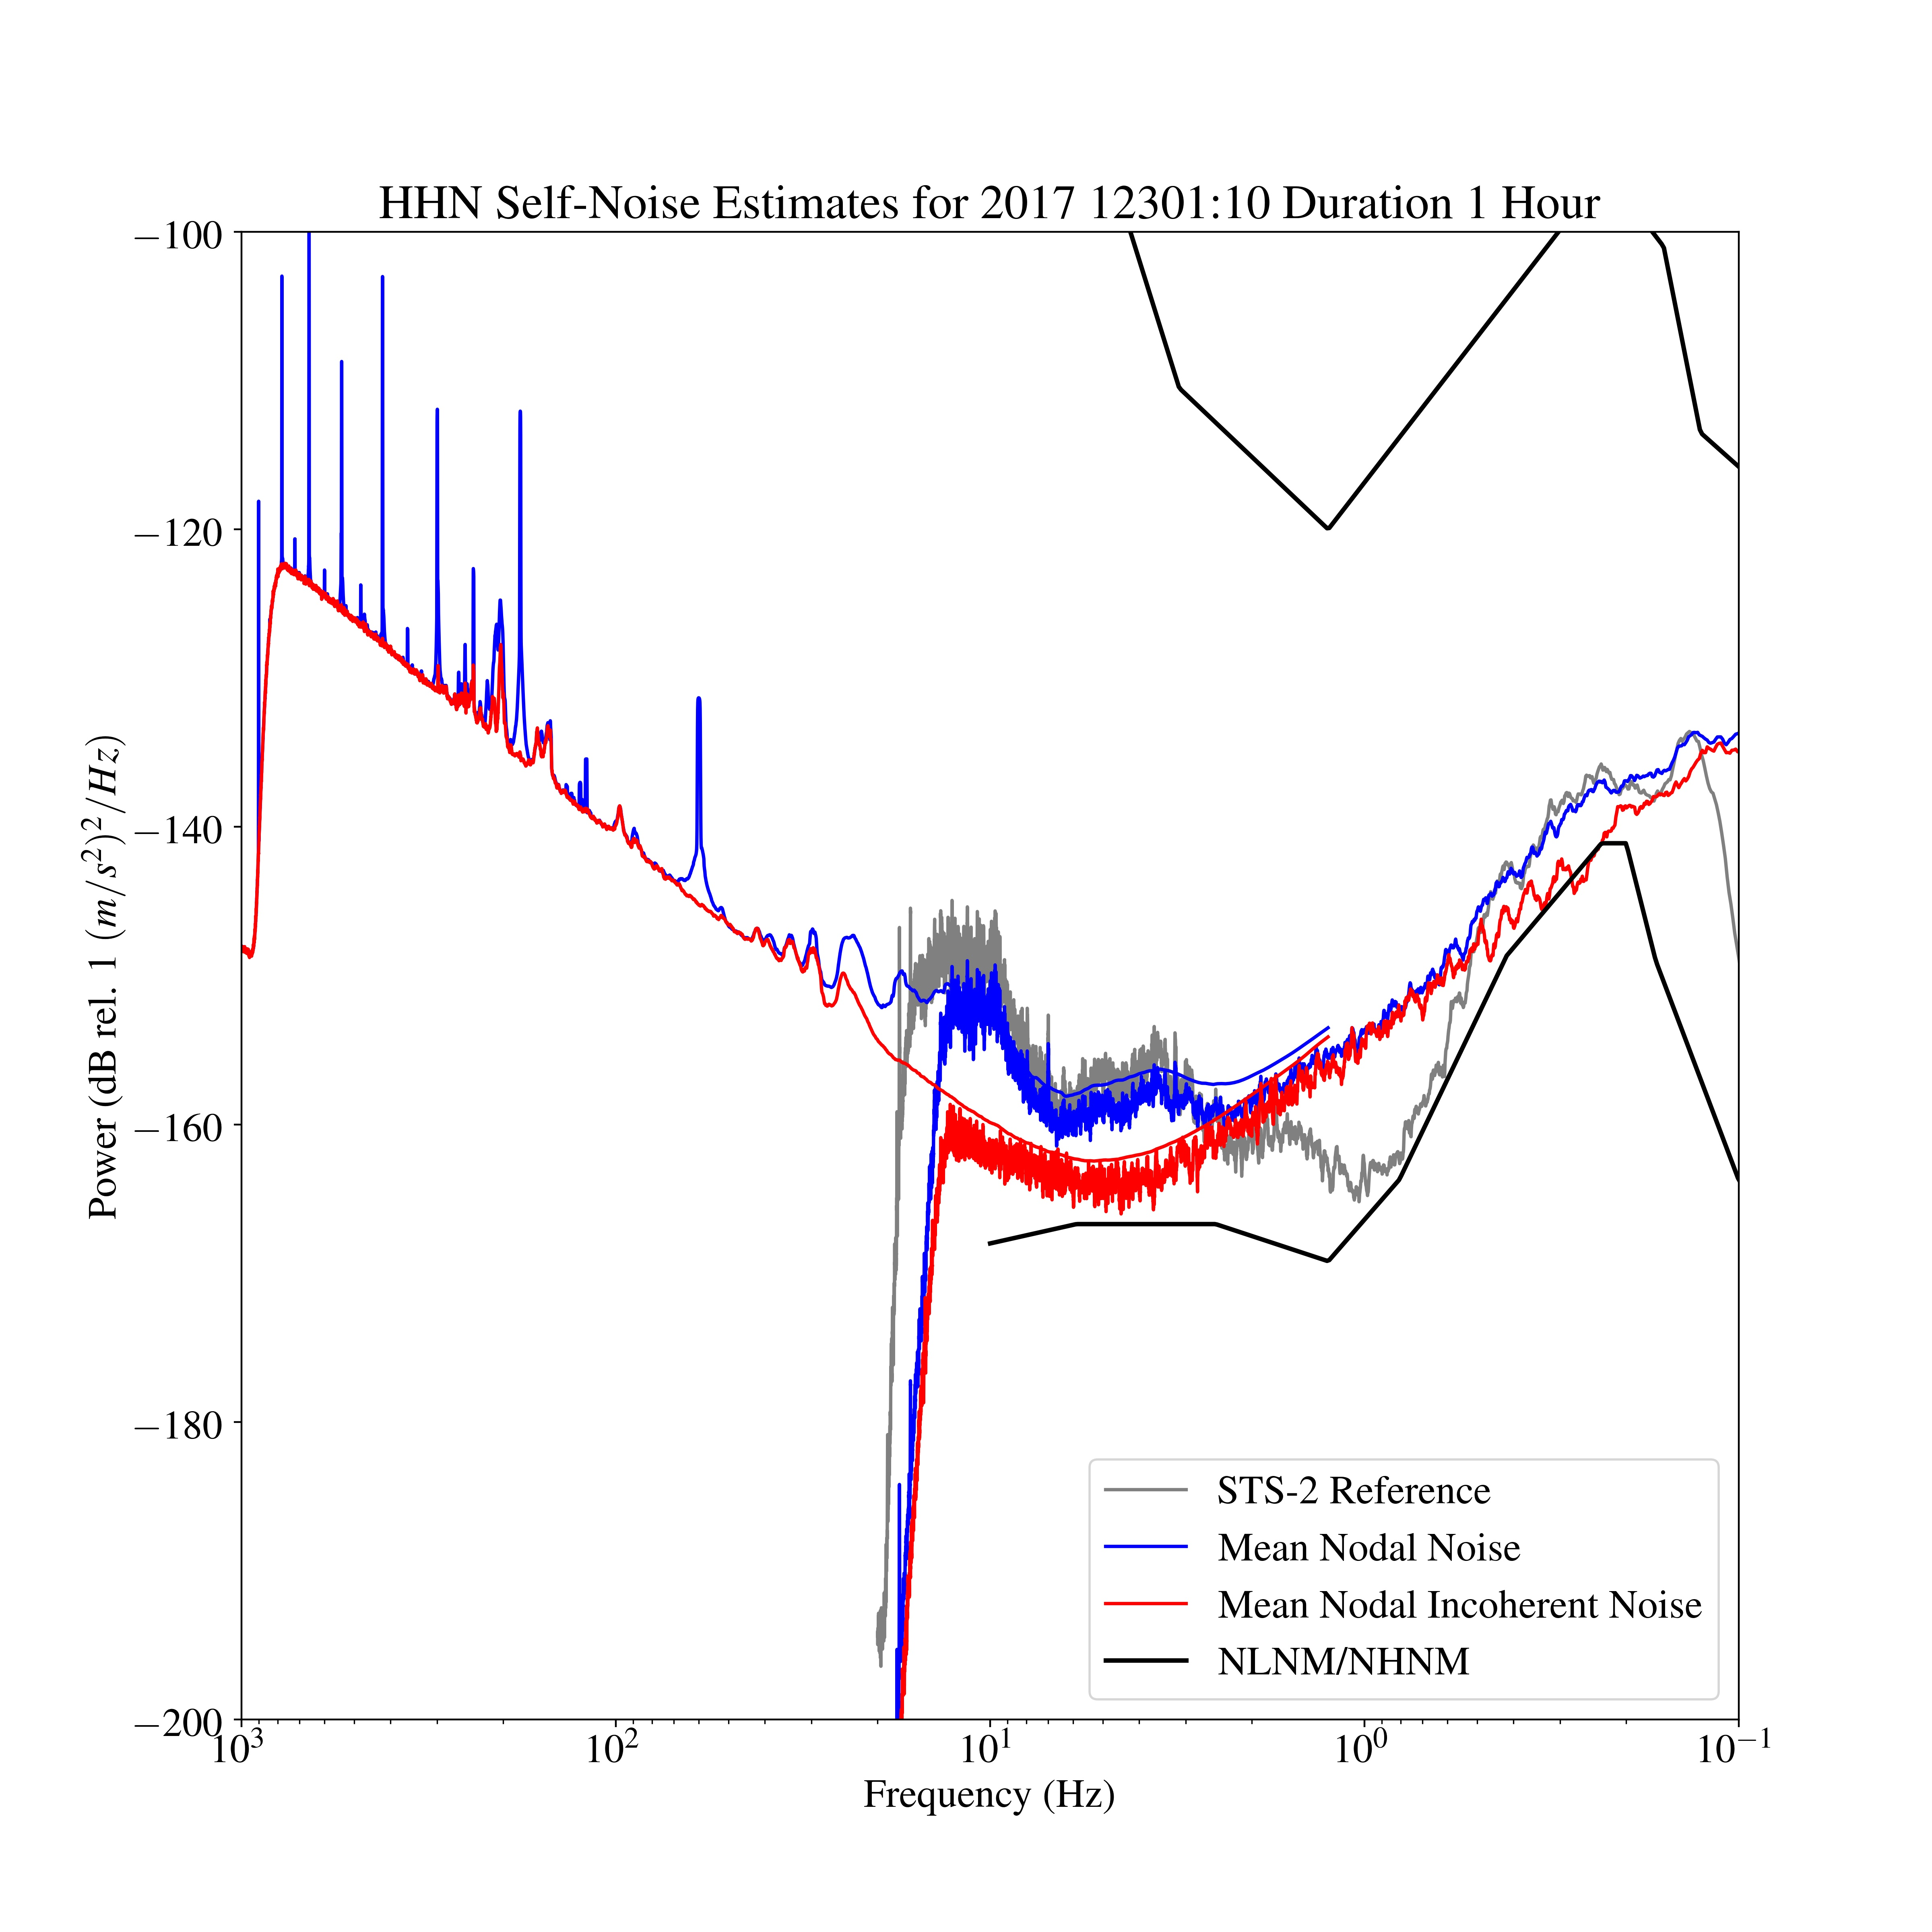
Self-noise model for STS-2 and Z-Land node
Plot from Adam Ringler, Albuquerque Seismological Lab
Notes:
There are two different curves that overlap because I tied down the sensitivity in the microseism band (~4 s period). Using this sensitivity I tied down the high-frequency part as well. This is a fairly large bandwidth so to get resolution at 1000 Hz as well as 0.1 Hz you need lots of samples and big FFT lengths.

Slide 23
Self-noise model for STS-2 and Z-Land node
Plot from Adam Ringler, Albuquerque Seismological Lab

Slide 24
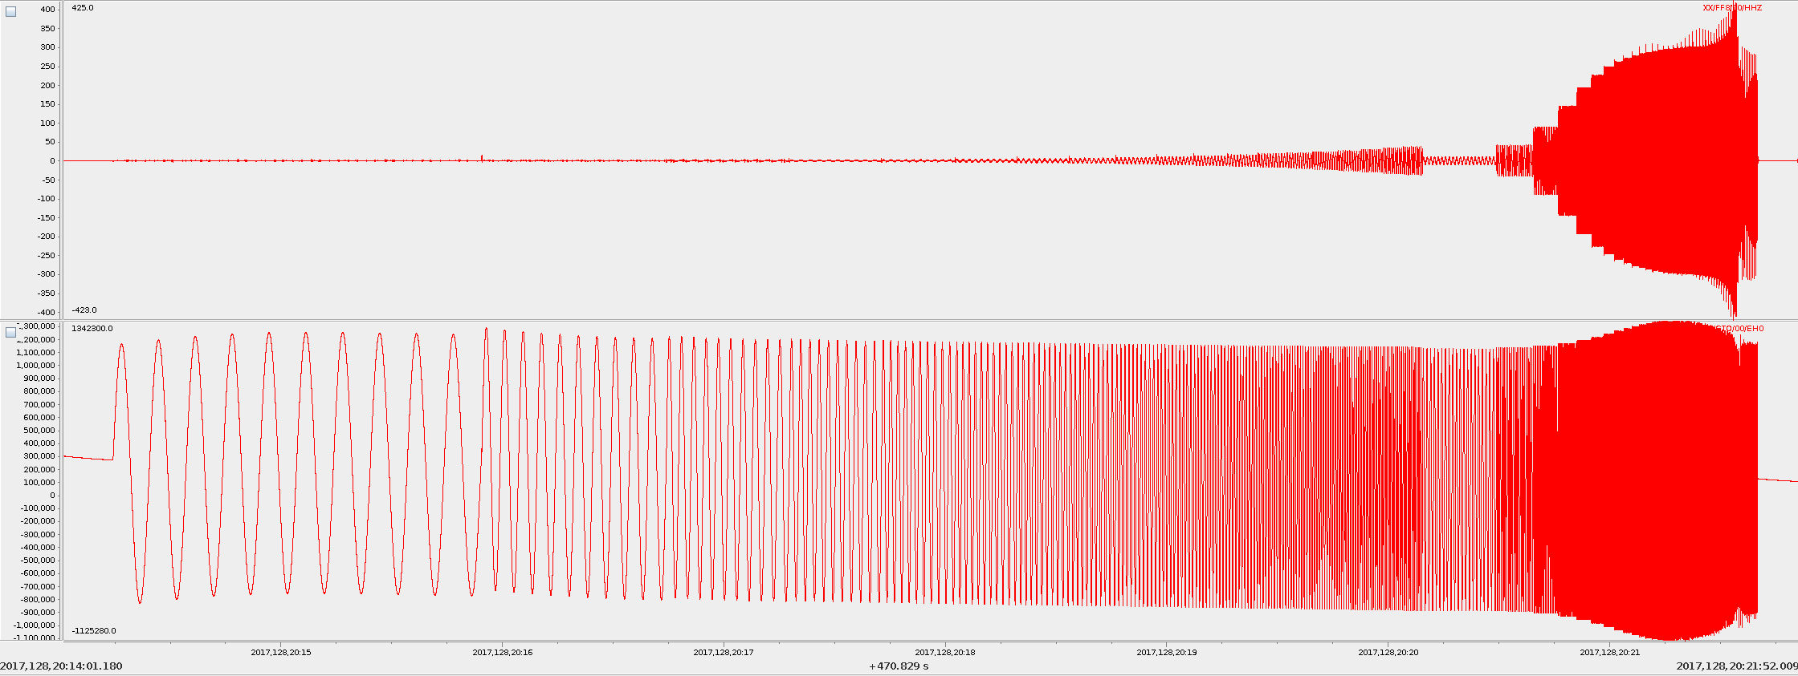
Swept sine on shake table with frequency increasing with time
Z-LAND NODE
TRILLIUM COMPACT
Time
Plot from Adam Ringler, Albuquerque Seismological Lab
Notes:
Attached is a figure showing a swept sine on our shake table with frequency increasing as time. The blip at 128 20:20 is where we started running a new sequence. The top trace is one of your nodes and the bottom trace is a trillium compact. This is a great example (imho) of why you want to remove the full response and characterize it. If you simply remove the mid-band gain you will have amplitude errors that are frequency dependent since both traces should look a like after correction.

Slide 25
Oklahoma wavefields data initial QC
Fairfield Harvest Management Console is where the data is downloaded, organized, QC’ed, and then written out in *.fcnt (‘Fairfield continuous’ format – a variation of SEG-D format) files.
Note: IRIS converts nodal datasets to PH5 format. I typically work with nodal data in SAC format (converted from fcnt).
Next slides give a brief intro to the Harvest Management Console.

Slide 26
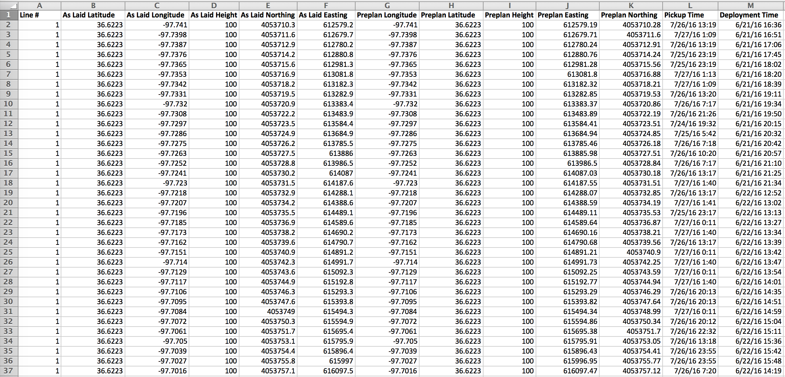
Harvest Management Console deployment table

Slide 27
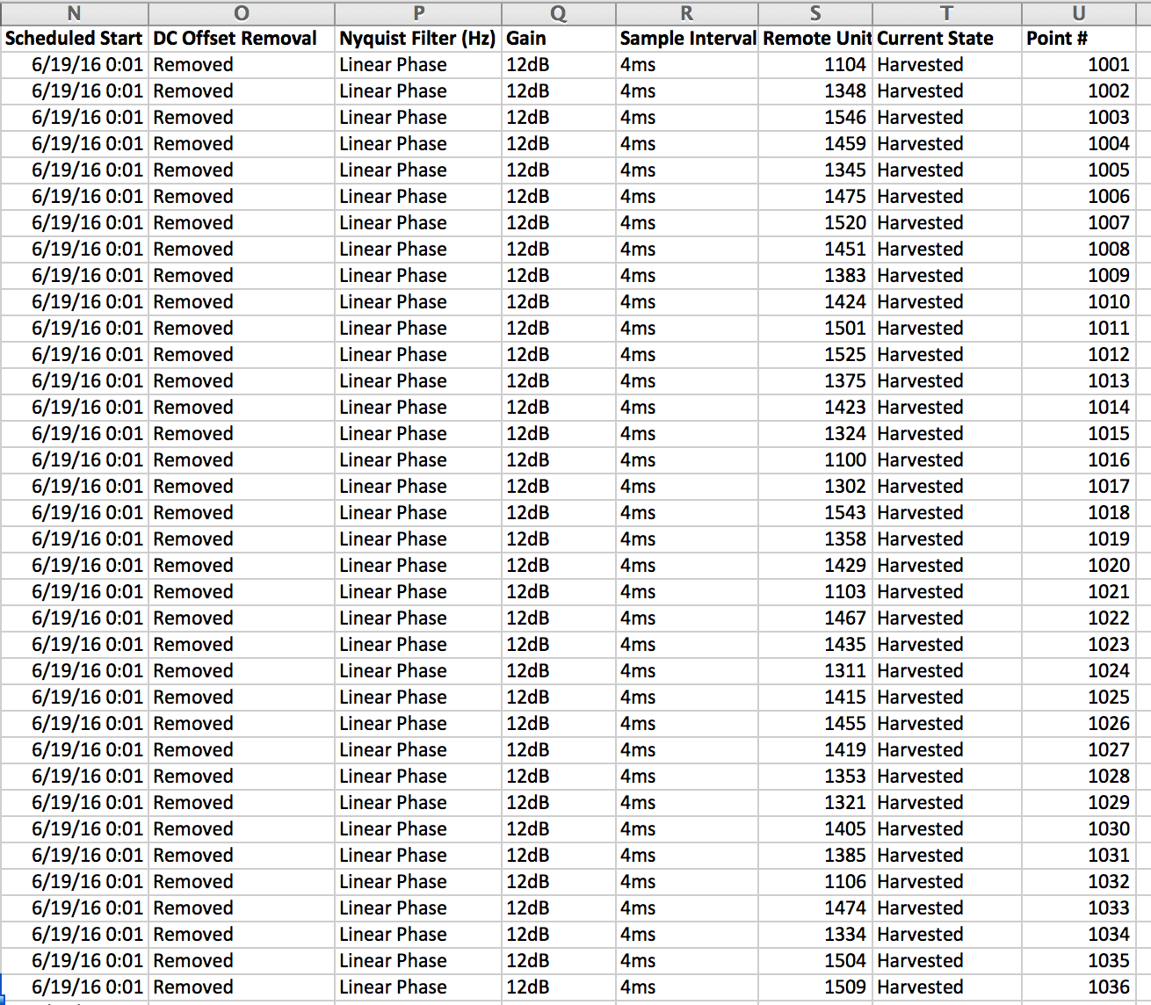
Harvest Management Console deployment table

Slide 28
Station 1010: Drift vs. Time

Slide 29
Station 1010: Temperature vs. Time

Slide 30
Station 1010: # Satellites vs. Time

Slide 31
Battery remaining vs. Time

Slide 32
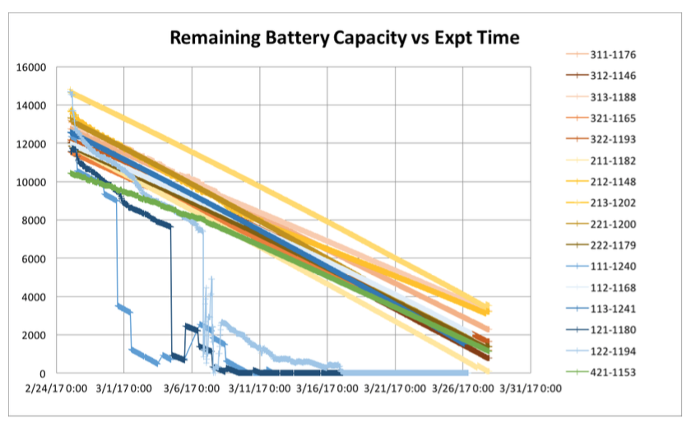
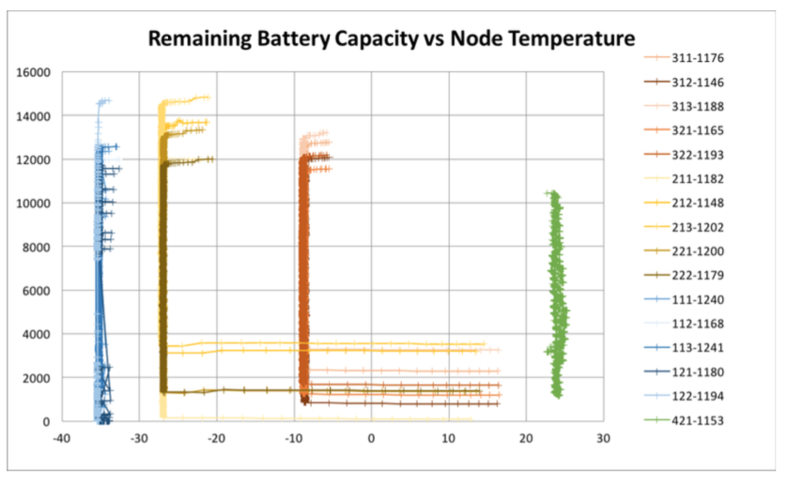
One reason you might want to look at this data: Low temperature performance of the nodes

Slide 33
Summary
Important to keep in mind Z-Land nodes have a lower sensitivity and dynamic range compared to many broadband, short-period, and long-period seismometers. It is more similar to other 5-Hz geophone technology like the Texan + geophone combination or the L28/ L22.
Practically, some researchers have tried using them for receiver functions and other teleseismic earthquake studies with some apparent success (when compared to receiver functions calculated from broadband stations).
The Z-Land nodes appear to perform well in self-noise tests and shake table tests.

Slide 34
Summary
Keep in mind you can ask Brit O’Neill (PASSCAL) or me (for Wavefields data) if you have questions about specific node tests in the Harvest Management Console.
Z-Land nodes are very powerful as easy-to-deploy, inexpensive, hardy little instruments. Possibility of recording the full seismic wavefield with a large N array is especially powerful. BUT it’s important to keep in mind their limitations and for which tasks they are best-suited: higher frequency studies, active-source studies, local earthquake studies, ambient noise, etc.
For more on seismometry, see Aki & Richards, Chapter 12.

Slide 36
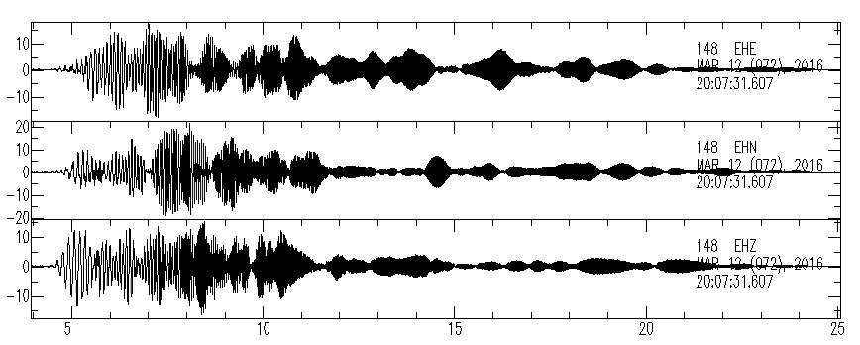
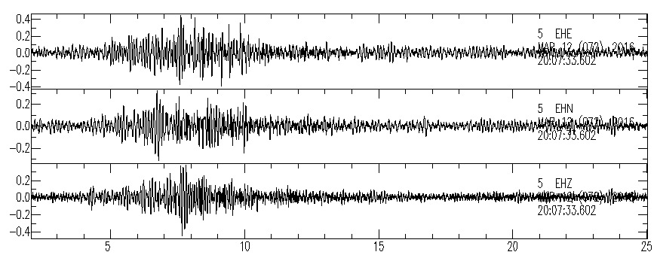
Example vibroseis sweeps
Node near
source,
strong
signal
Time (seconds)
Node far
from source,
weak
signal
Slide from Cliff Thurber, 2017
Time (seconds)
Active Source

