Slide 1
Introduction to Infrasonic Data Processing
Fransiska Dannemann + Brian Stump
LA-UR-17-26690
IRIS USArray Short Course 2017
August 8th, 2017
Notes:
Content Slide Notes
“UNCLASSIFIED” marking of slides is not a security requirement and may be deleted from the Slide Master (View › Master › Slide Master). In general, slides should be marked “UNCLASSIFIED” if there is potential for confusion or misinterpretation of something that could be deemed classified. For guidance on marking slides containing classified and unclassified controlled information, see the Protecting Information Web site at http://int.lanl.gov/security/protectinfo/.

Slide 2
Overview
Difference Between Seismic and Acoustic Data
Brief Introduction to Python and Obspy
Data Processing Exercise
Pulling Data from IRIS
Plotting Waveforms
Spectral Analysis + Filtering
Beamforming
Detection
6 months of processing

Slide 3
Differences Between Seismic and Acoustic Data
 | Seismic | Acoustic
Frequency Band | 1-10 Hz | 1–10 Hz
Velocity | 3-12 km/s | .22-.4 km/s
Wavelength | 10’s of km | 10’s – 100’s meters

Slide 4
A *Brief* Introduction to Python and Obspy
Why Python?
Free and open source
Modules for: computing, mapping/plotting, seismology
Obspy is the “Python Toolbox for seismology and seismological observatories”
In other words, it is an open-source project that provides a Python framework for processing seismological data

Slide 5
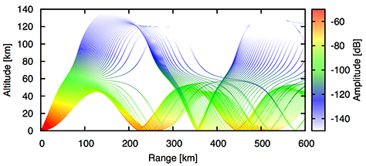
Resources
Geo-Ac – Acoustic Propagation and Ray Tracing Software (C++)
Anaconda – Python package, dependency and environment manager
Homebrew – “The missing package manager for macOS”
Obspy – “A Python Toolbox for Seismology”
Python Tutorial – Python Interactive Tutorial (from 2015 IRIS Short Course!)
Obspy Tutorial – Obspy Interactive Tutorial (from 2015 IRIS Short Course!)

Slide 6
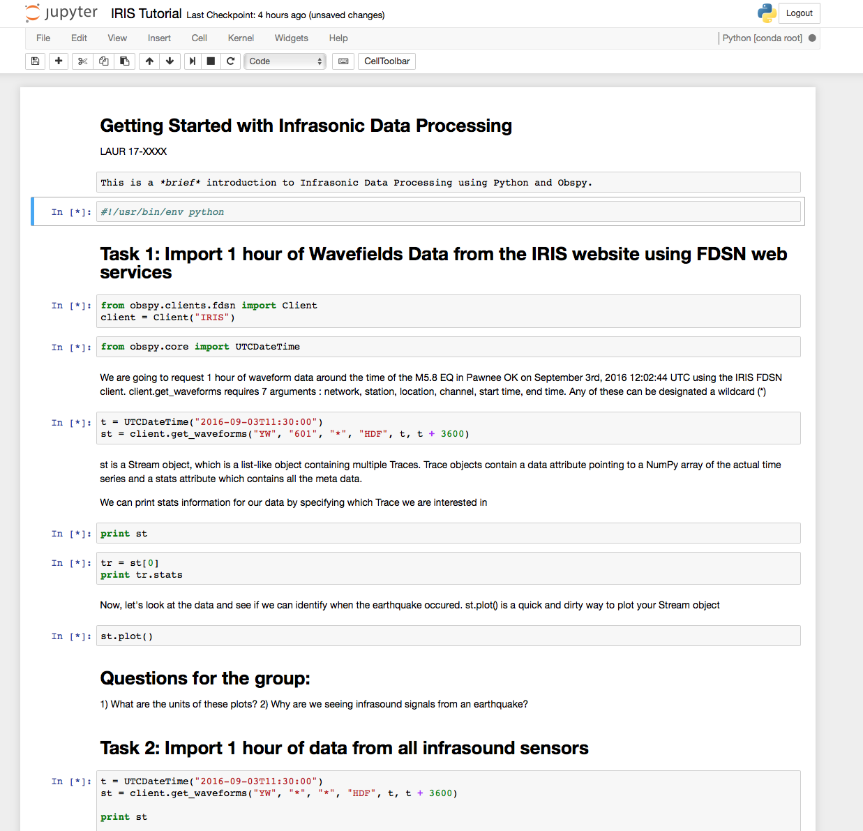
Data Processing Exercise: Introduction to Jupyter
“The Jupyter Notebook is an open-source web application that allows you to create and share documents that contain live code, equations, visualizations and explanatory test”
See more at https://jupyter.org Great tutorial found here: Jupyter Tutorial
Another great tutorial here: Jupyter Tutorial 2

Slide 7
Data Processing Exercise: Jupyter Toolbar and Commands
Shift + Enter: Execute cell and jump to the next cell
Ctrl + Enter: Execute cell and don’t jump to the next cell
If code execution is not responding anymore: Restart kernel (cache of previously assigned variables gets emptied)
Graphic and instructions from 2015 IRIS Short Course Obspy Introduction
Execute Task #1 in the IRIS Tutorial Notebook

Slide 8
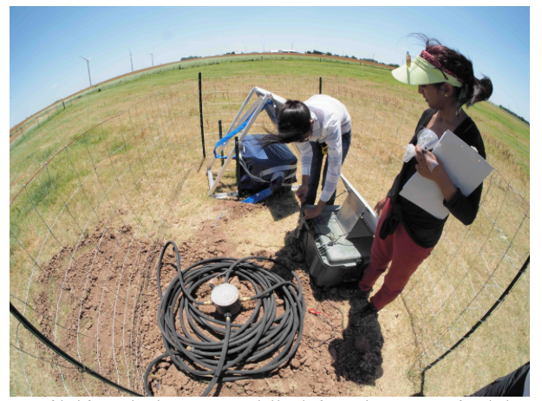
Data Processing Exercise: Deployed Acoustic Sensors
Execute Task #2 – Pull waveform data from IRIS using FDSN services and plot
Execute Task #3 – Pull waveform data from ALL stations and compare

Slide 9
Data Processing Exercise: Deployed Acoustic Sensors

Slide 10
Data Processing Exercise: Identifying Noise Sources
Chisholm View Wind Project
140 GE 1.6 MW Turbines with 3 blades
6-16 rpm
Execute Task #4 – Fundamental Frequency Calculations
Notes:
Signals are being contaminated with noise – potentially from the WT. Is there a way we can clearly identify if that is the noise source? Wind turbines have a fundamental frequency component that we can calculate from readily available information

Slide 11
6 Months of OK Wavefields Processing: Acoustic Results
FK-Processing
Signal Detection

Slide 12
6 Months of OK Wavefields Processing: Seismic Results
FK-Processing
Signal Detection

