Slide 1
Beam Forming Arrays
Charles A. Langston
Center for Earthquake Research and Information
University of Memphis

Slide 2
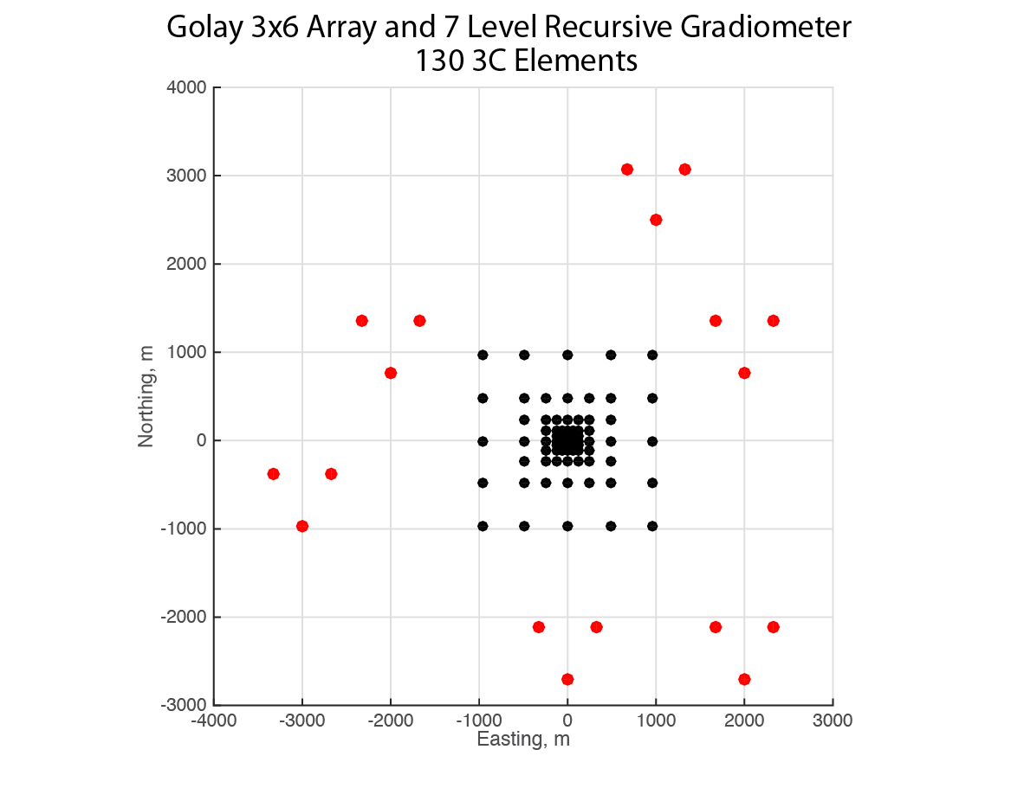

Slide 3
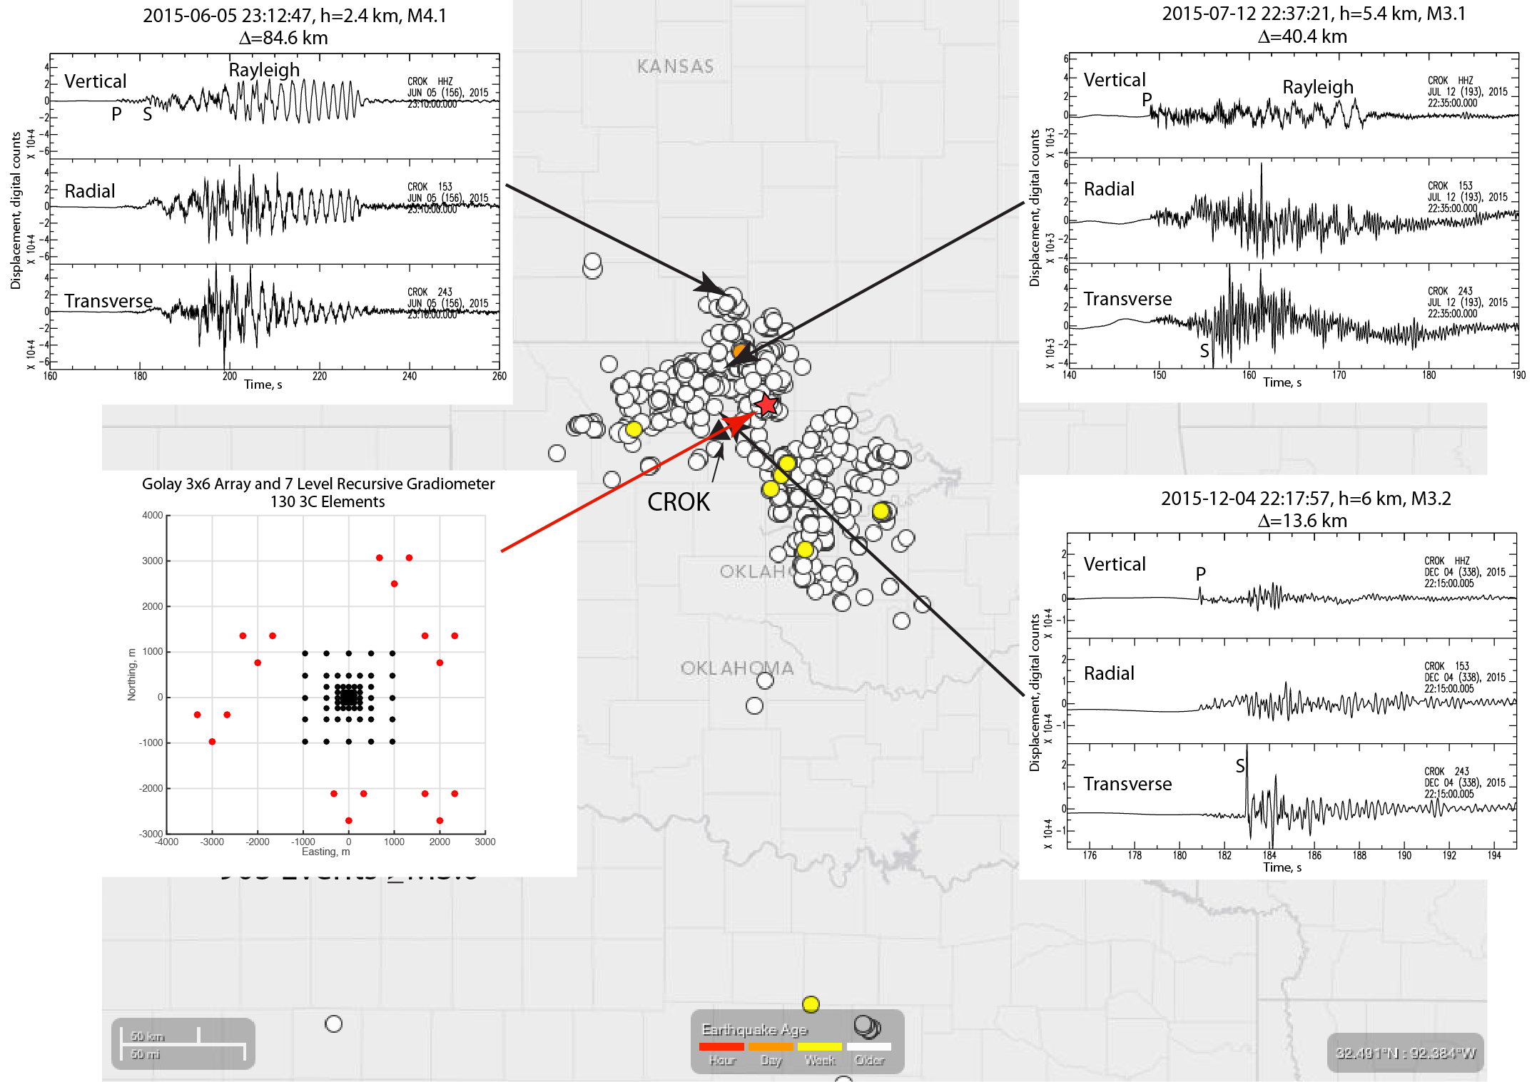

Slide 4
Array Design Criteria
Station spacing
Array Diameter
Wave Correlation Distance
(as determined from regional arrays)
Notes:
Array designs must sample the spatial wavefield a frequencies less than Nyquist frequency, which is related to average sensor spacing. The array Diameter must be greater than a wavelength of the wave under study. Results from regional arrays show that crustal and upper mantle phases generally decorrelate over a distance, a, which is roughly a single wavelength. Thus, regional array resolution is limited by this degradation in correlation distance since beam forming implicitly assumes that the underlying wave signal is identical over all array elements.

Slide 5
Horizontal
Phase Velocity
Horizontal Slowness
0
D
Horizontal Wavelength
Wave velocity v
i

Slide 6
Horizontal Wavenumber (Slowness) Spectra

Slide 7
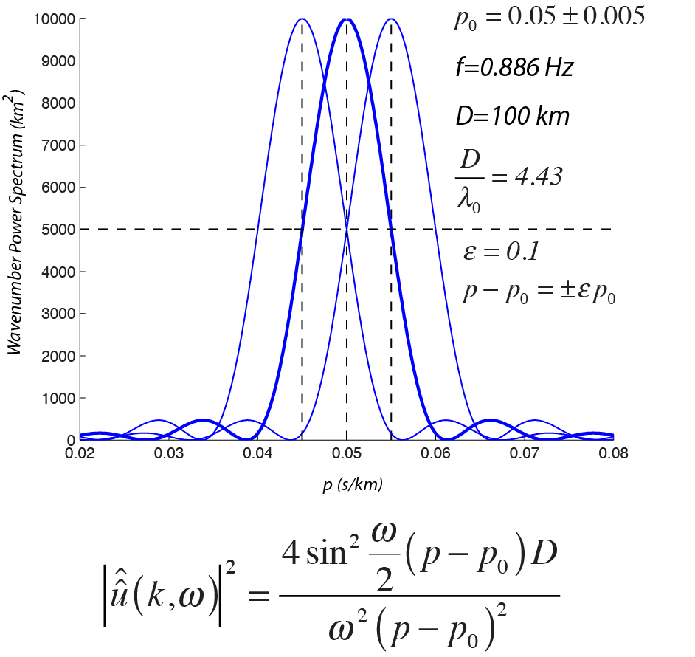
Notes:
The ability to resolve two signals can be estimated using a 1D line array that is D long. The frequency-wavenumber power spectrum is a sinc function to the fourth power. If resolution is defined as separation at the half-width of the signal peak, then a minimum array diameter, D, can be estimated for a given difference in the target slowness. Here it is assumed that we want to separate two signals with a 10% slowness difference. The array diameter must be greater than 3 times the horizontal wavelength to do so. Thus, it is difficult for regional arrays to perform at this level since signal correlation degrades significantly over a single wavelength.

Slide 8
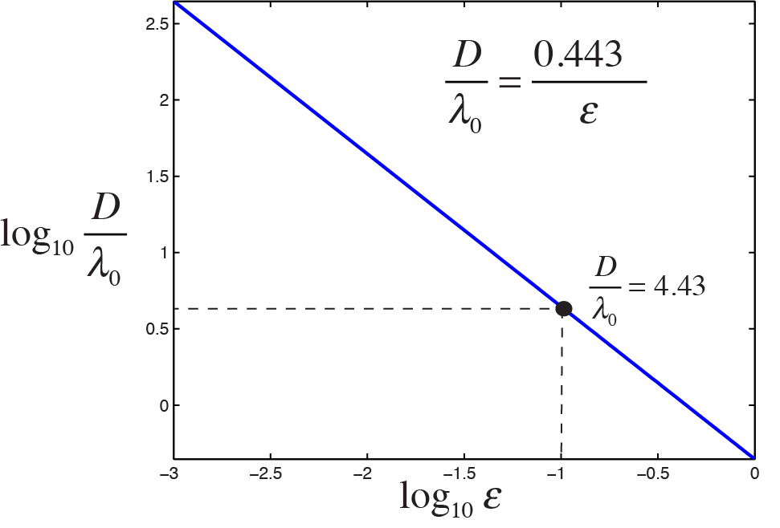
Notes:
This is a plot of of the needed array diameter to target wavelength ratio for different desired error thresholds. Smaller separations in slowness require greater array diameters.

Slide 9
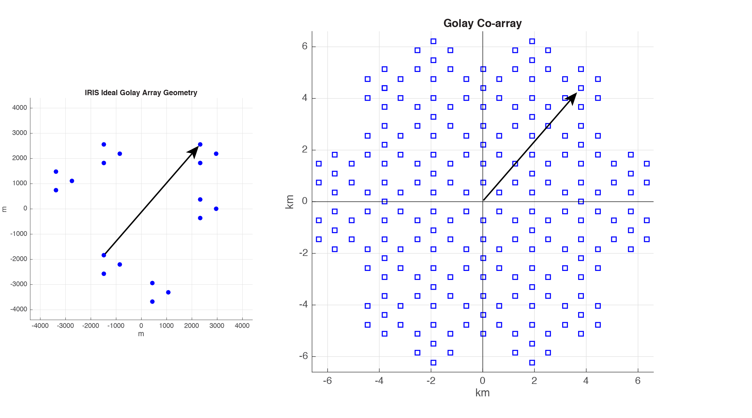

Slide 10
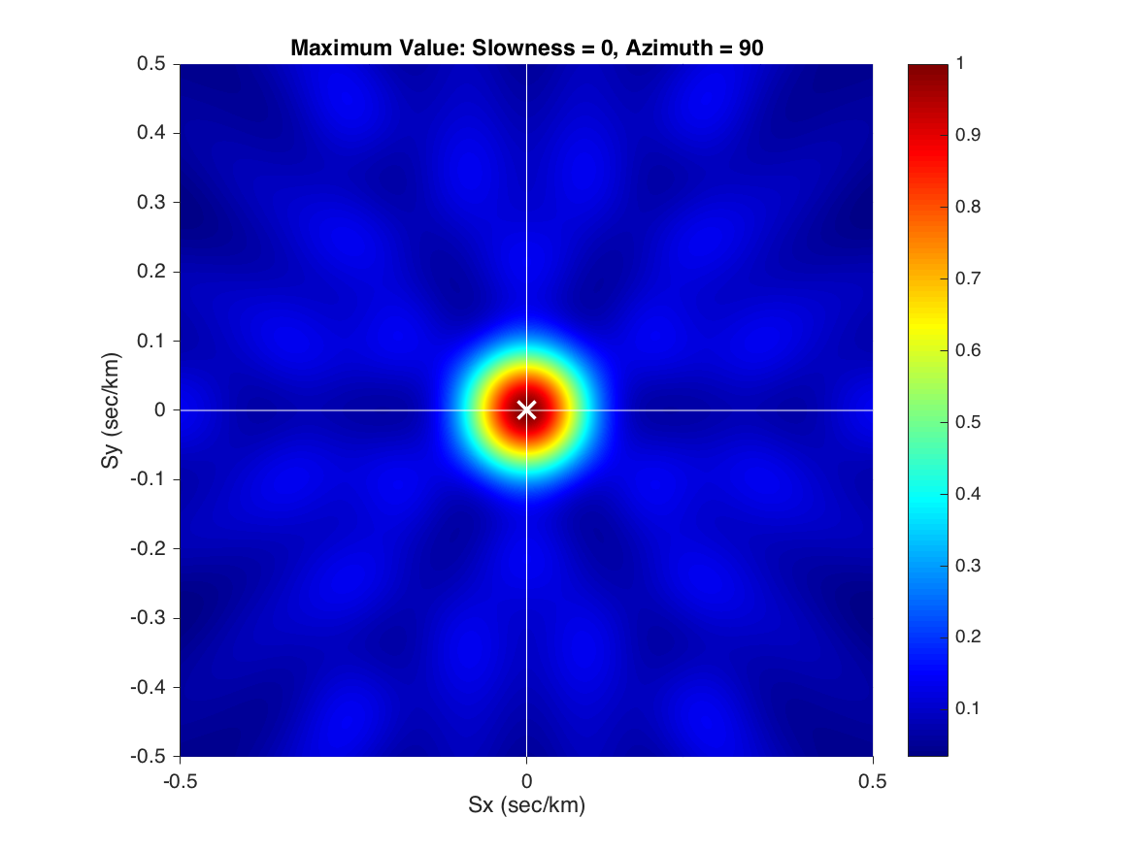
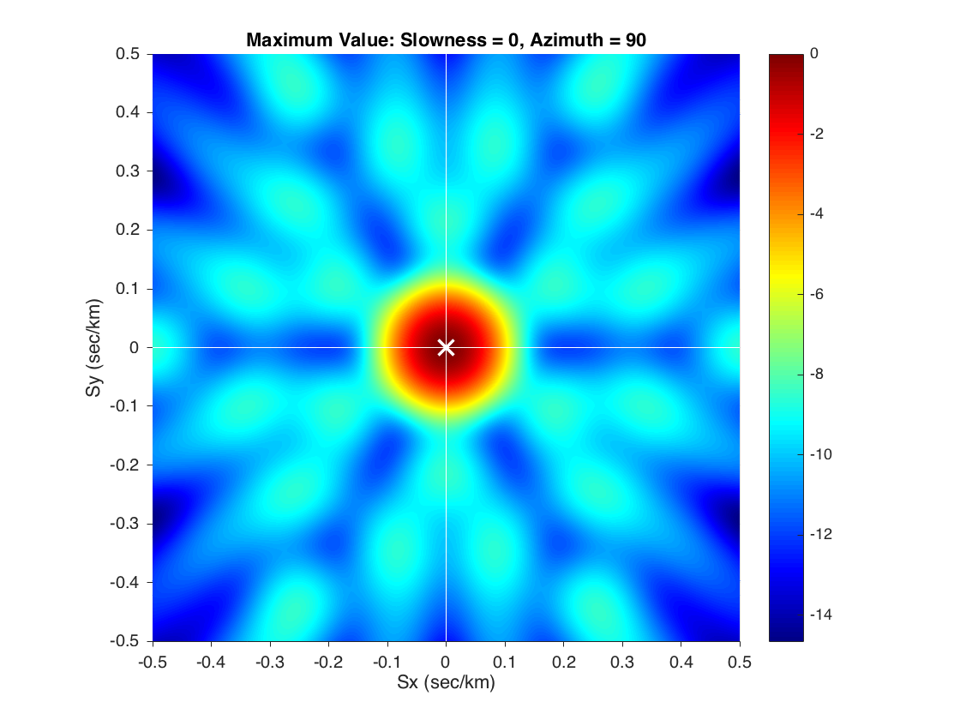
Array Slowness Response 0.3 to 1 Hz Bandpass Signal Power
Linear density scale
Logarithmic density scale (dB)

Slide 11
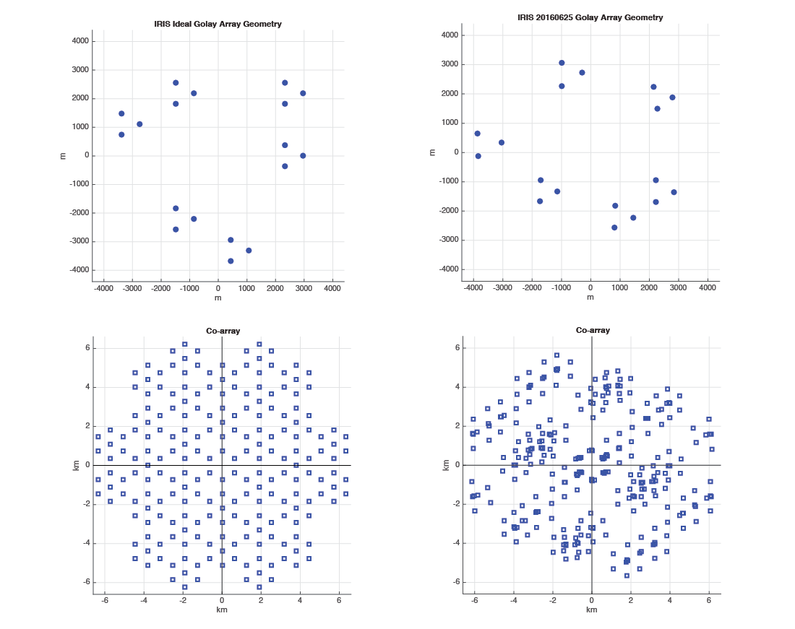
Array Diameter > Wavelength

Slide 12
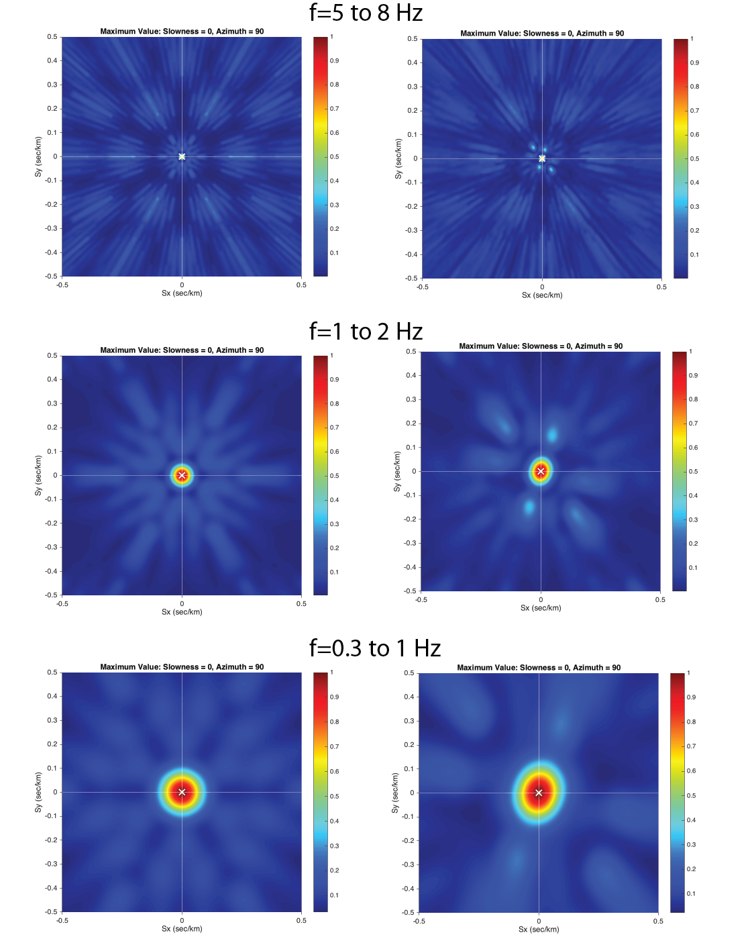
Is this possible?
Ideal
Actual

Slide 13
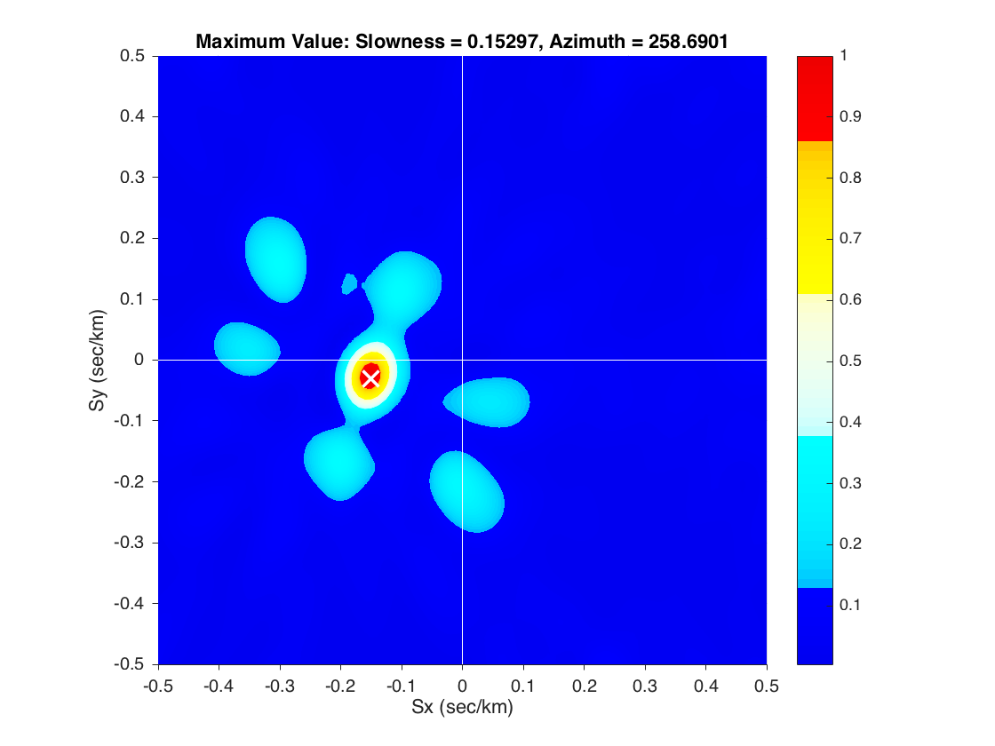
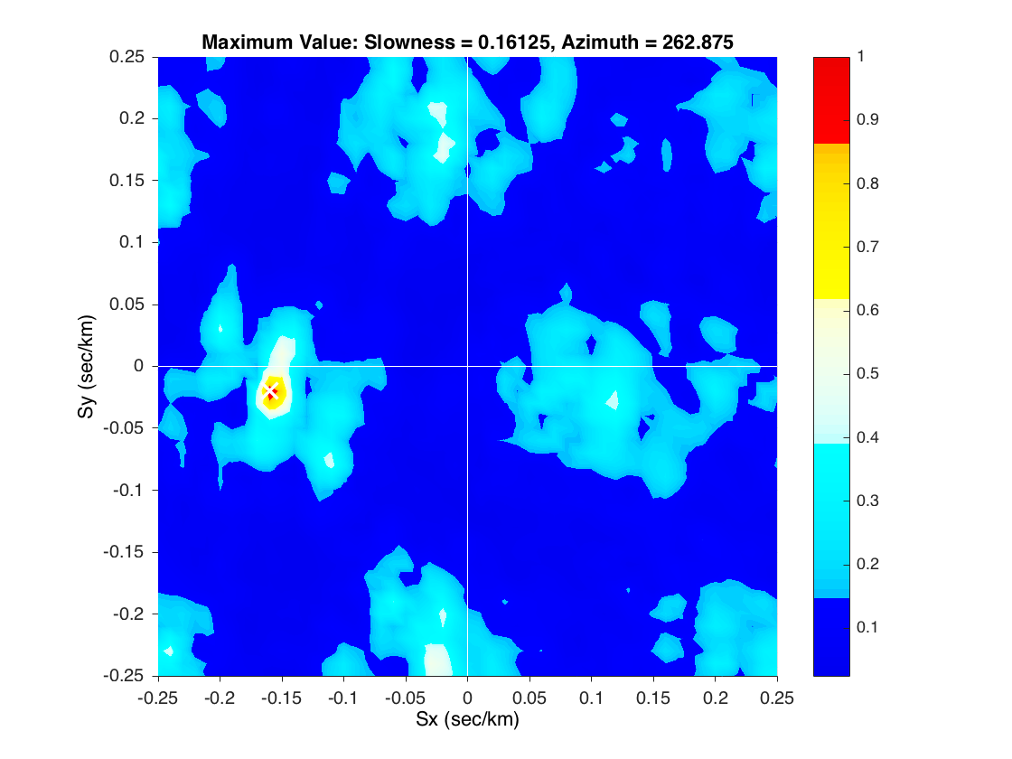
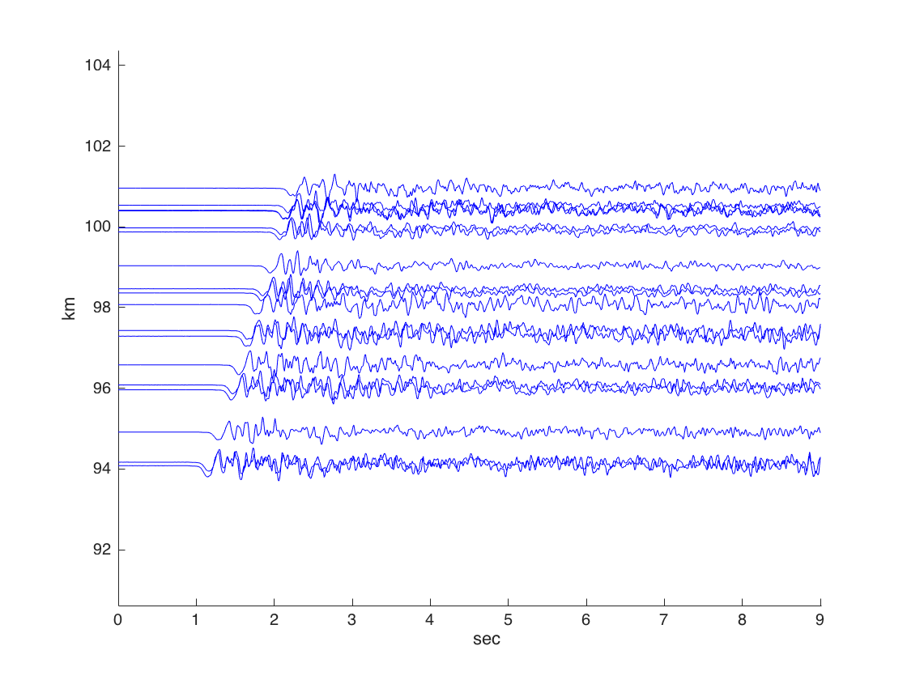
1 to 2 Hz
M4.2 Fairview, OK, Earthquake
Backazimuth = 262.5º
It actually works!
P waveforms
5 to 8 Hz

