Slide 1




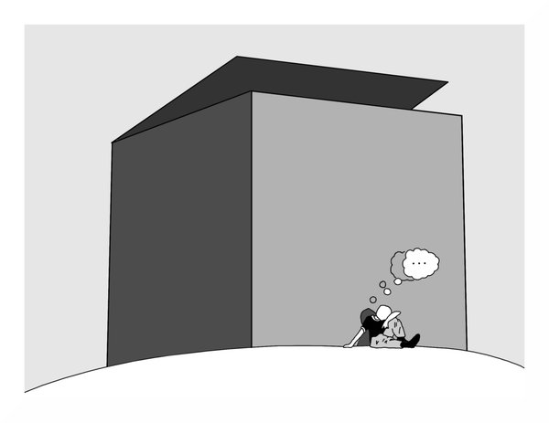

Slide 2


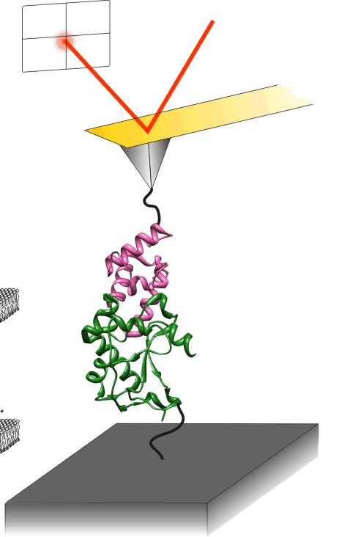
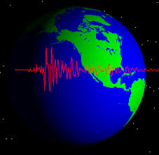
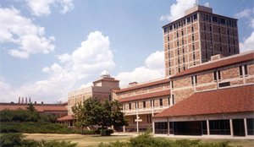
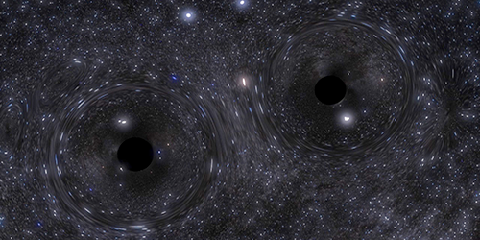


Slide 3
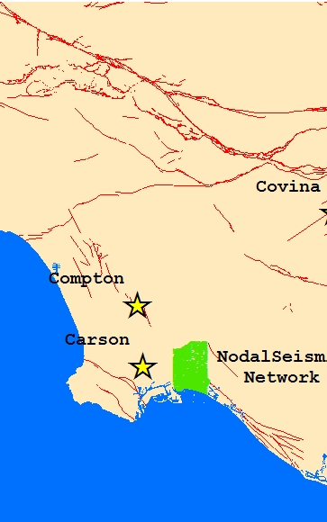
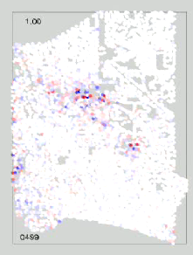

Constructing noise cross-correlation wavefields with dense geophone arrays
Fan-Chi Lin
(& Elizabeth Berg)
University of Utah
August 9, 2017
at
IRIS Advanced Short Course
Carson 2011/05/14 Mb 2.5 distance 5 km
Notes:
It is such a nice array. And of course also because that’s the array I have been working on. Receiver function is sensitive to sharp structure contrast. Surface wave tomography can give absolute structure but have poor resolution. Good thesis topic. Well posed problem. Likely successful. My advisor have funding for. Most important, can be published.

Slide 4
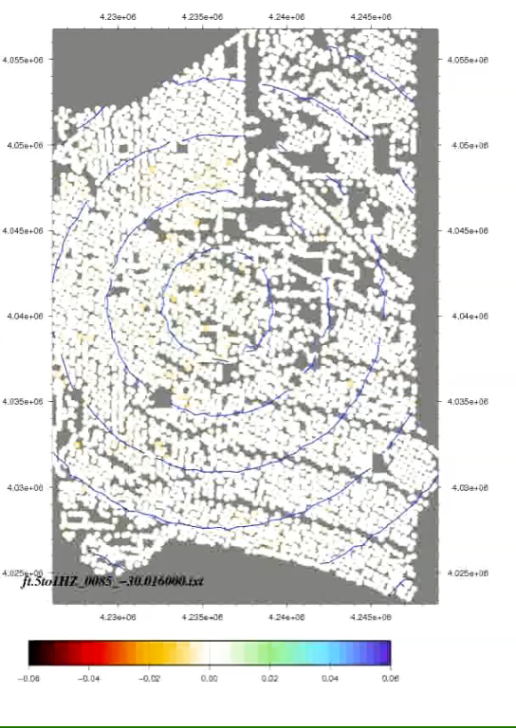
Constructing noise cross-correlation wavefields with dense geophone arrays
Fan-Chi Lin
(& Elizabeth Berg)
University of Utah
August 9, 2017
at
IRIS Advanced Short Course
Notes:
It is such a nice array. And of course also because that’s the array I have been working on. Receiver function is sensitive to sharp structure contrast. Surface wave tomography can give absolute structure but have poor resolution. Good thesis topic. Well posed problem. Likely successful. My advisor have funding for. Most important, can be published.

Slide 5
About the code
Reference
  Lin, F.-C.,D. Li, R. W. Clayton, and D. Hollis, High-resolution 3D shallow crustal structure in Long Beach, California: Application of ambient noise tomography on a dense seismic array, Geophysics, 78(4), Q45-Q56,doi:10.1190/geo2012-0453.1, 2013
Work but poorly organized.
There are probably better code out here!
  E.g. http://msnoise.org/doc/index.html

Slide 6
Background Check
How many of you have done noise cross-correlation before?

Slide 7
Background Check
How many of you have done noise cross-correlation before?
How many of you have analysis data from a large N array? (N>1000)

Slide 8
Background Check
How many of you have done noise cross-correlation before?
How many of you have analysis data from a large N array? (N>1000)
How many of you have done noise cross-correlation across a large N array?

Slide 9
Background Check
How many of you have done noise cross-correlation before?
How many of you have analysis data from a large N array? (N>1000)
How many of you have done noise cross-correlation across a large N array?
N>5000?

Slide 10
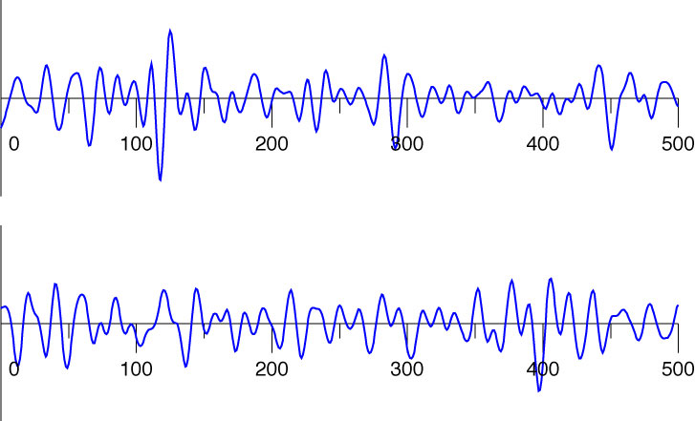
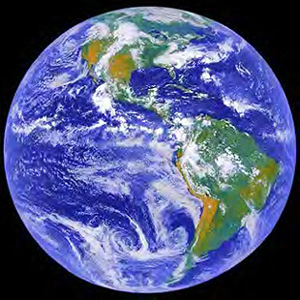
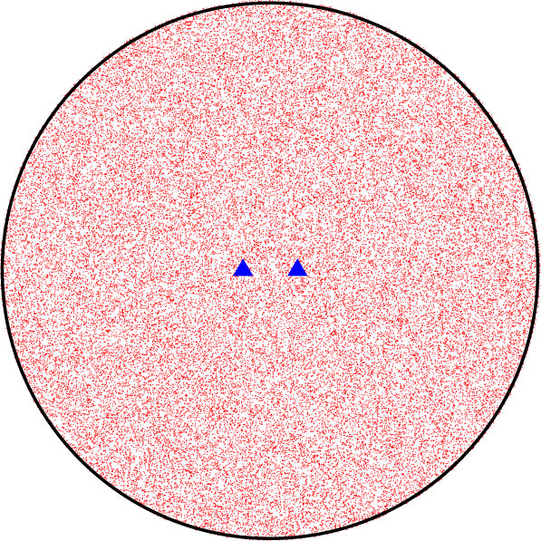
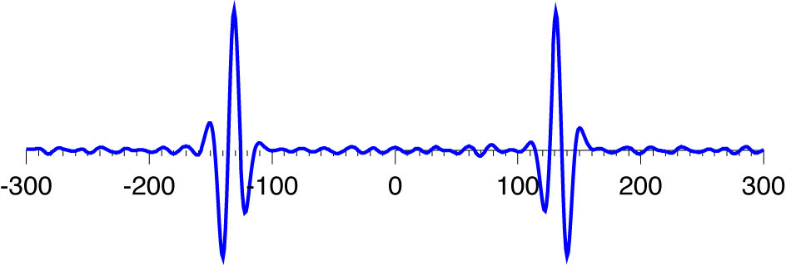
Noise cross-correlation and Green’s function
Time (sec)
Notes:
Simulation! Non homogeneous. Can not stop seismologists to trying.

Slide 11
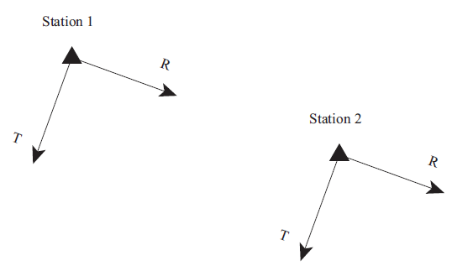
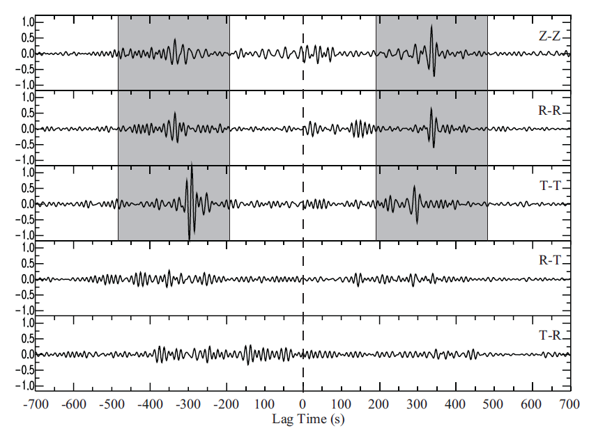
Applications across the microseism period band
Year long cross-correlations between two TA stations (116A and R06C)
Lin et al. (2008)
Notes:
Usually use the symmetric component

Slide 12
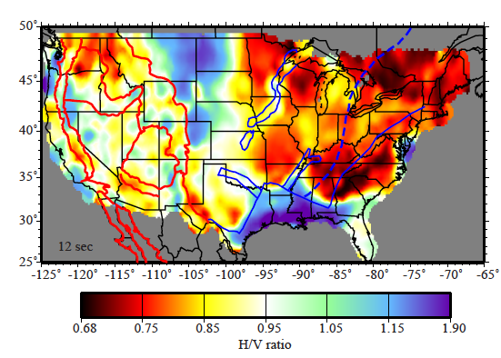
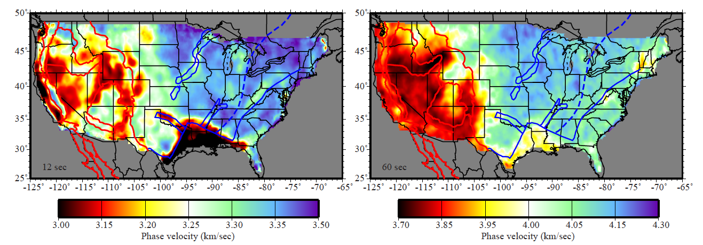
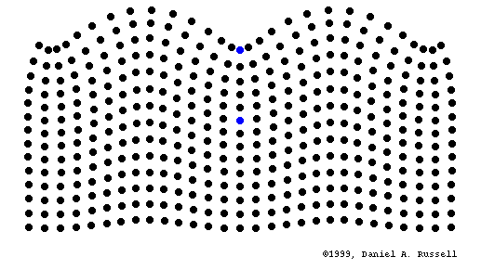
Rayleigh wave phase velocity & ellipcity maps
12 sec period
12 sec period
Phase Veolocity H/V
sensitivity depth ~14 km <5 km

Slide 13
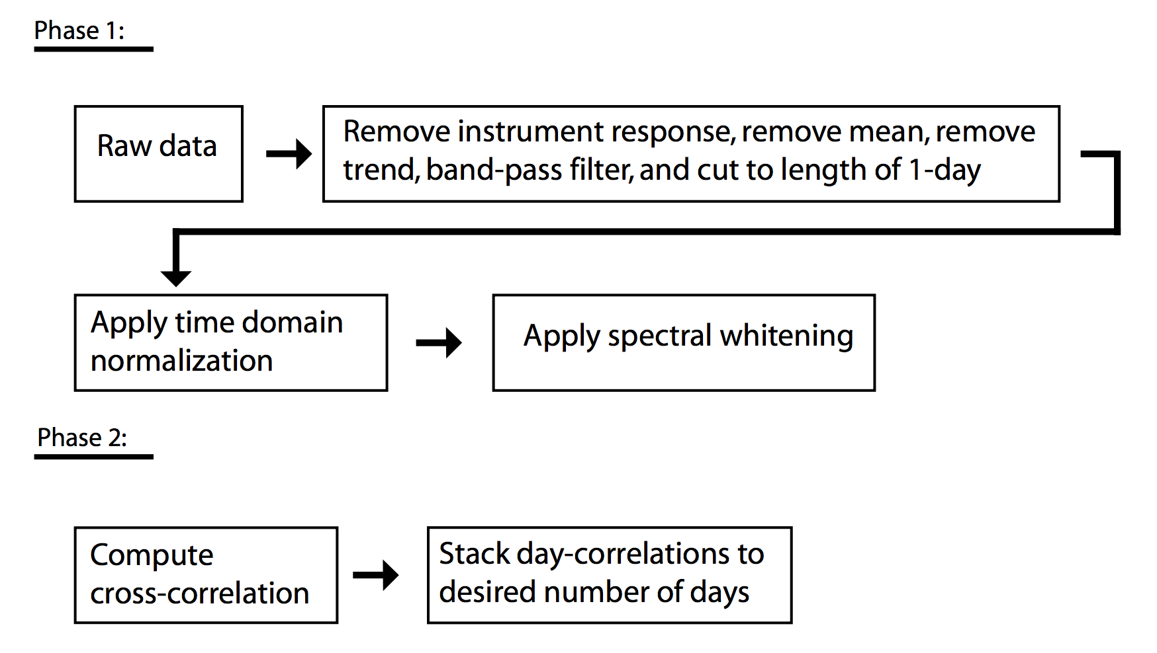
Typical process scheme

Slide 14
Potential Problems?

Slide 15
Potential issues
Inhomogeneous source distribution
  Velocity bias
Unreliable amplitude information due to temporal and spectrum normalizations
  Attenuation bias
  Amplification bias

Slide 16
What’s the advantage of having a large N dense array?

Slide 17
What’s the advantage of having a large N dense array?

Slide 18
The cross-correlation wavefield
Assume the noise wavefield u(x,t) satisfies the wave equation L:
The cross-correlation wavefield between a source station A and all other locations is:
The cross-correlation wavefield satisfies the wave equation:

Slide 19
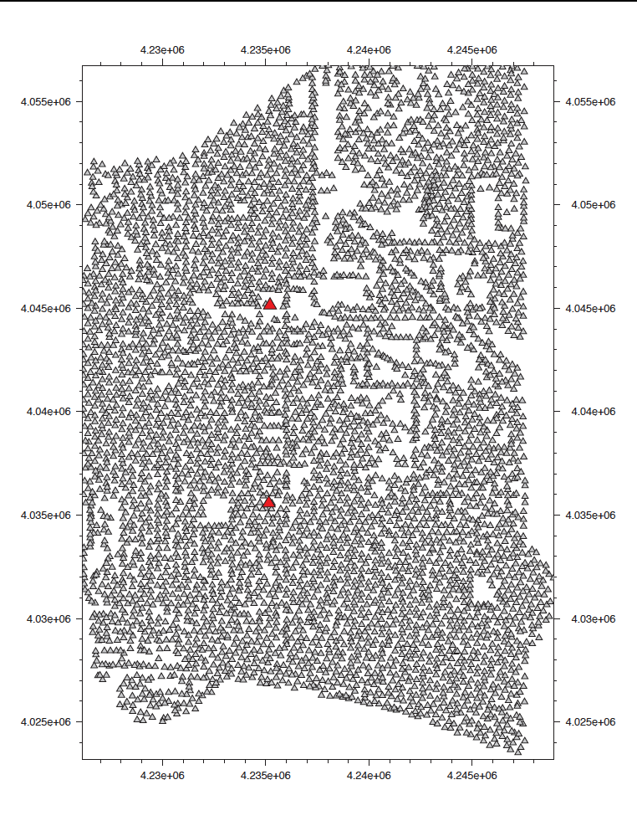
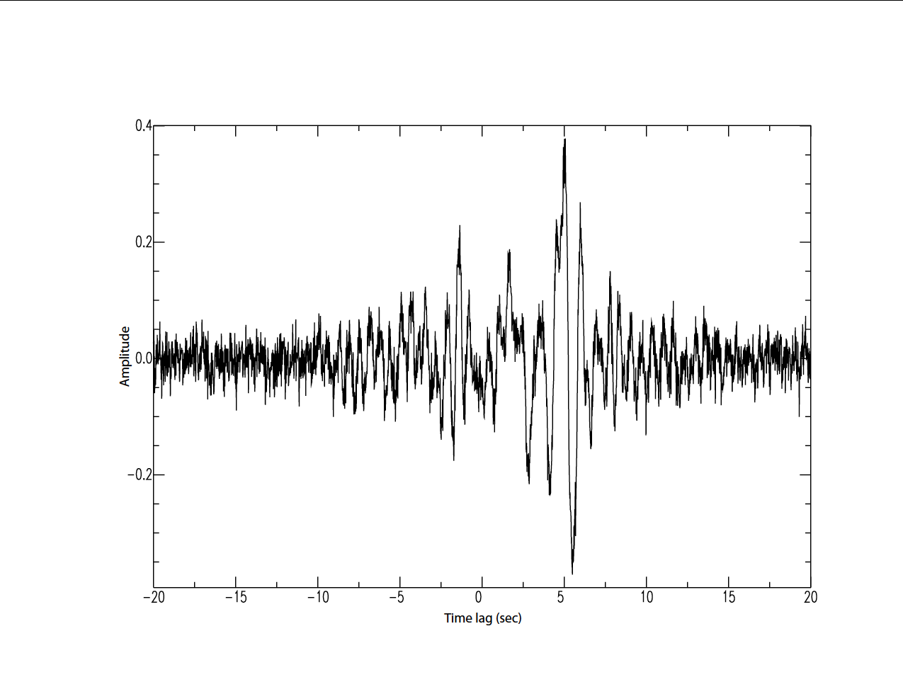
Long Beach Dense Array
3 week of noise

Slide 20
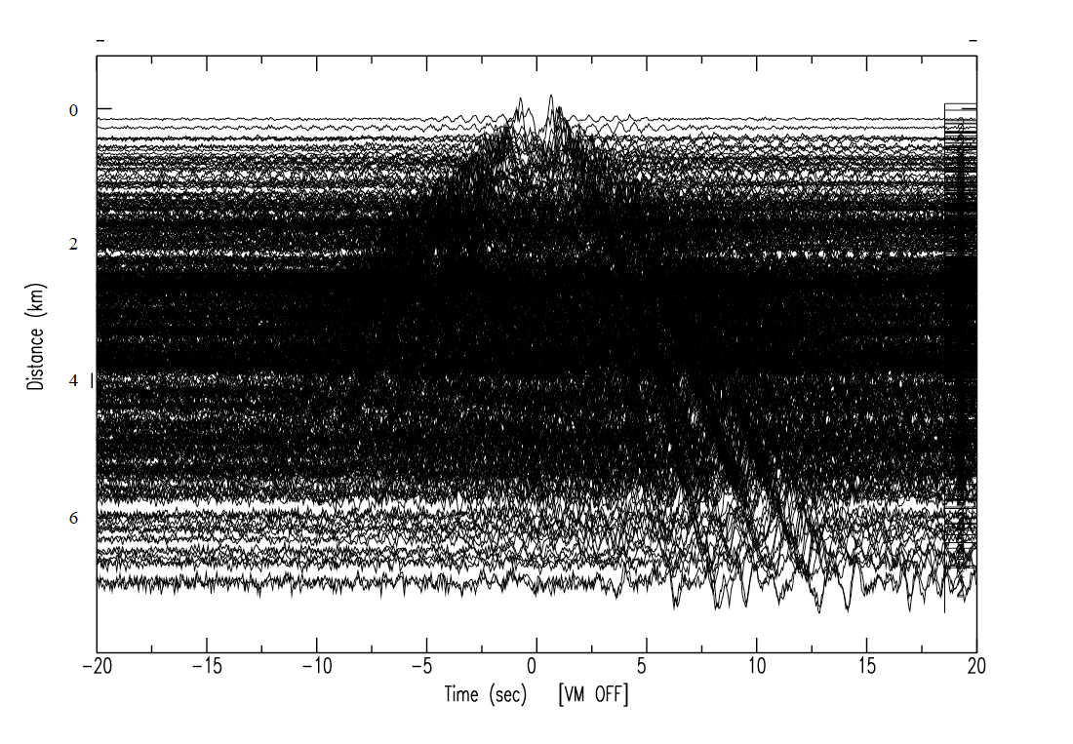
Long Beach Dense Array
3 week of noise

Slide 21
Long Beach Dense Array

Slide 22
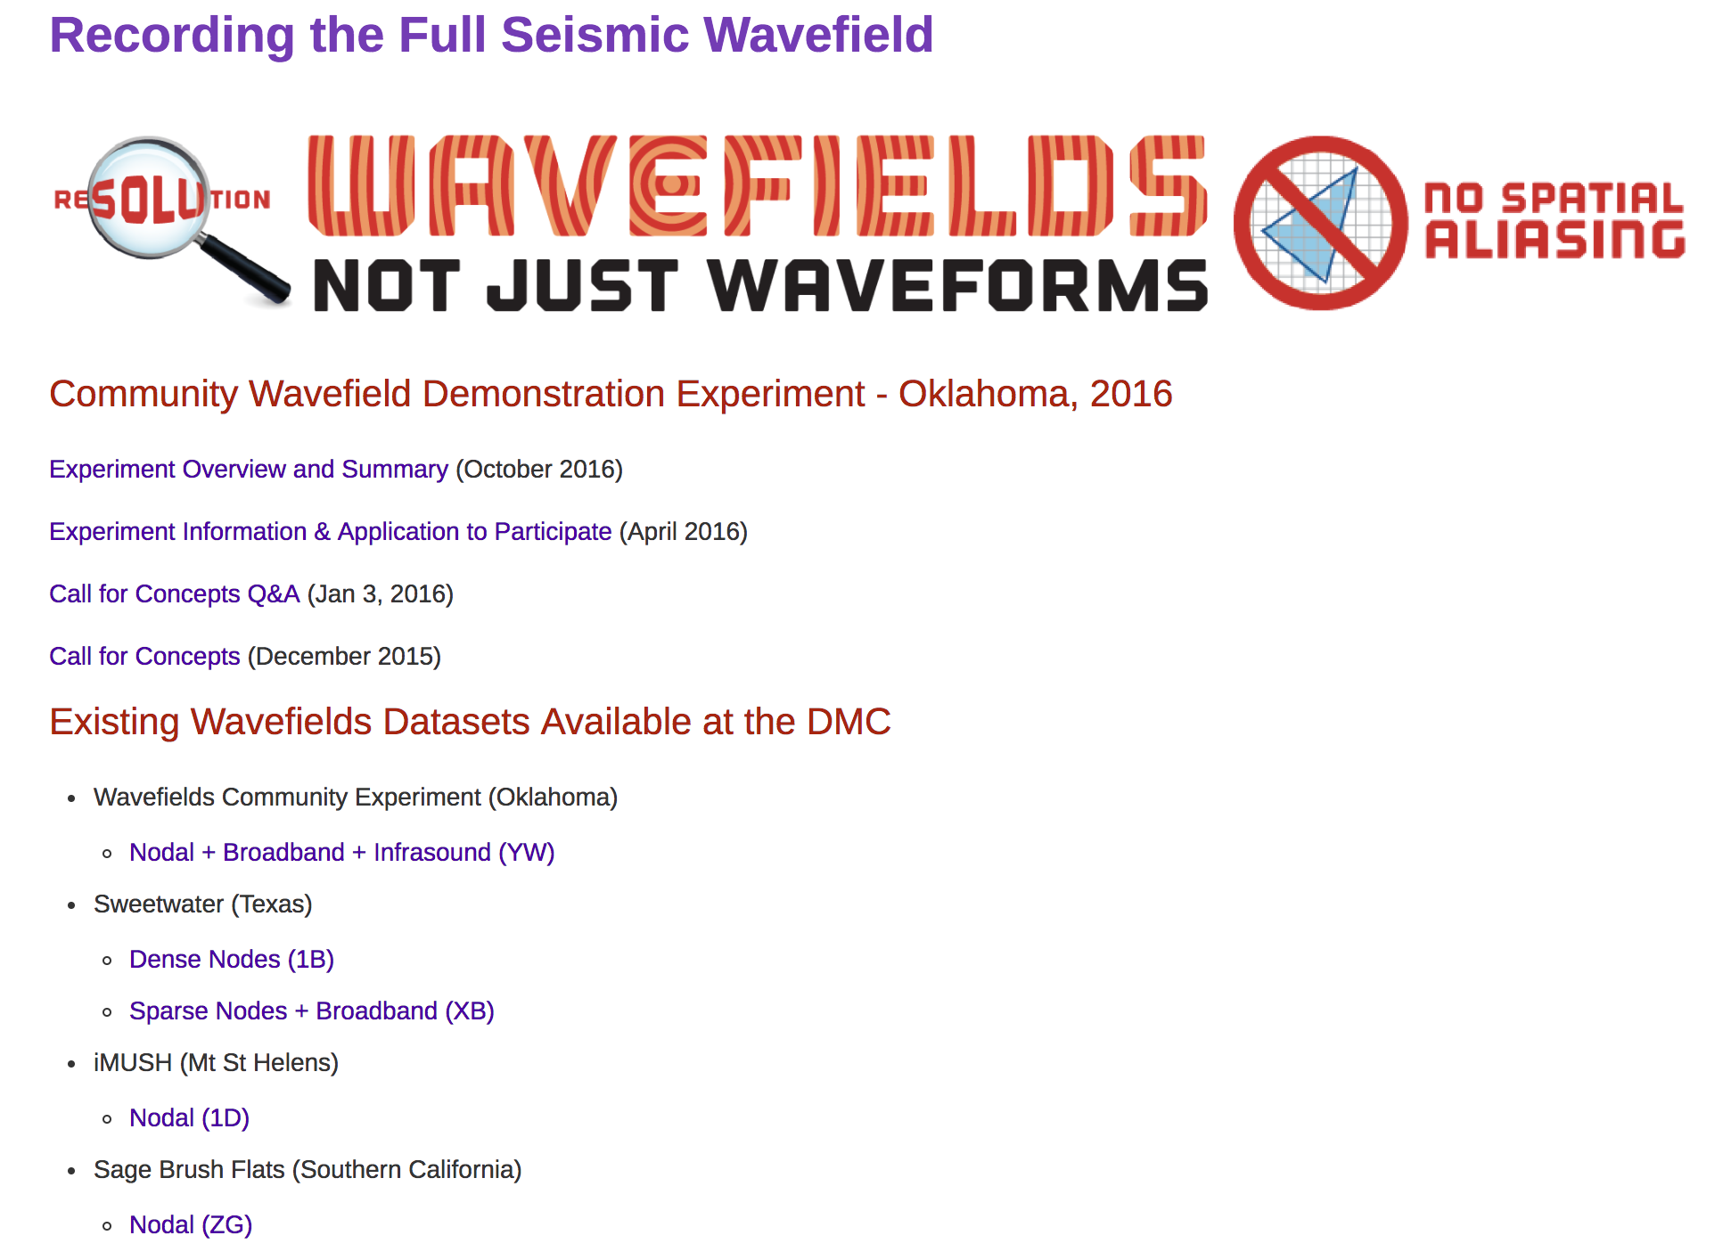
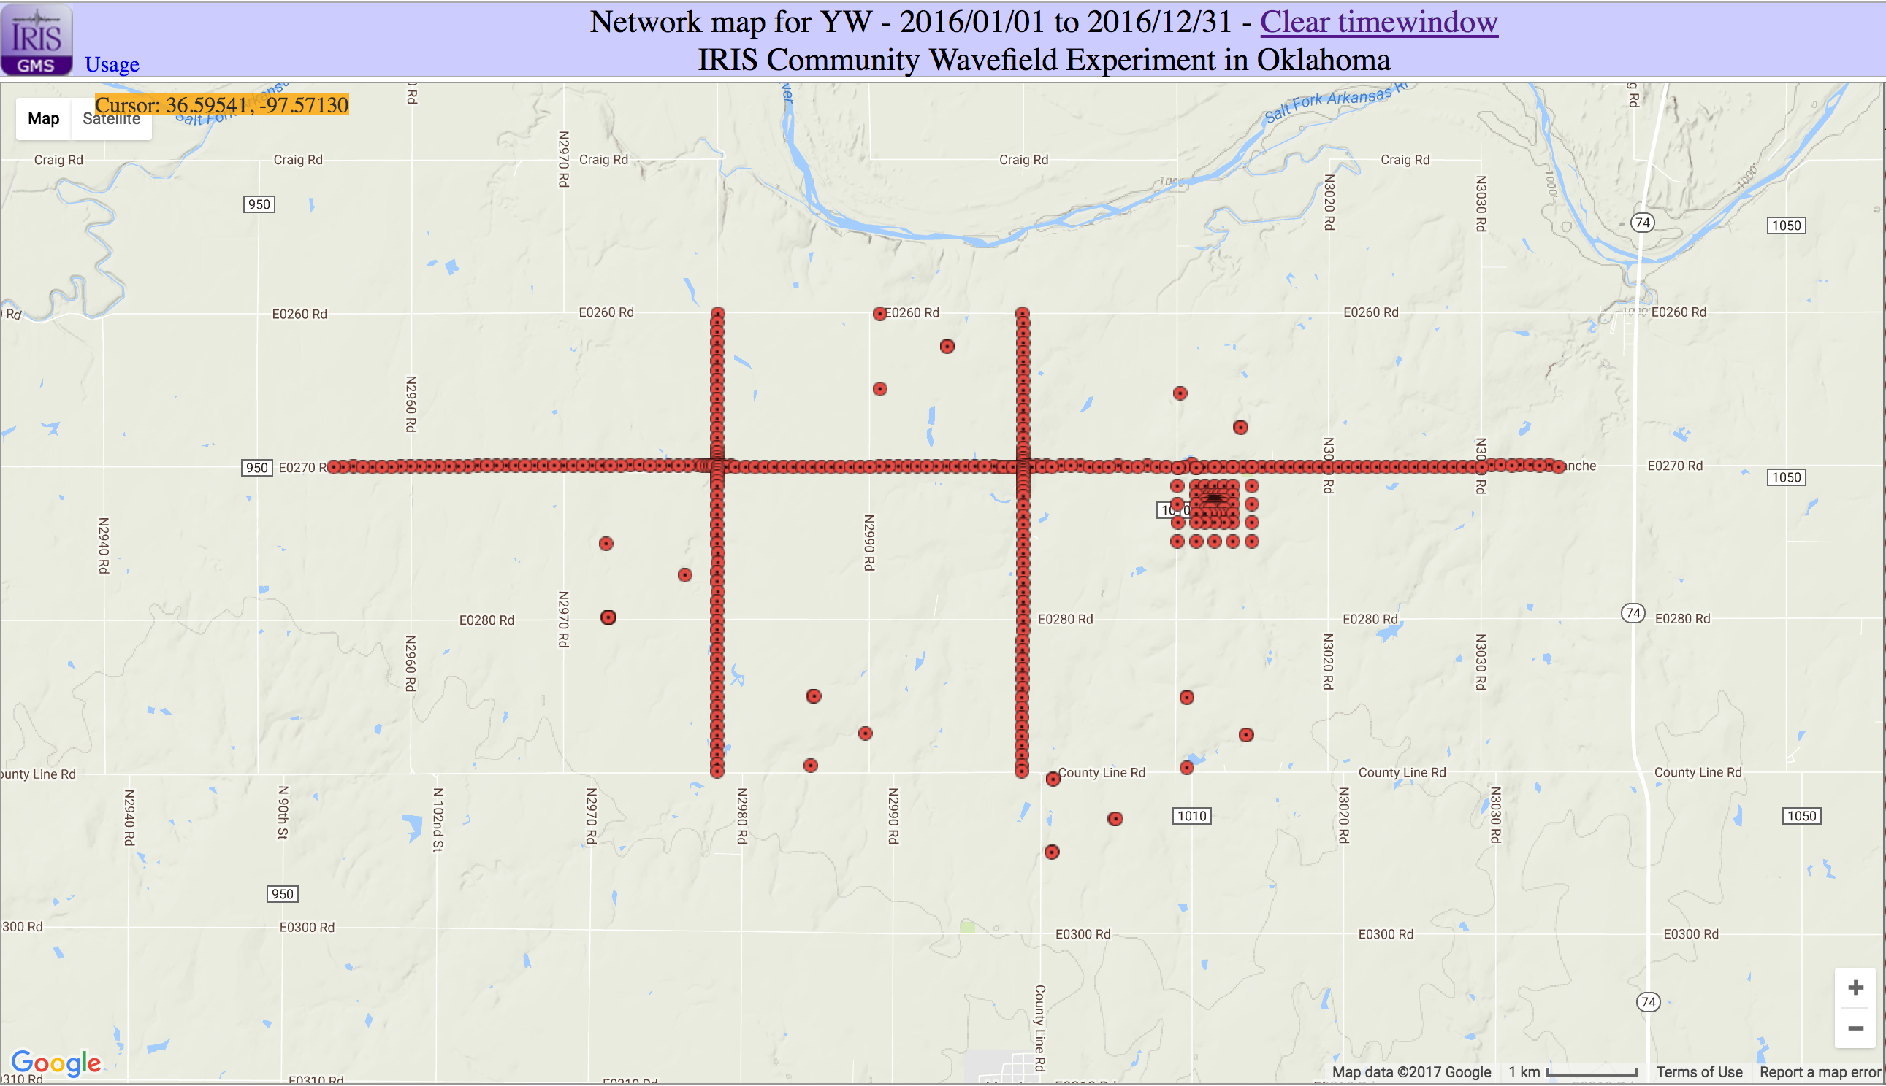

Slide 24
