Slide 1
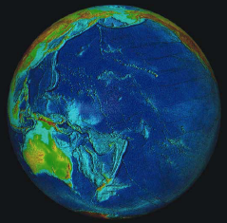
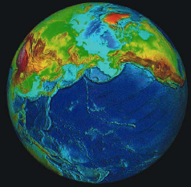
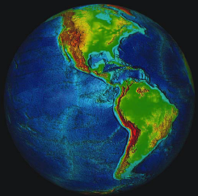
Subduction Zone Observatory
An international multi-disciplinary observatory along a major subduction zone plate boundary
“subduction collaboratory”
AGU 2013 SIG

Slide 2
Subduction Zone Observatory
From a UW workshop on seafloor geology in Cascadia, June, 2012

Slide 3
Subduction Zone Observatory
Must have:
Transformational & high impact science
Societal relevance (strong focus on hazards)
International collaboration
Multi-disciplinary components
On-shore/off-shore
New technologies
Atmospheric link
New high quality Data
Strong integration with modeling

Slide 4
Subduction Zone Observatory
Science motivation
Systems approach to a complex inter-linked set of processes
Observe the entire deformation spectrum from sec to Myrs
Capture the pre-seismic, co-seismic and post-seismic deformational response to a megthrust earthquake(s)
Mega thrust interface - earthquakes, slow slip events, episodic tremor
Compare deformation over all scales (self-similar?)
Tsunamis generation and impact (inundation)
Volcano processes & hazards
Geochemical processes at arcs
Fluid flux through the crust and mantle
Lithospheric removal processes
Water in the deep mantle
Subduction into the lower mantle
Geodynamic processes associated with subduction

Slide 5
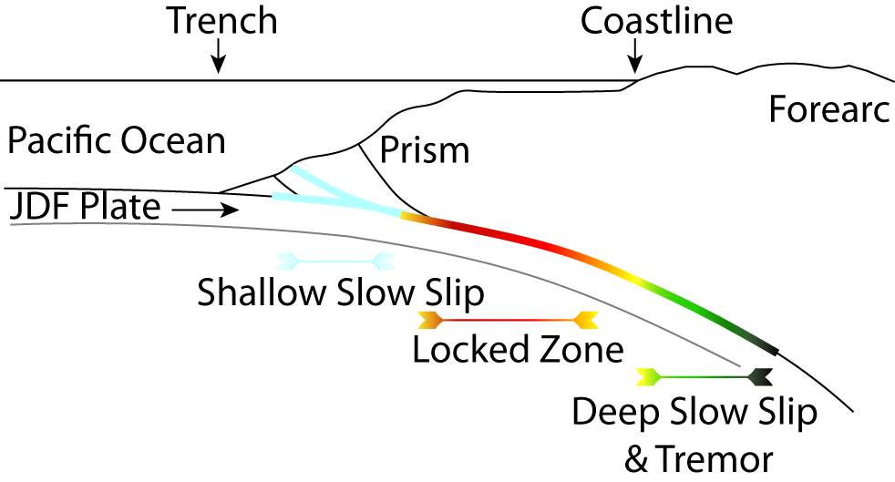
Subduction Zone Observatory
On-shore – Offshore
Observations
Modified from a UW workshop on seafloor geology in Cascadia, June, 2012
On-shore off-shore observations would contribute to a number of important scientific goals, specifically:
Constraining the rate of plate convergence
Determining the seaward extent of the locked zone
Detecting shallow slow slip events
Constraining the partitioning of strain across the prism
Understanding the nature of segmentation

Slide 6
From O. Oncken and IPOC Group

Slide 7
Subduction Zone Observatory
An international multi-disciplinary observatory along a major subduction zone plate boundary
Related on-going initiatives and activities
Cascadia – US, Canada, and Japan
Neptune – Canada cabled observatory
Alaska EarthScope - US
GeoPrisms – US and international
IPOC – GFZ, IGP Paris, Chile, Caltech
COCONet – Geodesy in Caribbean/central America - UNAVCO & international
TLALOCNets - Geodesy initiative in Mexico – international (proposal stage)
JAMSTEC – Japan
International Ocean Drilling Program
Many more…

Slide 8
Subduction Zone Observatory
From Glen Mattioli, UNAVCO

Slide 9
From O. Oncken
and IPOC Group

Slide 10
Subduction Zone Observatory
What are the benefits / costs / payoffs of observatory approach as opposed to individual PI campaign observations and studies?
Alternatively – what will the observatory achieve that won’t be achieved otherwise?

Slide 11
Subduction Zone Observatory
Backbone instrument deployments and focused high-resolution studies
Onshore and offshore seismology and geodesy
Magnetotellurics
Geochemical & Geological
InSAR
Crustal fluids
LIDAR and bathymetry, seafloor mapping
Infrasound
More ….
Leverage past, present, and future observing systems and temporary deployments
Major international collaboration

Slide 12
Subduction Zone Observatory
Lessons Learned
From EarthScope we know that we can:
Produce both expected and completely unexpected advances in scientific knowledge and methods
Leverage existing strategies and capabilities to increase scale by 10x or more
Create a community resource
Successfully straddle “big” and “small” science
Combine community experiments and individual PI experiments
Other large community driven projects?
A seemingly intractable scale problem can yield to a structured approach

Slide 13
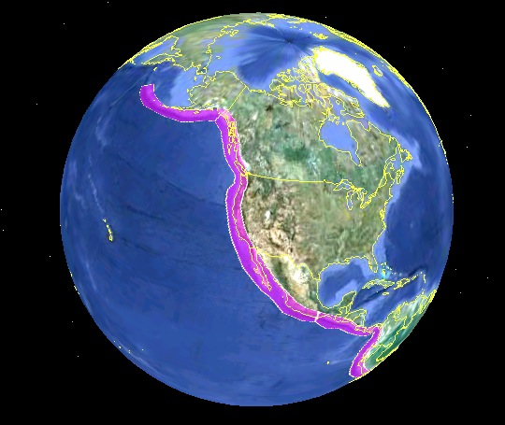
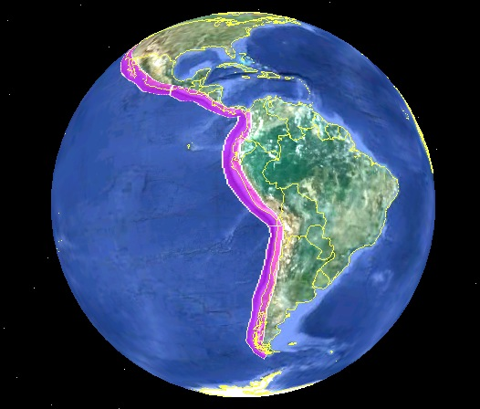
Subduction Zone Observatory
A coherent, structured, multi-disciplinary observatory along the length of the eastern Pacific
From IRIS presentation at EarthScope meeting, 2013

Slide 14
Subduction Zone Observatory
International Collaboration
Leveraged international resources and collaboration will allow us to do even more and move the science forward.
We should be mindful of differences internationally:
different funding methods
Different resources
Different cultures
The entire international community must benefit!

Slide 15
Subduction Zone Observatory
Where do we go from here?
Build momentum in the community!
Organize an international workshop to articulate the major science objects, facilities, etc…
Identify a small group to write proposal(s) for a coordinated international workshop to be submitted to different international agencies.
Compile information about on-going and related activities.
Compile slides to use in community discussions.
Identify other venues for a SZO discussion.
IRIS and UNAVCO workshops in 2014.
IASPEI regional seismology meeting in July of 2014.
Others?

