Slide 1
Exploring a Subduction Zone Observatory Town Hall Meeting
Exploring a Subduction Zone Observatory Town Hall Meeting
December 14 at the 2015 Annual American Geophysical Meeting

Slide 2
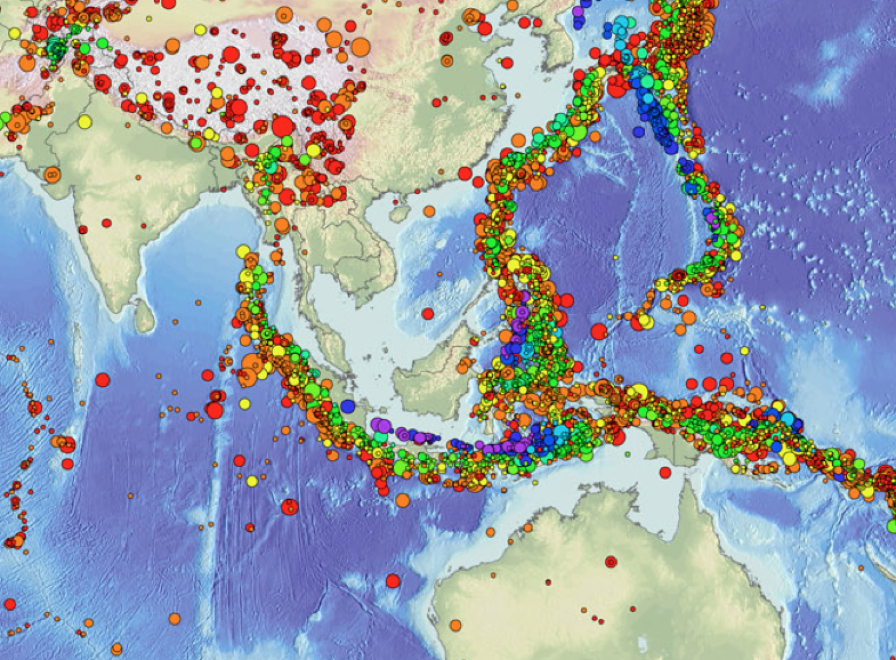

The Sunda Megathrust as a Subduction Zone Observatory
Kerry Sieh
14 December 2015
American Geophysical Union
Fall meeting

Slide 3
The Sunda megathrust extends about 6,000 km from Bangladesh past Indonesia to northern Austrtalia

Slide 4

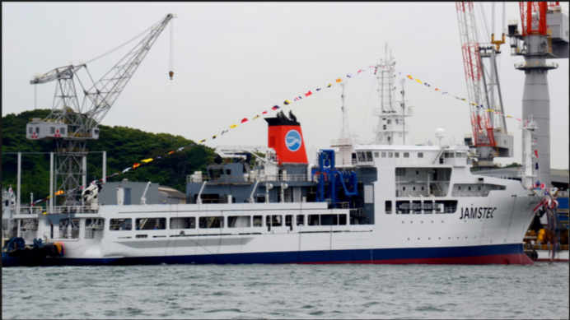
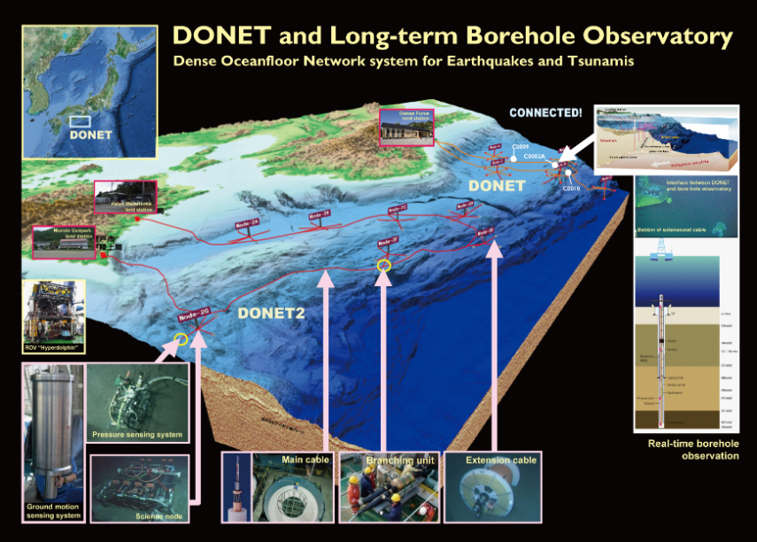
Japan Agency for Marine-Earth Science & Technology
Suichi Kodiara
SZO-like efforts happening in your region/discipline,
  JAMSTEC Research direction: understanding subduction zone processes to contribute hazard mitigation
  Approaches to mitigate earthquake and tsunami hazards
    Prediction before event: need physical model and continuous time series data
    Early warning after event: need data base and real time data
    for both approach, need to know subduction zone/fault structures and need real-time/continuous monitoring system
  Research projects:
  Active-passive seismic study by JAMSTEC R/V and their equipment
    Japan Trench, Nankai Trough, Ryukyu Trench and outer rise of the Japan Trench
  Real-time earthquake, geodetic and tsunami monitoring by seafloor cable
  system
    Nankai (DONET) and Japan Trench (S-net by NIED)
  Future direction:
    Research on submarine giant caldera volcano
    Seismogenic zone study out-side of the Japan water in the western Pacific, cooperating with foreign research teams
New R/V KAIMEI
Complete construction in March 2016, and NIED will in charge of operation

Slide 5
What would you like to see in a broader SZO
  International framework to have an information exchange and to discuss future collaboration
  Cooperation with the Asian/Oceania countries along the western Pacific
How such an SZO might further your own goals and those of the scientific community generally
  Building and expanding SZO related scientific community. Scientific facilities, assets and human resources are limited to cover the entire Pacific-rim subduction zone
New R/V KAIMEI
Complete construction in March 2016, and NIED will in charge of operation

Slide 6

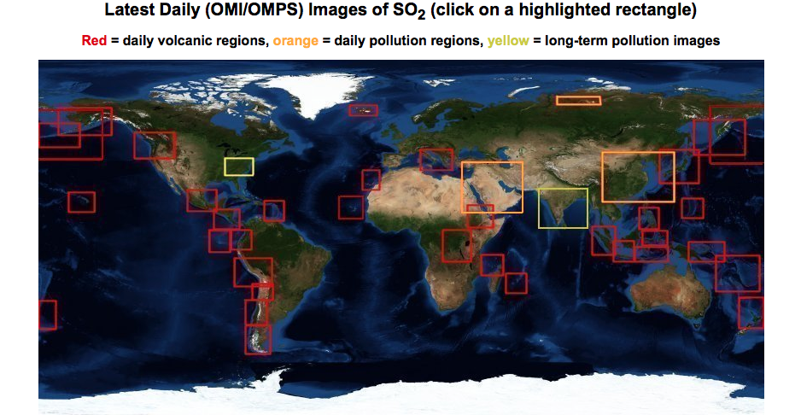
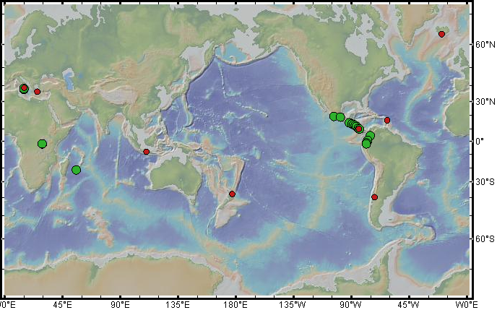


DECADE volcanic gas monitoring network
Erik Hauri
Erik Hauri, Carnegie Institute
Notes:
The main objective of the DECADE project is to install instruments for simultaneously measuring gas composition and flux at persistently degassing volcanoes.
Currently 6 permanent instruments for SO₂ + CO₂ flux calculation; 33 have SO₂ flux capabilities
- White Island MG installed last week
- Popo programmed in Feb-March 2016
- MG operational: WI, Merapi, Turrialba, Masaya, Poas
- MG operational, but no feedback from observatories: Nevado de Ruiz, Galeras
Additionally, scientists in our group have worked to conduct field campaigns at several remote arcs (Indonesia, South America, Kurile, Aleutian Arcs)

Slide 7
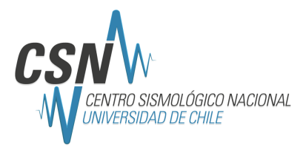
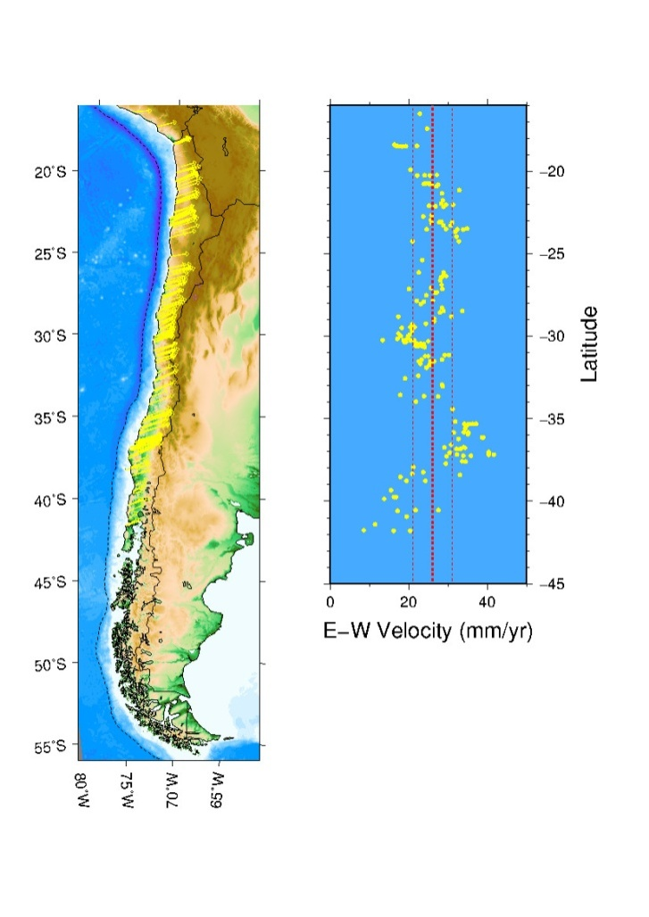
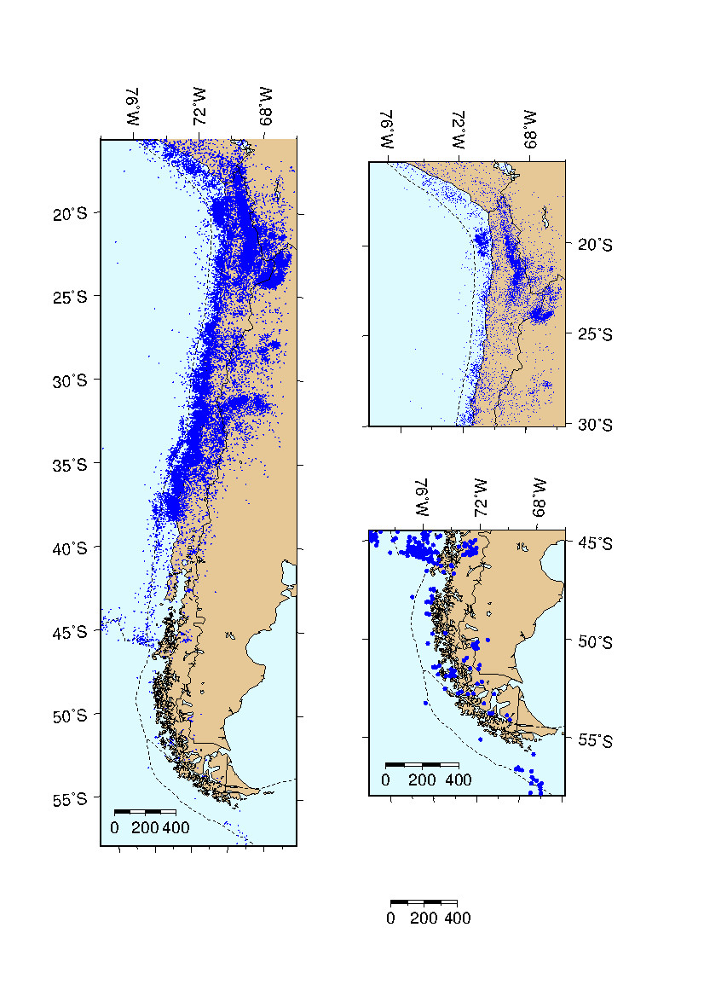
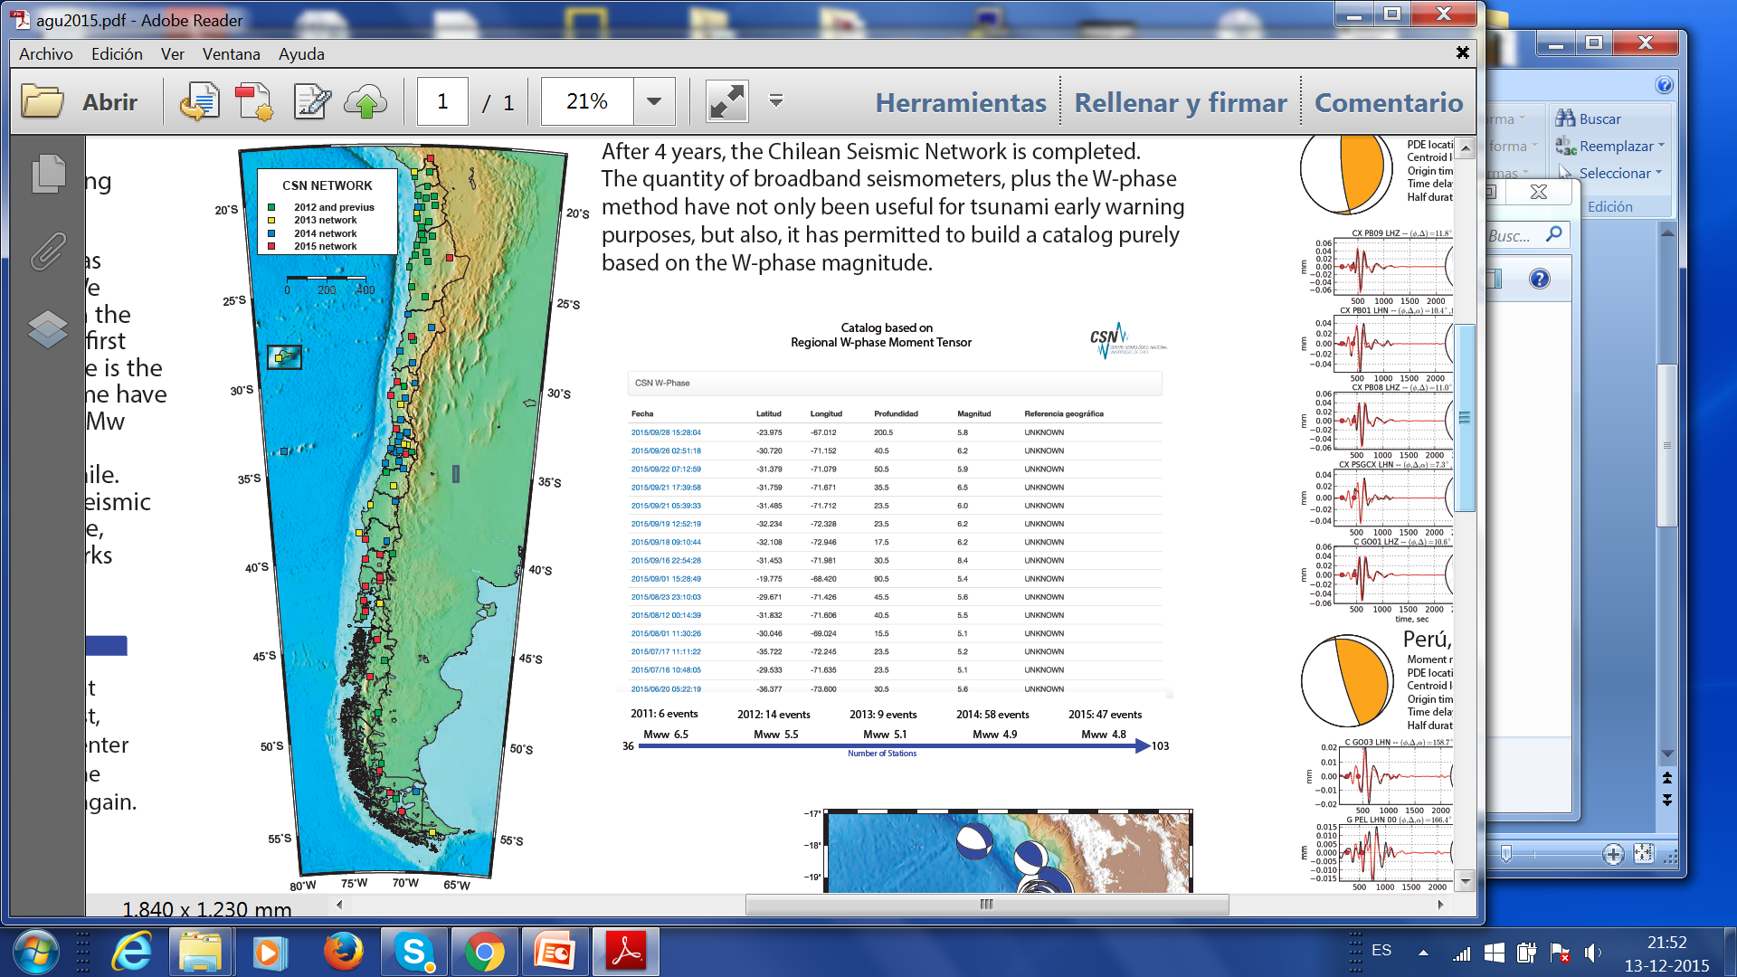
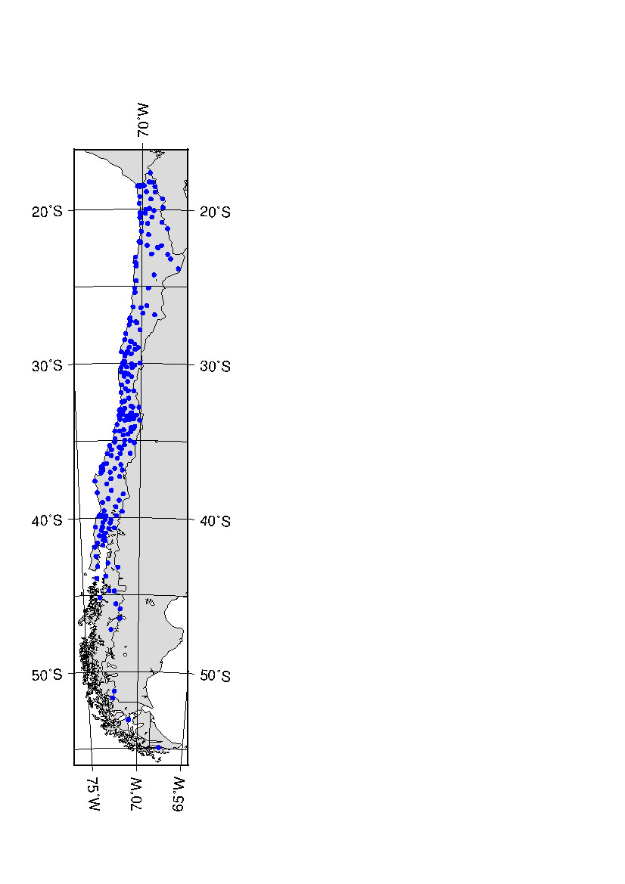
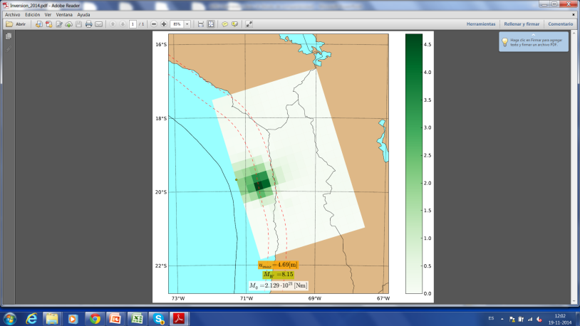
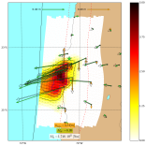
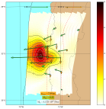
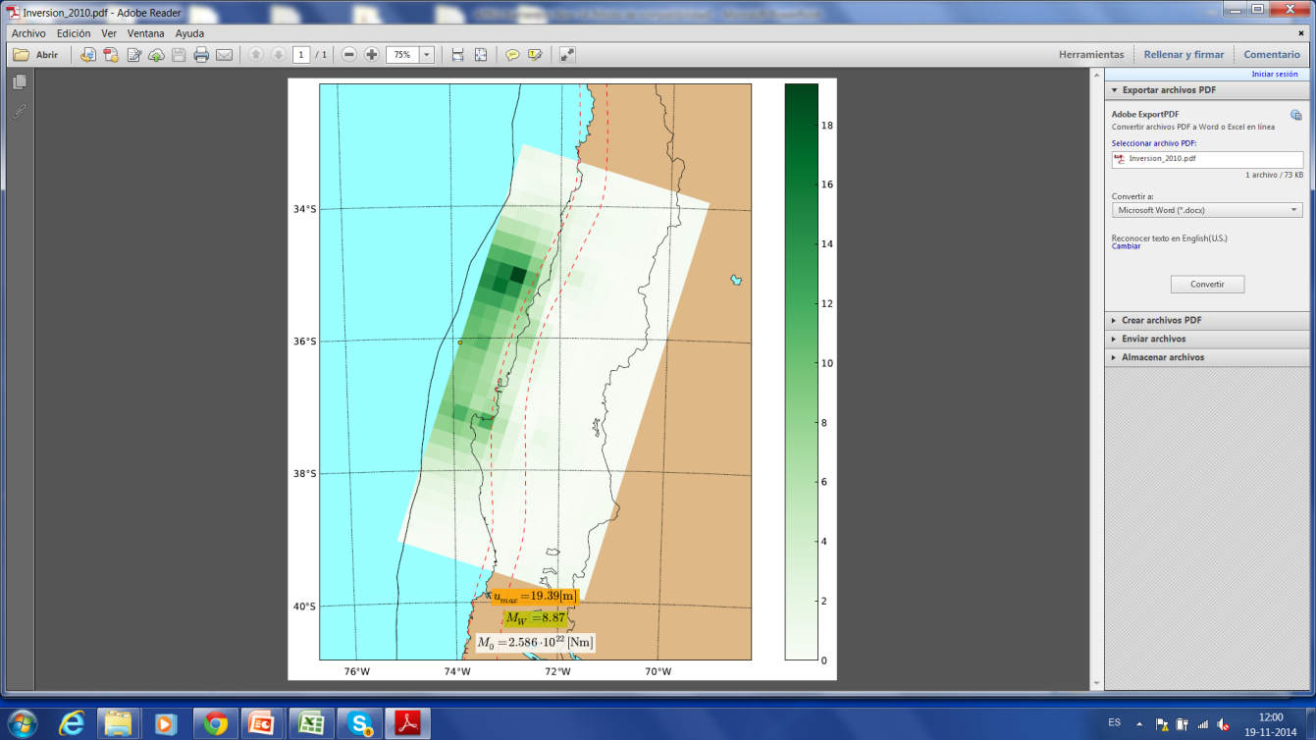
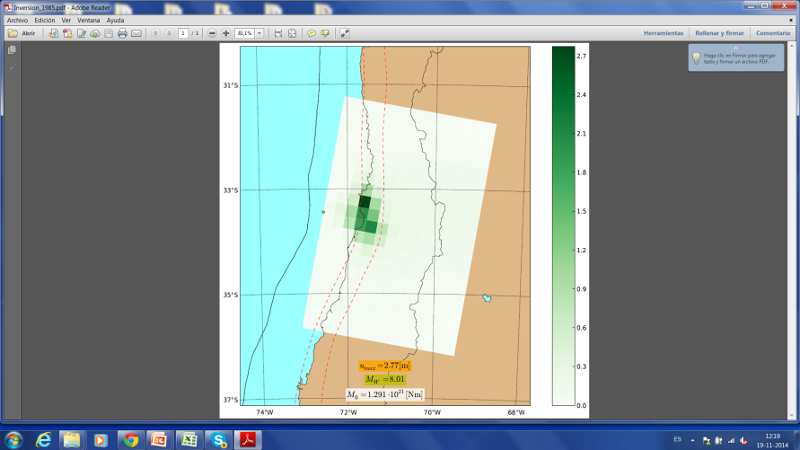
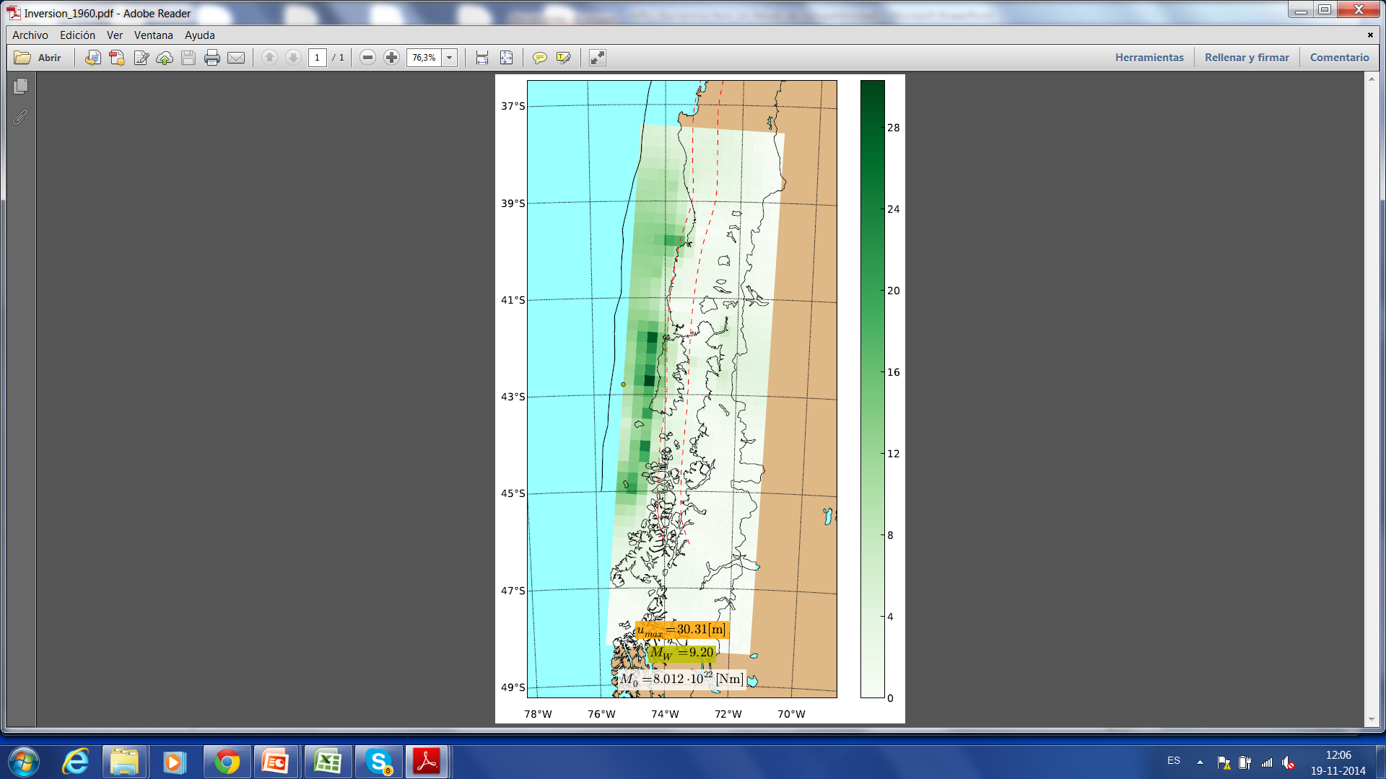
Subduction Observatory – Chile
Sergio Barrientos
BB-SGM Strong Motion GPS
103 297 130
1995
2014
2015
2010
1985
1960

Slide 8
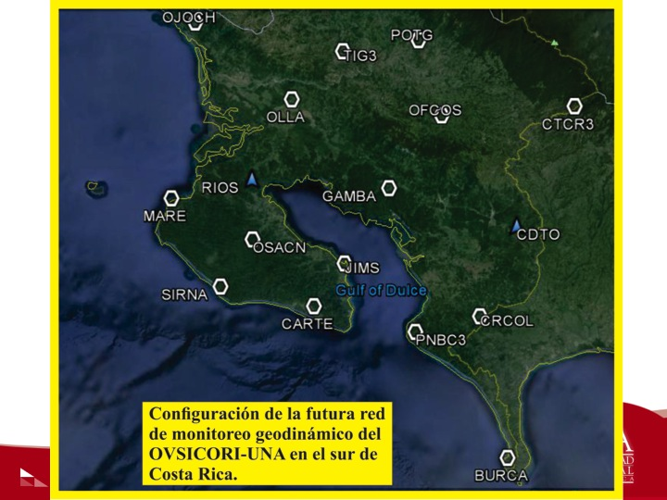
Nicoya Plate Boundary Observatory (NicPBO)
Nicoya Seismic Cycle Observatory (NSCO)
Susan Schwartz- UC Santa Cruz
Tim Dixon- Univ. of South Florida
Andrew Newman- Georgia Tech
Marino Protti and Victor Gonzalez- OVSICORI-UNA Costa Rica
Notes:
NicPBO established around 2006
Characteristic earthquake occurred in 2012- Learned a lot about eq cycle, before during and ater
Because of Peninsula’s proximity to trench we have some sensitivity to offshore area, but seafloor observations are also critical
Had OBS experiment here in 2000 and an ODP borehole was installed soon after this providing important information.
For Earthquke studies, Future SZO should have seafloor observations possibly making use of the Amphibious Array Facility

Slide 9
SZO Geodesy
Jeff Freymueller
In combination with other data,
Observe the entire deformation spectrum from sec to Myrs
Capture the pre-seismic, co-seismic and post-seismic deformational response to a megathrust earthquake(s)
  Mechanical properties of subduction zones, and in particular deep shear zones and the mantle wedge
Megathrust interface – locked, creeping, earthquakes, slow slip events, episodic tremor, tsunami generation
Magma supply to shallow depth in Volcanoes, eruptions
Lithospheric dynamics and orogeny – long term deformation of the overriding plate

Slide 10
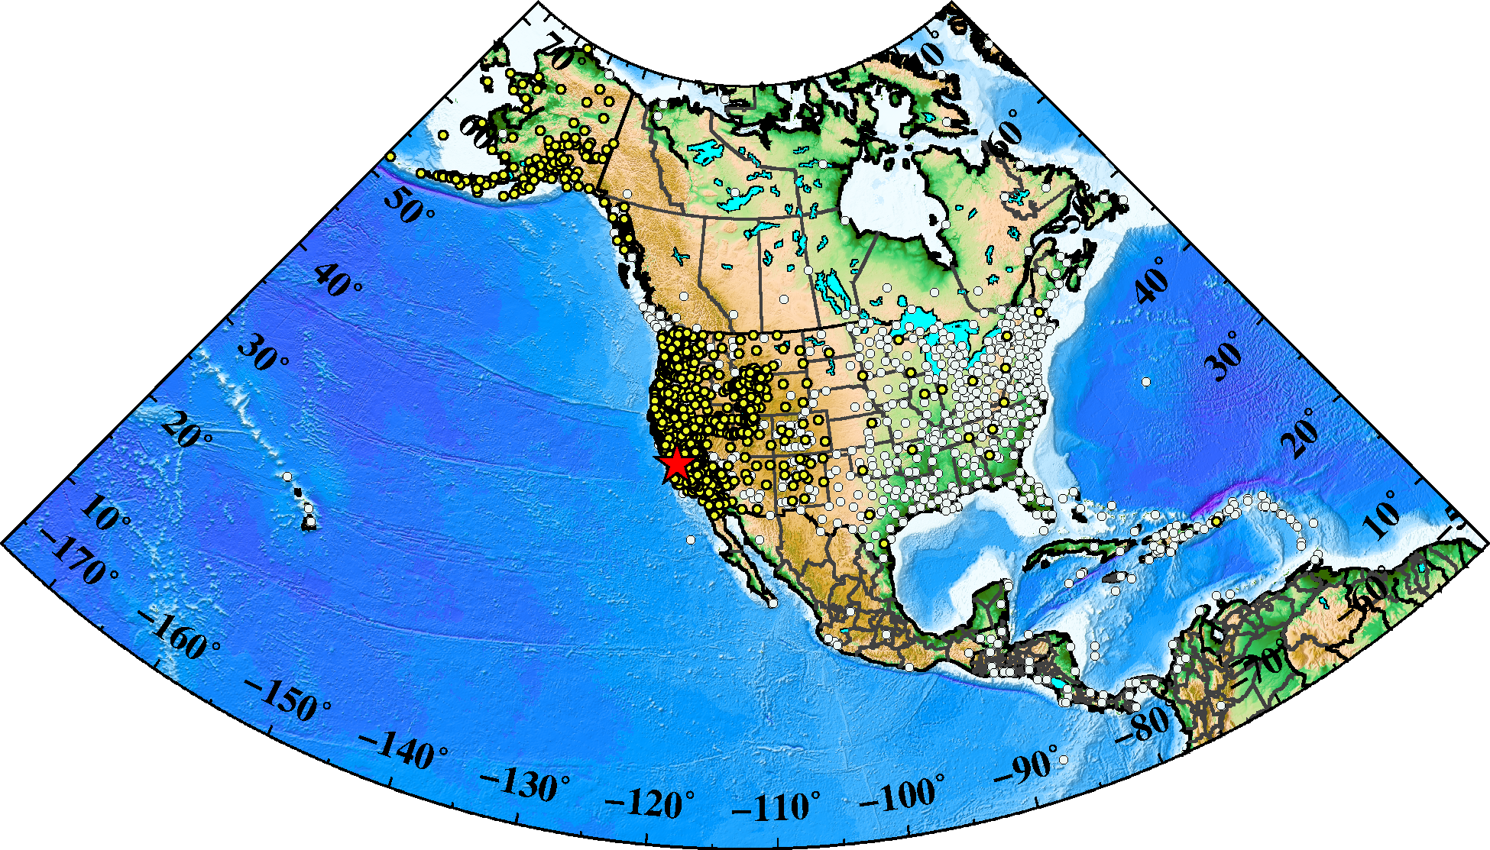
Present GAGE Velocity Solution
PBO +
COCONET +
TlalocNET +
CORS + IGS

Slide 11
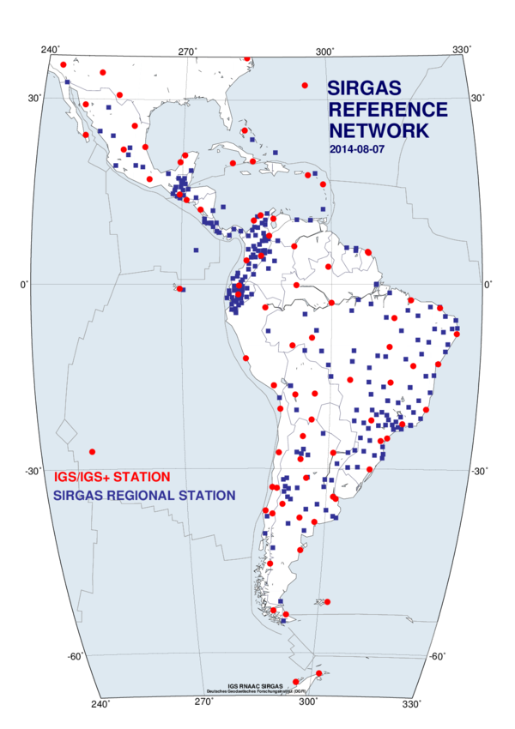
Considerable Instrumentation in Place
SIRGAS GPS network is made up from participating national GPS networks.
Data are shared within SIRGAS, with varying degrees of general open-ness.
Cooperate with existing regional organizations and framework.

Slide 12
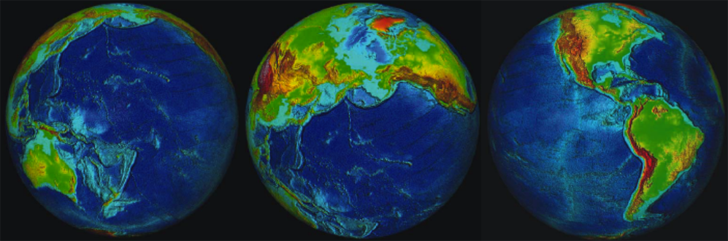
Subduction Zone Observatories
Opportunities to Get Involved
December 2015: AGU Town Hall, Monday Lunch
Sept 2016: Planned International Workshop –
to develop science and facility plan
Mailing list:http://www.iris.washington.edu/mailman/listinfo/szo
Website: http://www.iris.edu/hq/szo
Terry Plank

Slide 13
Sept 2016 SZO Workshop
Proposal at NSF this Fall (Detrick, Meltzer)
Organizing Committee:
Jeff McGuire (WHOI) – Co-chair
Terry Plank (LDEO) – Co-chair
Sergio Barrientos (Nacional de la Universidad de Chile)
Magali Billen (UC Davis)
Patrick Fulton (UCSC)
Joan Gomberg (USGS)
Sean Gulick (UTIG)
Diego Melgar (Berkeley)
Sarah Penniston-Dorland (Maryland)
Diana Roman (Carnegie)
Phil Skemer (Wash Univ St Louis)
Evan Solomon (Univ Washington)

Slide 14
Sept 2016 SZO Workshop
26-28 Sept, 2016 in Boise, Idaho
~100 NSF-Supported Participants
Plus USGS
Plus EOSingapore
Application Process
Early career, international scientists encouraged
One pagers, questionnaire prior to meeting
Outcomes: report, plan for proposal to NSF

Slide 15
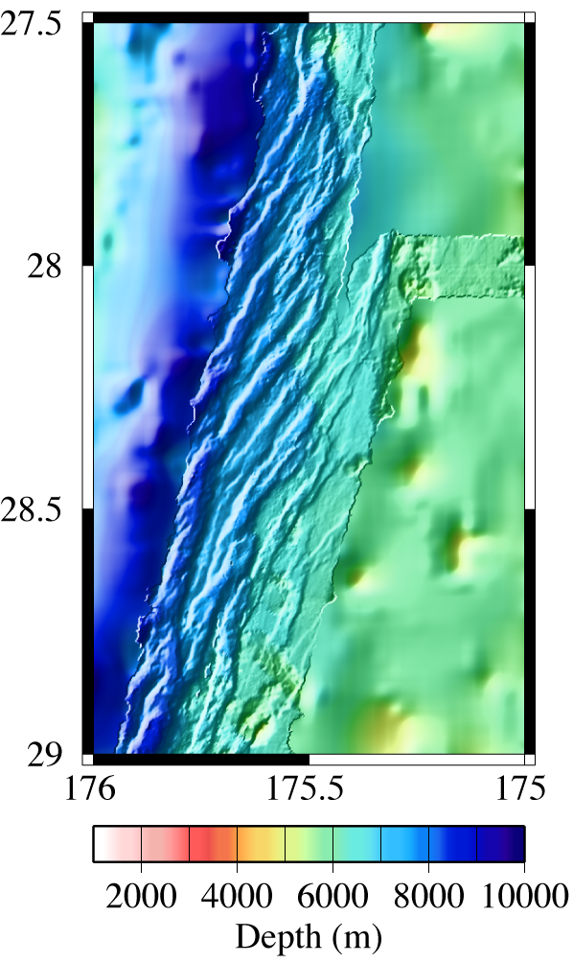
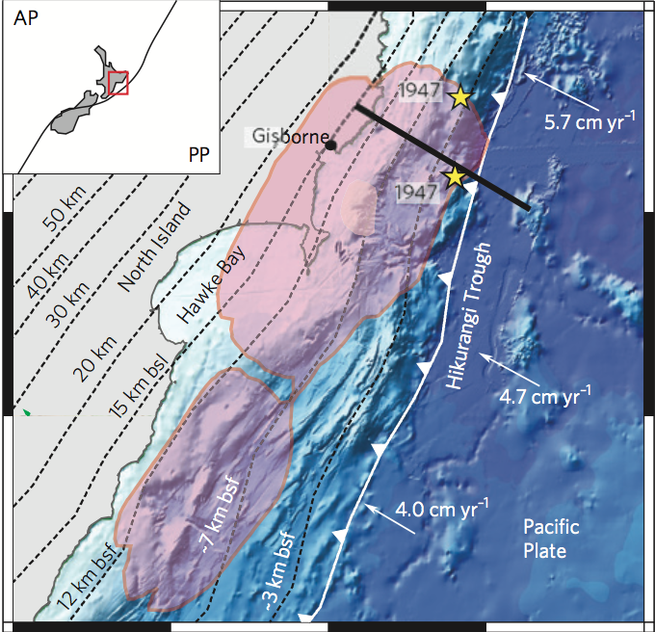
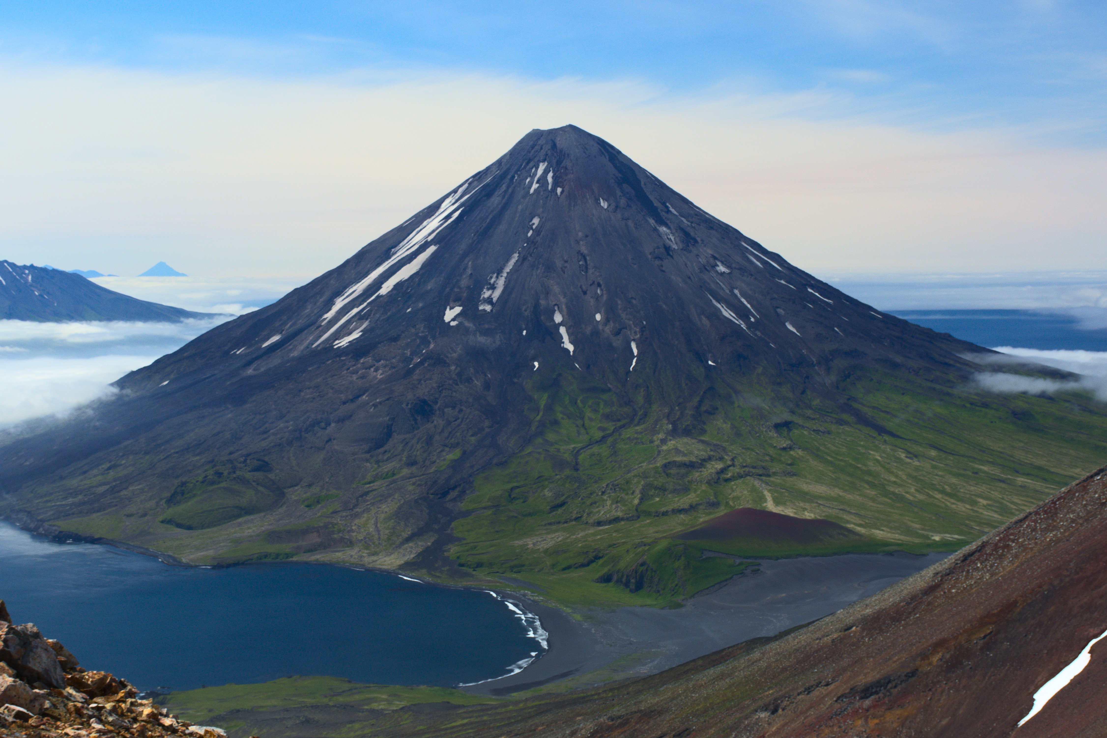
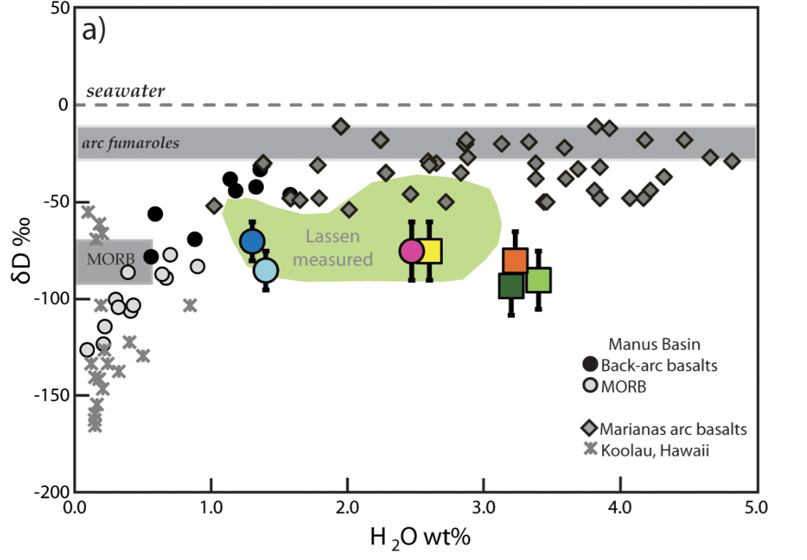
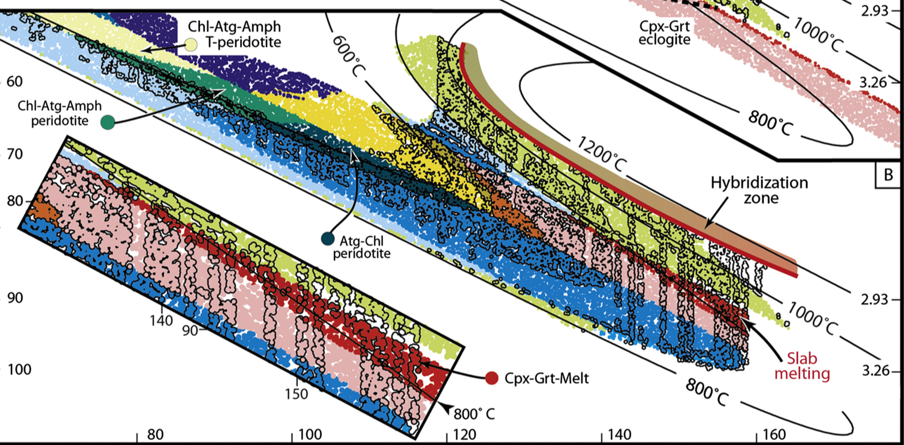
SZO Themes
Deformation & Fault Slip
Landscape and Climate Feedbacks
Volatiles from Serpentinization to Volcanism

Slide 16
SZO: Observing the Entire System Across-Margin:
From the Bending Plate to the Volcano
Seismic Imaging
Fluid/Rock/Gas Geochemistry
Geochronology
GPS
Heat Flow
MT, EM
InSAR
Geological Mapping
Seafloor Observatories
Drilling
ROV
Laboratory Experiments • Theory •
Geodynamic Models • Systems Approach

Slide 17
Important Questions that need Your Input
What are the major scientific and geographic targets?
What is needed to solve the big science problems?
- greatly improved observational systems
- better synergies across disciplines
How to phase short term and long term plans to
build a Program?
How to build international participation?

