Slide 1
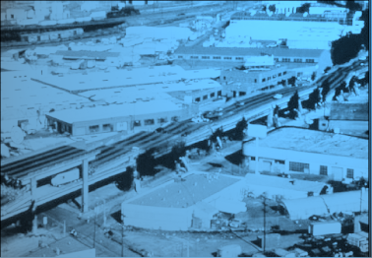

ShakeMap
Some more details…
David Wald, Kuo-Wan Lin, Bruce Worden
U. S. Geological Survey, Golden, CO

Slide 2
ShakeMap
New Web Pages & Content

Slide 3
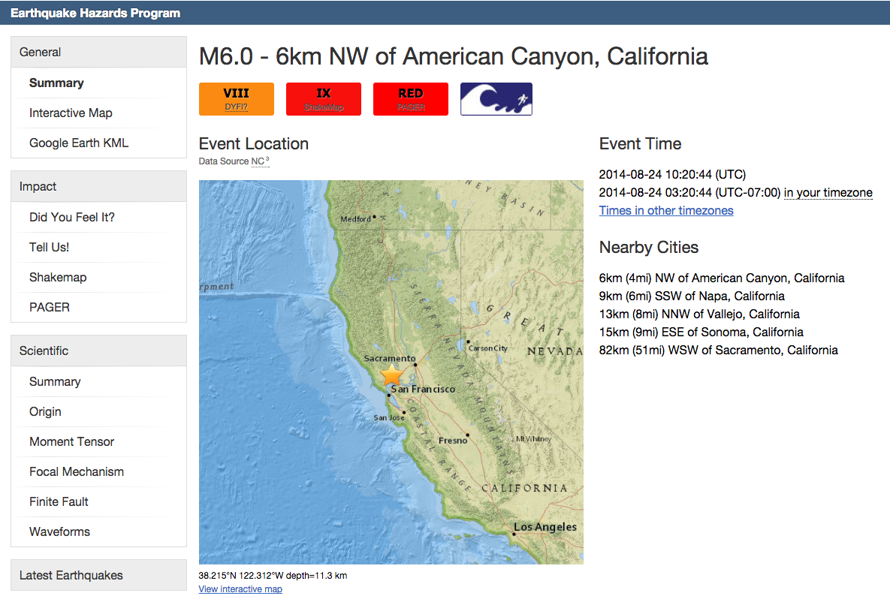
New Webpages/infrastructure
~30% mobile background
~60% phone + tablet following Napa earthquake

Slide 4
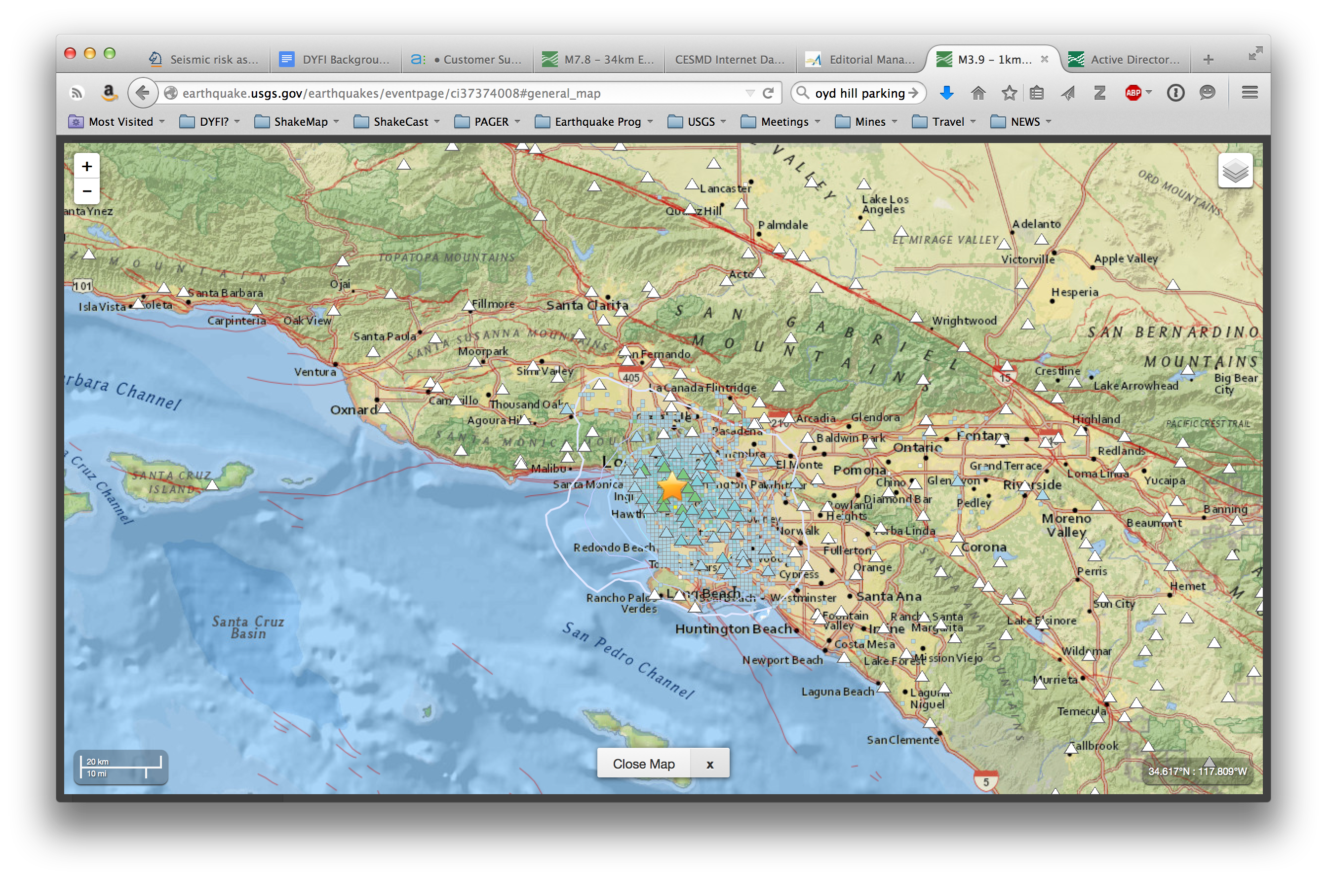
New Webpages/infrastructure
Deliver content/products, not maps & plots

Slide 5
ShakeMap
US & National Systems

Slide 6
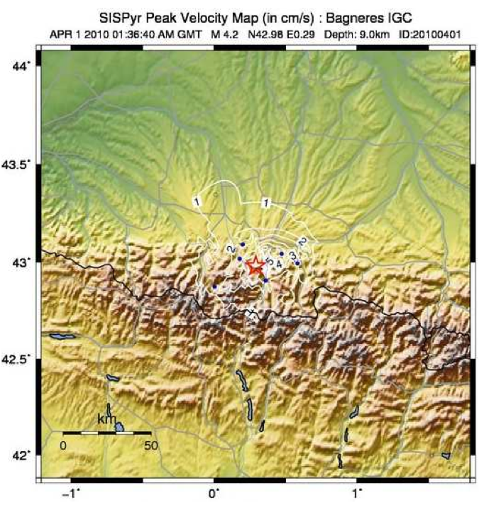
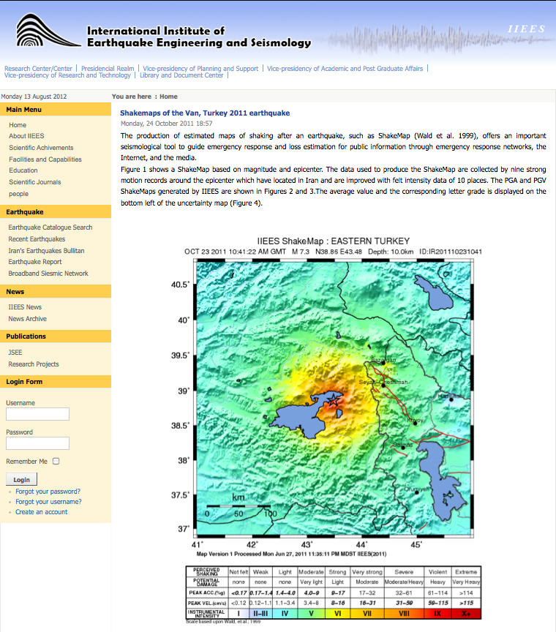
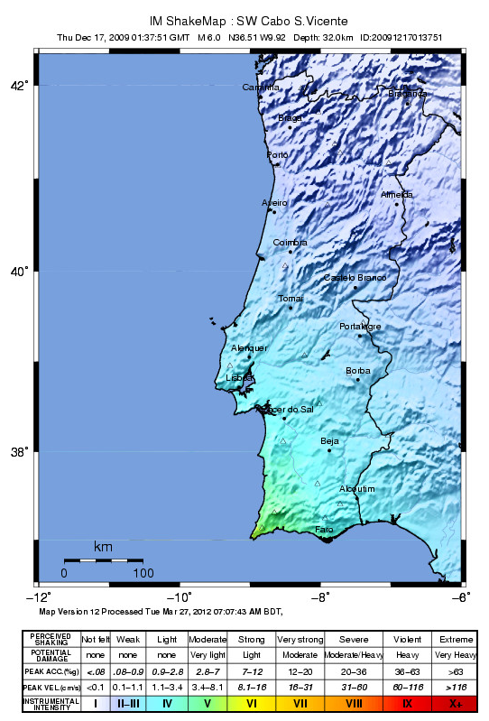
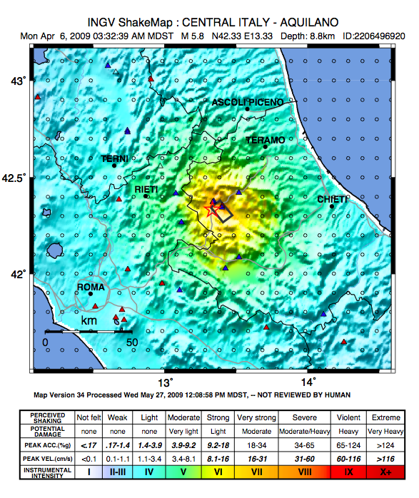

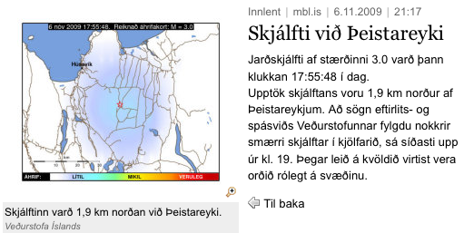
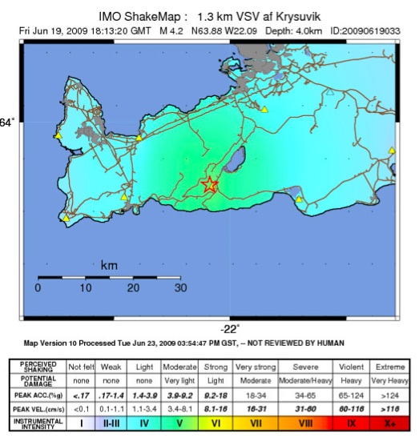
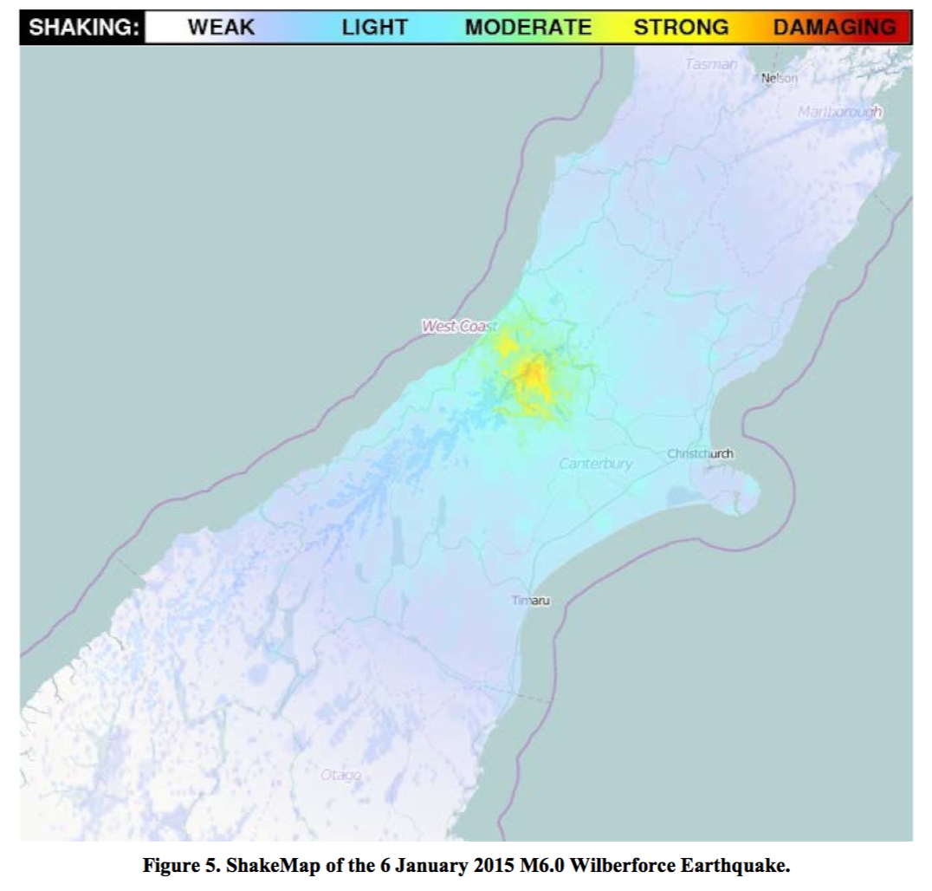
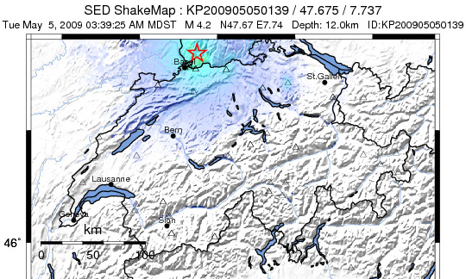
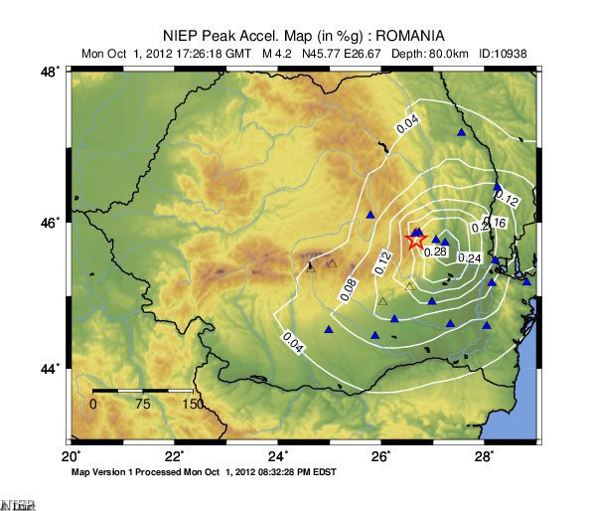
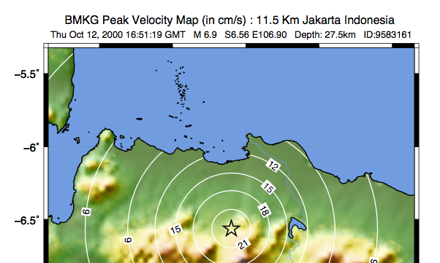

National/
Regional
ShakeMap Implementations
France/Spain (BRGM/IGC)
Portugal (IM)
Instituto de Meteorologia
Iran (IIEES)
Italy (INGV)
Global
ShakeMap
(USGS)
New Zealand (GNS)
Iceland
Indonesia
(BKMG)
Switzerland
Romania (NIEP)

Slide 7
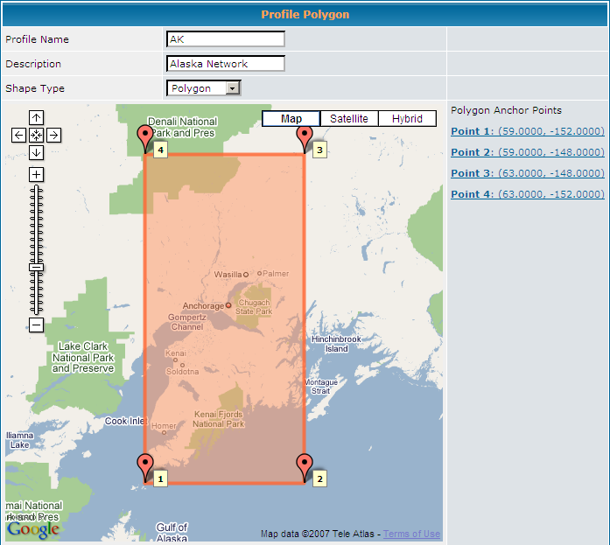
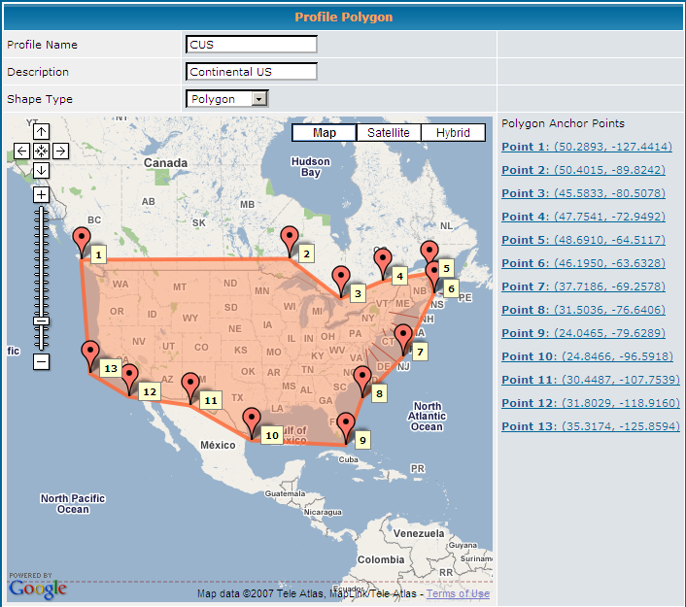
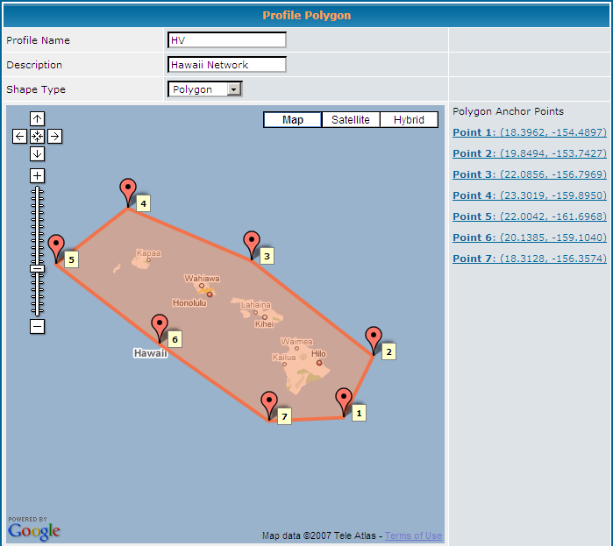
M>4.0
M>3.5
M>3.5

Slide 8
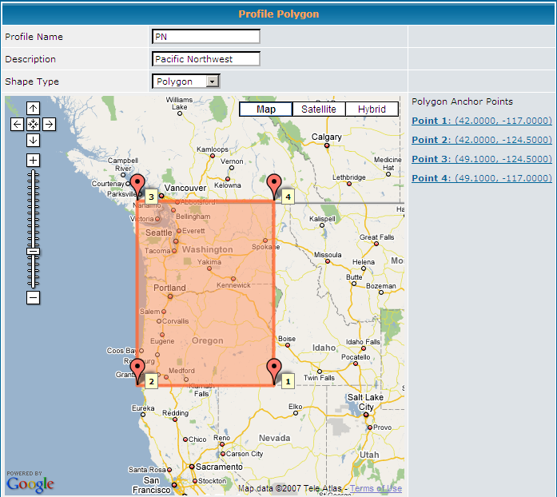
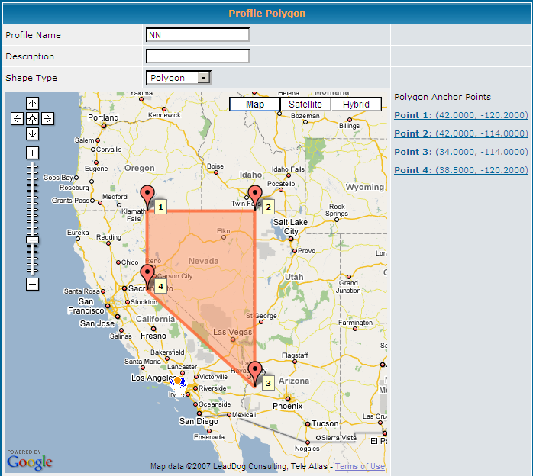
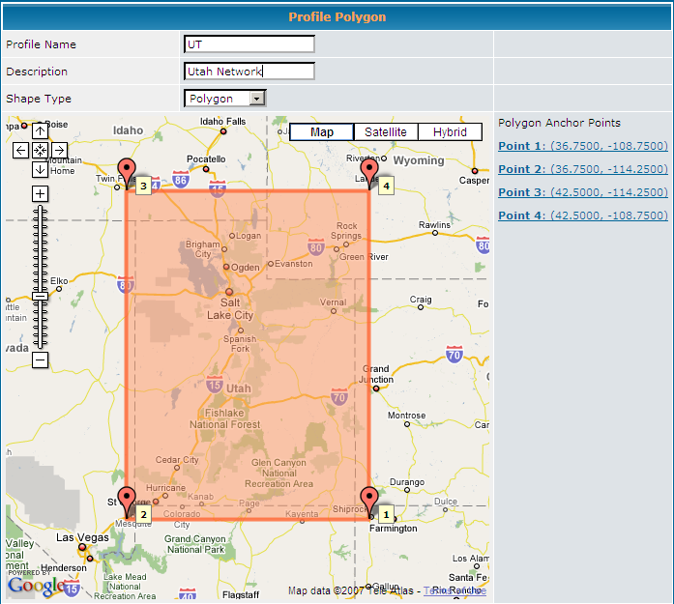
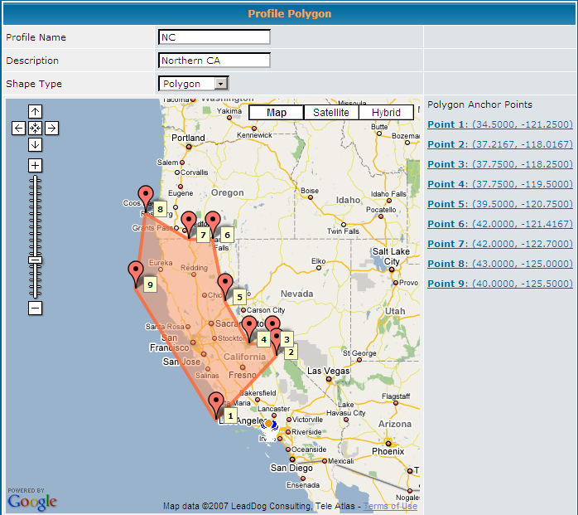
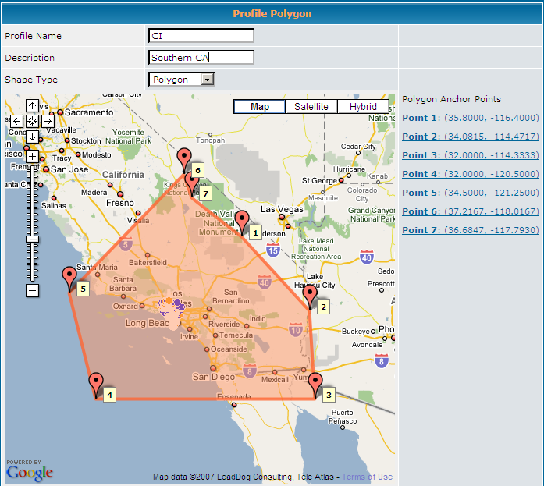
M>3.5
M>3/4
urban/rural
M>3/3.5/4
M>3.5
M>3.5/4
M>3.5/4

Slide 9
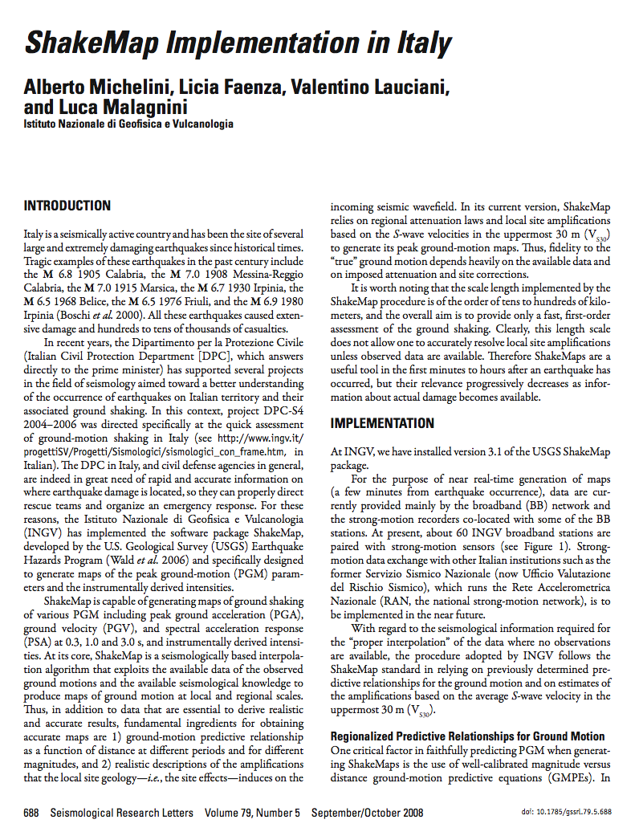
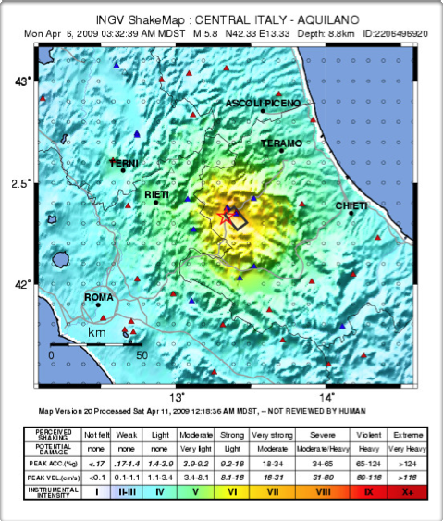
ShakeMap Italy

Slide 10

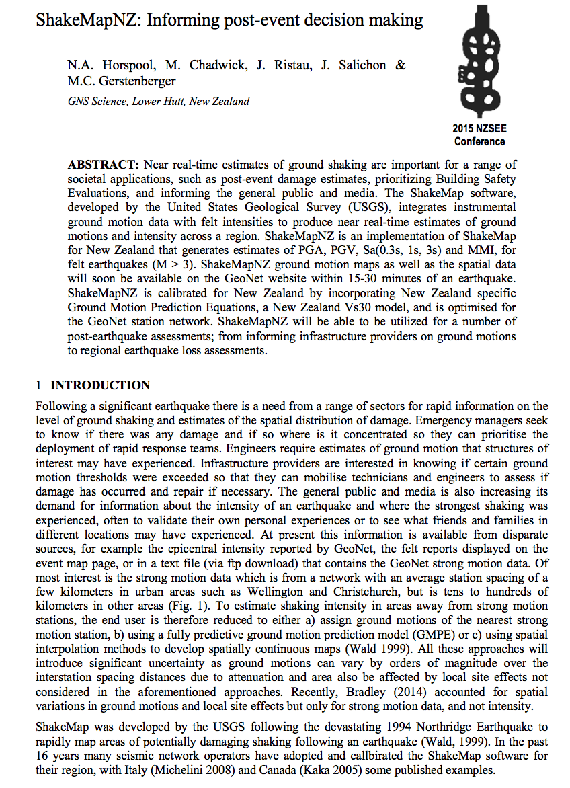
ShakeMap New Zealand
Courtesy GNS/Nick Horspool

Slide 11
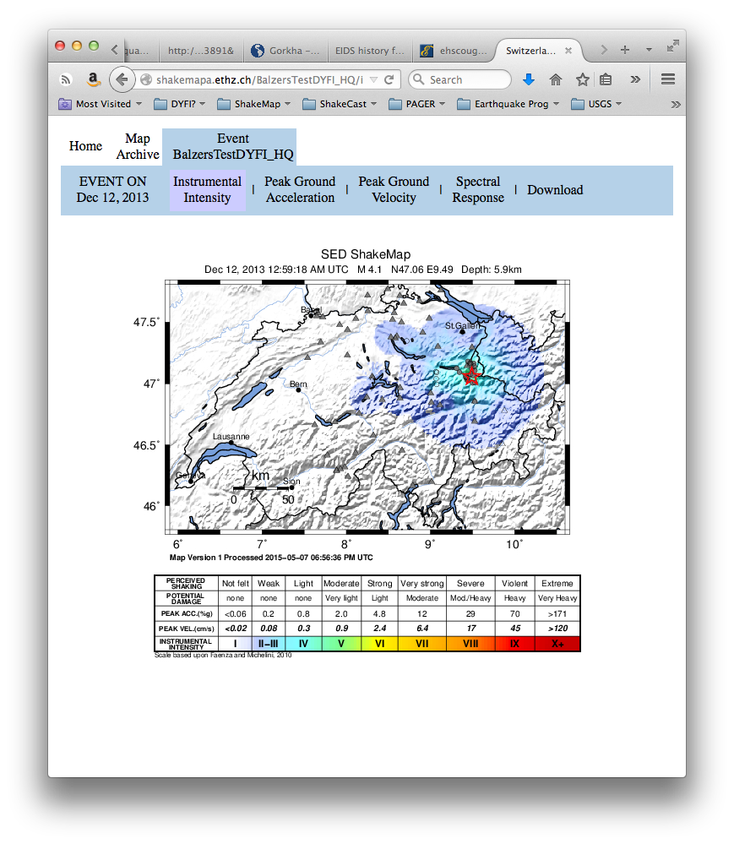
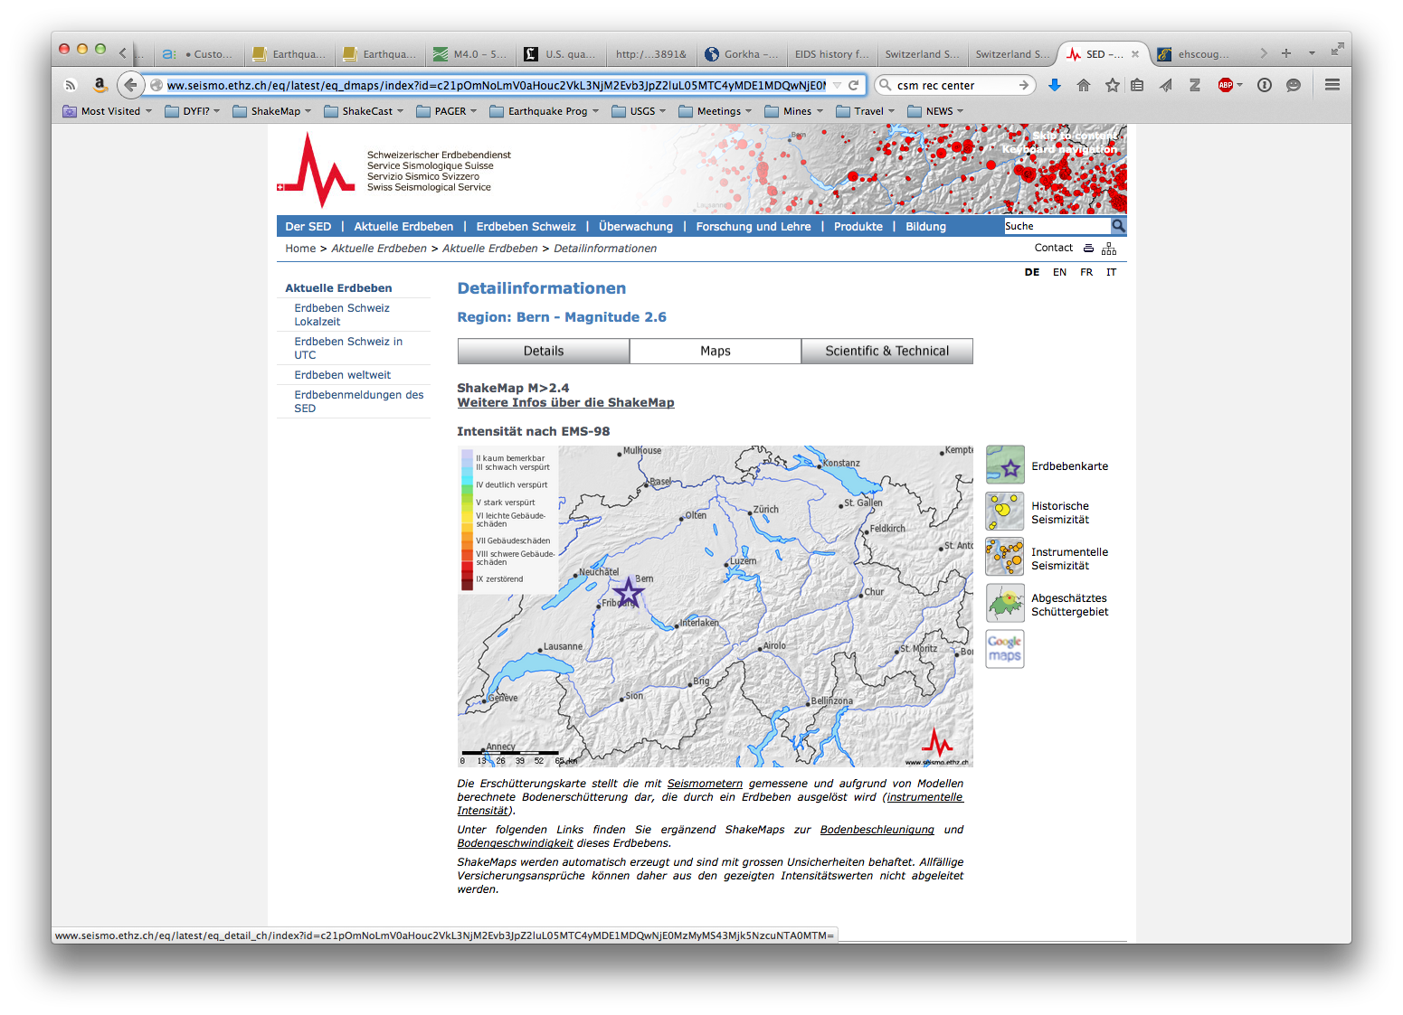
ShakeMap Switzerland
Courtesy ETHZ/Carlo Cauzzi

Slide 12
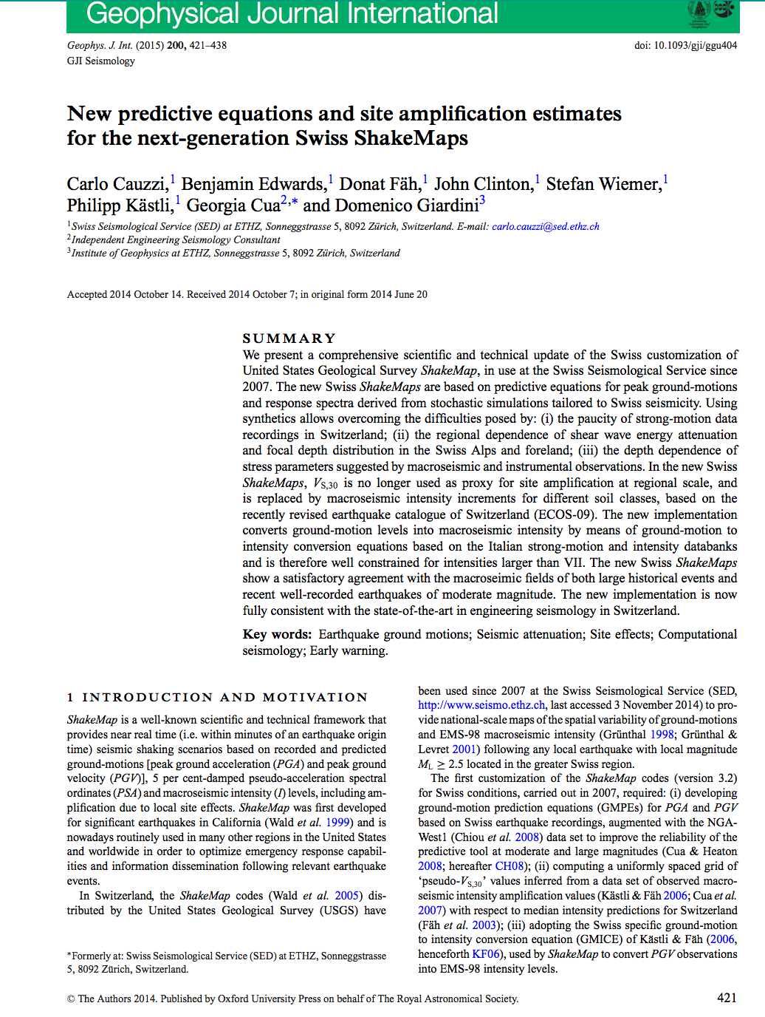
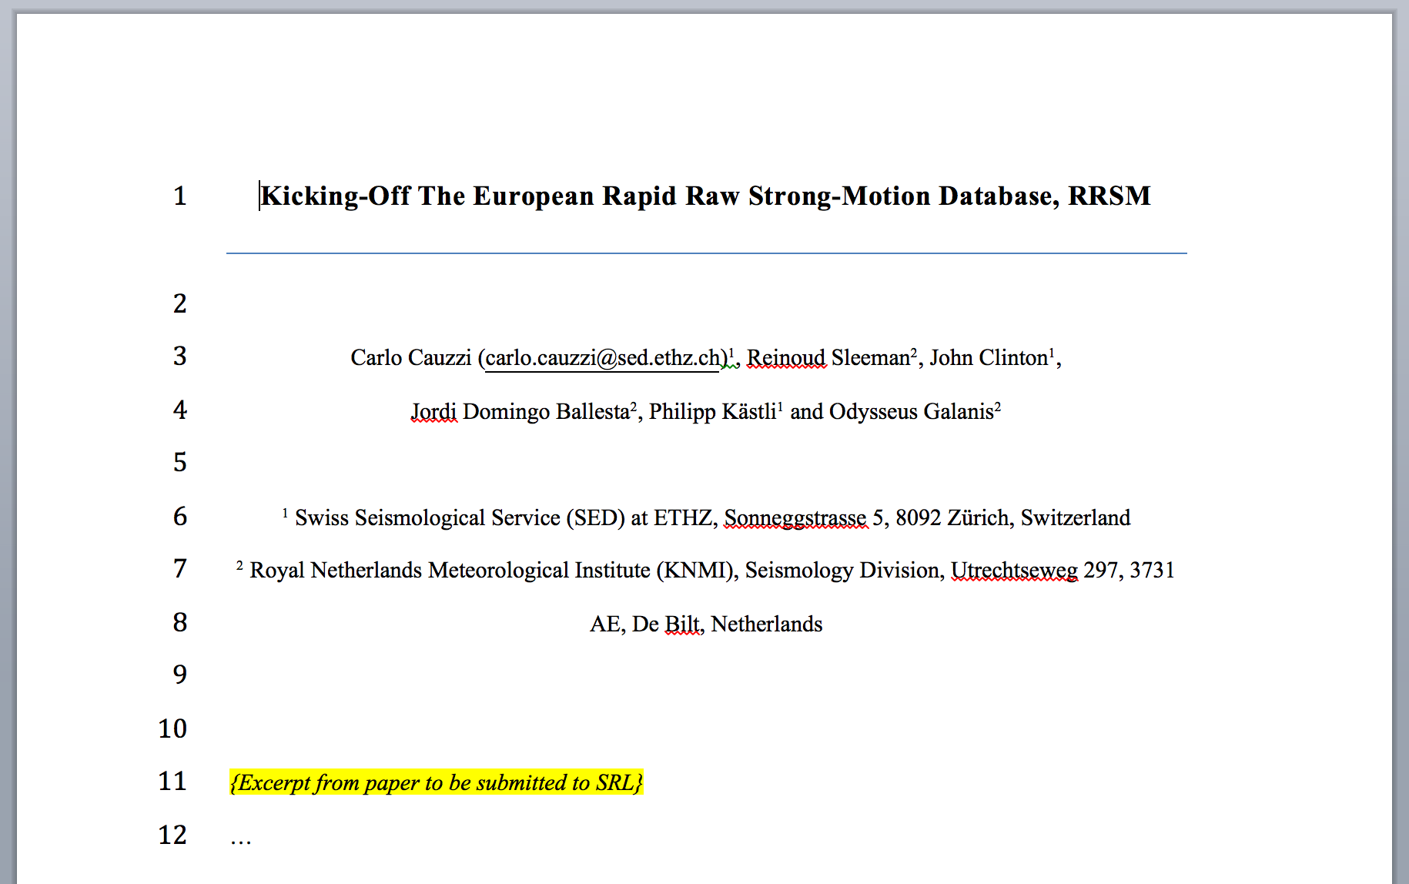
ShakeMap Switzerland
Courtesy ETHZ/Carlo Cauzzi

Slide 13

Peak-motions through scwfparam
Waveform extraction for SM and BB data
Processing scheme
Computation of engineering parameters
Scheduling
Real-time (automatic start based on SeisComP3 locations)
Playback (offline start, manual relocations, command line)
Real-time updates (reprocessing and check on new waveforms, process scheduler)
Waveform query
SeedLink (real-time) / ArcLink (offline)
Extraction rules
Fixed max distance from epicentre or
Max distance depending on magnitude
Fixed max length of time window or
Max length of time window depending on magnitude
Selection of waveforms to be processed
White / black list
Saturation (clip) check (% of full scale in raw counts)
STA/LTA check (around the estimated onset of P waves)
Co-location check (BB preferred if not clipped)
Differentiation of velocity traces
Waveform cut-off and 0th order correction
Pre-event cut-off
Coda cut-off and aftershock removal (based on normalized Arias intensity, Figini, 2006, Paolucci et al, 2008 EESD)
Pre-event baseline removal
From digital counts to ground-motion units
Bandpass gain correction
Restitution (full deconvolution of instr. response, if known)
Filter options
Butterworth is standard
Filter order
Bandpass, high pass, low pass
Causal, acausal (zero-phase)
Zero padding (Boore, 2005 BSSA)
Tapering (% of pre-event length)
Computation of PGA and integration
Computation of PGV
Optional archival of processed waveforms (miniSEED)
Response spectra
Newmark’s method β = 1/4 and γ = ½
Custom vibration period range (log. and lin. spacing, Caltech T)
Configurable set of damping ratios
Optional local archival of response spectra (db and ASCII format)
Duration based on Arias intensity
USGS ShakeMap input
event.xml
event_dat.xml (all channels or max of horizontal)
Call script for USGS-style ShakeMap generation
Rapid Raw Strong-Motion Database
Extension of the original SC3 database for event-specific and waveform-specific strong-motion data
Optional (user selects to enable messaging to database)
Rupture information (if available)
Peak motions and spectra
Processing chain

Slide 14
ShakeMap
Site Corrections

Slide 15
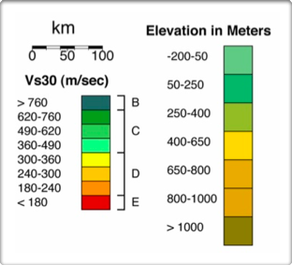

Slide 16
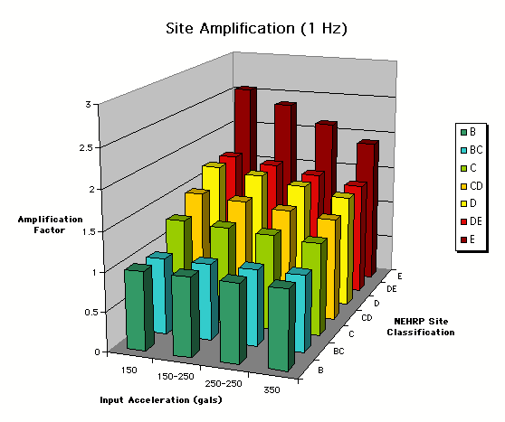
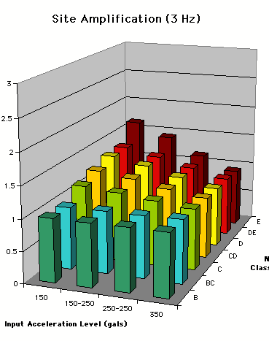
Nonlinear, Frequency-Dependent Site Amplification
Amplification (1 Hz)
Amplification (3 Hz)
AMP FACTOR
Input Acceleration (gal)
Input Acceleration (gal)
[From Borcherdt, 1994 “NEHRP Factors”]

Slide 17
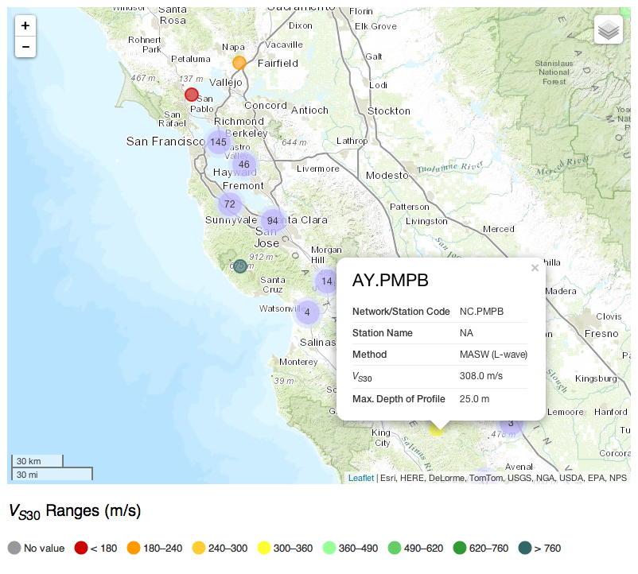
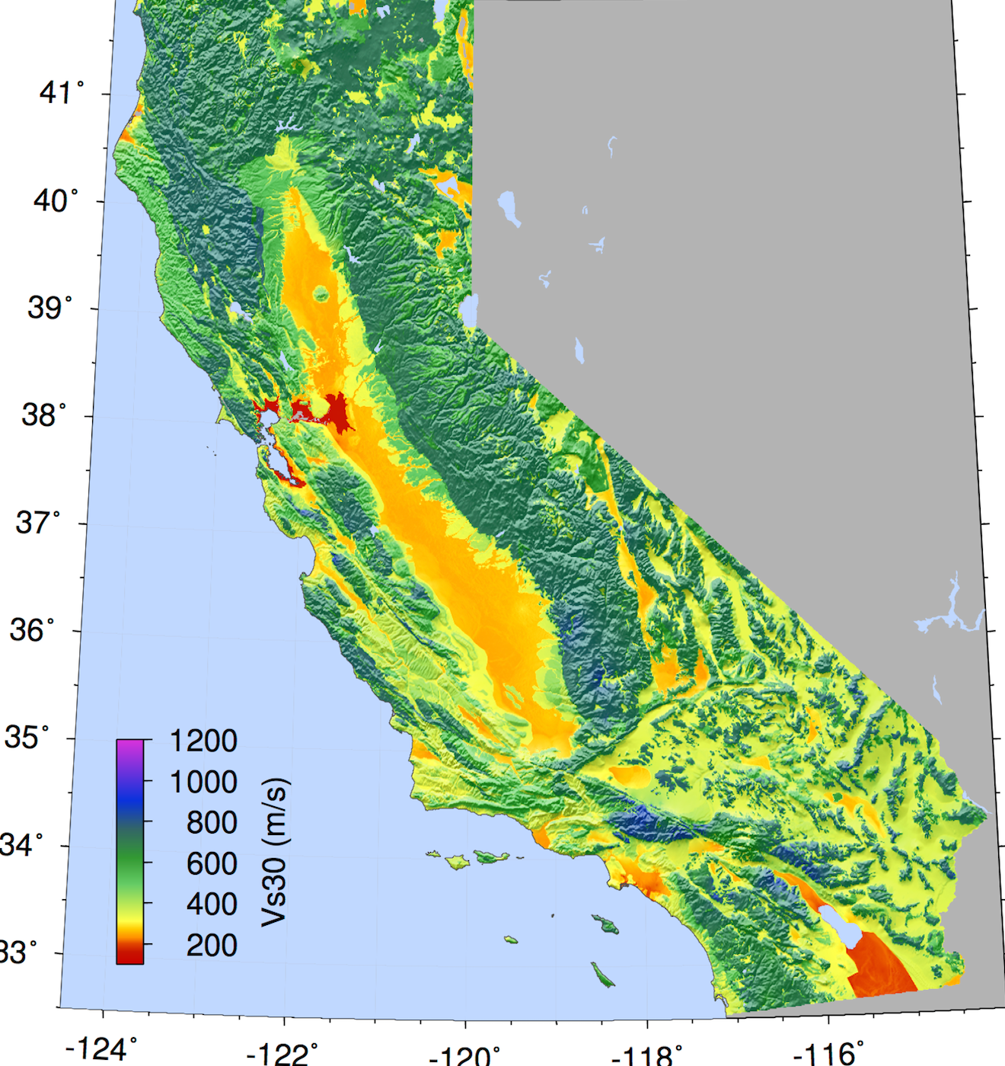
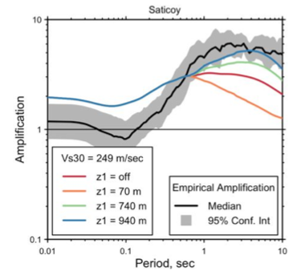
USGS Web-accessible Compilation of V_{S30} in the U.S. (Yong et al.)
Vs30 Map for California with Geologic, Topographic & Vs30 constraints via Kriging (Thompson et al)
On the Accuracy of V_{S30}-based Site Response Amplifications in California (Thompson & Wald)
Open-Source Hybrid Global Vs30 Model (Worden et al, 2014; Github)

Slide 18
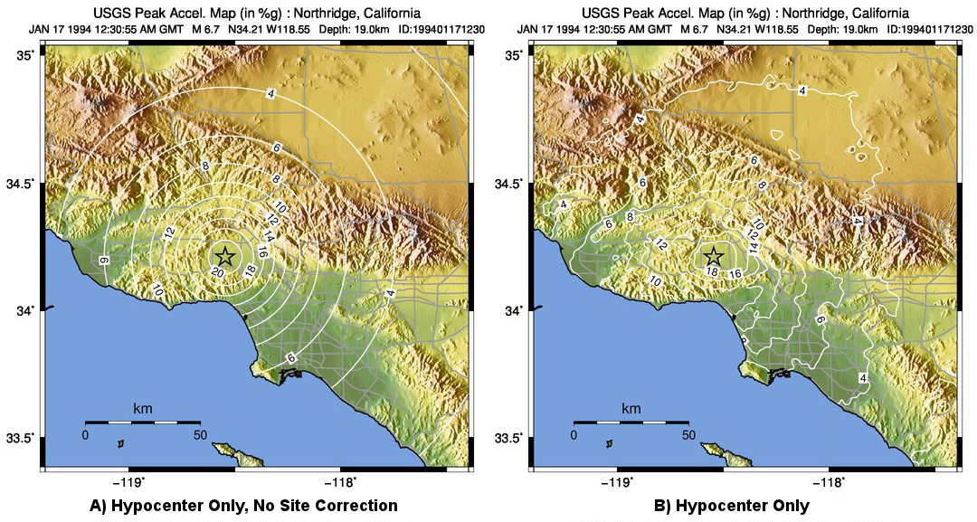
No Site Correction
Site Correction

Slide 19
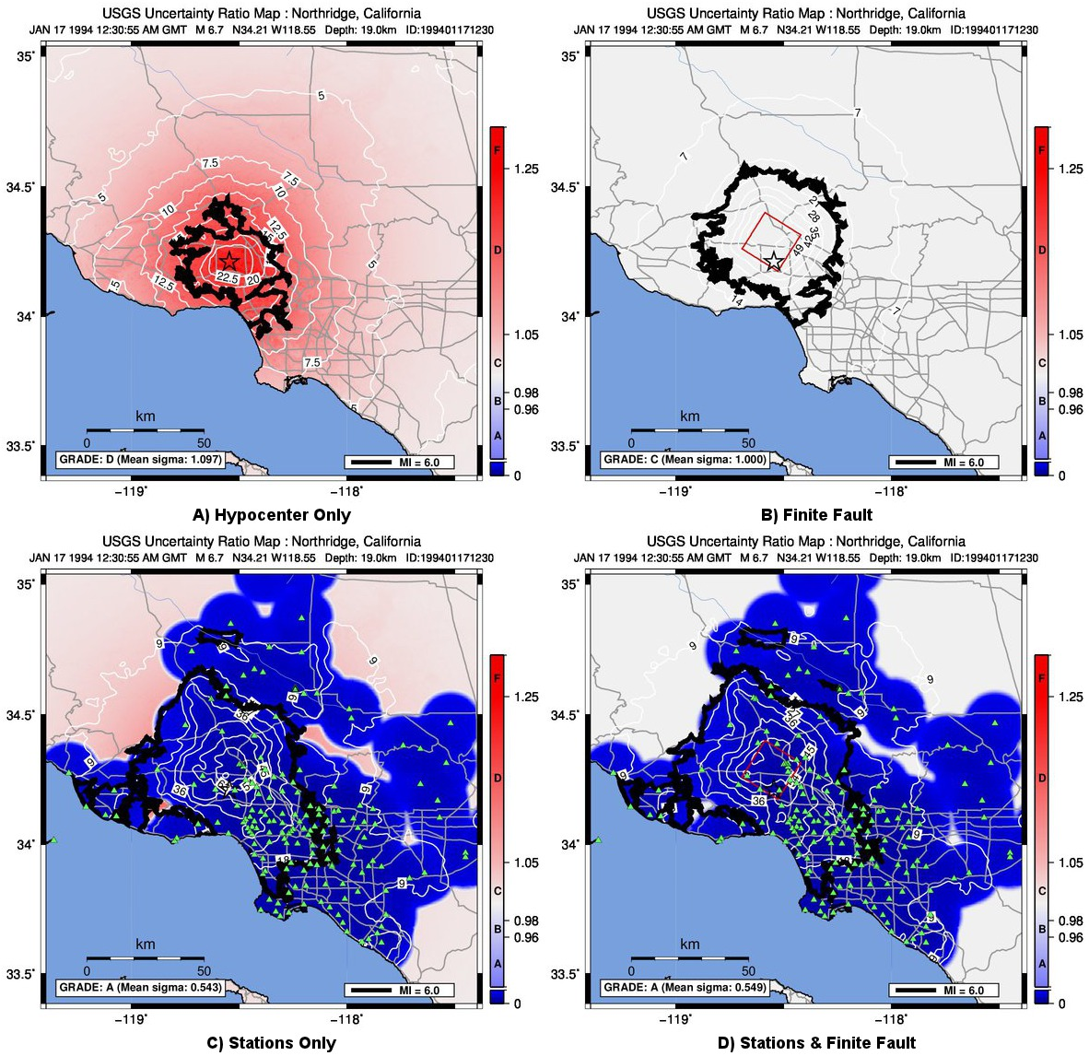

Slide 20
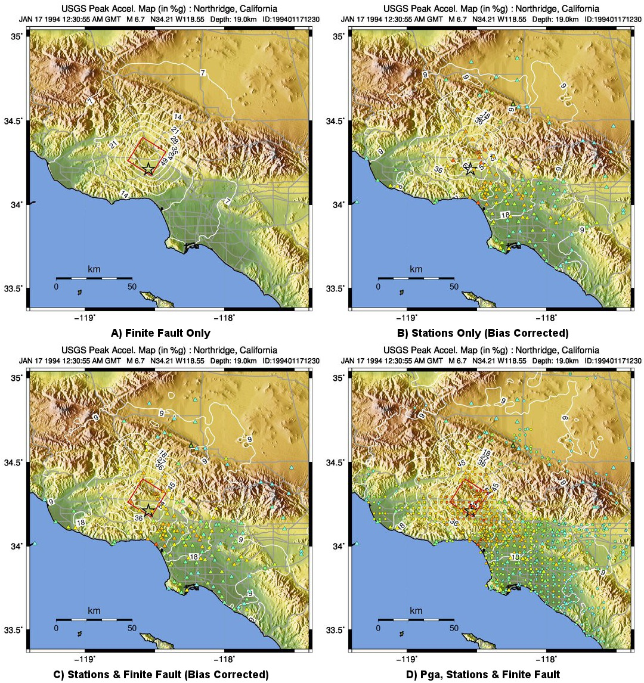

Slide 21
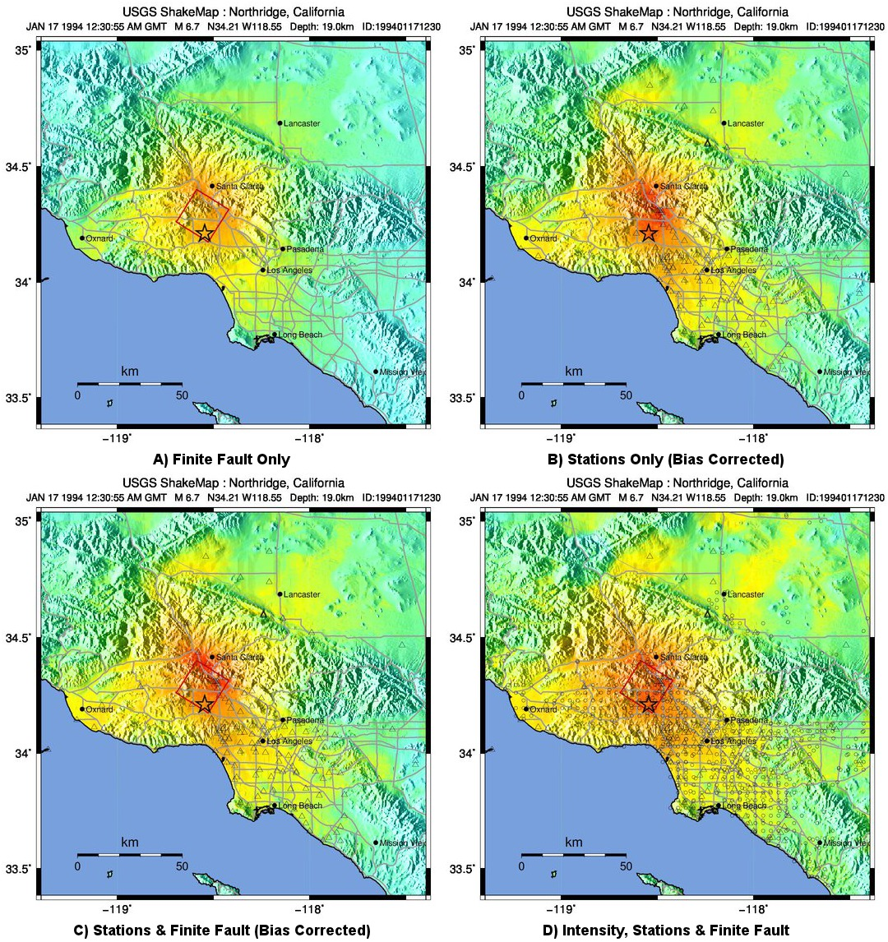

Slide 22
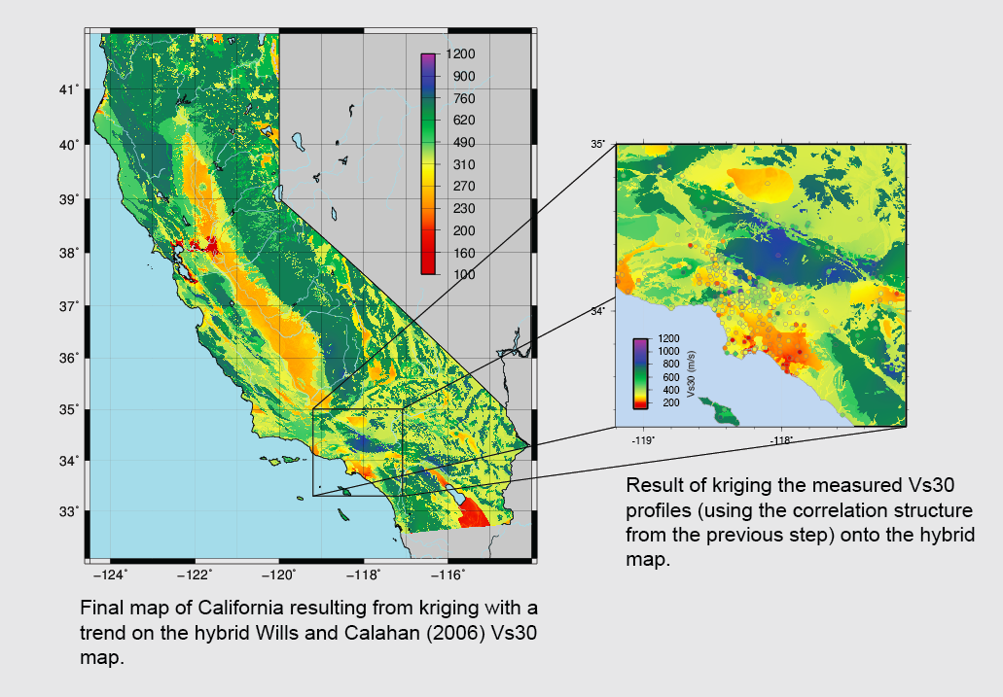
Refined Vs30 Maps
m/
sec
[Thompson, Worden & Wald, 2014]

Slide 23
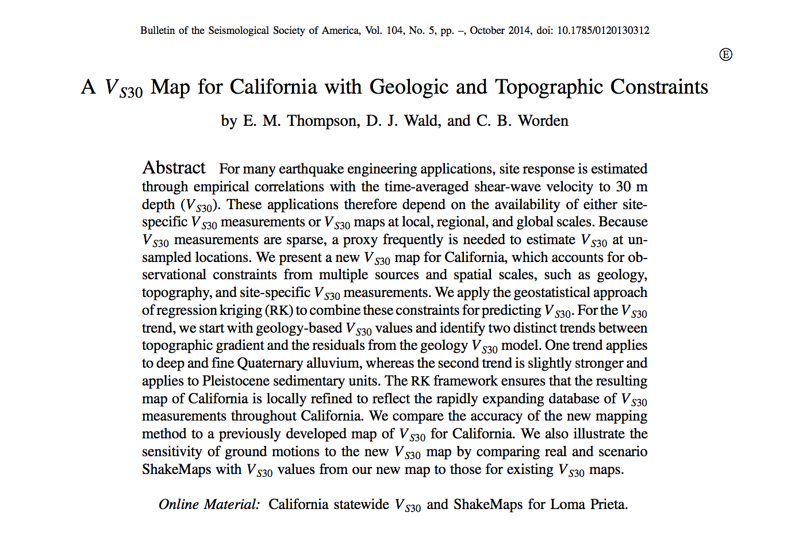

Slide 24
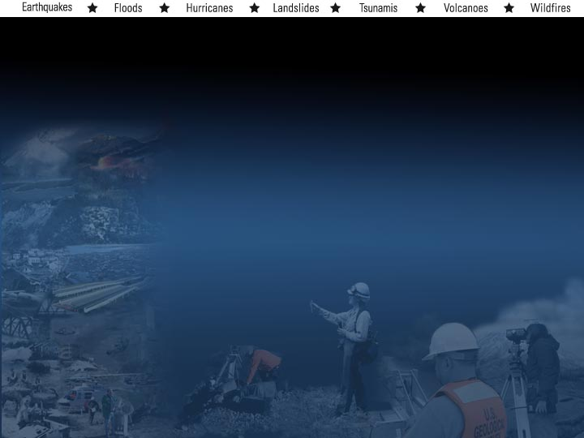
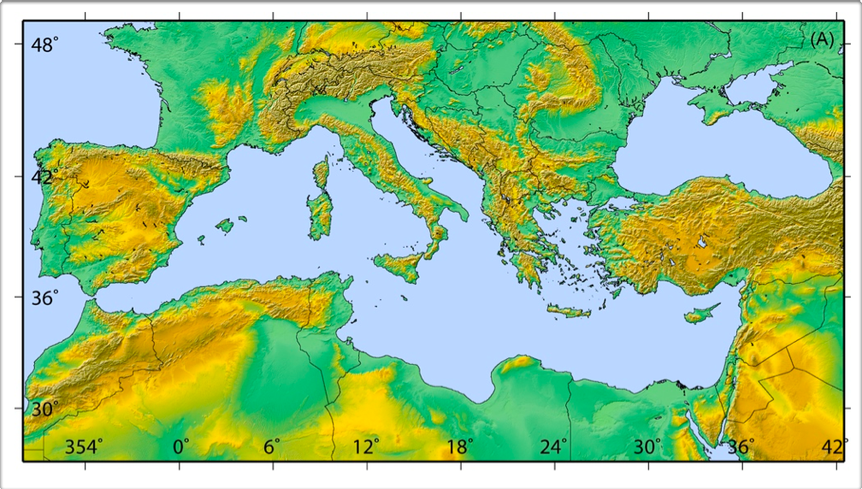
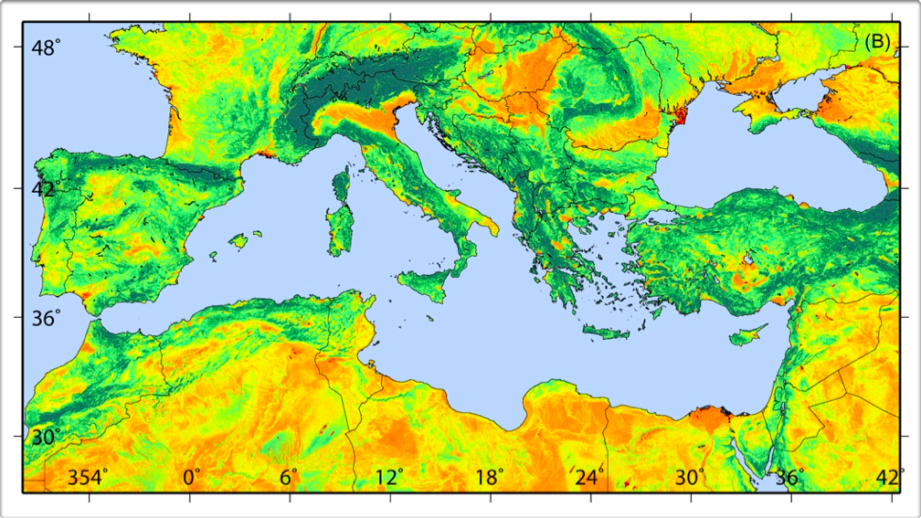


Global Vs30 Server

Slide 25
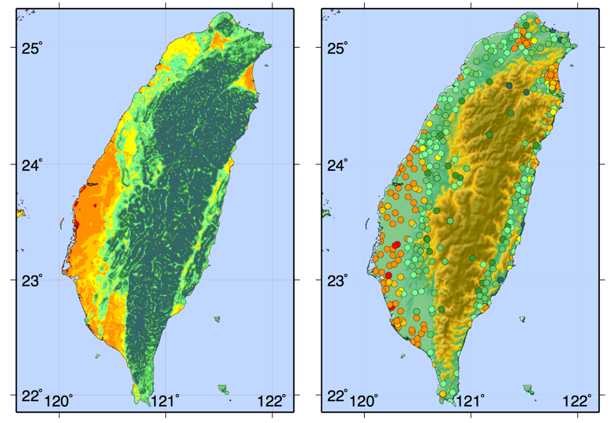
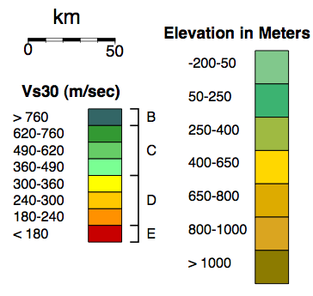
Taiwan
Vs30 Derived From
Topographic Slope
Topography & Vs30
Measurements
Wald & Allen (2007)

Slide 26
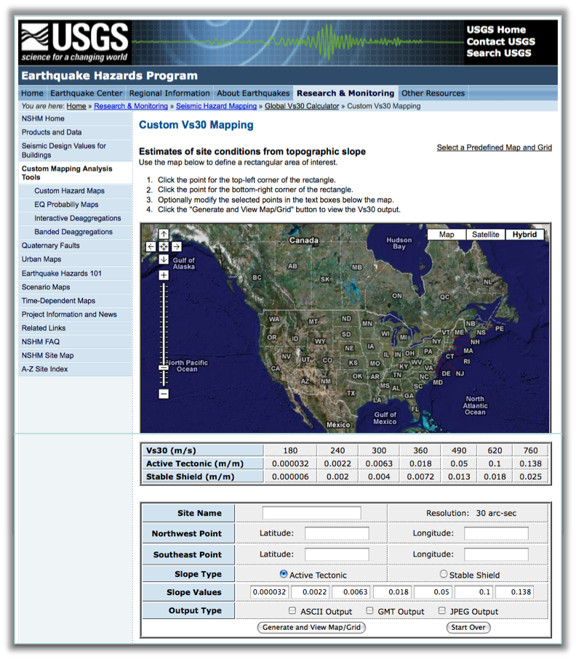
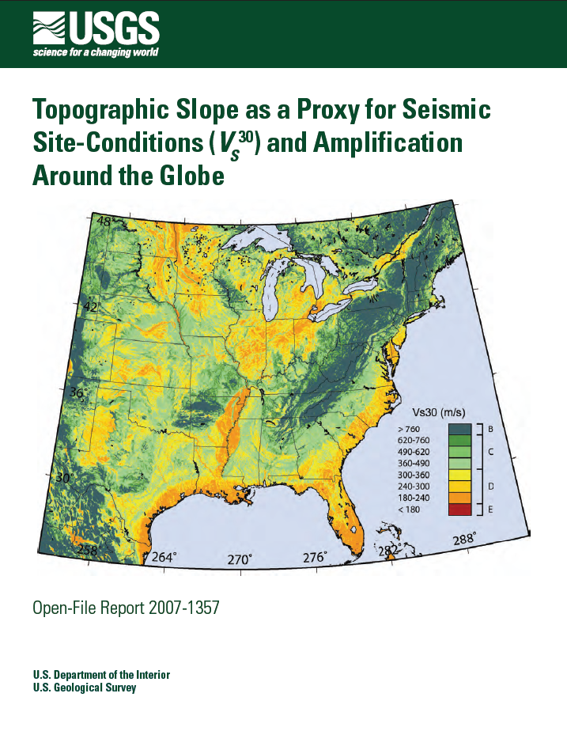


Slide 27
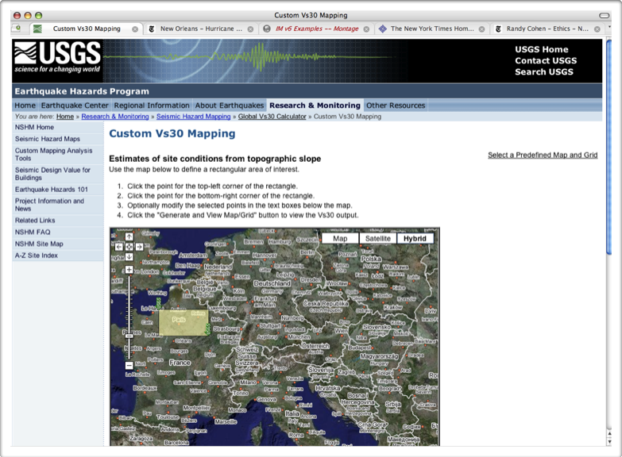
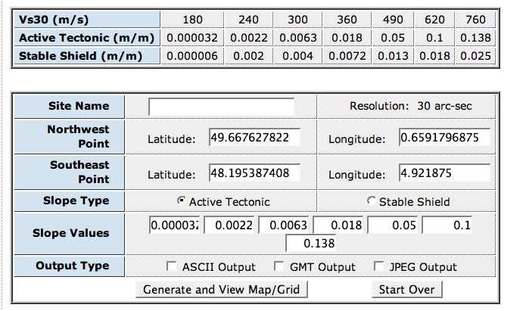

Slide 28
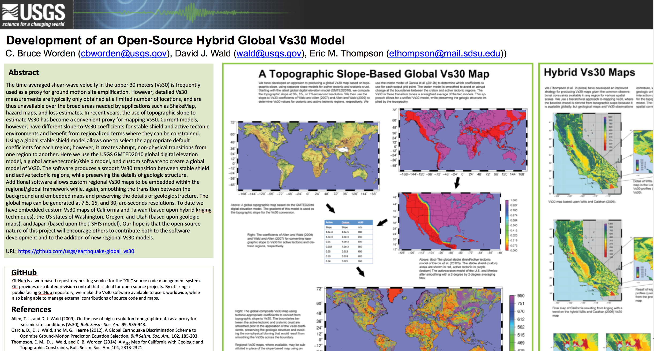


Slide 29


Slide 30




ASSESSING THE SEISMIC RISK POTENTIAL OF SOUTH AMERCIA
Kishor Jaiswal et al. (2014)
Fault
Model
Hazard Model
Site (Vs30)
Model
Population
Vulnerability
Risk Model

Slide 31
ShakeMap
Product Distribution Layer (PDL)

Slide 32
ShakeMap
Automatic GMPE Selector

Slide 33


Hayes’ Slab1.0

Slide 34

Motivation
Youngs et al. (1997) INTERFACE
Youngs et al. (1997) INTRASLAB

Slide 35







How it works
Local and regional studies
Seismicity catalogues
(PDE, gCMT, and Centennial
-Engdahl&Villaseñor, 2002-)
SCR Seismicity Catalogues
(Johnston et al., 1994; Triep&Sykes, 1996; Schulte&Mooney, 2005)
Plate boundaries
(Lowman, 1999; Bird, 2003; Tarr et al., 2010)
Flinn-Engdahl Geographical Regions
(FEGR)
SeismotectonicDomain
Hotspot Catalogue
(Anderson&Schramm, 2005)
Stable continental regions
(Johnston et al., 1994)
World Stress Map
(Heidbach et al., 2009)
Geological Map of the World
(Bouysee, 2009)

Slide 36

Subduction Zones -SZs-
Oceanic Boundary Region -OBR-
(ANSR)
Active Continental Regions
-ACRs-

Slide 37


Refined FEGRs&SCR borders
(Wheeler, 2011; García et al., 2012)
Subduction interface models
(Hayes et al., 2011)
Plate Boundaries(Coffin et al., 1998; Bird,
2003)

Slide 38

How it works

Slide 39
Caveats: lack of interface models in some SZs

Slide 40



3D interface surfaces vs. ‘default’ ones
Average interface dip: 17°

Slide 41


Putting everything together
STREC: SeismoTectonic Regionalization of Earthquake Catalogs
Stand-alone code (Python)
openquake.org

Slide 42

Automatic Global GMPE Selector
Daniel Garcia, USGS

