Slide 1


Slide 2

Node, cable-less, cable free, wire-less,
autonomous and standalone systems
2016.01.13

Slide 3

OBJECTIVE
This presentation is not focused on recommendations.
Its design and purpose is to evaluate all existing nodal systems on the market (as of this publication) from a technical, unbiased, perspective in order to provide a comparison venue featuring each products’ (1) characteristics, (2) mode of operation, and (3) advantages/disadvantages for the consumer who is seeking comparative gains to understanding certain requirements for decision-making.

Slide 4
All technical information presented herein was extracted from Internet pages or public domain locations, which is extracted for information gathering only. Manufacturers are continuously updating their products, so up-to-date accuracy cannot be guaranteed, but best efforts are made to keep up with the industry trends in this document.

Slide 5

First Generation
Nodal Systems

Slide 6

First Generation Nodal Systems
 |  |  |  |  |  |  | Y | E | A | R
MANUFACTURER | SYSTEM | 1988 1988 | 1990 | 1992 | 1994 | 1996 | 1998 | 2000 | 2002 | 2004 | 2006 | 2008 | 2010 | 2012 | 2014
Amoco/Grant Geo | SGR
Opseis | Eagle 88
I/O | RSR
Sercel | SU-6R
Fairfield | Box
I/O | VRSR
Ascend Geo | Ultra 5

Slide 7
What have we learned from the 1st Generation Nodal Systems?
Designed for use in areas where a cable system was ineffective. Quality Control of the energy source remained independent either with cable or nodal system. On average, the failure rate of a deployed spread decreased from 15% with the first systems to less than 1% with the latest systems. These nodal systems were more productive in certain areas than traditional cable systems.

Slide 8
What else have we learned from the 1st Generation Nodal Systems?
Last nodal systems offered better data quality compared with traditional cable systems. The 4 or 6 channels nodes still had cable problems. Connections and cable trouble were the weakest link with cable systems, while radio communications were the fragile point of the nodal systems.

Slide 9

Cable and Nodal Systems
Today

Slide 10
Seismic Acquisition Cable Systems Today
SYSTEM | G3i HD | Aries II | UniQ | 508 | 428 XL | Summit II Plus
MANUFACTURER | INOVA | INOVA | Schlumberger | Sercel | Sercel | DMT
2016.01.13

Slide 11

Why choose Cable over Nodal ?
Rapid assessment of the quality of all the deployed spread *
Ability to monitor spread noise of the active spread in real-time **
Recording data as well as processing reports in permissible time **
Easy to analyze acquisitions immediately and change system parameters if necessary *
No need for radio transmission for data management and status
Synchronization with GPS is not essential
Continuous monitoring of the power consumption and measured handling
* Not always the case with cable systems.
** Not applicable for all nodal systems.

Slide 12
New Age of Nodal Systems*
SYSTEM | HDR | Z Land | GSR | GCX | NuSeis | TremorNet High DR | TremorNet Low Power
MANUFACTURER | AutoSeis | Fairfield Nodal | Geospace Tech. |  | GTI | INNOSEIS
SYSTEM | Hawk SN11 | Sigma | Scout | U Nodal | Unite | RT2 | Spidernano
MANUFACTURER | INOVA | I-Seis | Geoseis Services | Seismic Instruments | Sercel | Wireless Seismic | World Sensing

Slide 13
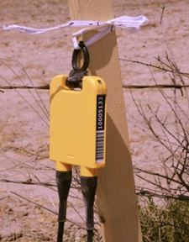
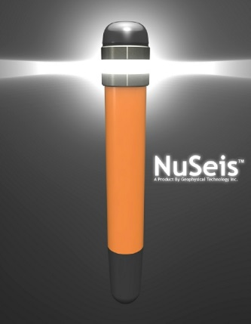
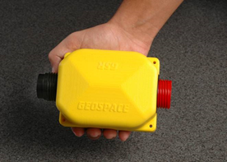
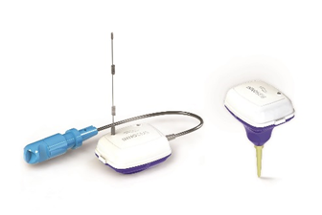
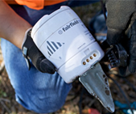
New Age of Nodal Systems in Pictures
SYSTEM | HDR | Z Land | GSR | GCX | NuSeis | TremorNet High DR | TremorNet Low Power
MANUFACTURER | AutoSeis | Fairfield Nodal | Geospace Tech. |  | GTI | INNOSEIS

Slide 14
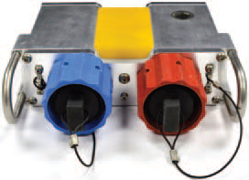
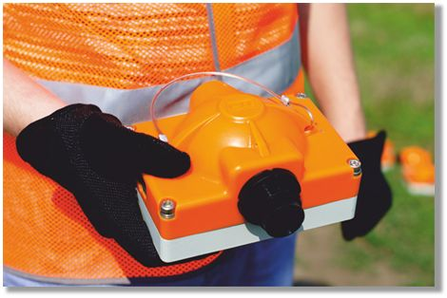
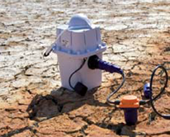
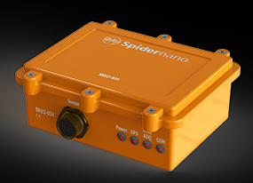
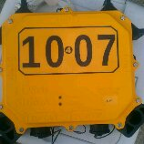
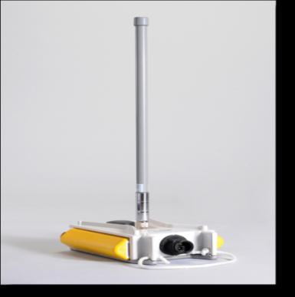
New Age of Nodal Systems in Pictures
SYSTEM | Hawk SN11 | Sigma | Scout | U Nodal | Unite | RT2 | Spidernano
MANUFACTURER | INOVA | I-Seis | Geoseis Services | Seismic Instruments | Sercel | Wireless Seismic | World Sensing

Slide 15
Second Generation Nodal Systems
With an influx of improved Nodal systems hitting the market between ‘04 and ‘06, experienced users took lessons learned from the previous generations and worked around those systems labeled as blind ("shooting-blind") for failing to assess the level of spread noise prior to acquisition. This blind shooting became a trusted method of exploration. Conversely, new buyers coming to the nodal market (i. e. cable users) were looking for the benefits of a cable system in a node format (“real-time”).

Slide 16

“We can not generalize about all nodal systems,
as each has its own personality”

Slide 17
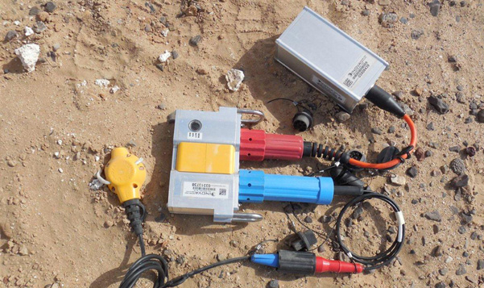
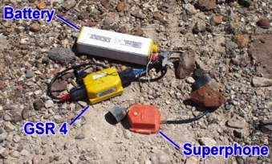
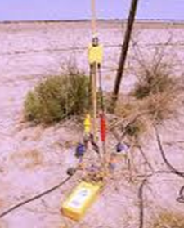
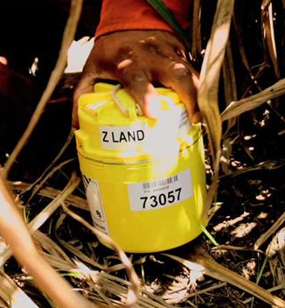
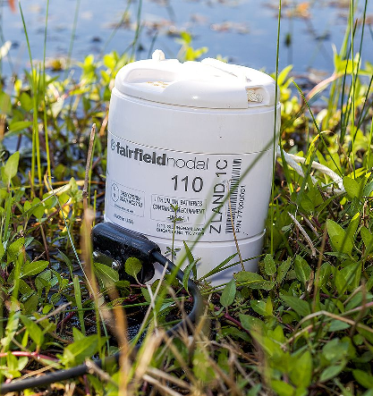
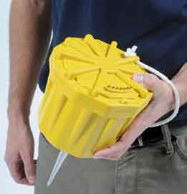
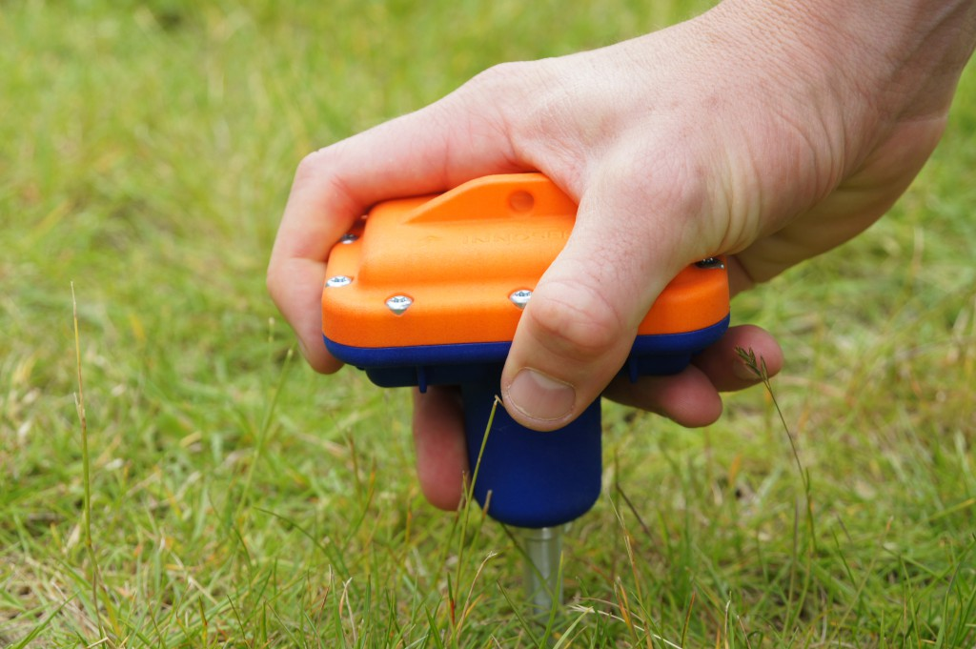
Physical Differences between Nodal Systems
INOVA Hawk
Geospace. GSR
GTI
AutoSeis HDR
Fairfield Nodal. Z Land
Geospace. GCX
Innoseis. TremorNet
Geoseis Services. Scout

Slide 18
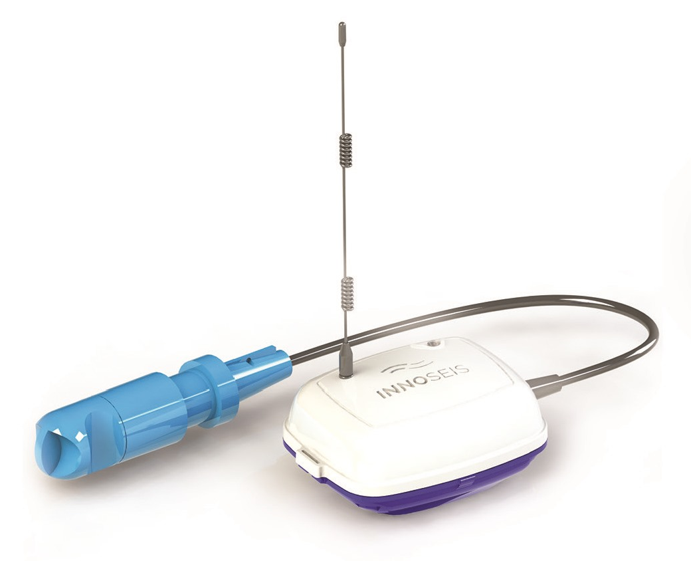
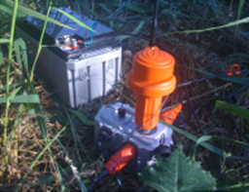

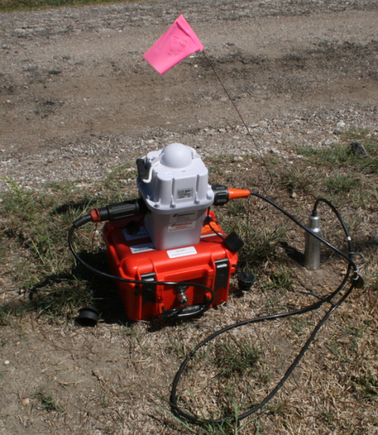
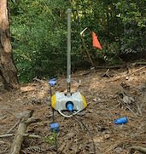
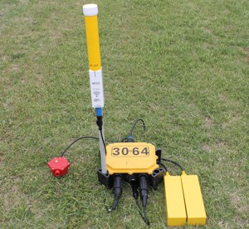
Physical Differences between Nodal Systems
Innoseis
TremorNet
Seismic Instruments
ARN
World Sensing. Spidernano
Sercel. Unite
Wireless
Seismic
WRU
I-Seis
Sigma

Slide 19

CONSIDERING
A NODAL SYSTEM

Slide 20
Check List Is a Nodal System for Me?
What to Consider:
Technical Characteristics
Acquisition capability in days
Mechanical characteristics
Technical specifications
Internal Testing
External testing
Advantages related to workspace, design and savings in cost and time

Slide 21
Check List Is a Nodal System for Me?
What to Consider:
General and Individual disadvantages
Operations including burying stations, QC status, noise monitoring, acquisition, transfer, transcription and data recording.
Easy to operate the equipment and field operations
Special configurations: 3-4 channels, Mixed
Field experienced systems
Market share
Costs

Slide 22

Technical Characteristics
of Nodal Systems

Slide 23

Nodal Systems What are my Technical Requirements?
Channels per Node: 1 / 2 / 3 / 4.
Ability to work with sensors: 1 / 3 / 4 components.
Digital sensors: Only two manufacturers offer this option.
Sensor(s): Integrated / connected to the Node.
Analog to Digital Converter: 24 / 32 bits
Sampling interval: 0.25 to 20 ms
Recording Format: SEG Y / SEG D / SEG 2.
Memory capacity: 2 to 64 GB.
Battery type and capacity: Li-Ion / Lead - Acid.
Battery usage: internal / external / or both.
Recording Capacity considering Memory and Battery (average 30 days)

Slide 24
Technical Characteristics Nodal Systems
MANUFACT. | AutoSeis | Fairfield | Geospace Tech. |  | GTI | Innoseis |  | INOVA | I-Seis | Geoseis Services | Seismic Inst. | Sercel | Wireless Seismic | World Sensing
SYSTEM | HDR | ZLand II | GSR / GSX | GCX | Nuseis | TremorNet Smart | TremorNet Blind | Hawk | Sigma | Scout | U Node | Unite RAU eX | RT 2 | SRU
Channels x Node | 1 | 1 or 3 | 1 / 2 / 3 / 4 | 1 o 3 | 1 | 1 | 1 | 1 / 2 / 3 | 1 / 2 / 3 |  | 1 - 24 | 1 o 3 | 1 o 3 | 1 / 2 / 3
Analog Input | 1C | 1C or 3C | 1C or 3C | 1C or 3C | 1C | 1C | 1C | 1C or 3C | 1C or 3C | 1C or 3C | 1C o 3C | 1C o 3C | 1C o 3C | 1C o 3C
Digital Input | no | no | no | no | no | no | no | 3C | No | no | no | YES | no | no
Internal Geophone | no | YES + connector | no | YES (GS One) | YES + connector | no | YES + connector | no | no | no | no | no | no | no
A/D Converter | 32 bits | 24 bits | 24 bits ΔΣ | 24 bits ΔΣ | 24 bits ΔΣ |  |  | 24 bits | 24 bits ΣΔ | 32 bits |  |  | 24 bits | 24 bits
Sample Rate (ms) | 1 or 2 | 0.5 to 4 | 0.25 to 4 | 0.25 to 4 | 1 or 2 | 1, 2, 4 | 1, 2, 4 | 0.25 to 4 | 0.25 to 8 |  | 0.25 to 2 |  | 0.5 to 4 | 2, 4, 10 & 20
Recording Format |  | FN & SEG Y | SEG D, SEG 2 | SEG D, SEG 2 |  |  |  | SEG Y | SEG Y & SEG D | SEG D / SEG Y | SEG Y * |  | SEG Y

Slide 25
Recording Capacity (Memory / Battery) Nodal Systems
MANUFACT. | AutoSeis | Fairfield | Geospace Tech. |  | GTI | Innoseis |  | INOVA | I-Seis | Geoseis Services | Seismic Inst. | Sercel | Wireless Seismic | World Sensing
SYSTEM | HDR | ZLand II | GSR / GSX | GCX | Nuseis | TremorNet Smart | TremorNet Blind | Hawk | Sigma | Scout | U Node | Unite RAU eX | RT 2 | SRU
Memory Capacity (GB) | 8 GB |  | Up to 16 GB X chan | 8 GB | 8 (16, 32, 64 optional) | 16 GB (up to 32 GB) | 16 GB (up to 32 GB) | 16 GB total | 2, 4 (64 Optional) | 32 GB | 64 GB
Internal Battery | No | YES | No | YES | 10 AH | YES | YES | No | No | Yes | 7 - 28 Vdc | Li-Ion | Li-Ion | No
External Battery | Yes | No | Yes | No | Optional | No | No | 11 - 17 Vdc | Yes |  | Yes | Yes | Yes | 65 AH @12 Vdc
Battery Type | Li-Ion | Li-Ion | Li-Ion / Li Polimer | Li-Ion | Li-Ion | Li-Ion | Li-Ion | Li-Ion |  |  |  |  |  | Lead Acid
Power (Acq. Mode x Channel) | < 300 mW |  | < 204 mW |  | < 100 mW |  |  | 309 mW | 480 mW |  | 250 mW |  |  | 500 mW / 3 chan
Recording Capacity (days) | > 42 | > 32 | > 30 | > 30 | > 14 | > 30 | > 40 |  |  | 28 |  |  | 20 | > 50

Slide 26

Nodal Systems
Mechanical Characteristics

Slide 27
Mechanical Characteristics Nodal Systems
MANUFACT. | AutoSeis | Fairfield | Geospace Tech. |  | GTI | Innoseis |  | INOVA | I-Seis | Geoseis Services | Seismic Inst. | Sercel | Wireless Seismic | World Sensing
SYSTEM | HDR | ZLand II | GSR / GSX | GCX | Nuseis | TremorNet Smart | TremorNet Blind | Hawk | Sigma | Scout | U Node | Unite RAU eX | RT 2 | SRU
Humidity (%) | 0 - 100 % |  |  |  |  | IP68 | IP68 |  |  |  |  | IP68 | 0 to 100 %
Water Immersion |  | 10 m | yes | water resistance |  | watertight | watertight | 3 m (24 Hs) | yes |  | watertight |  | 1 m
Weight (Kg) | 0.317 (0.7 lb) | 1.86 (4.1 lb) | 0.91 (2 lb) | 2.72 (6 lb) | 0.862 (1.9 lb) | < 0.5 Kg | < 0.5 Kg | 1.72 (3.8 lb) | 3.2 (7 lb) | 1.3 - 1.65 | (4.85 lb) | 1.6 | 3.3 (7 lb)
Dimensions (cm) | 12 x 7 x 1.7 | 11.7 D x 14.5 H | 16.9 x 8.9 x 7.6 | 16 D x 13.7 H | 5.1 D x 30 H | 11 x 9 x 5 | 11 x 9 x 9.8 | 16.7 x 20.3 x 5.6 | 29 x 33 x 10 | 16 x 11 x 7 | 8" x 6 " x 2.5" | 23 x 15 x 15 | 14.7 x 7.1 x 23
Operation Temperature (◦C) | (-50 C to +85 C) | (-40 C to +60 C) | (-40 C to +85 C) | (-5 C to +50 C) | (-40 C to +60 C) | (-40 C to +85 C) | (-40 C to +85 C) | (-40 C to +65 C) | (-40 C to +85 C) | (-40 C to +60 C) | (-40 C to +75 C) | (-40 C to +60 C) | (-40 C to +75 C) | (-40 C to +85 C)

Slide 28

Nodal Systems
Technical Specifications

Slide 29
Nodal Systems
Technical Specifications
Preamplifier and Filters: Input Impedance, Preamp Gains, Low Cut Filter or DC Offset, Phase and Bandwidth.
Interface with different energy sources: Source Controllers, auxiliary channels and timing.
Internal Instrument Testing: Dynamic Range, THD, EIN, Gain Accuracy, CMRR, Crossfeed, Impulse, Phase and Offset.
Sensors Instrument Testing: Impedance, Resistance, Step (Natural Frequency, Sensitivity), Impulse, Tilt. THD, Leakage, CMRR, Crossfeed.
Battery and GPS status.
Spread Noise level.
Mechanical: Humidity, Immersion in water, weight, dimensions, power consumption and temperature.

Slide 30
Technical Options Nodal Systems
Input Impedance
Preamplifier Gains: 0, 6, 12, 18, 24, 30, 36 dB
Low Cut or DC Offset Filter
Phase Type: Linear or Minimum
Bandwidth
Hardware and software interfacing with different energy sources (source controllers, auxiliary channels and timing)

Slide 31
Technical Specifications (Preamp and Filters) Nodal Systems
MANUFACT. | AutoSeis | Fairfield | Geospace Tech. |  | GTI | Innoseis |  | INOVA | I-Seis | Geoseis Services | Seismic Inst. | Sercel | Wireless Seismic | World Sensing
SYSTEM | HDR | ZLand II | GSR / GSX | GCX | Nuseis | TremorNet High DR | TremorNet Low Power | Hawk | Sigma | Scout | U Node | Unite RAU eX | RT 2 | SRU
Input Impedance |  |  | 20 KΩ | 20 KΩ | 20 KΩ |  |  | 20 KΩ | 20 KΩ |  | 1K7 |  | 20 KΩ
Max. Input Signal | 5 Vpp | 2.5 Vp @ 0 dB | 1.8 Vrms @ 0 dB | 1.8 Vrms @ 0 dB | 2.121 Vrms @ 0 dB |  |  | 1.768 Vrms | 5 Vpp |  | 5Vpp |  | 1.768 Vrms | 5 or 40 Vpp
Pre Amp Gain (dB) | 0 | 0 - 36 (6 dB steps) | 0 - 36 (6 dB steps) | 0 - 36 (6 dB steps) | 0 - 36 (12 dB steps) | 0 - 24 ( 6 dB steps) | 0 - 24 ( 6 dB steps) | 0 - 30 ( 6 dB steps) |  |  | 0 - 36 (12 dB steps) |  | 0 - 36 (12 dB steps) | 0 - 36 (6 dB steps)
Low Cut Filter | No | out or 1 to 60 Hz (1 Hz incs.) |  |  |  |  |  | DC | DC, 0.1, 2 Hz |  | DC
Phase | Linear only | Linear o Min | Linear o Min | Linear o Min | Linear o Min |  |  | Linear | Linear o Min |  | Linear o Min |  | Linear o Min | Linear o Min
Anti Alias Filter | 0.8 Nyq | 0.826 Nyq | 0.83 Nyq / 130 dB/oct | 0.83 Nyq / 130 dB/oct | 206 Hz @ 2 ms | 208 Hz @ 2 ms & 120 dB/ | 208 Hz @ 2 ms & 120 dB/ | 206 Hz @ 2 ms & 135 dB/ | 0.85 Nyq. |  | 130 dB/oct |  | 0.8 Nyq / 120 dB/oct | 0.83 Nyq / 130 dB/oct
Bandwidth (Hz) | 0 - 375 |  | 1 - 1600 | 1 - 1650 |  |  |  | 0 - 1652 | DC - 15 KHz |  | DC - 428

Slide 32
Technical Specifications Nodal Systems
MANUFACT. | AutoSeis | Fairfield | Geospace Tech. |  | GTI | Innoseis |  | INOVA | I-Seis | Geoseis Services | Seismic Inst. | Sercel | Wireless Seismic | World Sensing
SYSTEM | HDR | ZLand II | GSR / GSX | GCX | Nuseis | TremorNet High DR | TremorNet Low Power | Hawk | Sigma | Scout | U Nodal | Unite | RT 2 | SRU
Total System Dynamic Range | 160 dB |  | 140 dB | 140 dB |  |  |  | 147 dB | 144 dB |  |  |  | 143 dB @ 2ms | 143 dB @ 2ms
Inst. Dynamic Range |  | 127 dB @ 0 dB | 126 dB @ 0 dB | 124 dB @ 2 ms | 123 dB @ 12 dB & 2 ms | 134 dB | 127 dB | 127 dB @ G0 | 126 dB |  | 120 dB @ 0 dB |  | 125 dB @ x1 | 125 dB @ x1
THD | > 105 dB | 0.0002% | 0.0005% | 0.02% | 0.00018% |  |  | 0.0001% | 0.0012% |  | >110 dB |  | 0.0002% | 0.0003%
EIN |  | 0.1 µV @ 36 dB | 0.17 µV @ 36 dB | 0.17 µV @ 36 dB | 0.348 µV @ 12 dB & 2 ms |  |  | 0.09 µVrms @ G5 | 0.09 µVrms @ 2 ms |  |  |  | 0.13 µV @ x64 | 0.13 µV @ x64
CMRR |  | > 110 dB | 0.001% | 0.001% |  |  |  | > 110 dB | > 100 dB |  |  |  | > 100 dB | > 100 dB
Crossfeed |  |  | yes | yes |  |  |  | No | > 125 dB |  |  |  | > 120 dB | > 110 dB
Gain Acc. |  | 0.5% | 1% | < 1% | 0.25% |  |  |  | 1% |  | 1% |  | 0.1% | < 1%

Slide 33
Timing Specifications Nodal Systems
MANUFACT. | AutoSeis | Fairfield | Geospace Tech. |  | GTI | Innoseis |  | INOVA | I-Seis | Geoseis Services | Seismic Inst. | Sercel | Wireless Seismic | World Sensing
SYSTEM | HDR | ZLand II | GSR / GSX | GCX | Nuseis | TremorNet Smart | TremorNet Blind | Hawk | Sigma | Scout | U Node | Unite RAU eX | RT 2 | SRU
Time Standard |  |  | < 1 ppm | < 1 ppm | < 500 ppb
Timing Acc. | < 25 µs | +/- 10 µs | < 20 µs | < 20 µs | +/- 12.5 µs | < 20 µs | < 20 µs | (+/- 25 µs) |  |  | < 1 µs | < 20 µs |  | < 10 µs

Slide 34

Nodal Systems
Instrument Tests

Slide 35
Instrument Tests Nodal Systems
MANUFACT. | AutoSeis | Fairfield | Geospace Tech. |  | GTI | Innoseis |  | INOVA | I-Seis | Geoseis Services | Seismic Inst. | Sercel | Wireless Seismic | World Sensing
SYSTEM | HDR | ZLand II | GSR / GSX | GCX | Nuseis | TremorNet High DR | TremorNet Low Power | Hawk | Sigma | Scout | U Node | Unite RAU eX | RT 2 | SRU
Internal Noise |  | √ | √ | √ | √ |  |  | √ |  | √ |  | √
THD |  | √ | √ | √ | √ | √ | √ | √ |  | √ |  | √
Gain Accuracy |  | √ | √ | √ | √ |  |  |  |  |  |  | √
Dynamic Range |  |  | √ | √
CMRR |  | √ | √ | √ |  |  |  | √ |  | √
Crossfeed |  |  | √ | √ |  |  |  |  |  |  |  | √
Impulse Response |  | √ | √ | √ | √
Offset / Phase |  |  |  |  |  |  |  |  |  | √ |  | √

Slide 36
External Tests Nodal Systems
MANUFACT. | AutoSeis | Fairfield | Geospace Tech. |  | GTI | Innoseis |  | INOVA | I-Seis | Geoseis Services | Seismic Inst. | Sercel | Wireless Seismic | World Sensing
SYSTEM | HDR | ZLand II | GSR / GSX | GCX | Nuseis | TremorNet High DR | TremorNet Low Power | Hawk | Sigma | Scout | U Node | Unite RAU eX | RT 2 | SRU
Sensor Impedance |  | √ | √ |  | √ | √ | √
Sensor Resistance |  | √ |  |  | √ | √ | √ | √ |  | √ |  | √
Sensor Step* |  | √ |  |  | √ | √ | √
Sensor Impulse |  |  |  |  |  | √ | √ |  |  | √
Tilt |  |  |  |  |  | √ | √ |  |  | √ |  | √
THD |  |  |  |  |  |  |  | √
Leakage |  |  |  |  | √ |  |  | √ |  |  |  | √
CMRR |  |  |  |  |  |  |  | √
Crossfeed |  |  |  |  |  |  |  | √ |  | √ |  | √
GPS / Batt Status |  |  | √ | √ |  |  |  |  |  | √
Spread Noise |  |  | √ | √ |  |  |  | √ |  |  |  | √

Slide 37
Observed Advantages
Using Nodal Systems

Slide 38
Nodal Systems Design Advantages
With no cables, the quality of data in each acquisition will improve due to the reduction of CMRR, Crossfeed, static, lightning and transmission problems.
98-99% reliability of certain systems.
Most of Nodal systems do not require crossline equipment and transverse cables *.
Newer technology, low power consumption, lower cost and miniaturization in GPS technology.
Ability to record short or long events.
Option “Shot Gather“ and "Receiver Gather".

Slide 39
Nodal Systems Field Operation Advantages
Easier access to difficult or restricted areas. Examples are:
Rough terrain, environmental protections, urban settlements, no-permit zones, river crossings, roads, obstacles, cattle ranches, infestations (rodents/insects).
Ease of use in areas known for high static and lightning.
No restrictions between receiver stations.
Ability to acquire simultaneous configurations and deployments adapted to the working area including quasi-random projects.
Permanent monitoring (4D, fractures, Seismology, civil engineering)

Slide 40
Nodal Systems Time and Cost Advantages
NO CABLES, leads to less troubleshooting required on the spread, resulting in HIGHER PRODUCTIVITY.
Elimination (or significant reduction) of the cost of field equipment repair, especially in cattle zones.
Fewer damage issues on gear and less time consumption in hi- static/bad weather areas.
Less weight per channel, means lower transportation costs *.
Reduced environmental foot print.
Lower HSE risk due to lighter weight and volume of the equipment.
May consider burying the equipment in certain hi-risk areas to avoid losses **.

Slide 41

Observed Disadvantages
of Nodal Systems

Slide 42
Observed Disadvantages of all Nodal Systems
Significant increment in Battery count. Logistic strategy in the field is recommended if the channel count is high and time prohibitive. Possible drifts in GPS signal. Increased risk of data loss due to theft, fire, or flood of partial channels count. Large data volumes cause delays in handling for processing.

Slide 43
Observed Disadvantages of some Nodal Systems
No ability to monitor active spread in real time (Shooting Blind). No immediate analysis of information. Immediate instrument tests or quick change of certain parameters can be challenging. In areas where ample QC is required, a blind nodal systems will need specialized personnel and equipment to carry out that task. Despite the advantages of using Li-ion batteries, there are restrictions on transportation.

Slide 44
Observed Disadvantages of some Nodal Systems
If radio communications are required, many factors involved may prove costly and less reliable; and considerations should include power consumption, line of sight between units, mast height, antennas, connections, ease of access and urban environment. Most nodal systems still have cables and connectors at each station. A nodal system could still have more weight when compared with a short cable system.

Slide 45

Nodal Systems
Mode of Operation

Slide 46
Acquisition and Recording Steps Using Nodal Systems *
Note: * No all the Nodal systems follow certain steps.
1. Survey
Place Sources
Place Receivers.
2. Drilling.
Hole Drilling (if burying)
Single sensors, strings or the whole spread.
3. Pre-Deployment
Charging batteries
Equipment Testing
Programming Parameters
4. Deployment of Field Electronics
Sensors
Batteries
Nodes
Radio telemetry (if applicable)
5. Quality Control at each station.
(Visiting or requesting status by radio)
Includes Battery, GPS, Sensors and Spread Noise Tests.
6. Data Acquisition and QC
Quality Control of:
Sources
Receivers
7. Data Collection at each station by:
Locally connected at each node
Retrieve and download Nodes at a centralized recorder
Radio transmission (WiFi, Bluetooth, etc)
8. Synchronization and Data Transcription
Shot Gather
Receiver Gather
Continuous recording
9. Data Recording and Deliverable Reports
SEG D data
SEGY data
SEG 2 data
Reports

Slide 47
Nodal Systems Operations Burying Receiver Stations
MANUFACT. | AutoSeis | Seismic Instruments | Wireless Seismic | Innoseis | I-Seis | Sercel | World Sensing | Geospace Tech. | Innoseis | INOVA | Geoseis Services | GTI | Fairfield Nodal | Geospace Tech.
SYSTEM | HDR | U Node | RT 2 | TremorNet Smart | Sigma | Unite RAU eX | SRU | GSR / GSX | TremorNet Blind | Hawk | Scout | Nuseis | ZLand II | GCX
BURY OPTION | √ | √ | √ | √√ | √√ | √√ | √√ | √√√ | √√√ | √√√ | √√√ | √√√√ | √√√√√ | √√√√√
CONSIDERATIONS:
Dimensions
Connector type
Location of antenna
Immersion in water
Batteries and Sensors
Recording long periods. (seismology, fractures)
Weight

Slide 48
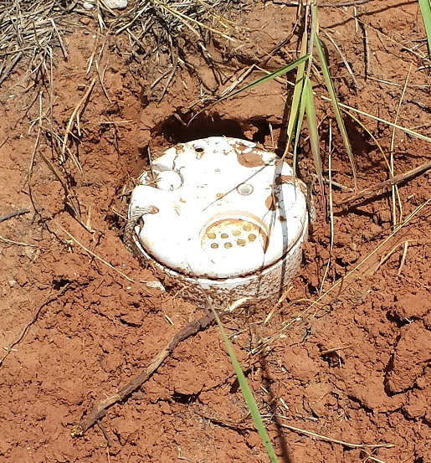
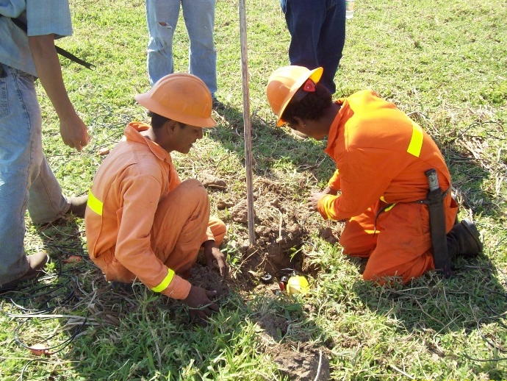
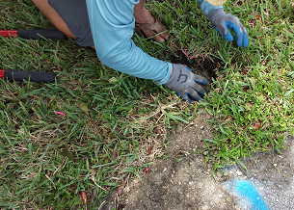
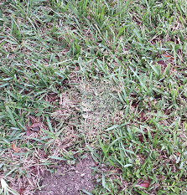
Burying Nodes Pre-Acquisition (courtesy de Fairfield Nodal y Geospace Technologies )
Fairfield Nodal . ZLand
Geospace Technologies . GSX

Slide 49
Nodal Systems Operations Continuous QC Status
MANUFACT. | GTI | Innoseis |  | Geoseis Services | World Sensing | AutoSeis | Fairfield Nodal | Geospace Tech. |  | INOVA | Sercel | Seismic Inst. | I-Seis | Wireless Seismic
SYSTEM | Nuseis | TremorNet Smart | TremorNet Blind | Scout | SRU | HDR | ZLand II | GSR / GSX | GCX | Hawk | Unite RAU eX | U Node | Sigma | RT 2
QC STATUS | LED and BLE | Bluetooth | Bluetooth | No information | LED | LED | LED / Serial | LED / ZigBee | LED / ZigBee | LED / WIFI / Blue Tooth | LED / WiFi | LED / WiFi | LED / WiFi / MRN | LED / Radio
QC STATUS | No information | No information | No information | No information | No information | √ | √√ | √√√ | √√√ | √√√ | √√√ | √√√√ | √√√√ | √√√√
CONSIDERATIONS:
QC Status options
Local or by Radio
Radio type
Software for analysis
Efficiency

Slide 50
Nodal Systems Operation Spread Noise Monitoring in Real Time
MANUFACT. | GTI | Innoseis |  | Geoseis Services | Seismic Inst. | AutoSeis | Fairfield Nodal | Geospace Tech. |  | INOVA | Sercel | I-Seis | Wireless Seismic | World Sensing
SYSTEM | Nuseis | TremorNet Smart | TremorNet Blind | Scout | U Node | HDR | ZLand II | GSR / GSX | GCX | Hawk | Unite RAU eX | Sigma | RT 2 | SRU
SPREAD NOISE | No information | No information | No information | No information | No information | No | No | Local / Remote (limited) | Local / Remote (limited) | Local / Remote (limited) | Local / Remote (limited) | Local / Remote (real time) | Local / Remote (real time) | Local / Remote (real time)
SPREAD NOISE | No information | No information | No information | No information | No information |  |  | √√ | √√ | √√ | √√ | √√√√√ | √√√√√ | √√√√√
CONSIDERATIONS:
Option to monitor spread noise
Type of collection
Efficiency

Slide 51

Node Systems. Operations in Real Time
With a range of nodal systems available, we can categorize the operations in real time taking in consideration: (1) level of quality control, (2) noise monitoring and (3) delivery of data:
No options. All the benefits of avoiding radio communications will be reflected in productivity.
With some degree. Quality control is covered, burying the sensors is helpful, but noise monitoring in real time is limited.
Meet QC, monitoring and data delivery in real time. For areas with high and random noise, to meet QC standards requested by the client (and to emulate the benefits of cable systems – with or w/o radio), expect cost to be higher.

Slide 52
Nodal Systems Acquisition
MANUFACT. | AutoSeis | Fairfield Nodal | Geospace Tech. |  | GTI | Innoseis |  | INOVA | I-Seis | Geoseis Services | Seismic Inst. | Sercel | Wireless Seismic | World Sensing
SYSTEM | HDR | ZLand II | GSR / GSX | GCX | Nuseis | TremorNet Smart | TremorNet Blind | Hawk | Sigma | Scout | U Node | Unite RAU eX | RT 2 | SRU
SOURCE ENERGY OPTIONS | √√√√ | √√√√ | √√√√ | √√√√ |  |  |  | √√√√ | √√√√√ | √√√√ | √√√√ | √√√√ | √√√√
OPERATION |  | √√√√ | √√√√ | √√√√ |  |  |  | √√ |  |  |  | √√√√
CONSIDERATIONS:
Options available to interface with different types of energy sources.
Easy to operate the system overall.
Field operations logistics with handling batteries, sensors and nodes.

Slide 53
Nodal Systems Comparing Data Transfer Methods
MANUFACT. | Innoseis | AutoSeis | Fairfield Nodal | Geospace Tech. |  | GTI | INOVA | Sercel | Innoseis | I-Seis | Geoseis Services | Seismic Inst. | Wireless Seismic | World Sensing
SYSTEM | TremorNet Blind | HDR | ZLand II | GSR / GSX | GCX | Nuseis | Hawk | Unite RAU eX | TremorNet Smart | Sigma | Scout | U Node | RT 2 | SRU
TYPE | Bluetooth | USB / Infrared | Ethernet cable | Ethernet cable | Ethernet cable | Transfer Jet | Cable Ethernet / WiFi | WiFi / Ethernet | Bluetooth | WiFi / MRN / more options | Wi Fi | WiFi | Local in Node or by Radio | WI & 3G
ROUTINE | NO information | Taking Nodes to Transcriber | Taking Nodes to Transcriber | Taking Nodes to Transcriber | Taking Nodes to Transcriber | Taking Nodes to Transcriber | Taking Nodes and by radio in time (limited) | Taking Nodes and by radio in time (limited) | By Radio in real time | By Radio in real time | By Radio in real time | By Radio in real time | By Radio in real time | By Radio in real time
DATA TRANSFER | NO information | √√ | √√ | √√ | √√ | √√ | √√√ | √√√ | √√√√ | √√√√ | √√√√ | √√√√ | √√√√ | √√√√
CONSIDERATIONS:
Method available
Reliability
Channel count

Slide 54
Nodal Systems Data Transcription Handling 10,000+ Channels
MANUFACT. | GTI | Innoseis |  | I-Seis | Geoseis Services | Seismic Inst. | Sercel | Wireless Seismic | World Sensing | AutoSeis | INOVA | Fairfield Nodal | Geospace Tech.
SYSTEM | Nuseis | TremorNet Smart | TremorNet Blind | Sigma | Scout | U Node | Unite RAU eX | RT 2 | SRU | HDR | Hawk | ZLand II | GSR / GSX | GCX
DATA TRANSCRIPTION | NO information | NO information | NO information | NO information | NO information | NO information | NO information | NO information | NO information | √ | √√√ | √√√ | √√√√√ | √√√√
CONSIDERATIONS:
Channel count
Software options (Roll, replacement of nodes, GPS location)
Vibroseis method (CAS, CBS, Diversity and Vertical Stack, etc)
Area type

Slide 55

Nodal Systems
Operations
Bury . The option of burying sensors to abate noise has been a useful tool in seismic. The added benefit to bury complete stations has prevented theft, thus reduced loss. The Nodal systems so called “Blind Shooting” may greatly benefit with this option.
QC Status. The methods used to maintain the quality of a spread have changed but most are still handling it locally visiting each station or centralizing the information using radio.
Spread Noise Monitoring . Since this important tool, available locally or by radio, the decision should be made how to acquire data: Using “blind”, “one-eyed”, or a “20/20” system. Either choice will directly affect the cost – benefit ratio.

Slide 56
Nodal Systems
Operations
Acquisition. Easy to carry out the entire process of acquisition in the field (i. e. system rotation) and, as an aggregate, the ability to synchronize the system with different energy sources.
Data Transfer. The handling of information must be reliable and at large-scale effortless. Basically two methods are used: Sending nodes to Transcriber or transferring information by radio.
Data Transcription. Whether shooting 1,000 channels or 10,000, the difference is substantial for data transcription, especially when adding variables such as intricate areas of operation; node and battery rotation; replacement of bad equipment; specified parameter settings such as Shot Gather / Receiver Gather, Correlation /Stacking process. Once these variables are locked in, the time spent on data transcription may or may not be significant.

Slide 57

Special Configurations
with Nodal Systems

Slide 58

Special Considerations of Multichannel Node
Advantages using three (or 4) channels/node:
Cut by one third (or ¼) the total amount of nodes required.
Decreased by one third (or ¼) the total amount of batteries required in certain systems.

Slide 59
Special Considerations of Multichannel Node
Disadvantages units using 3 (or 4) channels/node:
To reach the adjacent receiving stations its necessary to add cables.
The cost of the cables is high even building them with not twisted pairs (using not twisted pairs leads to more susceptibility to electromagnetic fields).
All the associated problems with the use of cables and more connectors.
The GPS coordinates associated with the line/station will be only for one receiver point. The other two stations will be interpolated.

Slide 60
Special Considerations of Multichannel Node
Disadvantages units using 3 (or 4) channels/node:
The battery consumption won’t tripled, but every third station will have more power requirements meaning more batteries or recharging is necessary.
The deployment of strings, cables and nodes will be more time-consuming.
Fault detection and repair will be more difficult and time-consuming.
The possibility of losing three or four channels simultaneously by a singular problem.

Slide 61
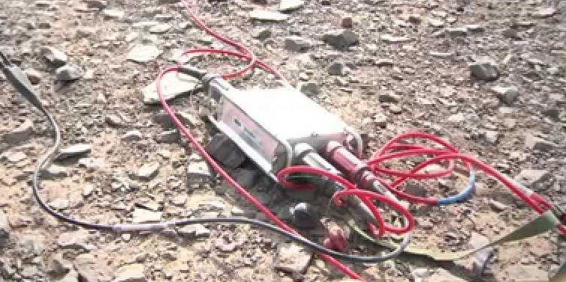
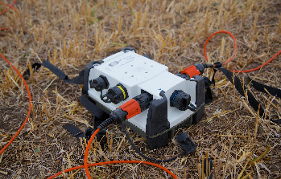
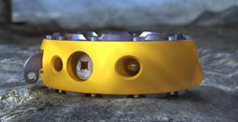
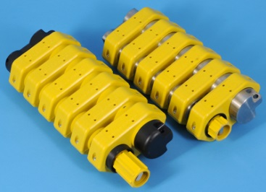
Special Considerations Mixed Systems
SYSTEM INTEGRATION USING SAME MANUFACTURER :
Land
INOVA. Hawk with G3i HD
Sercel. Unite with Sercel 428 o 508
Offshore and Transitional
Fairfield Nodal. Z LAND with Z100
Geospace Technologies. GSX, GCX with OBX
SYSTEM INTEGRATION USING DIFFERENT MANUFACTURER
All, but considering certain characteristics (i. e. Preamp, Filters,
Recording Format, Aux channels, GPS Synchronization, etc.)

Slide 62
Field Experienced Nodal Systems
MANUFACT. | GTI | Innoseis |  | Geoseis Services | Seismic Inst. | World Sensing | I-Seis | Sercel | Wireless Seismic | INOVA | Autoseis | Fairfield Nodal | Geospace Tech.
SYSTEM | Nuseis | TremorNet Smart | TremorNet Blind | Scout | U Node | SRU | Sigma | Unite RAU eX | RT 2 | Hawk | HDR | ZLand II | GSR / GSX | GCX
Experienced | NO information | NO information | NO information | NO information | √√ | √√ | √√√ | √√√ | √√√√ | √√√√ | √√√√ | √√√√√ | √√√√√ | √√√√
CONSIDERATIONS:
Channel count (100, 1,000, 10,000 ).
Area type
Type of Acquisition

Slide 63

Future of
Nodal Systems

Slide 64

Taking Advantage of New Technology
Reduction in the size of the instruments
Latest technology in GPS receivers at a lower cost
Greater data storage capacity at a lower price and size
More reliable equipment
Lower power consumption
Less weight
New battery technology allows for faster recharge, longer charge and life
Newer radio frequency communications (WiFi, MRN, Blue Tooth, etc.)
“We cannot jump into a new era of seismic imaging with new technology
if we continue with traditional seismic methodology. "

Slide 65
Future of Nodal Systems
More than half a million channels of nodal systems have been sold in recent years.
It is common to see 10,000+ channels nodal crews operating in the U.S.
Many exploration companies that have experienced nodal systems are gradually replacing their cable systems with nodes, and have no plans to return.
The acceptance of nodal systems is increasing rapidly.
Majority of new CAPEX spending is earmarked for cable-less systems in U.S.

Slide 66

Market Share and Costs

Slide 67

Nodal Systems Estimates
Consider whether the following will be included in the package to compare prices between systems:
Batteries
Sensors
Peripheral Equipment (i. e. battery chargers, HHT, WiFi network, etc.)
Software
Trailers and generators if applicable.
Software license if applicable
Energy Controllers and interface cables
Technical support during the years of use including software updates.
Guaranty

Slide 68
When to buy a Nodal System
Bright ideas often come from budding new companies, however buyers base decisions of high investments on needs of support by established companies, whose continuity should not be a concern.
The decision to buy a big channel count nodal system may force a buyer to commit to a single vendor.
The country of manufacture, and vendor’s repair centers, should be considered when thinking about system technical support; but above all, proper maintenance is key for the life of the system.
History dictates that a system supported with quality technical care and maintenance can yield over ten years of utilization; however, that time frame may decrease significantly due to emerging technology and lower price points on product.
“Today, tomorrow’s technology makes yesterday’s technology obsolete"

Slide 69
Nodal Systems Current Market Share
GSR/GSX/GCX. Manufactured by Geospace Technologies in USA.
Ranks first on channels sold.
Unite. Manufactured by Sercel in France.
Ranks second on channels sold.
Sigma. Manufactured by I-Seis in USA.
Ranks first on systems sold.

Slide 70
Cost Considerations of Nodal Systems
“Blind" nodal systems generally are more efficient and more economical.
In some projects seismic crews recording with big channel count using “Blind” or “One-eyed” Nodal systems have been adding either a small cable systems or small “20/20” Nodal systems to complement the QC .
Low quality sensors have evidenced more trouble meeting specifications over time.
“All factors must be weighed when a system is purchased. In general,
the benefits are highlighted prior to purchase and pitfalls learned after that. "

Slide 71

Conclusions

Slide 72
CONCLUSIONS
Given the history of growth to date, we can see how nodal systems will continue to advance in the industry, benefitting all facets from the contractor to the field worker in areas of cost to ease of use. It is also clear to see the nodal systems jump ahead from an alternative system to a favorite choice for these reasons. (Many cabled or hybrid combination systems remain design options per specific target areas or client driven).
Operations with 100, 1000 or 10,000 channels are handled differently in all stages of the cable-free spread.
Manufacturers talk about the ability to reach high channel counts with their wireless systems, but only a few have experienced successful continuous 10,000 channel recording numbers using nodal systems.
“ It is ironic to say that the main issue of the cable systems are cables and cable-less systems contain cables "

Slide 73
CONCLUSIONS
“Shooting Blind”
We agree that the excellence of acquired data is divided by the quality of source and its reception, passing through the acquisition including recording units, cables, and the method of deployment in the field. Everything under the foundation of adequate geophysical parameters.
If the choice is nodal for acquisition, with a good count on field proven data reliability of 98-99%, adding better quality due to the reduction of CMRR and cross-feeding, minor static, thunderstorms and transmission errors. More time can be spent on planting sensors properly.
If we consider the Signal to Noise Ratio as the primary data quality factor and if the dominant noise in the area is random, having a system that displays the noise level in real time would be the solution (though this does not guarantee noise will not be recorded). The best solution will be to bury sensors. This eliminates random noise problems with wind, rain, coupling and other variables, resulting in quality data even the most skeptical QC person can’t ignore.

Slide 74
CONCLUSIONS
Potential problems. Recall that cables, connections and radio communication problems were the most common problems in the past. The problems have been more exposed to large seismic groups and / or when a system has not been given proper maintenance.
The continued reliability of the nodal systems has helped garner its acceptance in the industry.
The ability to bury the equipment is important for concealment, but the data quality output is equally as important.
QC Status. Obtaining QC status in real time does not mean that spread will be fixed immediately. While the repair of a cabled system spread begins with the recording system going outward, a Nodal system operates from the time of deployment and later in zones.
“If we avoid past problems, we will have an echo in productivity”.

Slide 75
CONCLUSIONS
An important feature for many buyers is that the system be easy to handle, a plus when combined with other systems.
When comparing the technical specifications of the nodal systems, besides the available internal and external tests, we found slight differences in each, however certain technical characteristics may have greater impact over others in making your final choice.
Some colleagues or companies not familiar with Nodal systems consider that the data quality with such systems is missing. The bottom line is how quality control is carried out and trusting the reliability of the product.
"The best data quality acquired that I've seen in my life has been with the use of a nodal system.“

Slide 76
Bibliography
http://www.fairfieldnodal.com/assets/media/pdf/ZLand-1C-typical-specs.pdf
http://www.fairfieldnodal.com/assets/media/pdf/ZLand-3C-typical-specs.pdf
http://www.fairfieldnodal.com/seismic-systems/zland-operation
http://www.geospace.com/product-listings/geophysical-products/
http://geophysicaltechnology.com/
http://www.geoseis.tn/en/equipments/cableless-seismic-data-acquisition-system-scout/
http://www.globalgeophysical.com/content.aspx?cid=282
http://http://www.innoseis.com/
http://www.inovageo.com/images/stories/resources/Hawk-Datasheet.pdf
http://www.inovageo.com/products/hawk.html
http://iseis.com/documents.html
http://www.seismicinstruments.com/downloads/brochures/UNodalFlyer.pdf
http://www.sercel.com/products/Pages/land.aspx
http://www.sercel.com/products/Lists/ProductSpecification/Unite_brochure_Sercel.pdf
http://www.sercel.com/products/Lists/ProductSpecification/Unite_Specifications_Sercel_EN.pdf
http://www.wirelessseismic.com/
http://www.wirelessseismic.com/technology/technical-overview
http://www.worldsensing.com/ftp/Products/Sn_Brochure_A4_EN_140228.pdf

Slide 77
Bibliography
http://assets.geoexpro.com/legacy-files/articles/Cable-free%20Freedom.pdf
http://www.geotecspa.com/documents/NEWS/Wireless_vs._Wireline_Land_3D_Seismic_in_North_Italy.pdf
http://www.spgindia.org/geohorizon/dec_2007/whatsnew.pdf
http://www.geoexpro.com/articles/2011/10/seismic-surveys-without-cables
http://www.geoexpro.com/articles/2012/10/cableless-confusion
https://www.iris.edu/hq/files/publications/brochures_onepagers/doc/NewTechReport-plus-summary.pdf
http://www.sercel.com/products/Lists/ProductPublication/Current-cabled-and-cable-free-seismic-acquisition-systems.pdf
http://www.sercel.com/products/Lists/ProductPublication/Equipment_QC_approaches_in_land_seismic_Jun15.pdf
http://www.publish.csiro.au/?act=view_file&file_id=PVv2012n157p38.pdf
http://www.geoexpro.com/articles/2012/10/cableless-confusion
http://www.geoconvention.com/archives/2015/309_GC2015_Cableless_Seismic_Acquisition.pdf
http://www.wirelessseismic.com/news/articles/item/330-cabled-versus-cableless-seismic-recording-systems
http://www.trimble.com/Infrastructure/Trimble-REF-TEK-130S-01.aspx
http://www.spgindia.org/geohorizons_vol_20_january_2015/technical_articles3_january_2015_30_12_14.pdf

