Slide 1
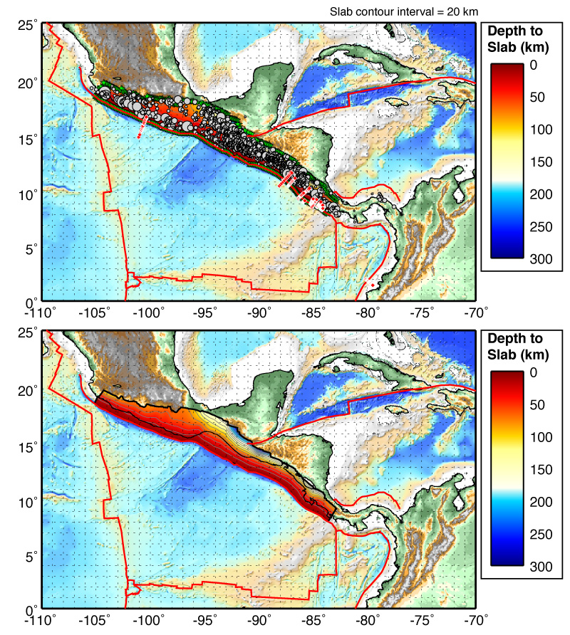
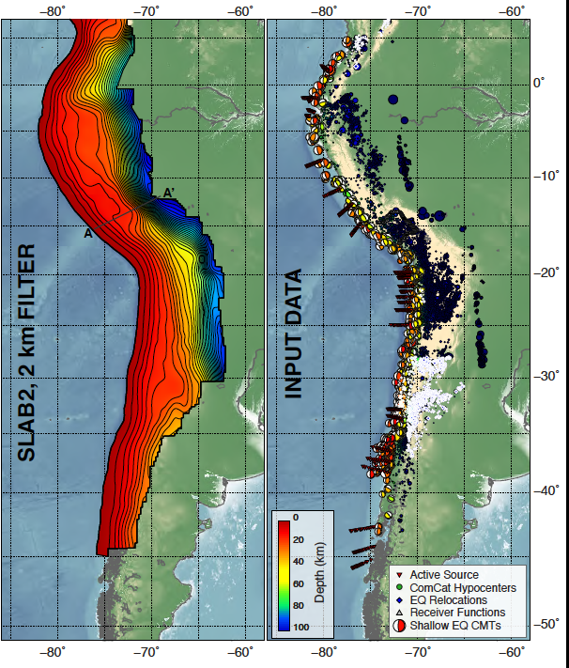
Mexico, Central and South America Subduction
Slab1.0
Susan Beck, Michael Carr, Allen Husker, Onno Oncken, Xyoli Pérez-Campos, Esteban Gazel, Frederik Tilmann, Mario Ruiz, Sergio Barrientos
Long continuous subduction
high rates of seismicity, frequent large earthquakes, tsunamis, slow slip events, creep, several areas with land over the seismogenic zone - hazards!
along strike and temporal variations in the slab dip, slab tears, multiple subducted oceanic ridges and plateaus - variation
slabs that extend into the lower mantle
320 active volcanoes, high rates of magma production
Continental crust formation and modification and deformation
Partners and ongoing subduction science to build on
Hayes et al., 2012
Slab2.0
South
America
Plate
Nazca
Plate

Slide 2
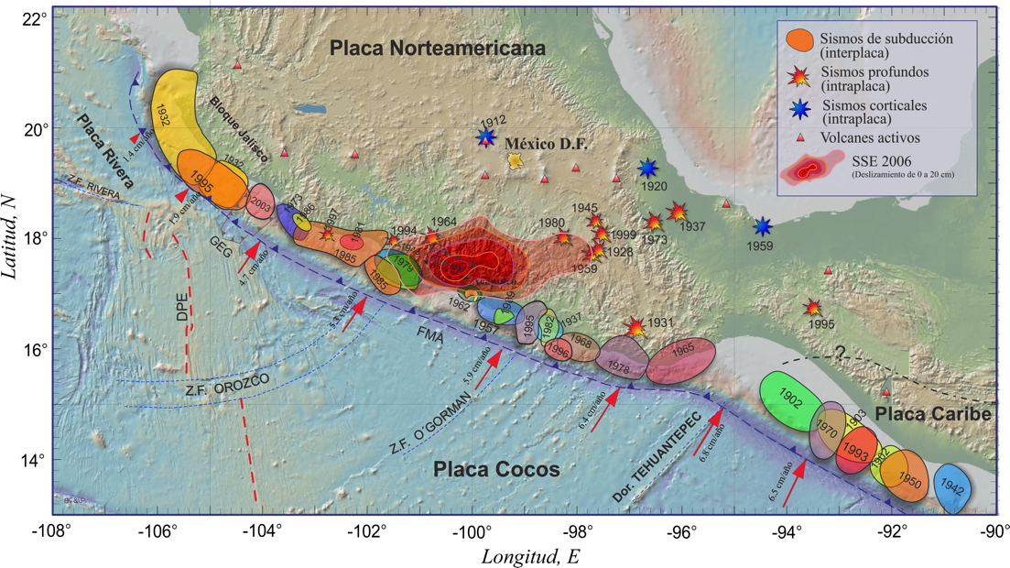
Large Subduction Earthquakes
Partially Under the Continent
Modified from Kostoglodov and Pacheco, 1999
Modfied from Ferrari et al., 2014
Space-time distribution of magmatism
Slow slip
Events (Mw=7.4)
Gap
Allen Husker

Slide 3
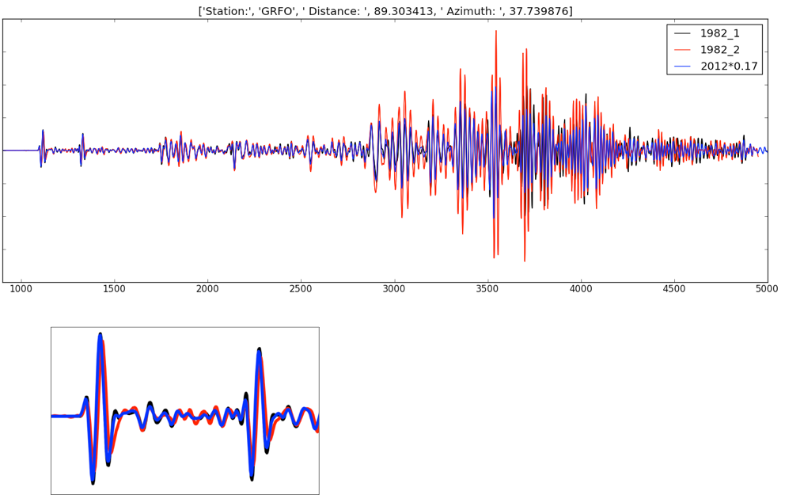
Slow, medium, and fast earthquakes,
Repeating large earthquakes
Hjorleifsdottir
Audet and Kim, 2016
Up dip segment?
Allen Husker

Slide 4
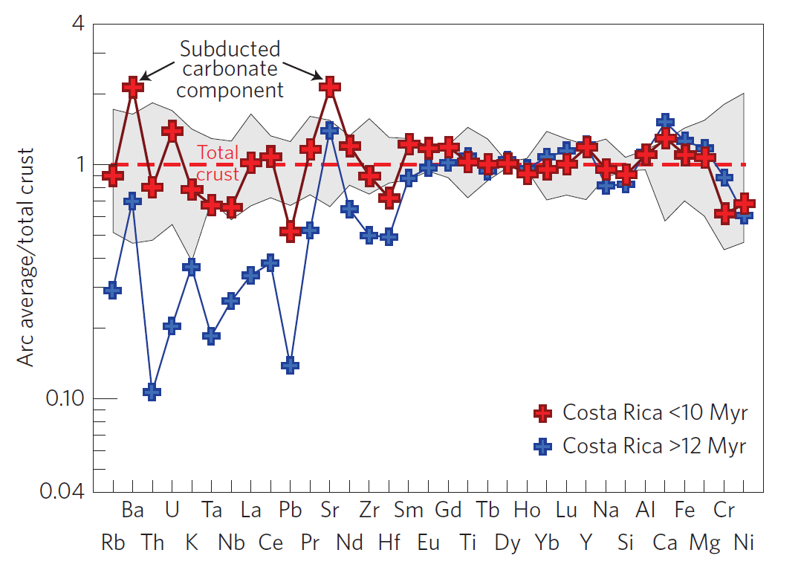
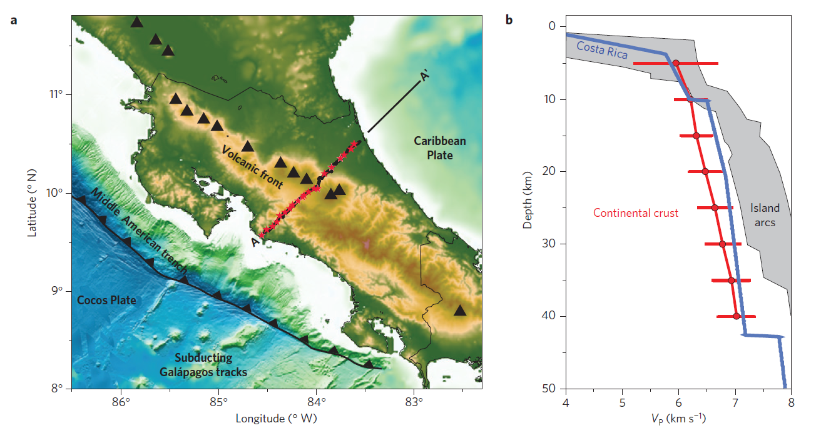
How does continental crust form?
Nicaragua to Talamanca: arc crust to continental crust.
Different segments have different compositions – opportunities to compare crustal formation with crust and upper mantle seismic structure
Arc like
Gazel et al., 2015
Nicaragua is not continental
In between
T - continental?
Michael Carr
Notes:
Gazel E, JL Hayes, K Hoernle, P Kelemen, E Everson, WS Holbrook, F Hauff, P van den Bogaard, EA Vance, S Chu, AJ Calvert, MJ Carr, GM Yogodzinski (2015) Continental crust generated in oceanic arcs. Nature Geoscience 8:321–327 doi:10.1038/ngeo2392

Slide 5
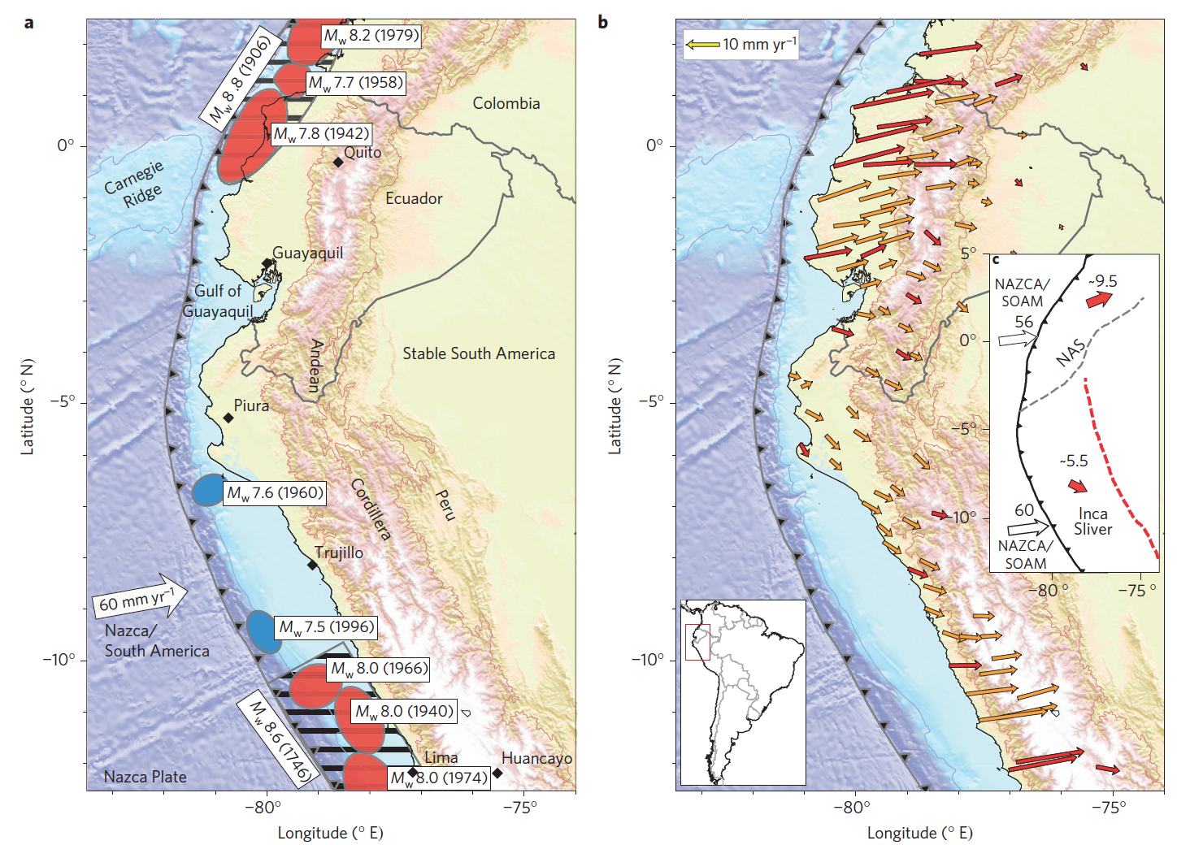
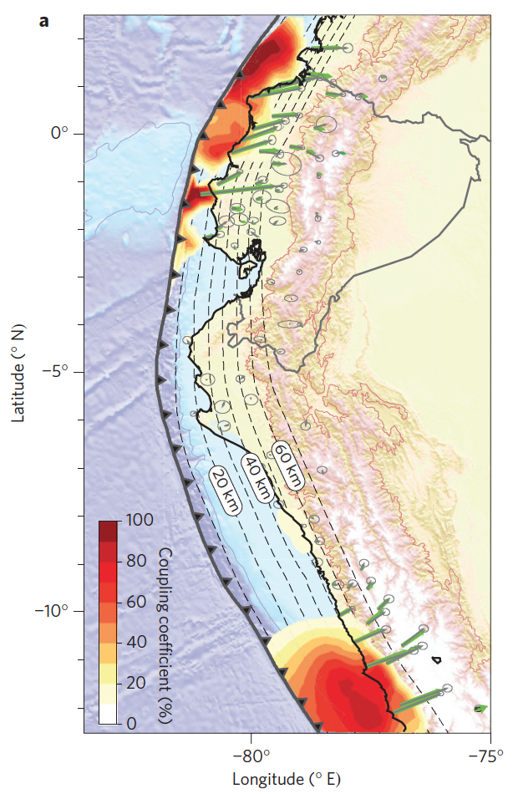
What controls the behavior of the seismogenic zone?
2016
Pedernales
Mw=7.8
1960 long duration event?
Creep?
Rupture areas of past earthquakes
Gap in large earthquakes
Up- & down-dip behavior?
Based on continuous (red) and campaign (orange) GPS data
Limited data coverage
Interseismic coupling
Why the large variations in along strike coupling?
Nocquet et al., 2014

Slide 6
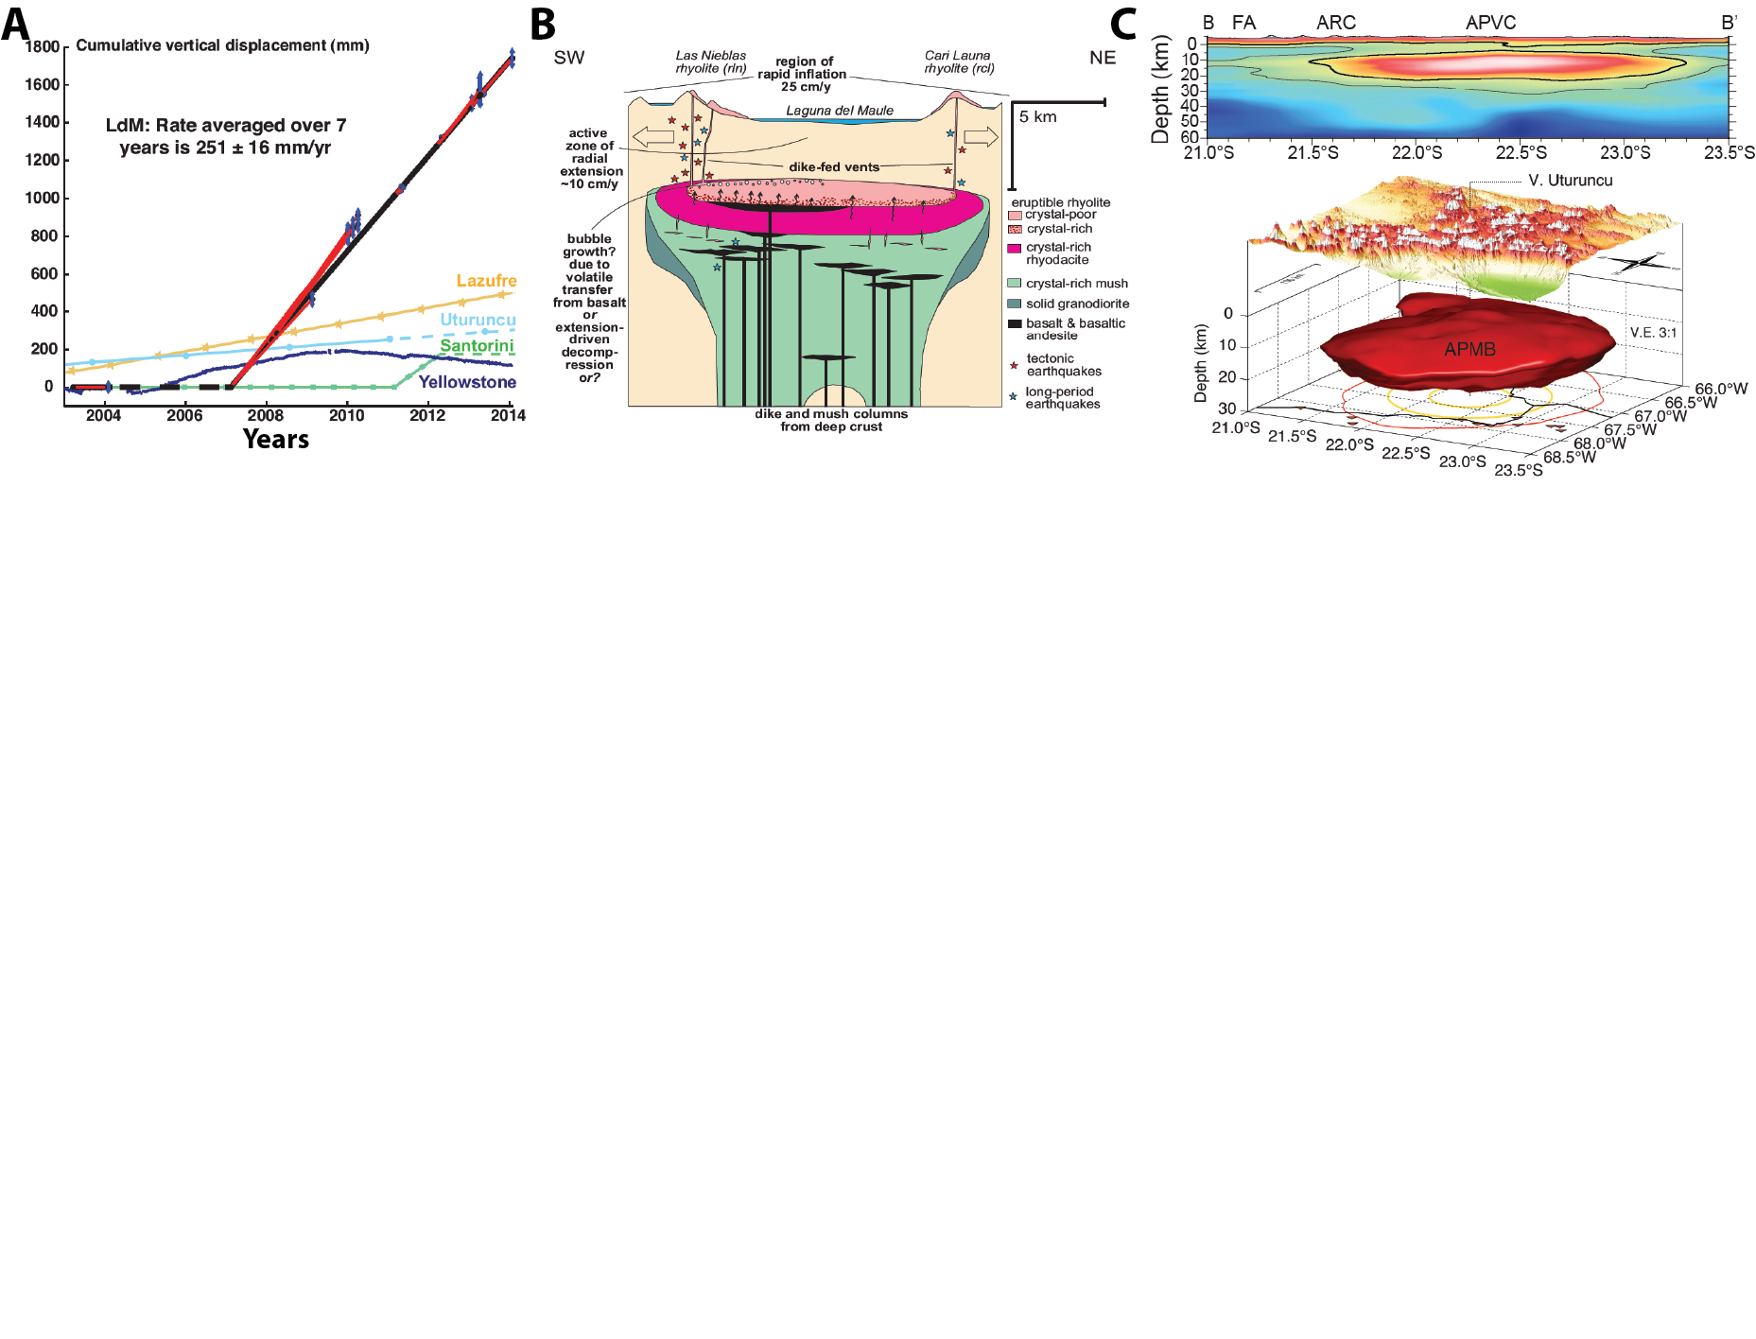
Active volcanoes and arc magmatic processes from the mantle to the surface – how does it work?
~2km/s
Uplift calculated from InSAR models between 2003 and 2014 for the large rhyolitic magma system at Laguna del Maule, Chile compared to other systems around the world (Singer et al., 2014)
Schematic diagram of the magma system for the Laguna del Maule region (Singer et al., 2014).
We need integrative data sets – seismic geochemistry, gas, MT…
Shear-wave velocity model of the Altiplano Puna Magma Body (APMB) in southern Bolivia from a joint inversion of ambient noise and receiver functions showing a very large mid-crustal low-velocity zone (Ward et al., 2014)

Slide 7
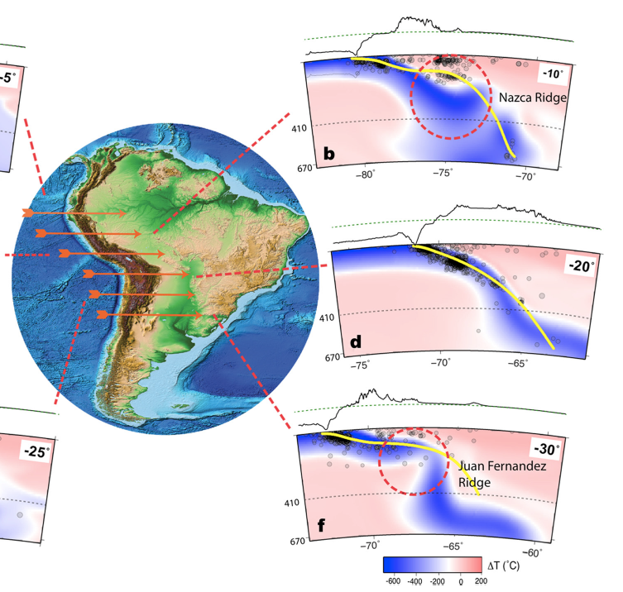
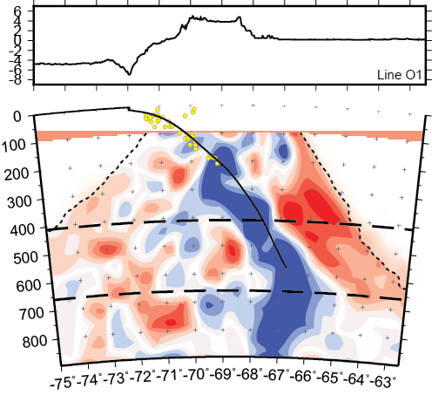
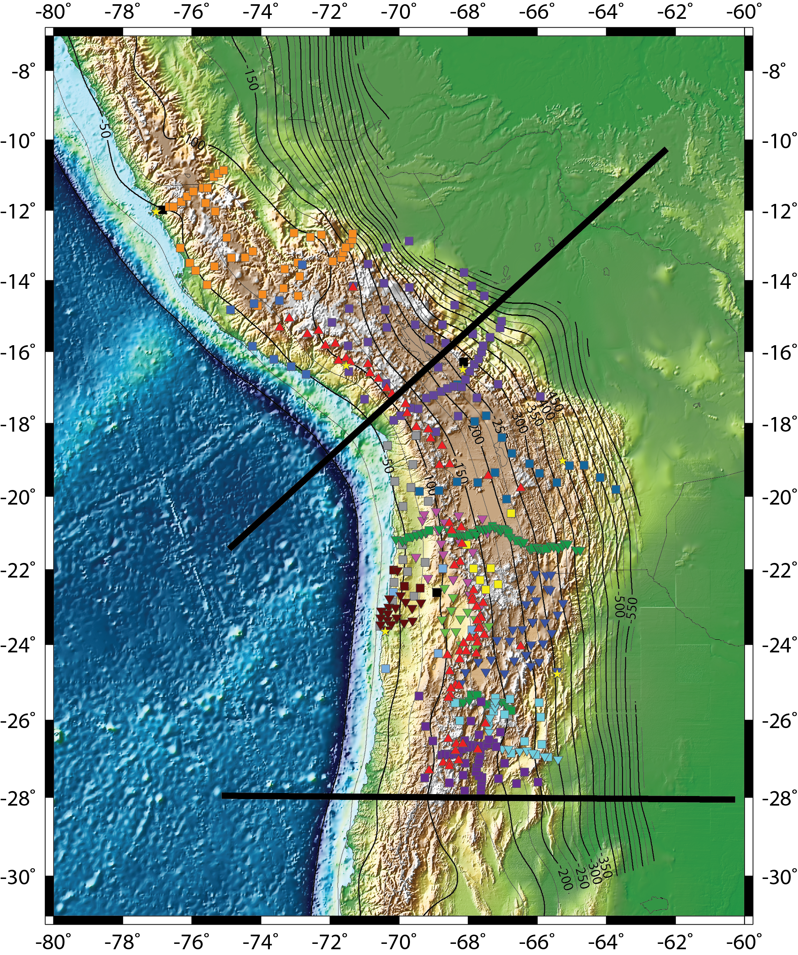
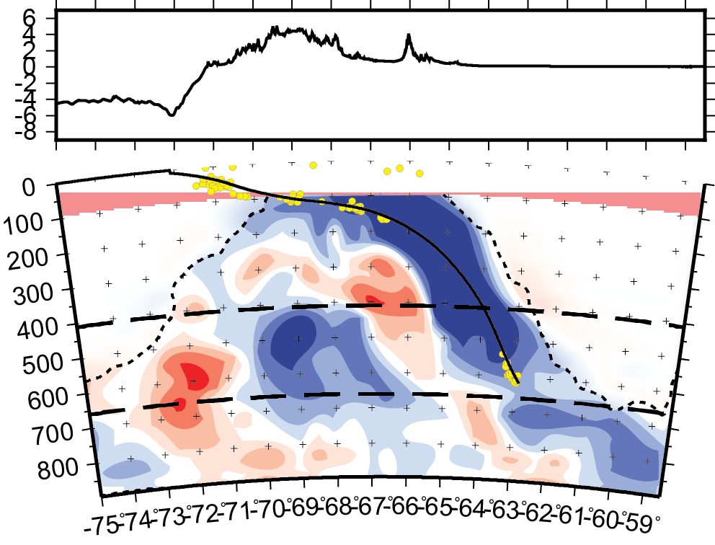
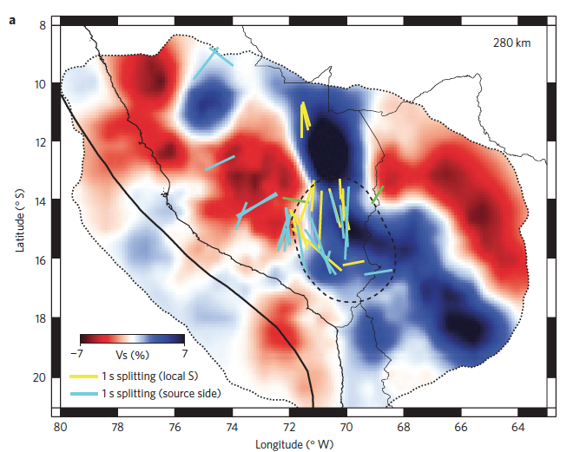
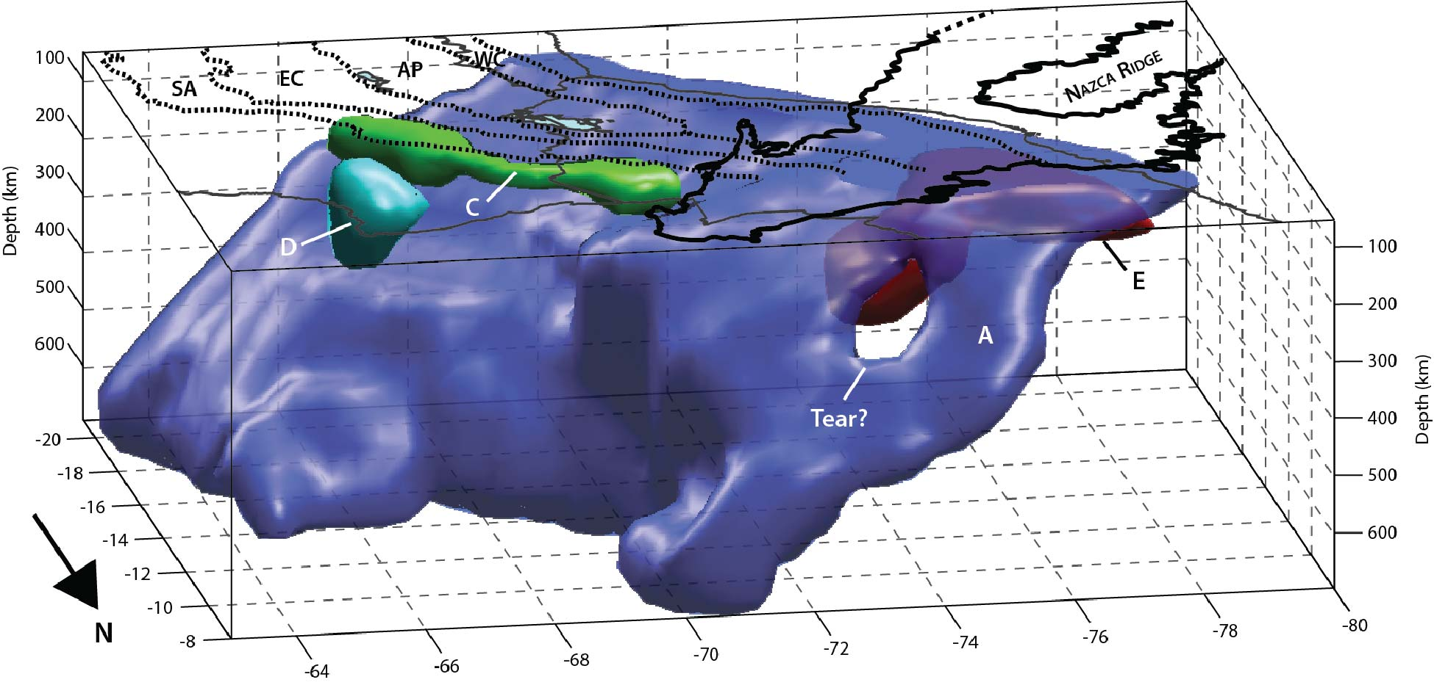
Subduction Processes – observations & modeling
P-wave Teleseismic Tomography
4D Geodynamic Models
Slabs penetrate into the lower mantle – need better data & improved techniques
Connections to the surface?
1
Northern Altiplano
1
2
2
Other anomalies below the slabs - pieces of remnant slabs (blue) and indications of water (red) in the transition zone? Anisotropy?
Anisotropy – slab anisotropy is modified from the fossil fabric formed at ridge in S. Peru
Sierras Pampeanas
Modeled thermal anomalies of the Slab in South America after 100 Ma incorporating plate kinematics, seafloor ages, and tectonic features including the buoyant oceanic crust, continental cratons & oceanic plateaus (Hu et al., 2016)
Opportunities for integrating modeling with diverse data sets
280 km
slab
Slab anomaly beneath N. Bolivia & S. Peru (Scire et al., 2015; 2016)
Shear-wave splitting plotted on S-wave slab anomaly (Eakin et al., 2016; Scire et al., 2015)

Slide 8
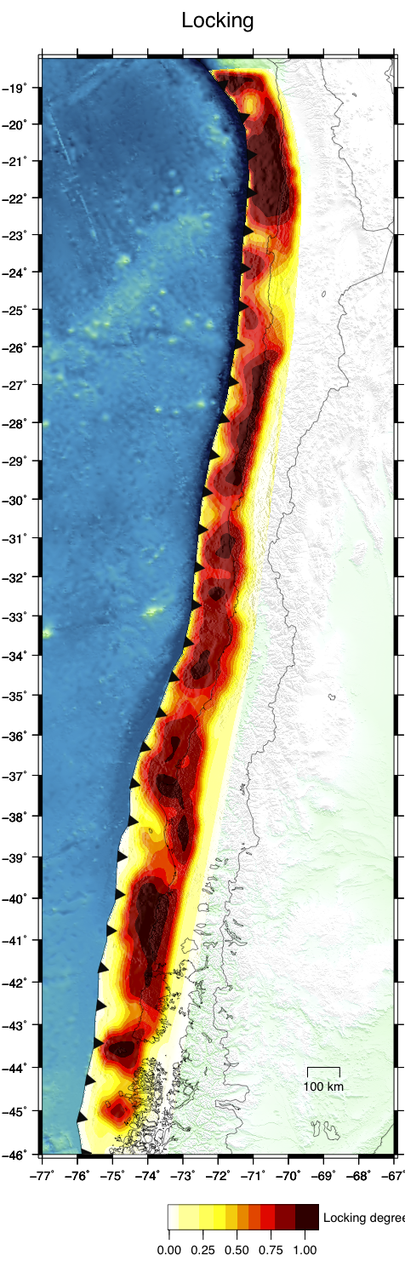
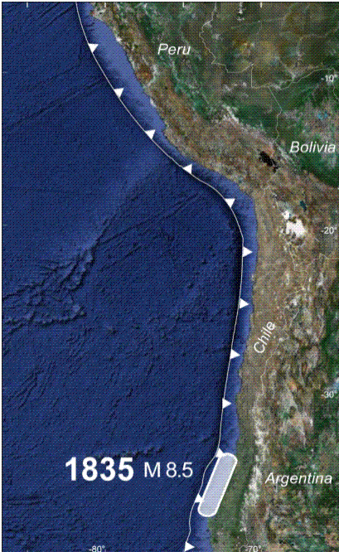
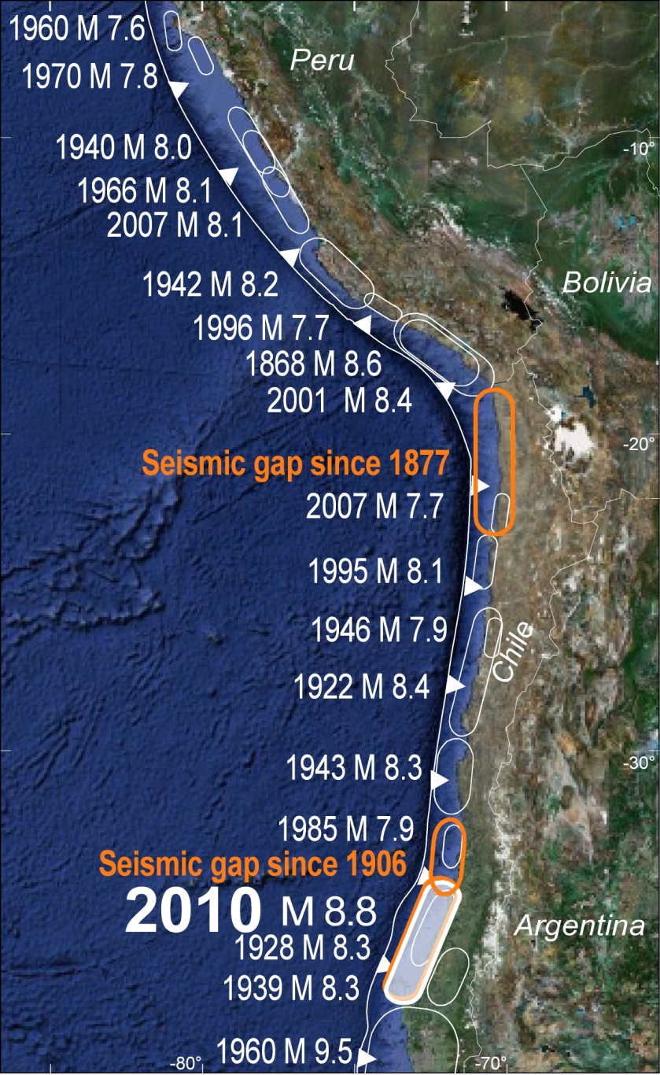
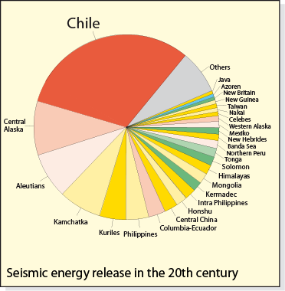
2001
Locking, earthquakes and why Chile is a perfect natural lab
1877
1995
1922
2014 M 8.1
1943
Scholz, 2002
1906
2010
1960
Moreno et al., in prep.
Ipoc-network.org
Ipoc-network.org
IPOC - Onno Oncken
>100 yrs since last event

Slide 9
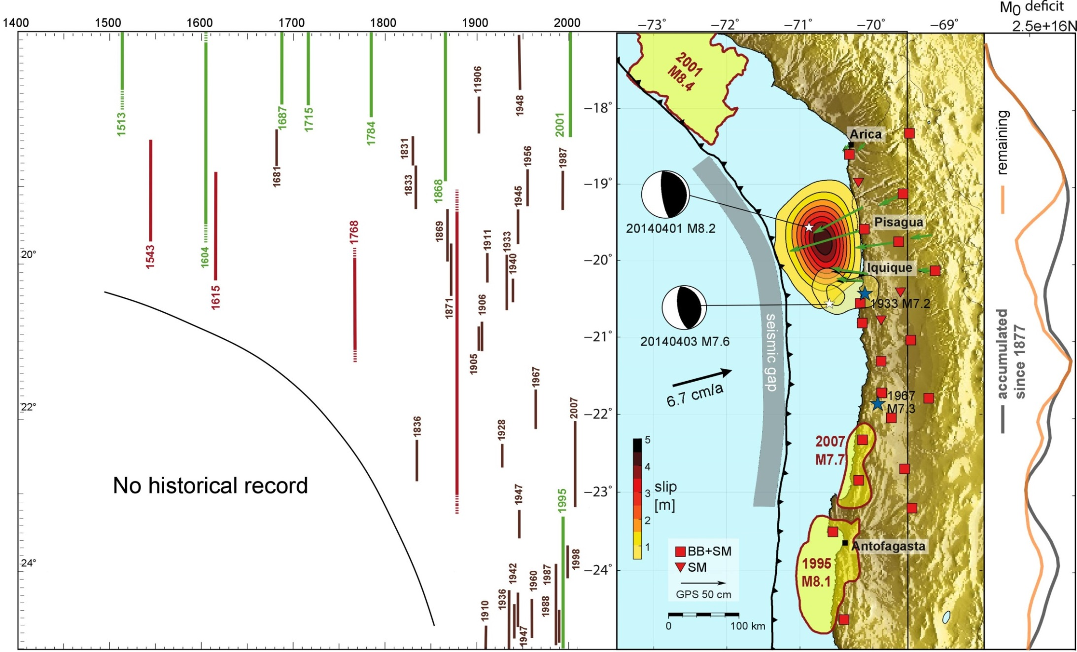
Earthquake record since arrival of Spanish
2014
IPOC - Onno Oncken
Remaining deficit equivalent to Mw=8.9
Likely place to “catch” a major earthquake

Slide 10
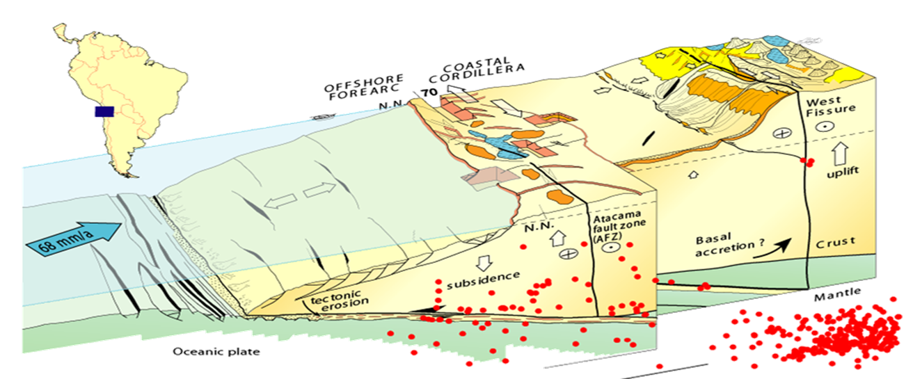
Coupling and the upper plate
Forearc
Arc
Backarc
Uplift
Damaging earthquakes
Coupling of processes in a convergent plate margin
Connection between downgoing plate, upper plate faulting, arc magmatism, fluids, backarc...
IPOC - Onno Oncken

Slide 11

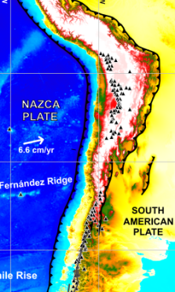
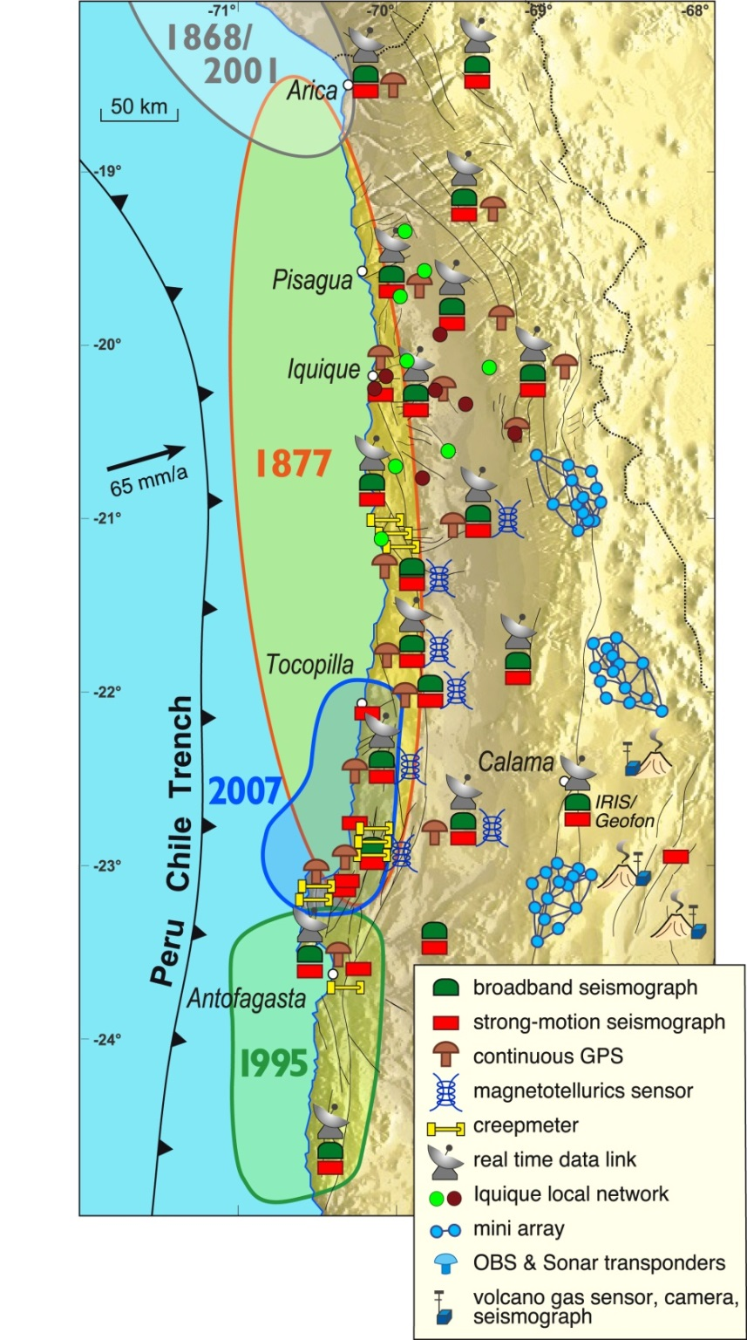
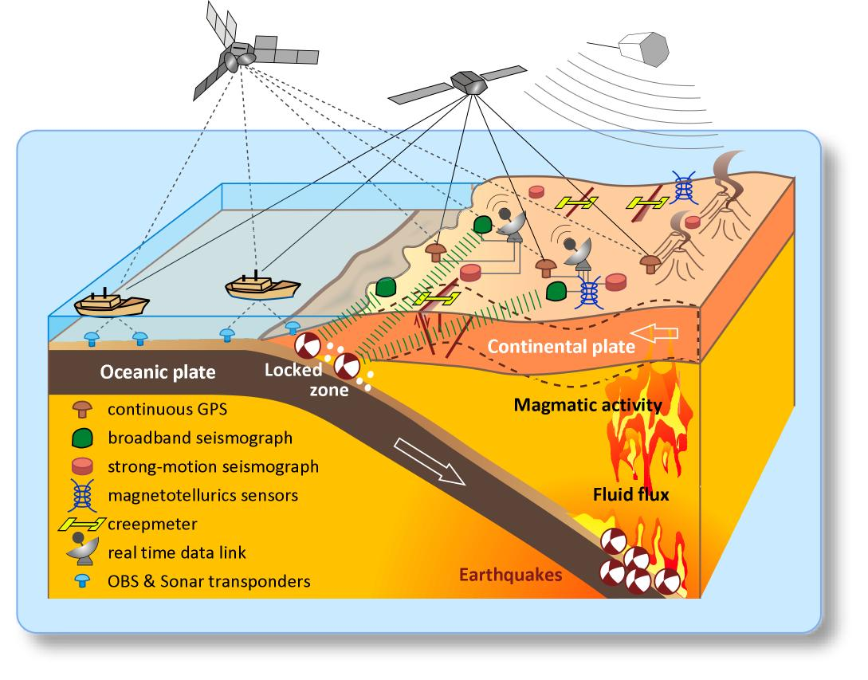










Science network IPOC
(started 2007)
Understand process interaction at plate boundary and its consequences for hazard assessment
Multiparameter Research Observatory
operated by:
  GFZ Potsdam, FU, UP, GEOMAR, u.a.
  IPG Paris, ENS, INSU, CNRS
  DGF (U de Chile),
  Chilean Seism. Survey (CSN)
  Universidad
  Catolica del Norte
  CALTECH,
  Pasadena, USA
  Pontificia Univ.
  ….
Ipoc-network.org
Onno Ocken

Slide 12
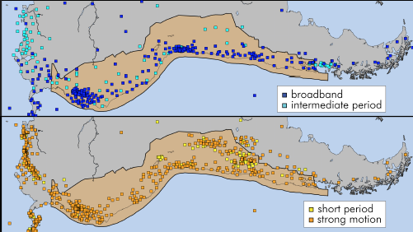
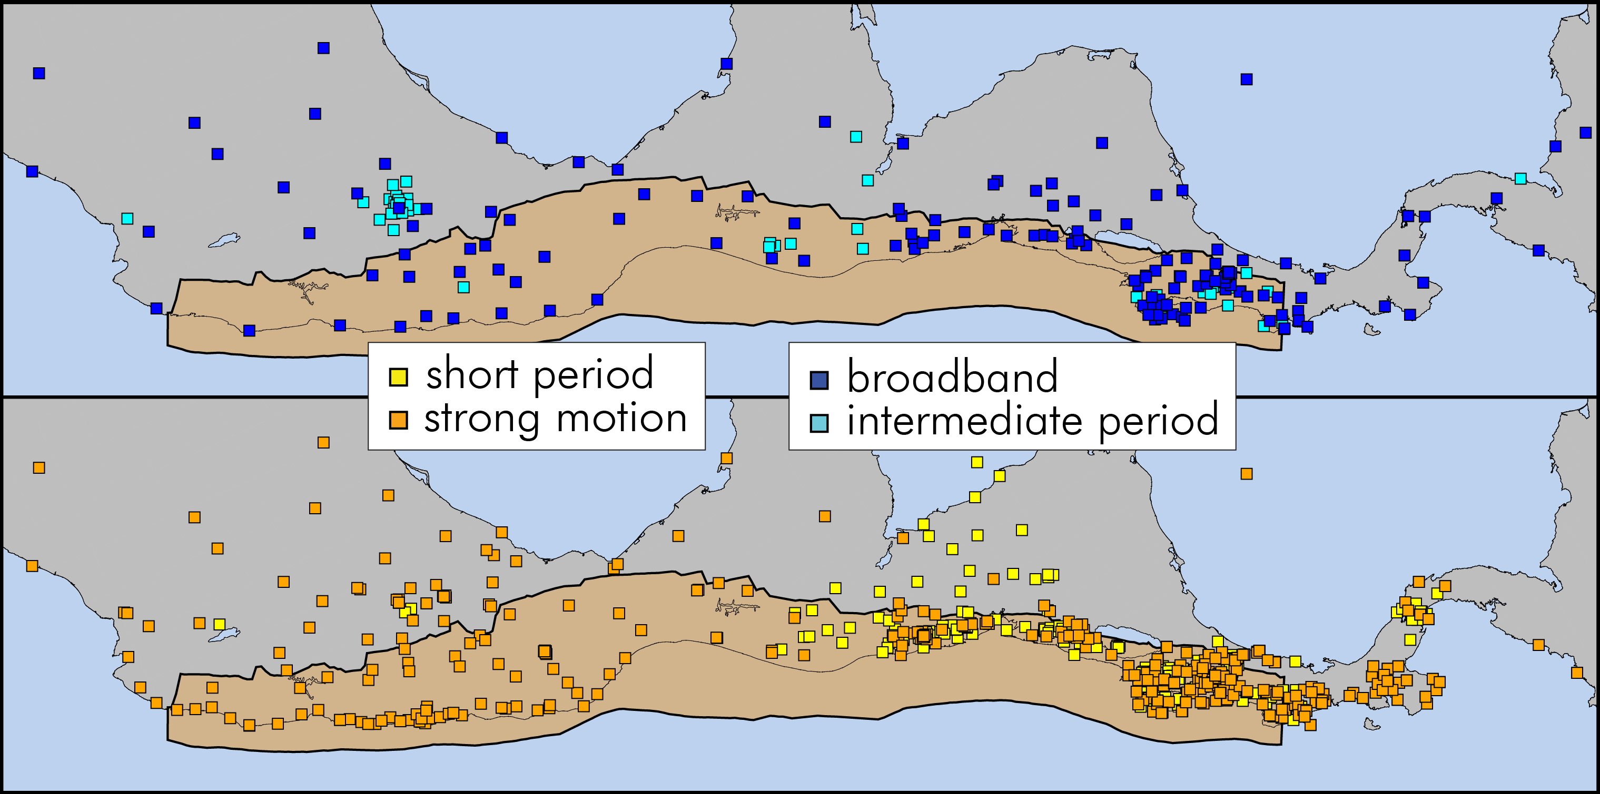
Why Latin America?
We need a suite of SZO sites in Latin America
Lots of science drivers at all scales including the entire seismic cycle
Large number people and infrastructure at risk
Large number of partners and collaborations – leverage
South America
Central America
Example of existing seismic stations in (A. Frassetto) –Data from > ~1000 seismic stations from temporary deployments - similar maps for GPS…
We need off-shore measurements!

