Slide 1

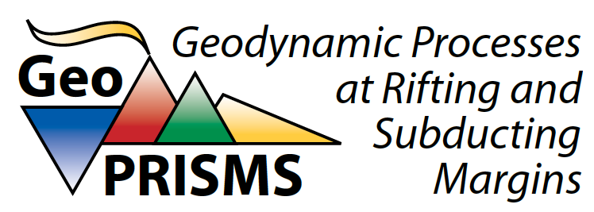
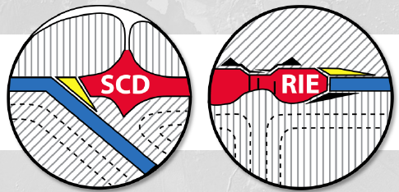
MARGINS and GeoPRISMS
Geoff Abers (Cornell), MARGINS Chair 2006-2010
occasional PI; GeoPRISMS gadfly
Focused, community-coordinated NSF programs to advance science at continental margins
Structure and Goals
  Build interdisciplinary communities, integrating lab, theory
  Cross the shoreline
  Explore active processes
  Concentrate resources at Focus Sites
  Rely upon existing NSF-supported Facilities
Science Themes (GeoPRISMS)
  Subduction Cycles & Deformation
  Rift Initiatiation & Evolution
  MARGINS: 4 related “initiatives”
Notes:
somewhere: 1st meeting in 1988! What my colleagues hear… what my friends hear… what my reviewers hear… what my chair/dean hear, etc.

Slide 2
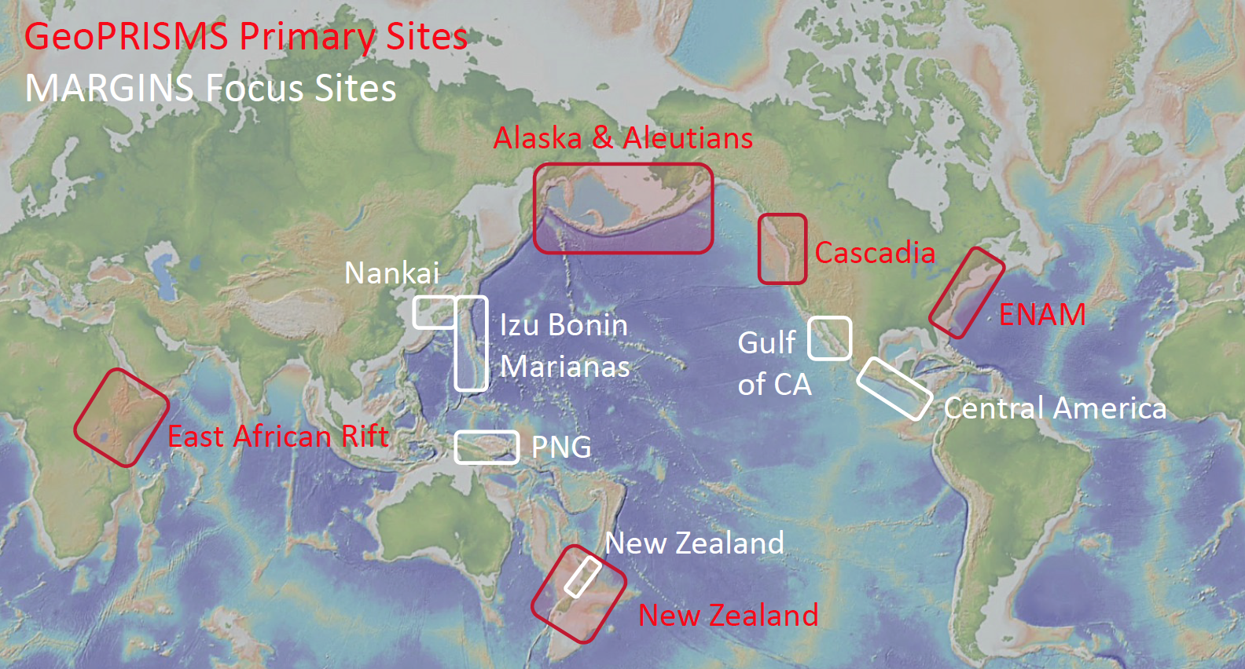
Primary sites to focus resources
map w/ boxes
SEIZE: Nankai, CentAm SubFac: IBM, CentAm
RCL: GofC S2S: PNG, NZ
SCD: Casc, AK, NZ
RIE: ENAM, EAR

Slide 3
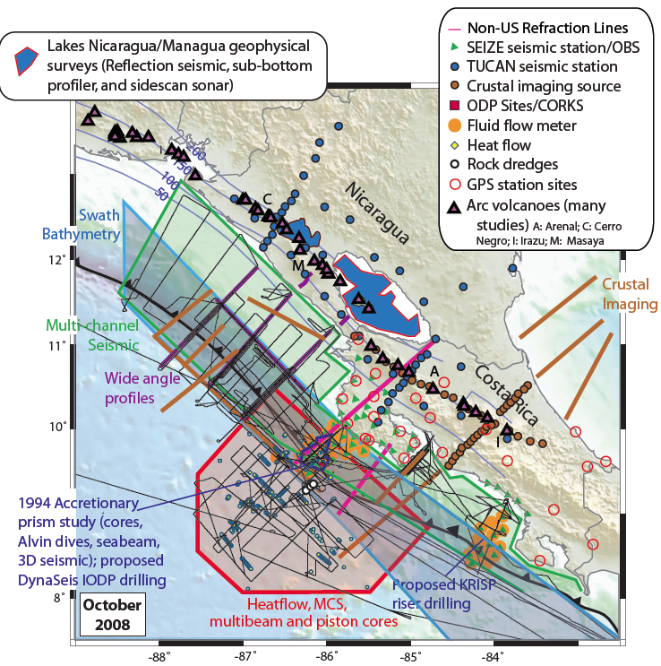
Focus on Central America (CentAm MARGINS site)
This is an example, NOT an endorsement!
41 awards, 29 projects (33% of MARGINS)
Papers 2001-2015 ++
Highlights:
  Serpentinization of the incoming plate & signature in arc
  Tremor, slip & fluid flow
  Arc deformation & bookshelf faulting
  Imaging melt pathways

Slide 4
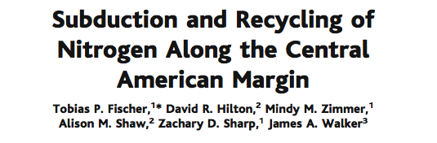
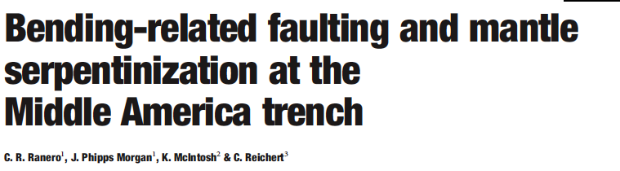
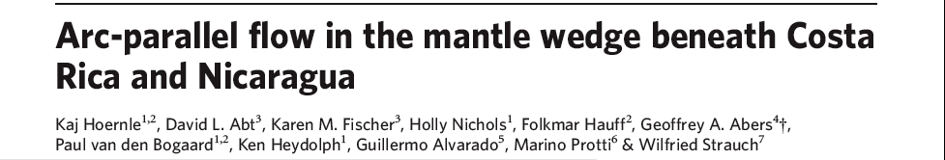
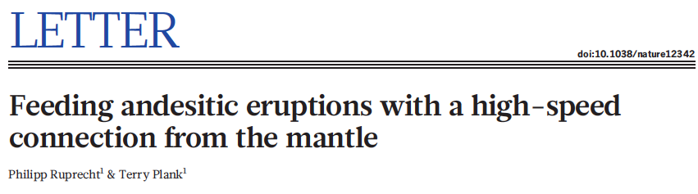
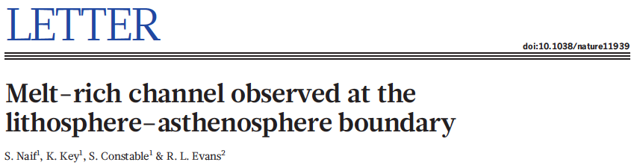
CentAm: Some Science/Nature papers related to MARGINS
International partners critical (often lead)
Integrate geochemistry, geophysics, etc.
Builds on big new datasets
Big collaborations work if worry about good science, not credit
Science, 2002
Nature, 2003
Nature, 2008
Nature, 2013
Nature, 2013
Notes:
need to be big enough to not fight over top-bill credit, but recognize that science is advancing in unique ways because of these programs

Slide 5
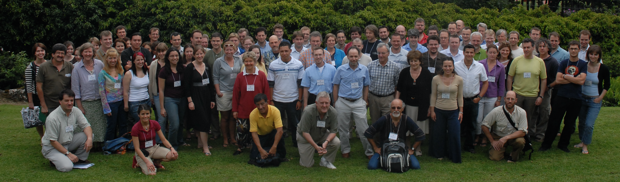
Ingredients for success in CentAm
Successful community building (especially workshops)
  Most PI’s had not worked in focus site before
  Strong interdisciplinarity encouraged
Excellent international partnerships
  Costa Rica, Nicaragua: scientific and logistical partnerships
  Germany: Kiel/GEOMAR/SFB574 parallel program
Good site choice:
  easy access to shallow thrust zone
  global variability in arc output over small area
Heredia Synthesis Workshop, 2007

Slide 6
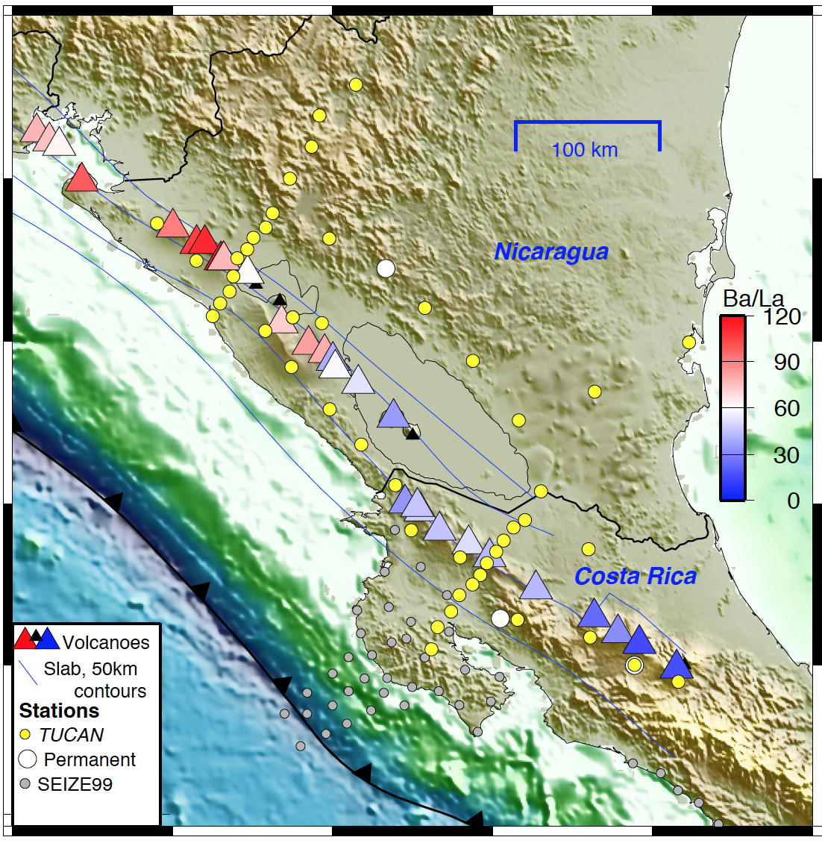
Challenges to CentAm
Coordinating timing of results
  Each project separately goes through peer review
  Some (e.g., big seismics) have long lead times
Some critical things never get proposed, or never get funded; especially data-driven followup work.
  3D imaging under volcanoes, coordinated MT & seismic
No site has everything: CentAm lacks…
  a “pristine” oceanic arc for arc growth
  a quasi-autochthonous continent
Depend on other facilities (IODP, JOI, IRIS, UNAVCO, etc.) or individual labs to supply data

Slide 7
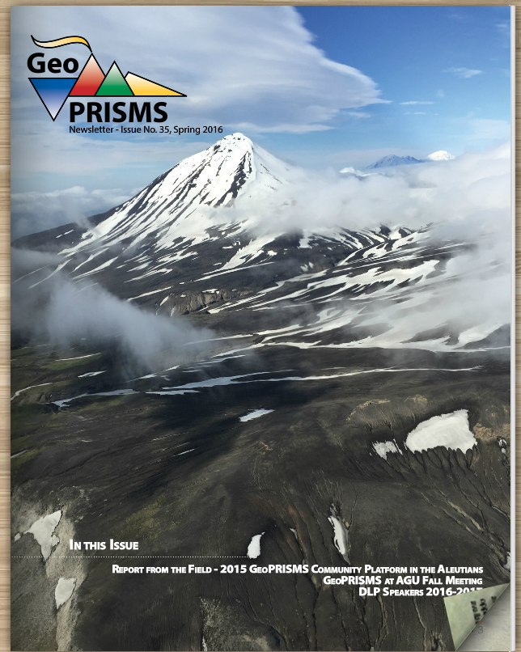
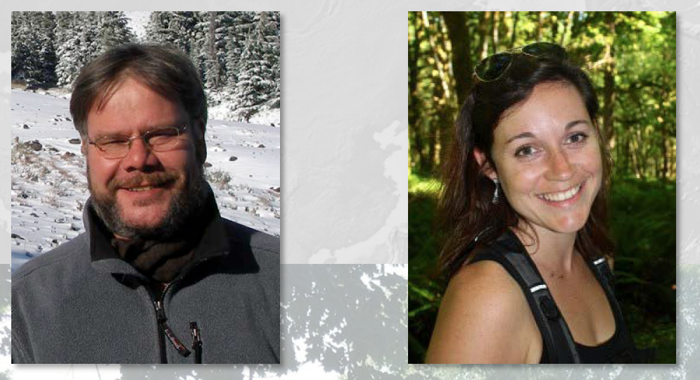
Overall Program success:
Importance of an Office & Steering Committee
Runs well-coordinated workshops that
  initially, bring people together on novel projecs
  later, bring people together for synthesis
  allow monitoring of program success
Highlight and advertise opportunities; facilitate new scientists
Document success: report on # papers, participants, PI’s, growth of community
Bridge between NSF and science needs

Slide 8
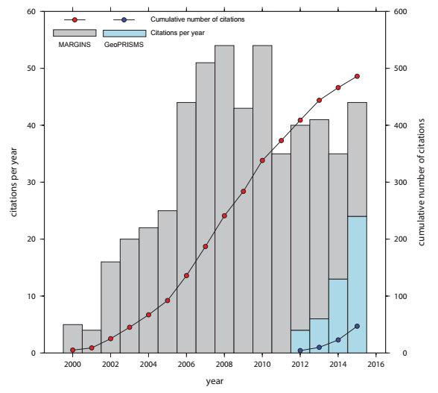
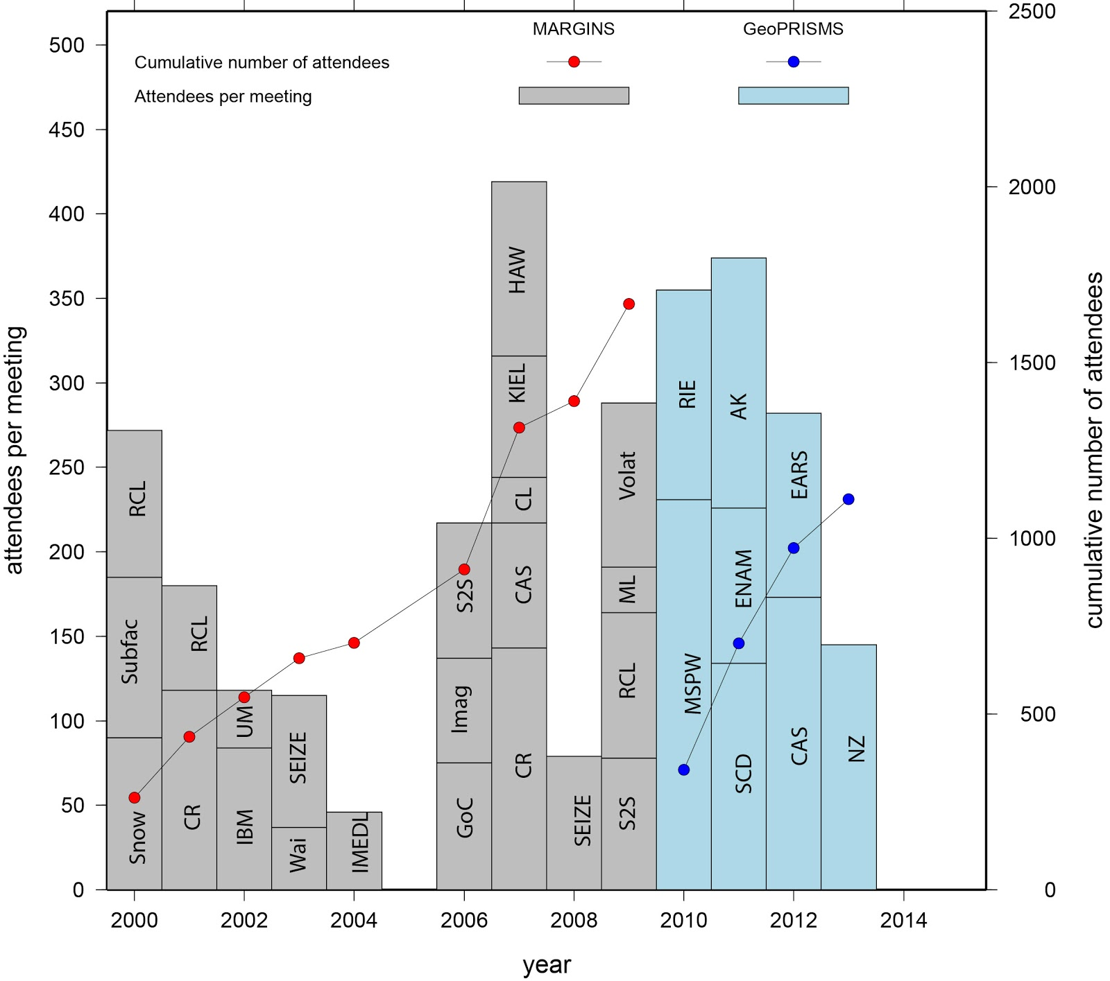
Documenting Success:
Science and community building
Publications
Workshop Participation
Unique attendees: 1001 (M) + 680 (GP)

Slide 9
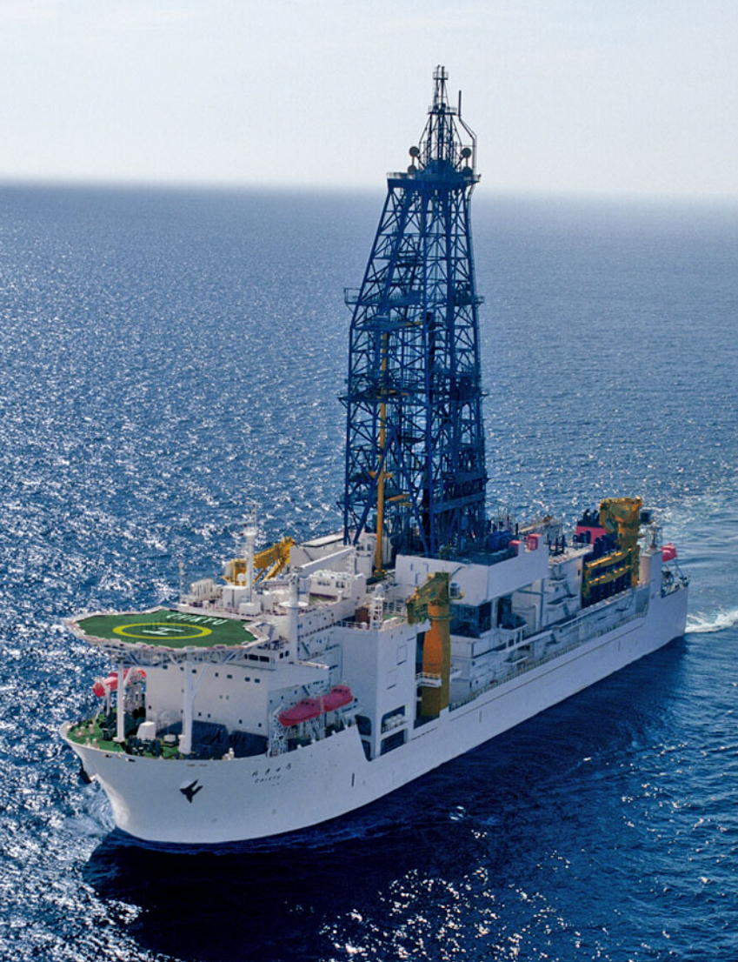
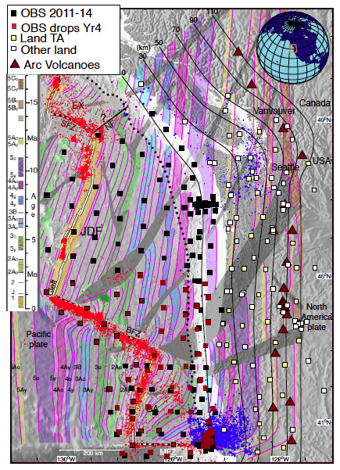
Program success:
Importance of healthy facilities
M/GP strongly leverage other investments and programs: $3-5M/yr spent only
MARGINS started during the “NSF doubling” era. Geophysical instrument pools were new; ships were being launched; new chem labs built.
We now face sequesters, aging equipment and “Sea Change” retreat from instrumenting the oceans. This has slowed GeoPRISMS and will slow SZO if not directly addressed

Slide 10
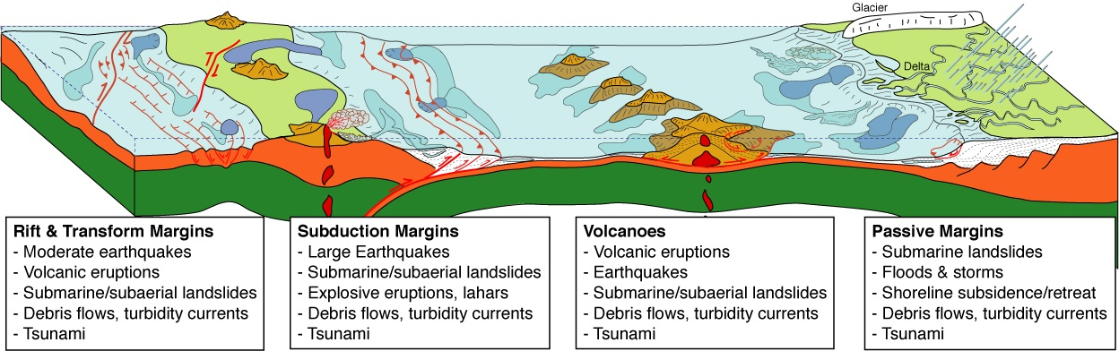
Final thoughts: Key Ingredients
Science needs to be important; low-hanging fruit can be identified early.
Building a new community of PI’s, committed to cross-disciplinary science.
Crossing the shoreline means negotiating the EAR/OCE divide, with huge potential benefits.
Engaged and enthusiastic international partners; think globally.
Integrate laboratory and modeling with data.
Focus on problems that matter – hazards, resources, ties to climate.

Slide 11
