Slide 1


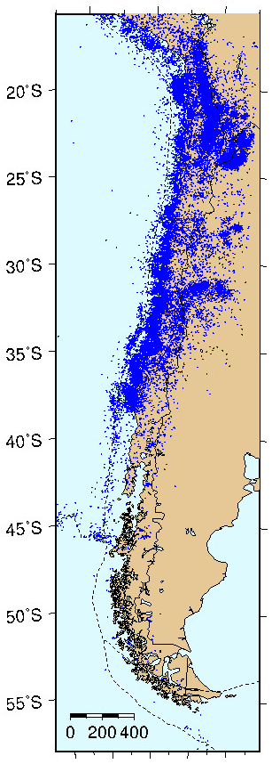
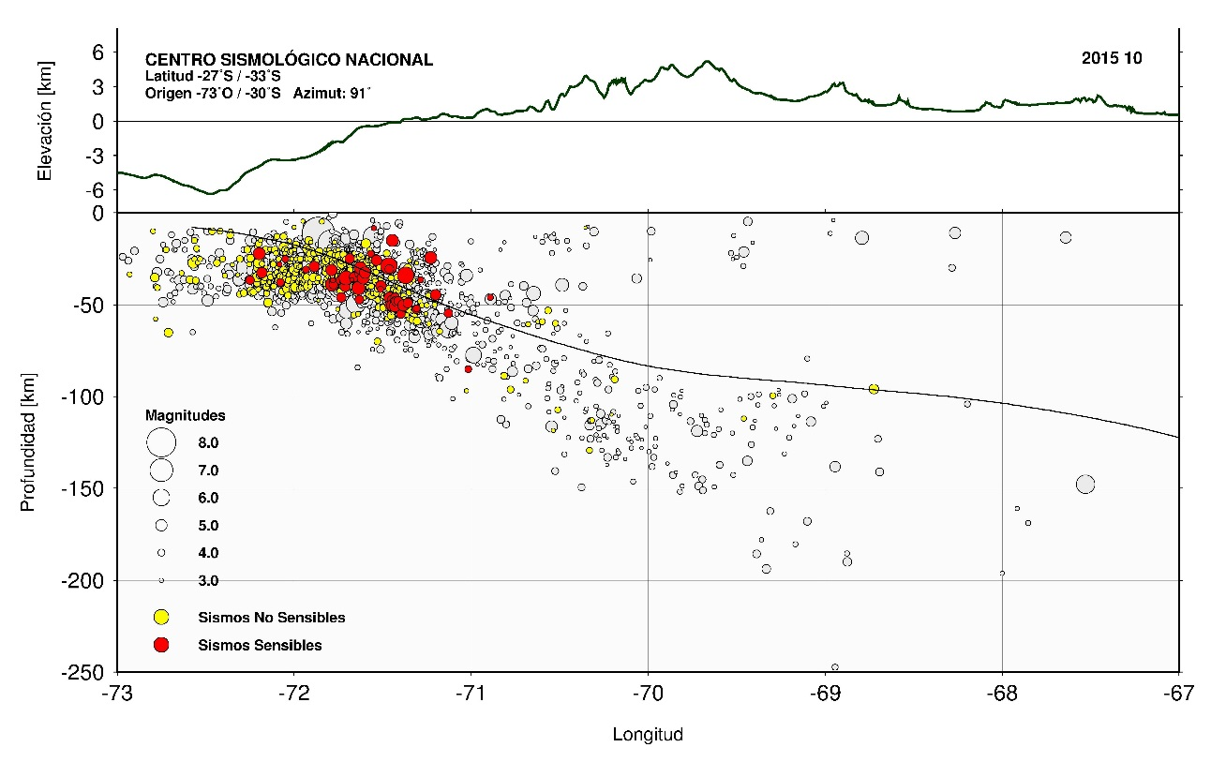
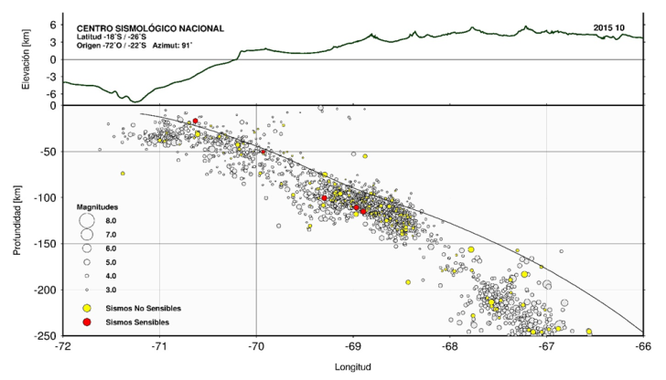
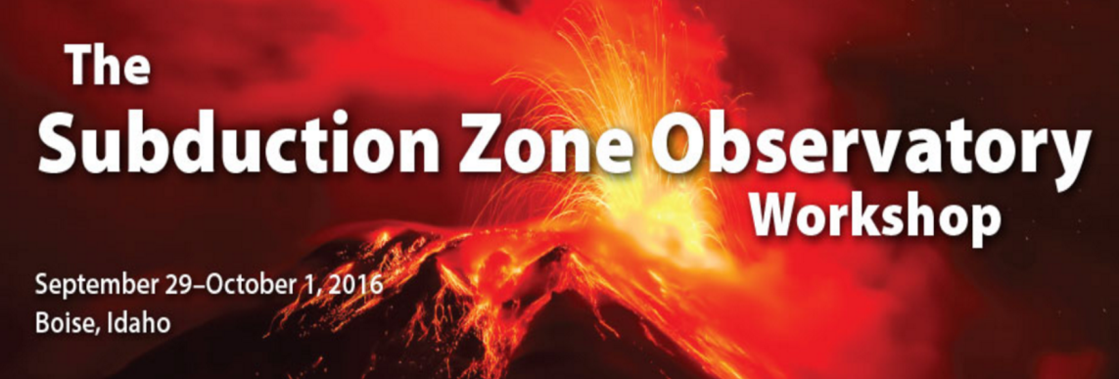
Subduction Zone Observatory Chile
Sergio Barrientos
National Seismological Center
Universidad de Chile

Slide 2
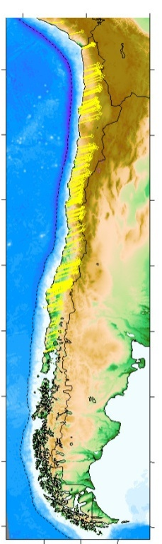
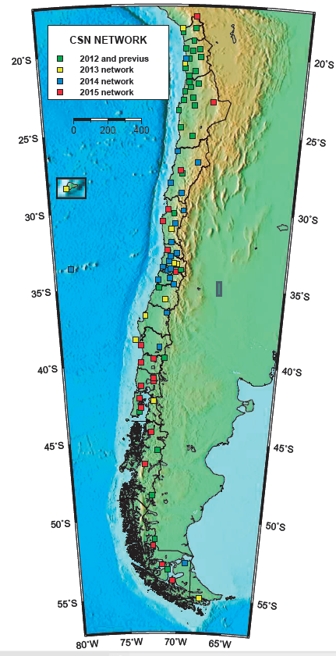
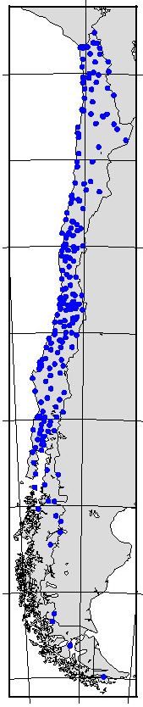
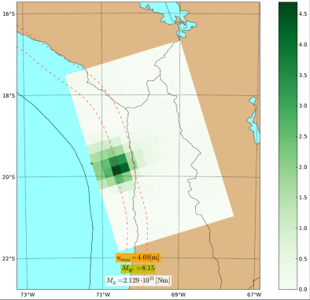
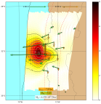
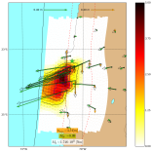
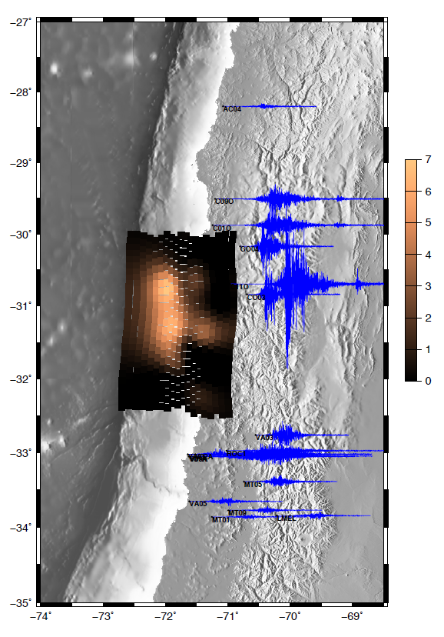
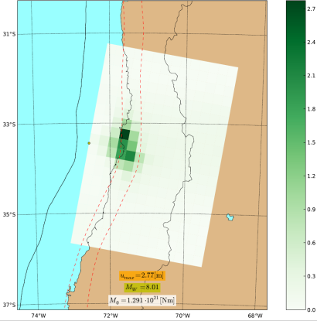
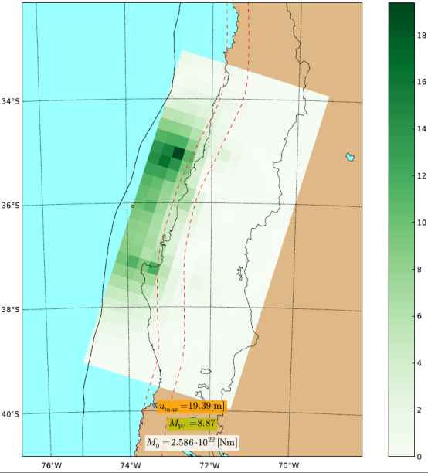
Subduction Zone Observatory - Chile
BB-SGM Strong Motion GPS
100 297 130
2014
2015
1995
1985
2010
Riquelme et al. (2015)
Mainly built for rapid response

Slide 3
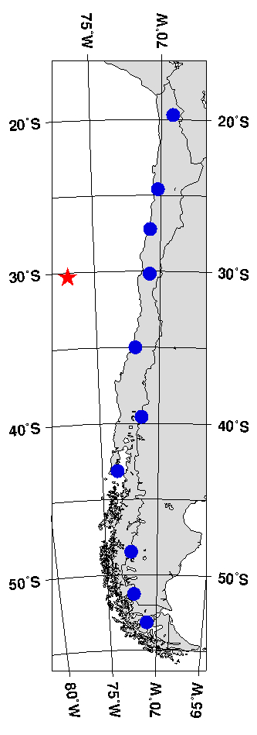
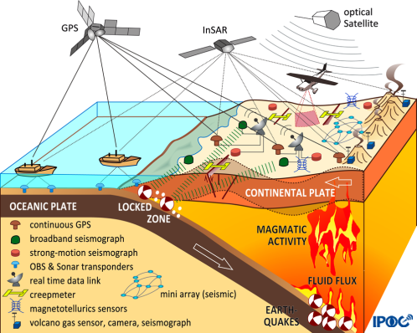
IPOC CHILE
Volcanological Network: of the order of 40 volcanoes to be monitored (Chilean Geological Observatory) OVDAS
PICTURES (Pisagua-Iquique multichannel, OBS´s)
CEVICHE (Multichannel) over 1960, 2010 and 2015 ruptures
(Trehu/Bangs White paper)
GEOMAR OBS and Geodetic experiment Iquique(Lange)
USGS: Rapid response, smartphone experiment (Brooks)
10 IRIS GRO stations

Slide 4
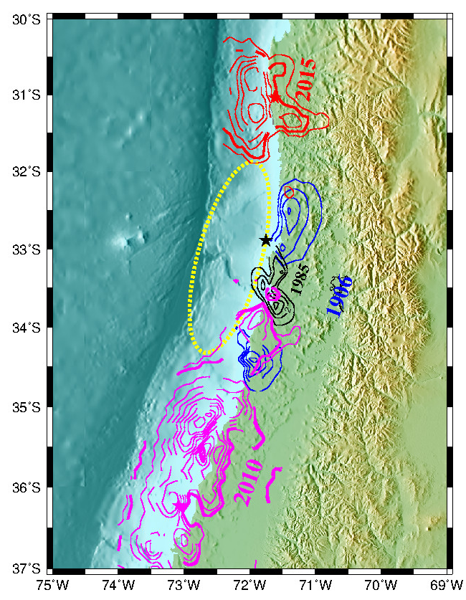
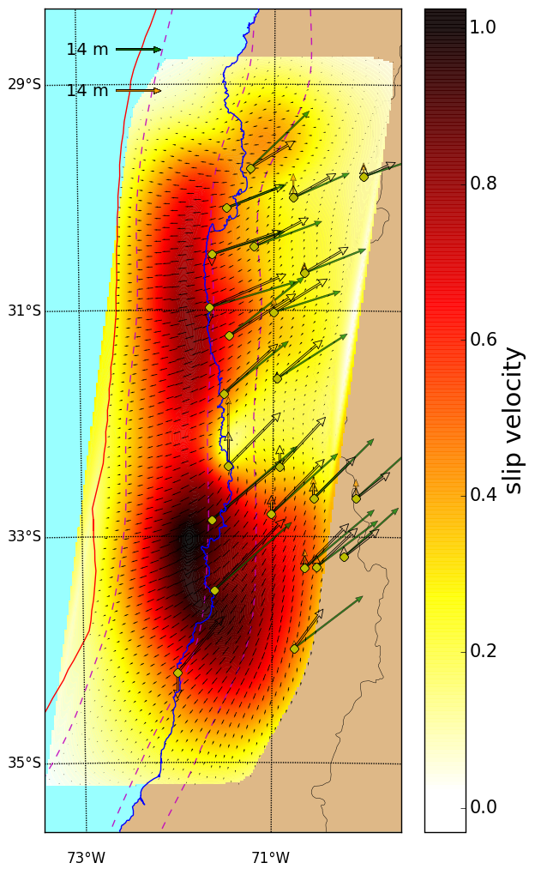
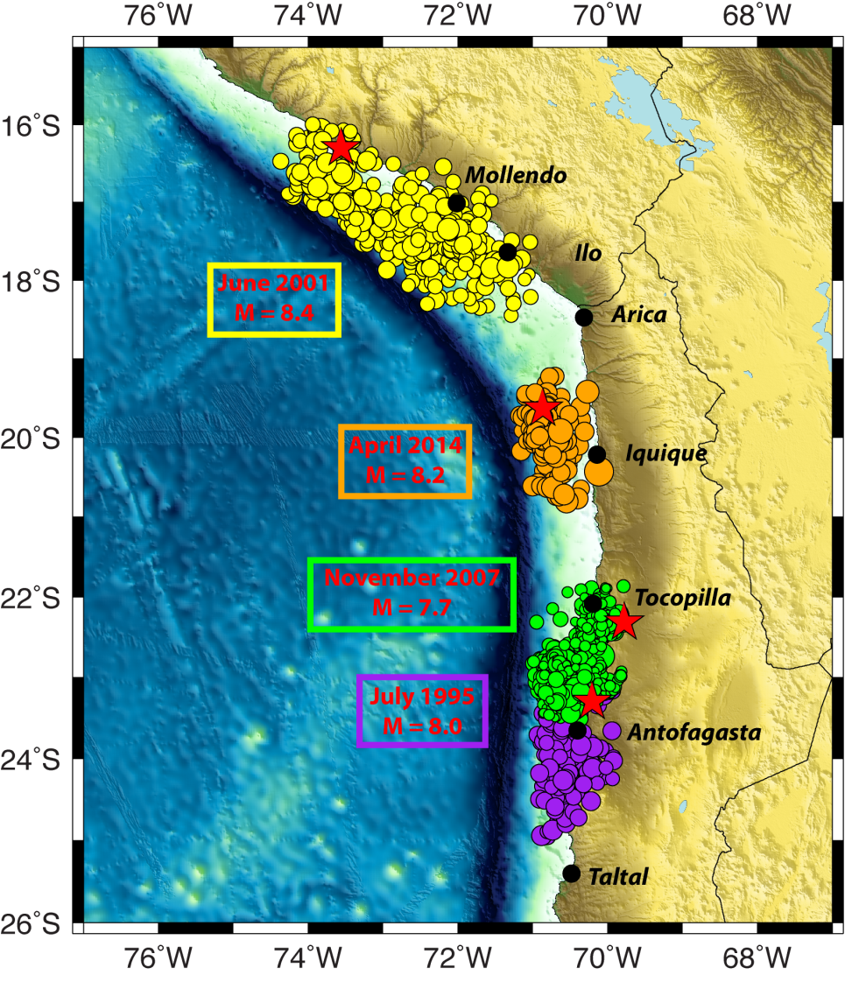
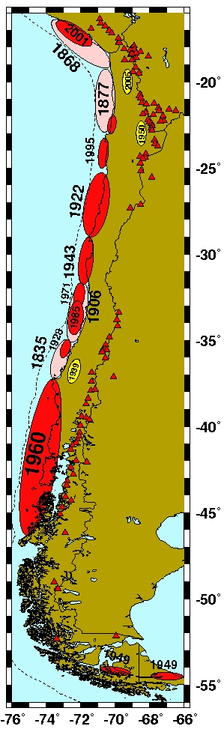
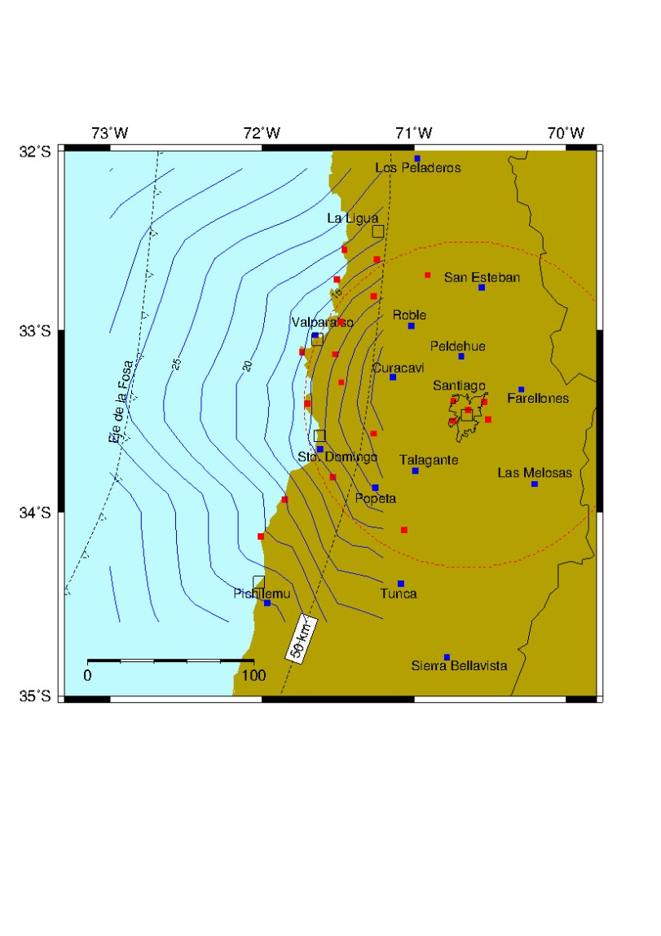
Subduction Zone Observatory - Chile
2014
S. Beck
1995
Rupture ?
Extending observation
to sea floor
EEW, Tsunami EW
1985
EEW
2010

