Slide 1
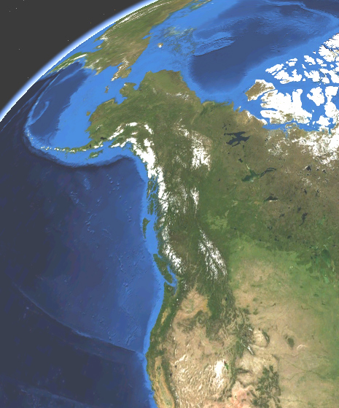
Cascadia/Alaska
Webinar
Convenors: David Schmidt
            Donna Shillington
Michelle Coombs
Other contributors: Diana Roman, Doug Toomey, Paul Wallace, Rob Witter
Held September 20th
70 attendees
7 panelists

Slide 2
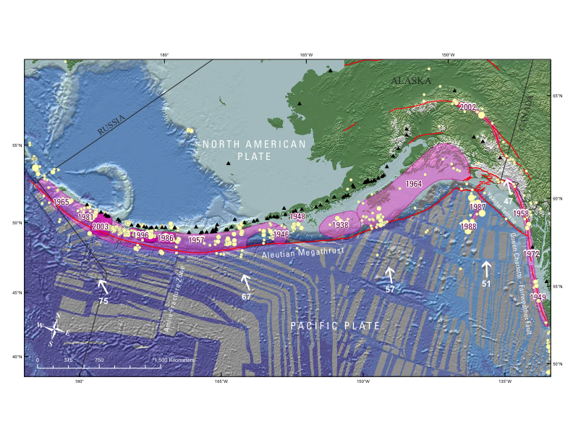
Unique Attributes Alaskan-Aleutian
Hosts some of the largest earthquakes and slow slip events; frequent eruptions.
Along-strike variation in input parameters (sediment flux, obliquity), as well seismic and magmatic processes that could be used to test hypotheses.
Subduction of thick, anomalous terrane (Yakutat) to the east, and ocean-ocean collision to the west.
Peter Haeussler

Slide 3
Unique Attributes Alaskan-Aleutian
Hosts some of the largest earthquakes and slow slip events; frequent eruptions.
Along-strike variation in input parameters (sediment flux, obliquity), as well seismic and magmatic processes that could be used to test hypotheses.
Subduction of thick, anomalous terrane (Yakutat) to the east, and ocean-ocean collision to the west.
Questions well suited to Alaska
What controls the along-strike variation in magmatism (magma flux and geochemistry, crustal storage of magmas) and rupture behavior (segmentation, recurrence)?
How persistent are rupture boundaries of historic earthquakes?
How are variations in seismicity, plate coupling, and properties of the subducting slab related to great earthquakes?

Slide 4
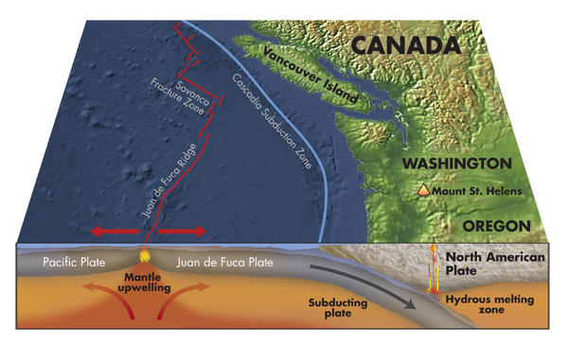
Unique attributes for Cascadia
Hot and young subducting slab (end member system); thick sediment cover.
Significant societal hazards from earthquakes, tsunamis, landslides, & volcanoes.
Well-studied active tremor and frequent slow slip events.
Seismically quiescent subduction zone.
Kathleen Cantner

Slide 5
Unique attributes for Cascadia
Hot and young subducting slab (end member system); thick sediment cover.
Significant societal hazards from earthquakes, tsunamis, landslides, & volcanoes.
Well-studied active tremor and frequent slow slip events.
Seismically quiescent subduction zone.
Questions well suited to Cascadia
What is the consequence of having a hot/young downgoing slab?
What does the paleoseismic record tell us about past rupture? Can paleogeodesy reconstruct the slip distributions of past Cascadia earthquakes?
What happens when a hot spot interacts with a subduction zone?

Slide 6
Other points raised in the webinar
New techniques and observations
Community experiments
Offshore geodetic observations
Cross-disciplinary studies
Paleoseismology/older volcanic rocks
Role of monitoring, including offshore cabled systems/observatories and real-time warning systems?
Synthesis of existing data and experimental results
Education/outreach opportunities: open data, community experiments, short courses and training sessions to exploit new dataset, participation in cruises, programs to broaden participation

Slide 7
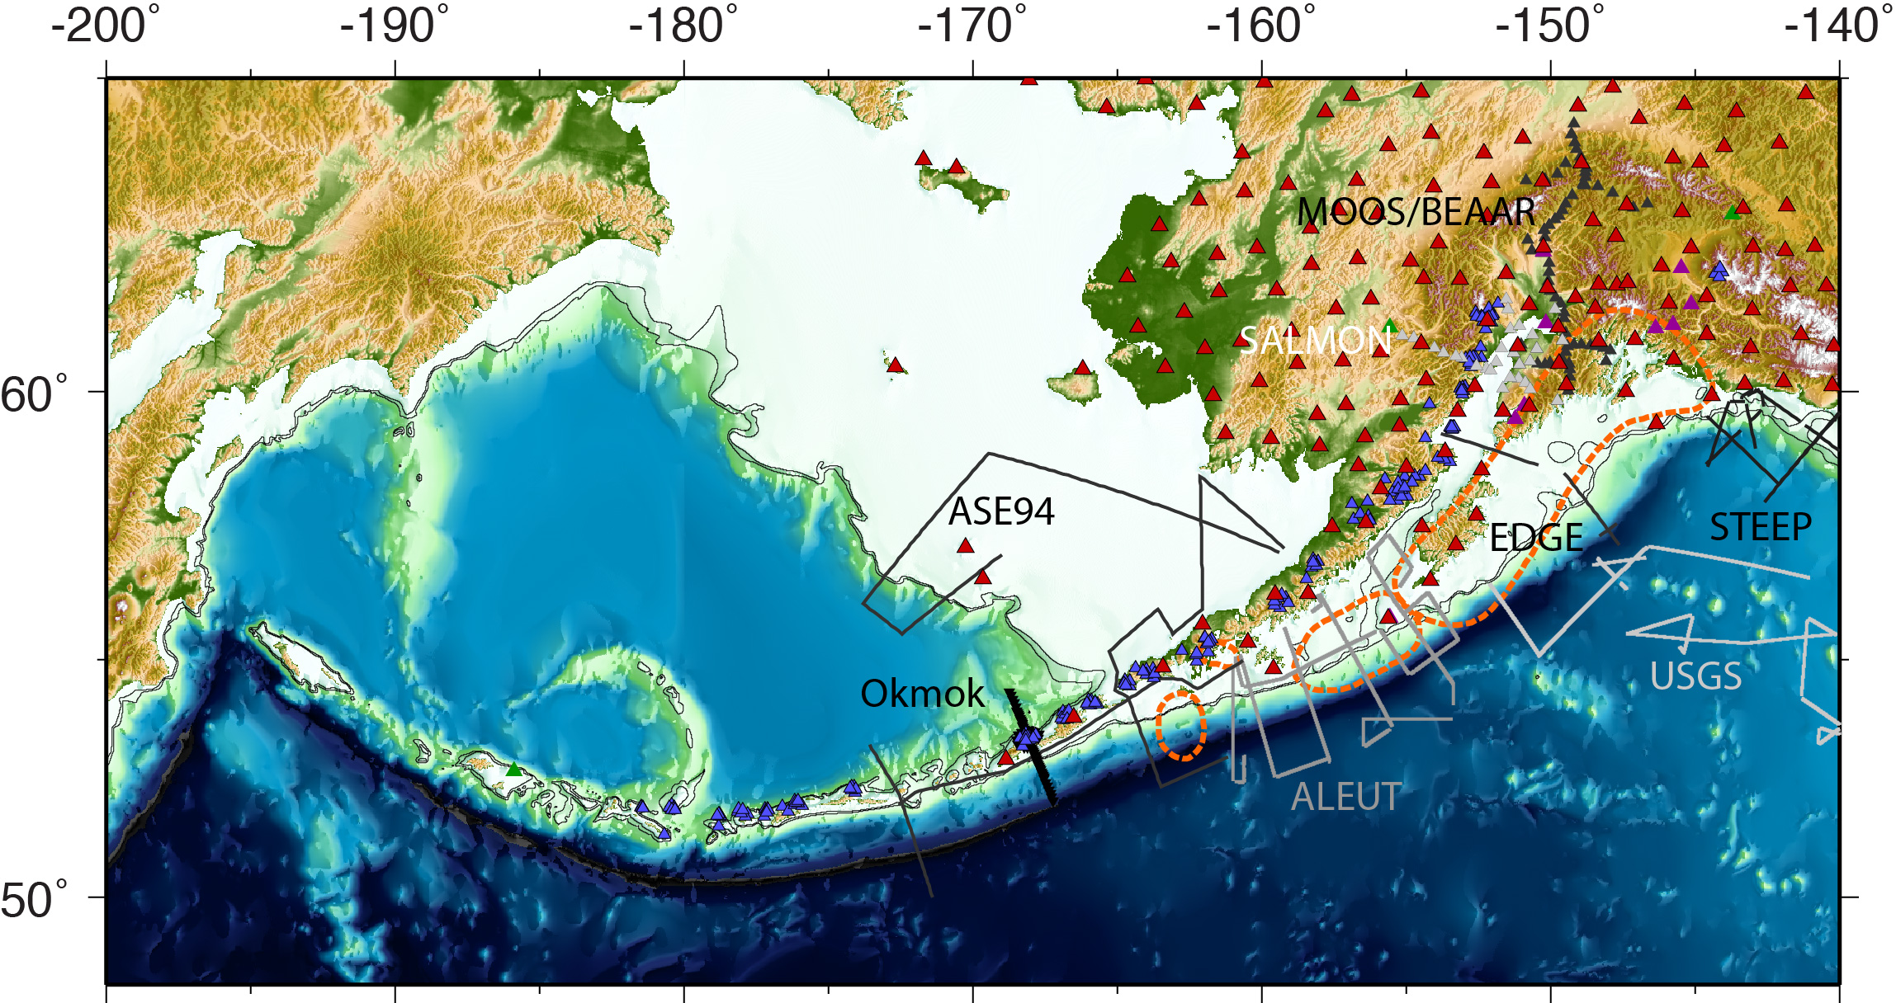
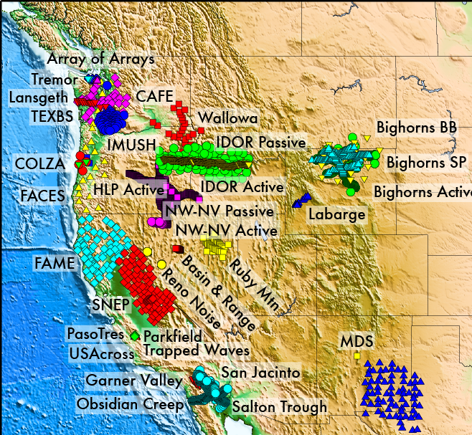
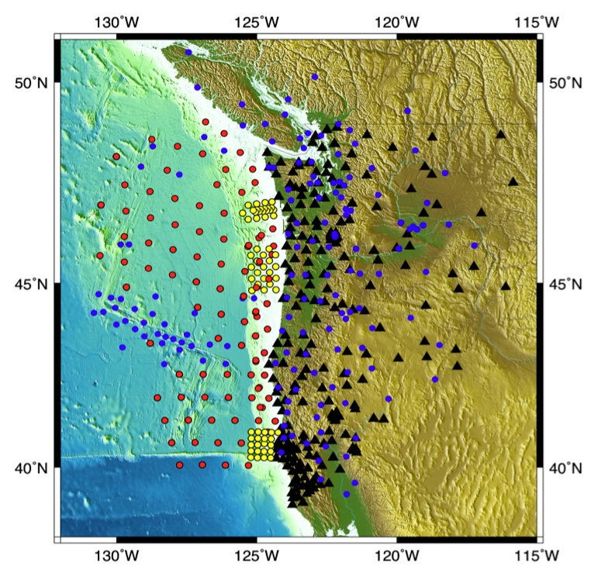
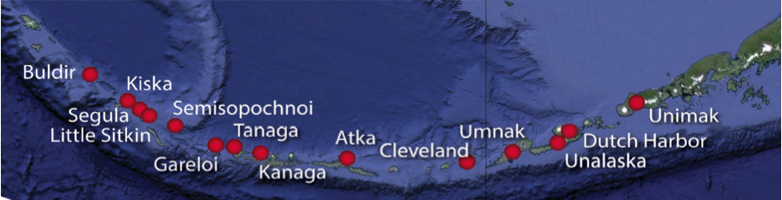
Practical Considerations for Alaska & Cascadia
Well-studied systems from previous/ongoing US efforts: enables the community to ask more sophisticated scientific questions.

Slide 8
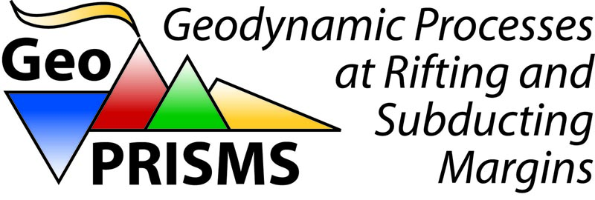







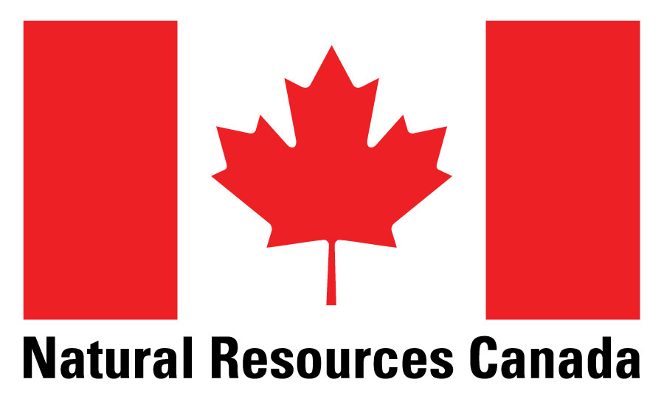




Practical Considerations for Alaska & Cascadia
Well-studied systems from previous/ongoing US efforts: enables the community to ask more sophisticated scientific questions.
Important for US geohazards - these are our two subduction zones.
Lots of partnerships with other US national and state organizations and programs: USGS, AVO, AEC, PBO, EarthScope, GeoPRISMS…
Cascadia - easy access; Aleutians - more remote

