Slide 1
Lessons from EarthScope
Dr. Jeffrey T. Freymueller
Geophysical Institute, University of Alaska Fairbanks
Director, EarthScope National Office http://www.earthscope.org/ jfreymueller@alaska.edu +1 907 474-7286

Slide 2
EarthScope Science Themes
EarthScope Science
Making and Breaking the Continent
Structure of the continent
How continent is deforming
How these are related
Complete continental coverage to enhance discovery
All data open to everyone
Notes:
What follows is only a sampler of the range of EarthScope findings and discoveries. Selections indicate my own personal opinions and the theme of this talk, and many significant results are left out so that this does not become a laundry list!

Slide 3
Modes of Discovery
EarthScope Science
Planned, hypothesis testing
Eureka, Serendipity
Notes:
The comprehensive nature of EarthScope data has made the program well-suited to both focused hypothesis testing and the discovery of the unexpected that results from exploration.

Slide 4
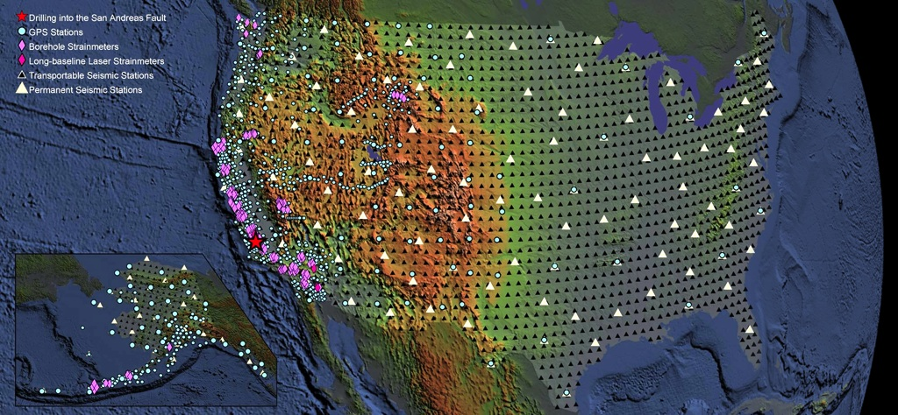
EarthScope Facilities
USArray: temporary seismic network (IRIS)
Plate Boundary Observatory (PBO): GPS (UNAVCO)
San Andreas Fault Observatory at Depth: sampling fault zone
Notes:
EarthScope facilities were completed on time and on budget!

Slide 5
The Origin Story: Part 1
EarthScope History
In those days, NSF’s budget kept increasing every year; NSF was thinking big.
In the 1990s, Congress doubled the NIH budget over several years, and wanted to do the same for NSF.

Slide 6
The Origin Story: Part 2
EarthScope History
We had some pre-existing big ideas
SAFOD: Drill into the San Andreas Fault, measure stress and sample material
USArray: Deploy a seismic network across the US (Lower 48)
PBO: Deploy a bunch of strainmeters along the San Andreas fault system to measure transient deformation
NSF and community leaders hit upon the idea of combining these initiatives to form NSF’s first distributed facility

Slide 7
Early History
EarthScope History
Concept and development 1998-2002
Each component was the subject of one or more workshops
EarthScope-wide workshops to develop the overall science plan (+ later revision)
Ultimately led to approval under MREFC
Facility construction, 2003-2008
Facility operation, 2008-2018

Slide 8
Example: PBO
EarthScope History
PBO became a GPS + strain project
Scientific scope expanded:
Transient deformation on faults, earthquake cycle, large-scale plate boundary deformation
Geographic scope expanded:
San Andreas Fault → Western US → “Baja to Bering”
“GeoPBO”: Lidar and InSAR across active faults

Slide 9
Important Lessons
Lessons Learned
Must start with compelling science
Development of a broad science plan
Inclusive geographic scope
Community planning and governance
Open data
Unanticipated discoveries, applications, techniques
Resulted in a long-term augmentation of hazard monitoring capability

Slide 10
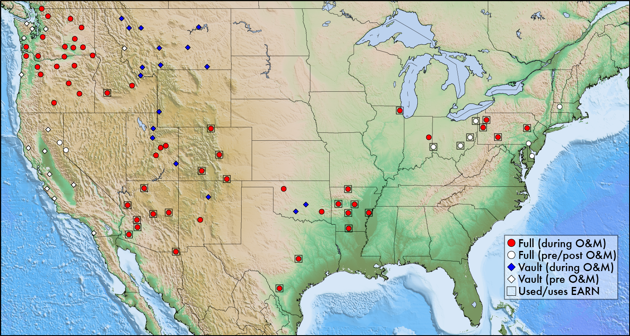
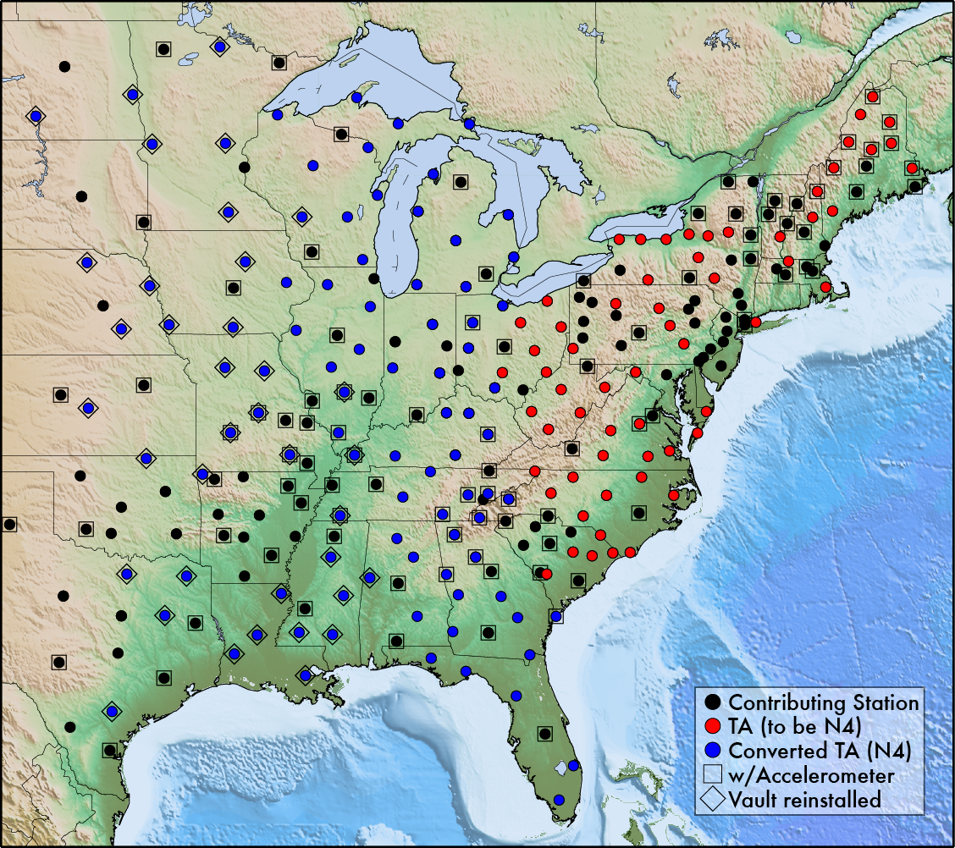
Impacts on Society
Fundamental improvement in long-term science and monitoring capacity (geodetic and seismic)
PBO used for earthquake and volcano monitoring, tsunami warning
Between TA and Cascadia-TA adoptions and CEUSN, potentially 235 new “permanent” stations in N.A. since 2008

Slide 11
Important Lessons
Lessons Learned
The MREFC rules imposed some limits:
MREFC funds were for facility construction, so some things could not fit into this mold
Paleoseismology, for example, which limited the temporal history aspect of earthquake cycle studies
Maintain balance between funding for facilities and science
Maintain balance between disciplines

