Slide 1

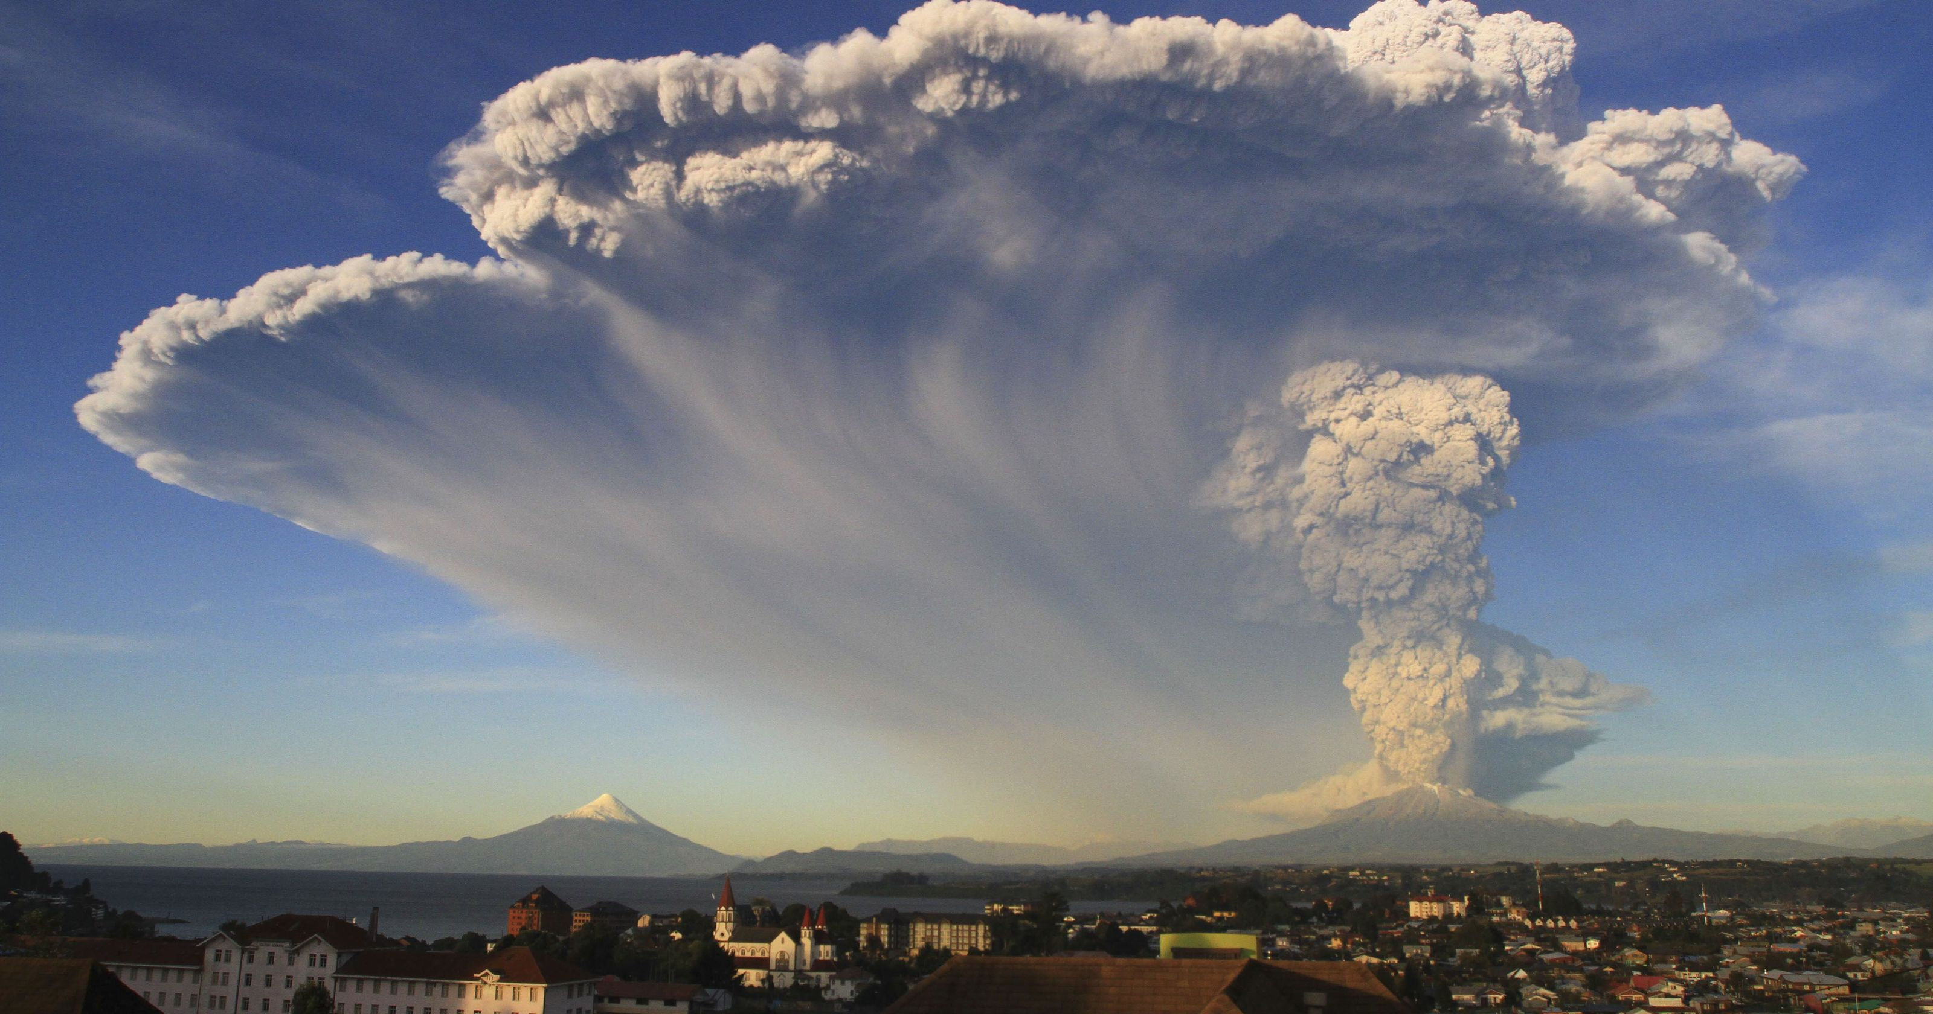
Volcanoes: subduction’s exhaust pipe
Big Picture Plenary Talks with a Wide View of Each Discipline, Looking Forward, 30 minutes
Volatiles, magmatic processes, and volcanic systems – Marie Edmonds
What do volcanic plumbing systems look like?
How does this knowledge link to volcano monitoring data?
New directions for measurements on volcanoes
What is rate-limiting our progress?
Implications for hazards
Marie Edmonds
Calbuco,
Chile
Notes:
using evidence that ranges from microscale (petrology based) to macro scale (seismic)

Slide 2
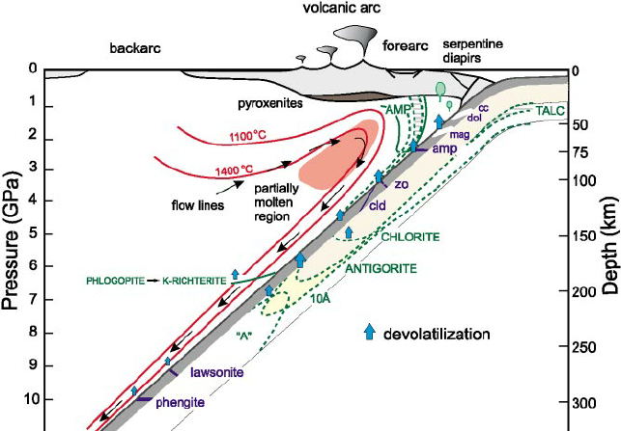
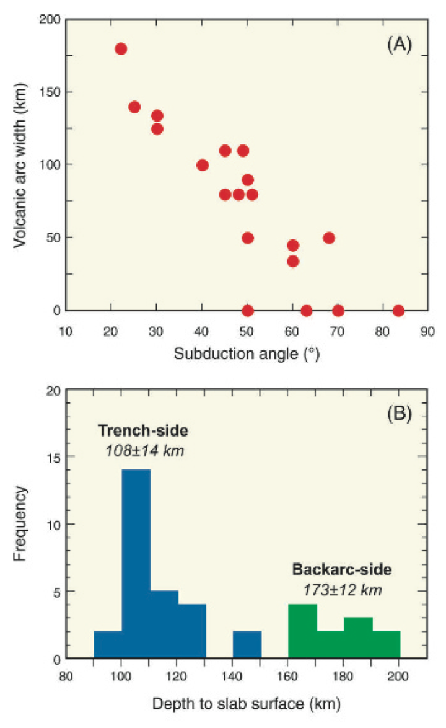
Location of volcanoes above the slab
Schmidt and Poli, 1993
Tatsumi and Eggins, 1995
Notes:
First let’s put the volcanoes into context. Melting in the mantle wedge is induced by overlap of regions that are hotter than the solidus; and regoins where hdrous minerals in the slab break down. These two limits, when combined with kinematic factors such as oncvergence rate and slab dip, determine where the volcanic arc is relative to the trench. There is a strong relationship between the distance to the volcanic arc and the slab dip, indicating that the processes causing melting are pressure-dependent, i.e. volatile-assisted melting of the mantle above the slab.
Volcanoes therefore represent the outputs of subduction zones.

Slide 3
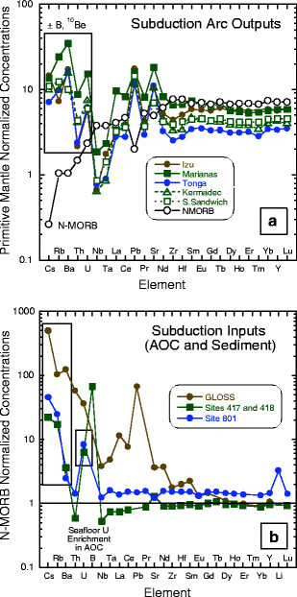
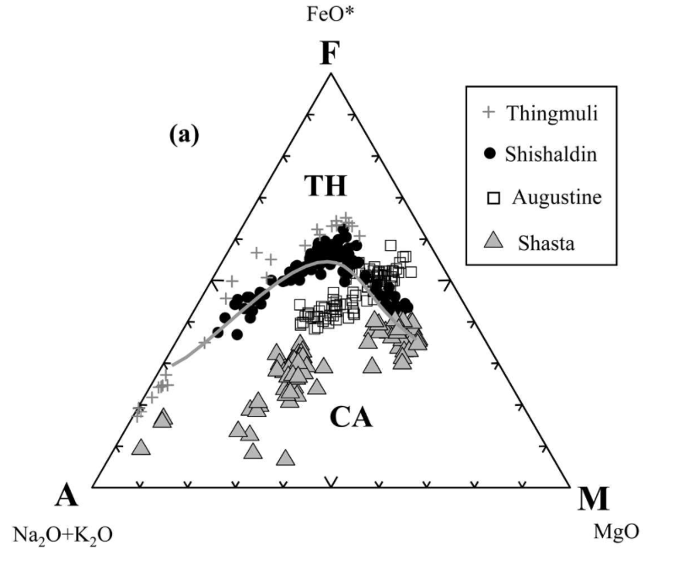
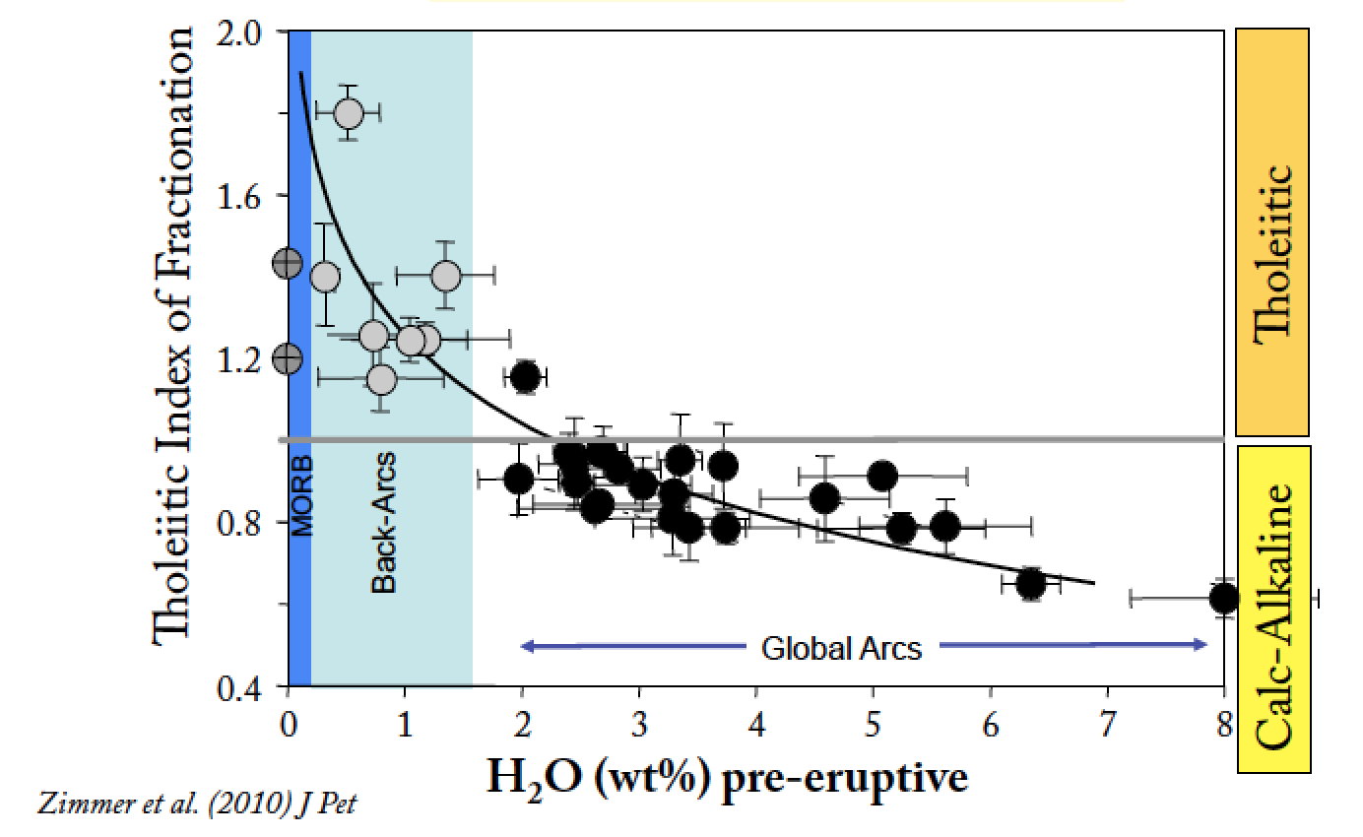
Arc magma geochemistry
Plank and Langmuir (1998)
Sisson and Grove, 1993
Zimmer et al., 2010
Notes:
The chemistry of the magmas output from volcanoes reflect slab input, with enrichments in elements that are enriched in sediments and altered oceanic crust (LILE) and showing characteristic depletions in Ta and Nb thught to be due to the refractory nature of these elements in phases such as rutile on the slab. The magmas in arcs display a wide range of SiO2 contents, indicating that they differentiate to a high degree within the overriding crust, bothin island arcs and in continental arcs, and the calc-alkaline magma series is characteristic of arcs, found in no other tectonic setting and has been shown to be directly related to the water contents of primary melts, wherby suppression of plag fractionation and the fractionation of amph and mgt prevents Fe enrichment.

Slide 4
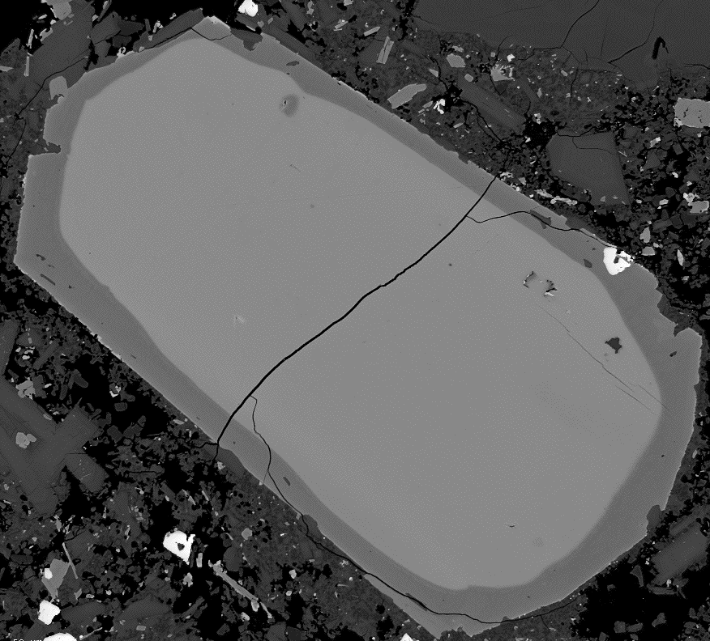
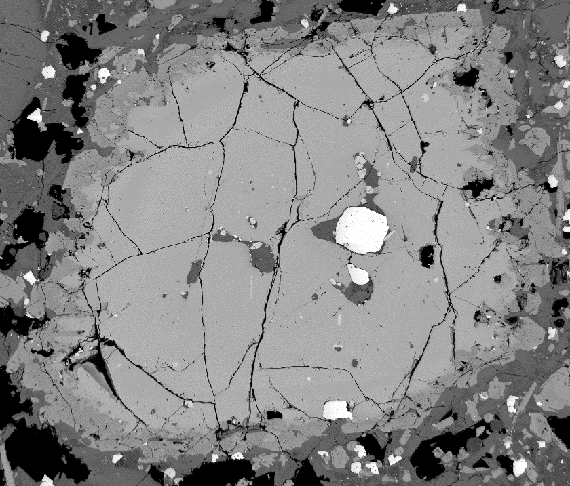
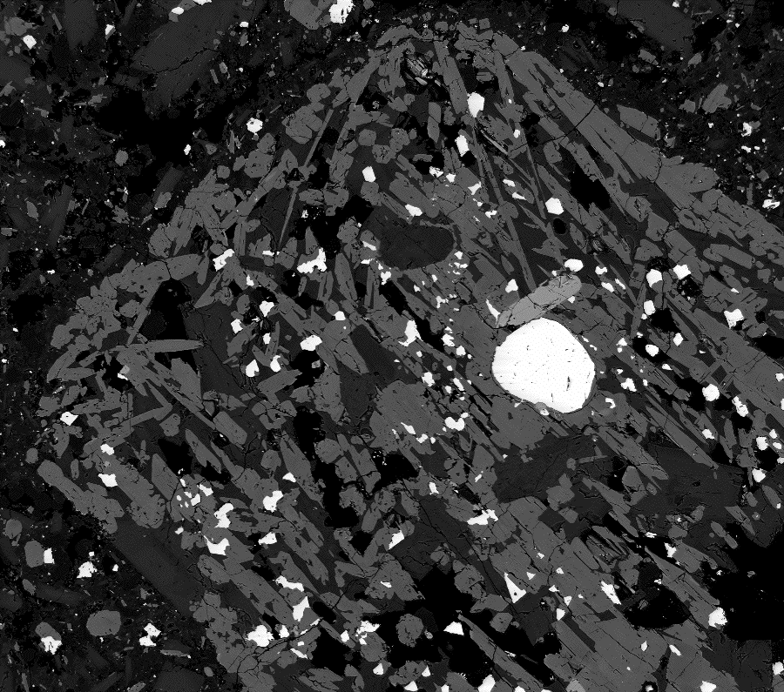
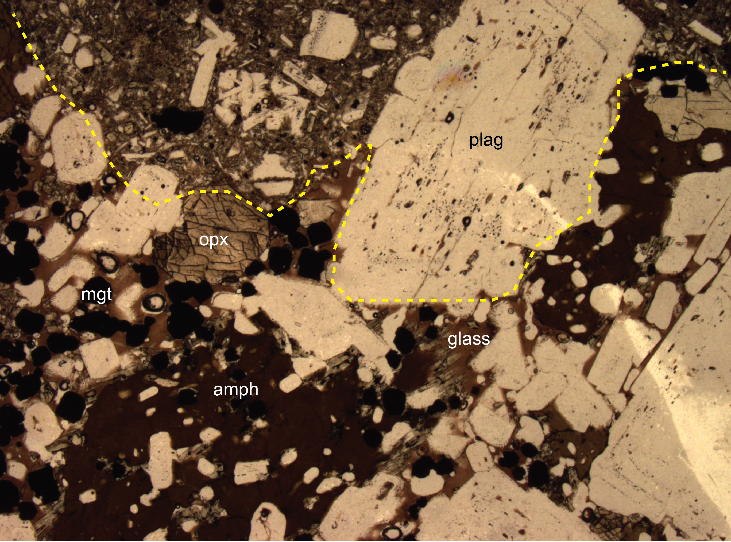
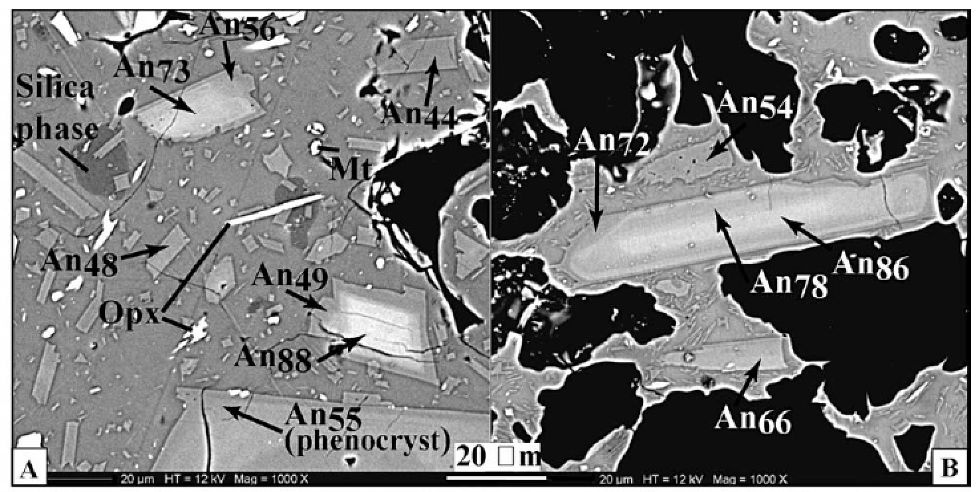
opx
opx
hbl
Andesite
Mafic microlites
Clynne, 1999
Martel et al., 2006
Humphreys et al., 2009
Kent et al., 2010
Mafic enclave
Notes:
Magmas in arcs are not straightforward, however, despite the seemingly simple fractionation trends. Arc magmas, particularly the more differentiated magmas, frequently (usually) show signs of magma mixing, containing mafic enclaves, and ubiquitous signs of disequilibrium and heating prior to eruption – up to 10 % vol mafic microlites have been discovered in the groundmass of rhyolitic melts from Lesser Antilles rocks, and reverse zoning, resorption textures and reaction rims.

Slide 5
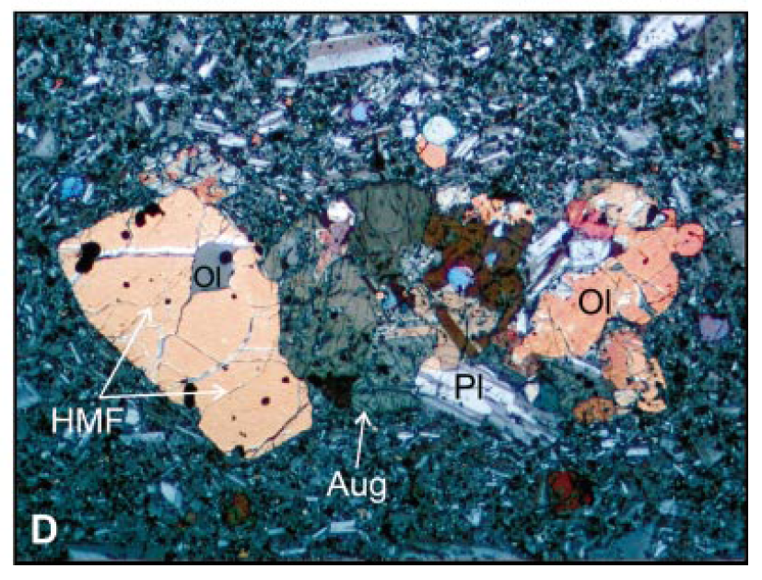
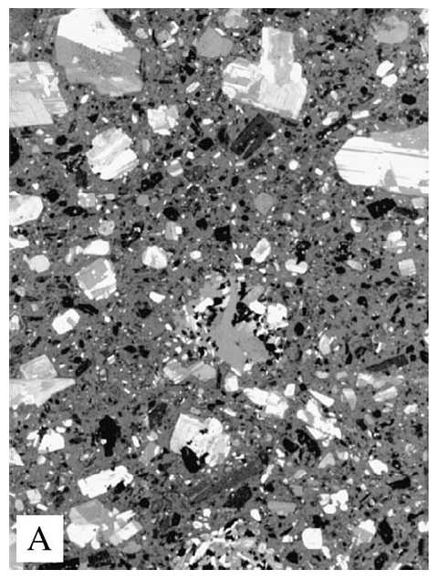
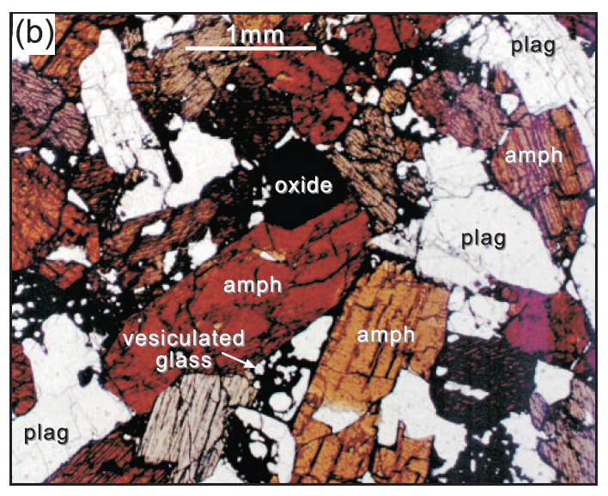
Most arc magmas do not represent true liquids, but liquid plus crystal cargo
Dungan & Davidson (2004)
Volcàn San Pedro, Chile
Eicheberger et al. (2006)
Unzen Volcano, Japan
Davidson & Wilson (2011)
The Quilll, Lesser Antilles
Notes:
It seems clear that many arc magma;s whole rock compositions do not represent true liquids, but instead may be described as liuids plus crystal cargoes. At this point I would like to recognise our colleague Jon Davidson’s extraordinary contributions to arc magma geochemistry.

Slide 6
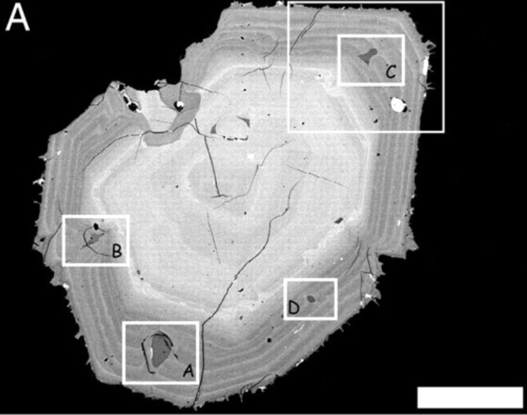
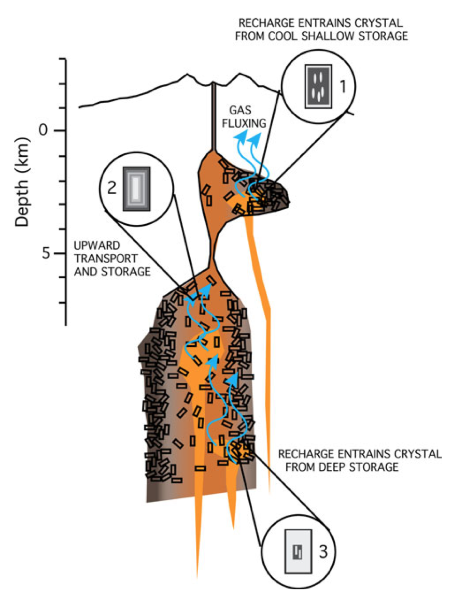
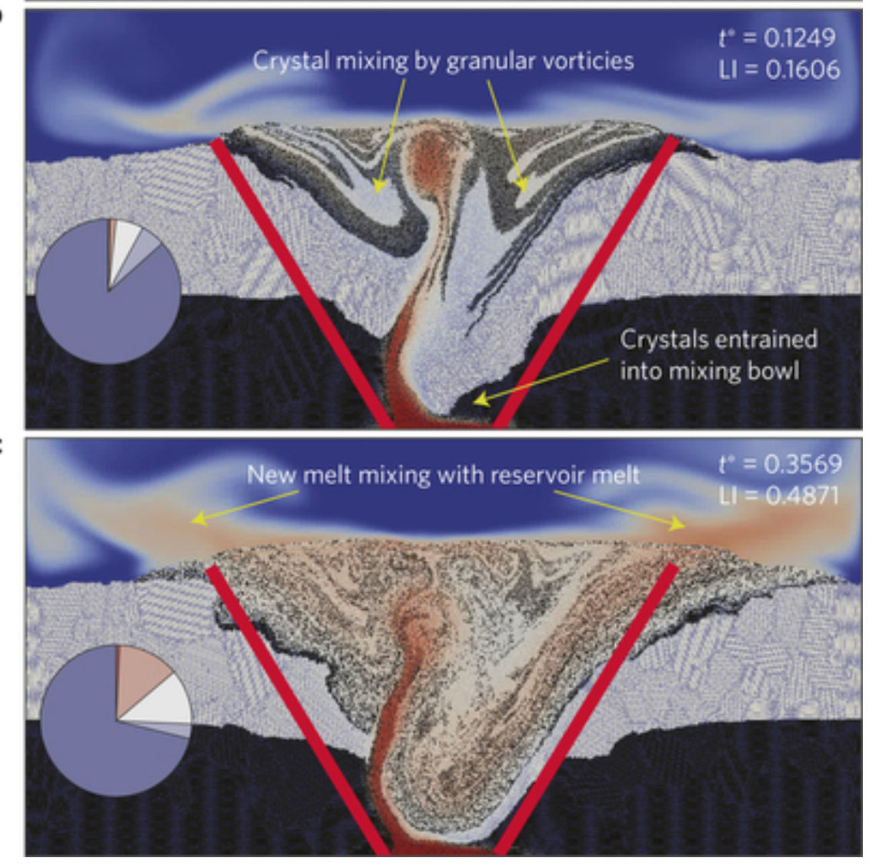
Recharge and magma mixing
Mount St Helens
Cashman et al., 2013
Bergantz et al., 2015
Notes:
The complexity and heterogeneity of the crystals within a single hand specimen of arc rock has given rise to models describing their genesis. A numerical model last year from George Bergantz and others shows how magma recharge into a crystal-rich mush can disrupt the mush and cause extensive mingling, resulting in a heterogeneous mixture of evolved melt, complexly zoned and heated crystals, and mafic components.

Slide 7
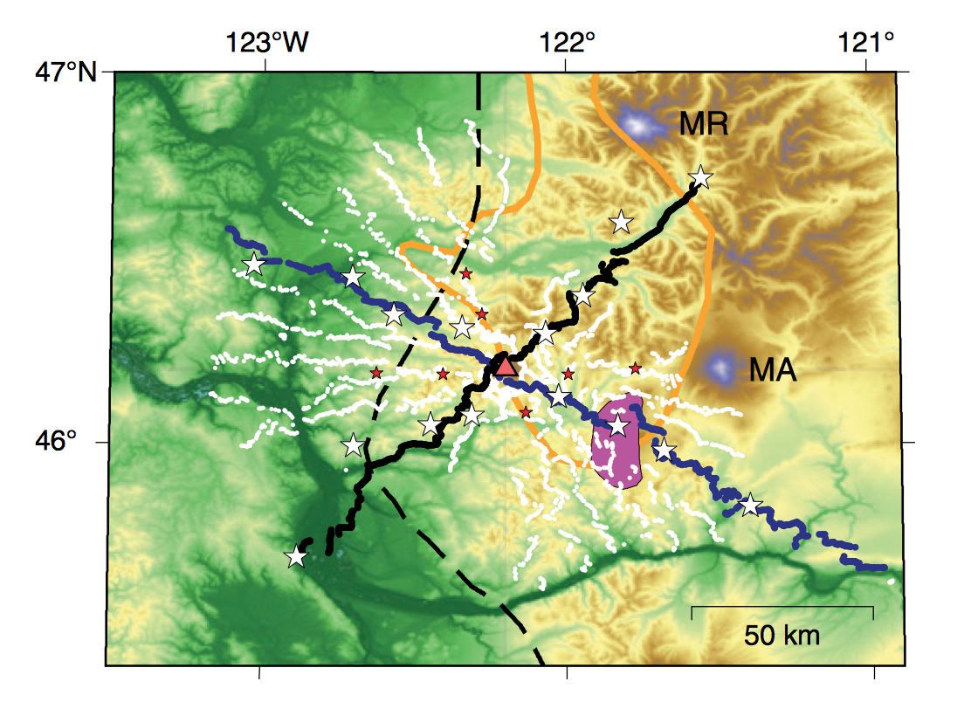
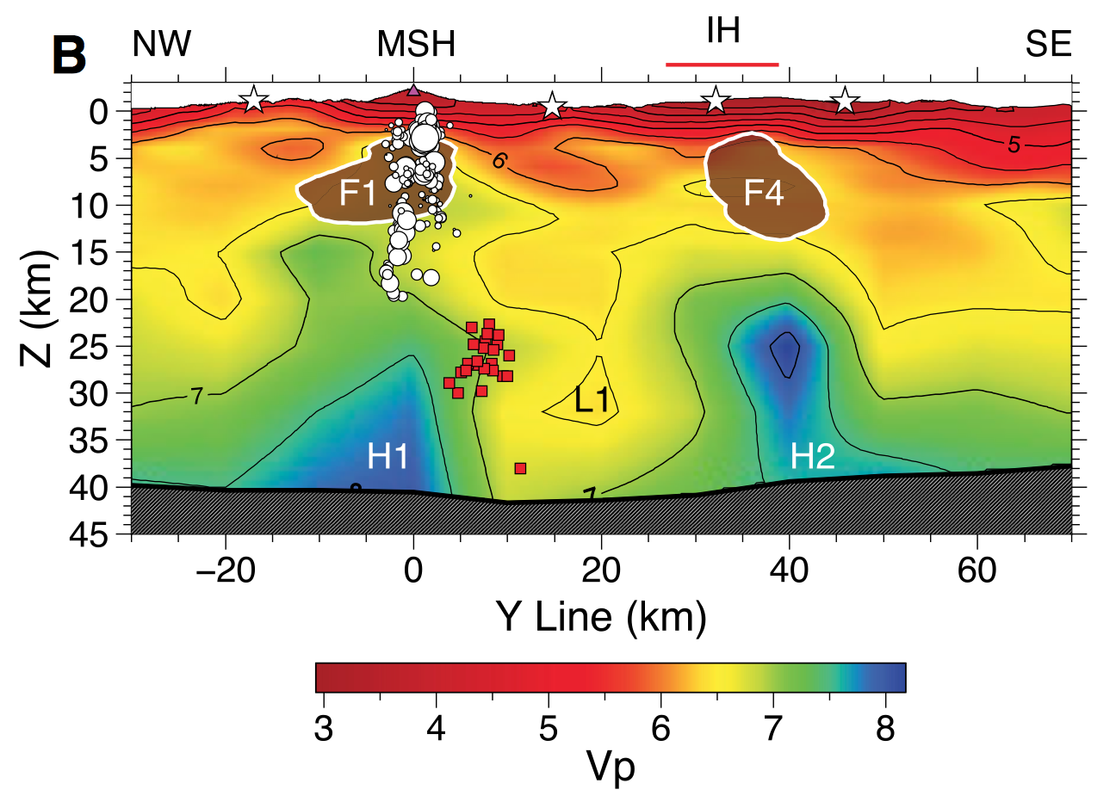
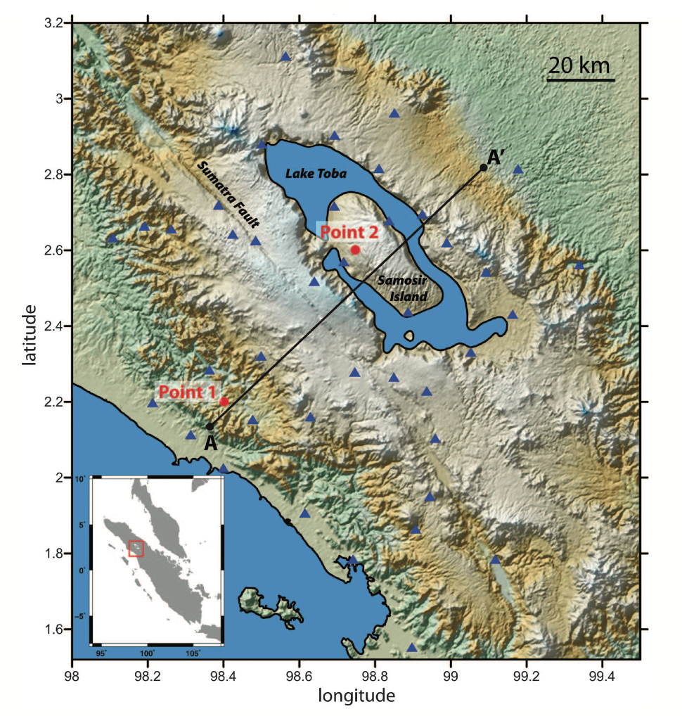
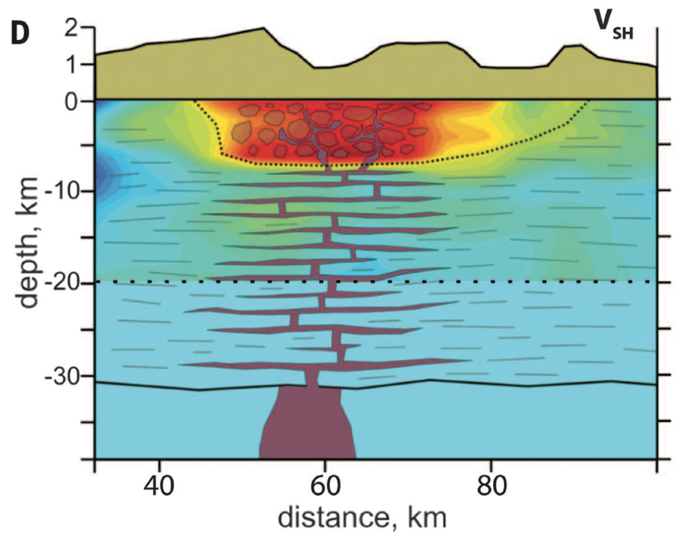
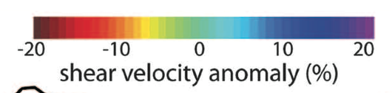
Seismic evidence: vertically protracted melt-poor reservoirs
Mount St Helens, USA
Kiser et al., 2016
Toba,
Indonesia
Jaxybulatov et al., 2014
Notes:
Recent crustal-scale seismic tomography experiments have hinted at melt-rich regions in the crust extending down to the Moho and laterially, conntecting the deeep root zones of arc volcanoes. The imush experiment has so far yielded tantilising results; as has forerunner studies on Toba, and also ongoing surveys beneath Santorini.

Slide 8
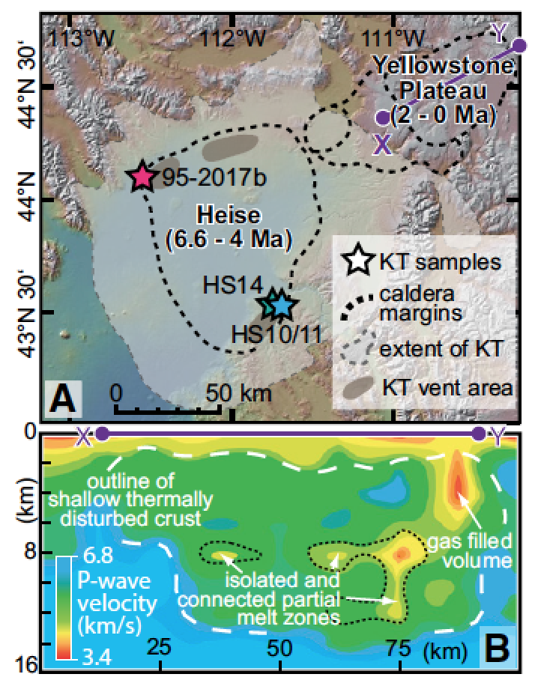
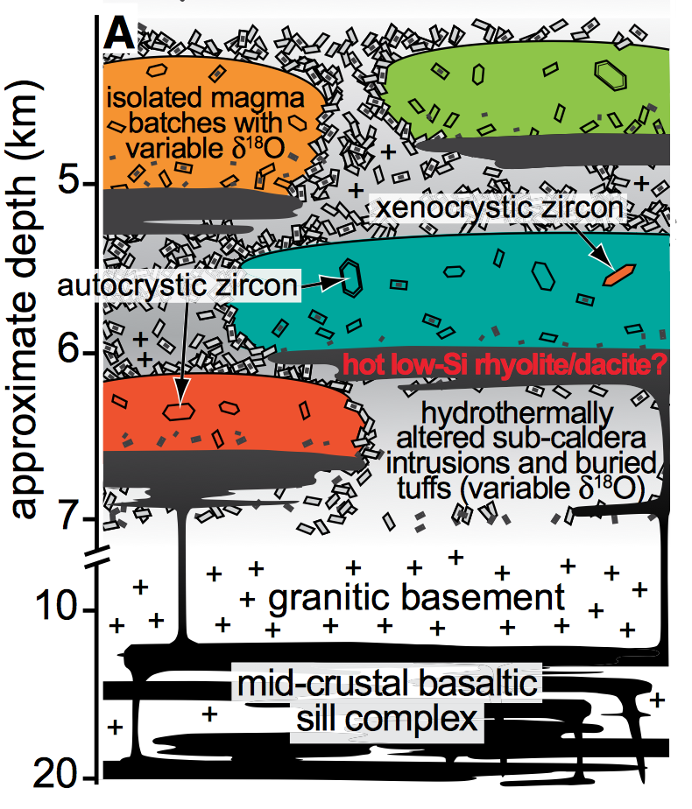
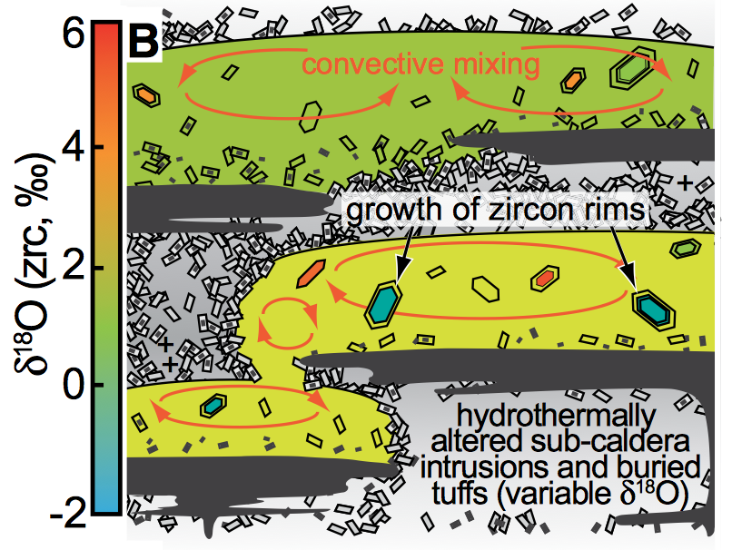
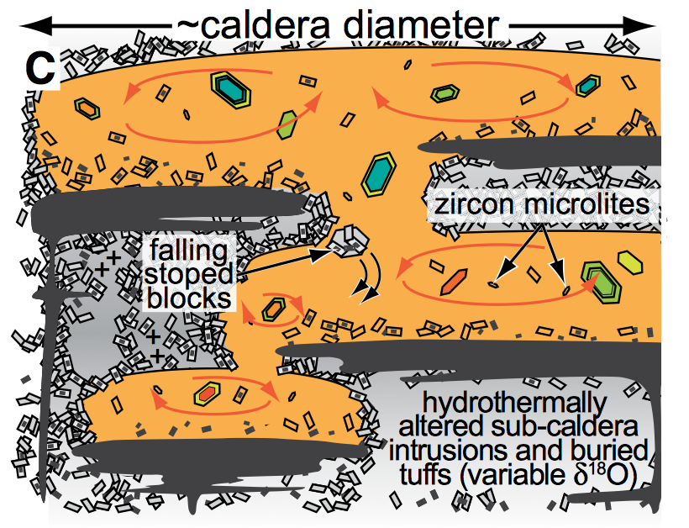
Mixing of isolated melt batches shortly before eruptions
Charlier et al., 2005;
Druitt et al., 2012;
Cooper et al., 2012;
Gualda and Ghiorso, 2013
Wotzlaw et al., 2014
Notes:
Geochemistry and geochronology of the deposits of large explosive eruption – many studies have appeared in high impact journals over the past few years. The studies use zircon geochronology (zircon U-Pb or U-Th), isotopic data (e.g. O isotopes) and trace element geochemsitry. The emerging picture from these studies, and this example is from Yellowstone (not an arc volcano but some of the same processes apply) is one of isolated melt batches (some of which have remelted hydrothermally altered material) and large magma bodies assembled over 104-105 years, with frequent recharge events, a few motnhs to decades prior to large explosive eruptions, whereby these melt batches join up, mix and overpressures become significant enough to trigger eurption.
Dating

Slide 9
Christopher et al., 2015
Oppenheimer et al., 2015
Parmigiani et al., 2016, Nature
Exsolved magmatic vapor phase accumulates in liquid layers
Notes:
These reservoir systems also contain exsolved vapor. Our observations at Soufriere Hills led us to propose that segregated regions of magmatic vapor exist in the topmost parts of these systems. Later experiments on analogue systems and numerical models have shown that exsolved gases are transported through brittle fractures in mushes and accumulate in the rhyolitic liquid –rich regions.

Slide 10
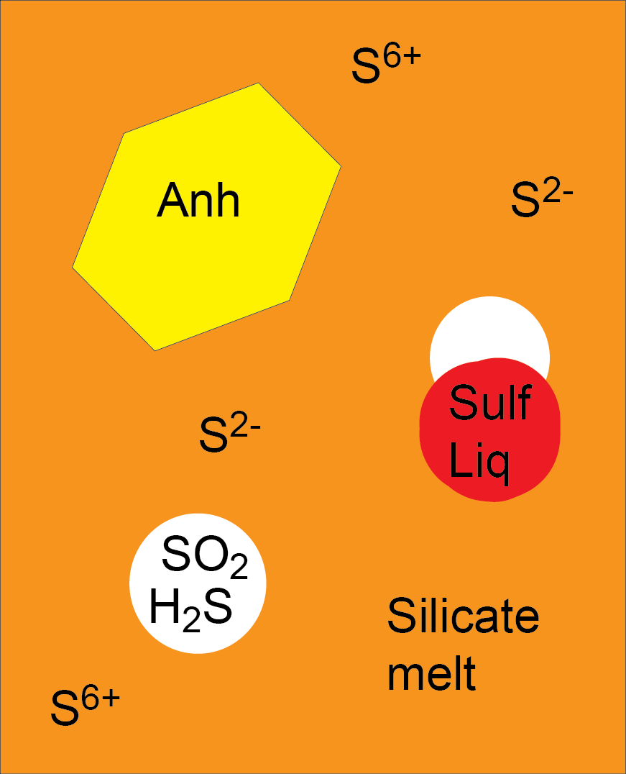
Sulfur yields of explosive arc eruptions
partitioning
Masotta et al., 2016
Yu et al., 2016
Wallace, 2001
McCormick et al., in press; Nat Comms
Notes:
The accumulation of gas in the liquid regions has important implciations for how we understand sulfur loadings from explosive arc eruptions. This is a recent compilation of explosive eruptions, with their sulfur yield (Tg/km3 erupted) shown at the bottom in rank order, with the erupted volumes at the top. There is clearly not a clear relationship between volume erupted and sulfur loading, which makes sense in the framework of the magma reservoir model, whereby sulfur partitions between soid phases (anhydrite) melt (silicate and sulfide) and gas, with the gas being mobile and allowed to accumulate in gas-rich caps.

Slide 11
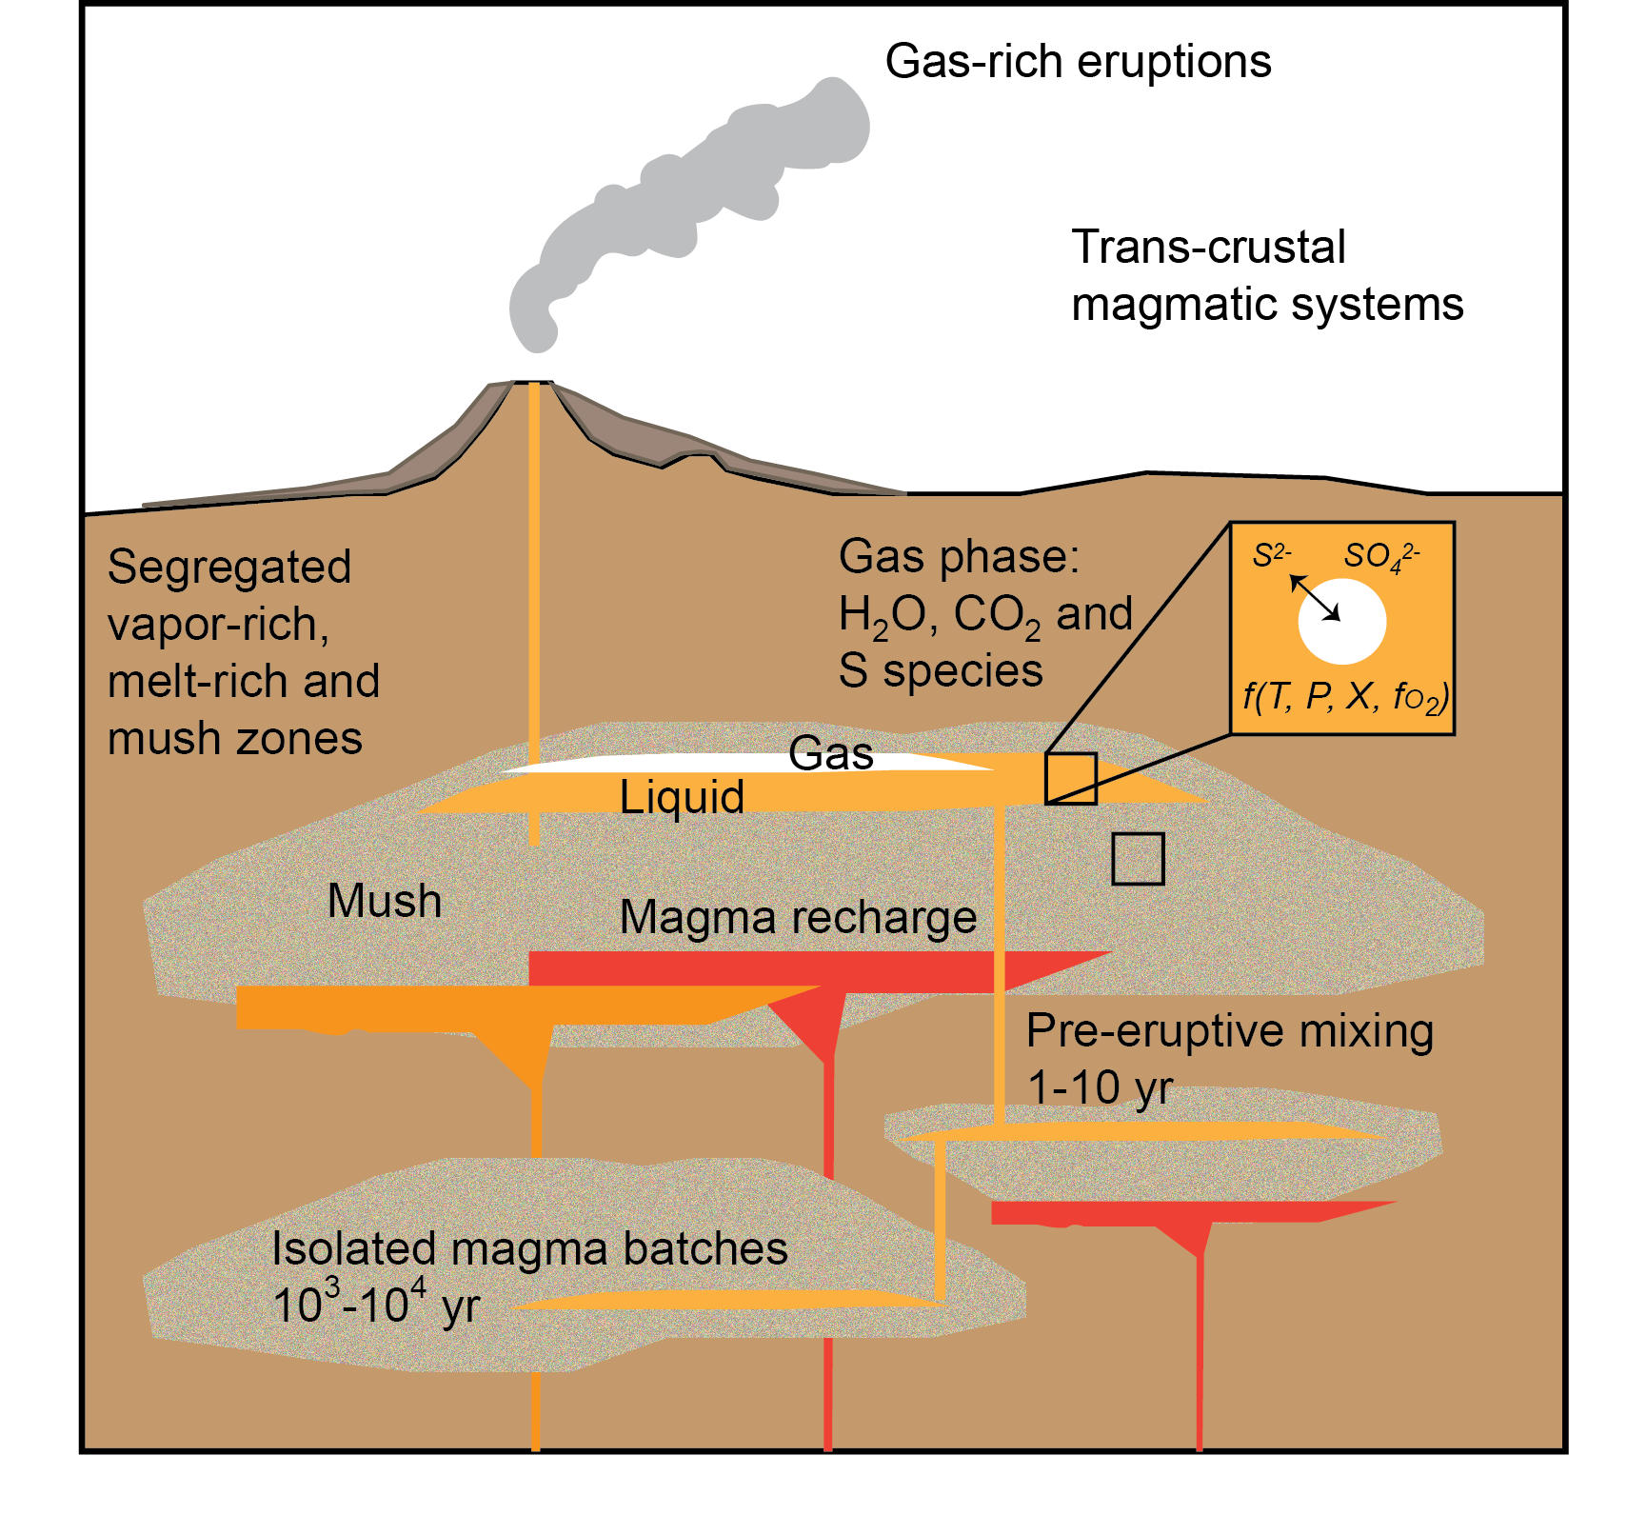
How does this picture help us interpret volcano monitoring signals?
Hildreth, 2004
Bachman, Bergantz, 2006
Huber et al., 2011
Magma supply rates?
Recognising magma recharge
Timescales
Volcanic-plutonic connection
Implications for ore deposits?
Notes:
So how does hit emerging picture (which is based on work done by many authors and groups over the past couple of decades and longer) feed into our underdtanding and interpretation of volcano monitoring signals? Interesting questions that arise are linked to quantifying magma supply rates, understanding how lower crustal cuulates relate to erupted rocks and the implications for ore deposits.

Slide 12
Models of magma reservoirs
-grain scale (petrology, geochemistry, rock mechanics)
-reservoir scale (seismic, deformation, analog experiments, gas)
Depth, km
Annen et al., 2008
Solano et al., 2012
Notes:
There is immense opportunity for development of nested models on both grain scale and reservoir scale building on this understanding. This figure shows the results of a coupled geochemical-thermal model showing that complex arrangements of mush and liquids arise when basalts are repeatedly intruded into continental crust

Slide 13
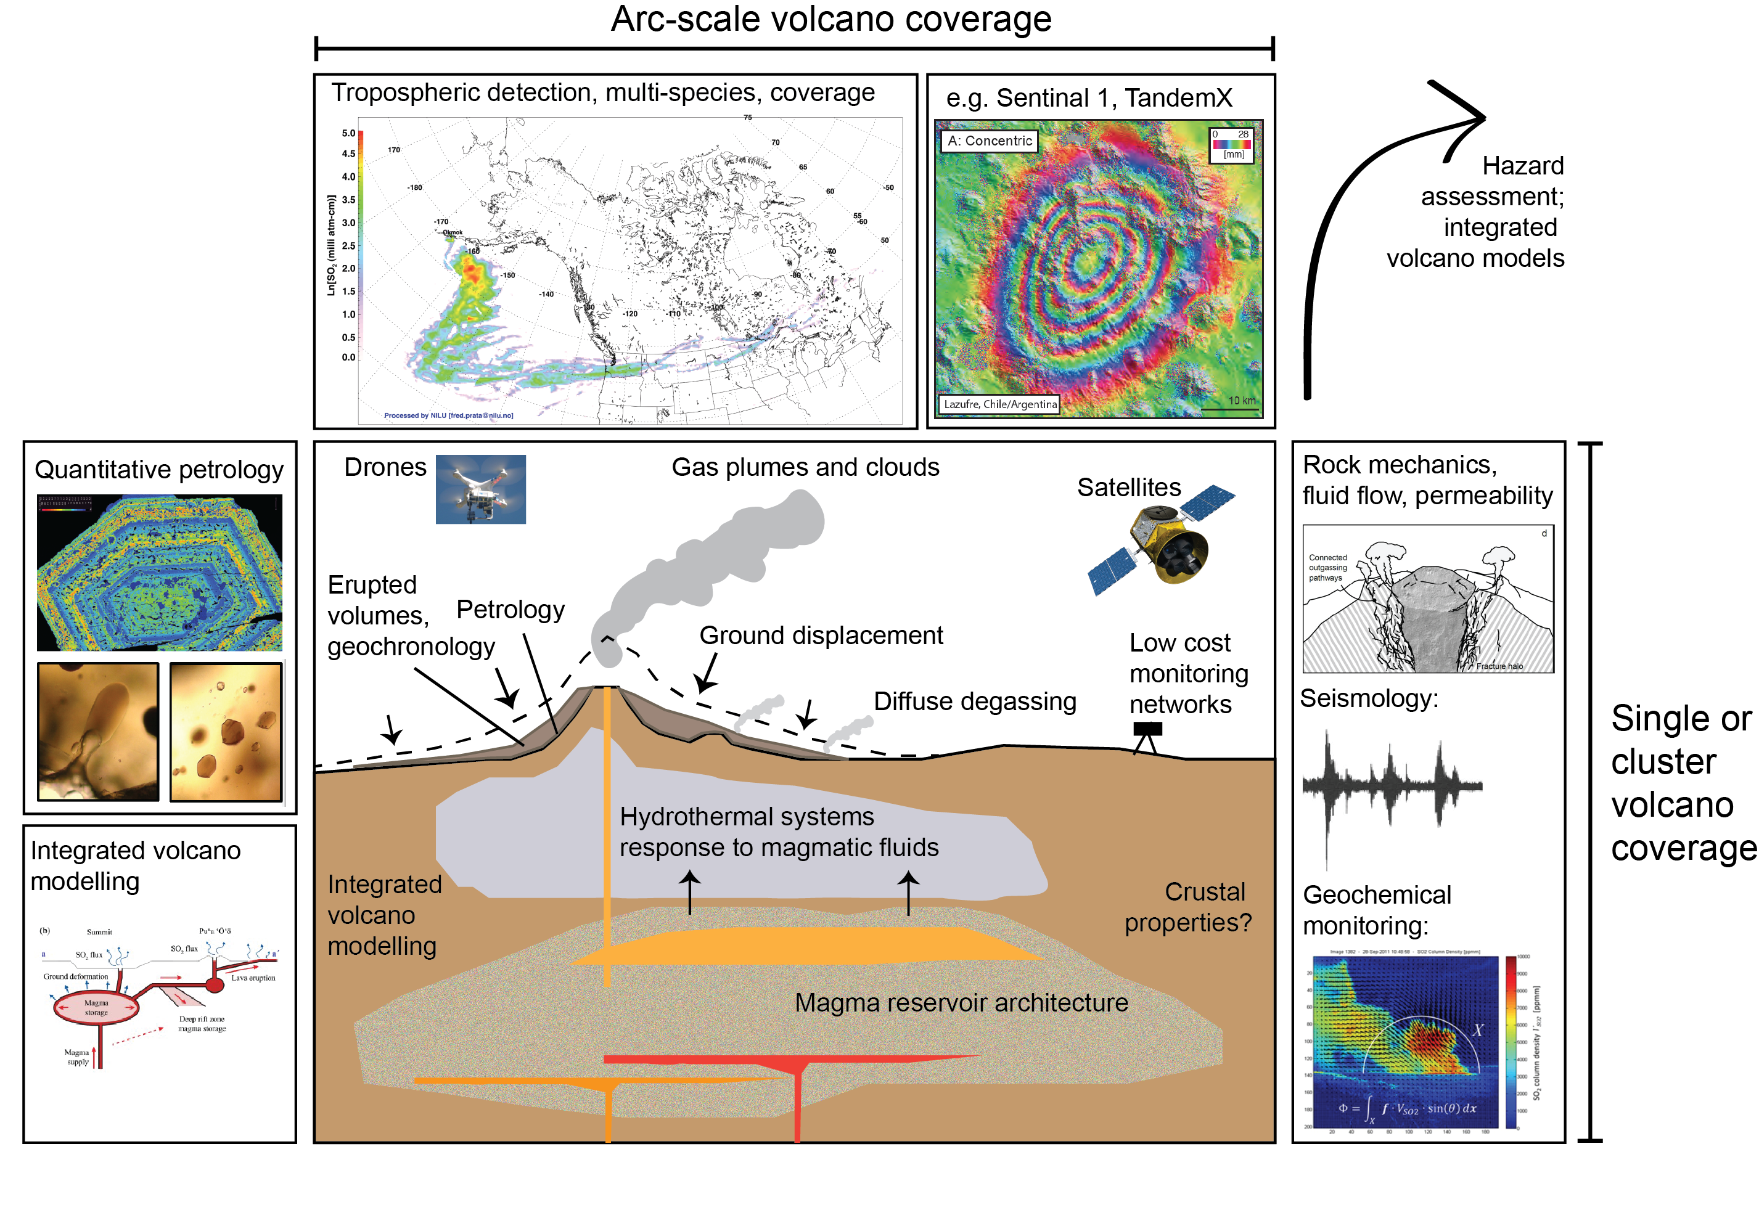
Integrated volcano monitoring
Notes:
Let’s turn to volcano monitoring. This schematic summarises the range of types of observations that can be made on volcanoes, focussing on those I want to highlight today. The arc scale observations are dominated by new satellite absed observations, and theere are huge opportunnities offered by new InSAR platforms, such as ESA’s sentinal 1, and the radar measurements offered by TandemX and its successors. Gas observations will be similarly augmented by new sensors offering better sensitivityi in the toposphere, such as tropOMI, and multispecies sensors such as the new OCO2. The rapid rise of the field of rock physics as applied to volcanoes has meant a huge advance in our understanding of deformation, perneability and fkuid fow and its consequent feed in to seismology and geochemical monitoring of gas emissions. Simialrly “quantititaive petrology” leads to testable hypothesis of magma ascent rates and mixing timescales that might be tested by geophysical observations. Yhe new challenge is to produce integrtaed models to describe multiple strands of data.

Slide 14


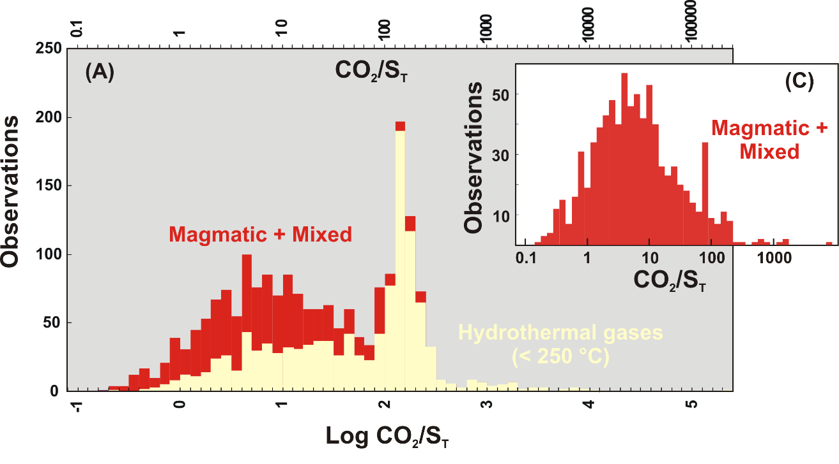
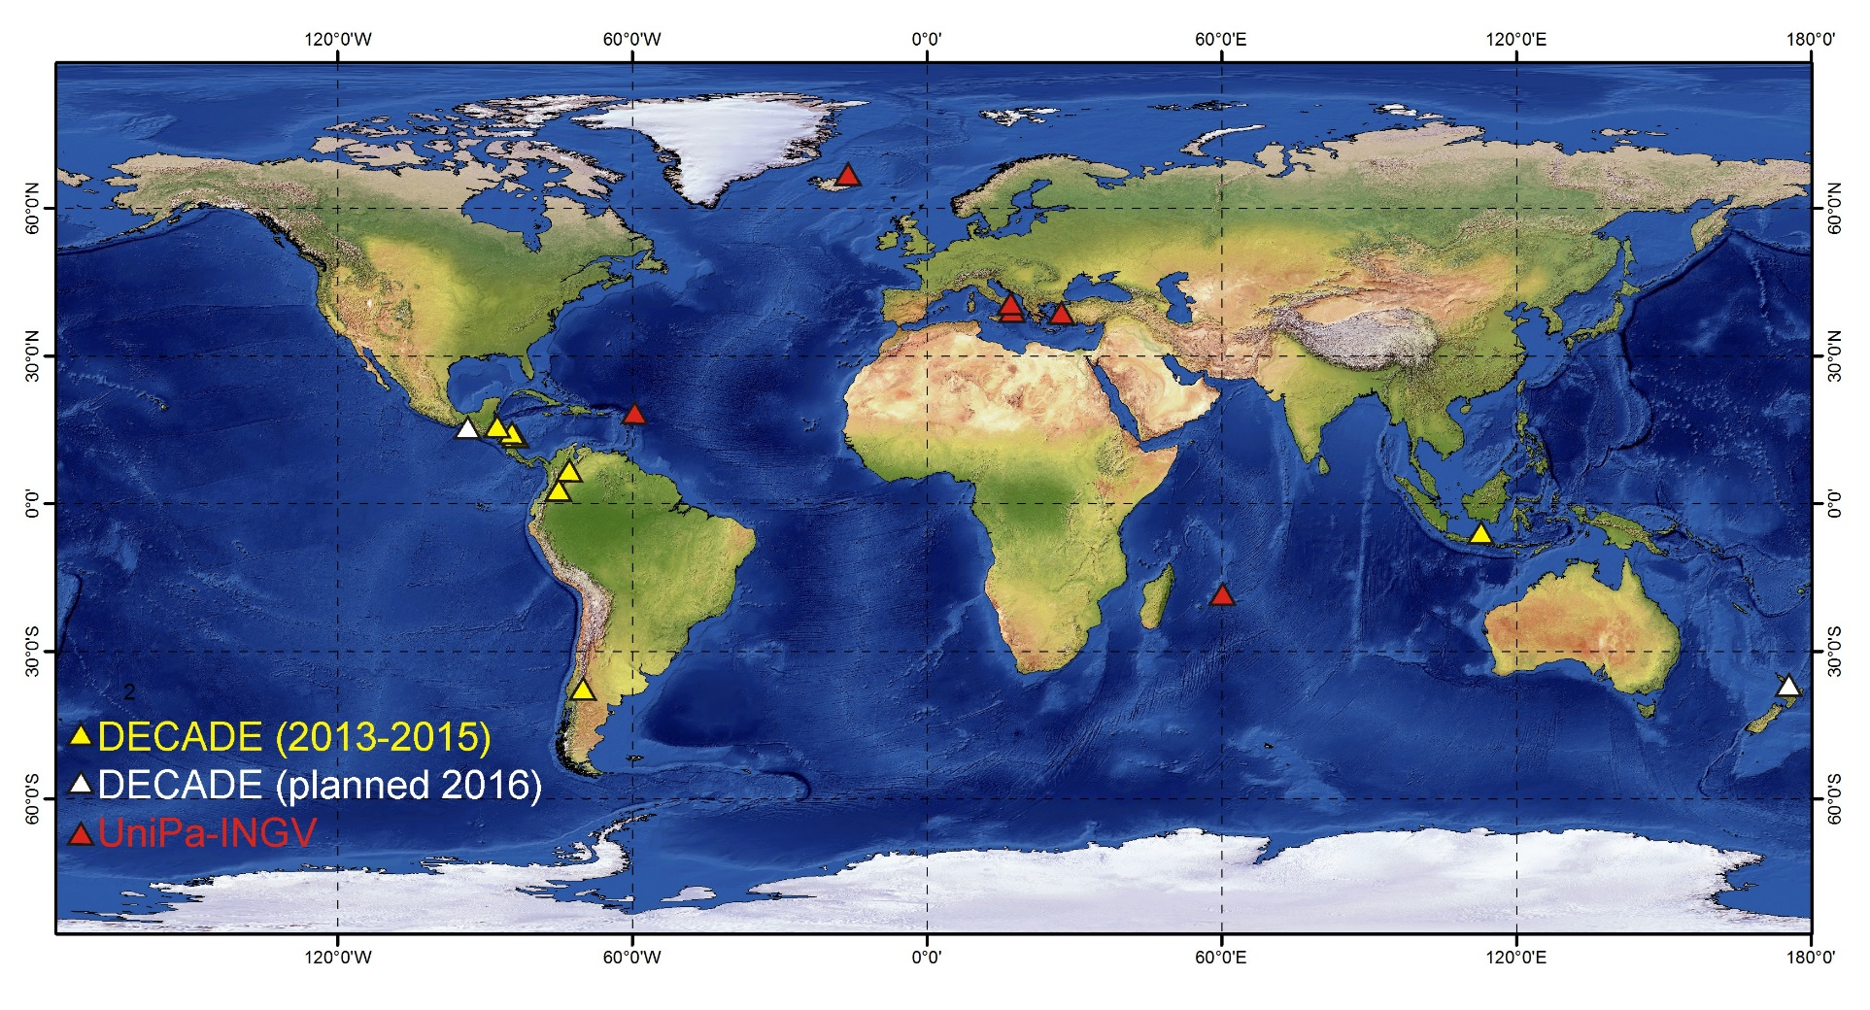
Measurements of volcanic gases
Instrumental developments: multi-species closed path instruments, IR sensors for C isotopes, satellite-based observations, laser spectroscopy, 2D imaging of plumes. Low cost, high resolution, automated.
Aiuppa et al, in press
Earth Science Reviews
Fischer and Lopez, 2016, GRL
See also talks by Taryn Lopez, Tobias Fischer
Notes:
The field of volcanic gas monitoring has pgoressed in leaps and bounds in recent years, particular since the advent of the Deep Carbon Observatory DECADE initiative, which has promoted development of the multigas system of sensors, to measure carbon/sulfur ratios in voclanic gases – a complilation from Alessandro Aiuppa is shown here. Other developments have included ifled measurements of C isotopes using ***, laser spectroscopy and UV and IR cameras to image gas plumes. Imstruments are low cost, automated with a temporal resolution to rival (almost) geophysical observations

Slide 15
Poas Volcano, Costa Rica
Precise forecasting of phreatic eruptions using gas composition
de Moor et al., 2016 EPSL
Notes:
An example is the recent data produced by the multigas instrument at Poas Volcano in Cosaa Rica, which shows very clear cycles in C/S ratio which correlate with seismciity in the lead up to phreatic eruptions, caused by magmatic gases travelling up throug the lake waters.

Slide 16
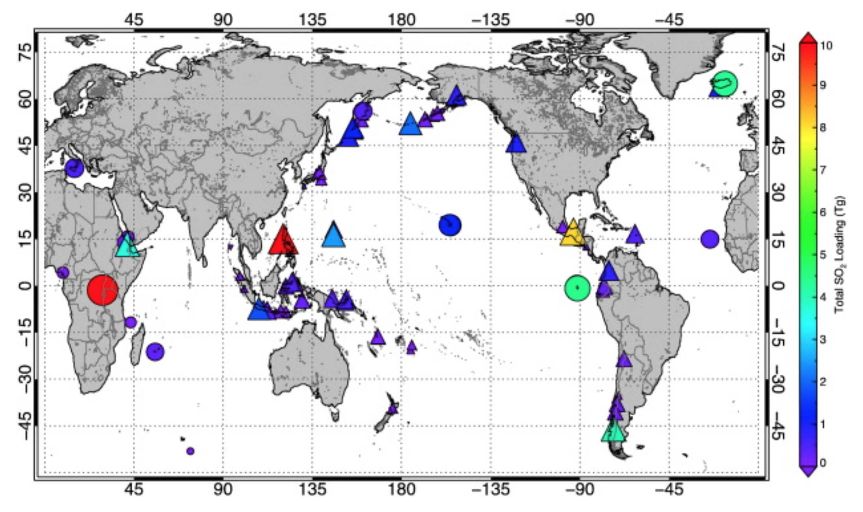
Eruptive SO₂ emissions detected from space (OMI/TOMS) 1978–2014
Carn et al., 2016
Frequent detections volcanic SO₂: Aleutians, PNG, Indonesia, S. America
Notes:
Of all the eruptive emissions detected from space, the most frequent are from arcs, and of those, the most frequent sulfur-producing eruptions are in the Aleutians, PNG, Indonesia and S. America. This is an image from Carn et al., 2016.

Slide 17
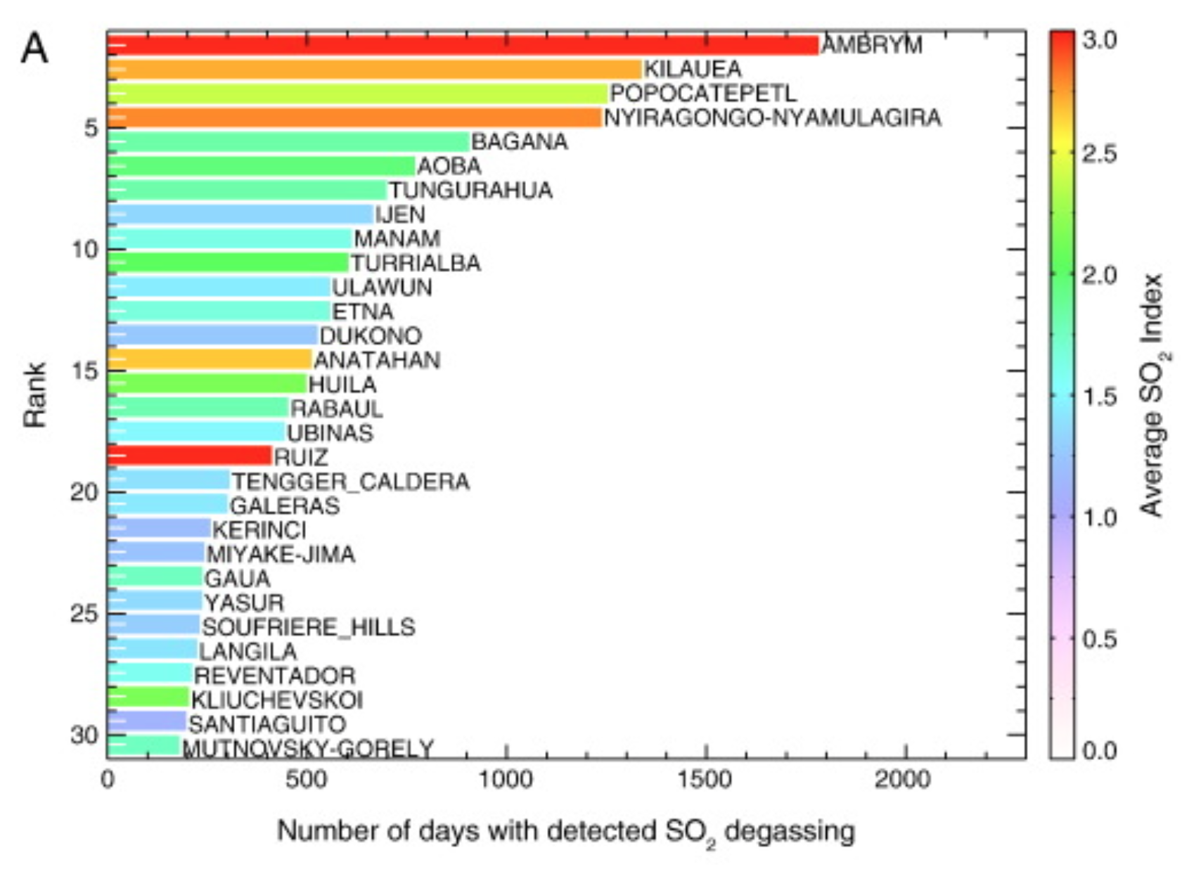
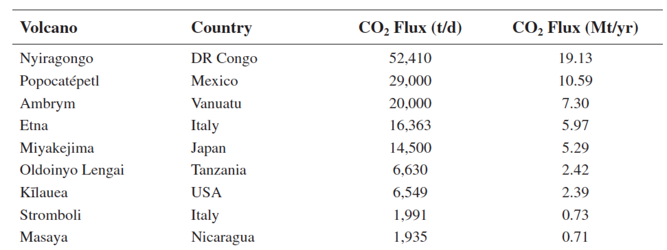
Most prolific
outgassing arc
volcanoes:
Ambrym (Vanuatu)
Popocatepetl, Masaya (C. Am.)
*Bagana, Ulawun, Rabaul (PNG)
Ubinas, Riuz, Tungurahua (S. Am)
Top volcanic
SO₂ outgassers
2004-2013
Carn et al., 2016
Top 10 volcanic
CO₂ outgassers
(more incomplete)
Burton et al., 2013
Notes:
The most prodigious individual volcanic outgassers are Ambrym, central merican volcanoes, Papua new guinea volcanoes, and south american volcanoes. Same is true for CO2 outgassers, alhtough these data are far less complete. This is a compilation from Mike Burton

Slide 18
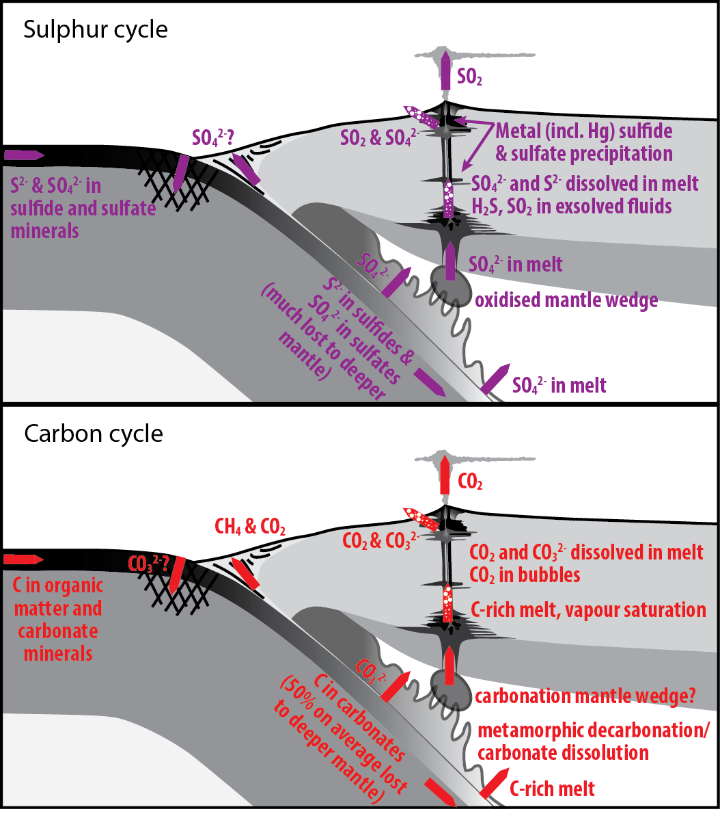
How do gas emissions relate to volatile cycling?
Decarbonation and desulfurization of slab poorly constrained.
Volcanic gas geochemistry suggest much carbon and sulfur derived from slab.
Links with biological cycling of volatiles (Barry et al. poster)
Extrapolation to the past
Zellmer, Edmonds, Straub, 2014
Notes:
The million dollar question is of course how do these volatile outupts relate to slab intputs and processing? Decarbonation by metamoprhic reaciton is thought to be very inefficient on all but the hottest slabs, but the process of carbonate dissoluation might be responsible for mobilising carbon dissolved in aqueous, solute-rich fluids. The gas geocehmistry suggest significant input from slab compeonts. An interesting future resaerch direction is the proposal under review by the slaon foundation to look at the influence of biological carbon on subduction processes.

Slide 19
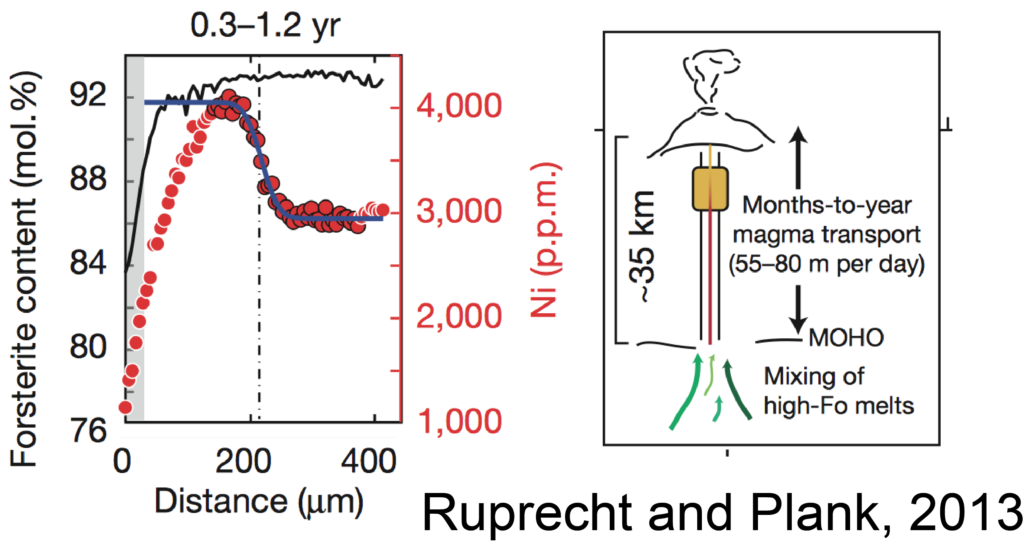
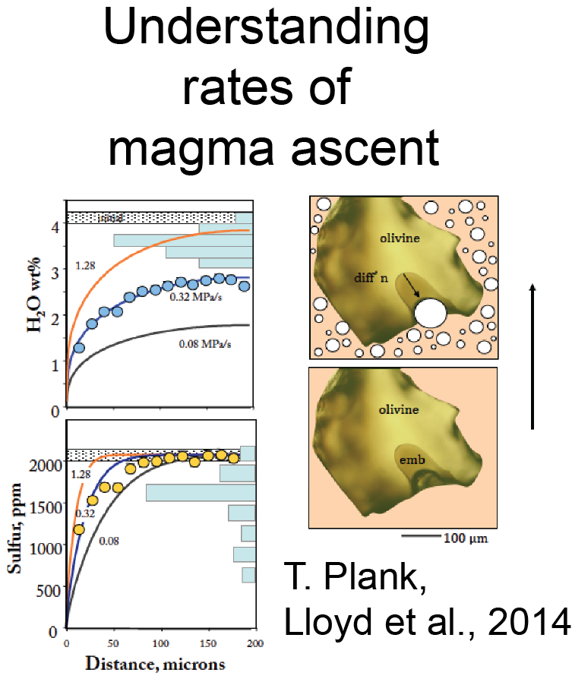
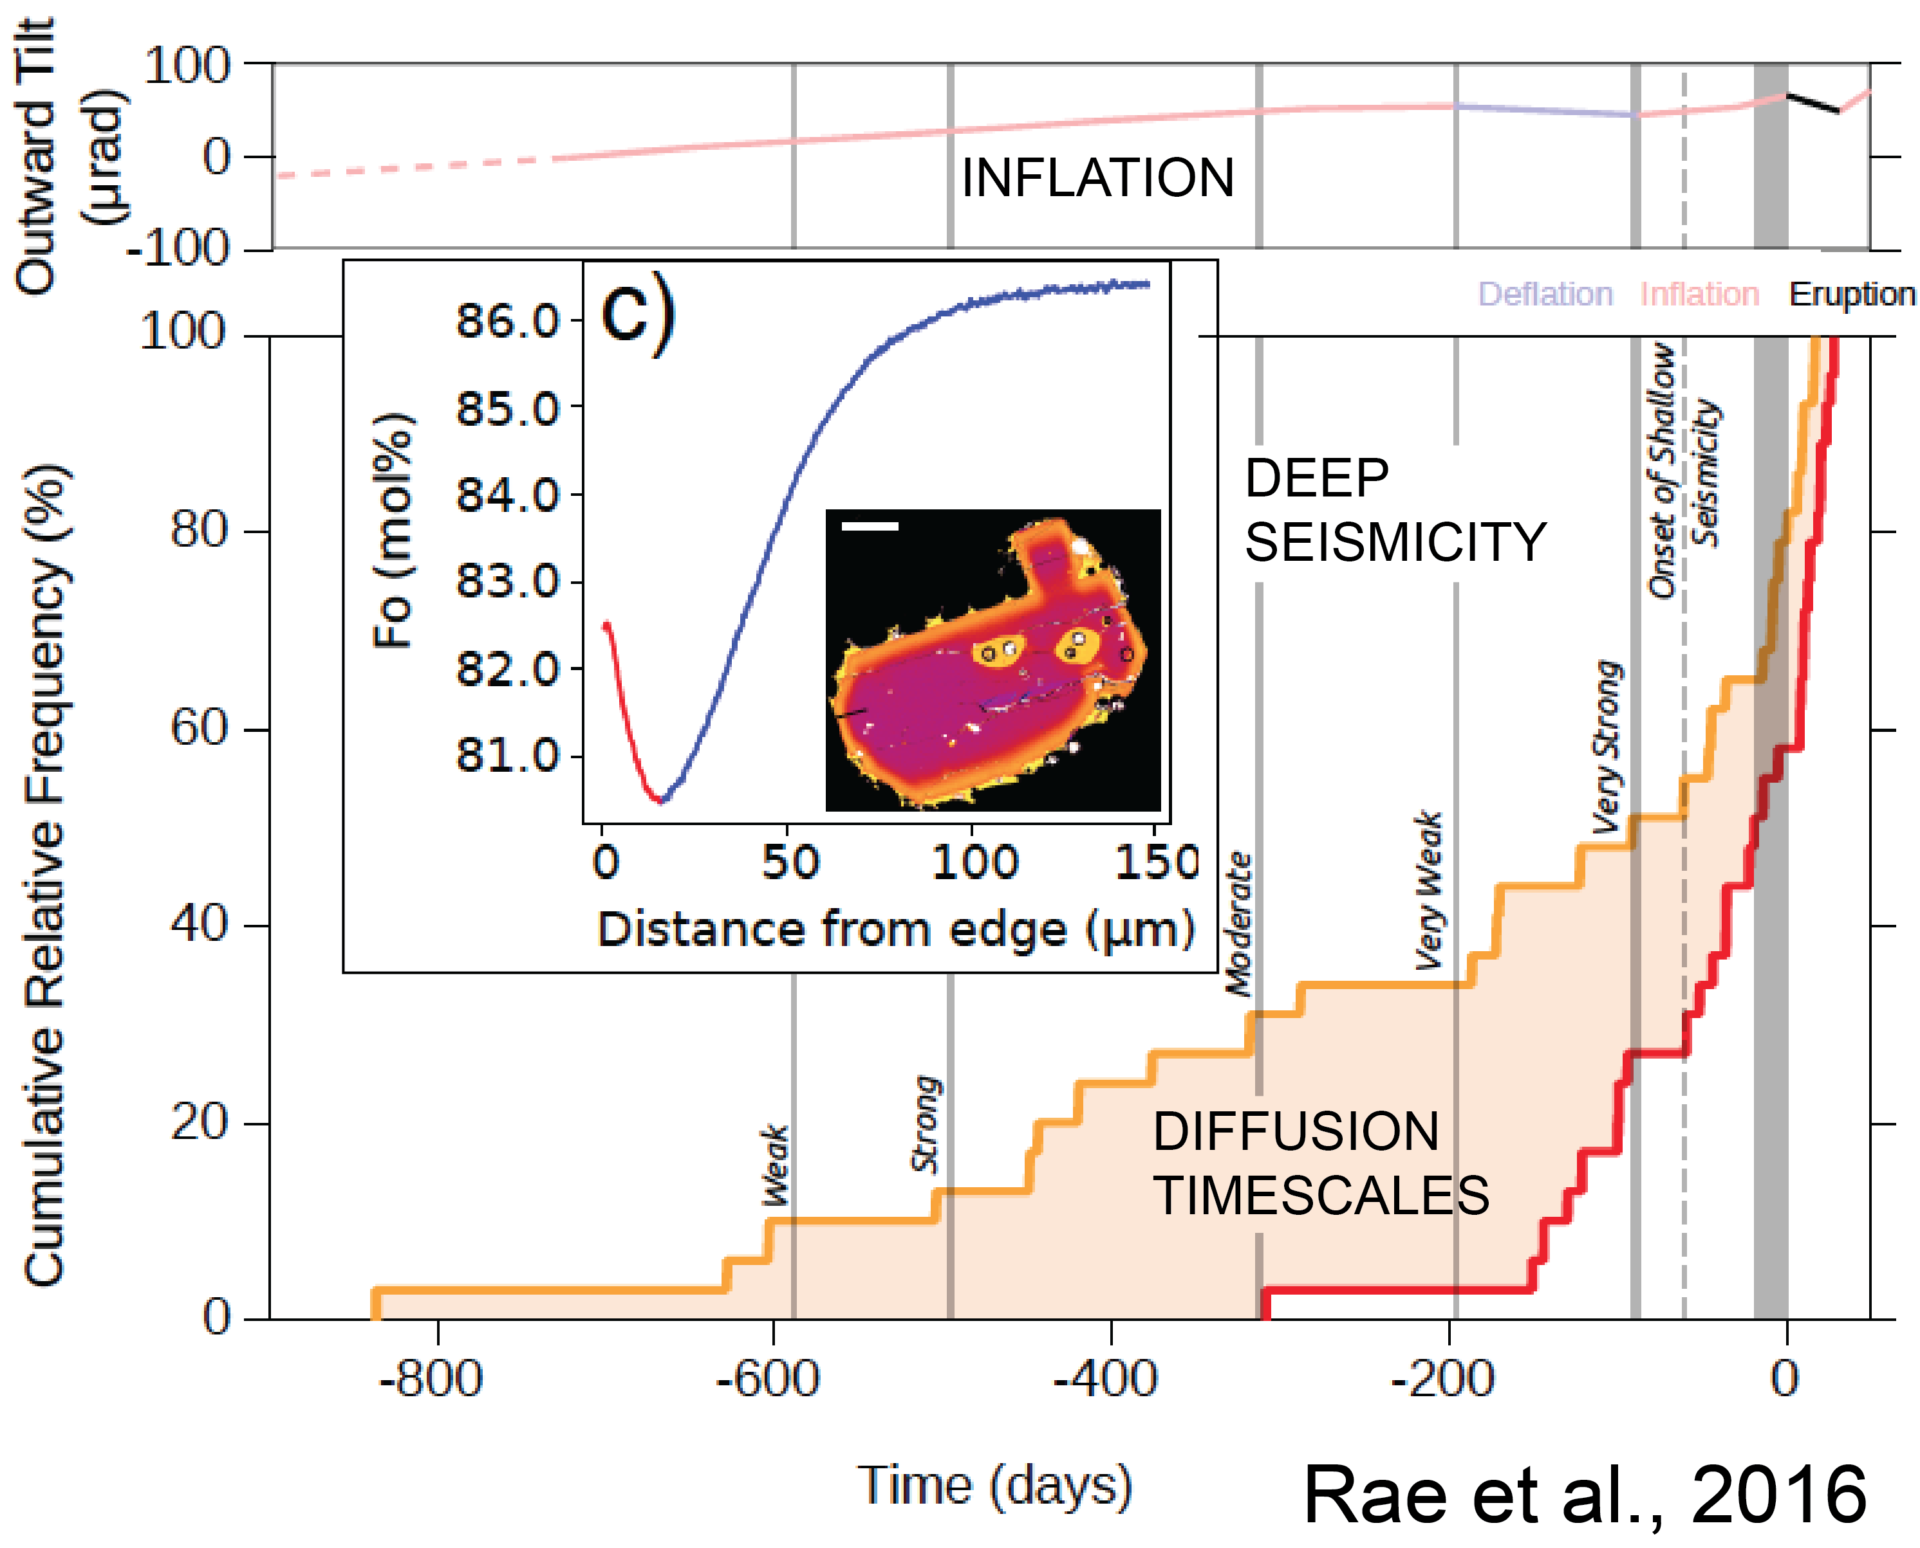
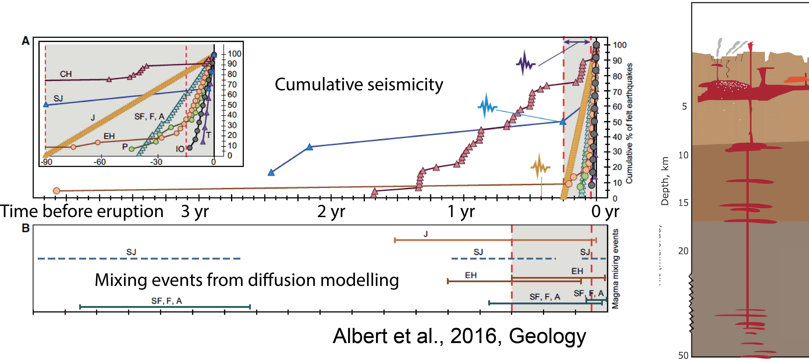
Quantitative petrology
Notes:
A major development in volcanology has been the advent of geochronology absed on diffusion modelling to a range of vocalnic problems. Profiles in volatile concentratoins in embayments in open melt inclusions have beben sused to infer magma ascent rates; Ni and other element diffusion have been used to infer magma ascent rates from the mantle to the surface in subduction zones by Ruprecht and Plank. A couple of other studies I would highlight here are Rae et al., from my group, who try to link diffusion timecsales from olivines with the timings and depths of earthquakes beneath Kilauea; and a very new study from Albert et al who look at a range of subduction-related monogenetic eruptions, those are “one-off” eruptions, linking timescales of magma mixing with the onset of seismiciity prior to eruptions to infer timescales of magma ascent, in this case 1-2 years prior to eruptions.

Slide 20
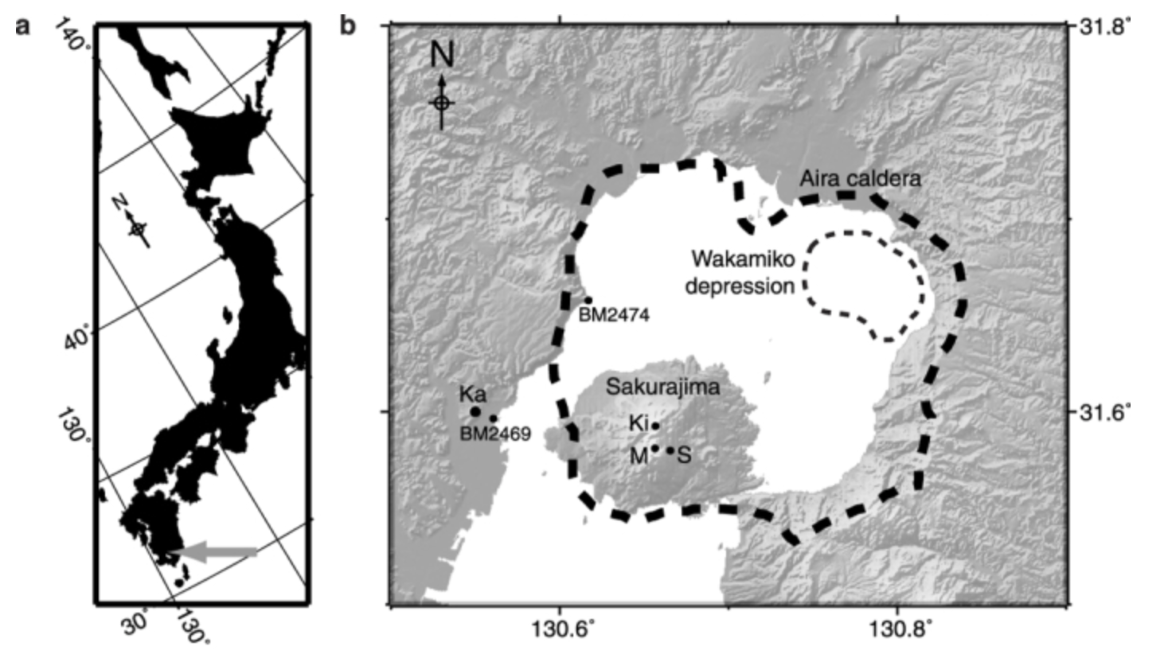
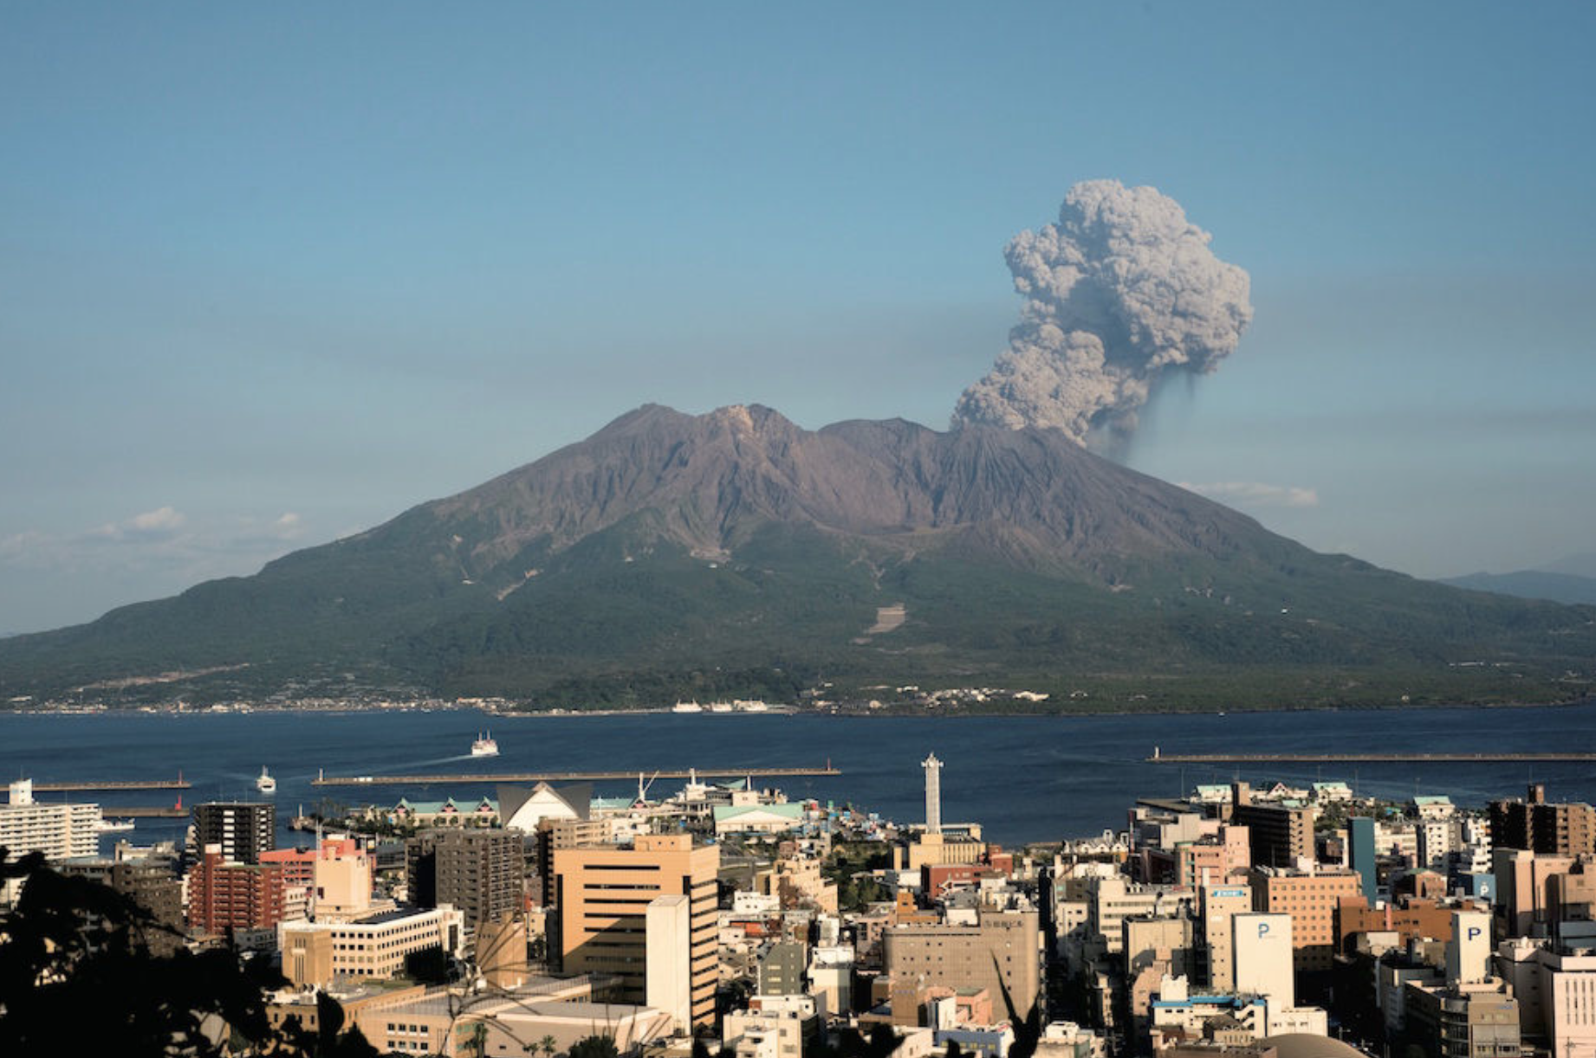
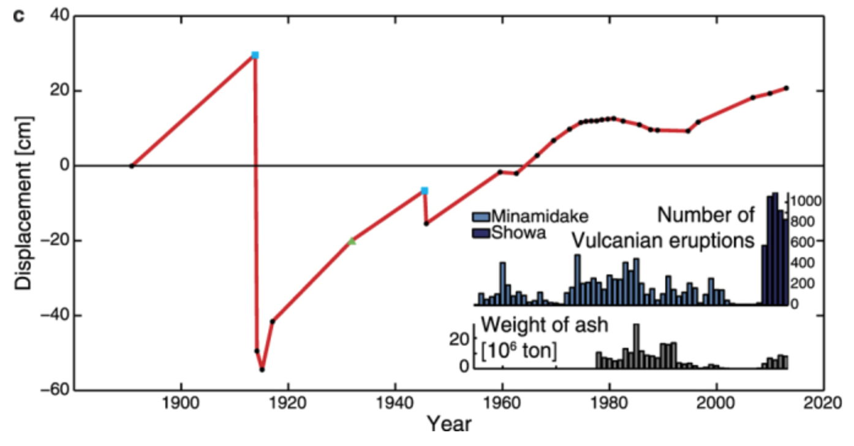
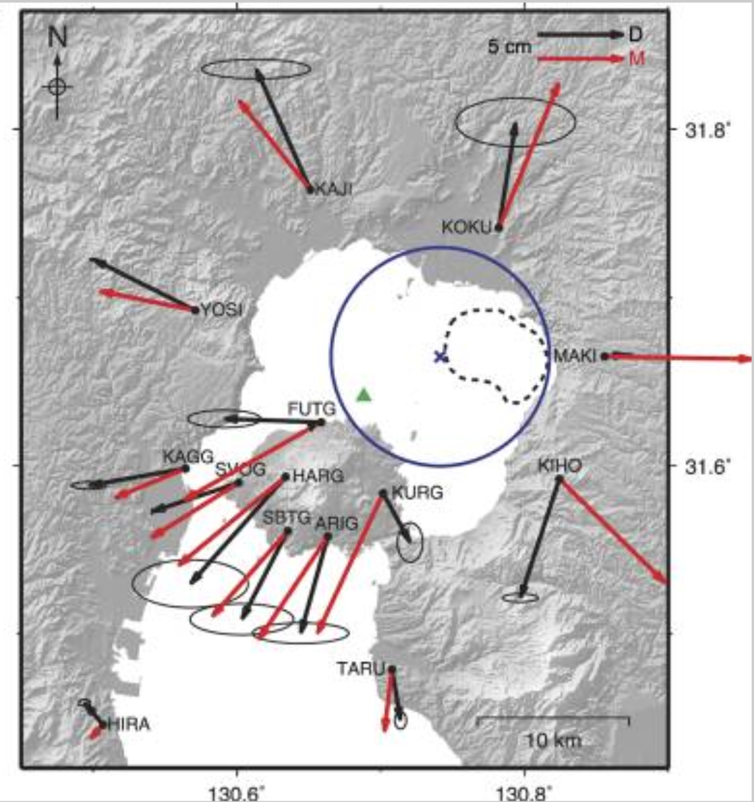

Deformation associated with compressible, complex magma mushes
Heterogeneous crust (from p wave tomography)
Non-uniform temperature, viscoelastic response
Non-spherical source
Finite element mesh
Hickey et al., 2016
Notes:
Modelling geodetic data has increasingly taken on board these new models of magma reservoirs. Here is a recent example from Hickey et al., part of the COMET project in the UK, who model magma intrusion into s complex reservoir beneat Sakurajima volcano in Japan, utilising a heterogeneous crust (from p wave tomogarphy), a non uniform temperature, non-spherical source, visco=elsastic response to rpoximate the mush, and a finite element mesh to account for laterally and vertically extensive storage zones.

Slide 21
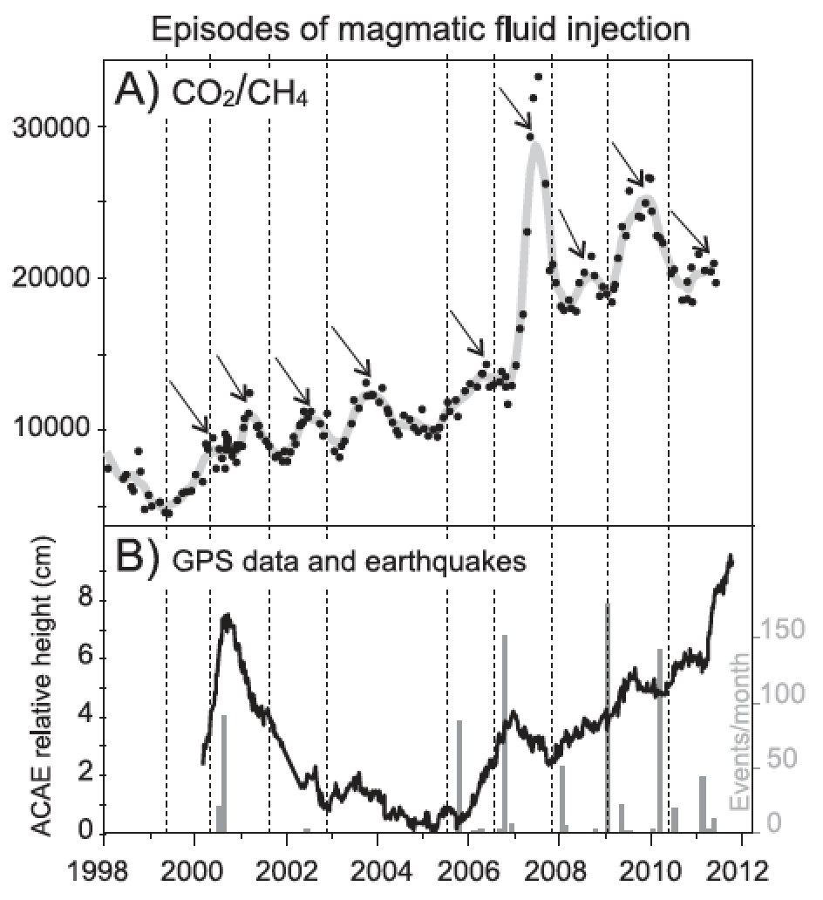
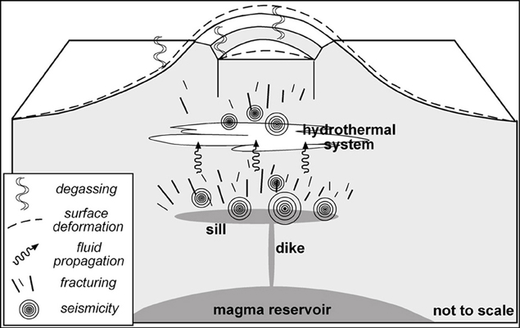
Volcanic unrest:
interaction between magmatic fluids and hydrothermal systems
Hurwitz et al, 2007
Chiodini et al., 2012
Acocella, 2014
Notes:
I want to highlight the importance of understanding hydrothermal systems, which are a major cause of unrest, still frquently confused with magmatic activity. Hydrothermal activity which occurs as a result of input of magmatic fluids results in geochemical, geodetic and seismic manifestations which should be distinctive, as shown by pionneering work by Hurwitz and later by Chiodini, showing cycles. This is an area where much progress reamins to be made, particularly on the observational side.

Slide 22
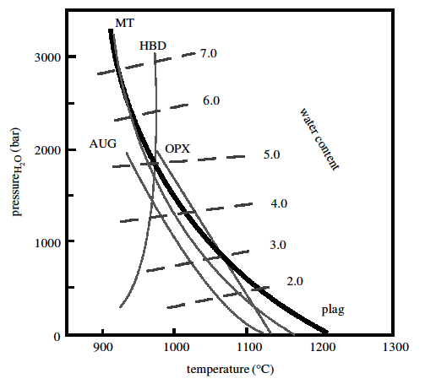
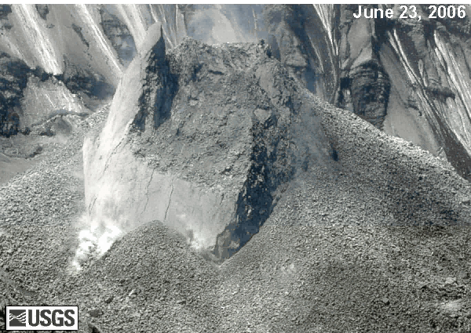
Rheology and rock mechanics
Pallister et al., 2008
Cashman et al., 2008
Phase diagram for a hydrous andesitic melt
Notes:
The Mount St Helens seruption 2004-2006 showed us, once again, the importance of magma rheological properties in deterning eruption style and seismciity. The ascent of magma is associated by enormous rheological changes in the upper 1-2 km of the conduit as a result of water exsolution and degassing-inducated crustallisation, which ultimately results in the etrusion of almost olid magma plugs, as shown here in a USGS video.

Slide 23
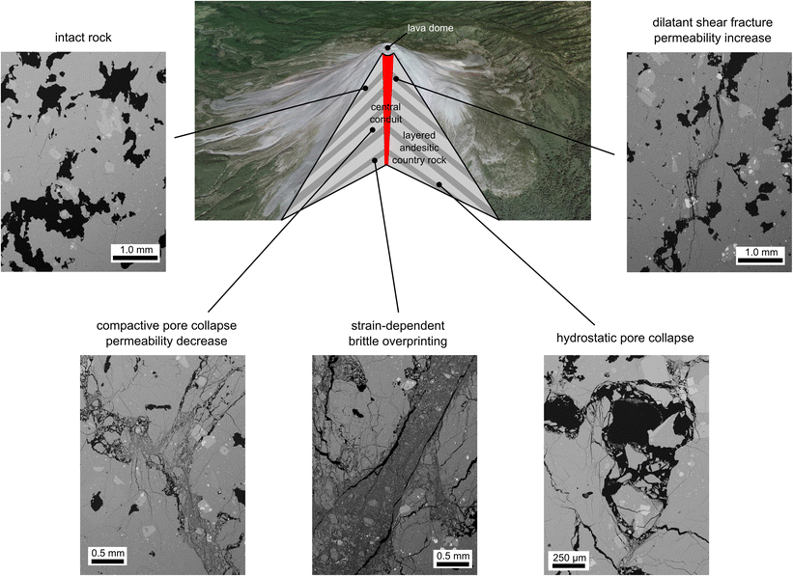
Advances in rock mechanics:
Implications for understanding seismicity and permeable gas flow
Tuffen et al., 2003
Heap et al., 2015 Bull. Volc.
Notes:
These observations led to a renewed effort to understand the details of the rock mechanics responsible for rock fracturing and fluid fluid in arc volcanoes; which is shown here as a sequence of BSE images of variably factured and strained rocks. These subsolidus relationships are first order control on the build up of overpressures in the sjallow system of arc volcanoes.

Slide 24
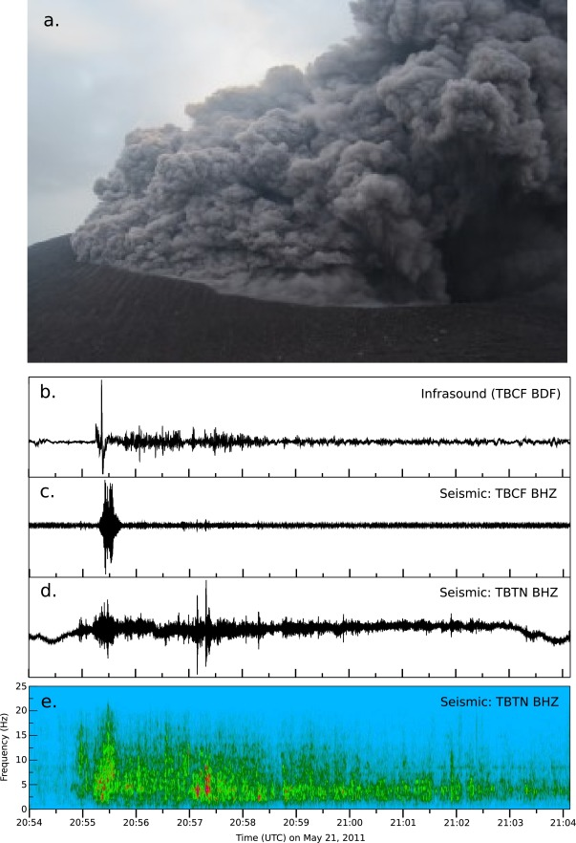
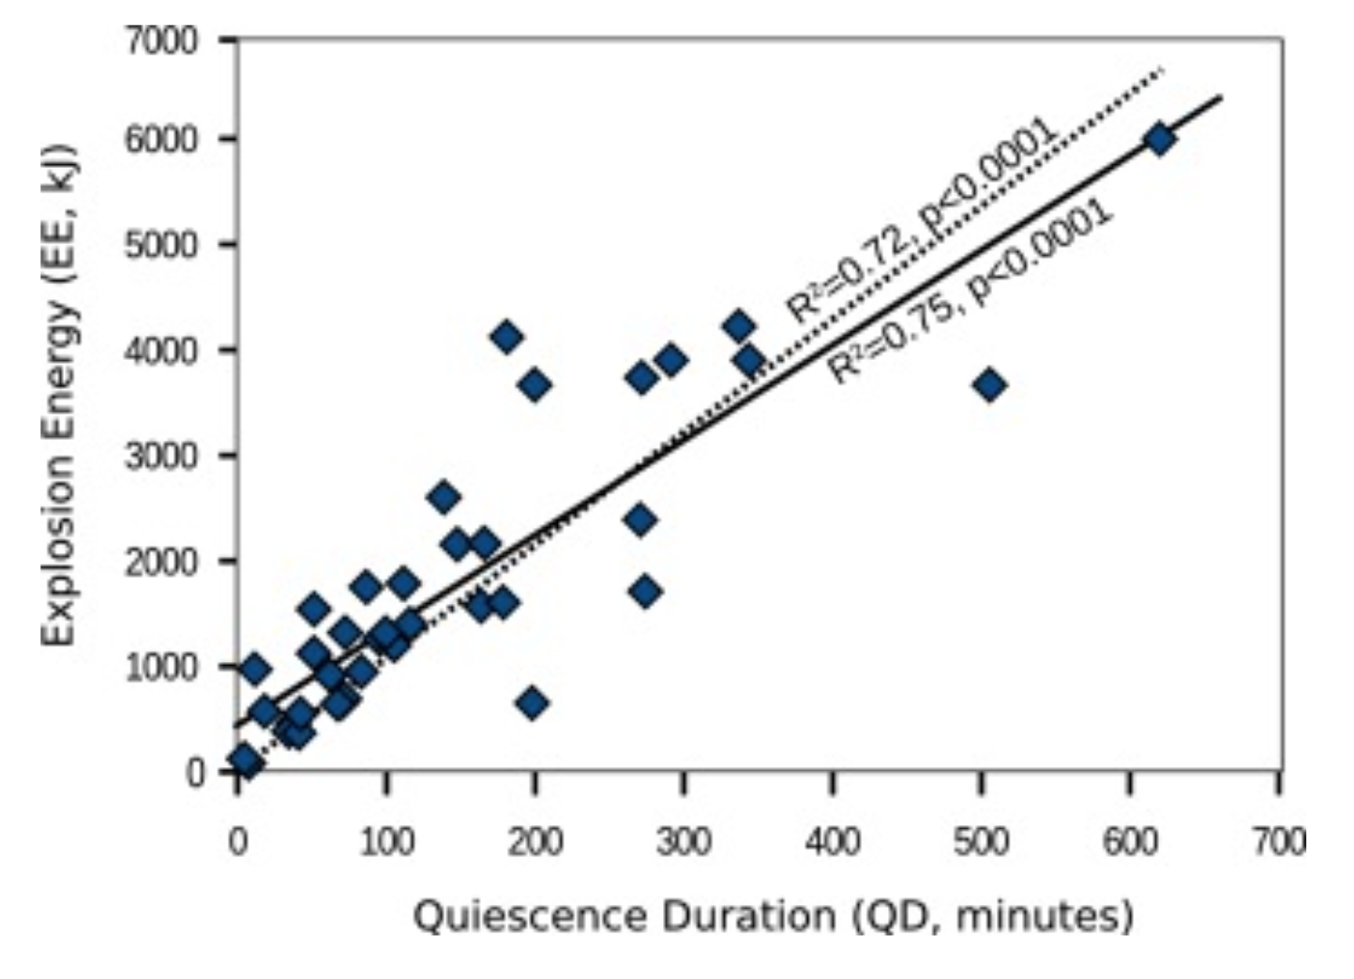
Explosions caused by conduit sealing and gas overpressures at Telica Volcano
Roman et al., 2016, EPSL
Notes:
A recent study led by Diana Roman showed this very nicely at Telica Volcano in central America, where periods of quiescence are followed by explosions; it was found that the quiescence duration was direcrly proportional to the energy releasesd during the explosion, suggesting that the explosions are caused by thr build up of fluid pressures in quasi-permeable systems.

Slide 25
Edmonds and Wallace, in press, Elements
Notes:
This, as well as magmatic fragmentation processes, leads to a huge range of eruption styles in arc volcanoes. Understanding these eruption processes feed directly into hazard assessment.

Slide 26


Integrated models of magma storage, transport and eruption
Gas emissions,
Summit and rift
InSAR data
Anderson and Segall, 2011, 2013
Anderson and Poland, 2016, EPSL
Notes:
A last feature I would highlight are the increasing efforst to understand multiple streams of monitoring data in tandem – geodetic, seismic, geochemical. Numerical models using Bayesian approaches to deal with uncertainties in the data are proving to be successful in predicting first order parameters such as eruption rates, taking into account the comporesibility of magma.

Slide 27

Rabaul
@pngvolc2016
Bagana
Ambrym
Allard et al., 2015
Complex magma reservoirs, frequent magma recharge
Implications for interpretation seismic/deformation/gas
Understanding signs of unrest – recharge/hydrothermal
New opportunities - instrumentation
Integrated monitoring and models
Notes:
To conclude I leave you with this image of the Papua New guinea and Vanuatu arcs, to highlight a field campaign underway as we speak, led my postdoc Brendan McCormick, to understand volatile cyclng in PNG; and a recent paper showing the prodigious volatile outgassing at Ambrym. During this talk, I’ve shown you evidence for complex magma reservoirs, characterised by frequent magma recharge which we could target; and the implications of this model for understanding monitoring data. I’ve highlighted in particular the need to understand volcanic unrest which might be caused by recharge or by restless hydrothermal systems, and new opportunities and instrumentation; and the pressing need to bring it all together to make integrated models.

