Slide 1
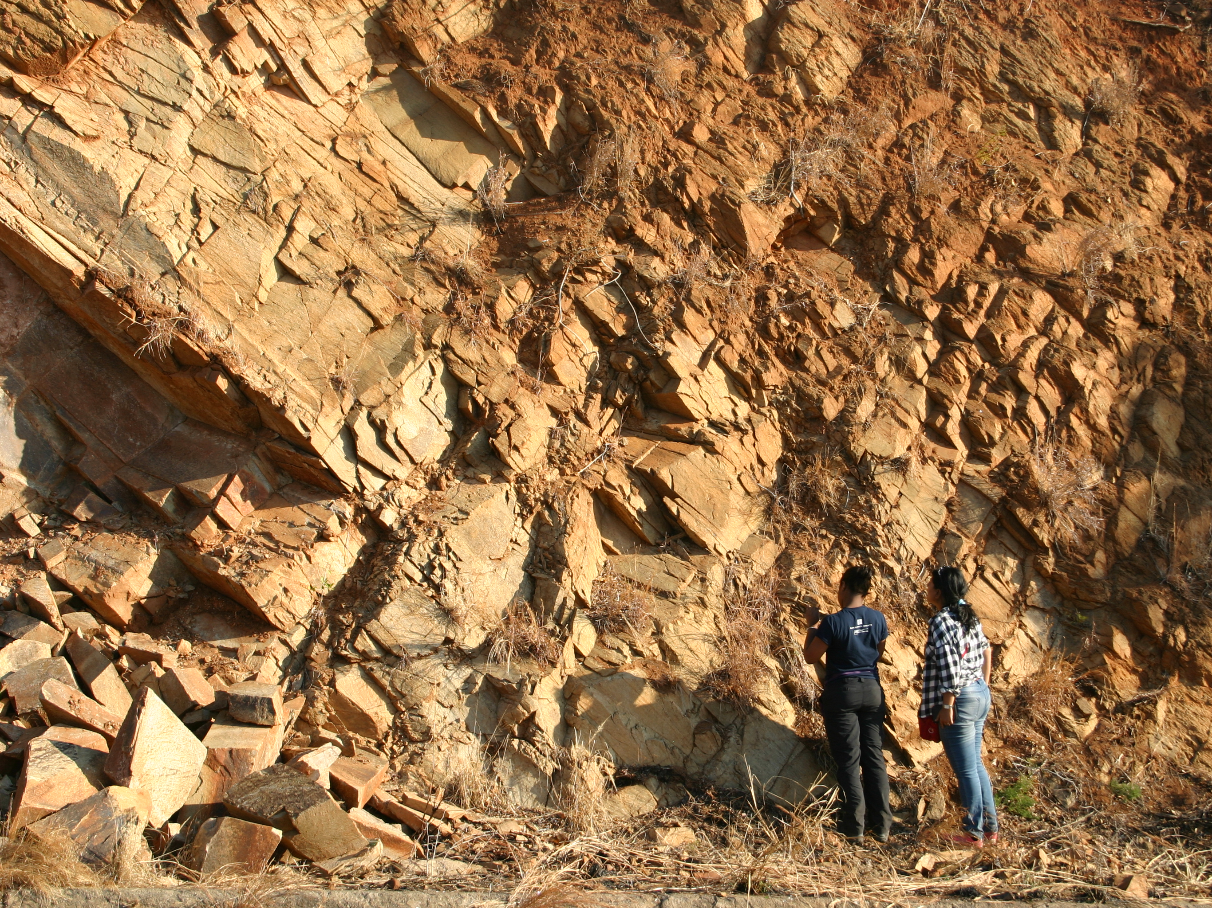
Experiential Education: Integrating Research, Education, and International Collaboration Maureen Feineman Pennsylvania State University

Slide 2
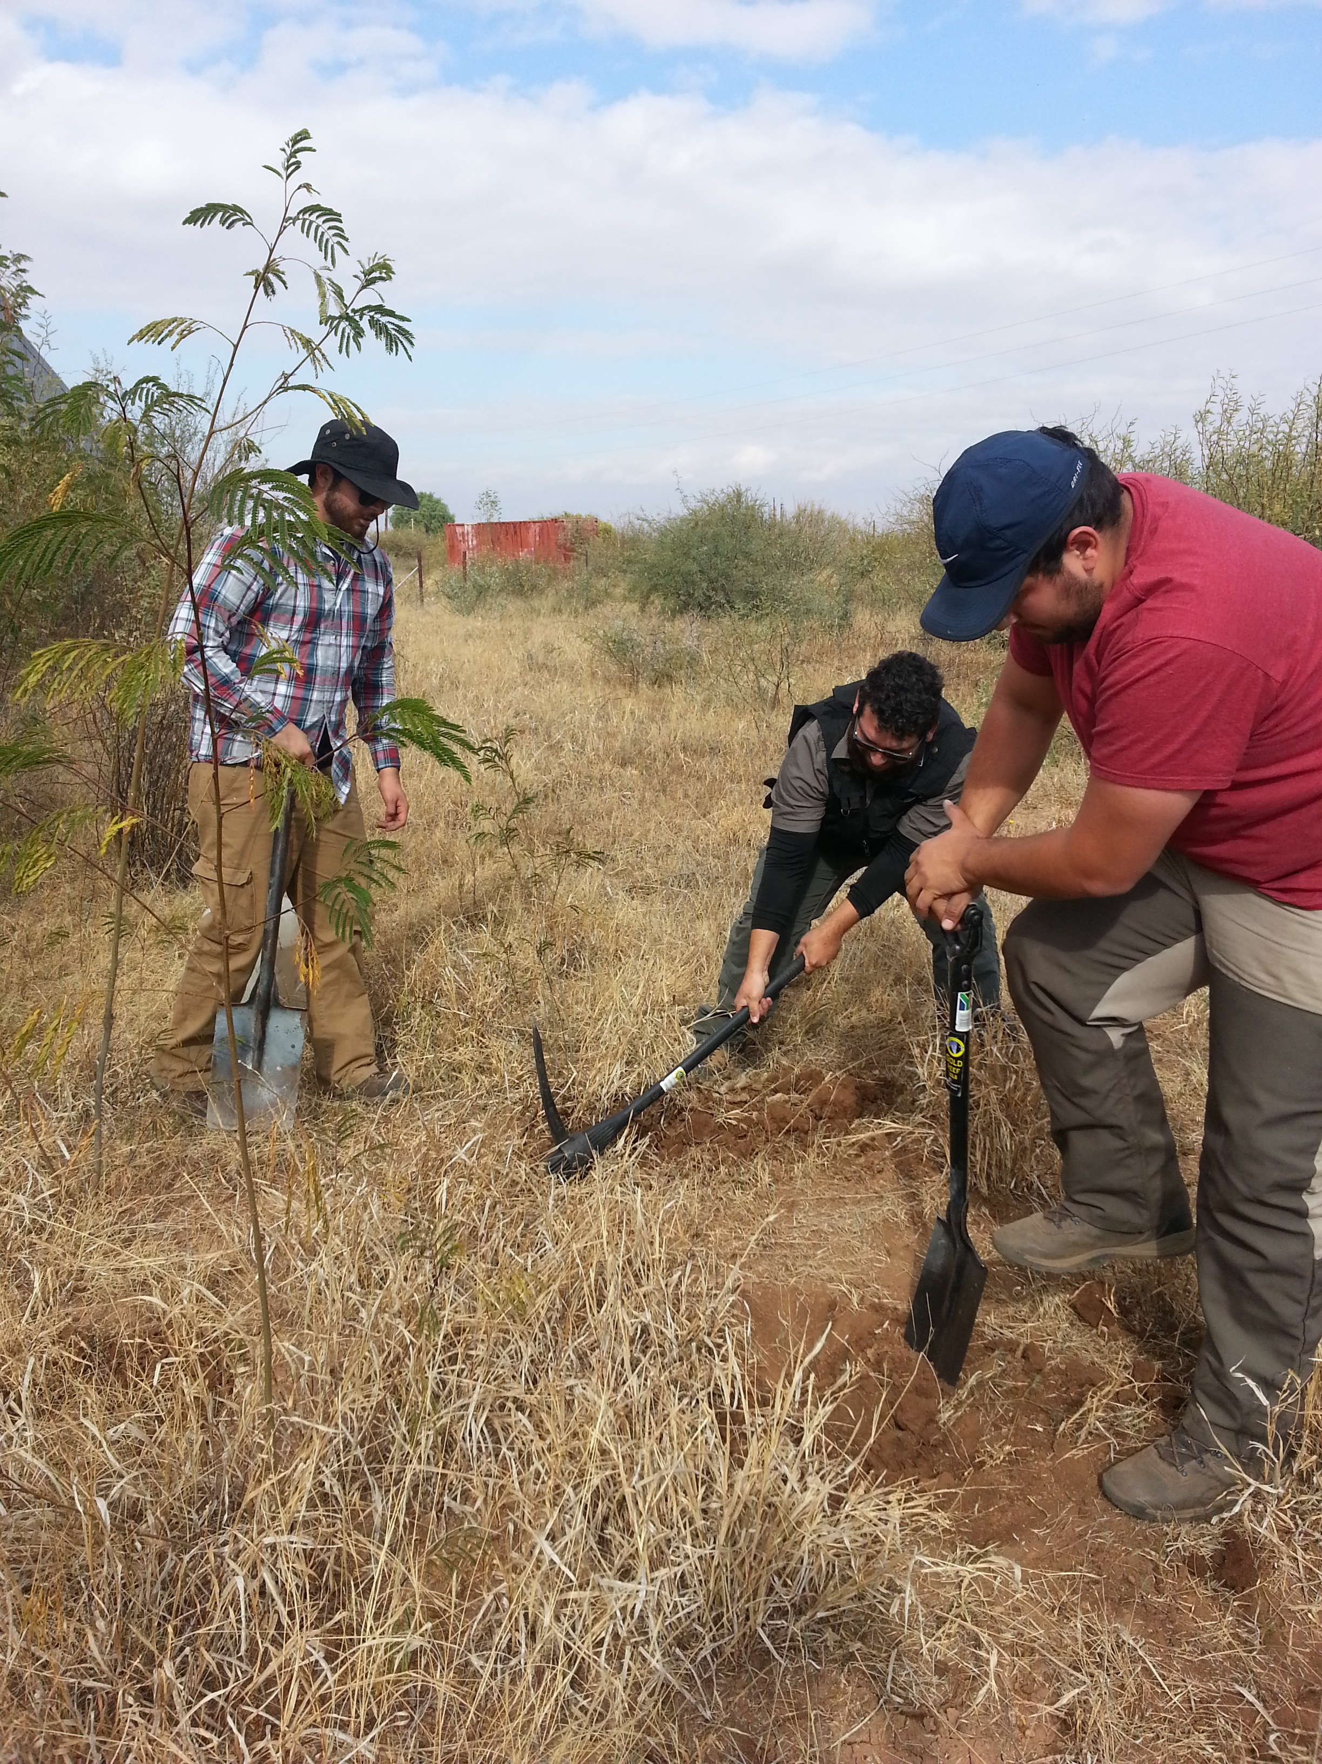
Active Learning in the Field
Is field-based learning inherently active learning?
Perhaps not, but field work is exceptionally well-suited for active learning approaches

Slide 3
Problem-based Learning
Goes beyond observation
not just “What do you see?”, but also “What does it mean?”
Guide students through process of critical thinking to “discover” the answer

Slide 4
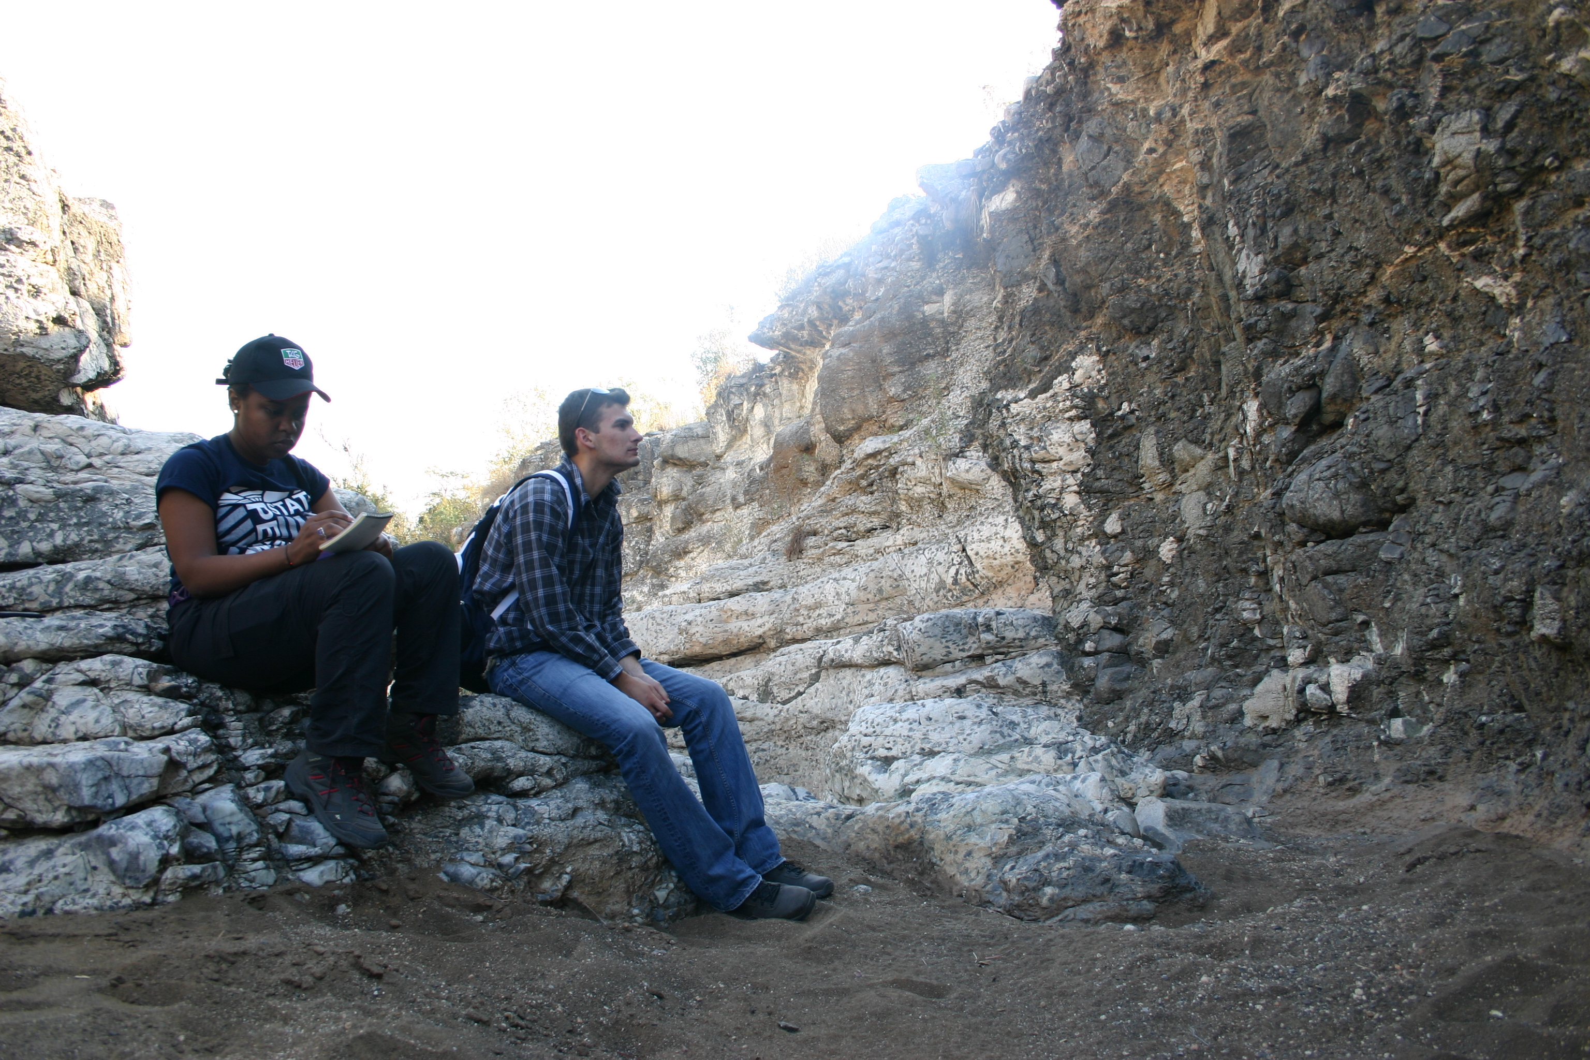
Personal Reflection
Key part of processing the learning experience
Journaling, blogging, reflective essays, reports

Slide 5
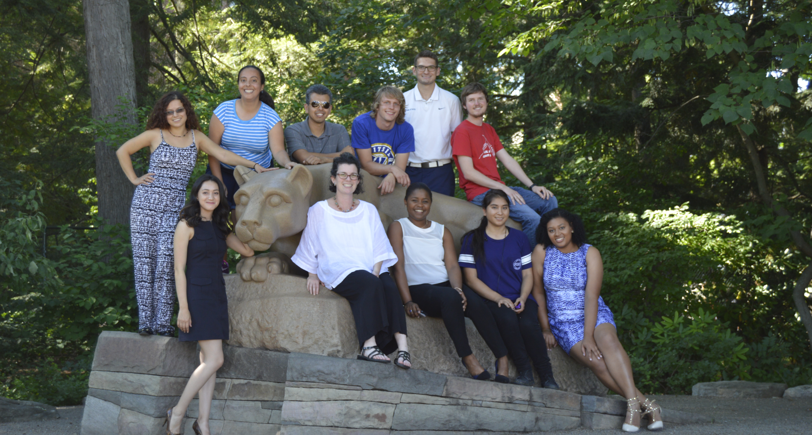
The Cohort Experience
The learning experience is reinforced when shared with a group, more so than individual research

Slide 6
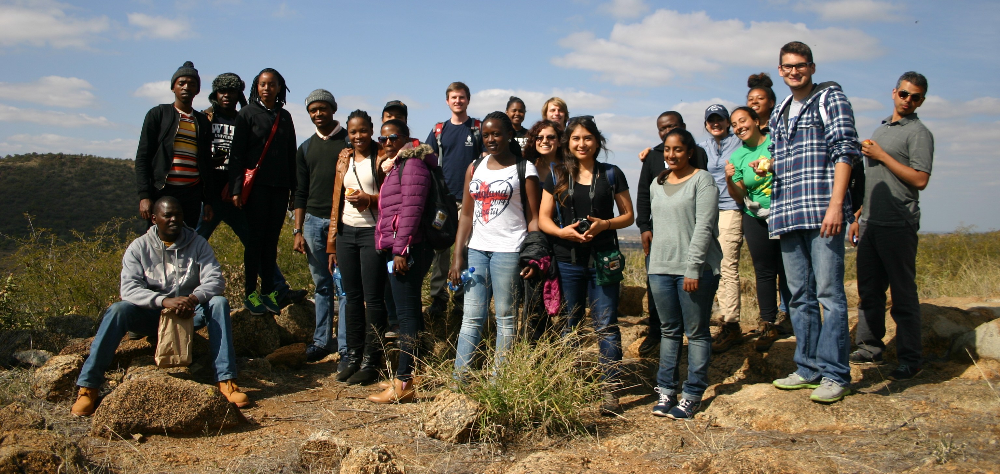
International Collaboration
Everyone wins when we work with the people - and students - who live in the places we study

Slide 7
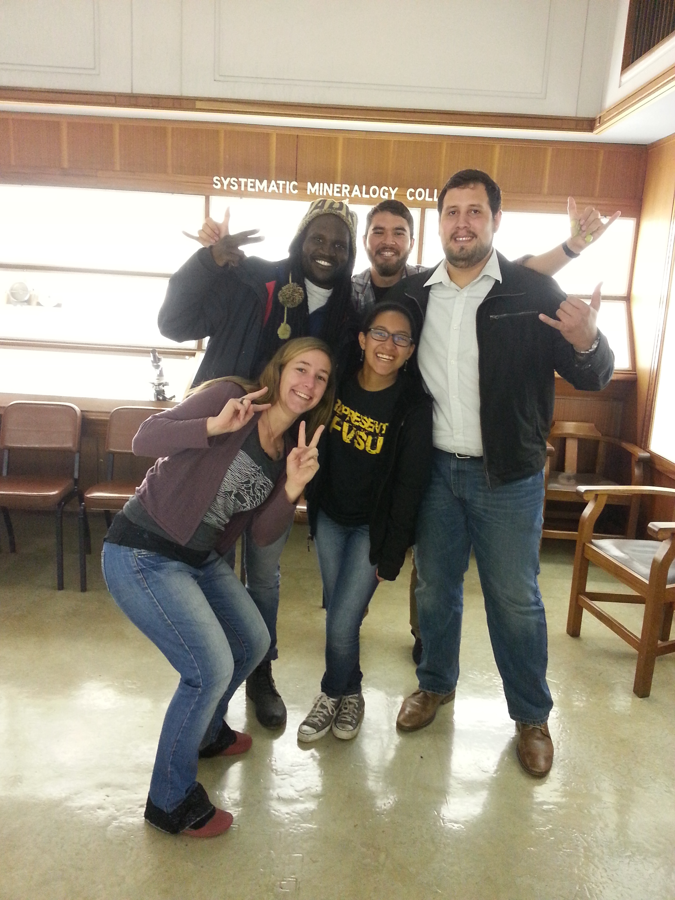
Prioritize Real Diversity
Mix of races, religions, and nationalities
Range of ages and experience levels
Gender balance
Socioeconomic backgrounds
Students with disabilities
LGBTQ rainbow
Undergraduate-only universities
No need to exclude exceptional white males!

Slide 8
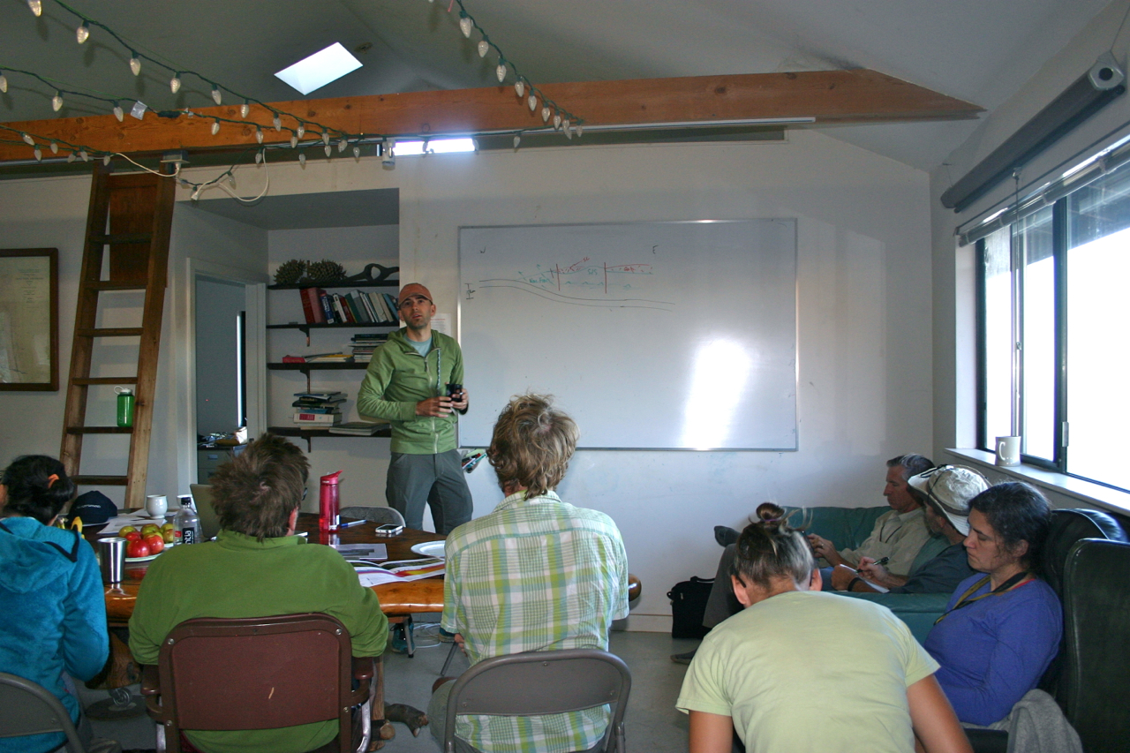
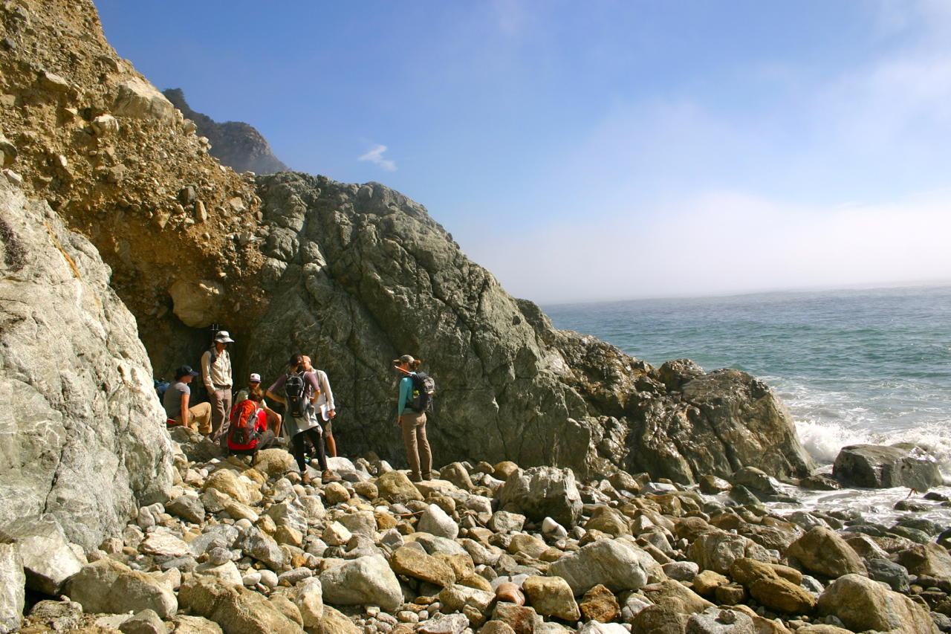
Field Institutes
Field trips with a scientific mission
Go beyond show-and-tell
Example: ExTerra Salinia Field Institute 2014
Morning lecture at the UC Whale Point facility
Afternoon sampling arc crust exposure

Slide 9
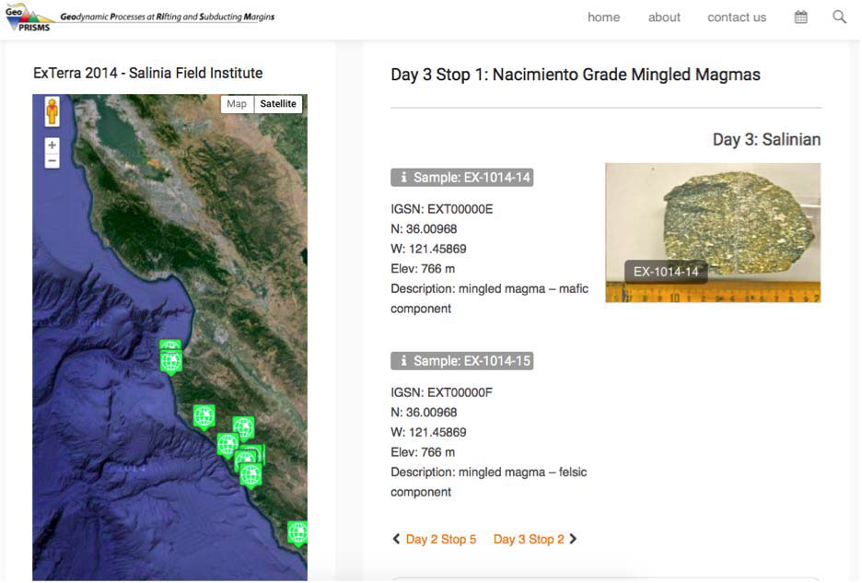
Field Institutes
Data / samples can be shared for research and education purposes
Samples assigned IGSN and archived
Data shared using publicly available data portals and databases
ExTerra Salinia Field Institute 2014
http://geoprisms.org/exterra/field-institutes/exterra-2014-salinia/

Slide 10
PIRE: Partnerships in International Research and Education
~$4 million over 5 years
Stresses international partnership
Serves educational / training mission
Addresses a relevant scientific problem

Slide 11
E-FIRE: ExTerra Field Institutes and Research Endeavor
5-year study of exhumed slab-mantle interface exposures in Western Alps
10 US faculty at 9 institutions and 9 European partners
Partnership with “ZiP” Marie Curie Training Network in EU
8 PhD students & 2 postdocs
2 field institutes in the Western Alps
Trellis, Google Hangouts for group communication

Slide 12
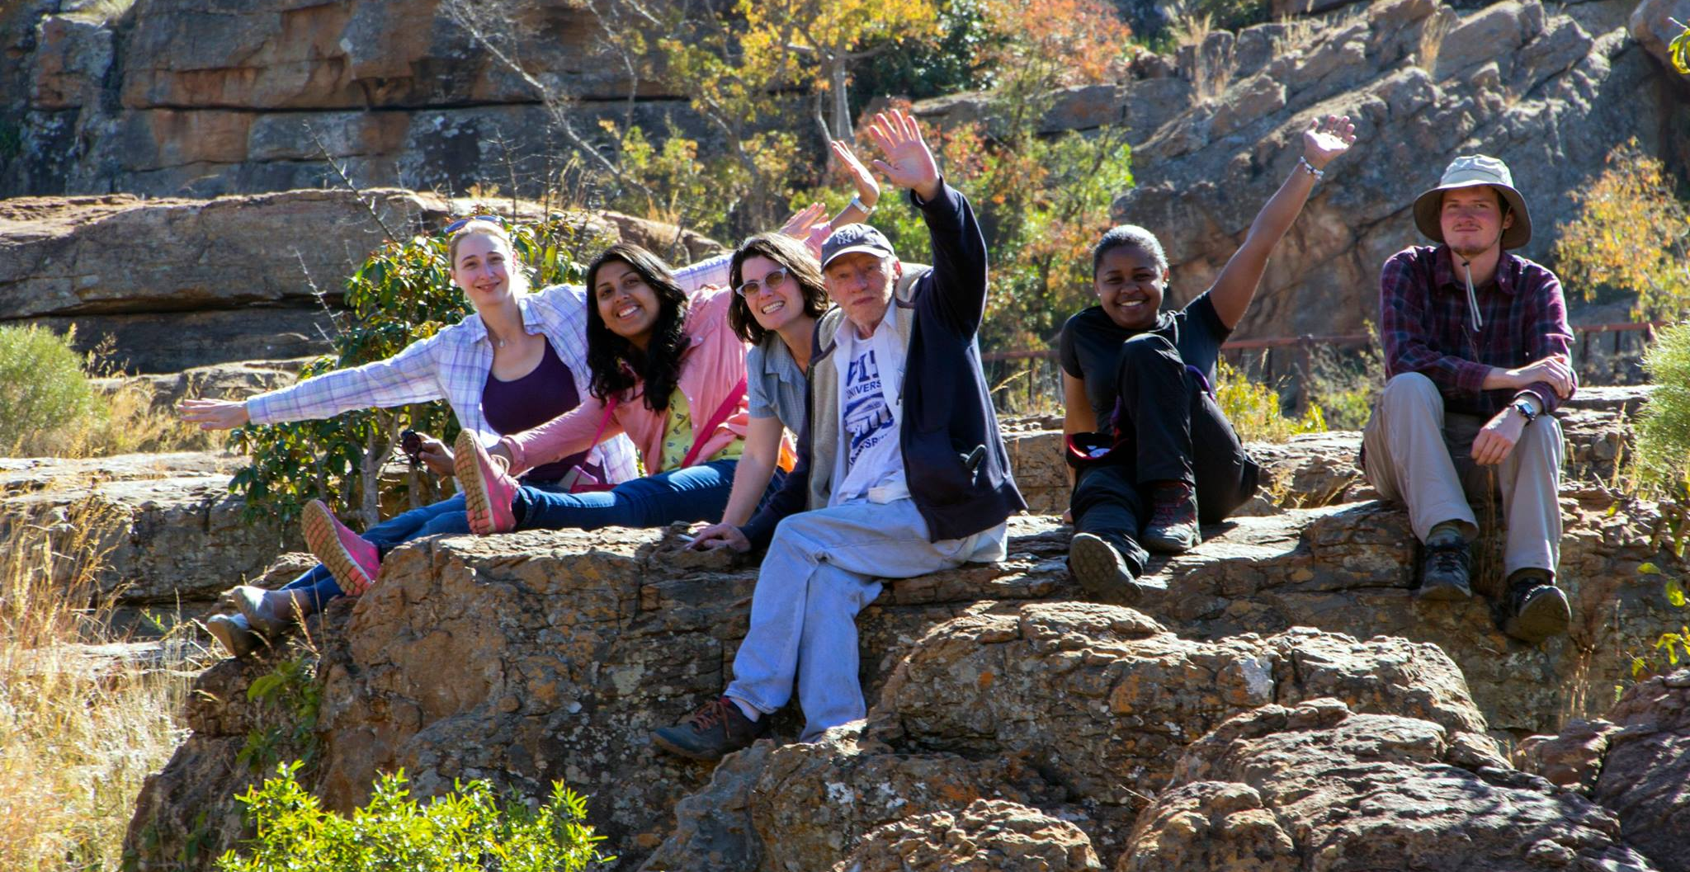
REU: Research Experience for Undergraduates
REU sites can host cohorts
Provides participant support for undergraduates
No reason grad students and postdocs can’t be involved as mentors
Penn State – AfricaArray REU 2016

Slide 13
Looking Forward
SZO can adopt PIRE- and/or REU- inspired model internally, or coordinate a group proposal to NSF
Work together! It can be much more rewarding to have an annual cohort of student researchers working together than to have each PI supervising one or two independently.
Be mindful. Embrace diversity, not checkboxes. Include the locals, especially students.

Slide 14
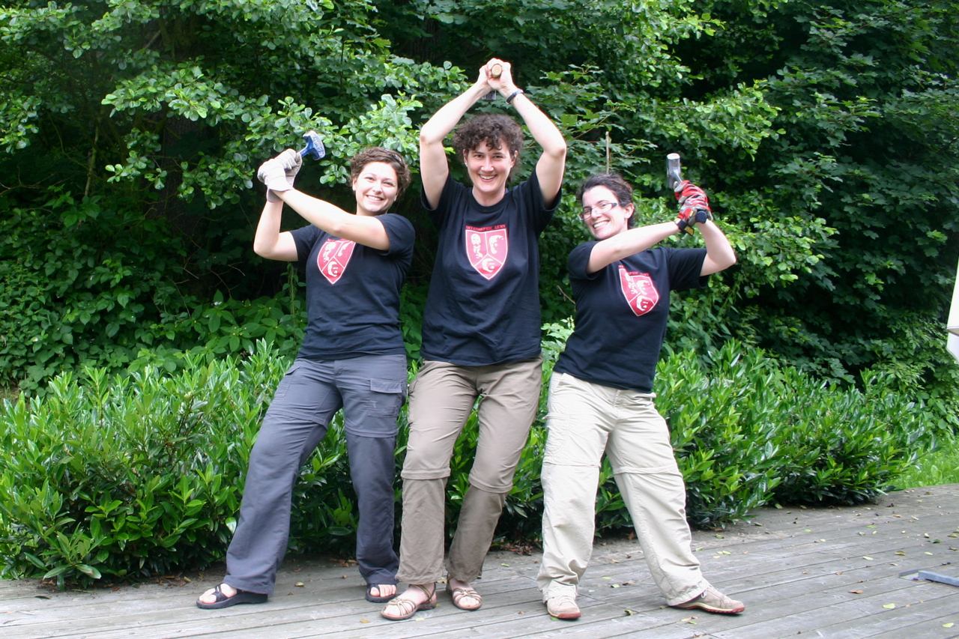
We are the Metamorphic Army
You will be assimilated

