Slide 1
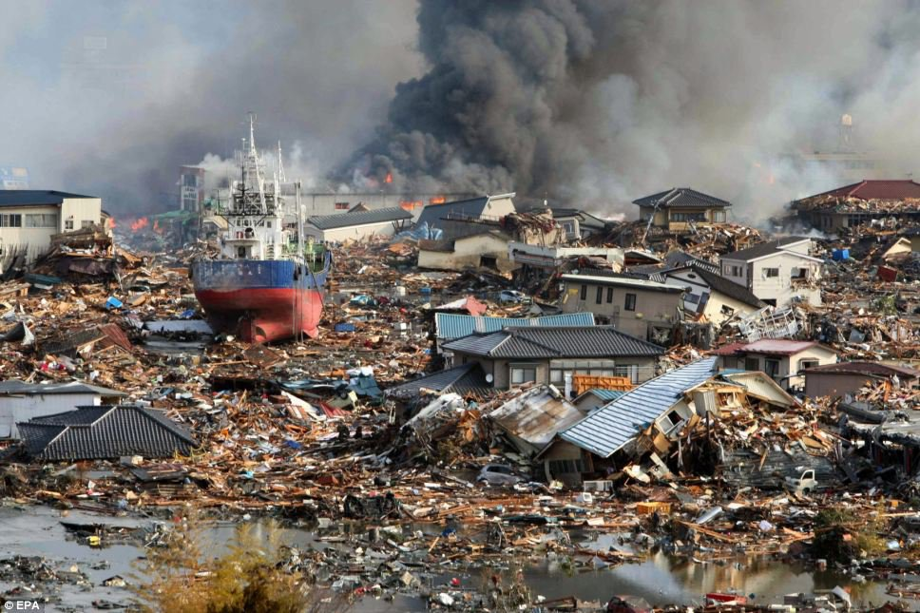
Research and Hazard Challenges Raised by
Recent Major and Great Earthquakes
Thorne Lay, University of California Santa Cruz
Notes:
1

Slide 2
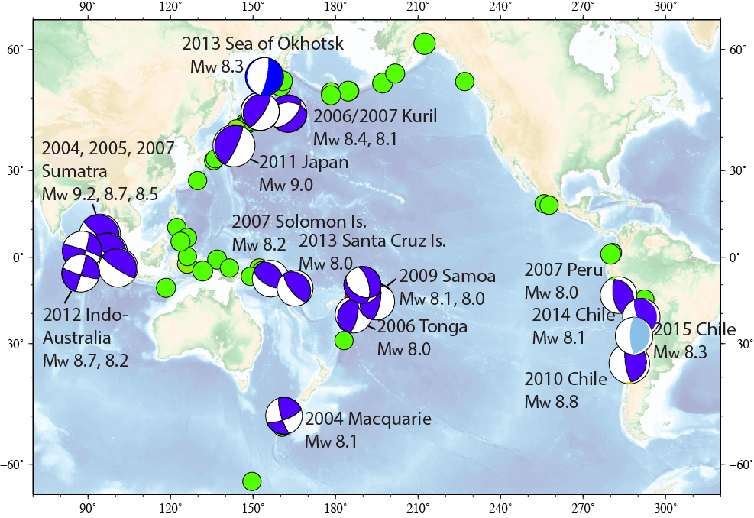
2004-2015 - 19 great earthquakes: rate 1.7/yr; rate over preceding century 0.7/yr
Green: M8+ earthquakes (1900-2003)
Blue: M8+ earthquakes (2004-2015)
Small Symbols: Great
Events 1900-2004
Updated from Lay, EPSL 2015

Slide 3
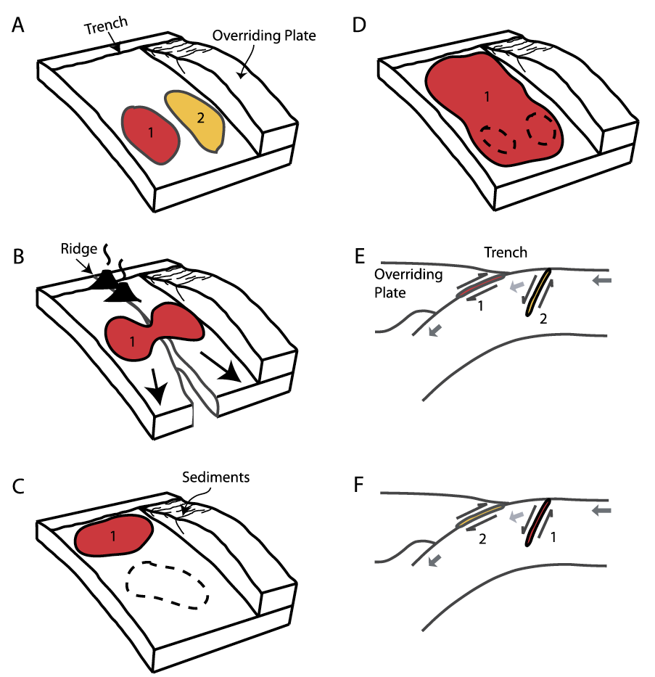
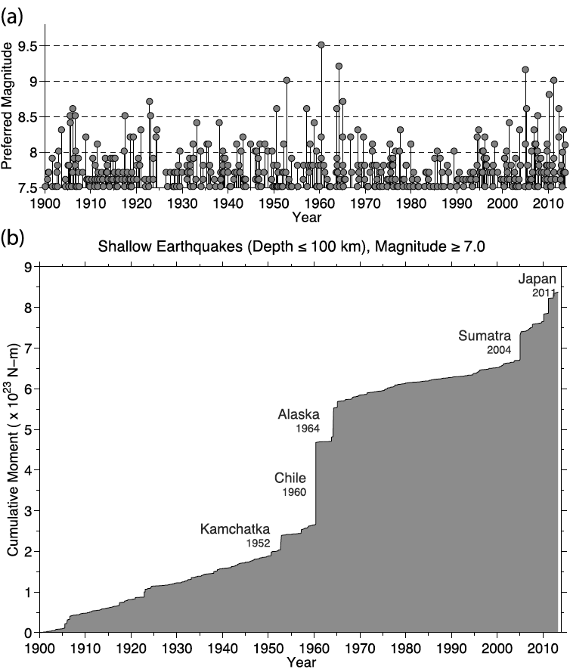
Large Earthquake Seismicity
Great Earthquake Scenarios
triggering interactions
Lay, 2015, EPSL
Notes:
In addition, the large earthquake did not occur regularly in time either. The surge of large earthquakes over last ten years have shown us a great diversity in the rupture pattern and earthquake triggering interactions.

Slide 4
Earthquake history gives useful guidance on behavior:
Seismic Gap notion – strain energy budget and seismic history
Site of great interplate rupture 2004-2015
McCann et al., 1979

Slide 5
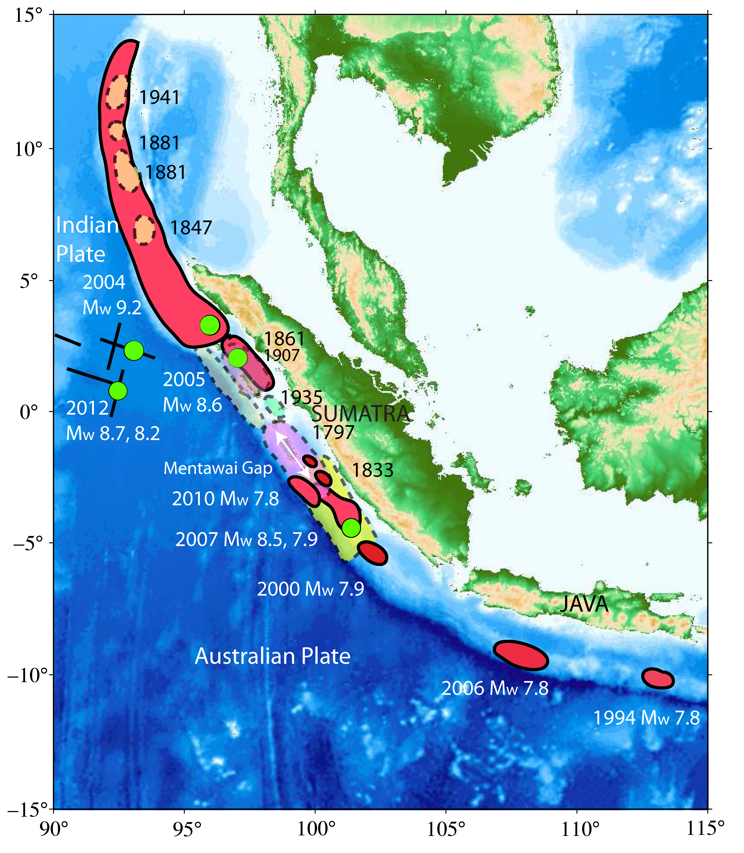
Sumatra-Sunda
Struck by a ‘cluster’ of great/very large
earthquakes since 2004.
Dec. 26, 2004 – ‘unexpected’ northward
extension to Andaman Islands. 9.2
March 2005 – adjacent ‘aftershock’. 8.6
July 2006 – Java tsunami earthquake. 7.8
Sept. 2007 – Kepulauan pair. 8.5, 7.9
Oct. 2010 – Mentawai tsunami
earthquake. 7.8
Similar to Alaska-Aleutians sequence of
1946, 1957, 1964, 1965
Where will the next one be? - 1797 ‘gap’?
Sumatran Fault? Sumba potential?
Lay, EPSL 2015

Slide 6
2001 8.4
2014 8.1
Remaining Mature
Seismic Gaps Along
Chile
30% 1868 zone
80% 1877 zone
1922 zone
2015 8.3
2010 8.8

Slide 7
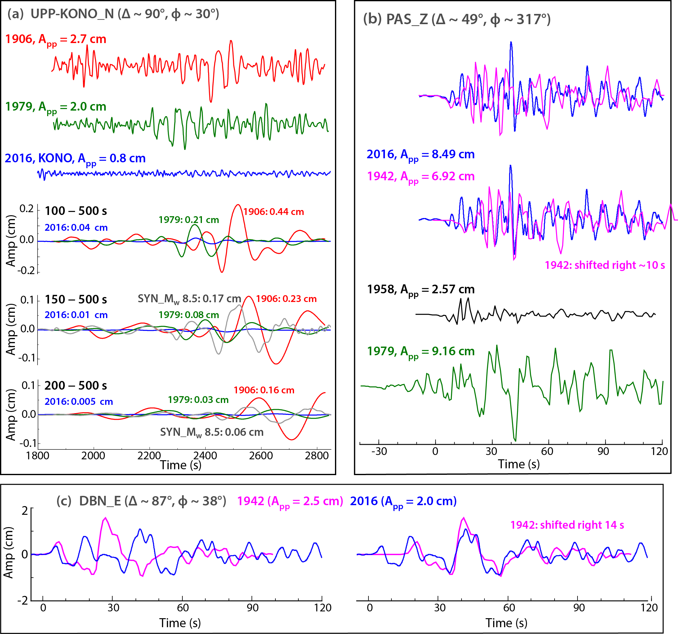
Are the recent events repeats?
Ye et al.,
EPSL in press

Slide 8
Large Mature Seismic Gaps That Could Be Targeted
Strain accumulation, seismicity
Mentawai Gap, near Padang (1797 last large rupture)
N. Chile Gap (1877; 20% ruptured 2014)
S. Peru Gap (1866; 70% ruptured 2011)
C. Chile Gap (1922)

Slide 9
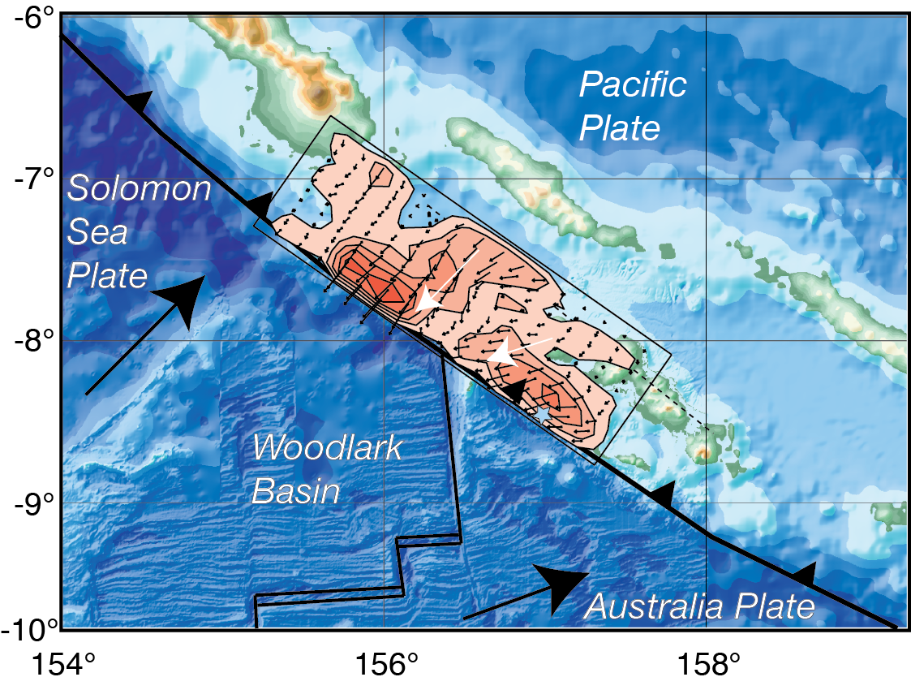
April 1, 2007 Solomon Islands Earthquake M_{w}=8.1 Rupture Across a Triple Junction
Furlong et al., Science (2009)

Slide 10
Subducting Ridge/Fracture Zone Structures That Could Be Targeted.
Strain accumulation (?), slow-slip events (?), tremor (?), hazard (?), friction (?), topographic effect (?)
Tehuantepec Ridge (Guatemala)
Carnegie Ridge (Ecuador)
Nazca Ridge (Peru)
Investigator Fracture Zone (Mentawai Gap)
Cocos Ridge (Costa Rica)
Louisville Ridge (Tonga)

Slide 11
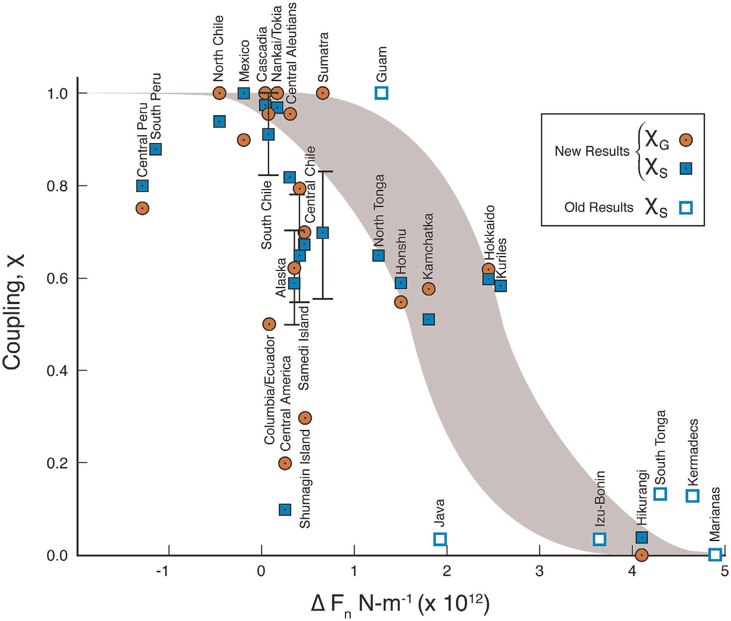

Slide 12
Subduction Zones with no history of great earthquakes.
Strain accumulation (?), slow-slip events (?), tremor (?), hazard (?), friction (?)
Tonga
Southern Kermadec
Izu
Marianas
Sunda

Slide 13
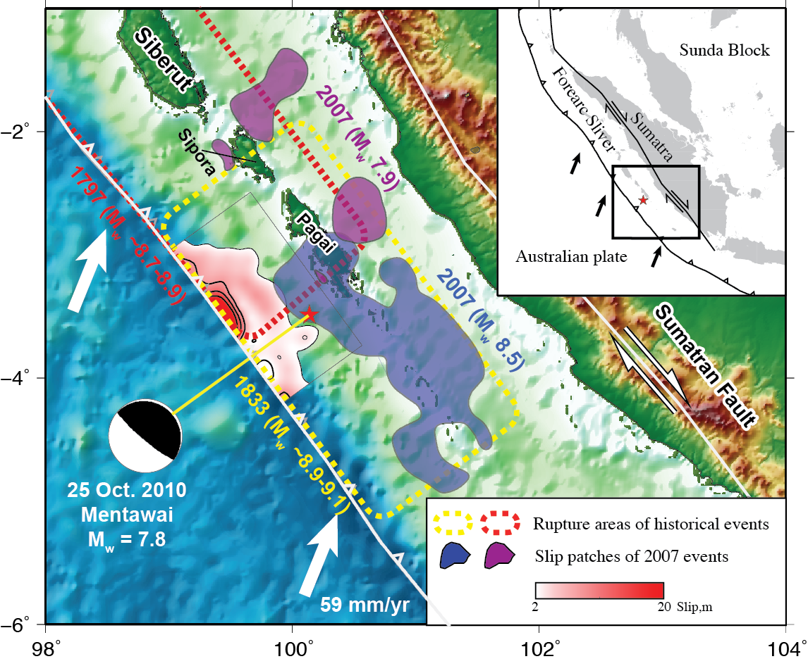
2010 Mentawai tsunami earthquake: Up-dip rupture from 2007 Sumatra events very shallow on plate boundary, with
up to 16 m high tsunami on Pagai islands
Have global
seismic data,
local hr-GPS
from islands,
and tsunami
recordings from
DART stations
and tide gauges:
Invert them all.

Slide 14
Shallow toes of subduction zones.
Strain accumulation (?), slow-slip events (?), tremor (?), tsunami hazard (?), sediments and friction (?)
Java
Up-dip of 2016 Ecuador
Up-dip zone in 1835/2010 Chile low-slip zone
Up-dip of 2007 Sumatra event (south of 2010)
Up-dip of 2003 Hokkaido event

Slide 15
Personal opinion:
SZO should target some long-standing
important problems and try to solve them,
not just do study of ‘complexity’ for the
sake of interdisciplinary participation.

