Slide 1
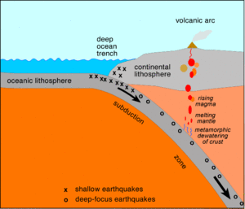
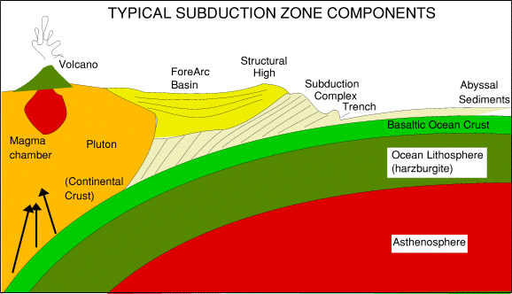
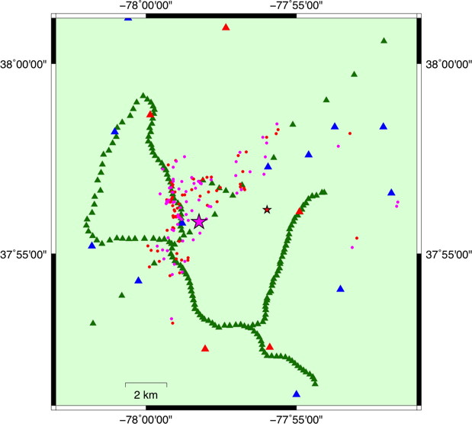
The SZO at the local scale
LASSO
iMUSH
San Jacinto Fault Study
Rapid Array Deployment
2011 Mw 5.8 Virginia Earthquake
SZO Workshop, 2016
Hillers et al., 2016

Slide 2
The SZO at the local scale
Dense (10-100 m), local 3D experiments over active systems with hazard implications
The SZO should occur in a region with 100s of these targets
Experiments should occur on a regular basis (months)
Proposed projects should be reviewed at relatively short time intervals and should be flexible in order to study seismic, volcanic, etc. activity in near real-time
Open data

Slide 3
The SZO at the local scale
Permanent
Deployment (~1-10 km, years)
Local
Deployment (~10-100 m, months)

Slide 4
The SZO at the local scale
Jan. 2000
Permanent
Deployment (~1-10 km, years)
Local
Deployment (~10-100 m, months)

Slide 5
The SZO at the local scale
July 2000
Permanent
Deployment (~1-10 km, years)
Local
Deployment (~10-100 m, months)

Slide 6
The SZO at the local scale
Jan. 2001
Permanent
Deployment (~1-10 km, years)
Local
Deployment (~10-100 m, months)

Slide 7
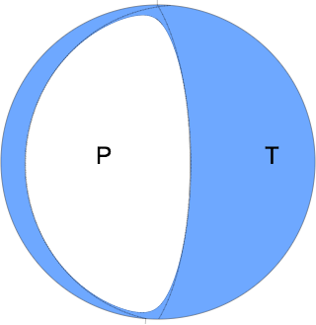
The SZO at the local scale
Feb. 28, 2001
Mw 6.8 EQ
Permanent
Deployment (~1-10 km, years)
Local
Deployment (~10-100 m, months)

Slide 8
The SZO at the local scale
Feb. 28, 2001
Mw 6.8 EQ
Permanent
Deployment (~1-10 km, years)
Local
Deployment (~10-100 m, months)

Slide 9
The SZO at the local scale
July 2001
Permanent
Deployment (~1-10 km, years)
Local
Deployment (~10-100 m, months)

Slide 10
The SZO at the local scale
Jan. 2002
Permanent
Deployment (~1-10 km, years)
Local
Deployment (~10-100 m, months)

Slide 11
The SZO at the local scale
July 2002
Permanent
Deployment (~1-10 km, years)
Local
Deployment (~10-100 m, months)

Slide 12
The SZO at the local scale
Jan. 2003
Permanent
Deployment (~1-10 km, years)
Local
Deployment (~10-100 m, months)

Slide 13
The SZO at the local scale
July 2003
Permanent
Deployment (~1-10 km, years)
Local
Deployment (~10-100 m, months)

Slide 14
The SZO at the local scale
Jan. 2004
Permanent
Deployment (~1-10 km, years)
Local
Deployment (~10-100 m, months)

Slide 15
The SZO at the local scale
July 2004
Permanent
Deployment (~1-10 km, years)
Local
Deployment (~10-100 m, months)

Slide 16
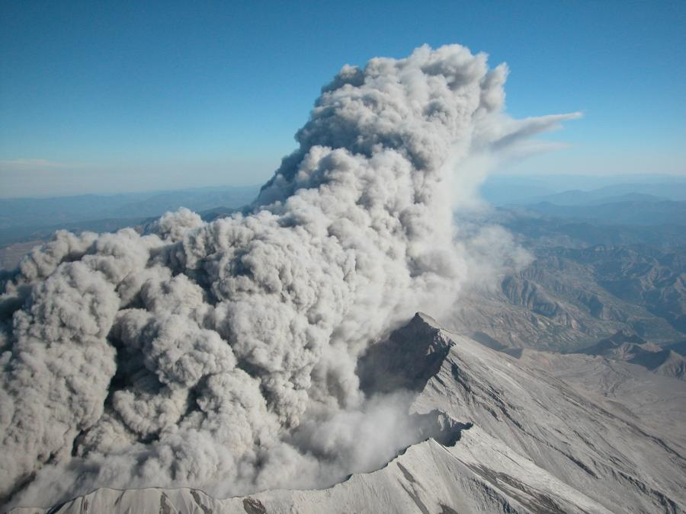
The SZO at the local scale
Sept. 2004
Permanent
Deployment (~1-10 km, years)
Local
Deployment (~10-100 m, months)

Slide 17
The SZO at the local scale
What we need
Instruments
People
Permits

