Slide 1

SZO workshop on social media
Tweet with #SZO2016, may be picked up by @IRIS_EPO
Wifi: SZOBoise
Password: SZOBoise2016

Slide 2

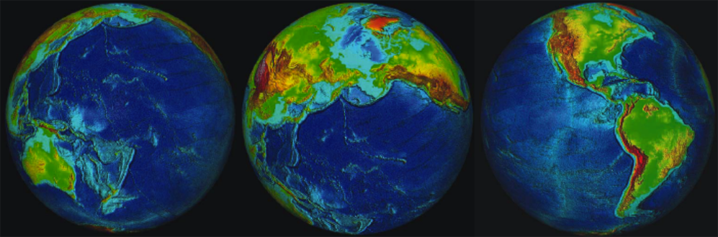

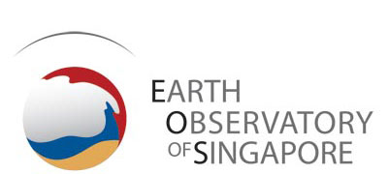



Subduction Zone Observatory Workshop
Boise , Idaho • Sept 29 – Oct 1, 2016
The Numbers:
342 Applications
242 Attendees
67 Early Career Investigators and Graduate Students
45 International Attendees from 21 Countries

Slide 3
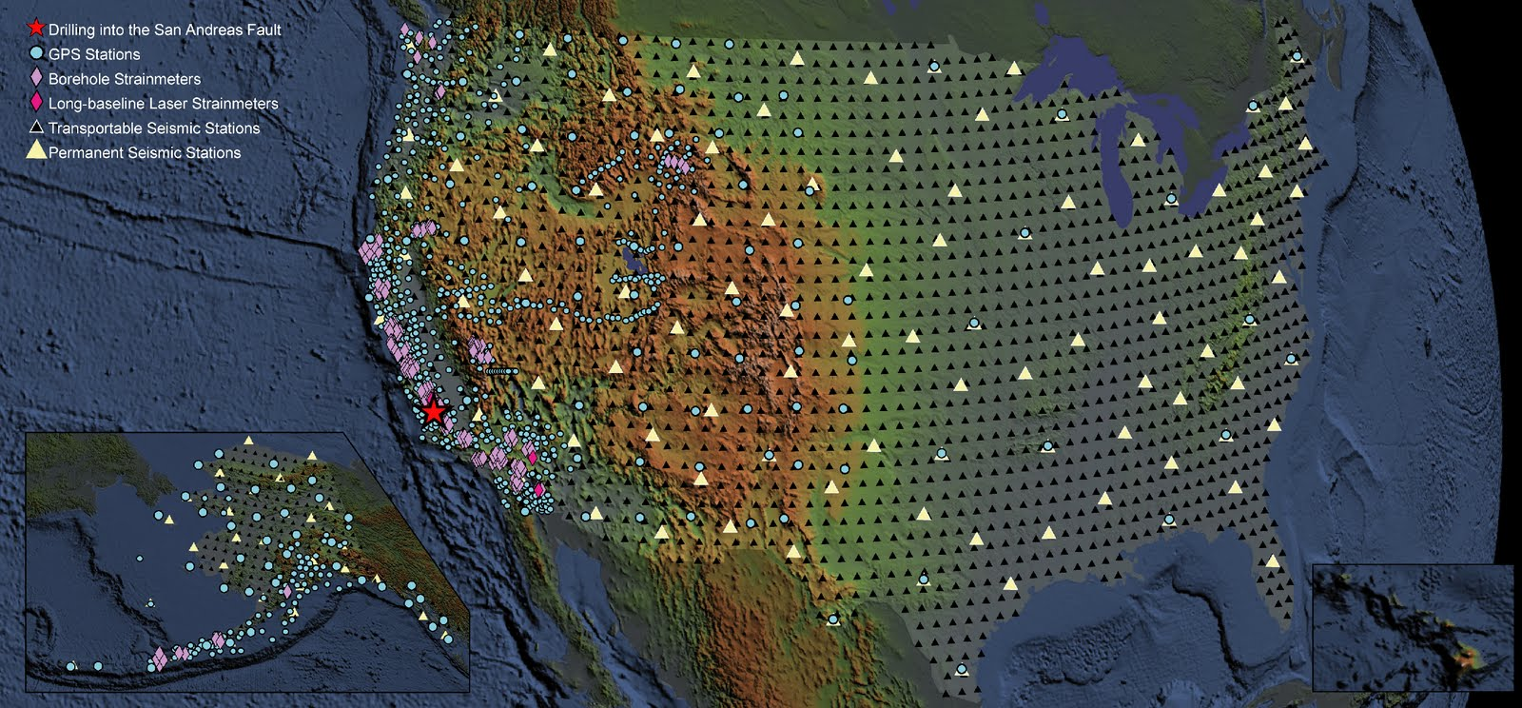
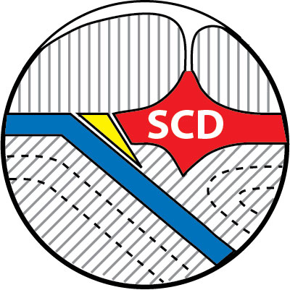
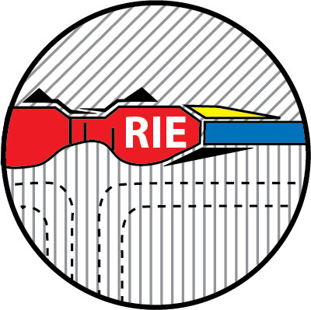
Earthscope (until 2020)
GeoPRISMS (until 2021)

Slide 4
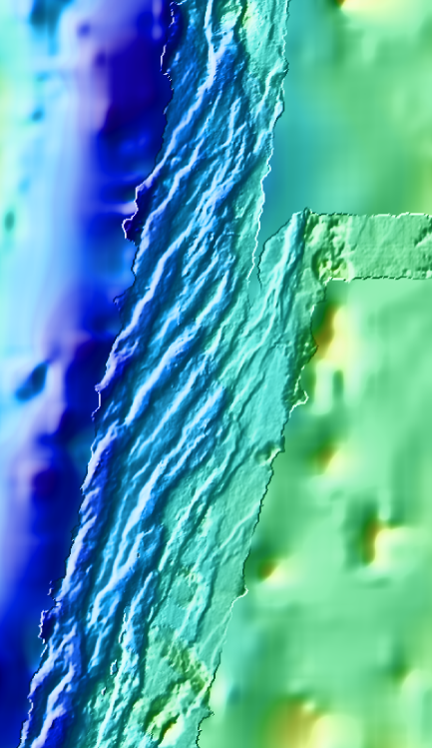
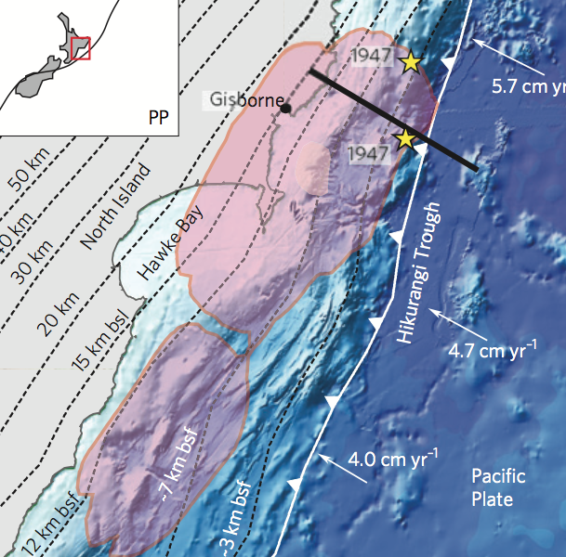
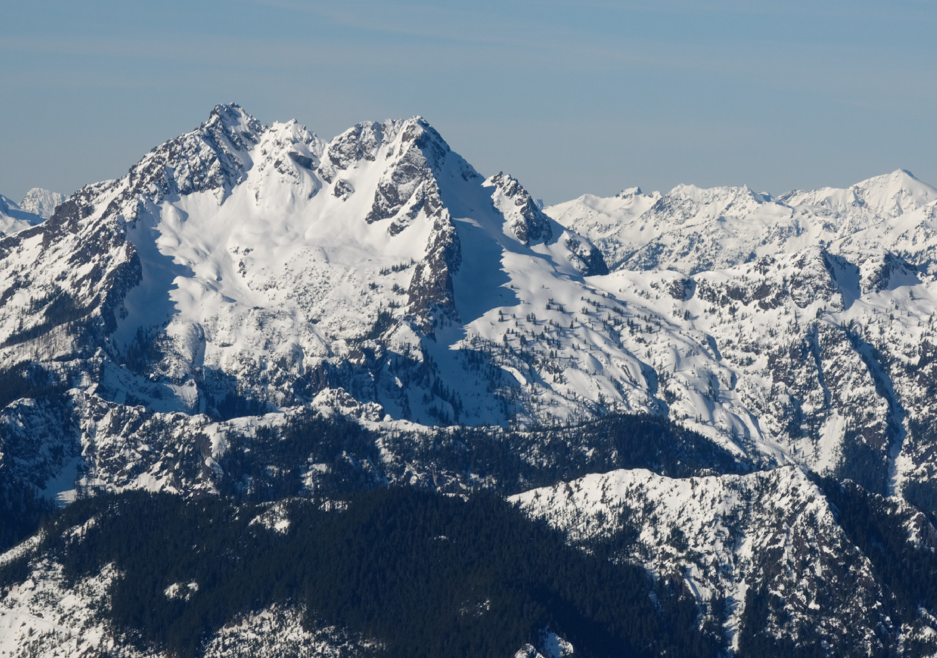
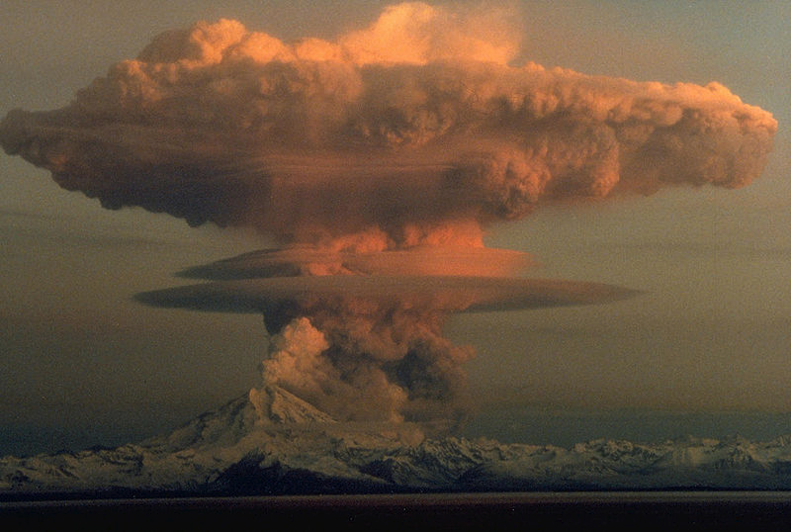
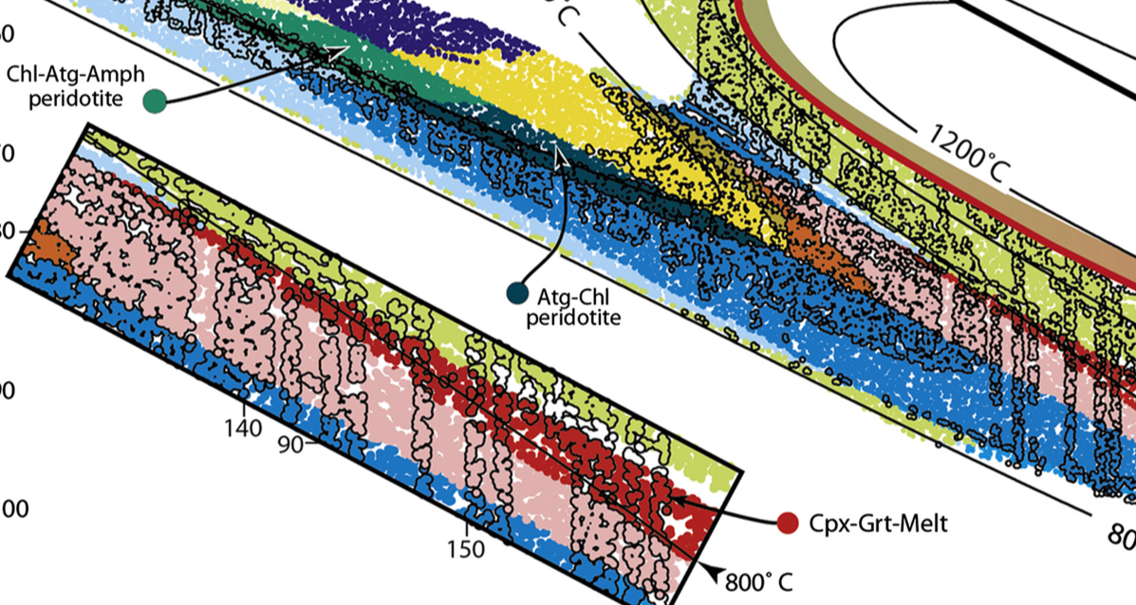
Science Themes
Deformation & Fault Slip
Landscape and Climate Feedbacks
Fluids from Serpentinization to Volcanism

Slide 5
SZO: From the Bending Plate to the Volcano – in 4D
Fluid/Rock/Gas
Geochemistry
Seismology
Geochronology
GPS
Heat Flow
MT, EM
InSAR
Geological Mapping
Seafloor Observatories
Drilling
ROV
Laboratory Experiments • Theory • Exhumed Rocks
Geodynamic Models • Systems Approach • History

Slide 6
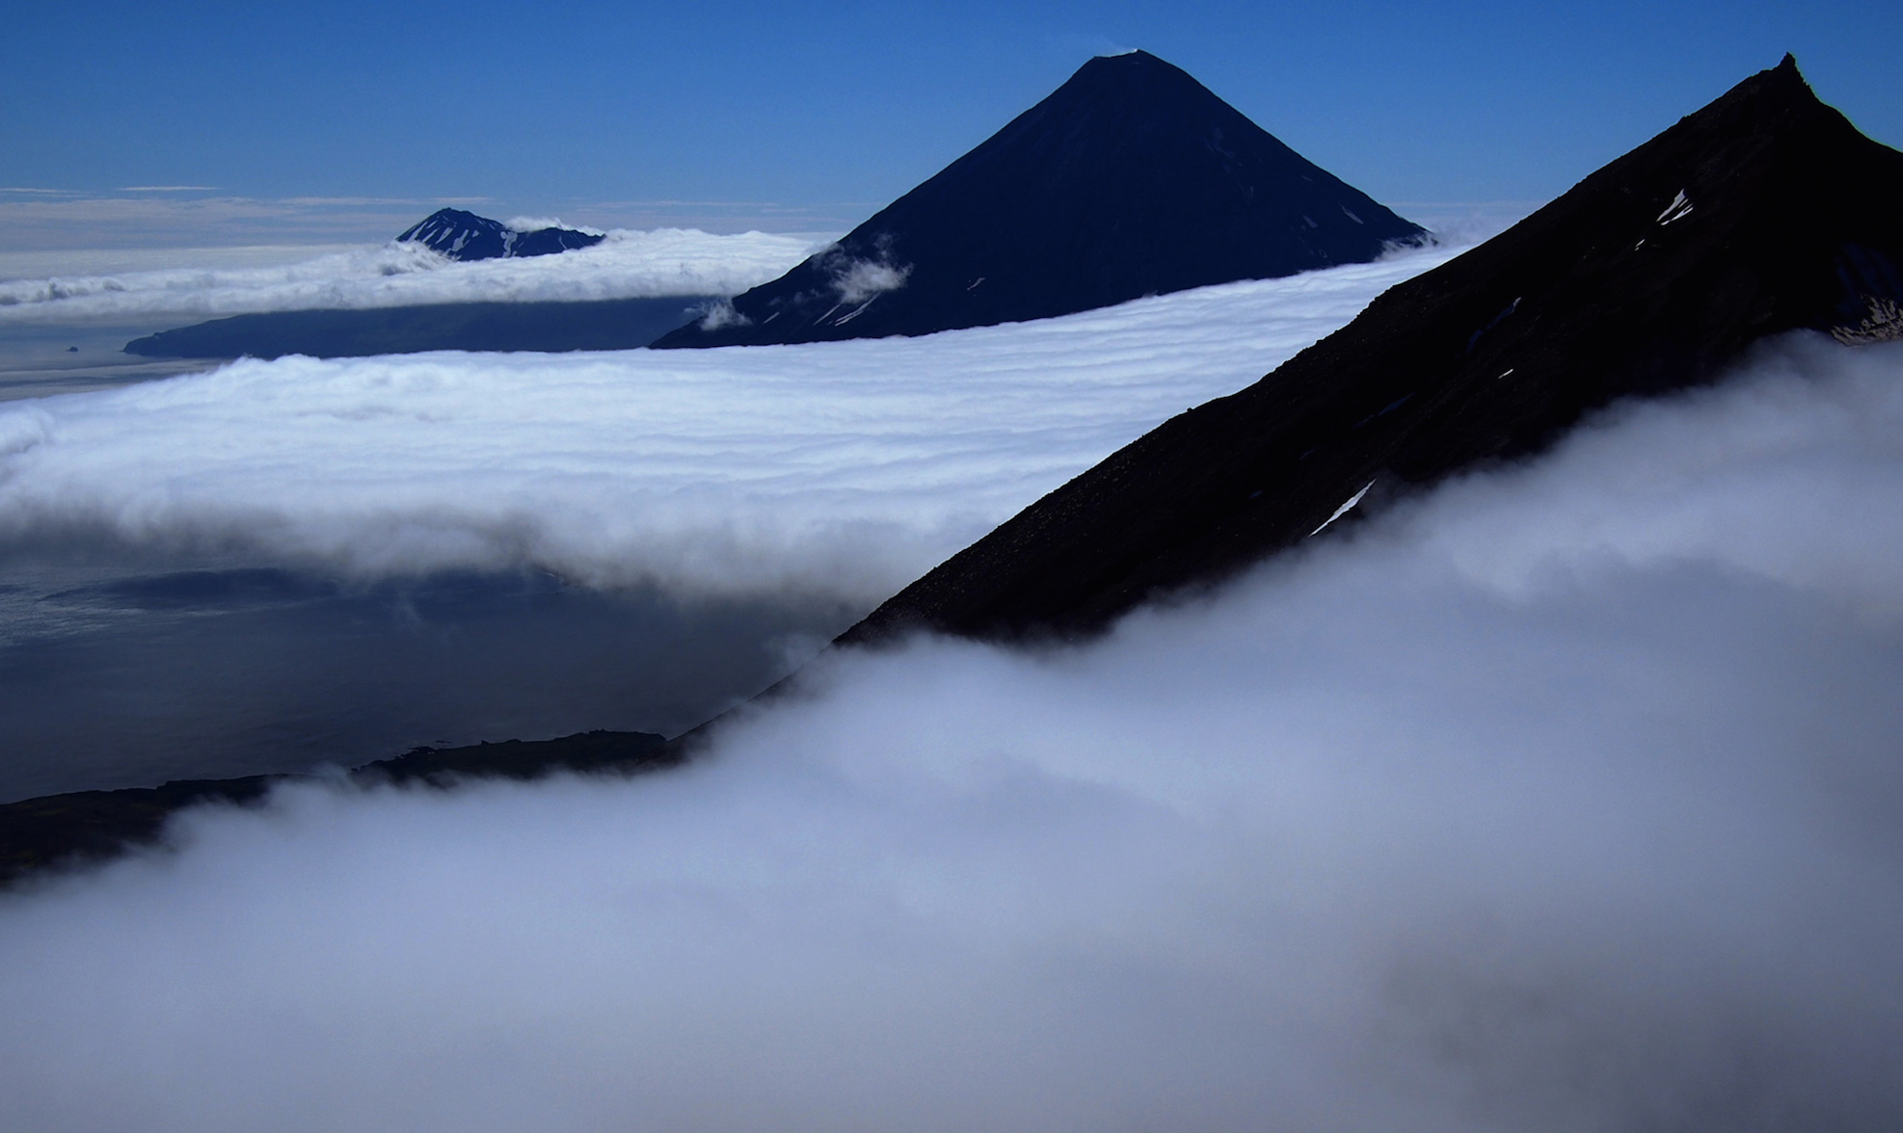
The Vision
Beyond individual projects, regional interests and new deployments

Slide 7
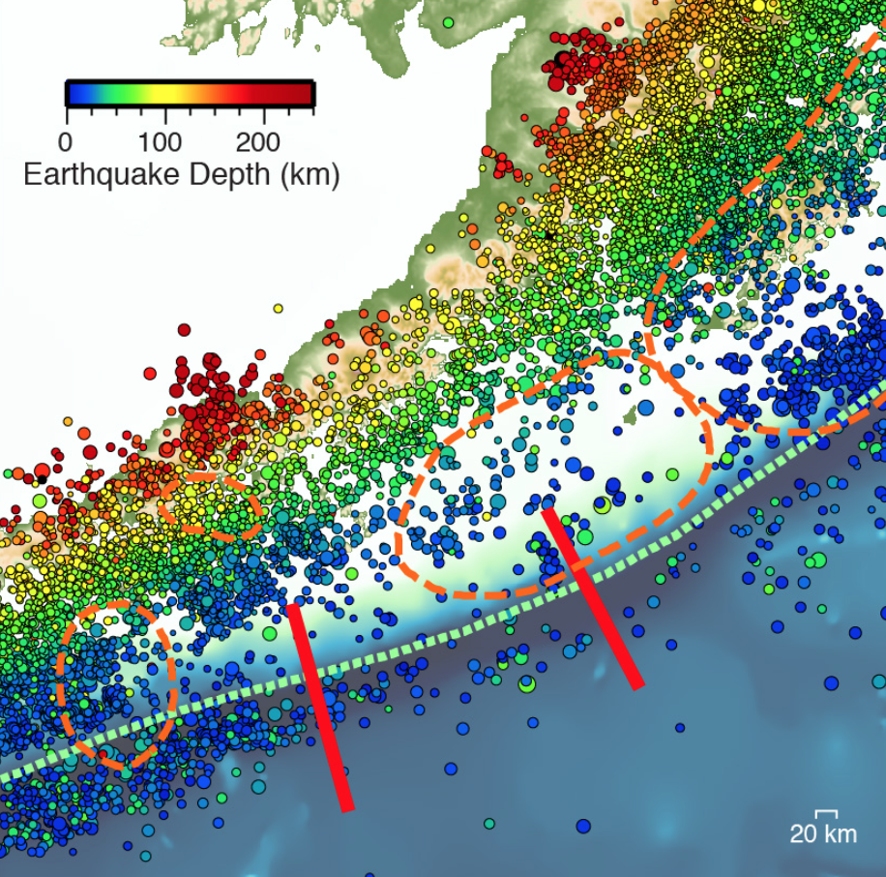
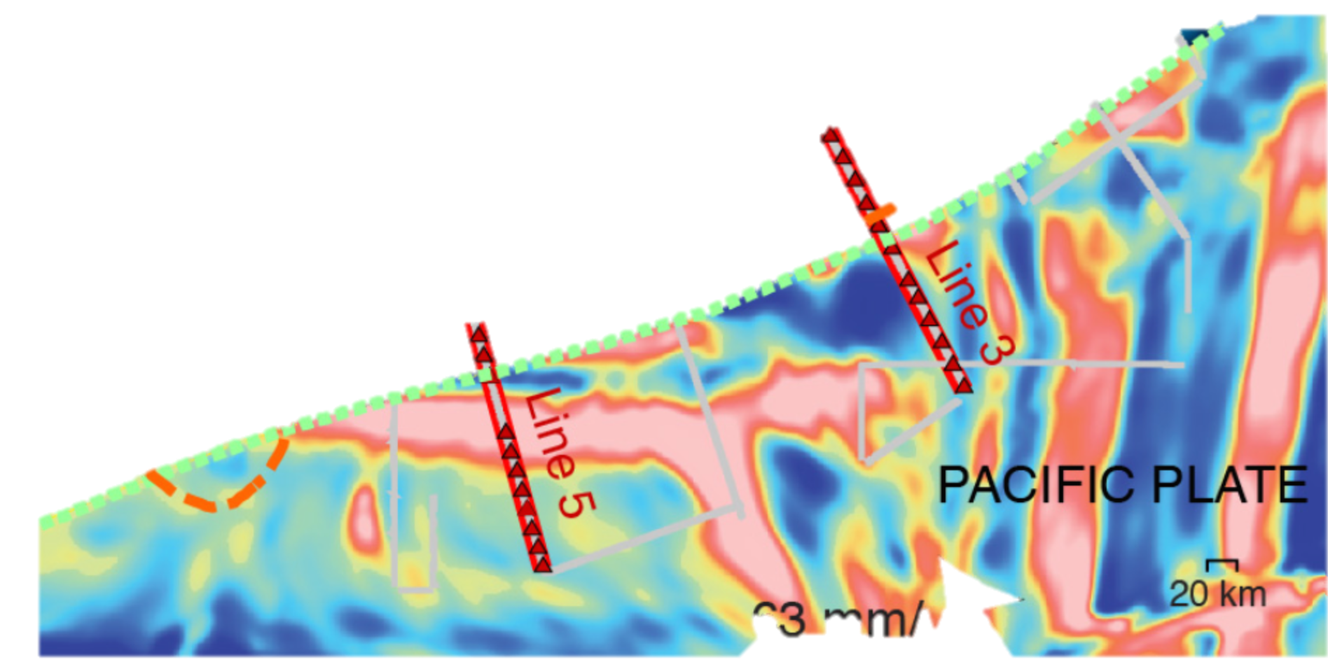
Shillington et al. (2015)

Slide 8
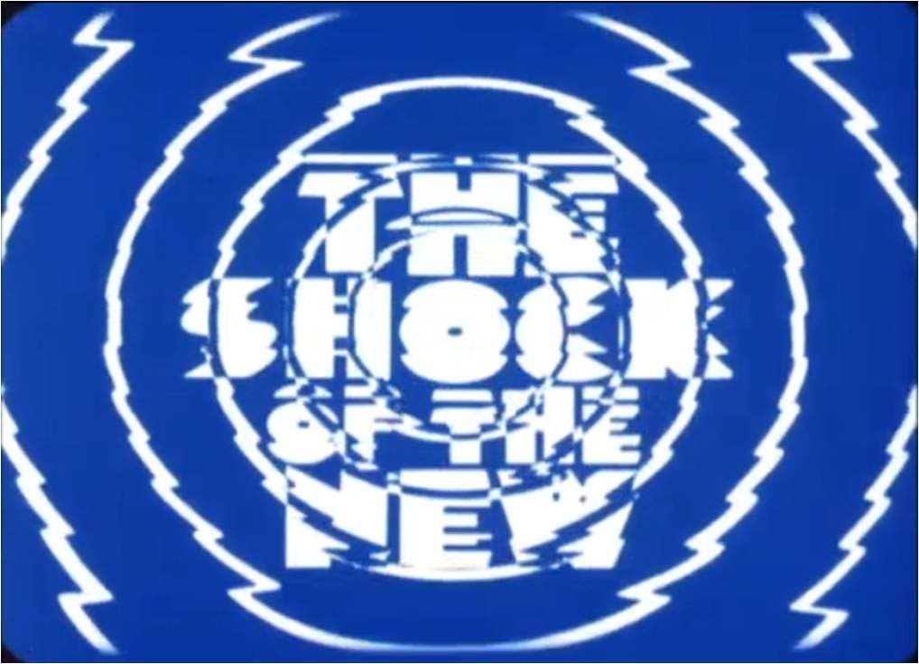
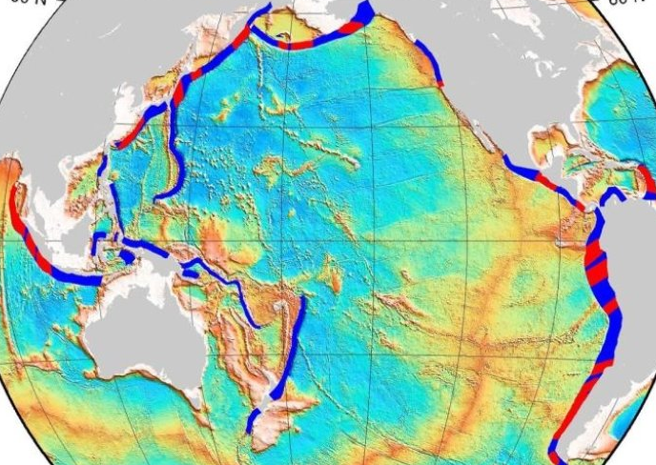
What’s New,
Exciting &
Doable?
It’s Global
Multiple Disciplines Communicating
Training Graduate Students
Cross-educating Each Other

Slide 9
Goals: • Driving Science Questions
• Implementation Strategies
• Building a Program
Report Writing Committee
Jeff McGuire (WHOI) – Co-chair
Terry Plank (LDEO) – Co-chair
Sergio Barrientos (Nacional Universidad de Chile)
Patrick Fulton (Texas A&M)
Joan Gomberg (USGS)
Sean Gulick (UTIG)
Lee Liberty (Boise State)
Diego Melgar (Berkeley)
Sarah Penniston-Dorland (Maryland)
Diana Roman (Carnegie)
Phil Skemer (Wash Univ St Louis)
Evan Solomon (Univ Washington)
Ikuko Wada (Univ of Minnesota)
Thorsten Becker (Texas)
Emily Brodsky (Santa Cruz)
Elizabeth Cottrell (Smithsonian)
Melodie French (Maryland)
Eric Kirby (Oregon State)
Harold Tobin (Wisconsin)
Doug Wiens (Wash Univ St Louis)

Slide 10
Structure of the Meeting
Driving Science Questions = Day 1 (Today)
• Successful Programs
• USGS “Ring of Fire”
• International Examples
• Pop-up Talks
Disciplinary Focus (Keynotes and Breakouts)
• Megthrust, Deformation, Earthquake Cycle
• Volatiles, Magmatic Processes, and Volcanic Systems
• Surface Processes, Feedback Between Subduction and Climate
• Plate Boundary Evolution; Dynamics in Space and Time
Break-out
Groups

Slide 11
Structure of the Meeting
Implementation Strategies = Day 2 (Tomorrow)
• Connections Between Fluids, Hazards, and Precursors
• Integrating the Rock Record and Geodynamics
• Emerging Technologies
• Capacity Building, Education and Outreach
• Perspectives from ECIs
• Summarizing Pre-workshop Regional Webinars
• Disciplinary Implementation (4 x 2)
• Broadly Distributed or Regionally Focused?
• Capacity Building and Education and Outreach
• How to Increase International Cooperation?
• Developing System Scale Models
Break-out
Groups

Slide 12
Structure of the Meeting
Building a Program = Day 3 (Saturday)
• Relationships to Existing Programs/Agencies
• How to Develop an Infrastructure Program
• Enabling Interdisciplinary Collaboration
• How to Develop a Science Program?
Break-out
Groups
Synthesis
Writing Committee Begins

Slide 13
Everything is on the Table!
Subduction Zone Observatory Workshop
Boise , Idaho • Sept 29 – Oct 1, 2016

