Slide 1
Sustainability and international capacity-building* in the context of a Subduction Zone Observatory
Jay Pulliam
Baylor University
Dept of Geosciences
*international scientific partnerships intended to transfer skills, data, technology, expertise

Slide 2
Scientific capacity-building = Science Diplomacy
Application of scientific advances is an important part of how people everywhere improve their lives.
When political relations between nations are strained, joint research efforts can give them a way to keep talking and to build trust.
Scientists have long history of putting aside ideological differences to focus on scientific problems and betterment of humanity.
Science diplomacy is more important than ever in a globalized world.
Distinguished from 'parachute science', in which investigators from developed countries merely collect data, return home, and publish papers.

Slide 3
Examples
Agreement signed between AAAS and the Cuban Academy of Sciences in 2014 to advance scientific cooperation between Cuban and U.S. scientists
  Topics include tropical infectious diseases, brain disorders, cancer, and antimicrobial drug resistance.
Collaboration between USGS and seismic networks in Chile, Cuba, Nicaragua…and elsewhere
“Joint research in almost any field can only work for the best aims and needs of both countries.”*
*Sergio Jorge Pastrana (2015), “Building a Lasting Cuba-U.S. Bridge through Science,” Science & Diplomacy, 4, No. 1.

Slide 4
Challenges
Wide range of scientific progress in different countries.
Research is sometimes considered a luxury, owing to economic constraints, and many scientists hold several other jobs.
Physical and communications infrastructure varies considerably.
Lack of scientific tradition, institutional support and collaboration within the local scientific community.
Available training is often operational rather than research oriented.

Slide 5
Type IRIS’s International Development Seismology Committee
2015 September 16-17: Advanced Studies Institute on Seismological Research, Hanoi, Vietnam
2014 August 1–2: Advanced Studies Institute on Earthquake-Related Data Products in Bogotá, Colombia
2013 July 26–27: Alliance for Middle America Seismology (ALMAS), Santo Domingo, Dominican Republic
2013 July 15–25: Advanced Studies Institute on Site Response, Santo Domingo, Dominican Republic
2013 January 19–22: Advanced Studies Institute on Lithospheric Structure, Kuwait City, Kuwait
2012 January 14–17: Advanced Studies Institute on Earthquake Location, Bangkok, Thailand
2011 July 10–24: Advanced Studies Institute on Sustainable Networks, Quito, Ecuador
2010 October 24–27: Strategic Planning for Middle America: Geophysical Hazards and Plate Boundary Processes in Central America, Mexico and the Caribbean, Heredia, Costa Rica

Slide 6
Type IRIS’s International Development Seismology Committee
2015 September 16-17: Advanced Studies Institute on Seismological Research, Hanoi, Vietnam
2014 August 1–2: Advanced Studies Institute on Earthquake-Related Data Products in Bogotá, Colombia
2013 July 26–27: Alliance for Middle America Seismology (ALMAS), Santo Domingo, Dominican Republic
2013 July 15–25: Advanced Studies Institute on Site Response, Santo Domingo, Dominican Republic
2013 January 19–22: Advanced Studies Institute on Lithospheric Structure, Kuwait City, Kuwait
2012 January 14–17: Advanced Studies Institute on Earthquake Location, Bangkok, Thailand
2011 July 10–24: Advanced Studies Institute on Sustainable Networks, Quito, Ecuador
2010 October 24–27: Strategic Planning for Middle America: Geophysical Hazards and Plate Boundary Processes in Central America, Mexico and the Caribbean, Heredia, Costa Rica

Slide 7
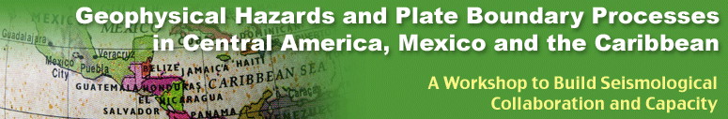
24-27 October, 2010, Heredia, Costa Rica
Colombia Red Sismológica Nacional de Colombia (INGEOMINAS)
Costa Rica Observatorio Vulcanológico y Sismológico de Costa Rica (OVSICORI)
Central America Seismic Center (CASC)
Instituto Costarricense de Electricidad, Costa Rica
Universidad Nacional de Costa Rica
Dominican Republic Instituto Sismólogico Universitario (UASD)
El Salvador Instituto Salvadoreno de Estudios Territoriales
Guadeloupe Observatoire Volcanologique de la Soufriere (OVS)
Guatemala Instituto Nacional de Sismología, Vulcanología, Meteorología e Hidrología
Honduras Universidad Nacional Autónoma de Honduras, Departamento de Física
Jamaica University of the West Indies-Mona (UWI-Mona)
Martinique Observatoire Volcanologique de la Montagne Pelee (OVMP)
Mexico Universidad Nacional Autónoma de México (UNAM)
Centro de Investigación Científica y de Educación Superior de Ensenada (CICESE)
Nicaragua Instituto Nicaragüense de Estudios Territoriales (INETER)
Panama Instituto de Geociencias, Universidad de Panamá (UPAN)
Puerto Rico Puerto Rico Seismic Network (PRSN), University of Puerto Rico, Mayagüez
Trinidad and Tobago University of the West Indies-Trinidad, Seismic Research Centre
Venezuela Fundación Venezolana de Investigaciones Sismológicas (FUNVISIS)

Slide 8
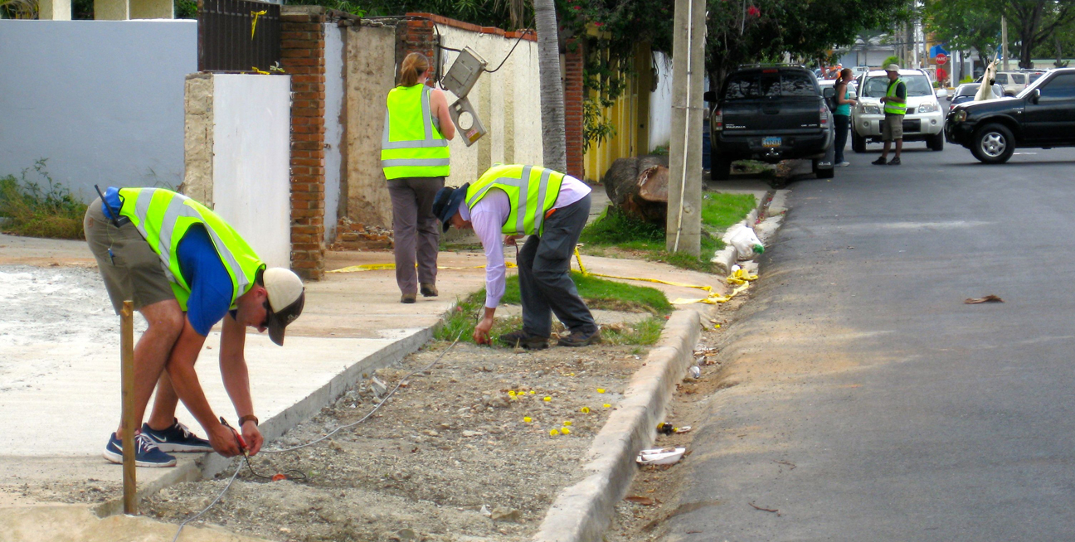
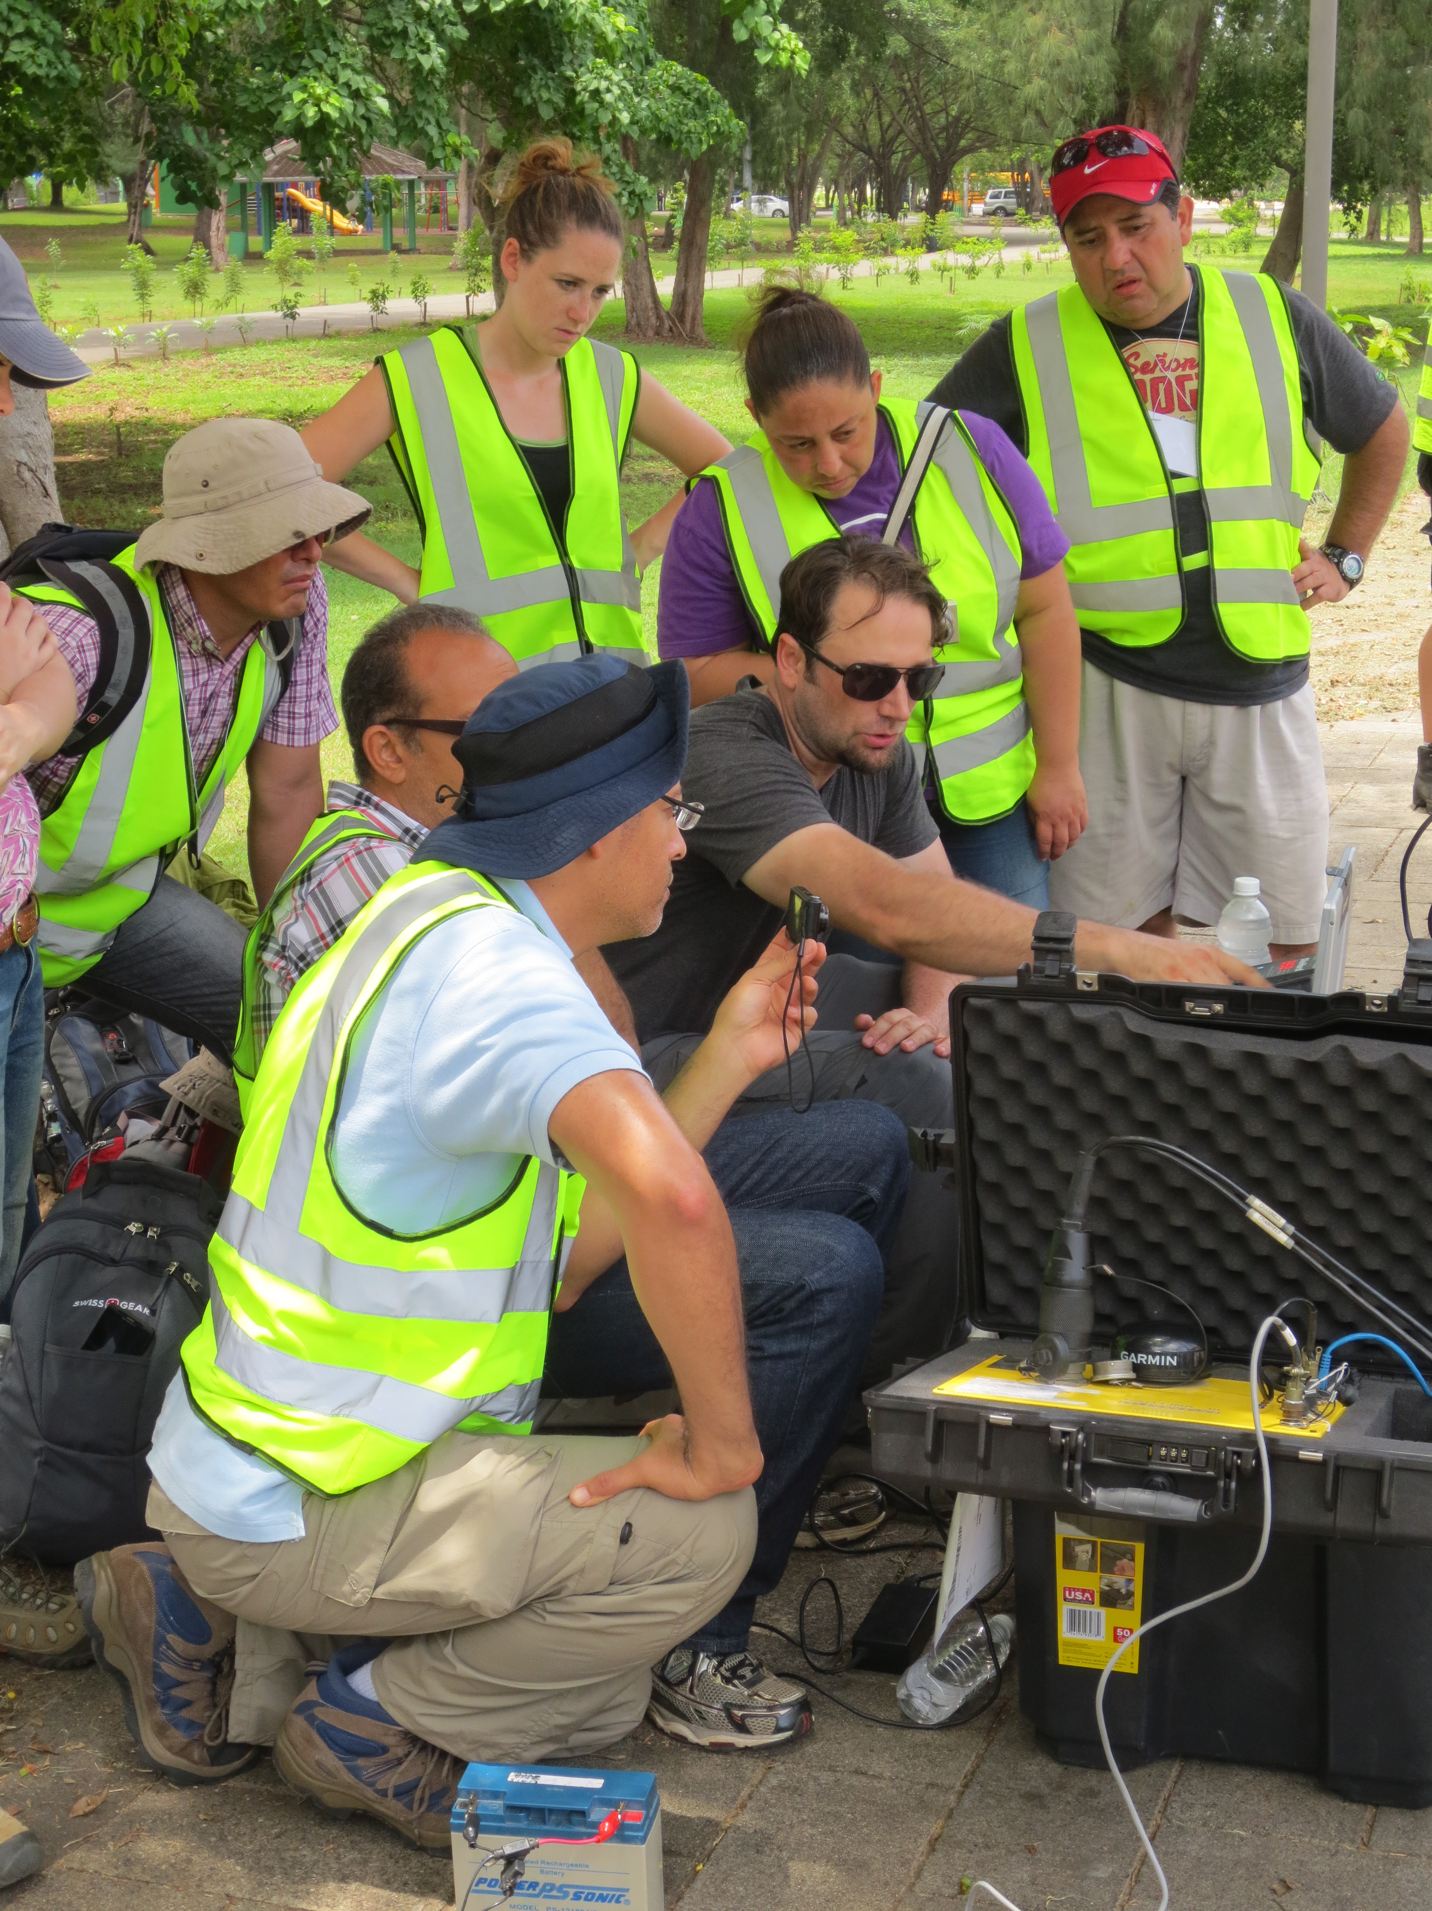
Pan-American Advanced Studies Institute in Santo Domingo, Dominican Republic, July 2013
There were 40 participants and 7 lecturers from across the Americas.
In the PASI we acquired and processed data from around the city of Santo Domingo using broadband and multi-channel instrumentation for three passive (“ambient noise”) techniques: ReMi, SPAC, and H/V Spectral Ratios.
Notes:
PASI is a program of the NSF’s Office of International Science and Engineering. It funds “Institutes” (“workshops”) of short duration that promote international collaboration and training of early career scientists and engineers.
IRIS’s International Development Seismology Committee submitted a proposal to NSF to conduct a PASI entitled “New Frontiers in Geophysical Research: Bringing New Tools and Techniques to Bear on Earthquake Hazard Analysis and Mitigation.” The proposal was funded and the PASI took place in Santo Domingo in July 2013.
Our objectives were to teach the methods to the participants, to explore the utility of the methods in a built-up urban environment, and to promote collegiality among participants by undertaking a project of practical significance together.

Slide 9
Characteristics of successful “capacity-building”
Satisfies mutual interests
  Many (current) local collaborators have mandates to monitor/assess hazards
  being responsive to actual needs increases the likelihood that the methods will be used, as does integration into national networks and infrastructures
Continuity
  Visibility of future projects over the horizon allows us to advertise far in advance, be inclusive, find additional funding, etc.
  Allows us to leverage other activities
  Ensures that events will happen
Fosters local & regional collaborations
Broad geographic participation
Opportunities for face-to-face meetings
  Enables networking
  Promotes collaborations
  Allows groups to identify region’s expertise, infrastructure, needs

Slide 10
Characteristics of successful “capacity-building”
Provides opportunities for follow-up
  Create archive for data, analysis products, workshop materials, etc.
  Virtual “institutes” or on-line
  Social media
  Ideally a second (or third) in-person meet-up would be planned
  Set goals and hold people accountable for progress
Open data
  Encourage network operators to contribute data
Local support & publicity
  Ideally local funding would support the program
Training should (ideally) encompass all the skills necessary to be a successful scientist
  Data acquisition, analysis, interpretation but also manuscript/proposal writing, communicating results, etc.

Slide 11
These characteristics must be built into the program from the outset!
How?

Slide 12
Roadmap
Build in flexibility
  Create broad categories of “events” that should be supported
  “Event” could mean workshop, training session, data acquisition, rapid response to an extreme event, or all of the above
  Ensure that each category is supported in the budget
  Plan specific events in response to white papers, proposals, extreme events, etc.
Identify stakeholders
  Cast a broad net to include relevant and interested scientists, engineers, planners, government officials, NGOs, institutions, agencies
Conduct grassroots planning exercises
  Identify mutual interests, infrastructure, logistics
  Solicit proposals or white papers to encourage clear planning and collaboration

Slide 13
Roadmap
Think broadly
  Look to movements/activities outside the geosciences for ideas and inspiration
  E.g., the “maker movement” entices people to tinker with electronics, including inexpensive processors to create and program innovative, highly-capable devices…
Identify appropriate technology and techniques
Lay the groundwork for events long before the events themselves take place
  For example, rapid response would benefit from logistics planning, identify type, quantity, deployment strategy for responding to certain events in certain places. Compile a list of critical personnel, available infrastructure. Explore shipping/customs requirements.

Slide 14
Science Across Virtual Institutes (SAVI): An NSF-wide Activity to Accelerate Advances in Science and Engineering Research and Education through International Collaborations
A virtual institute will serve as a catalyst to foster activities efficiently and economically….
SAVI is not a stand-alone program. Proposals to support SAVI activities can be submitted as a supplemental funding request to an existing award…
A team can be: 1) an existing NSF center/institute awardee; or 2) a virtual center/institute consisting of multiple investigators holding individual awards with common research/education interests.
At the time of proposal submission, the U.S. team's identified international partners should have support or apply to an appropriate funding organization in their country or region.
SAVI partnerships may be bilateral or multilateral.

Slide 15
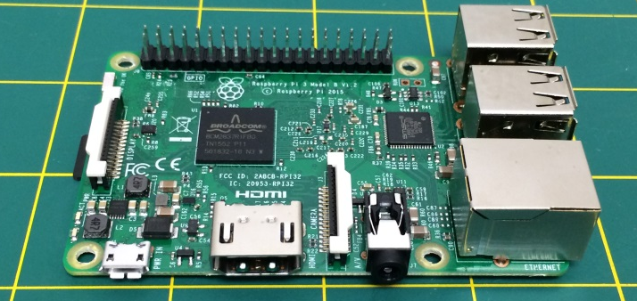
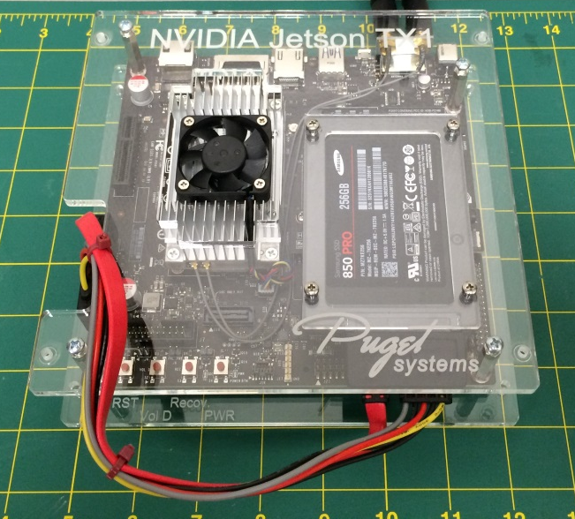
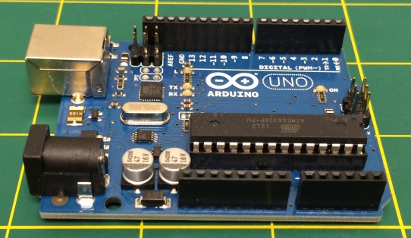
David vs. Goliath small (devices) slay big (data)
Embedded Systems
  Microcontroller, embedded computer, system-on-chip (SOC), etc.
  Processor and memory located on a single chip
  Low Size, Weight, and Power (SWaP)
  Have modest but significant capabilities when compared to desktop or laptop computers
“Maker” movement – build skills, confidence, curiosity through tinkering with electronics to build esoteric and/or useful devices
Arduino Uno
Raspberry Pi 3 Model B
NVIDIA Jetson TX1

Slide 16
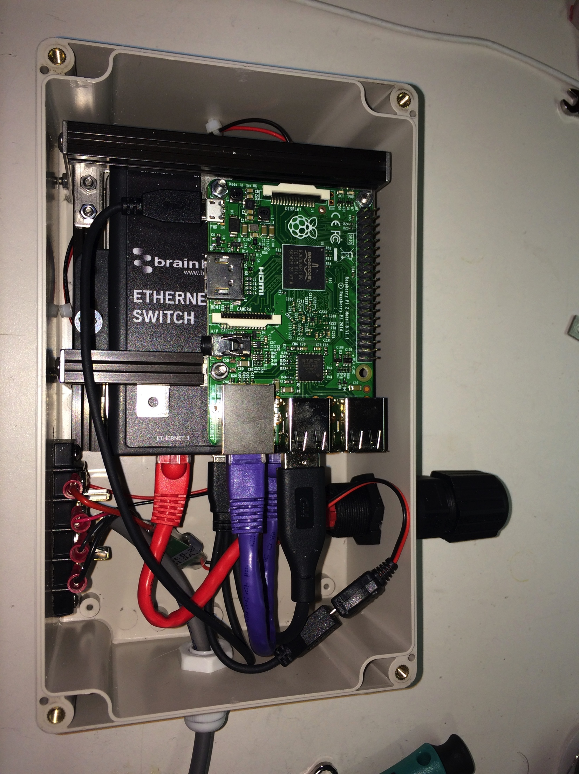
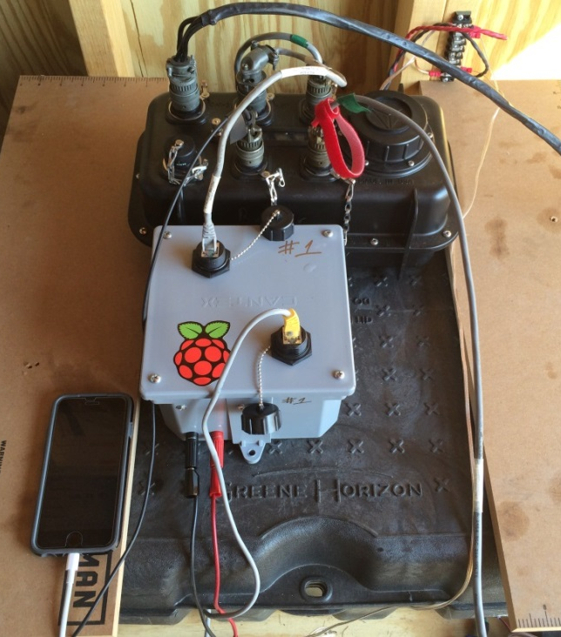
Raspberry Pi Enhanced REFTEK RaPiER
The integration of a Commercial Off The Shelf Data Acquisition System (DAS) with an inexpensive and easy-to-use embedded computer. Integrated radios create mesh network and send copies of data to other nodes
Using skills common to geoscientists, geoscientists can build their own "no engineer needed” Internet of Geophysical Things (IoGT) device
Geoscientists can utilize the Raspberry Pi’s ecosystem to bootstrap novel sensor node/network enhancements
Educational/capacity-building solution to develop “tinkering” skills while simultaneously performing automated processing
One example of automated processing via distributed computing

Slide 17
Examples of collaborative, capacity-building projects: Seismic hazards
Develop realistic probabilistic forecast of ground shaking for future earthquakes and use that product to define earthquake safety standards.
Create probabilistic seismic hazard maps.
  Includes using earthquake catalogs to determine the characteristics of potential earthquake sources, as well as determining appropriate attenuation relationships and site effects (from mapping soil depth and shear wave velocity in upper 30 meters).
Compute earthquake scenarios for fault segments that pose specific threats.
Perform seismic site characterization and microzonation studies of major cities.

Slide 18
Guiding Questions
How do (geo)science-oriented capacity-building, education and outreach initiatives differ from nation to nation and region to region? How do we strengthen cross-border collaborations and capacity-building efforts?
What sorts of geoscience-related knowledge, skills and experience are valued locally? How can an SZO be leveraged to expand them?
What obstacles inhibit people, governments, international organizations and non-governmental organizations from realizing their geoscience-related professional goals?
Are you aware of national or regional capacity building, education and outreach initiatives in the past years? Can you comment on positive experiences of these and how to improve on them?
Do you think that capacity building, education and outreach would be more effective if done regionally or as a whole throughout the SZO footprint? Are there any clear differences/necessities for each region?
How do we plan successful capacity-building efforts? i.e., How do we set identify mutual interests with local scientists/stakeholders and ensure that everyone’s interests are satisfied?

