Slide 1
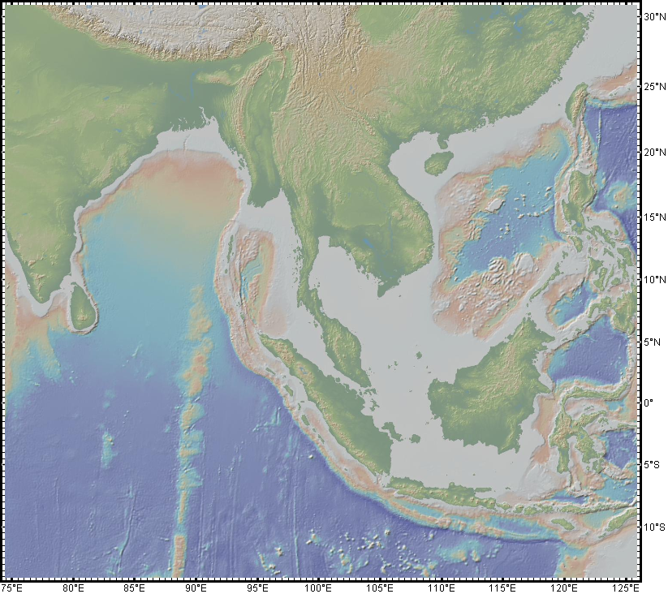
Java-Sumatra-Andaman-IndoBurma Subduction Zone:
Summary and Highlights
Michael Steckler
Lamont-Doherty Earth Observatory
Fidel Costa
Rino Salman
Wang Yu
Earth Observatory of Singapore
For full presentation, watch the webinar

Slide 2
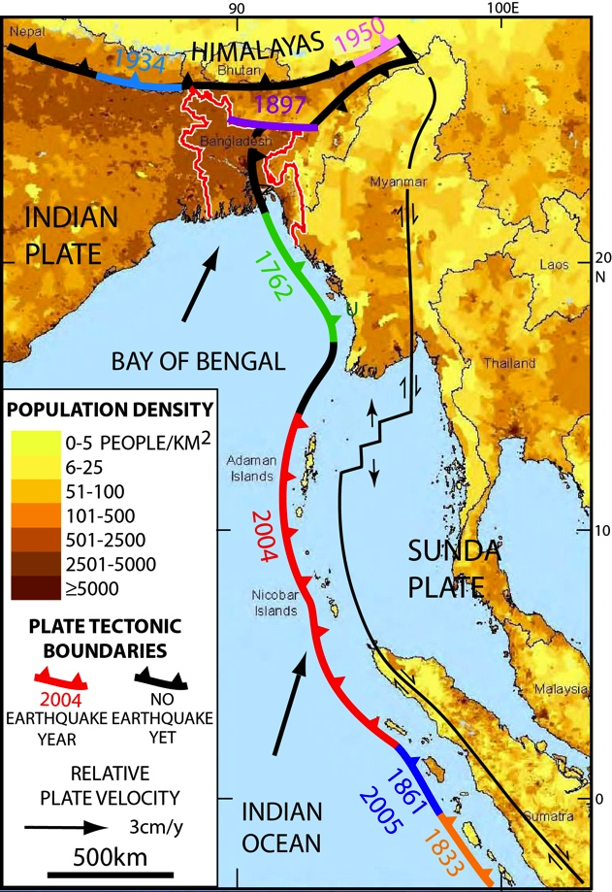
Java-Sumatra-Andaman-IndoBurma Subduction
Zone
Notable along-strike variations in:
Convergence velocity
Age of Ocean Crust
Slab Dip
Obliquity and partitioning
Sediment entering subduction zone
Volcanism
2015
1548?

Slide 3
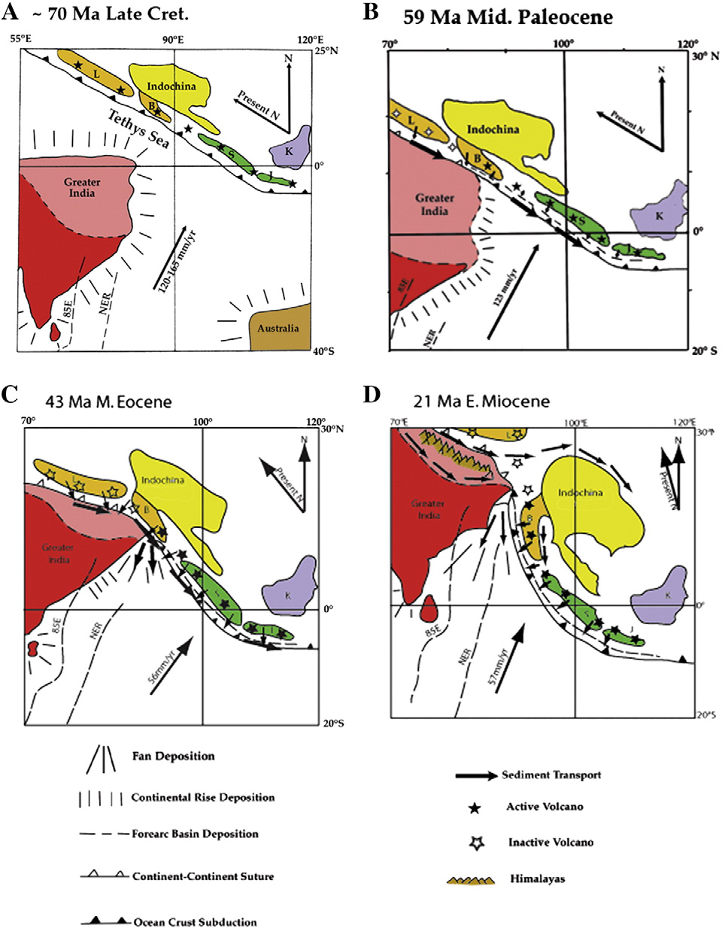
India collided with underbelly of Asia at ~50 Ma, ramming into subduction zone and wrapping Indochina around collision
Curray, 2014

Slide 4
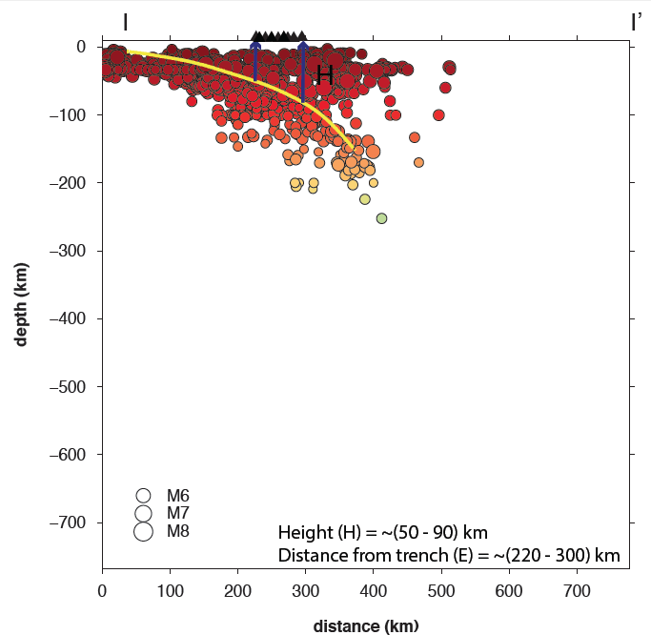
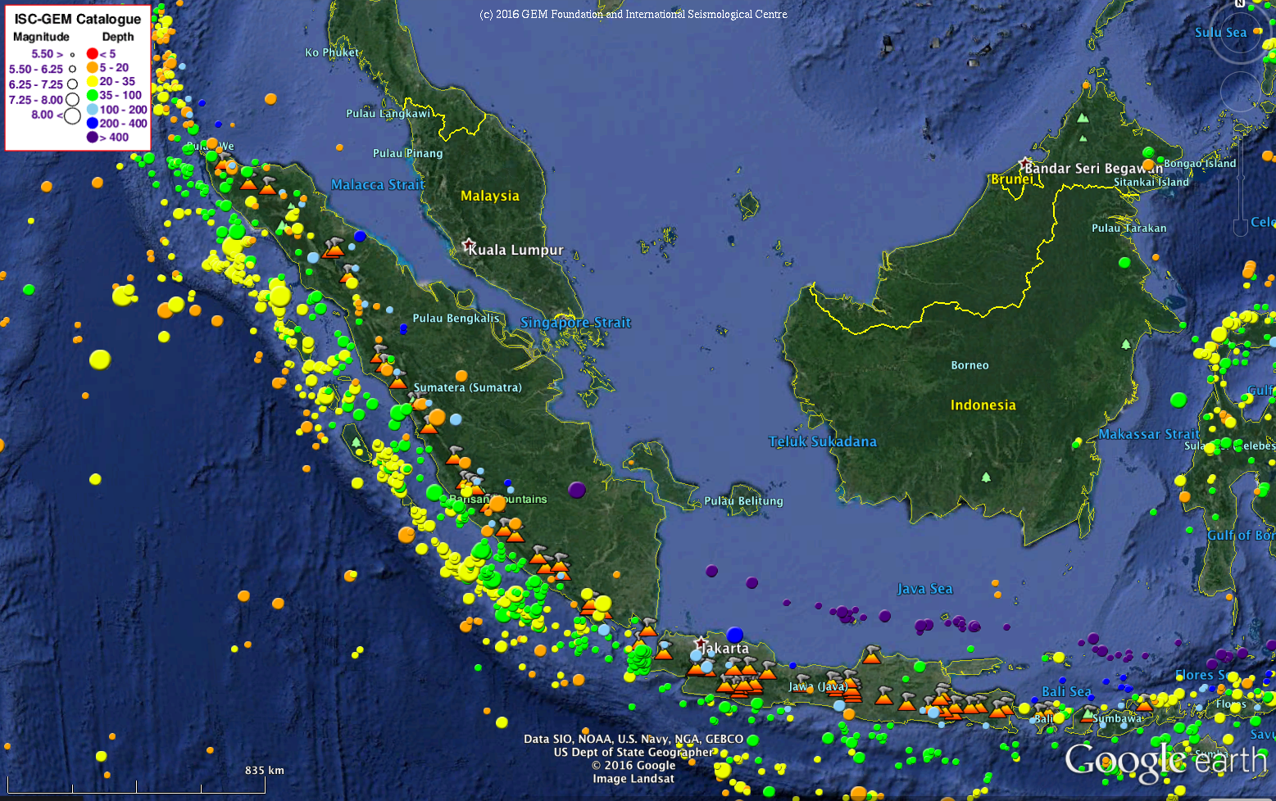
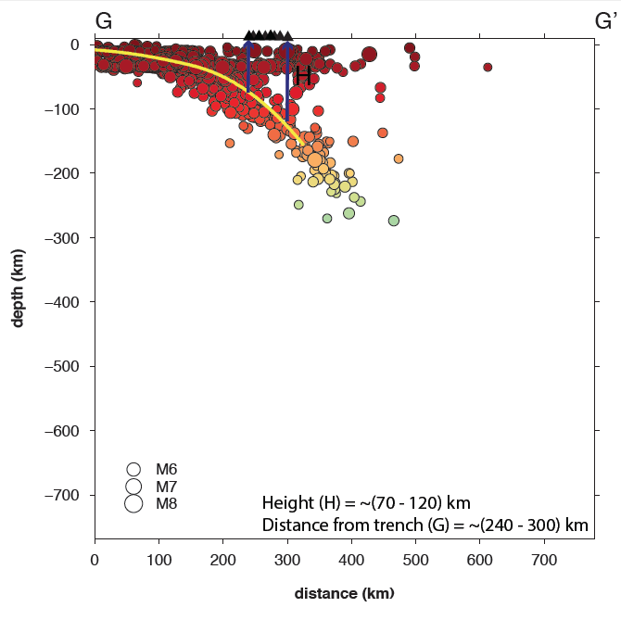
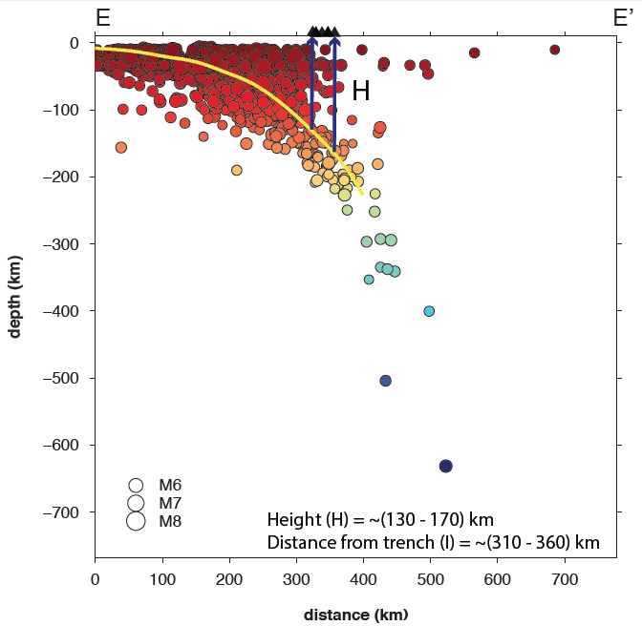
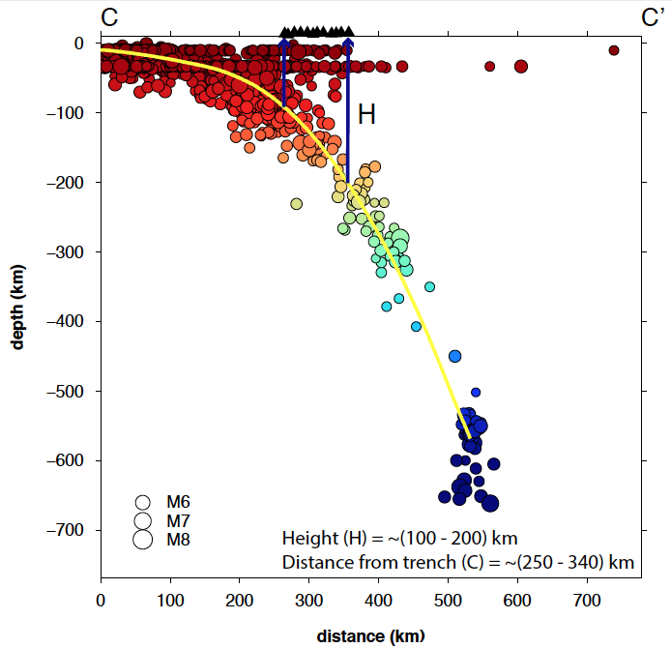
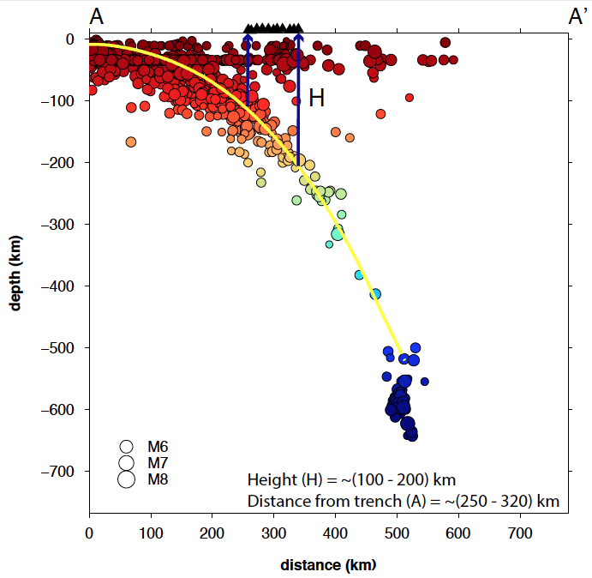
Angle of subduction decreases from about 70º in Java 45º to about in N Sumatra.
Notes:
44

Slide 5
7 8 9
7
7
7
With lower dip, the seismogenic zone is larger in Sumatra. As a result, there are
many more earthquakes (x 4) and of larger magnitudes in Sumatra vs Java
Notes:
Bathymetry of the Indonesian margin underlain by satellite altimetry (Smith and Sandwell, 1997). See text for details on data information. Major tectonic features on the incoming plate are annotated, off Sumatra mainly N-S trending fracture zones, off Java elevated plateaus and seamounts. Plate motion direction and velocity (indicated by annotated black arrows; after Simons et al., 2007) vary along the entire margin relative to the upper plate. Centroid Moment Tensors (CMT) of recent (starting from 1976) Mw ≥ 7 subduction fault related earthquakes are shown across the Sunda arc (size of “beach balls” correlates with earthquake magnitude, from http://www.globalcmt.org). Further details are discussed in text. WFR – Wharton fossil ridge.
Sketches of typical trench-perpendicular cross sections implemented in sections of bathymetrical charts for Sumatra (top) and Java and the Lesser Sunda islands (bottom) to highlight differences in subduction setting affecting the earthquake hazard across the Indonesian margin. Cross sections are modified after wide-angle refraction models from Dessa et al. (2009) for Sumatra and after Planert et al. (2010) for Java and the Lesser Sunda islands. SZ are thick solid grey lines along the subduction fault, terms characterizing the forearc are after Wang and Hu (2006). Thrust and backthrust connecting the SZ with the seafloor are indicated by dashed lines. Off Sumatra the backthrust is indicated only to a depth, where Singh et al. (2006) also observe the backthrust. Off Sumatra the upper plate mantle is indicated by two dashed lines, one interpretation off Simeulue (after Singh, et al., 2006; Dessa et al., 2009), where the SZ reaches down into the mantle at 140 km from the trench and the deeper mantle intersecting the subduction fault at the downdip limit of the SZ. Note that cross sections were originally located in the middle of these bathymetric maps.
Bathymetry of the Indonesian Sunda margin-relating morphological features of the upper plate slopes to the location
and extent of the seismogenic zone
A. Krabbenhoeft1, R. W. Weinrebe1, H. Kopp1, E. R. Flueh1, S. Ladage2, C. Papenberg1, L. Planert1, and Y. Djajadihardja3
Nat. Hazards Earth Syst. Sci., 10, 1899–1911, 2010

Slide 6
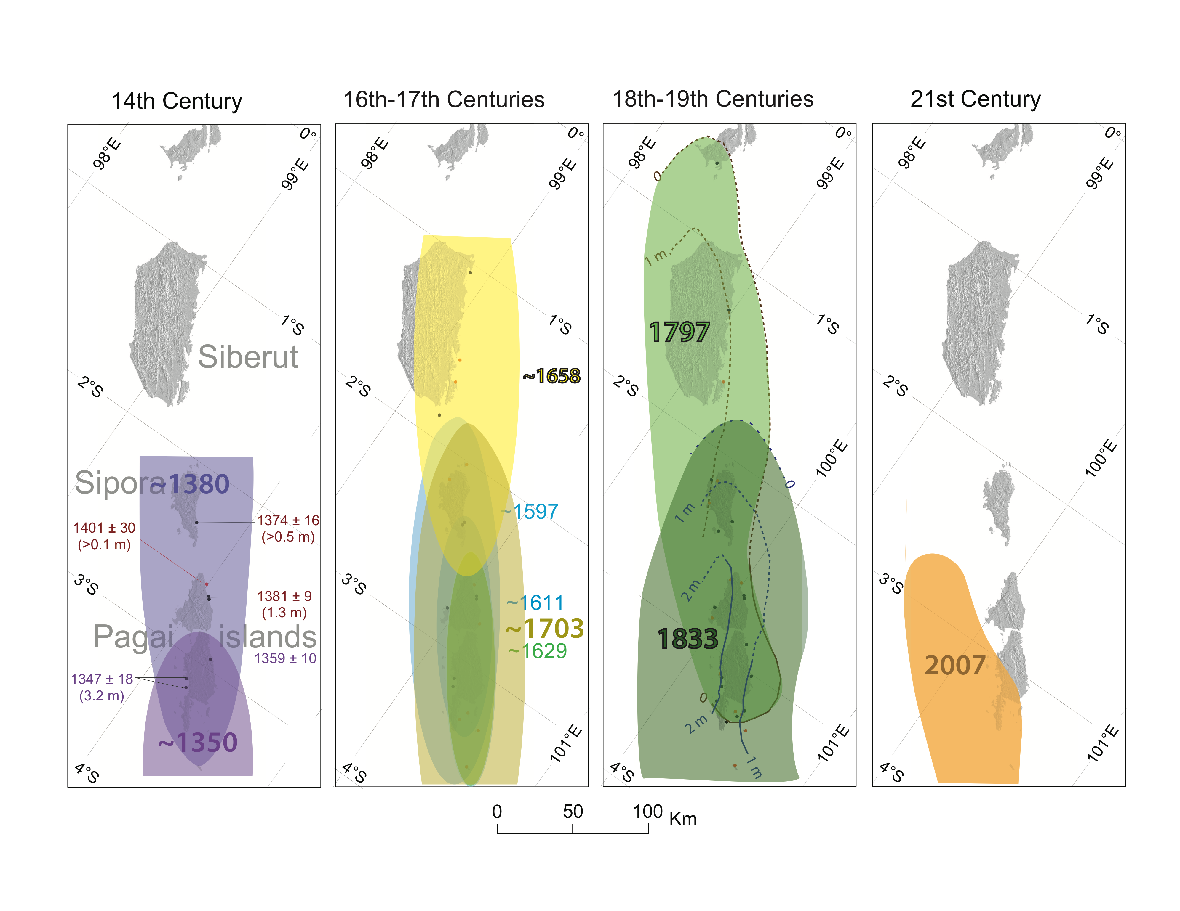
Much of the Sunda megathrust has ruptured in the last decade, but the Mentawai patch remains a seismic gap
Variable coupling and persistant seismic gaps
21c
?
18-19c
• 1 Mw 9.2
• 3 M~8
• 15 M~7
16-17c
14c
Coral microatolls show evidence for earthquake supercycles on the Mentawai patch
Lujia Feng et al., 2015
Notes:
*** Make it clear these are the number of earthquakes recorded by the SuGAr. Or get numbers from seismological records.
The SuGAr has recorded many earthquakes over the last decade
There have been XX M>6 earthquakes in Sumatra since 2004. 30 were recorded by the SuGAr.
Also, put statistic of all Mw 6 since 2004
Say “ all the red starts are earthquake with magnitude larger than 7, most of the coseismic offset estimated by SuGAR network are in Lujia’s paper

Slide 7
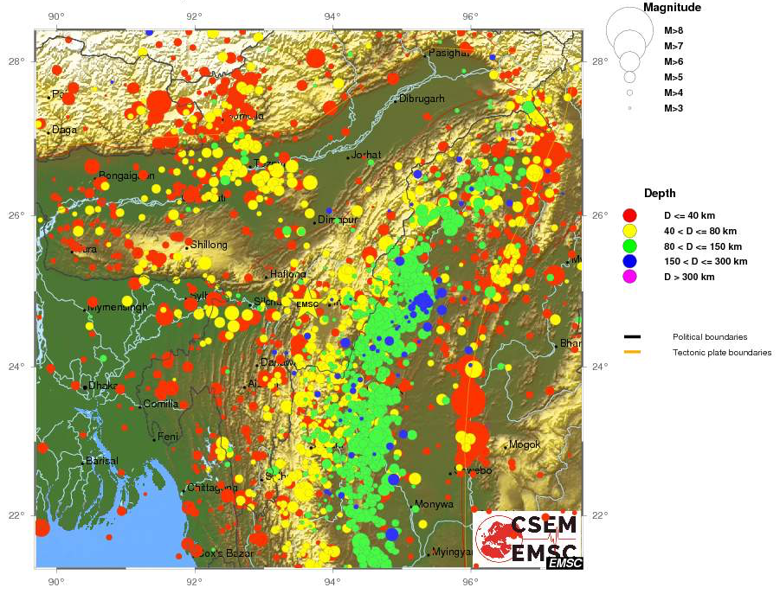
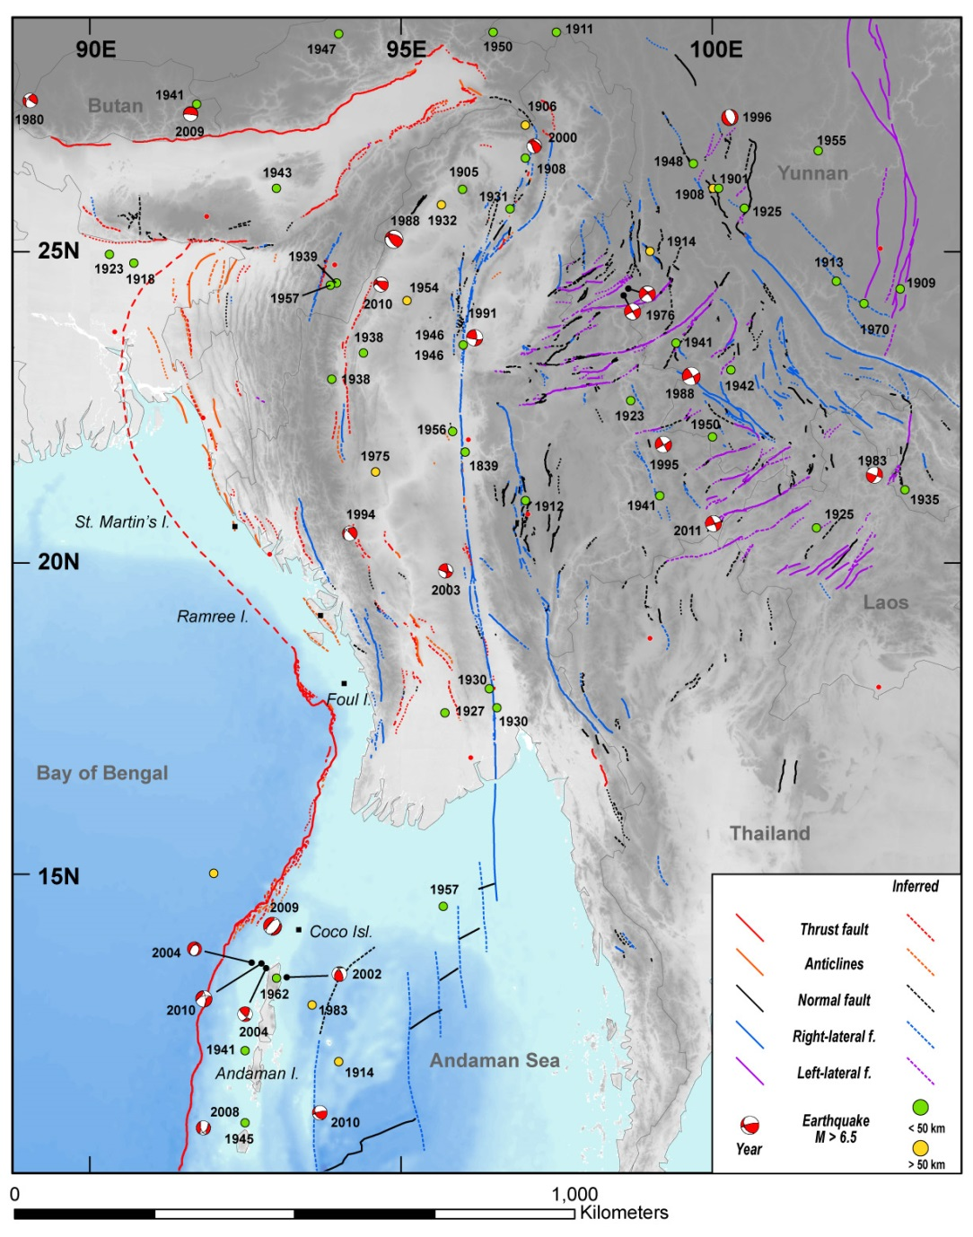
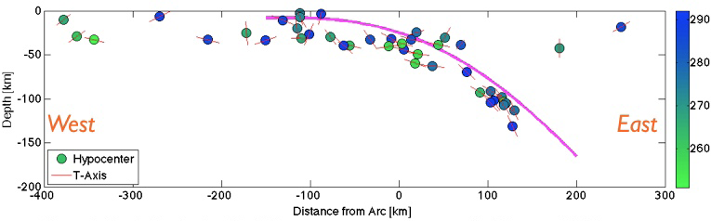
Wadati-Benioff Zone earthquakes to ~160 km, 50° dip Downdip T-axes, but most P-axes N-S
1762 Arakan earthquake (M~8.5 to ~8.8)
Coral record of uplift and subsidence in Myanmar and Bangladesh
1762
(M ≥ 8.5 )
2004
(Mw 9.1)

Slide 8
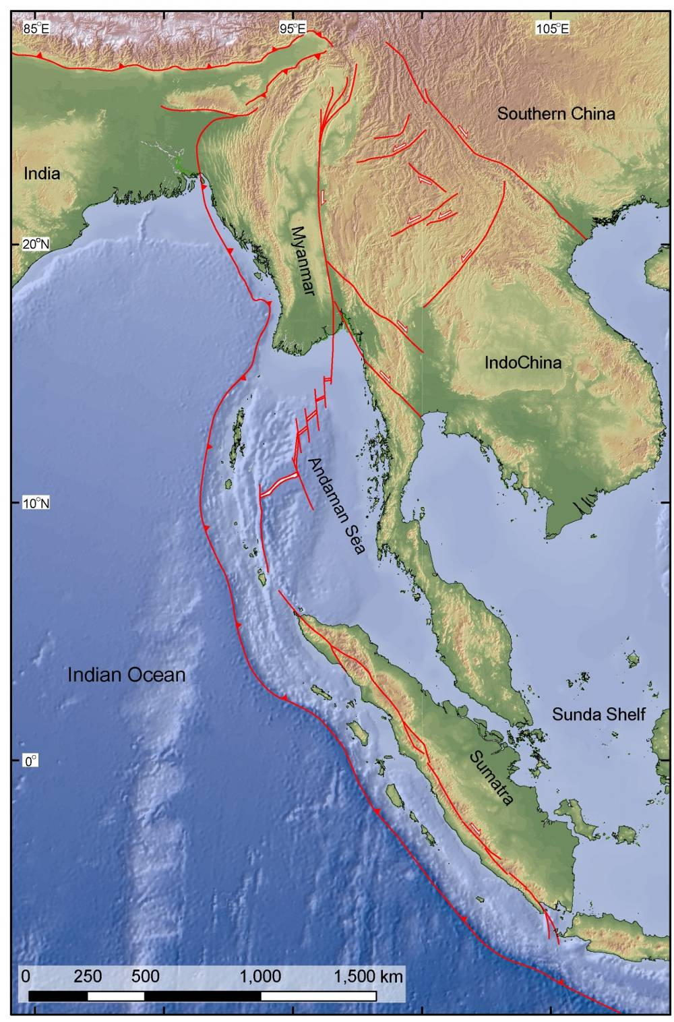
The slip partitioning system
_{Arakan megathrust}
_{Burma}
_{Plate}
_{Sagaing fault}
₄₂
_{Indian Plate}
Spreading center
₄₃
_{Sunda Plate}
_{Sumatran fault}
_{Sunda megathrust}
_{Sumatra sliver}
₅₄
_{Australian Plate}
60
(IN-SU & AU-SU; MORVEL 2010)
Notes:
The general overview of the 1st-order plate motion along the western boundary of Sunda Plate, showing the nature of slip partition system from Sumatra to Myanmar.

Slide 9
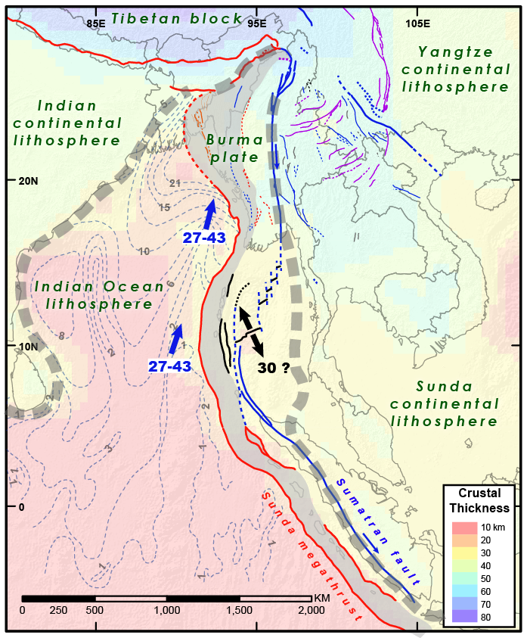
The role of sediment ?
>15 km of sediment are now underthrusting to the Burma plate
~2 km of sediment to the subduction zone
CRUST 2.0 + Curray, 1991
Blue vector: IN-SU plate motion

Slide 10
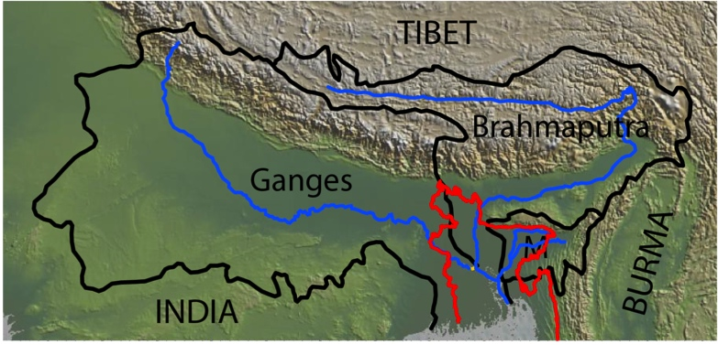
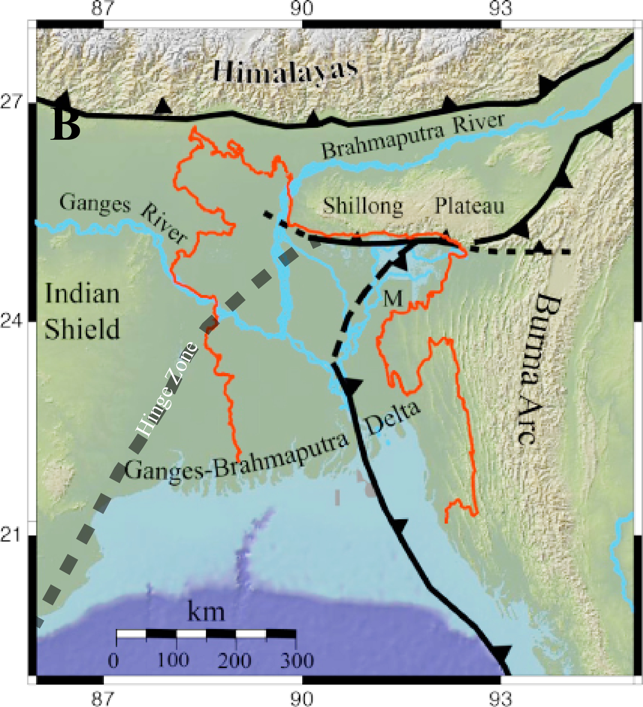
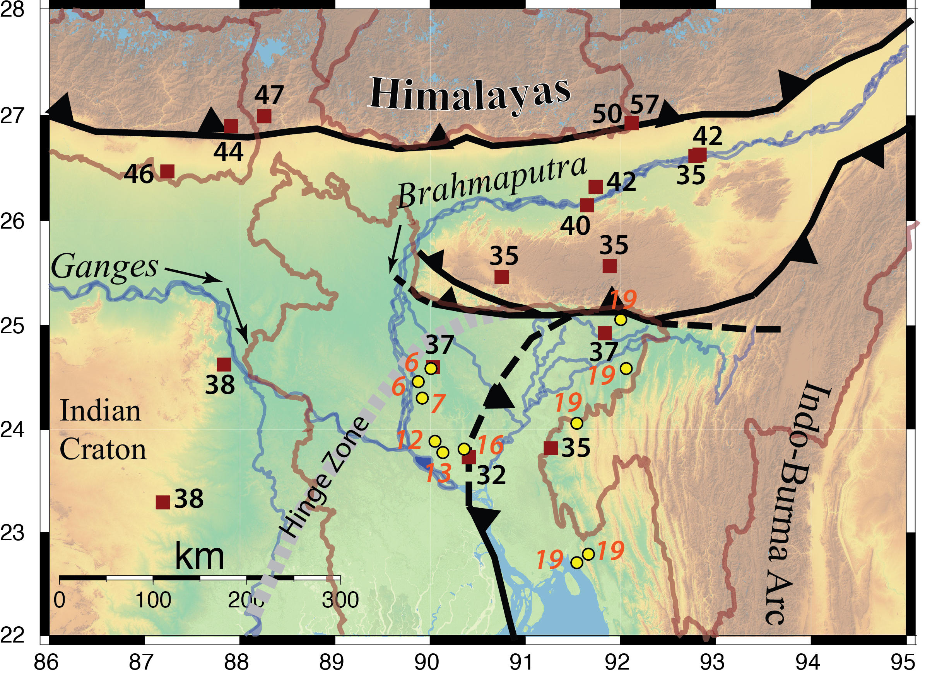
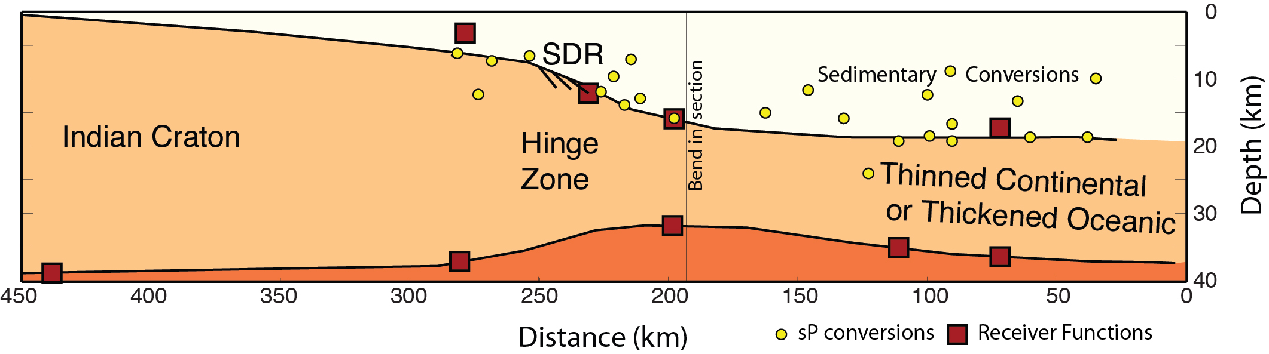
Erosion from Himalaya has prograded the margin by 300-400 km since Eocene. SZ entirely subaerial.
Delta front
Prograding 12-15 m/y
19 km of sediments over a 16-18 km oceanic(?) crust

Slide 11
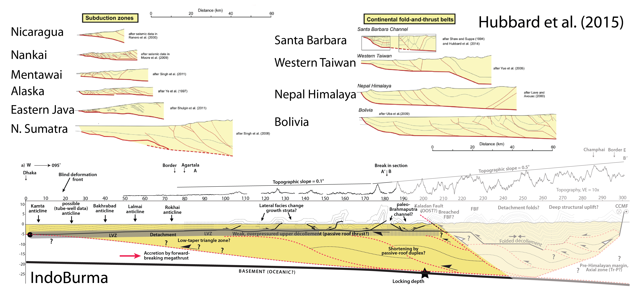
IndoBurma accretionary prism dwarfs most subduction zone accretionary prisms and continental fold-and-thrust belts
Active prism >200 km wide

Slide 12
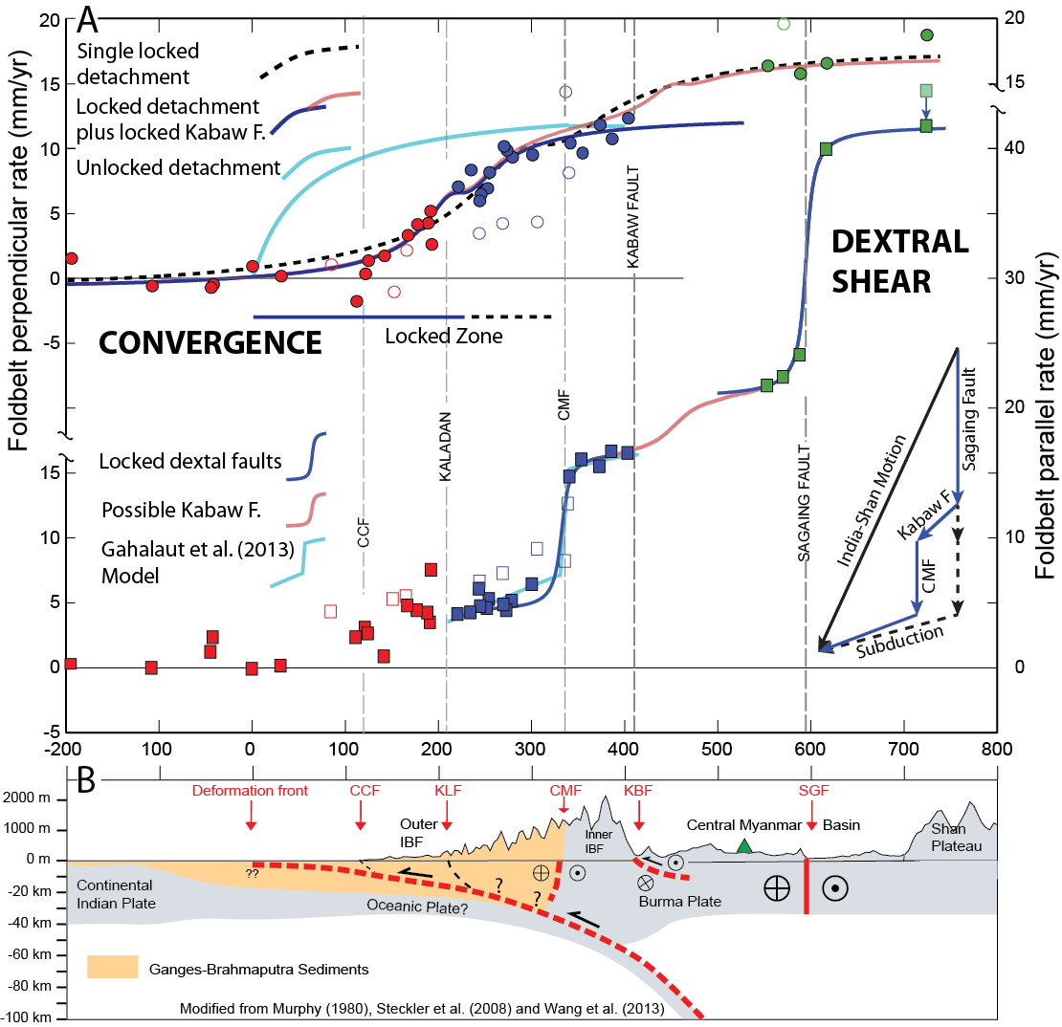
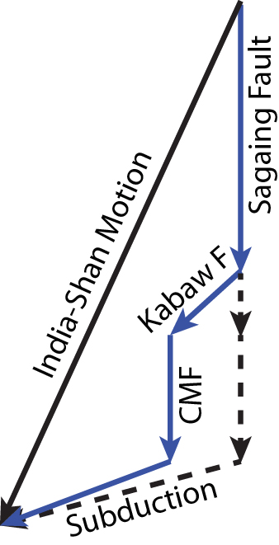
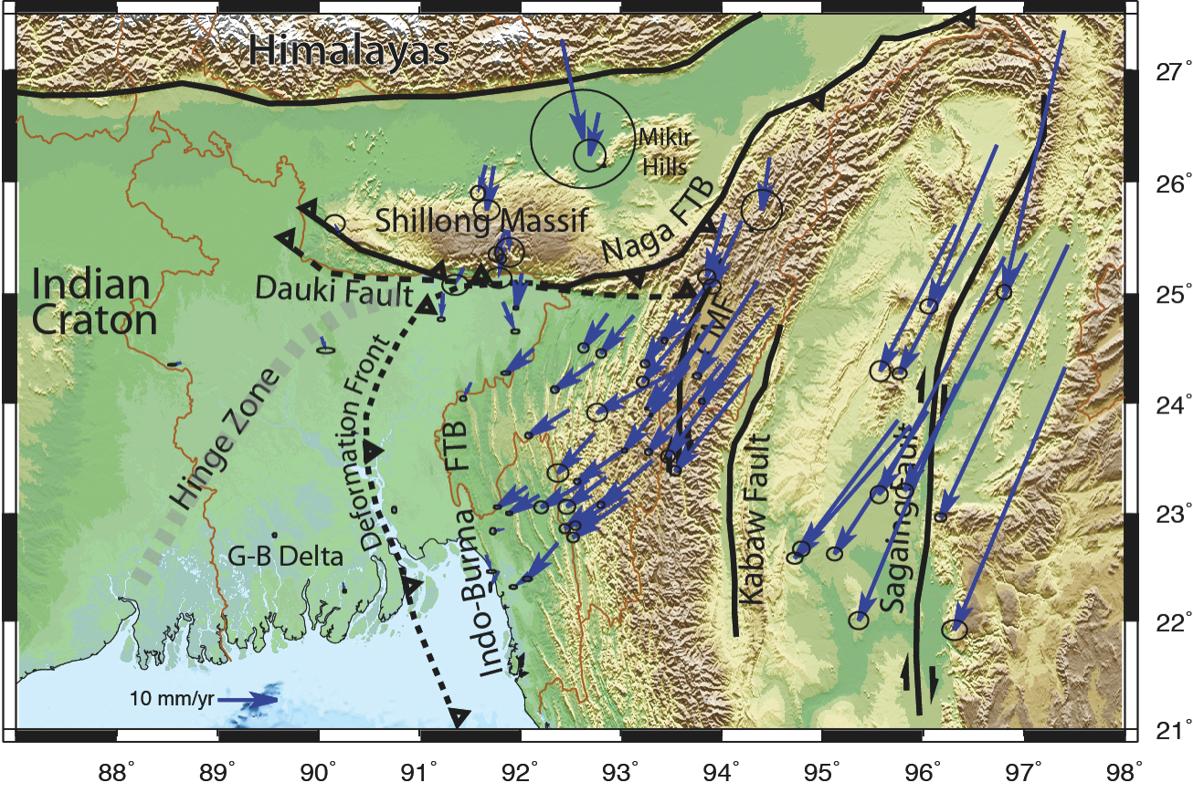

Slide 13
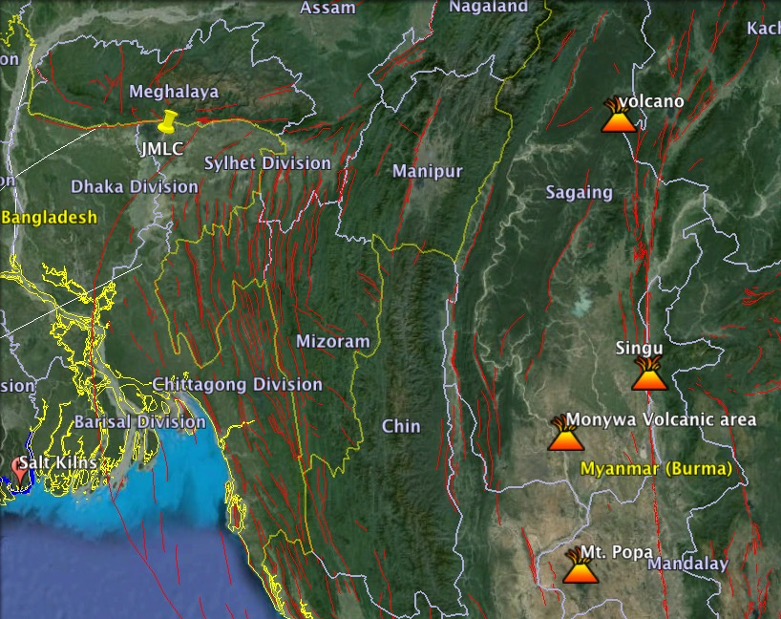
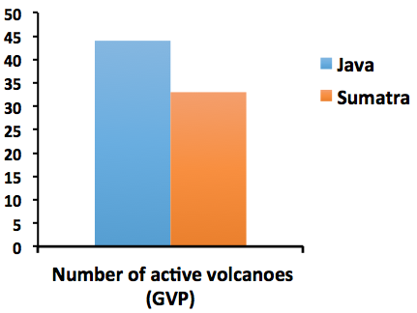
Java: 4 volcanoes per 100 km length
Sumatra: 2 volcanoes per 100 km length
IndoBurma: <1 volcano per 100 km length
IndoBurma
500 km

Slide 14
Java-Sumatra-Andaman-IndoBurma Subduction Zone
Notable along-strike variations in:
Convergence velocity
Age of Ocean Crust
Slab Dip
Obliquity and partitioning
Sediment entering subduction zone
Volcanism

