Slide 1

Observational strategies to address predictability of earthquakes and volcanic eruptions
Emily E. Brodsky
University of California, Santa Cruz

Slide 2
Are earthquakes predictable?

Slide 3
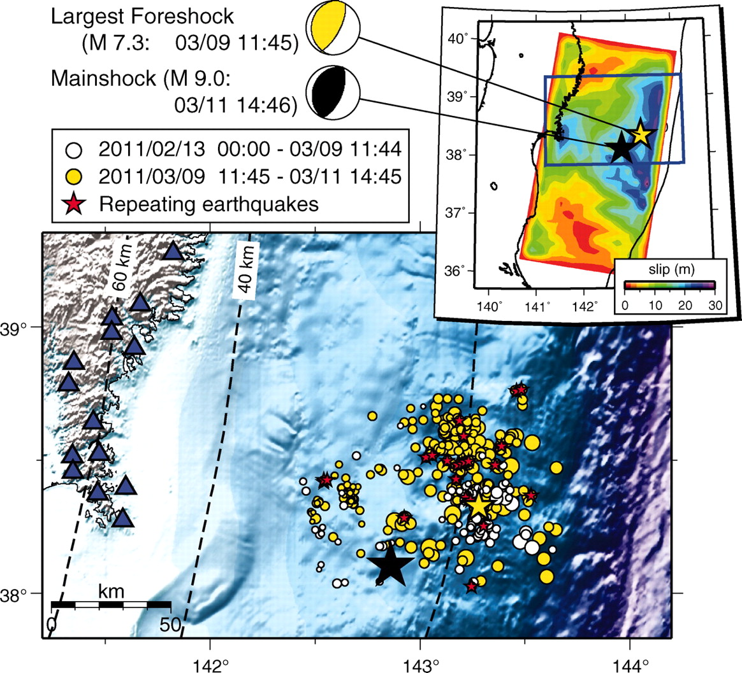
Foreshocks
Example: 2011 M9.0 Tohoku earthquake
~20-50% of
mainshocks have observable
foreshocks
Kato et al. Science 2012.
Notes:
NOT EVERYTHING & THE CONVERSE IS NOT TRUE Foreshocks and the mainshock rupture. Map of the foreshock region of the 2011 Tohoku-Oki earthquake, including the epicenters of the 11 March M_{w} 9.0 mainshock (black star), the 9 March M_{w} 7.3 largest foreshock (yellow star), and all 333 events in the JMA catalog between 13 February and 11 March 2011 (white and yellow circles scaled to magnitude). Blue triangles, seismic stations; dashed lines, iso-depth contours of the plate boundary at 20-km intervals (34); red stars, epicenters of small repeating earthquakes in the JMA catalog, identified as such based on a previous study (23). (Inset) Distribution of the total mainshock slip, imaged by a finite-source modeling using global broadband seismograms (13). Yellow/white and black/white spheres denote focal mechanisms of the largest foreshock and the mainshock, respectively.

Slide 4
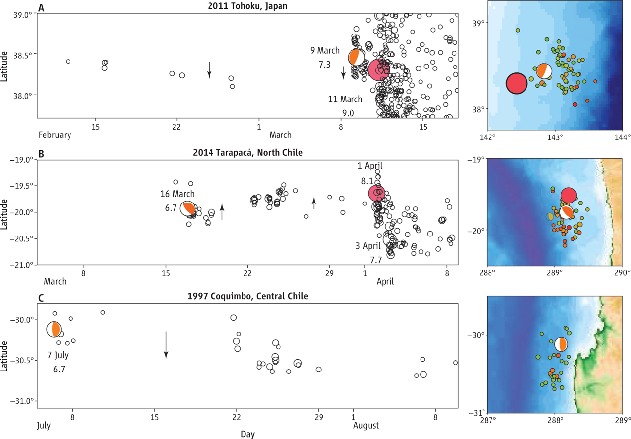
A Word of Warning
Observational Need:
Measuring Small Offshore Earthquakes
Brodsky and Lay, Science 2014
Published by AAAS
Notes:
Precursors or not?Plate boundary thrust sequences for the 2011 M_{w} 9.0 earthquake in Tohoku, Japan (A), the 1 April 2014 M_{w} 8.1 earthquake in north Chile (B), and the 1997 central Chile sequence (C). Red dots indicate great earthquake epicenters. The fault geometries of large foreshocks are indicated by orange focal mechanisms (the 1997 sequence was not followed by a great event). Arrows indicate migration direction. In the maps on the right of each panel, color denotes depth of foreshocks (red, 5 to 15 km; brown, 15 to 25 km; green, 25 to 35 km).

Slide 5
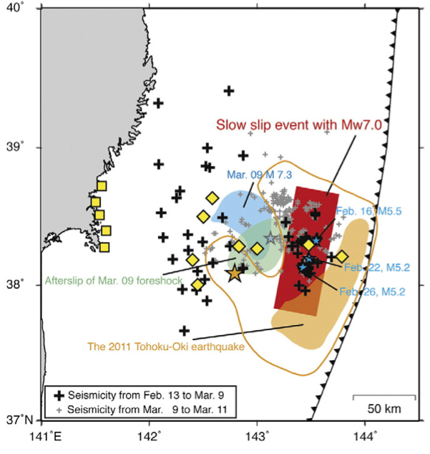
What makes foreshocks?
Cascades vs. Slow Slip
Ito et al., Tectonophysics, 2013
Ogata, 1988 ++
Notes:
This is the physics behind magnitude predictability

Slide 6
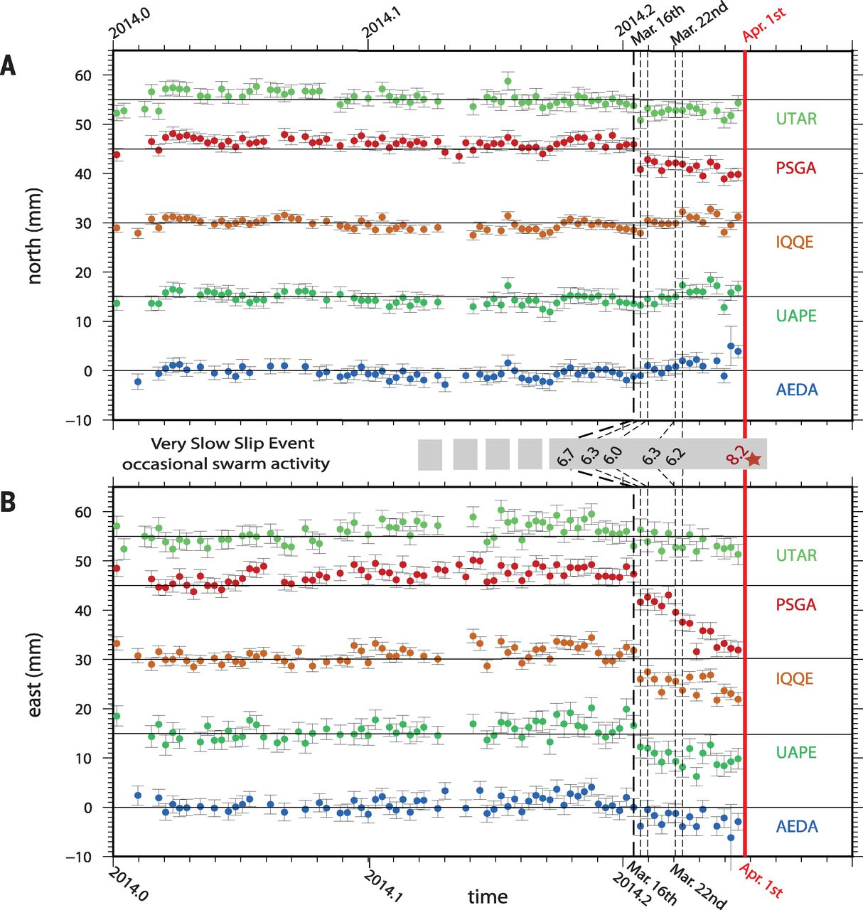
Interpreting pre-earthquake deformation from land
Example:
2014 M8.2 Iquique earthquake
Observational Need:
Continuous Seafloor Geodesy
Ruiz et al. Science 2014
Notes:
Motion of coastal GPS stations preceding the Iquique earthquake.(A) North and (B) east components relative to a linear evolution model with seasonal variations estimated since 2012 (14). The thick red line denotes the origin time of the mainshock, whereas the black dotted lines show the occurrence times of the M_{w} > 6 foreshocks. Error bars indicate 1σ formal uncertainty.

Slide 7
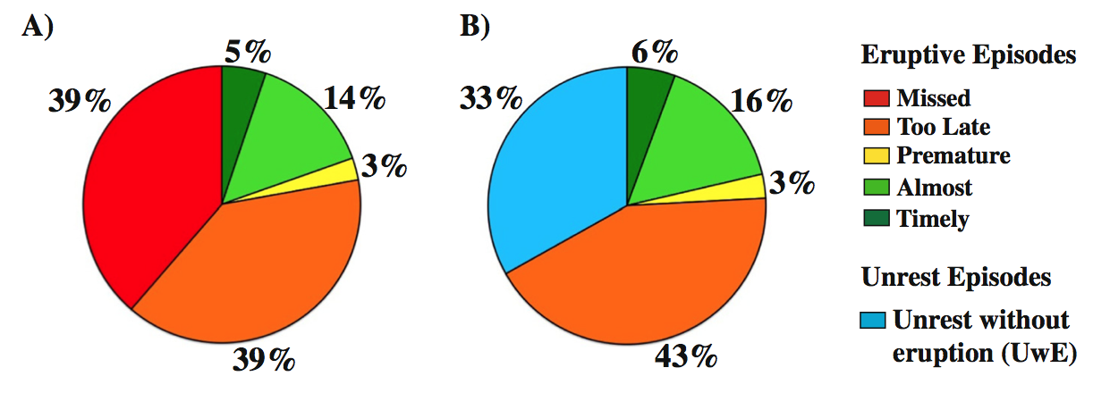
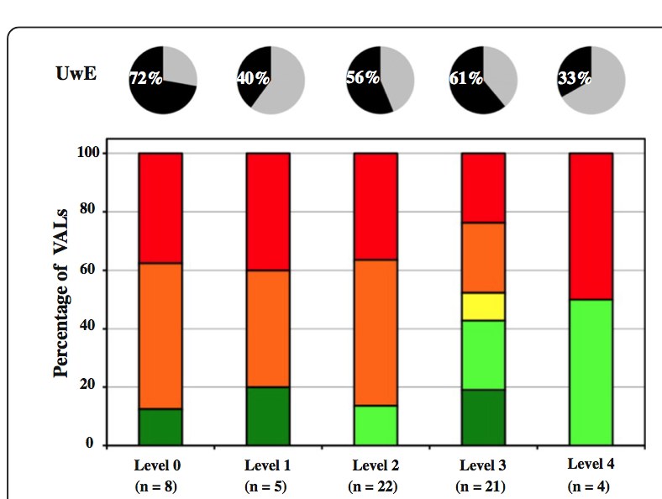
Are volcanic eruptions predictable?
Unrest
without eruptions
Observational Need:
Good (or better) Networks
Percentage of
Volcanic Alerts
Monitoring : None Limited Basic Good Research
Winson et al., J. Appl. Volc., 2014
Notes:
Good = 3-4 seismometers +
6 seismometers within 20 km of vent
Or 6 continuous GPS
or gas monitoring

Slide 8
Conclusions:
Observational Requirements to Assess the Conditions (if any) for Predictability
For earthquakes:
  Seismometers to measure small offshore earthquakes
    Preferably complete to M~2
  Long-term continuous seafloor geodetic monitoring
For volcanic eruptions:
  Good (as defined above) volcano networks
All on a suite of sites

Slide 9
Are volcanic eruptions predictable?
Unrest
without eruptions
Percentage of
Volcanic Alerts
Monitoring : None Limited Basic Good Research
Winson et al., J. Appl. Volc., 2014
Notes:
Good = 3-4 seismometers +
6 seismometers within 20 km of vent
Or 6 continuous GPS
or gas monitoring

Slide 10
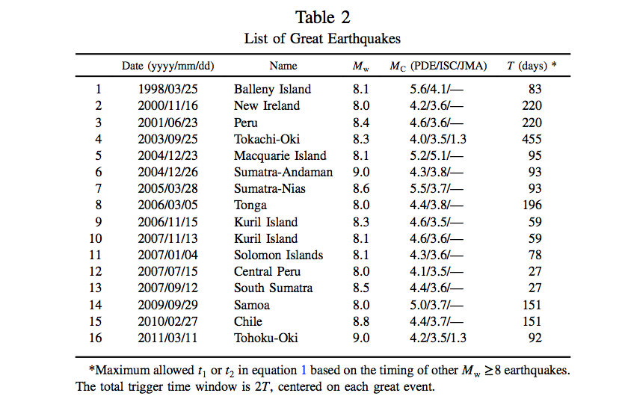
Van der Elst et al., BSSA, 2013

Slide 11
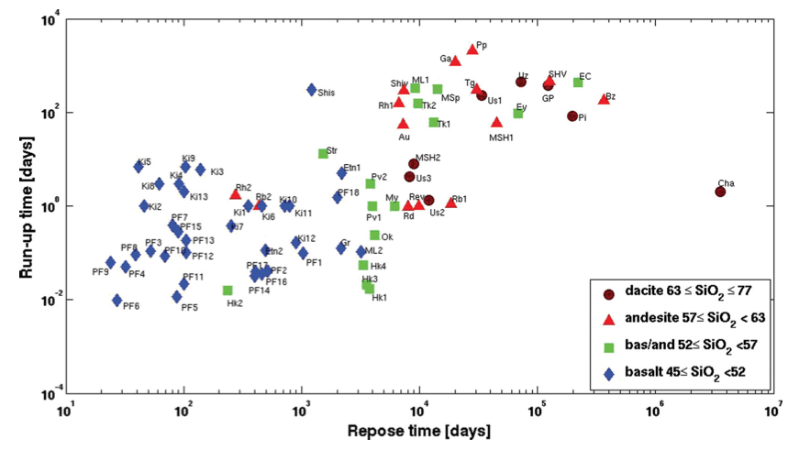
Under what physical conditions are volcanoes predictable?
Passarelli figure
Passarelli and Brodsky, GJI, 2012

