Slide 1
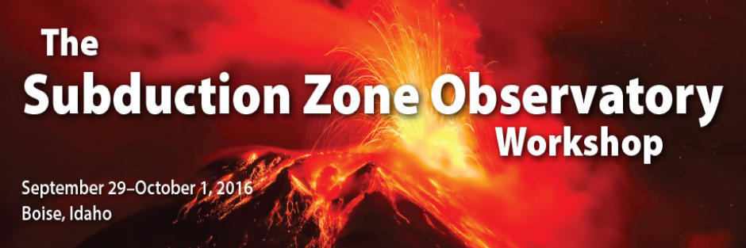

Vision for a Subduction Zone Volcano Observatory
Volcano
Jeffrey Johnson (Dept. of Geosciences, Boise State University)
Fifteen individuals contributed to white paper “A vision for community-scale volcano science activities under the auspices of a Subduction Zone Observatory” (D. Roman lead)

Slide 2
White Paper: A vision for community-scale volcano science activities under the auspices of a Subduction Zone Observatory
Research goals:
1) Increasing understanding of the relationship between volcanic systems and their tectonic/geological context (e.g., presence of faults or lithologic barriers, state of crustal stress)
2) Increasing understanding of the relationship between key subduction zone parameters (e.g, age, depth, subduction rate, and composition of the slab) and eruption sizes, frequencies and styles
3) Increasing insight into the effects of external processes (e.g., tectonic earthquakes; activity at nearby volcanoes; crustal deformation including aseismic slip events; atmospheric, glacial, or hydrological processes) on a volcanic system
4) Increasing understanding of the rates and potential cycles of magma fluxes from mantle to surface and how they translate to intrusive vs eruptive magma emplacement on an arc-wide scale
5) Investigating dynamic internal volcanic processes through 4-D imaging of sub-surface activity
6) Improving quantification of long-term patterns of volcanic unrest at both individual volcanoes and on an arc-scale through detailed mapping, evaluation of eruptive products, and contributions to open- access community databases (e.g., Smithsonian GVP, WOVOdat) that document eruptive activity and other volcanic events (deformation episodes, earthquake swarms, infrasonic signals, and/or gas emissions; fatalities; evacuations, forecasts)
7) Improved understanding of the relationships between magma chemistry, volcano morphology, and volcano dynamics, including seismicity and deformation.
8) Increasing understanding of what starts and stops volcanic activity and how a volcano transitions into new regimes of behavior
9) Translation of basic research outcomes into applicable procedures and products for mitigation of volcanic hazards and risk (e.g. hazards maps, early warning systems)
Do not even try to
read this now

Slide 3
Grand Research Goals
Distilled from white paper:
1) Map mid-crustal (and deeper) structures inherent to subduction zone magmatic processes
2) Elucidate the relationship between tectonism and magmatism
3) Image the volcanic systems in as great detail as possible in four dimensions
4) Understand the dynamics of, and quantify, eruptions and other surface volcanic processes

Slide 4
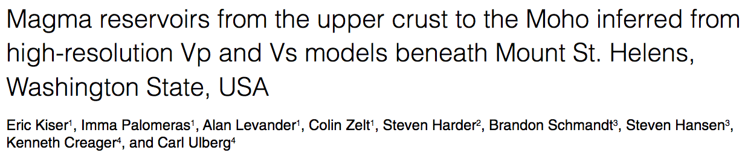
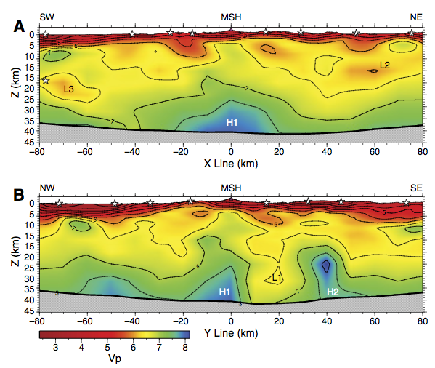
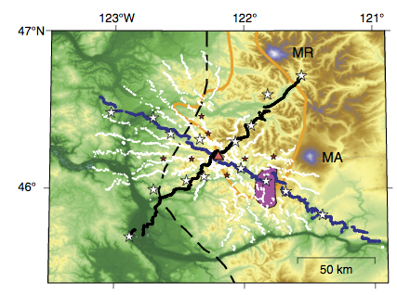
Grand Goal 1: Map mid-crustal (and deeper) structures inherent to subduction zones magmatic processes
Geology 2016
Seismic tomography is the go-to technology for imaging magma chambers or mush. Large-n deployments are increasingly common.

Slide 5
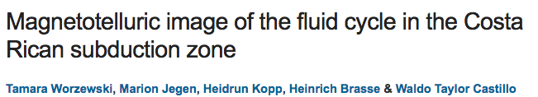
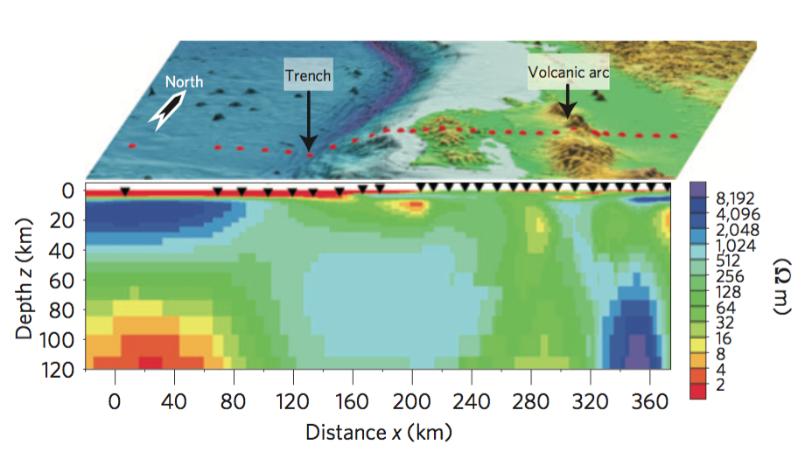
Grand Goal 1: Map mid-crustal (and deeper) structures inherent to subduction zones magmatic processes
Magnetotelluric studies are capable of identifying presence of fluids and relationship to volcanic ‘plumbing systems’ and potentially temporal changes to the sub-surface structure.
Networks of MT could be integrated into a distributed network infrastructure.
Nat. Geosc. 2011

Slide 6
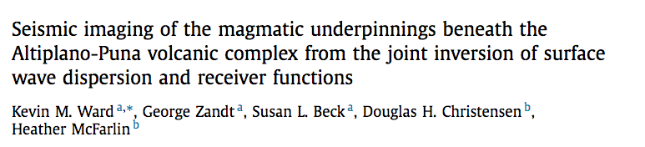
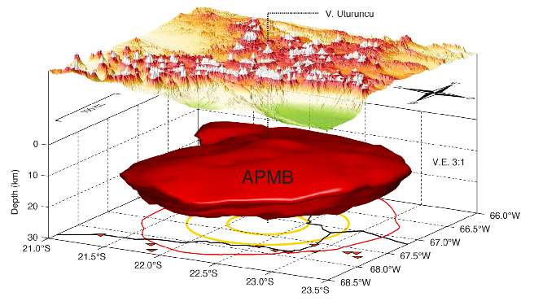
Grand Goal 1: Map mid-crustal (and deeper) structures inherent to subduction zones magmatic processes
2014 EPSL
Jointly inverted seismic, MT, and geodetic data hint at the presence of mid-crustal melt bodies

Slide 7
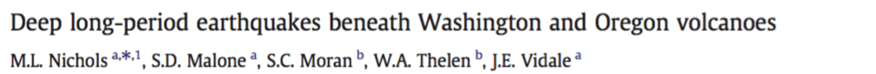
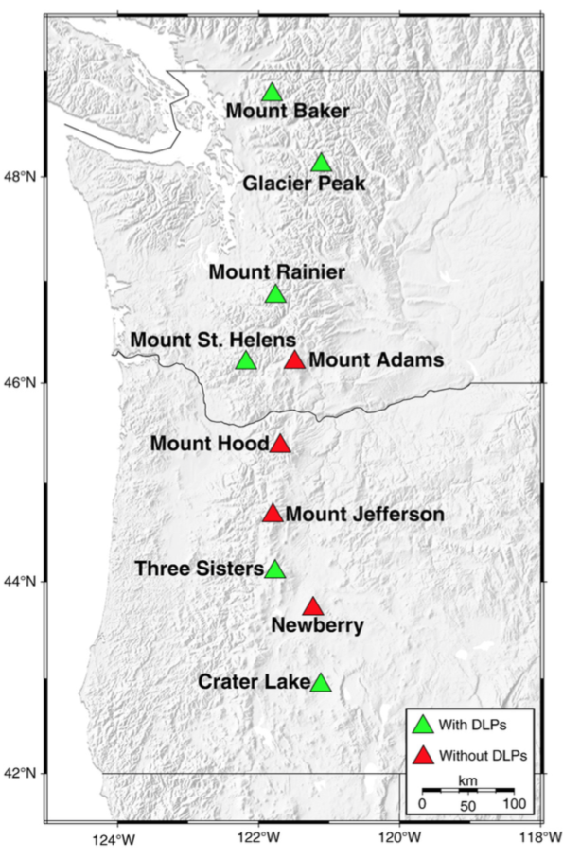
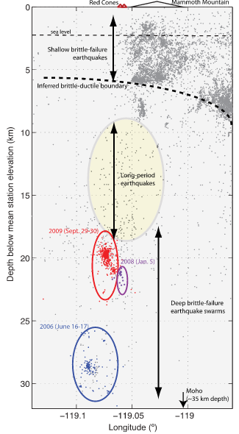
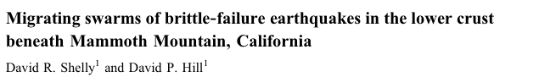
Grand Goal 1: Map mid-crustal (and deeper) structures inherent to subduction zones magmatic processes
JVGR 2011
Earthquakes occur deep (~30 km) beneath volcanoes and may be ubiquitous, but they are poorly studied.
As with subduction slow slip earthquakes, large N networks and arrays will be needed to advance the detection and study of deep volcanic earthquakes
GRL 2011

Slide 8
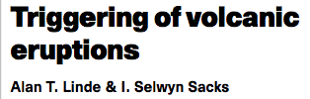
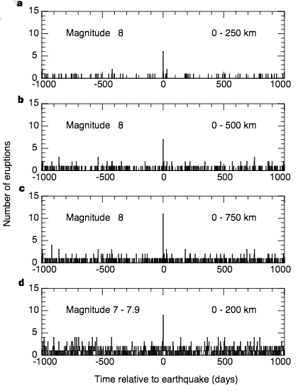
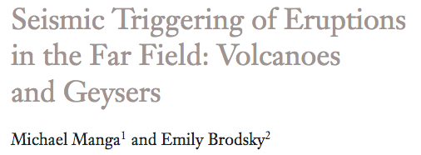
Grand Goal 2: Elucidate the relationship between tectonism and magmatism
There is observed correlation between large earthquakes and (large) eruptions (databases) and also between regionally-situated volcanoes
Relationship between regional stresses and subtle changes in the volcanic system is less well constrained.
Nature 1998
Ann. Rev. of Earth and Planet. Sci. 2006

Slide 9
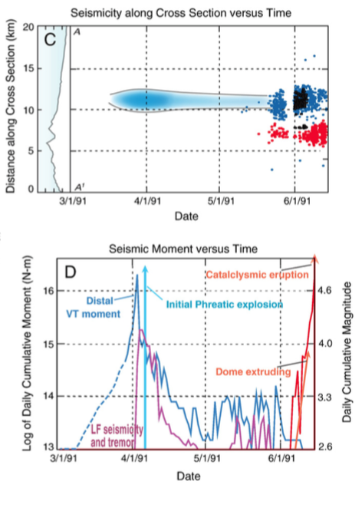
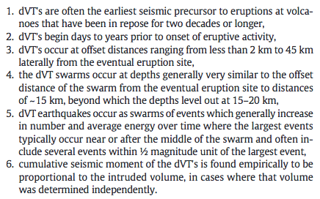
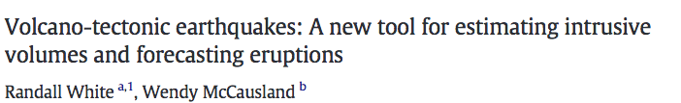
Grand Goal 2: Elucidate the relationship between tectonism and magmatism
Distant volcano-tectonic earthquakes (indirect measures of stress) commonly precede eruptions.
Causal relationship must be investigated and models developed.
JVGR 2016

Slide 10
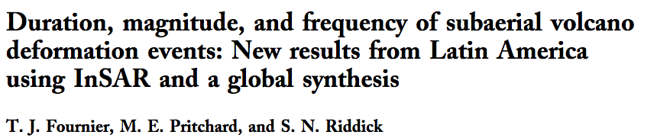
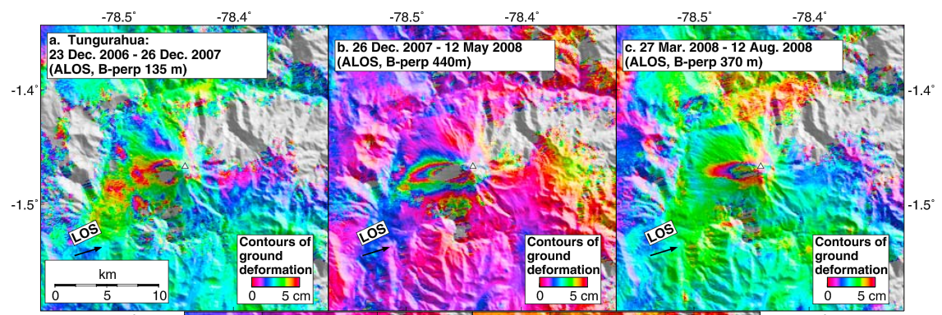
Grand Goal 3: Image the internal volcanic systems in as great detail as possible in four dimensions
Time lapse satellite deformation reveals cycles of inflation and deflation at volcanoes. Seismic tomography, including ambient noise, has promise for detecting temporal changes.
G3 2010

Slide 11
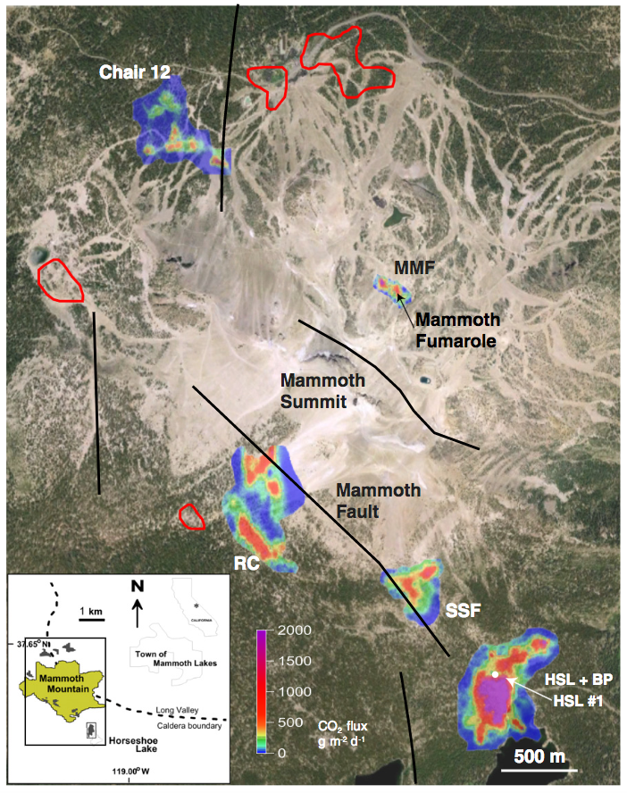
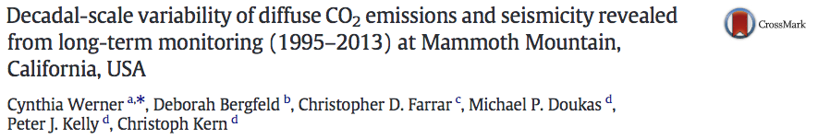
Grand Goal 3: Image the internal volcanic systems in as great detail as possible in four dimensions
Diffuse soil CO2 degassing shows time variations that reflect temporally varying structures in the sub-surface
JVGR 2014

Slide 12
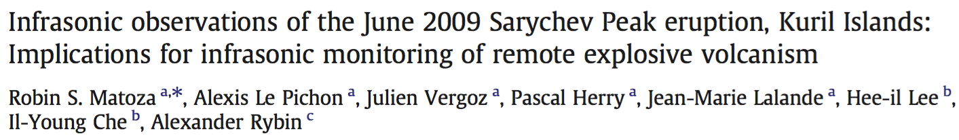
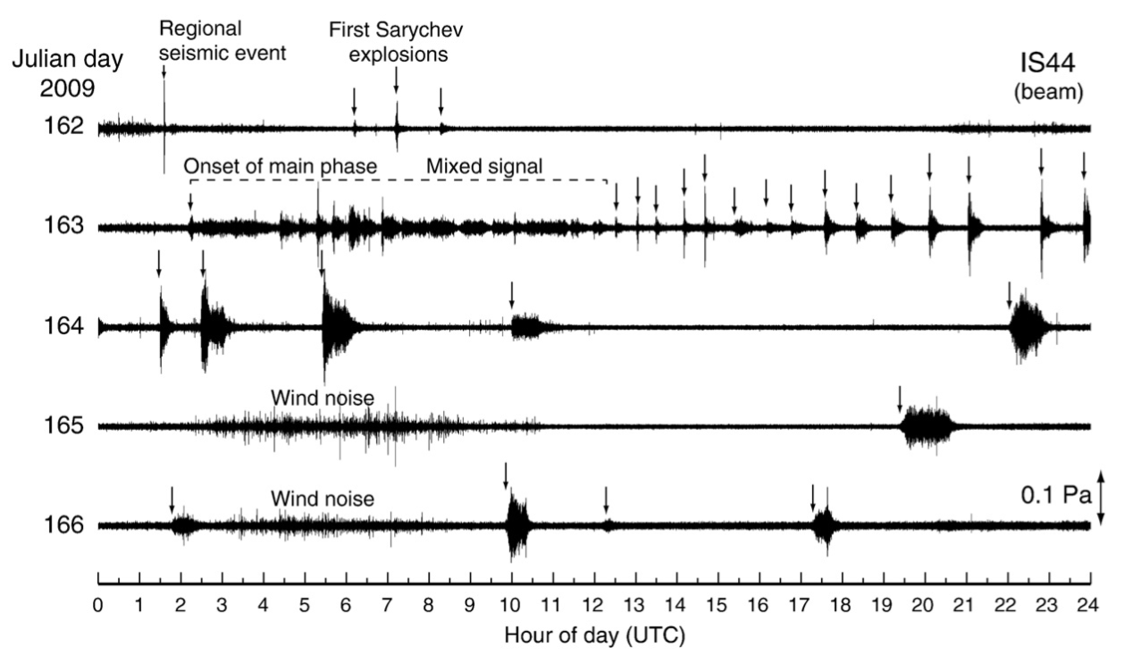
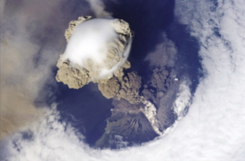
Grand Goal 4: Understand the dynamics of, and quantify, eruptions and other surface volcanic processes
Infrasound is permitting the remote detection and quantification of eruptive events

Slide 13

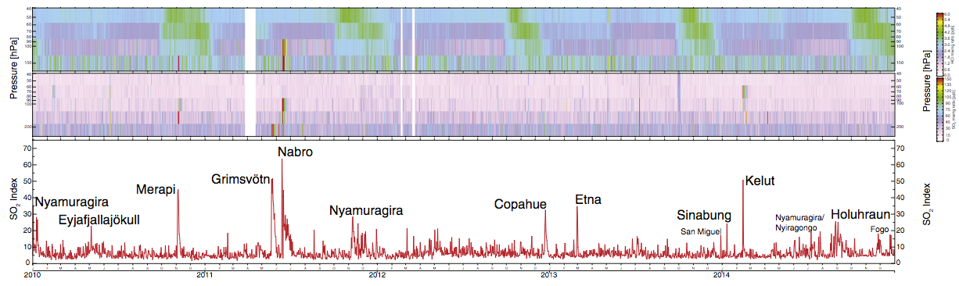
Grand Goal 4: Understand the dynamics of, and quantify, eruptions and other surface volcanic processes
Similarly, satellite remote sensing, including UV and IR monitoring (SO2 and thermal anomaly quantification), provide us with a means to track and quantify volatile and mass flux.
JVGR 2016

Slide 14

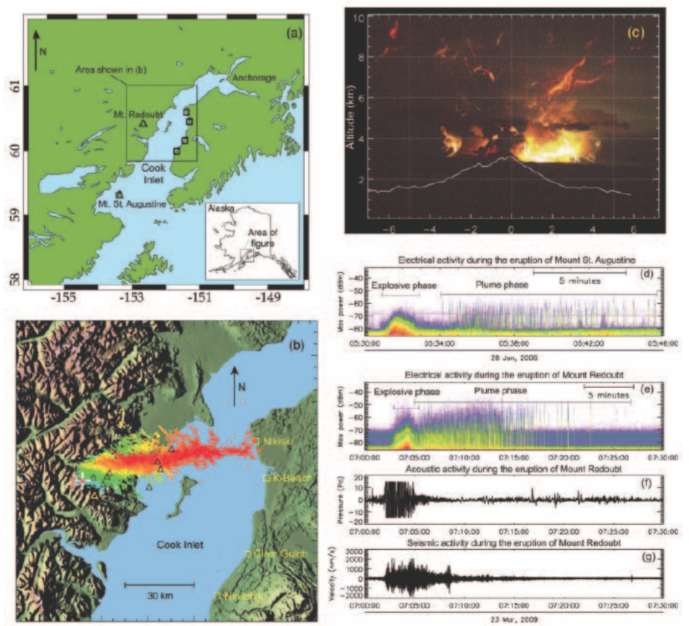

Grand Goal 4: Understand the dynamics of, and quantify, eruptions and other surface volcanic processes
Eos 2012
Application of new technologies, such as volcano lightning detection, are advancing our capabilities for quantifying eruption dynamics

Slide 15
Grand Research Goals Driven By Multi-disciplinary Observations:
Not explicity mentioned:
Ground-based UV imagery (SO2)
Fourier Transform Infrared (gas ratios)
Thermal remote sensing (heat flow)
Doppler radars (eruption velocities)
Ground-SARs (deformation)
Structure From Motion (DEM and mass flux)
Electrical methods (other than MT)
LiDAR (surface mapping)
Photgrammetry (surface mapping)
Cosmic ray detection (tomography)
Borehole strain (stress fields)
Petrologic Analysis (thermometry/barometry)
Geologic Mapping (‘paleovolcanology’)
Direct sampling (including boreholes/drilling)
Quantitative petrology
Direct gas sampling (flux, geochemistry, gas ratios)
Gravity (internal mass flow)
A huge challenge is how to integrate and prioritize these diverse tools!
Tools mentioned
Seismic
Infrasound
InSAR and GPS
Magnetotelluric
Cosmic ray tomography
UV and IR spectroscopy
Databases
Lightning detection/mapping

Slide 16
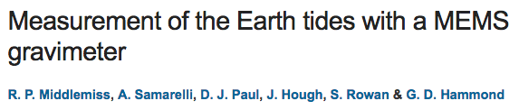
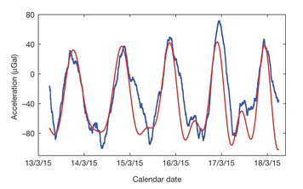
Technological Advances: Sensors
Nature 2016
Nature 2016

Slide 17
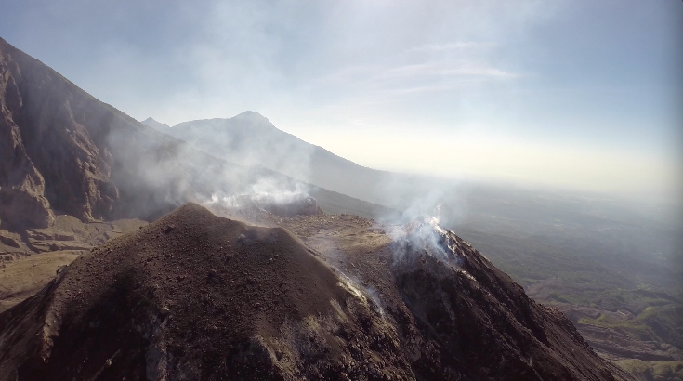
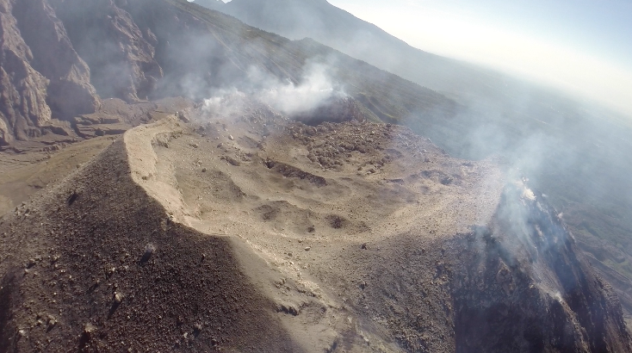
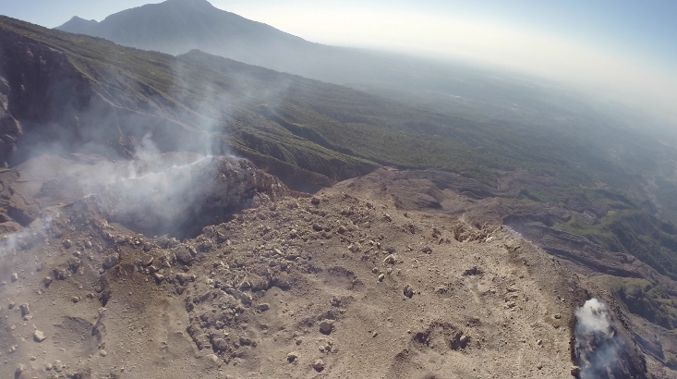
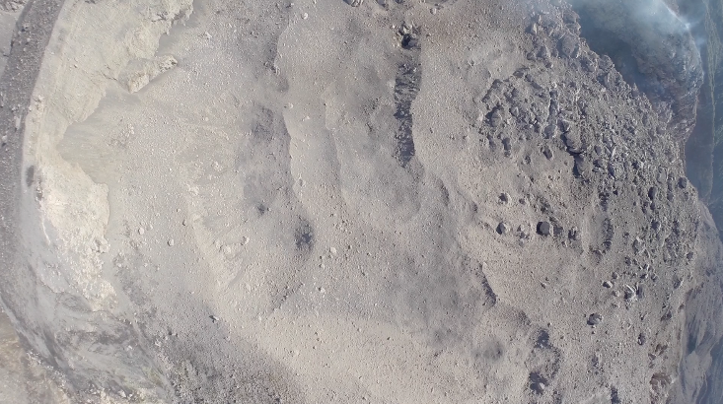
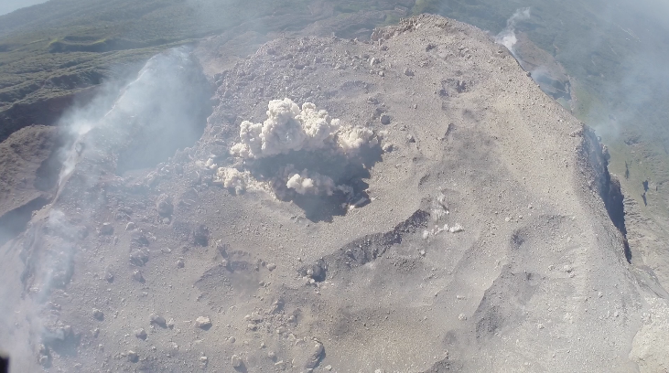
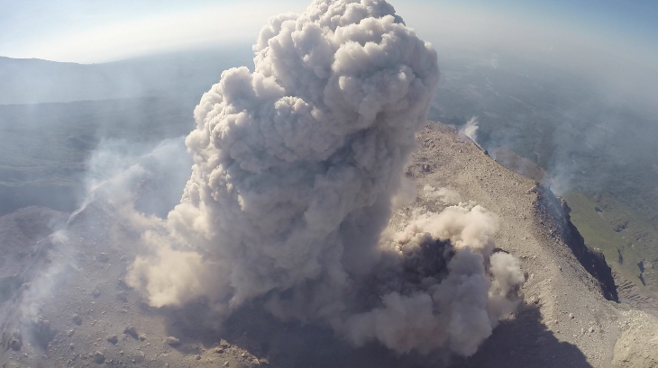
Technological Advances: Sensor Platforms
Courtesy of
Felix Von Auloch
(U. Liverpool)

Slide 18
Integrated Technologies and Joint Studies
Example of short-term deployment
(Santiaguito, Guatemala; Jan. 2016)
Short-duration campaign brings together diverse talents and instrumentation
Clockwise (infrasound, UV imagery, thermal imagery, Doppler radar, drone SFM, FTIR, tilt, broadband seismology)

Slide 19
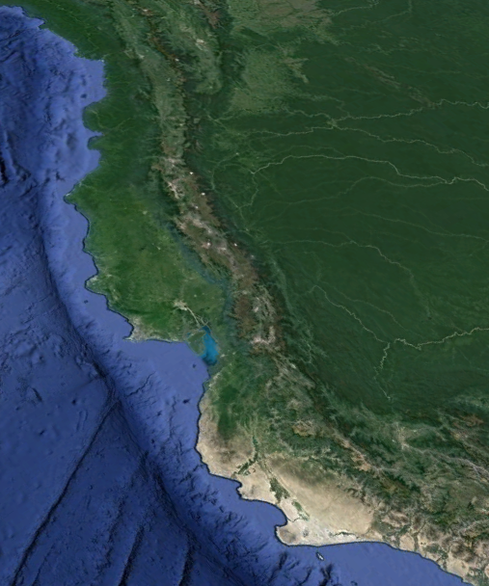
Current State of a Subduction Zone Sensor Network
Backbone regional geophysical network include:
Seismic
Geodetic
Infrasound
Strong motion
Volcano-centric networks include:
Seismic network
Infrasound network
Tilt/GPS/EDM
UV spectroscopy
Webcams
(station map is schematic… try to guess arc!)

Slide 20
Example: Northern Andes (Ecuador):
Current state of network:
Regional network includes geodetic (65 GPS), seismic (100/135 broadband), and strong-motion sensors (98) that are in place and telemetered
14 volcanoes outfitted with telemetered instrumentation (seismometers, tiltmeters, infrasound, GPS, mini-DOAS, EDM)
The challenges:
Focus is on hazard forecasting and communicating risks to authorities. Exploratory science is not the primary priority
Despite expert operational scientists and research staff little discretionary time available for novel scientific discovery
Emerging technologies require dedicated engineering and expertise and dedication
Maintenance of hardware requires huge commitments in cost and technical staff

Slide 21
An SZVO Regional Network
Regional geophysical/geochemical network
Seismic
Geodetic
Infrasound (arrays)
Magnetotelluric
Diffuse degassing measurements
Met station data
Lightning mapping network, other?
Comments: Modularity of the backbone network is essential. Not all sensors are appropriate in all sites. Logging, communication, and power infrastructure is key. Sensor incorporation can be driven by individual Pis.

Slide 22
Vision of Local Volcano Observatory as Part of SZO
Densely instrumented open-vent volcano networks
All of the standard tools
High resolution/speed video
Thermal imagery
Ground-based gas remote sensing
FTIR/radar
Ash collection
Electrical methods
other
Comments: An SZVO local volcano observatory should permit modular addition of sensor types and facilitate power, communications, and security.

Slide 23
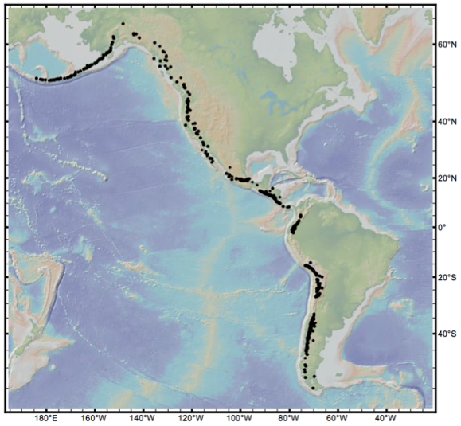
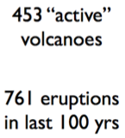
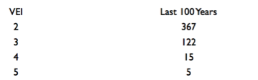
What About Rapid Response to Volcanic Unrest?
Large eruptions can not be forecast with reliability. RAMP-style funding mechanisms are essential to study these critical, and relatively events when they next occur.
A concerted academic-focused response should be prepared for the next VEI5+ eruption
Infrastructure and MOUs must be in coordinated with candidate nations and hazard response organizations (e.g., local observatories)
Global Volcanism Program, Smithsonian

Slide 24
Vision for a Subduction Zone Volcano Observatory
1) Provide a long-term backbone geophysical/geochemical network targeting all volcanoes in that same arc. Broadly this should complement existing networks and incorporate sensor diversity.
2) Infrastructure focus should be on densely instrumented open-vent (‘laboratory’) volcanoes in an arc. Modularity of sensor types and long term investment is infrastructure is essential.
3) Develop flexibility and capability, including an instrument pool, to ‘respond’ to volcano exhibiting sudden unrest. This response would include both ground-based and satellite assets. Question is does this fall within the purview of an SZO.
(Themes extracted from white paper)

