Slide 1
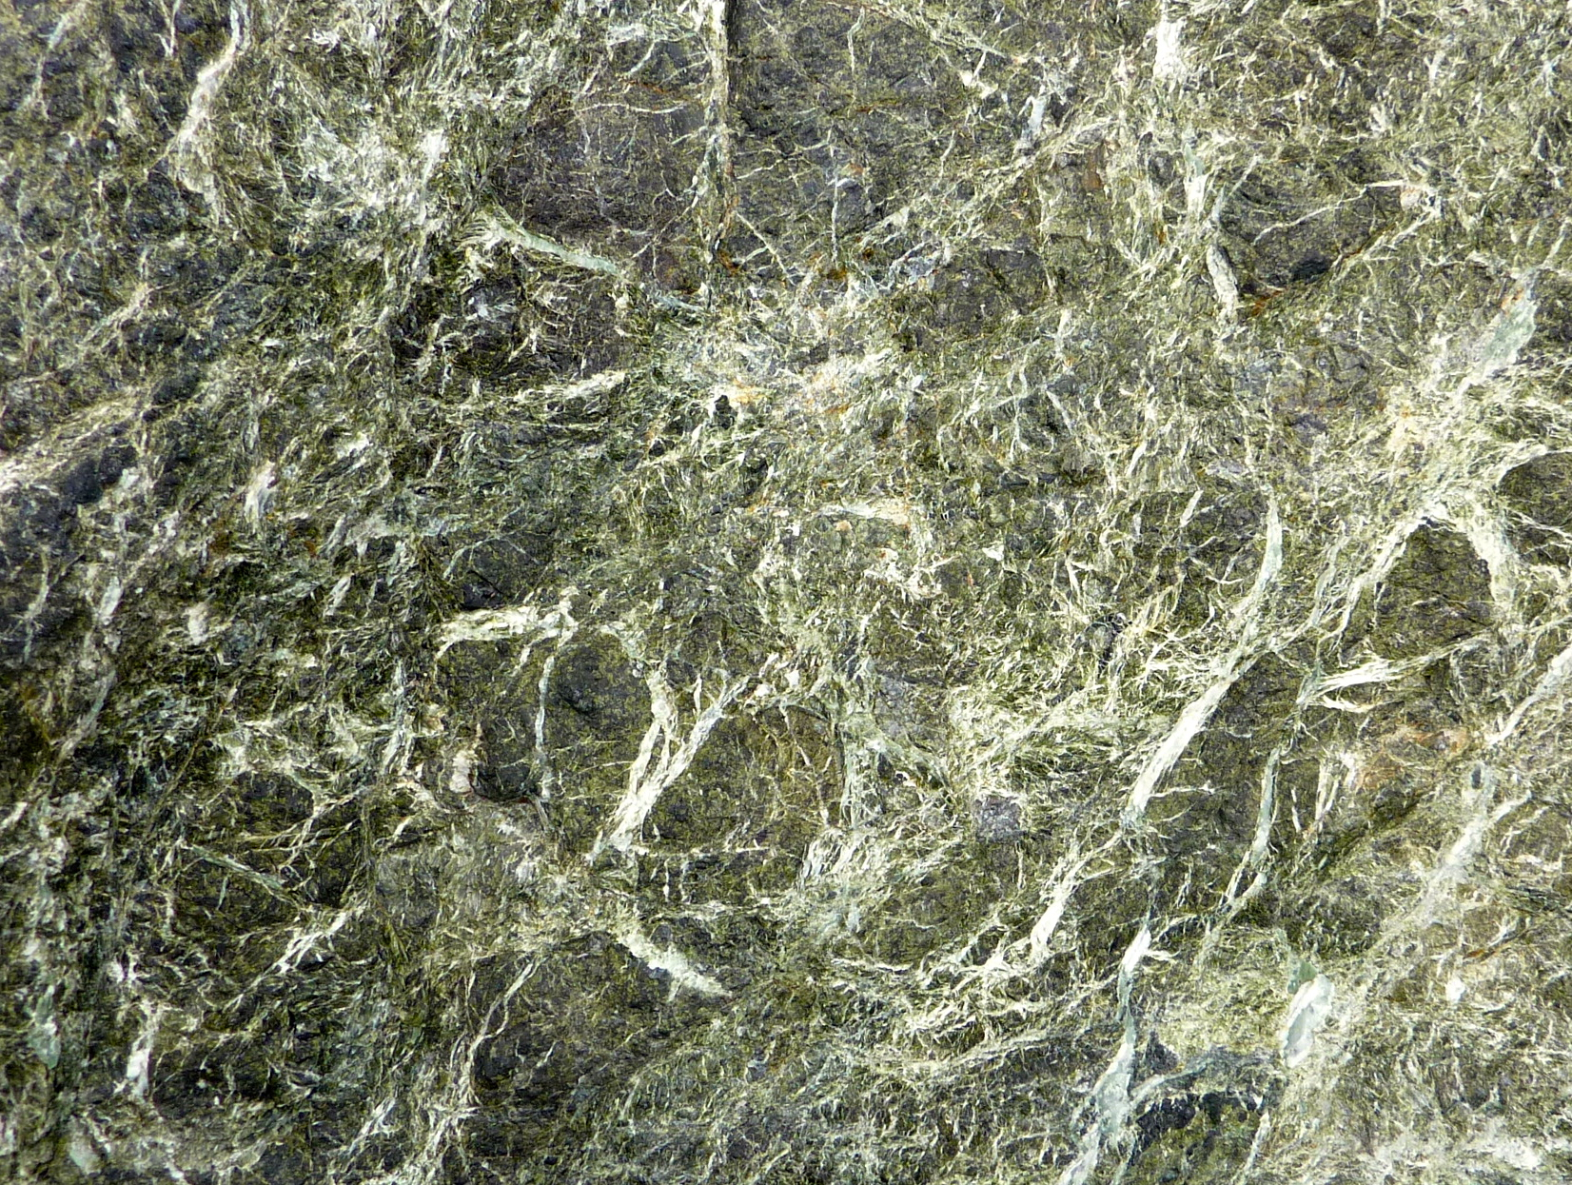

Squeezing the Slab: future directions for metamorphic petrology in the SZO
Andrew Smye
Notes:
Sentence about metamorphic petrology and need to link observations from exhumed rocks to observables at active SZs

Slide 2
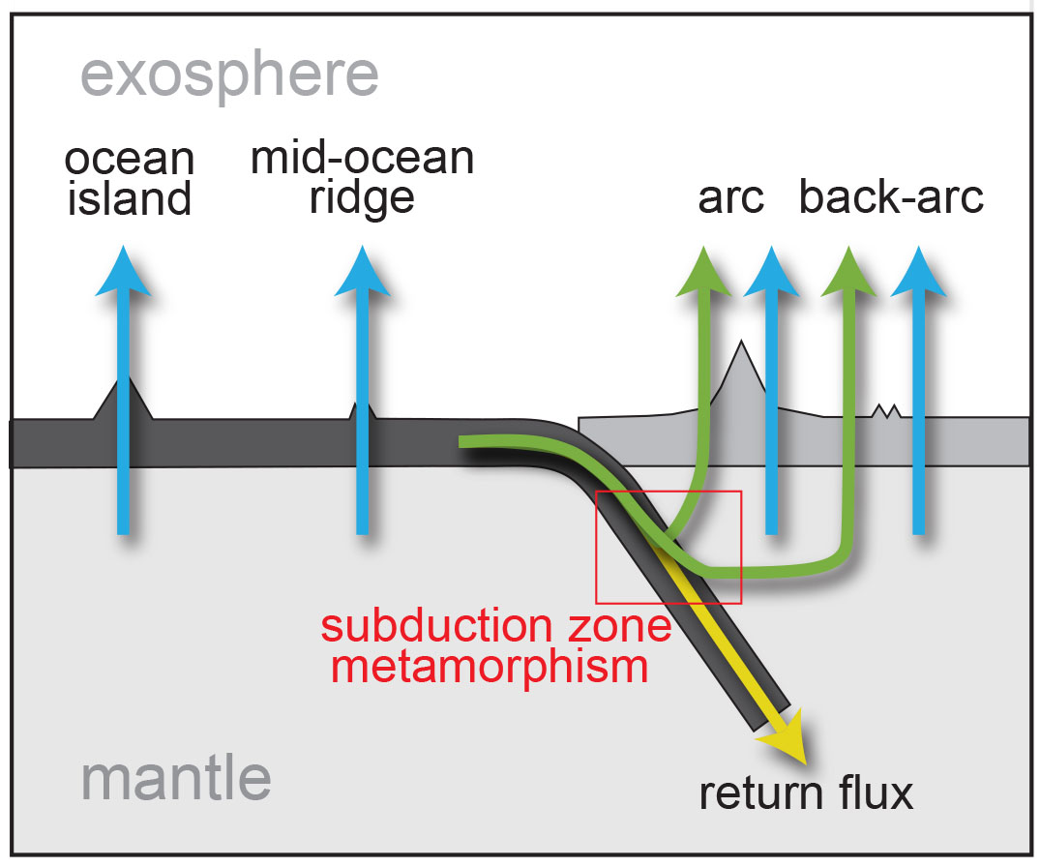
How large is the subducted H₂O flux?
Trench flux (10¹³ mol/yr)
Sediments: <1
Crust: 2 - 4
Mantle: 1 - 7
Modified from Parai and Mukhopadhyay 2012
Flux constraints from Jarrard (2003), Rupke et al (2004), Hacker (2008) & van Keken et al (2011)
Notes:
Return of water into mantle during subduction is key for mantle rheology, chemistry and physics of arc volcanism and subduction zone earthquakes
Initial hydration state of slab loosely constrained: particularly the role of mantle hydration (numbers)
IDEA FOR SZO: integrate petrologic models of fluid-rock interaction with measurements of heat flow and magnetism to constrain magnitude of pre-subduction serpentinization

Slide 3
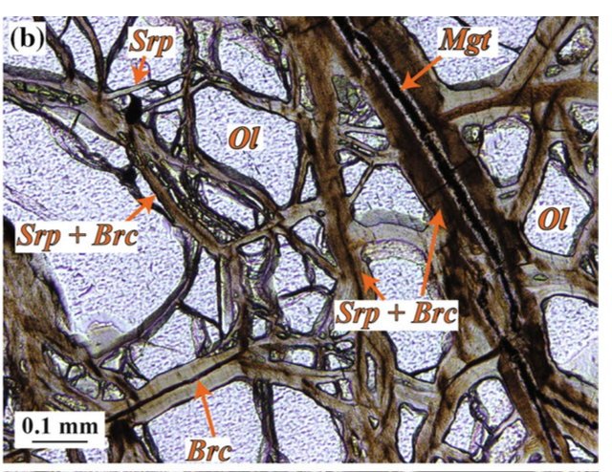
Serpentinization of oceanic mantle
Focused at outer-rise fracture zones
Extremely exothermic:
~10⁹ J/m³ peridotite
Magnetite formation
Large ΔV
Fast kinetics
Scwarzenbach et al (2016)
Notes:
Plates hydrate as they undergo bend faulting at the outer rise
Seawater fluids could penetrate as deep as 30 km (Ranero et al)
Serpentinite-group minerals then have the potential to carry water into the mantle
ANIMATION
Serpentinization is strongly exothermic, releasing ~10⁹ J/m3 peridotite – this is roughly approximate to the same amount of energy released by a granite over 20 Myr of radiogenic decay, or put another way, similar to the amount of energy released by burning a ton of crude oil!!
Magnetite formation
Volume increase
Fast reaction

Slide 4
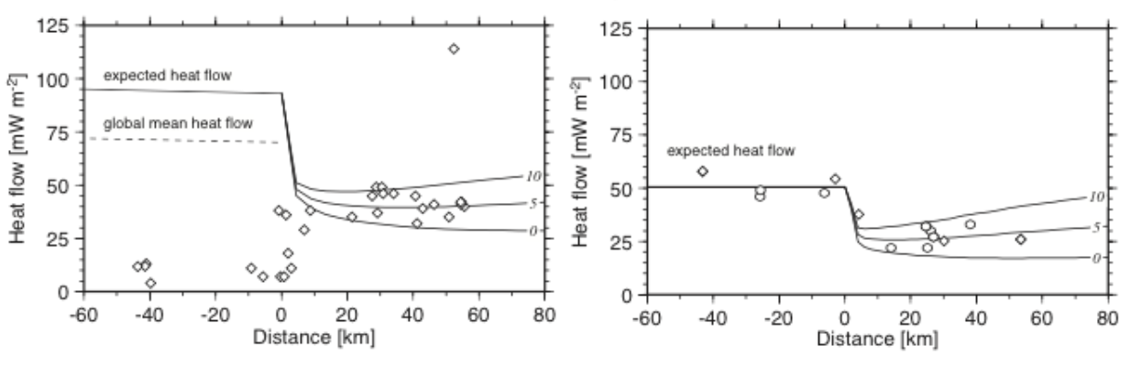
SZO: Can heat flow anomalies be used to constrain initial hydration of slab?
Peru
Bend-fault hydration
Heat of reaction
Grevemeyer et al. (2005)
Integrate high-resolution heat flow measurements with magnetics (magnetite), seismic (low Vp) and thermodynamic fluid-rock interaction model to constrain extent of hydration
Notes:
Ideally we’d be able to access drill core from fracture zones, but in the absence of this petrologic models of serpentinization could be used to predict the amount of heat and magnetite formed during bend-fault hydration
Paucity of available heat flow data across outer-rise
Available data show heat flow deficits relative to conductive plate cooling models, consistent with mining of heat by cold seawater
Size of heat flow deficit qualitatively correlates with seismic and geochemical indices of water content of slab
Effects of serpentinization unclear
Potential idea for the SZO: conduct series of high resolution heat flow measurements across outer-rise fracture zones of SZ’s with different thermal states. Use petrological fluid-rock interaction model to couple heat flow, magnetism and degree of hydration.

