Slide 1
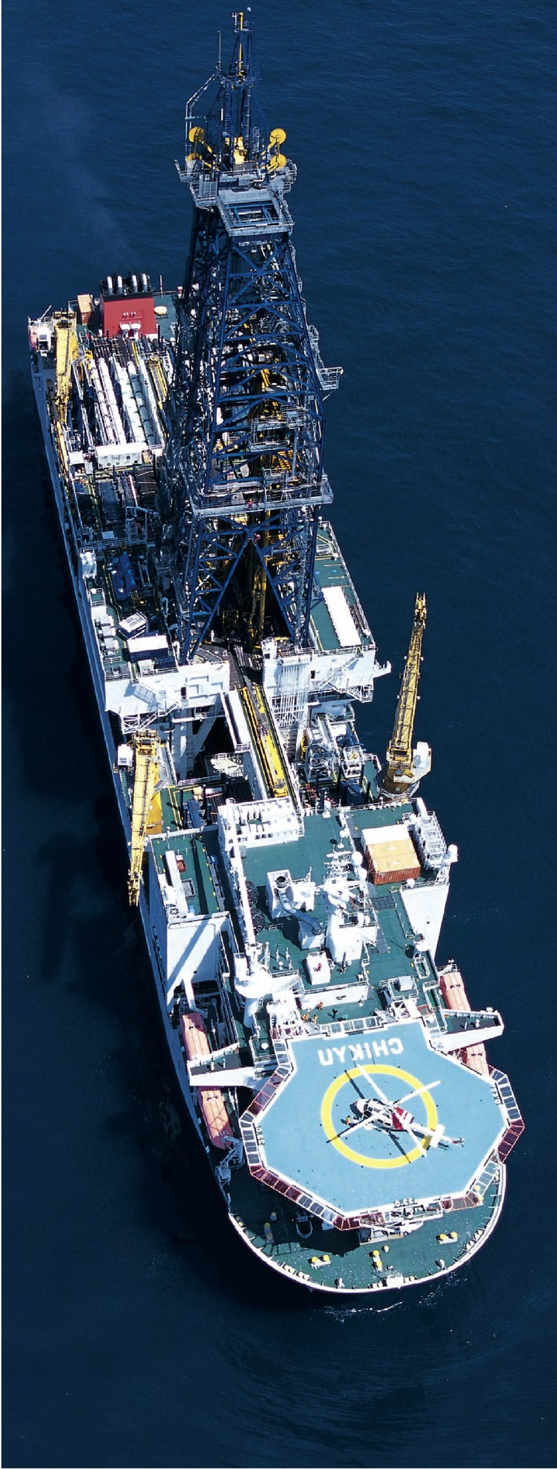
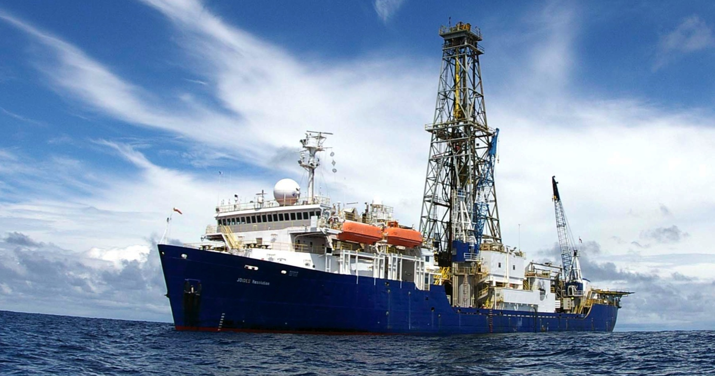
Scientific Ocean Drilling:
Building Consensus and Observatories
Harold Tobin
University of Wisconsin – Madison

Slide 2
Scientific ocean drilling has been part of the fabric of geoscience for more than 50 years

Slide 3
Site locations
over 50 years of
DSDP / ODP / IODP

Slide 4
A Little History
From 1968 – 2023
DSDP Deep Sea Drilling Project 1968– 1983
ODP Ocean Drilling Program 1984 – 2003
IODP Integrated (International) Ocean Drilling (Discovery) Program 2003 – 2023
A few small accomplishments:
Establishing age of ocean basins
Testing seafloor spreading & plate tectonics
Establishing large parts of global climate history
Discovering deep subsurface biosphere & hydrology
Many more via 100s of expeditions & 1000s of boreholes

Slide 5
Ocean Drilling is among the most international collaborations in all of science
An international program from very early days
3 ways to get holes drilled:
USA’s JOIDES Resolution
Japan’s Chikyu
Europe’s special project vessels (e.g., Arctic, Chicxulub)
Today, NSF spends about $48 million / year

Slide 6
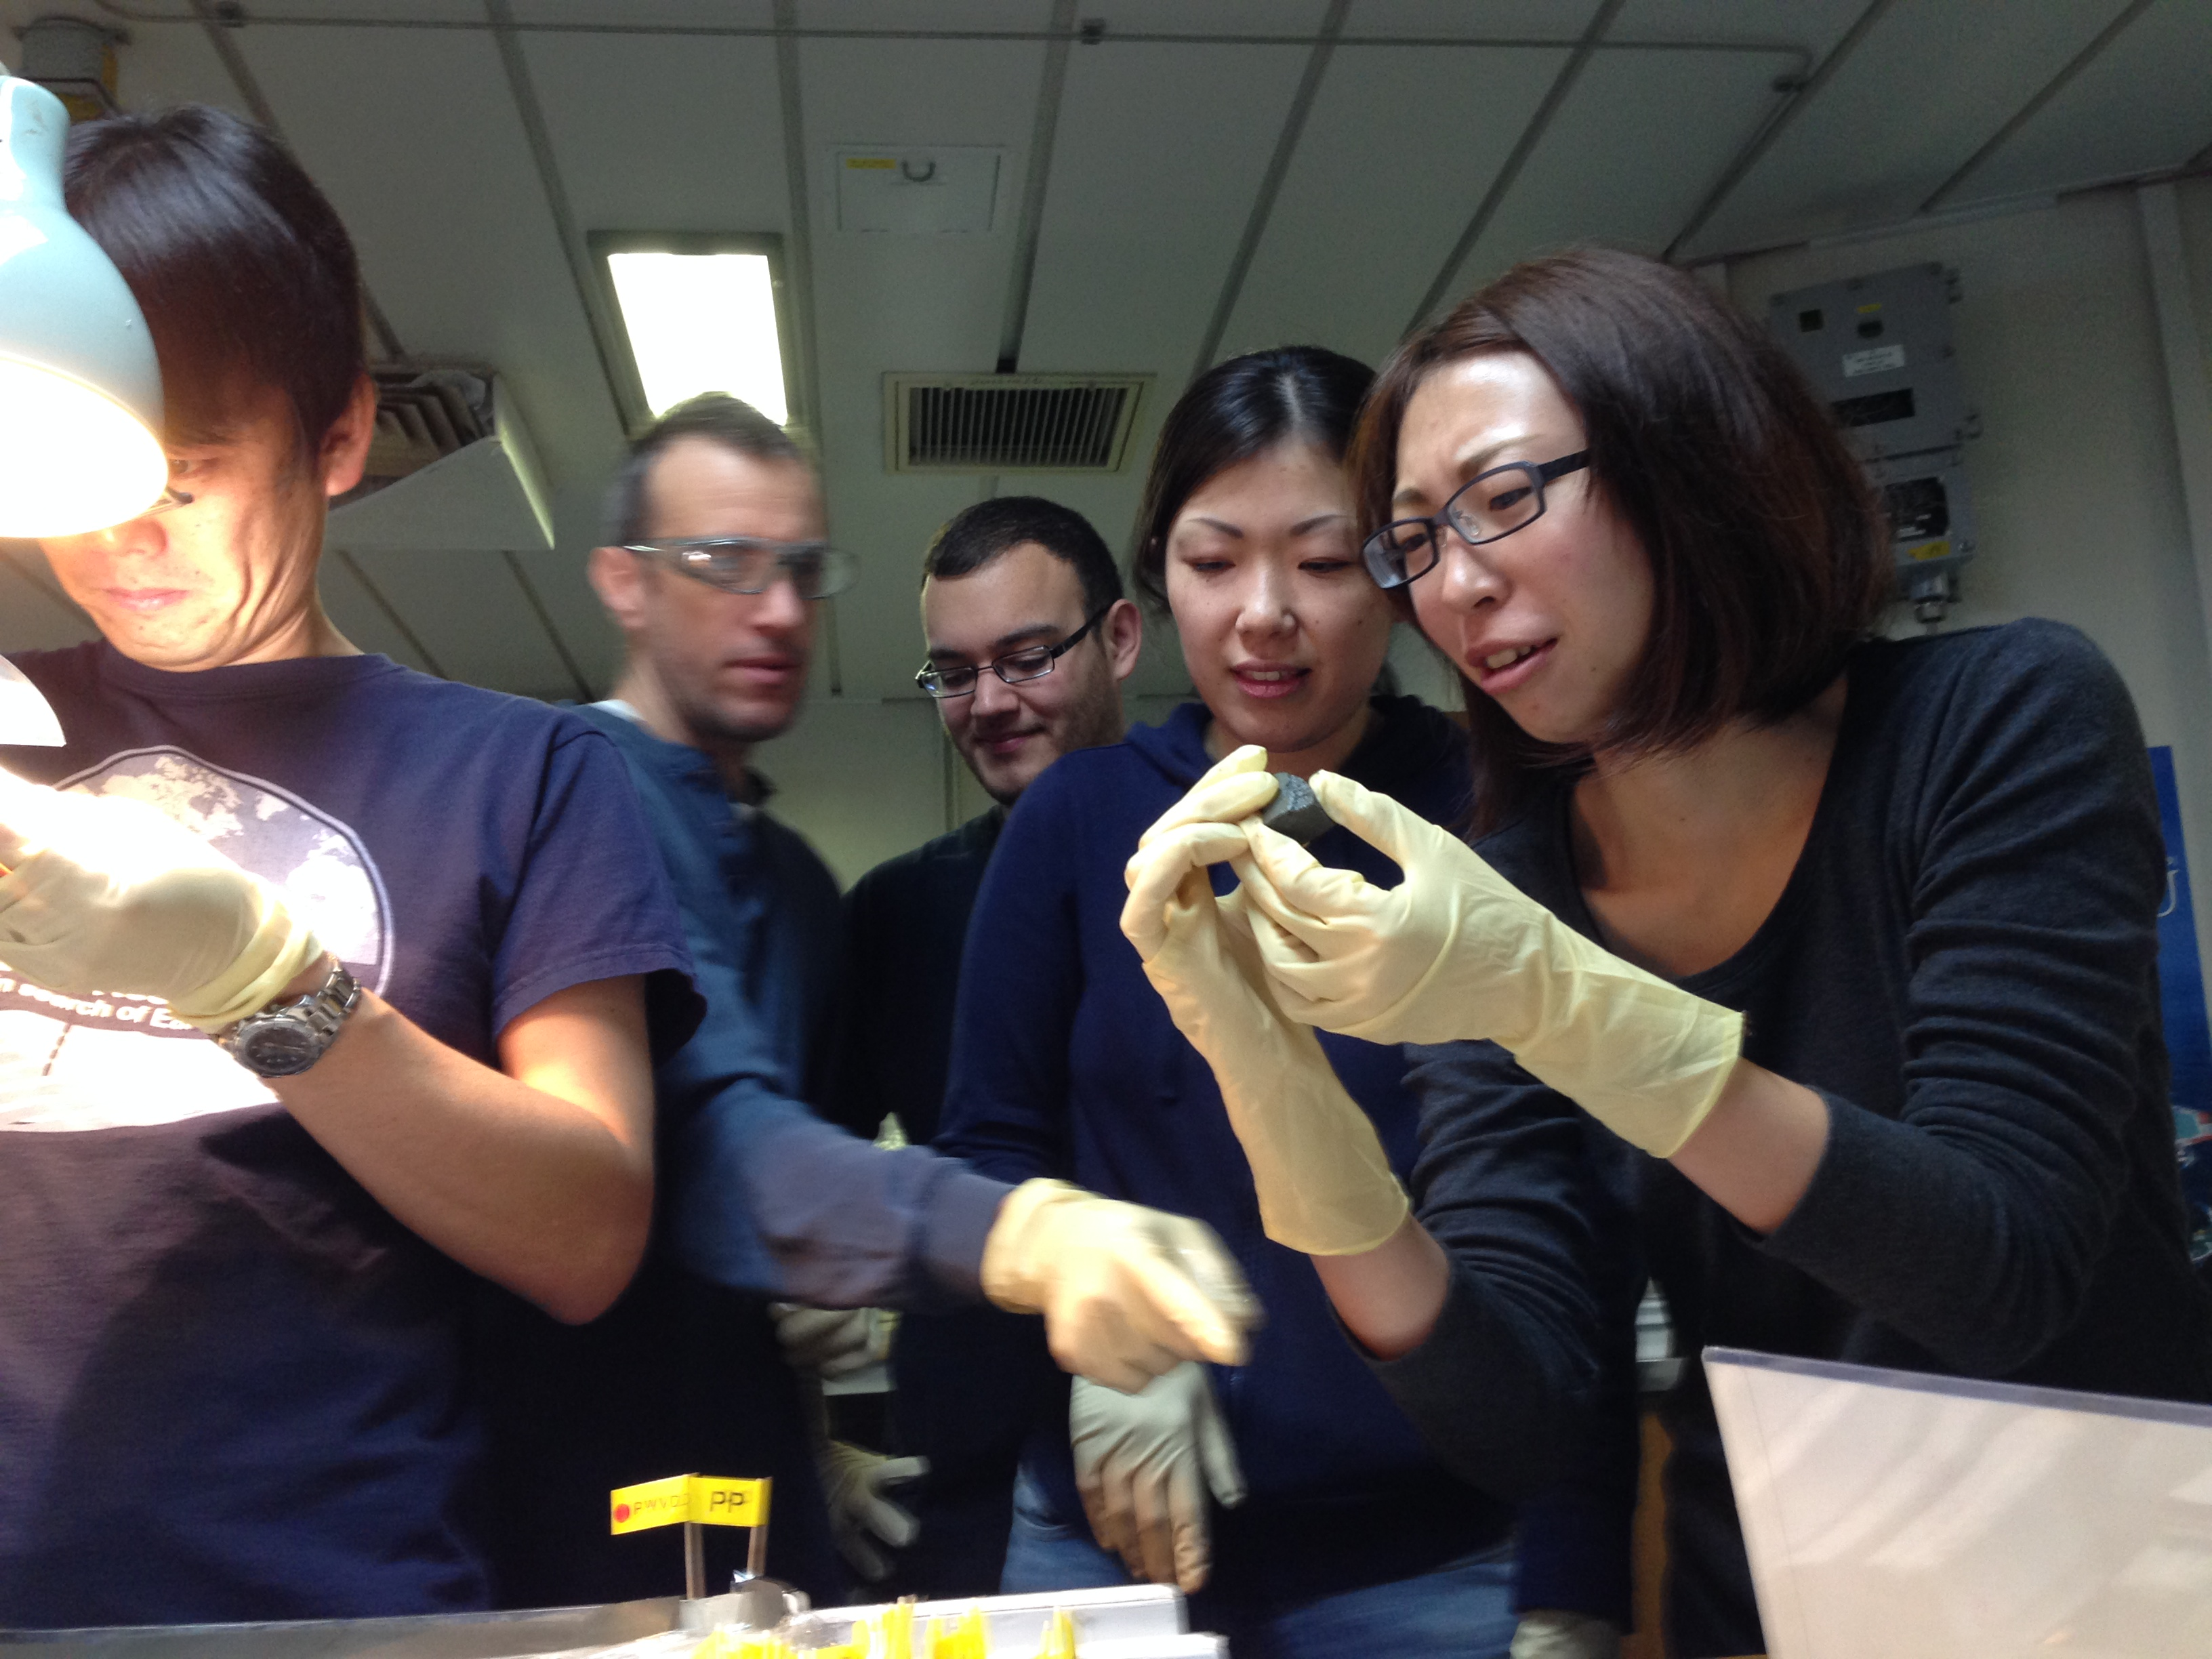
IODP Member Countries
Australia
Austria
Belgium
Brazil
China
Denmark
France
Germany
India
Israel
Italy
Japan
Netherlands
New Zealand
Norway
Poland
Portugal
Korea
Sweden
Switzerland
United Kingdom
USA

Slide 7
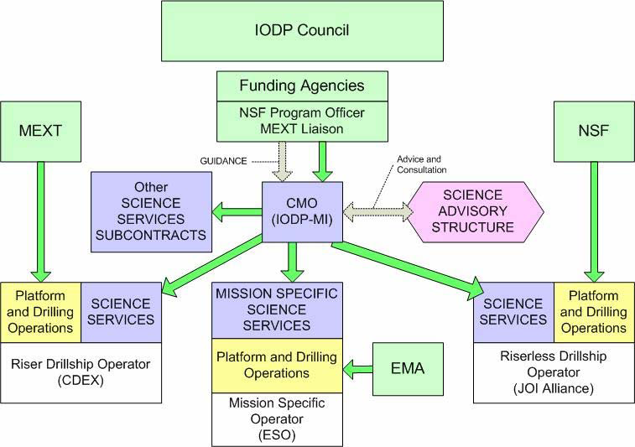

Slide 8
Ocean Drilling Proposal Selection
Drilling proposals submitted to IODP
Proposals submitted by international scientific community
Science Evaluation Panel
Panel of 54 international scientists evaluate science and recommend proposals for drilling
Ship
Facility Board
Facility Board determines which proposals are drilled, considering science priority, resources, ship track efficiency, risks, etc.
Call for participation – shipboard participants selected by national committees
Ship conducts drilling operations

Slide 9
Need to agree on where to go…

Slide 10
A drilling expedition is the culmination of a long and rigorous process
Extremely local targets must address the broadest scientific questions
Big questions, everyone has an opinion of where to go and how to address
Must build consensus to distill down to tractable projects (workshops & more workshops…)
Builds on a ‘food pyramid’ of geophysical and geologic data
Keep returning to key corridors … because we know more about them already

Slide 11
DSDP/ODP/IODP corridors for focused efforts: 1970s – today
Not coincidentally, linked to MARGINS & GeoPRISMS
Saffer & Tobin, 2011

Slide 12
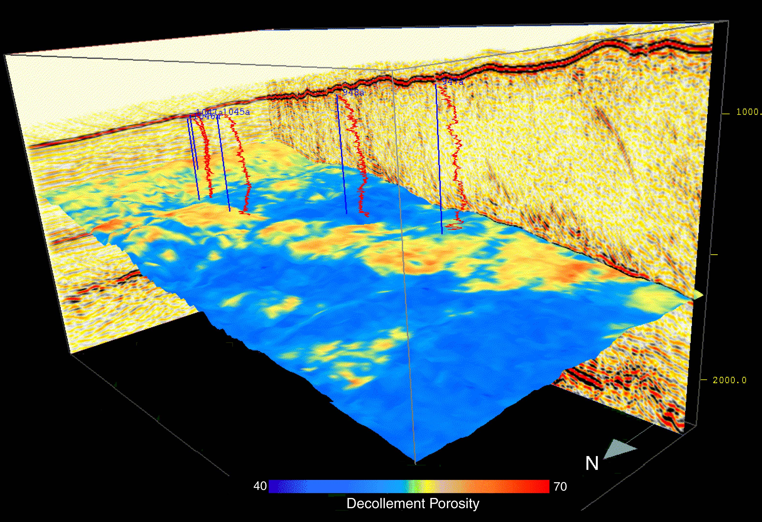
N. Barbados Ridge Transect
Bangs et al., 1999

Slide 13
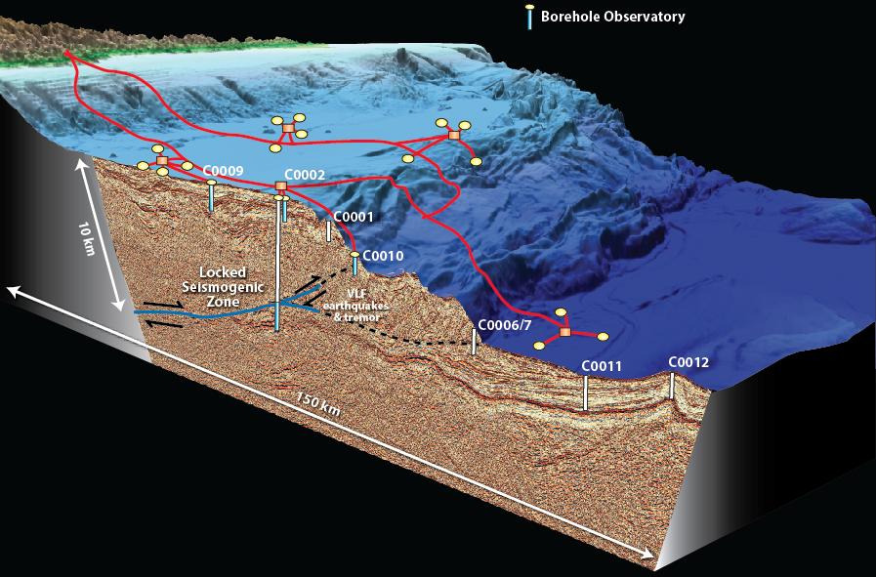
NanTroSEIZE: The Nankai Trough Seismogenic Zone Experiment
A multi-stage effort to
sample and instrument the
plate boundary fault zone across
the up-dip end of locking and rupture

Slide 14
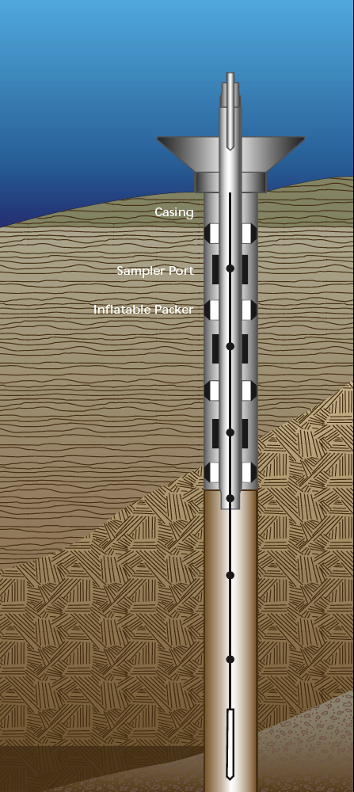
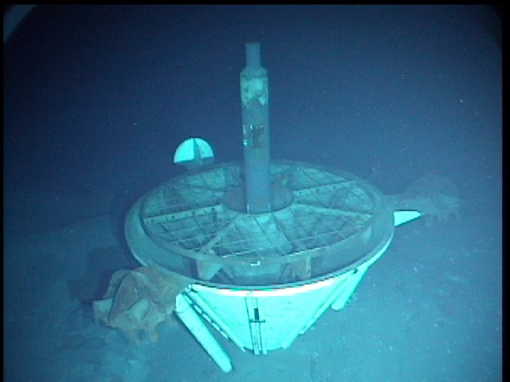
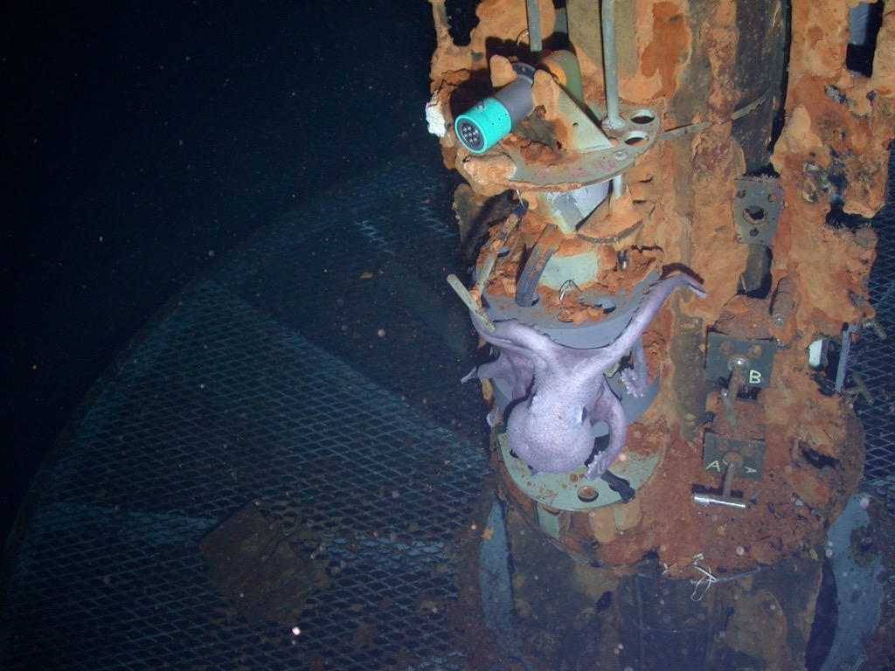
Put a CORK in it
Building observatories on the sea floor since 1991

Slide 15
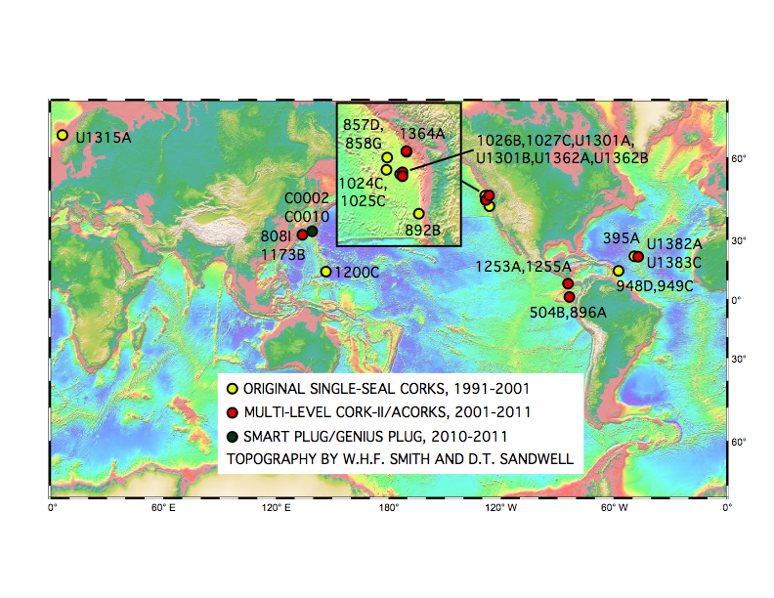
ODP/IODP CORK Installations, 1991-2011
(not included: 8 sites mainly for broadband seismology observatories)
Courtesy Keir Becker

Slide 16
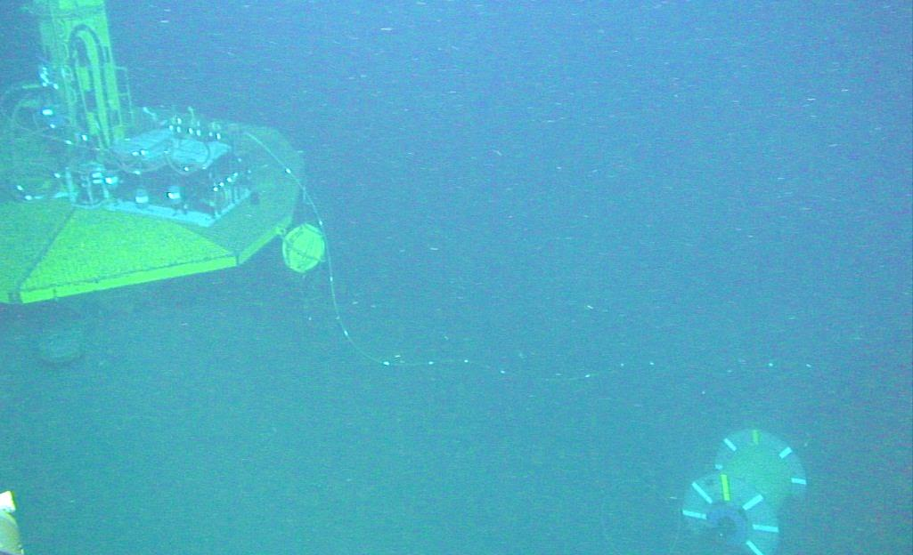
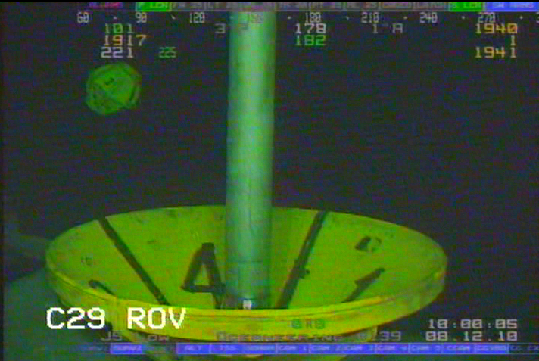
First Nankai LTBMS (“CORK”) was connected to DONET by ROV HyperDolphin in January 2013
Geophones
ROV platform
Thermometer
TIlt
Extension cable spool
BB seismic
sensor
DONET I/F
7m
ROV platform of C0002G borehole observatory with DONET interface and extension cable.
10m
All images courtesy E. Araki

Slide 17
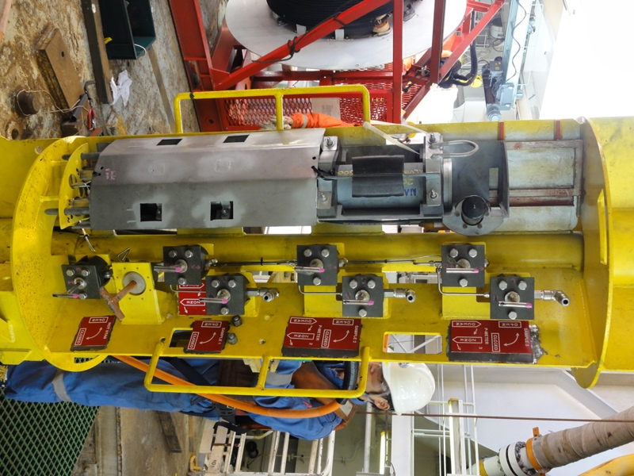
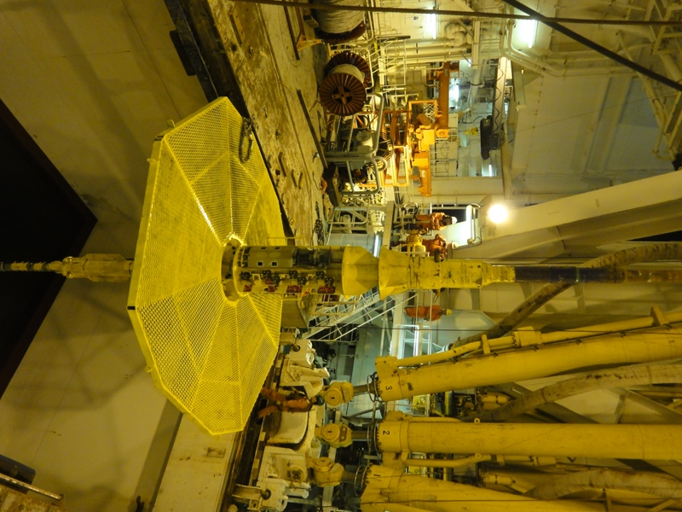
NanTroSEIZE LTBMS
long-term borehole monitoring installations by Chikyu

Slide 18
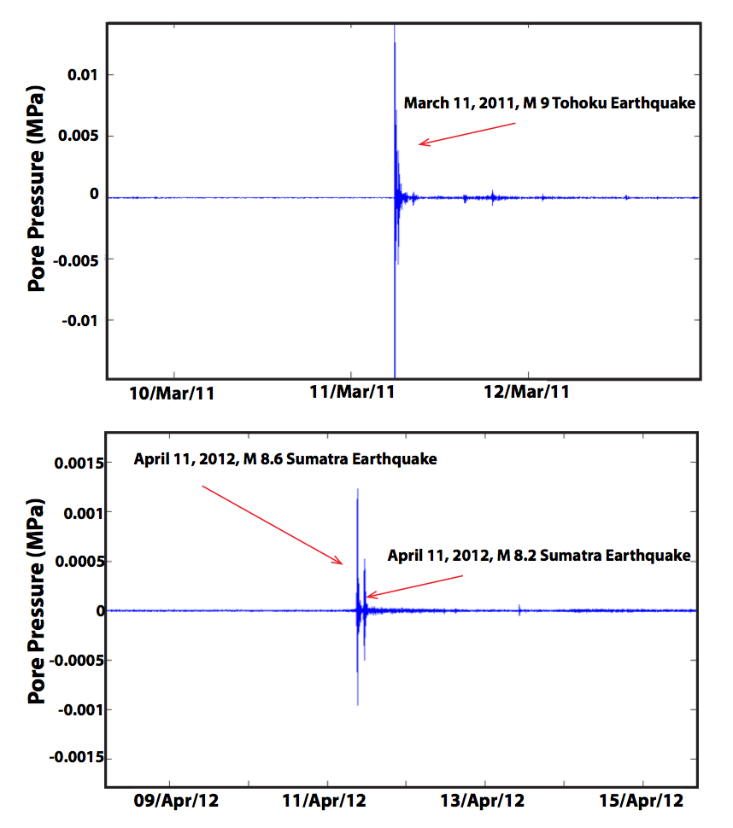
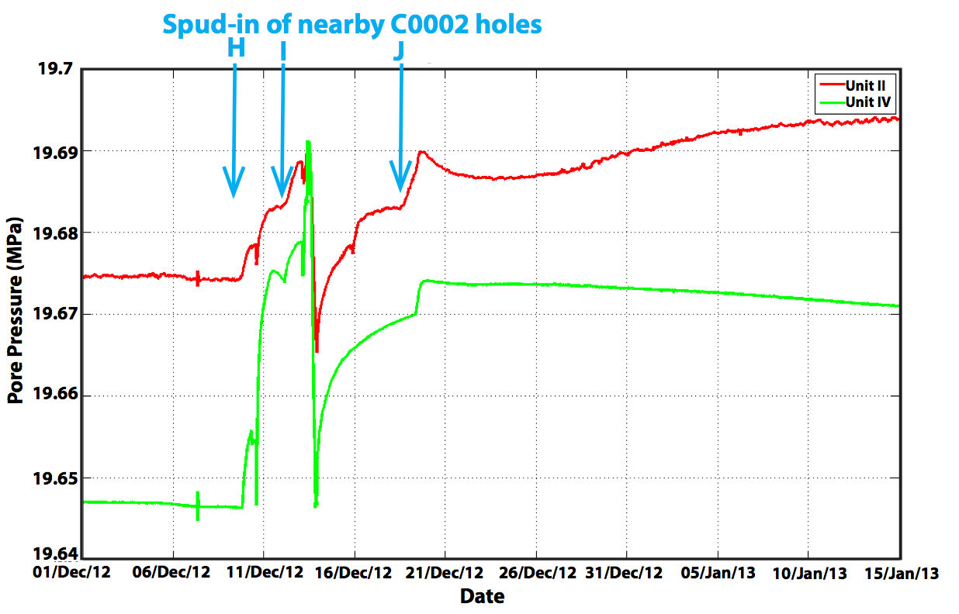
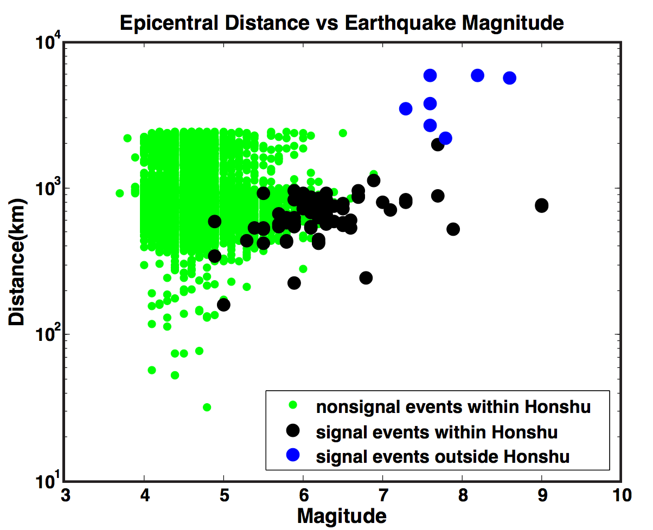
Rich Datasets:
P responses to earthquakes
P Recoveries → rock properties
EQ-induced changes in rock?
Detection of transients
Well interference examples
Tidal signals
Secular strain accumulation?
Slide courtesy of Demian Saffer

Slide 19
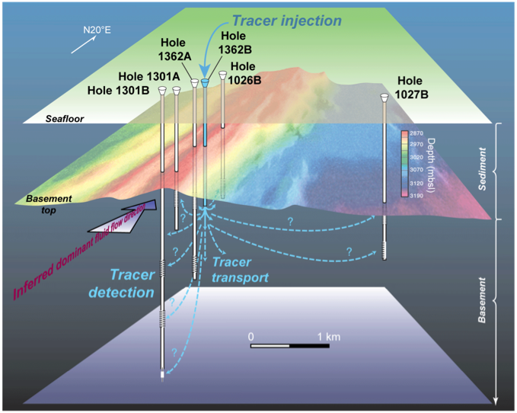
Spatial Arrays Suitable for Active Hole-to-Hole Hydrologic Testing, e.g. JdFR Flank
Long-term tracer injection experiment started on Expedition 327, 2010, concluded August 2014 with ALVIN.
First planned hole-to-hole hydrologic experiments in scientific ocean drilling.
Results resolved for the first time:
In-situ flow direction - S to N ridge-parallel
Flow mainly confined to ~1% inter-connected “effective porosity” that controls permeability
Andy Fisher et al., IODP Exp. 327, 2010
Results in Neira et al. (2016, EPSL)

Slide 20
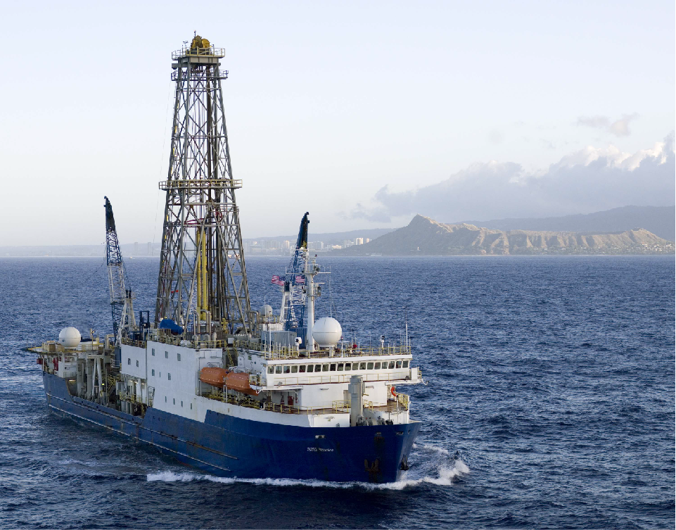
COLLABORATION & CONSENSUS
FOCUS

