Slide 1

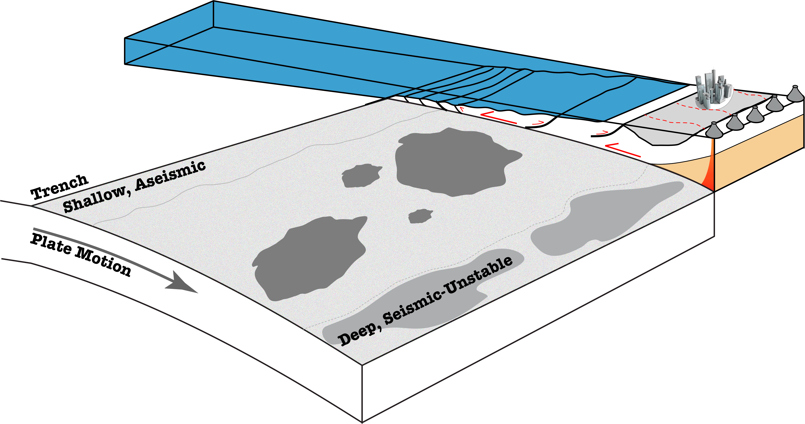
USGS Subduction Zone Science Planning:
Earthquakes
What are the key questions driving USGS exploration of a subduction zone observatory?
Hazard & Risk are our main drivers; so what do we need to know to improve our understanding of the hazard posed by subduction zones?
Notes:
Hazard & Risk main focus for USGS – science important, but…
All of the scientific questions we ask must link back to the implications for hazard.
Given the short time I have, I thought it’d be best to focus on key science questions we’d like to see addressed in an SZO, from an earthquake perspective

Slide 2
USGS:SZO - Key Questions
Which earthquakes
are tsunamigenic?
Where is the
megathrust locked?
(does this change with time)
=> Where will future EQs occur? How often?
e.g., Cascadia (1700, ??); N Chile (1877 vs 2014); Mentawai, 2010; Tohoku, 2011; Illapel, 2015
Notes:
Locking pattern & variability with time affects size of Eqs, and recurrence. In many places, we don’t know if Eqs repeat – i.e., if a section ruptured in one EQ will rupture in the same sized EQ at some point in the future. This has big implications for hazard.
Similarly, we don’t fully understand why some Eqs rupture to the trench and others don’t – and why some Eqs only rupture shallowly. This has big implications for tsunami hazard.

Slide 3
USGS:SZO - Key Questions
Can EEW be improved
in subduction zones?
Are megathrust EQ
aftershocks forecastable
in space and time?
=> Integrative monitoring for accurate characterization; regional-specific info on time-dependent hazard
e.g., Nepal, 2015
Notes:
Earthquake Early Warning and close-in tsunami warnings currently rely exclusively on monitoring data from seismic instruments only, which can saturate for large earthquakes. Frontier operations will integrate real-time GPS measurements with seismic network observations, as the former do not saturate and provide new constraints on the characteristics of the earthquake and its potential to generate a tsunami. GPS data can “augment” seismic EEW.
Currently implemented aftershock forecasts are based initially on statistical average behaviors of past sequences from subduction zones globally, despite the tremendous variability in behaviors and geologic settings from one zone to another, do not provide any information on where future aftershocks are likely to occur, and are updated only using rates of aftershocks in the ongoing sequence. Frontier forecasts would provide probabilities of aftershocks at particular time intervals and regions, by combining real-time GPS and satellite imagery data with the current, purely statistical characterization of aftershocks rates alone.

Slide 4
USGS:SZO - Key Questions
How does slab
geometry affect the
megathrust EQ cycle?
What does ETS tell
us about the
megathrust EQ cycle?
=> How do they impact hazard?
e.g., Cascadia; Mexico; Japan (ETS & tremor)
Sumatra, 2004+2005; Solomon Islands, 2007; Maule, 2010 (geometry)
Notes:
Does segmentation exist? Is it persistent? How does this affect EQ size and recurrence?
Also Slow slip, LFEs, ULFE’s, etc.

Slide 5
USGS:SZO - Key Questions
Can we forecast EQ-driven
land level changes?
Where does strong
ground shaking
originate?
=> Impact on flooding hazard and post-EQ recovery
Low VS high freq. sources => Hazard implications
e.g., Maule, 2010; Tohoku, 2011; Nepal, 2015
Notes:
No tools currently exist to forecast the sudden, permanent rise or fall in coastal land-level that will accompany great subduction zone earthquakes, nor to guide recovery decisions when it does occur. Forefront forecasts are possible using available in earthquake scenarios, updated with multiple, complementary measurements. These land-level changes are measurable now using data from real-time GPS stations (relatively dense networks exist in Cascadia and parts of Alaska), strainmeters (in Cascadia only), and the European Space Agency Sentinel 1 satellites and/or the Japan Aerospace Exploration Agency ALOS-2 satellite for all subduction zones (each dataset provides differing temporal and spatial resolution).

Slide 6
USGS:SZO - Key Questions
At what rates to upper
plate faults slip? What
is the recurrence of M6-7 EQs?
How to basins respond to
ground shaking? How do
buildings respond to long
duration shaking?
=> Better characterize hazard from upper plate EQs.
Does risk vary with shaking duration?
e.g., Nisqually, 2001
Notes:
The duration and oscillation periods of shaking resulting from great subduction zone earthquakes are significantly longer and more damaging than for other earthquakes, particularly to tall buildings and long bridges, but are not accounted for in earthquake risk assessments

Slide 7
USGS:SZO - Key Questions
What drives intermediate
depth EQs? What is their
recurrence rate, and Mmax?
How are intermediate depth
and deep EQs tied to the
shallow megathrust?
=> Rates and size of related events; forecasting ability
e.g., Tarapacá, 1997; Rat Islands, 2015

Slide 8
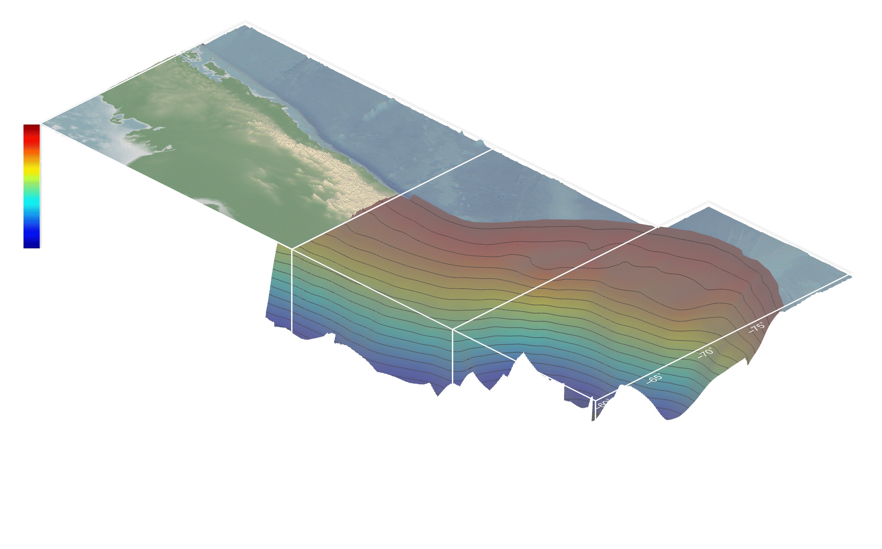
USGS:SZO
Future areas of focus, like EEW and aftershock forecasting, will rely on both seismic and geodetic data to be most effective.
=> Real-time, integrative monitoring is critical
Research is driven by need to mitigate hazard and reduce risk
=> Key science questions, even if related to the megathrust at depth, can be framed in the context of improving our understanding of shaking hazard at the surface

Slide 9
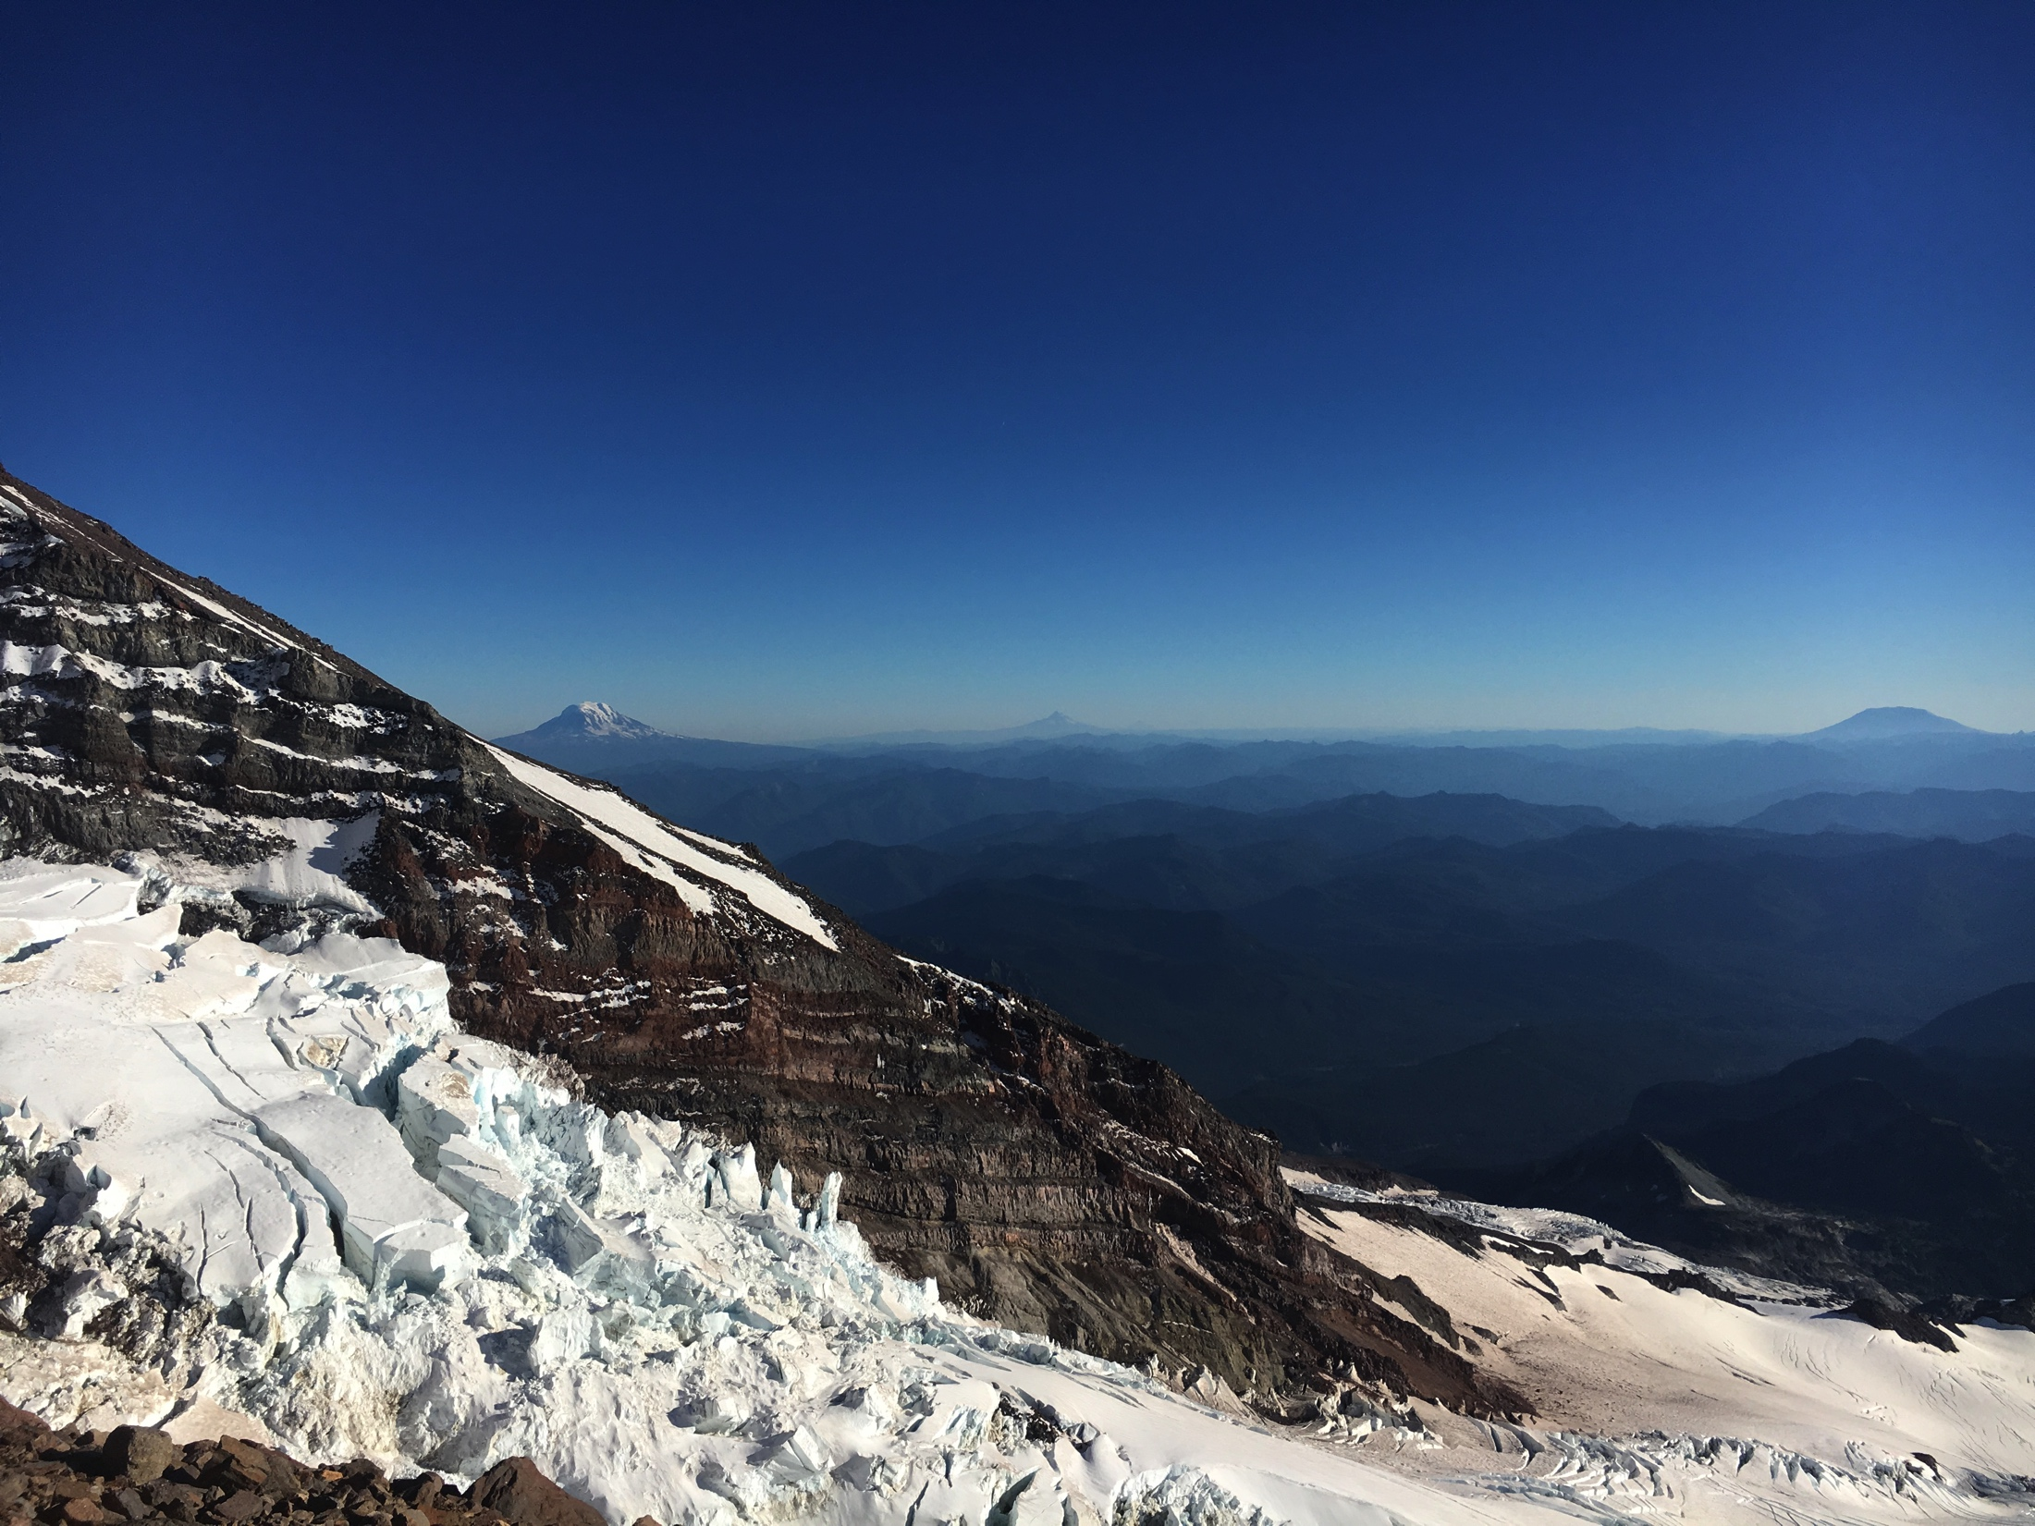

Volcano Hazards Program Perspective on a SZO
Mount Rainier
Mount Adams
Mount St. Helens
Mount Hood
Mount Jefferson

Slide 10
USGS Volcano Hazards Program Wears Many Hats
Monitoring
Volcano
Observatory
Research
Community
Preparedness

Slide 11
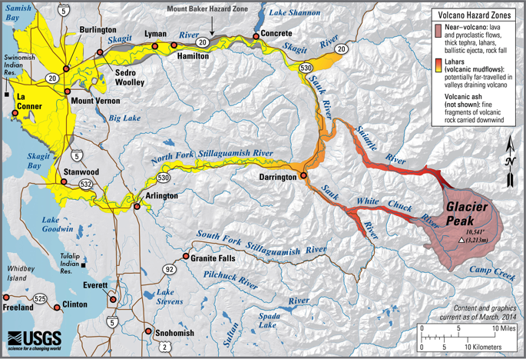
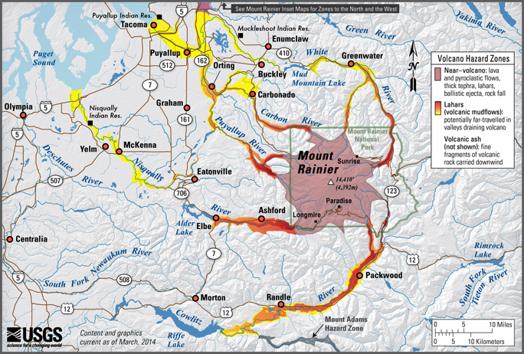
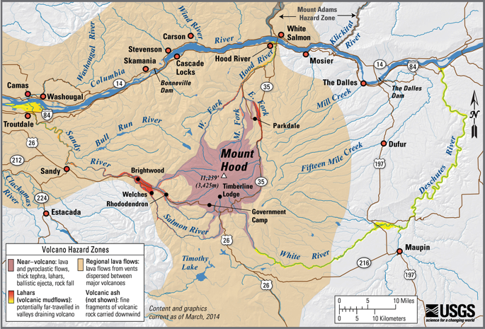
Community Preparedness
How research results get distributed to the masses
Joint federal, state, local effort
Common terminology using messaging developed in collaboration with emergency managers

Slide 12
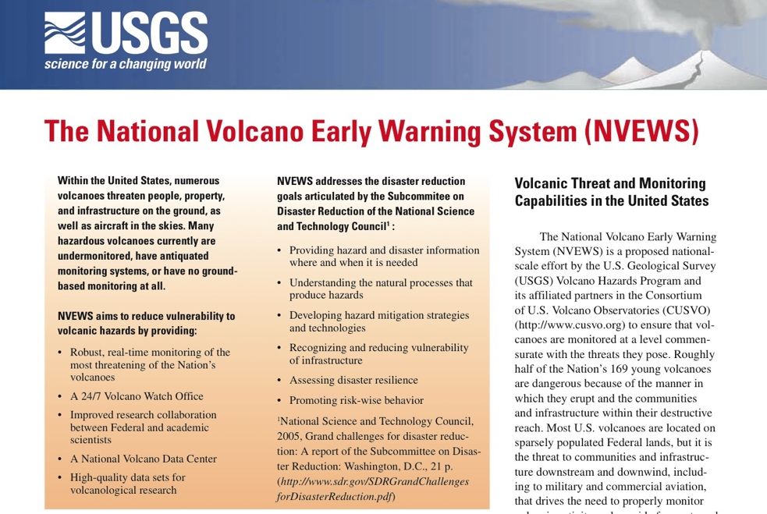
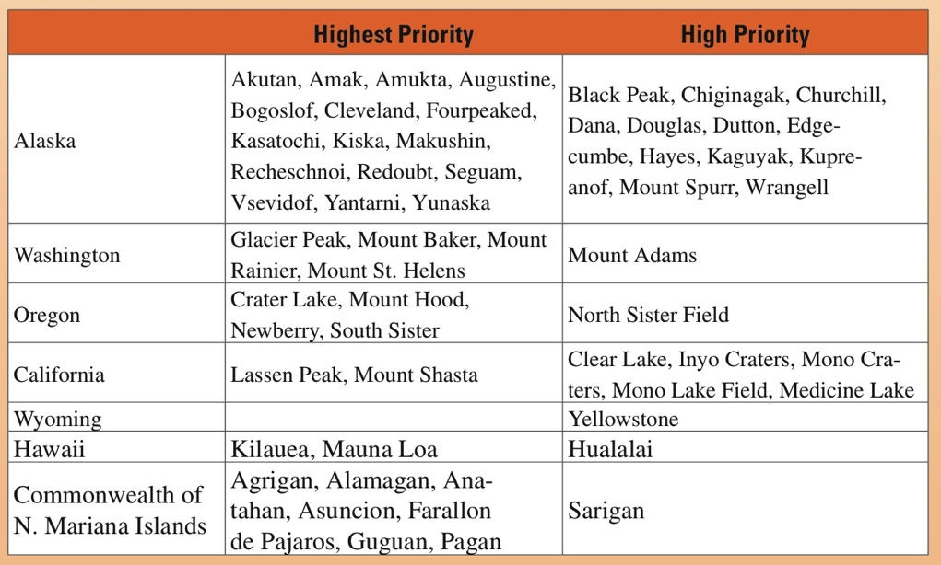
Monitoring
Prioritizing monitoring targets based on hazard AND risk
Guides current and future allocation of new permanent instrumentation
Related reports tie together the quality of monitoring network to the volcano “threat”

Slide 13

Synergy
The research aspect of the volcano observatories is where the Volcano Hazards Program has the most overlap with a US-based Subduction Zone Observatory

Slide 14
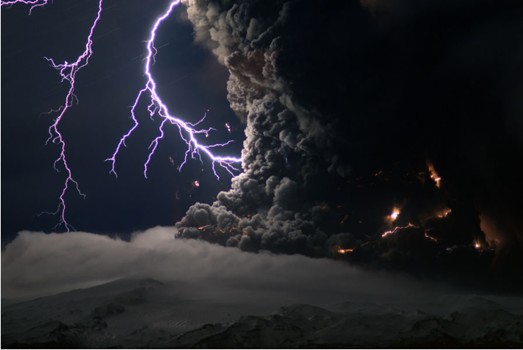
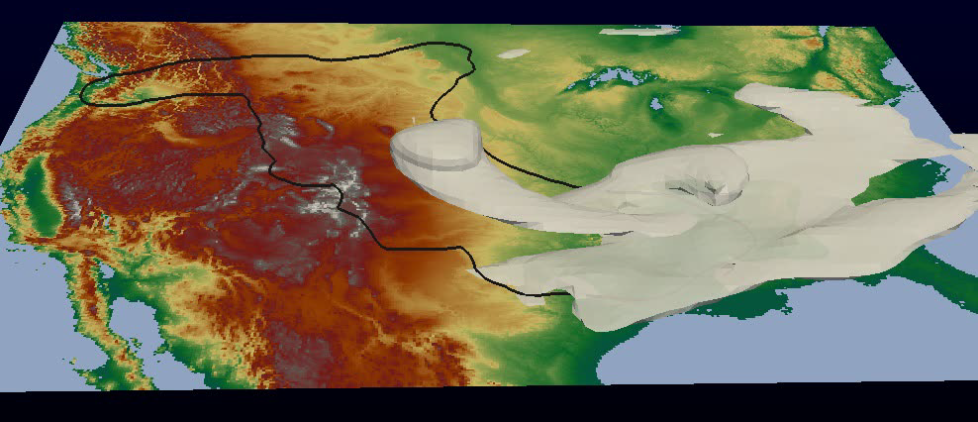
Research: Volcanic Ash and Gas
Ash3d numerical model of dispersal & fallout from explosive eruptions
New frontiers: integrating geophysical datasets into modeling in near real-time
  Lightning, seismic/infrasonic tremor
Improving hazard maps using models + eruptive behavior from the geological record
Notes:
Some points –
1. Underleveraged geophysical datasets, including detection of volcanic lightning, would help characterize the physical processes inside volcanic plumes that influence their hazards to people and property.
2. There is a real need to improve our understanding of each volcano’s eruptive behavior (e.g., eruptive frequency–magnitude). This leads to improved (probabilistic) hazard maps by providing better inputs for Ash3d and other numerical models. It would also allow us to explore fundamental volcano-atmosphere-climate interactions through time by simulating global ash/gas transport using data from the geological record.
Image credits
Animation: Ash3d simulation of a Mount St. Helens eruption (USGS Core Systems Science) –black contour shows ashfall on the ground
Photo: Lightning in the Icelandic Eyjafjallajokull eruption on April 17, 2010, photo by Marco Fulle.

Slide 15
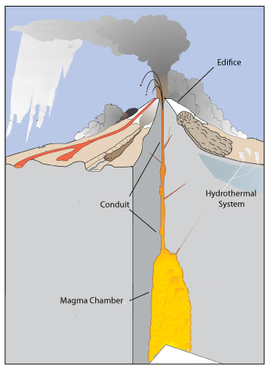
Research: Conceptual Models
Multidisciplinary effort to create conceptual models for several important volcanic centers in an arc
  Geophysical imaging (iMUSH)
  Field studies and sediment coring to refine eruption chronologies
  Geochemical analyses for storage depths, magma rise times, volatile content, etc.
Better understanding of volcanic systems, useful for better interpretation of unrest and possibly a longer forecast window

Slide 16
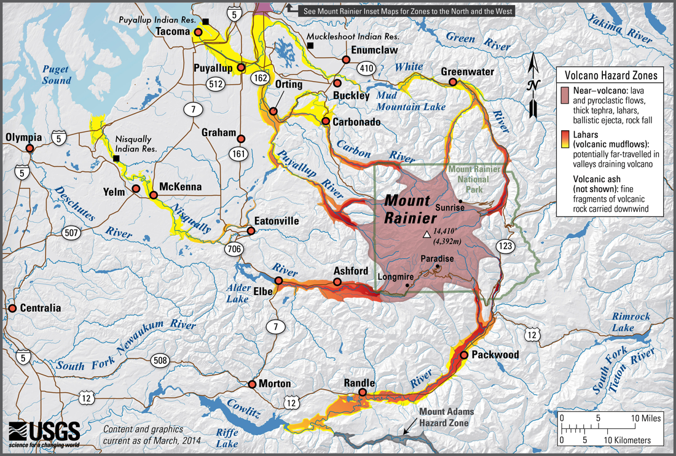
Research: Lahar Detection System
Volcanic lahars have potential to impact populations many 10’s of km away from the volcano
New system may include seismic and/or infrasound arrays, webcams and laser altimetry plus new alarming software
Update and expansion of lahar detection system on Mount Rainier
  On request local authorities
Notes:
LAHARZ simulation on Upper Puyallup and Carbon River valleys
This image is a shaded-relief DEM with simulated runs of two hypothetical lahar volumes using the LAHARZ technique. The LAHARZ technique for automated mapping of lahar-inundation zones (Iverson and others, 1998; Schilling, 1998) is based on a statistical analysis of lahar overbank deposits, from which Iverson and others (1998) derived a pair of semiempirical equations that predict cross-sectional and planimetric inundation areas as functions of lahar volume. The LAHARZ technique gives very broad results viewed as a range of possibilities rather than a single solution: within the 95th percentile confidence limits, there is more than an order-of-magnitude range of possible cross-sectional or planimetric inundation areas for any given lahar volume.
This image shows LAHARZ models of 40x10⁶m³ flows (deep red) and 250x10⁶m³ flows (light red). In either river, the 40x10⁶m³ flow extends into Orting, and the 250x10⁶m³ flow reaches beyond Orting.
Lahar-monitoring station locations on the Carbon and Puyallup rivers are represented by small diamonds. The five field stations in each station array are arranged along a 5-km-long stretch of each drainage. The station arrays are located just downstream of the mapped extent of relatively frequent, small lahars to reduce the chance of a small lahar triggering the system, yet provide as early a warning as possible in the event of a larger lahar. The 5-km length of the station array spreads the field stations apart for security against vandalism and destructive natural events.

Slide 17
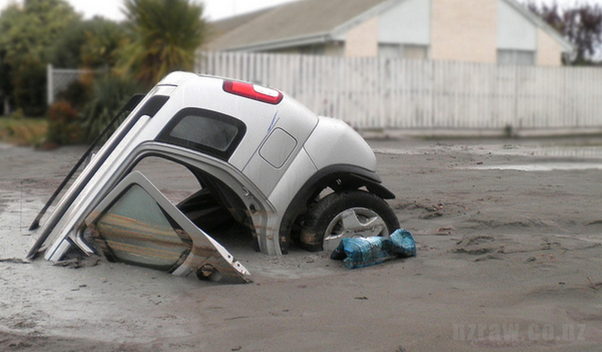
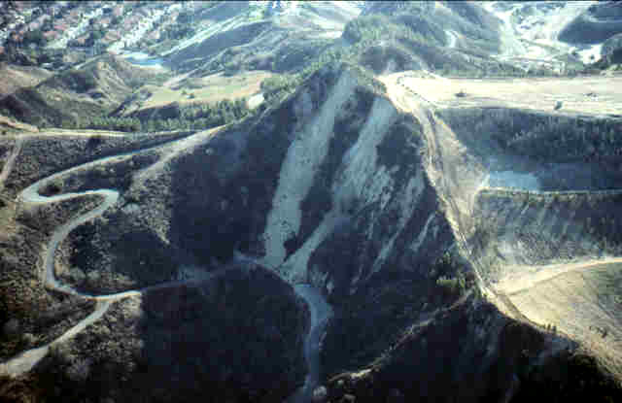
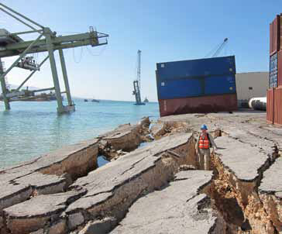
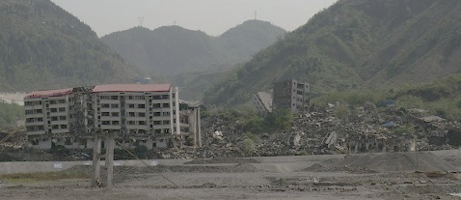

Earthquake triggered landslides and liquefaction
Northridge 1994
Christchurch 2011
http://www.nzraw.co.nz/news/eqc-interactive-map/
Haiti 2010
Harp
Wenchuan 2008
~6000 ls fatalities
https://www.eeri.org/2010/01/haiti/03-31/

Slide 18
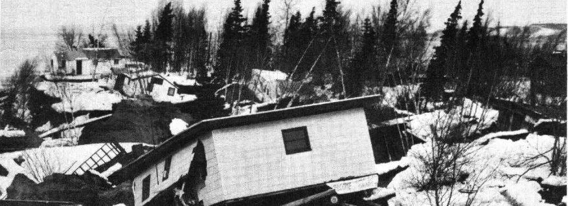
“Overall, landslides probably caused the most damage to manmade structures and property, but sea waves took the most lives”
(Hansen et al. 1966)
Subduction Zones are a Special Case
1964 Great Alaska Earthquake, M9.2
Hansen et al. 1966
“At Valdez and Seward, violent shaking spontaneously liquefied granular deltaic materials; slumping which initiated well below sea level carried away the waterfronts of both towns”
( Hansen et al. 1966)
Notes:
Larger affected area and longer duration shaking
Local tsunamis from subaerial and submarine landslides
Subsidence from nearshore submarine landsliding
Tsunami hazard near shore, landslide hazard uphill
Can have more artificial fill, young loose saturated deposits prone to liquefaction
Potential for higher impacts (more people, important infrastructure)
Also have volcanoes with their own slope stability issues, which Wes will talk about

Slide 19
Onshore-offshore earthquake-triggered ground failure map products
Probabilistic, scenario, and real-time maps using new modeling strategies
  Build on ongoing real-time ground failure modeling for PAGER, ShakeCast
Many science needs
  Slope response to shaking (duration, frequency)
  Modeling approaches
  Reducing uncertainties of model inputs (e.g. slope strength)
Many data collection needs
  Lidar, bathymetry, surficial mapping, lab and CPT tests, offshore core sampling
Notes:
It is intertwined mix of onshore offshore and coastal conditions, which are all often treated independently in regards to hazard analysis, we need to develop a modeling framework that accounts for interconnected nature and build our hazard products around that

Slide 20
    Characterize past triggered landsliding in U.S. subduction zones
Examining inland and offshore waterways for evidence of past triggered landsliding (high-res bathymetry, coring)
  Coring bottom of Port Valdez for proximal record of fjord landsliding
  Examining inland waterways in Cascadia for submarine landslides and landslide deposits
Mapping and dating subaerial landsliding
  Using Lidar, surface roughness and carbon dating to map and date landslides in Cascadia
Survey of range of conditions and variations in US subduction zones that could lead to different failure behavior
Notes:
But to look forward, we need to look backward. We need to better characterize what landsliding has been triggered by past earthquakes, both for understanding what conditions are most likely to lead to ground failure and what that might look like, and also for dating the earthquakes themselves, having additional paleoseismic records,

Slide 21
Offshore Studies: Alaskan Active Structures
Sea floor mapping to identify and characterize active structures
Seismic imaging
of splay faults

Slide 22
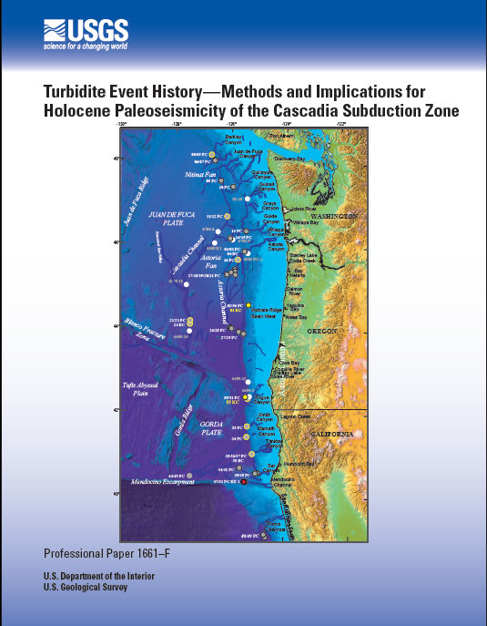
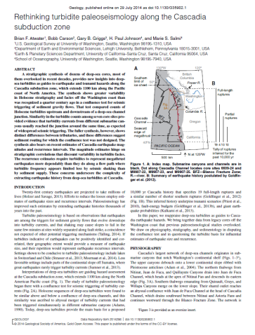
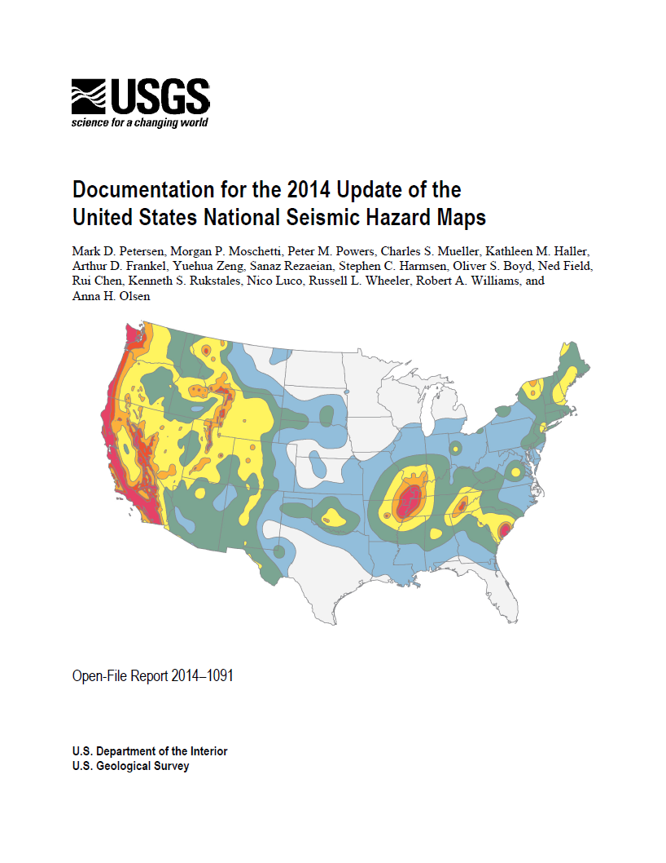
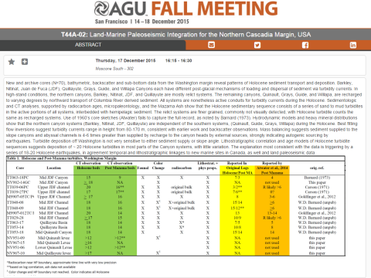
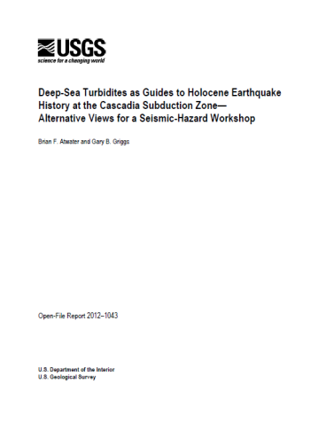
Offshore Studies: Evaluation of the Cascadia Turbidite Paleoseismic Record

Slide 23
Offshore Studies: Evaluation of the Cascadia Turbidite Paleoseismic Record
Full margin vs. segmented rupture
Correlation of the onshore vs. offshore
turbidite records.
Turbidity current flow paths
Identification of intra- and inter-canyon morphology, sedimentary inputs and processes
Provenance, transport and deposition of sediments along the margin
Timing

Slide 24
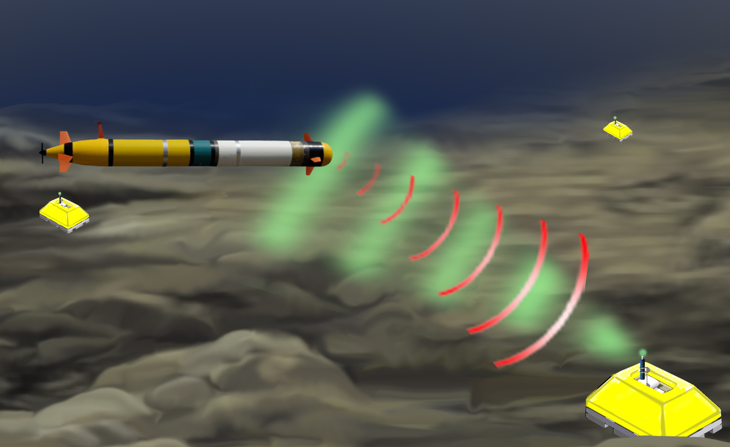
Offshore Studies: Cascadia Seismo-Geodetic Montioring using Autonomous Ocean-Surface Vessels
Real-time situational awareness
of megathrust activity to inform USGS
impact products (ShakeMap and PAGER)
and time-dependent seismic and
tsunami hazard estimates
Optimize Cascadia warning systems.
POSSIBLE 3-15 second EEW improvement.
Enable development of next-generation
tsunami models with direct seafloor deformation.
Build next-generation seafloor sensing
Capacity through the operational use of
autonomous ocean vessels.

Slide 25
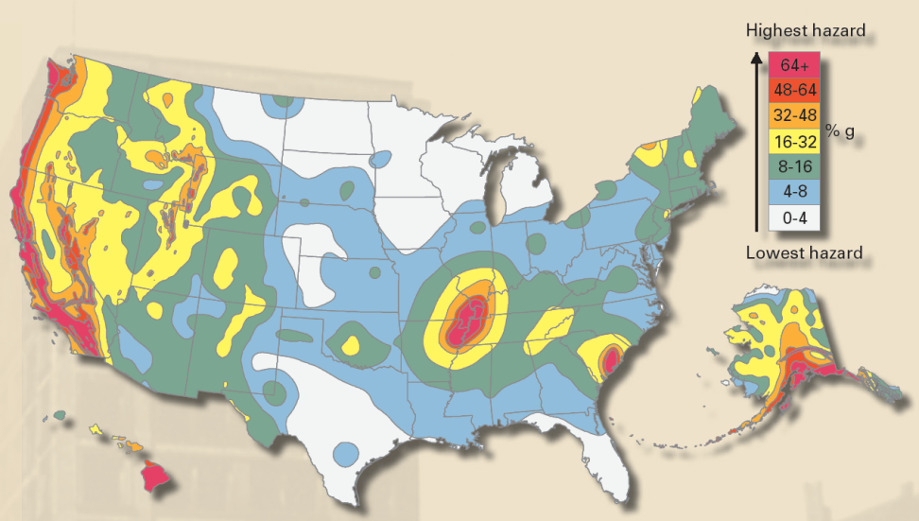
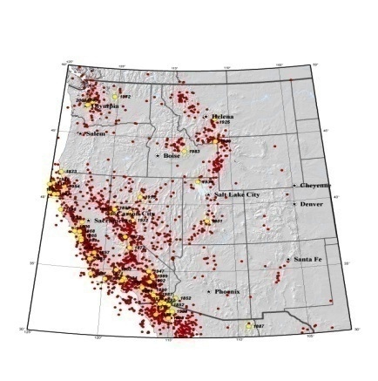
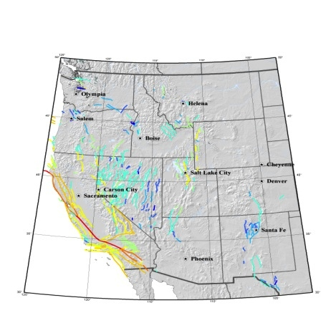
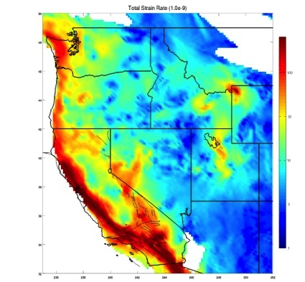
Scientific building blocks of the
USGS National Seismic Hazard Maps
Attenuation Relations
Seismicity
Geodetics
QuaternaryFaults
Inputs are derived from studies of regional geology, seismology, crustal structure, and the travel of seismic waves through the Earth
Notes:
These show where the hazard is, and they provide quantitative inputs to make safer buildings and structures.
Earthquakes don’t kill people, buildings do.
Although there is not much we can do about stopping the hazard, there is a great deal we can do to ensure that our buildings and infrastructure are more resilient to earthquake shaking. The heart of the four-agency NEHRP partnership is the use of USGS seismic hazard information to inform the seismic provisions in model building codes that are then adopted across the country.

Slide 26
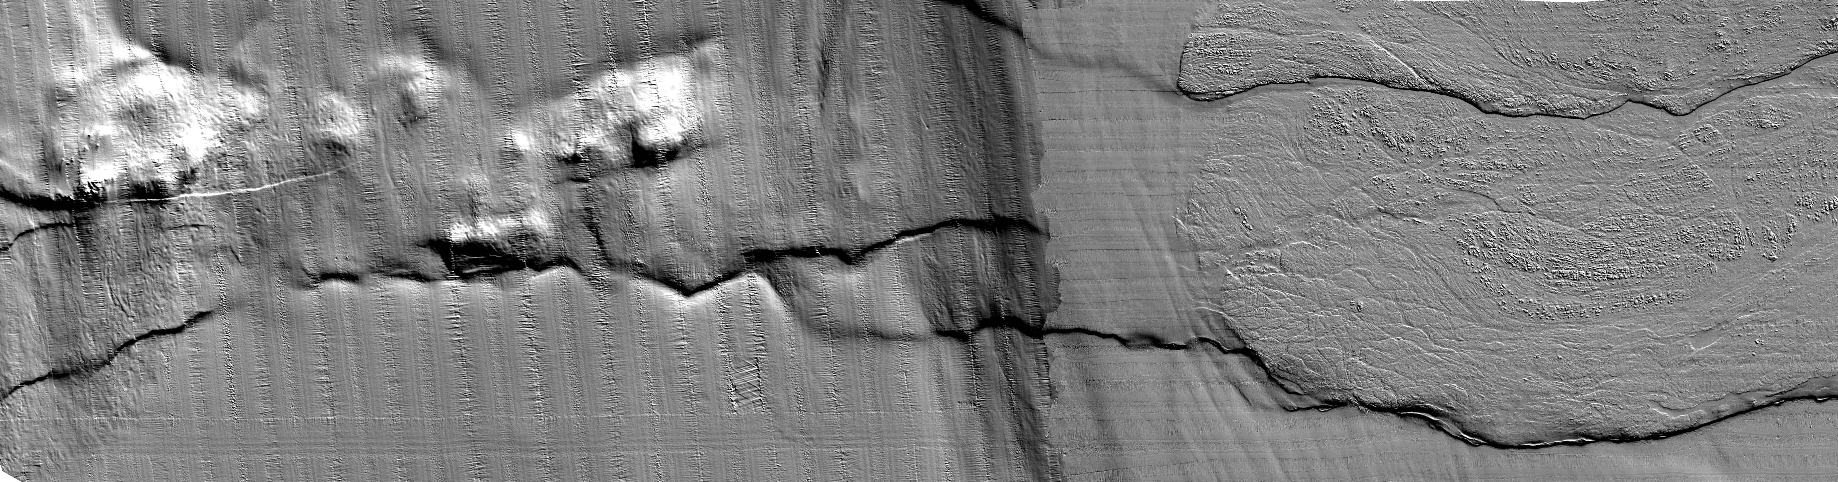
Geologic Studies at Subduction Zones
Identify and characterize active faults
  Mapping, paleoseismology, deformation rates
Data needed:
  Comprehensive high resolution topography and bathymetry – we need it everywhere – trench to the mountaintops (topo and bathy ‘moonshot’!)
  Cannot characterize active structures without being able to first identify them
Patton Bay fault
Cape Cleare fault
Notes:
From a study at Sitkinak Island it appears that the western edge of the 1964 Alaska earthquake is not a persistent rupture boundary. But what about other historic rupture boundaries?
In the Shumagin Islands it appears that creep on the megathrust may have controlled rupture size for thousands of years. Elsewhere, however, the megathrust has ruptured areas that presently are locked and creeping.
Paleogeodetic studies have shown that the great AD 1700 Cascadia earthquake probably involved heterogeneous slip. But did predecessors of the most recent Cascadia earthquake have similar slip distributions?

Slide 27
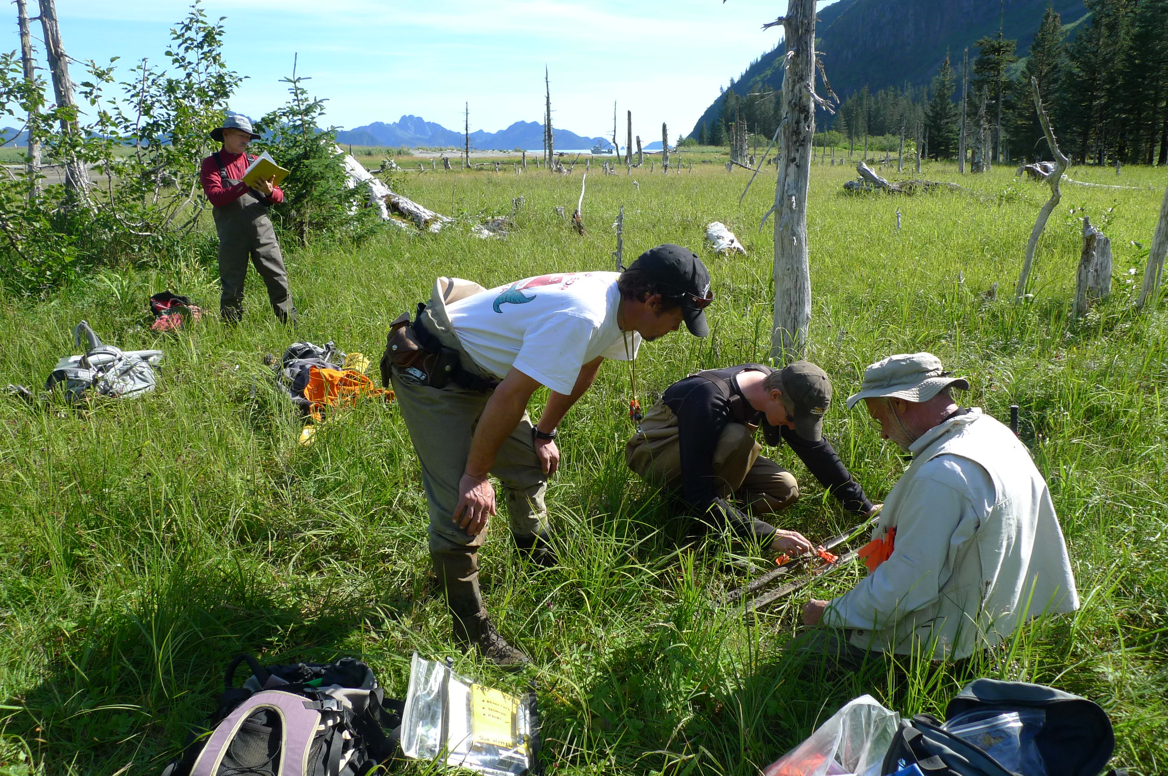
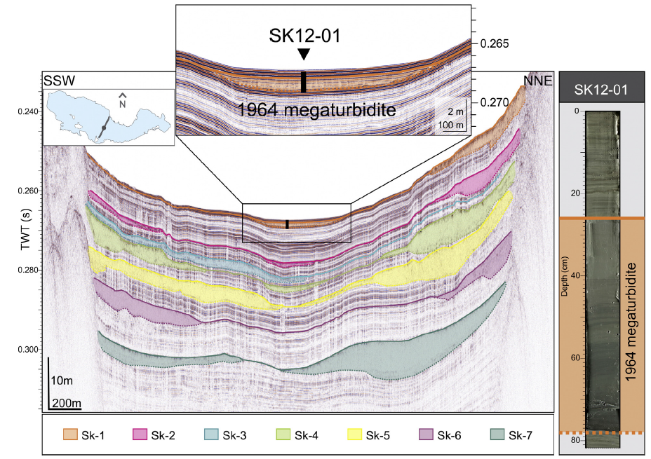
Geologic Studies at Subduction Zones
Identify and characterize active faults
  Mapping, paleoseismology & paleogeodesy, deformation rates
Data needed:
  Coastal marsh studies, lake paleoseismolgy studies, trenching studies
Praet et al., 2016
Skilak Lake, Alaska
Resurrection Bay, Alaska
Notes:
From a study at Sitkinak Island it appears that the western edge of the 1964 Alaska earthquake is not a persistent rupture boundary. But what about other historic rupture boundaries?
In the Shumagin Islands it appears that creep on the megathrust may have controlled rupture size for thousands of years. Elsewhere, however, the megathrust has ruptured areas that presently are locked and creeping.
Paleogeodetic studies have shown that the great AD 1700 Cascadia earthquake probably involved heterogeneous slip. But did predecessors of the most recent Cascadia earthquake have similar slip distributions?

Slide 28
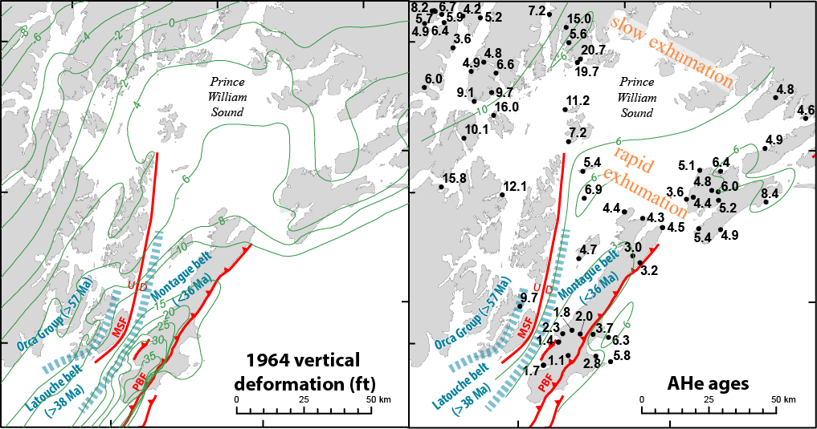
Geologic Studies at Subduction Zones
Identify and characterize active faults
  Mapping, paleoseismology, deformation rates
Data needed:
  Slip rates, exhumation rates, marine terraces, GPS
Patton Bay fault
Haeussler et al., 2016, QSR
Notes:
Exhumation, terrace, slip rate data also help to address the fundamental question of: how much deformation is elastic vs. permanent.

Slide 29
Related Fundamental Questions
How much deformation is permanent vs. elastic?
Patton Bay fault
Haeussler et al., 2016, QSR
Notes:
Exhumation, terrace, slip rate data also help to address the fundamental question of: how much deformation is elastic vs. permanent.

Slide 30
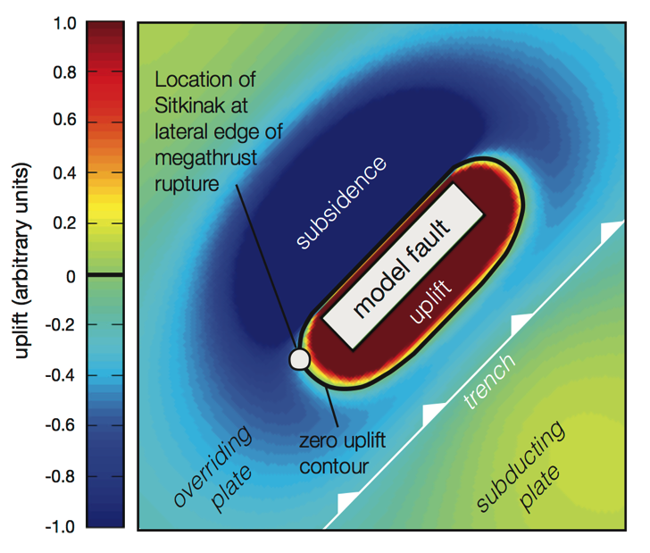
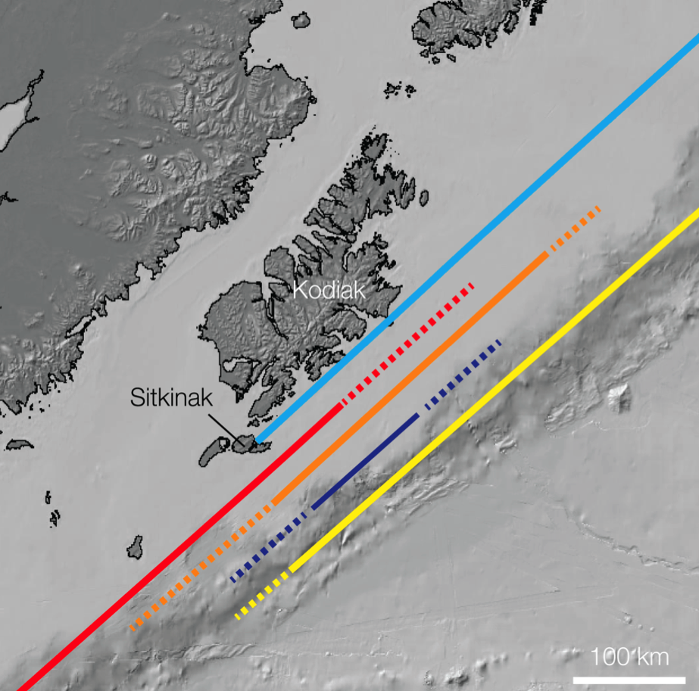
Related Fundamental Questions
How persistent are rupture boundaries of historic earthquakes?
The western edge of the 1964 Alaska rupture does not appear to be a persistent boundary; what about other historic rupture boundaries along the Alaska-Aleutian megathrust?
Briggs et al. 2014
Notes:
How much is the next earthquake like the last one?
From a study at Sitkinak Island it appears that the western edge of the 1964 Alaska earthquake is not a persistent rupture boundary. But what about other historic rupture boundaries?
In the Shumagin Islands it appears that creep on the megathrust may have controlled rupture size for thousands of years. Elsewhere, however, the megathrust has ruptured areas that presently are locked and creeping.
Paleogeodetic studies have shown that the great AD 1700 Cascadia earthquake probably involved heterogeneous slip. But did predecessors of the most recent Cascadia earthquake have similar slip distributions?

Slide 31
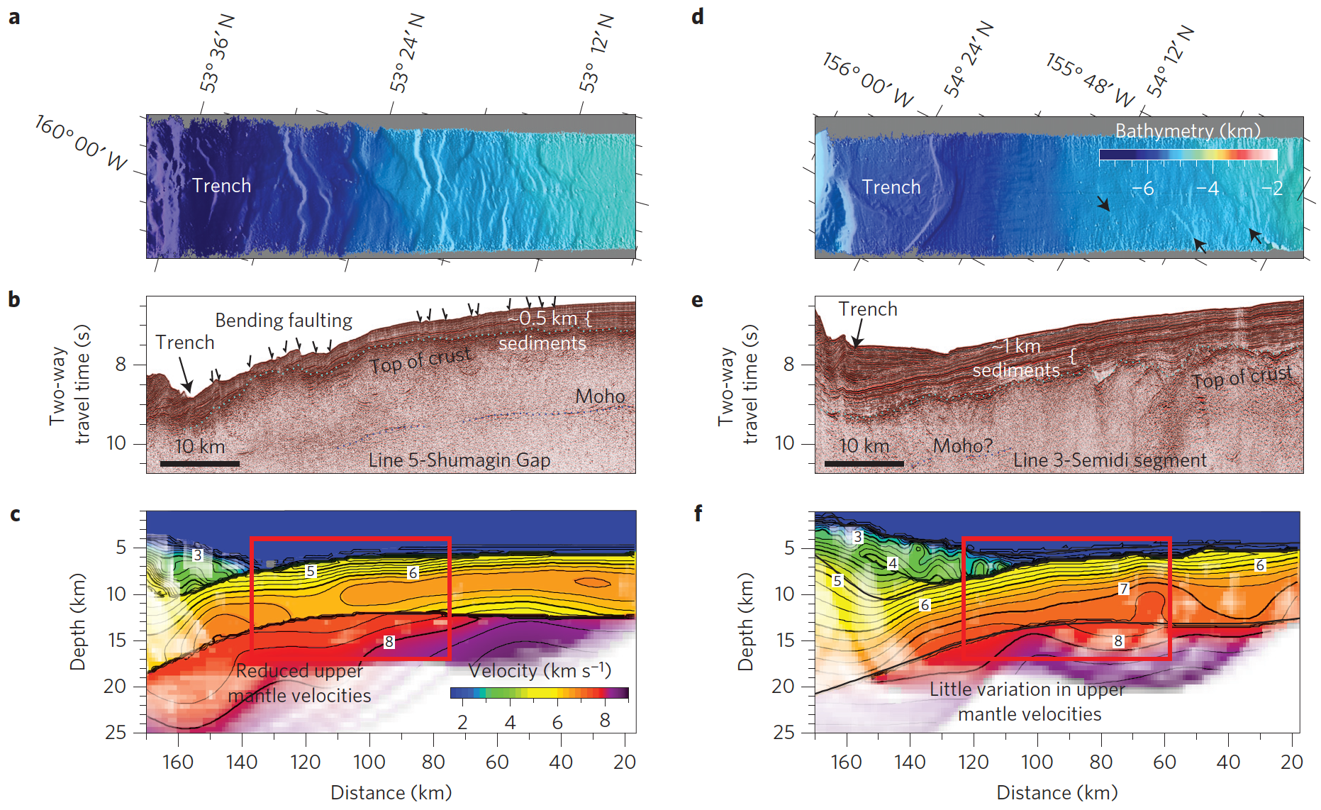
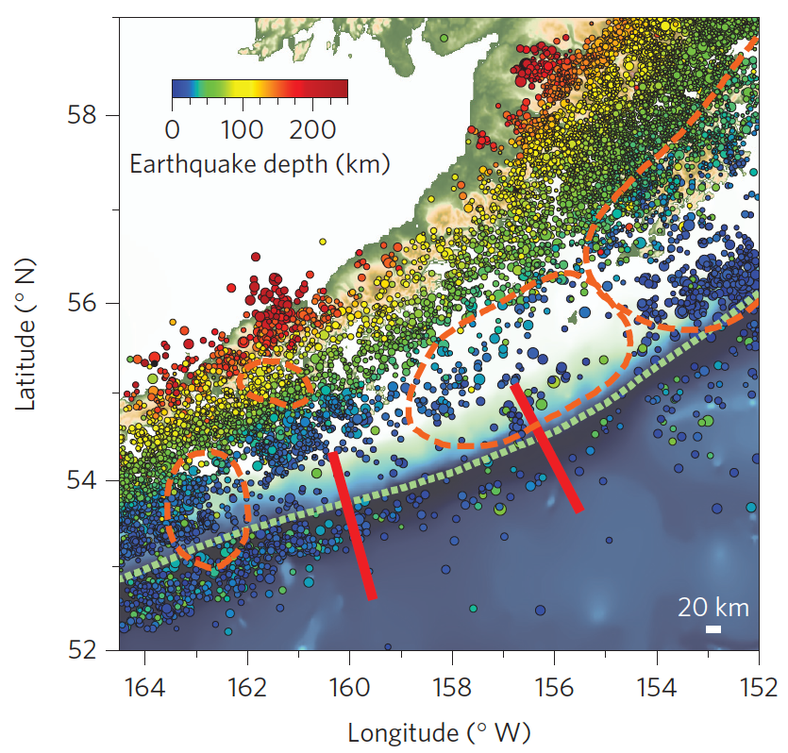
Related Fundamental Questions
How do variations in seismicity, plate coupling, and properties of the subducting slab influence great earthquakes?
“Shumagin Gap:”
rough, hydrated slab,
more microseismicity
“Semidi segment:”
smooth, thick sediment,
less microseismicity
Alaska Peninsula
seismicity
1964
1938
1946
“Shumagin
Gap”
“Semidi
segment”
Shillington et al., 2015
Notes:
From a study at Sitkinak Island it appears that the western edge of the 1964 Alaska earthquake is not a persistent rupture boundary. But what about other historic rupture boundaries?
In the Shumagin Islands it appears that creep on the megathrust may have controlled rupture size for thousands of years. Elsewhere, however, the megathrust has ruptured areas that presently are locked and creeping.
Paleogeodetic studies have shown that the great AD 1700 Cascadia earthquake probably involved heterogeneous slip. But did predecessors of the most recent Cascadia earthquake have similar slip distributions?

Slide 32
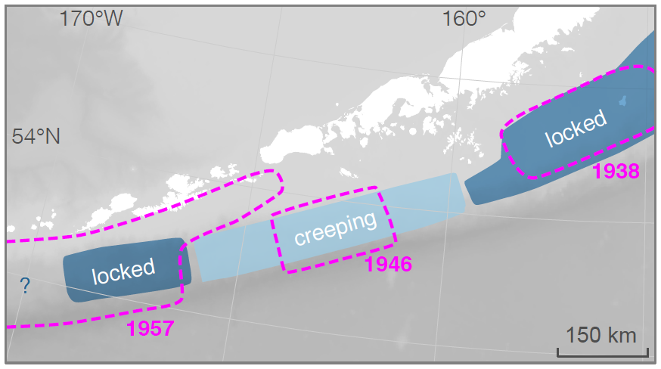
Related Fundamental Questions
How do variations in seismicity, plate coupling, and properties of the subducting slab influence great earthquakes?
Creep on the megathrust may have controlled rupture size in the Shumagins. Elsewhere, the megathrust has ruptured areas that presently are locked and creeping.
Cross and Freymueller, 2008
Shumagin Islands
Absence of evidence for great earthquakes or tsunamis implies that creep has relieved strain for thousands of years.
Chirikof Island
Ruptures of the mega- thrust probably laun- ched large tsunamis every 180–270 yrs over the past 3500 yrs.
Fox Islands
Unusually large tsunamis frequent a currently creeping part of the Aleutian megathrust.
Sanak Island
ancient tsunamis occurred prior to ~2000 yr ago, but not in 1788.
Notes:
From a study at Sitkinak Island it appears that the western edge of the 1964 Alaska earthquake is not a persistent rupture boundary. But what about other historic rupture boundaries?
In the Shumagin Islands it appears that creep on the megathrust may have controlled rupture size for thousands of years. Elsewhere, however, the megathrust has ruptured areas that presently are locked and creeping.
Paleogeodetic studies have shown that the great AD 1700 Cascadia earthquake probably involved heterogeneous slip. But did predecessors of the most recent Cascadia earthquake have similar slip distributions?

Slide 33
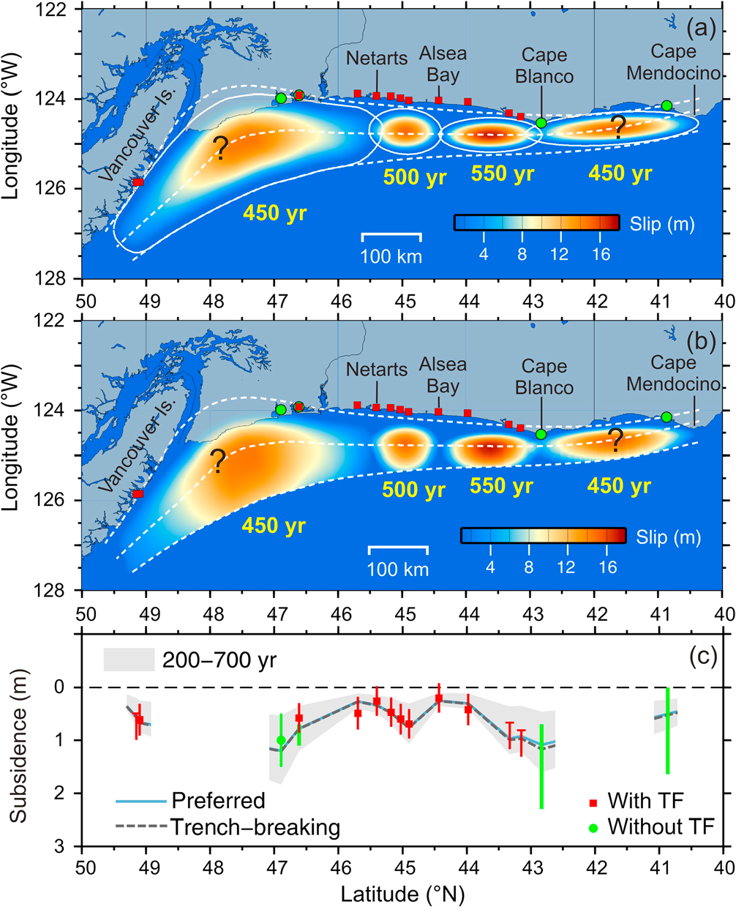
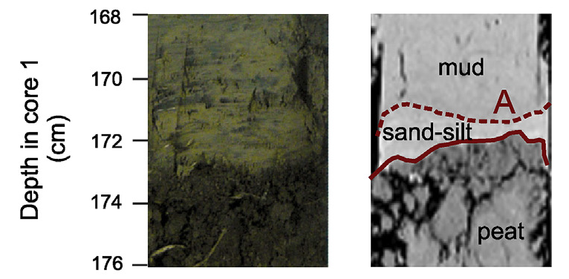
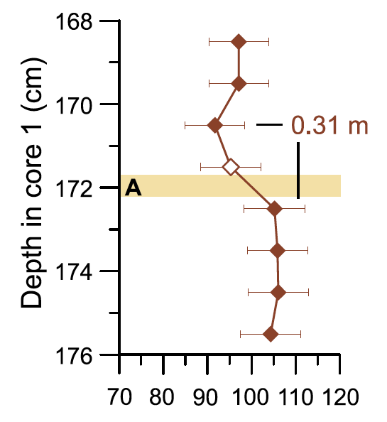
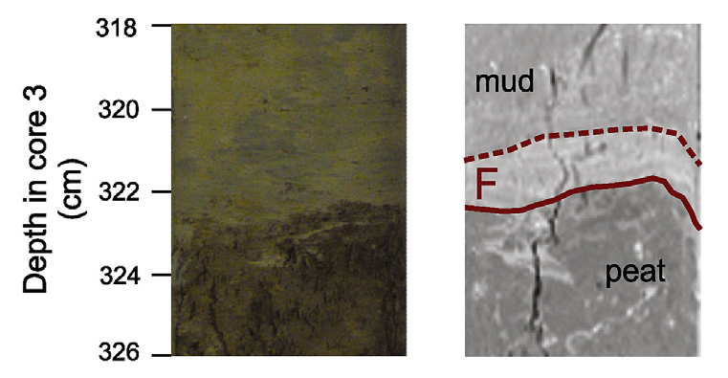
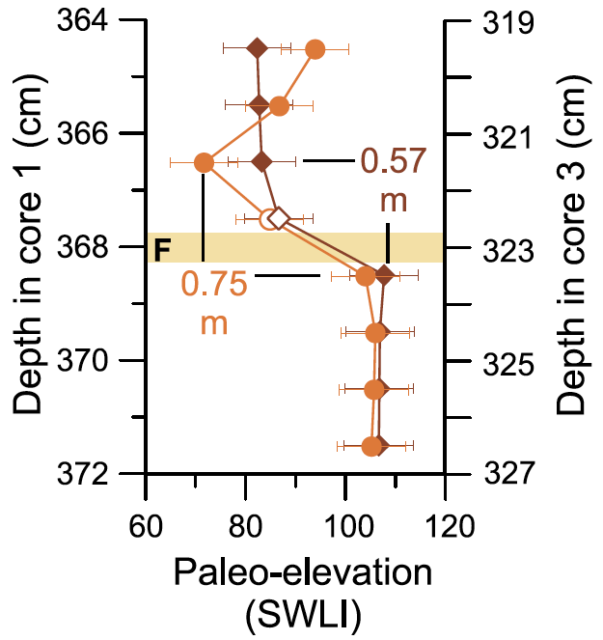
Related Fundamental Questions
Can paleogeodesy reconstruct the slip distributions of past Cascadia earthquakes?
Contact A (AD 1700)
mud
peat
Contact F (2955–2795 cal yr BP)
Milker et al., 2016
Wang et al., 2013
Notes:
From a study at Sitkinak Island it appears that the western edge of the 1964 Alaska earthquake is not a persistent rupture boundary. But what about other historic rupture boundaries?
In the Shumagin Islands it appears that creep on the megathrust may have controlled rupture size for thousands of years. Elsewhere, however, the megathrust has ruptured areas that presently are locked and creeping.
Paleogeodetic studies have shown that the great AD 1700 Cascadia earthquake probably involved heterogeneous slip. But did predecessors of the most recent Cascadia earthquake have similar slip distributions?

Slide 34
USGS Geologic Studies Summary
Work is motivated by seismic hazard mapping
The basic work to identify and characterize active faults consists of: mapping, paleoseismology, paleogeodesy, deformation rates
These data will allow us to answer fundamental questions related to assessing hazard, such as:
  How much deformation is permanent vs. elastic?
  How persistent are rupture boundaries of historic earthquakes?
  How do variations in seismicity, plate coupling, and properties of the subducting slab influence great earthquakes?
  Can paleogeodesy reconstruct the slip distributions of past megathrust earthquakes?
Notes:
From a study at Sitkinak Island it appears that the western edge of the 1964 Alaska earthquake is not a persistent rupture boundary. But what about other historic rupture boundaries?
In the Shumagin Islands it appears that creep on the megathrust may have controlled rupture size for thousands of years. Elsewhere, however, the megathrust has ruptured areas that presently are locked and creeping.
Paleogeodetic studies have shown that the great AD 1700 Cascadia earthquake probably involved heterogeneous slip. But did predecessors of the most recent Cascadia earthquake have similar slip distributions?

